Slide 1
de novo mutation and gene constraint
Benjamin Neale
March 5th 2015
IBG Workshop

Slide 2

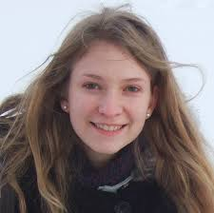



Collaborators
Dan Howrigan
Kaitlin Samocha
Sam Rose
Steve McCarroll
Mark Daly

Slide 3
De novo mutation analysis
Exome
~1.5% of genome
All exons
  Some pseudogenes missed
Deeper coverage
  Average 60-180x
Success in Mendelian disease
A/A
A/A
A/C
New mutations in trios
average 1 per exome

Slide 4
Two problems in interpreting de novo mutations from sequencing
As we sequence many trios some genes are bound to have multiple mutations
How do we calculate the significance when the number of observations is inevitably small?

Slide 5
Two problems in interpreting de novo mutations from sequencing
As we sequence many trios some genes are bound to have multiple mutations
How do we calculate the significance when the number of observations is inevitably small?
Solution – model mutation rate to create accurate per gene estimate of mutation

Slide 6
Modeling of de novo variation
…ATCGGCTGG…
…ATCGACTGG…
Change Probability
AAA → ACA a
AAA → AGA b
AAA → ATA c
AAC → ACC d
AAC → AGC e
AAC → ATC f
…
Created a mutation rate table
…CTCACCGGA…
…CTCACTGGA…
…CCTAGCTAA…
…CCTGGCTAA…
…TACGGA…
Per gene, per trio:
p(synonymous)
p(missense)
p(nonsense)
p(splice site)
Used the sequence to determine each gene’s probability of mutating
ACG
AAG
AGG
ATG

Slide 7
Probabilities of Mutation
P(synonymous)
Same amino acid
P(miss)
Protein-altering
P(nonsense)
Premature stop
P(splice site)
Disrupts splice donor/acceptor site
P(frameshift)
Disrupts reading frame
Global
Gene Specific
Rates of mutation types
Overlaps with gene sets
Single gene significance
Constrained genes

Slide 8
Probabilities of Mutation
P(synonymous)
Same amino acid
P(miss)
Protein-altering
P(nonsense)
Premature stop
P(splice site)
Disrupts splice donor/acceptor site
P(frameshift)
Disrupts reading frame
Global
Gene Specific
Rates of mutation types
Overlaps with gene sets
Single gene significance
Constrained genes

Slide 9
Probabilities of Mutation
P(synonymous)
Same amino acid
P(miss)
Protein-altering
P(nonsense)
Premature stop
P(splice site)
Disrupts splice donor/acceptor site
P(frameshift)
Disrupts reading frame
ΣN*μ_{j}
j = mutation class
Global
Gene Specific
Rates of mutation types
Overlaps with gene sets
Single gene significance
Constrained genes

Slide 10
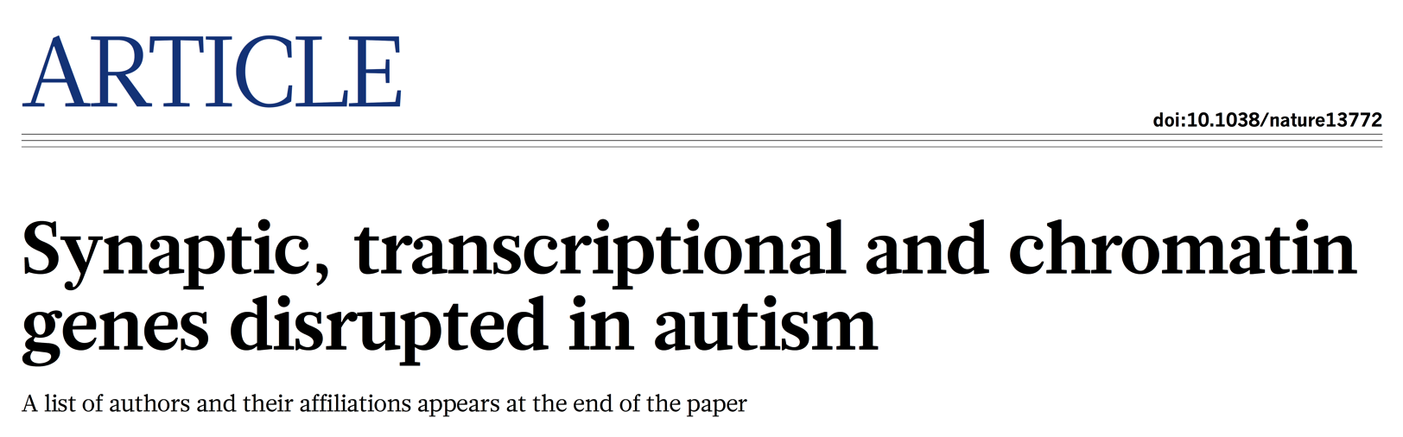
Autism Sequencing Consortium
Autism spectrum disorder
SSC published 823
ARRA published 367
German 354
Middle Eastern 255
TASC / Buxbaum 203
Costa Rican 177
UK 10K 67
Finnish 51
Unaffected
Iossifov et al 2012 343
TASC / Buxbaum 79
Middle Eastern 75
German 13
510 unaffected trios
Manuscript online at Nature
2297 ASD trios
contributing PIs: Buxbaum, Daly,
Barrett, Cutler, Devlin, Palotie,
Roeder, State, Walsh
Oct 2014

Slide 11

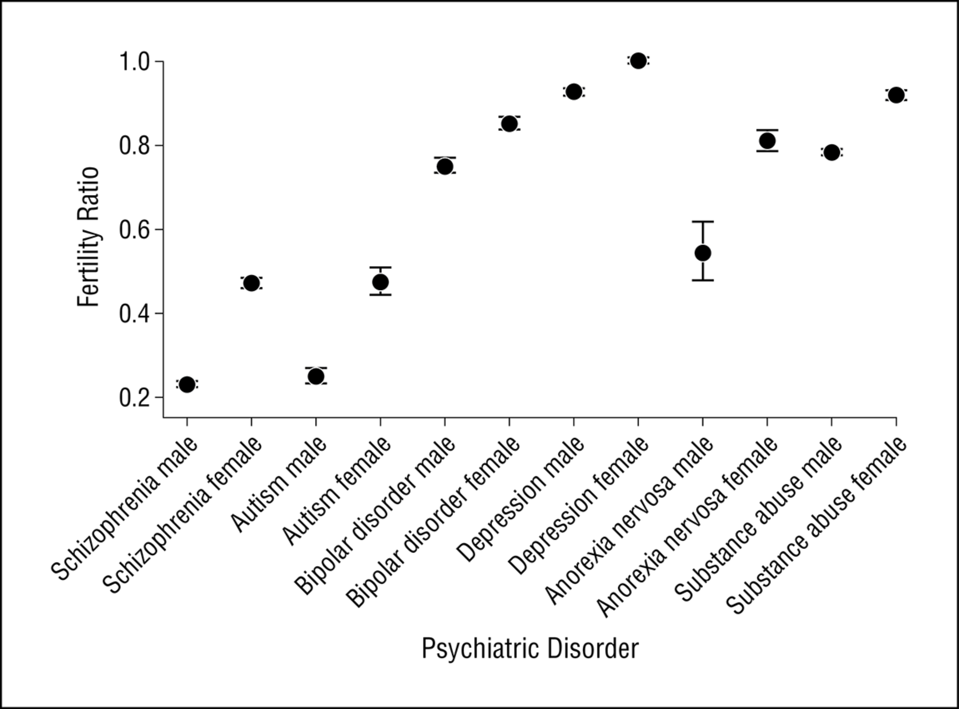
From: Fecundity of Patients With Schizophrenia, Autism, Bipolar Disorder, Depression, Anorexia Nervosa, or Substance Abuse vs Their Unaffected Siblings
JAMA Psychiatry. 2013;70(1):22-30. doi:10.1001/jamapsychiatry.2013.268
Ramifications:
Common and low frequency variants can be plentiful at very low effect sizes (OR < 1.1)
Large effect alleles must be extremely rare
Figure Legend:
Figure 1. Fertility ratios for individuals with schizophrenia, autism, bipolar disorder, depression, anorexia nervosa, and substance abuse. A fertility ratio of 1 (highlighted) represents that of the general population.
Date of download: 3/5/2014
Copyright © 2014 American Medical Association. All rights reserved.

Slide 12
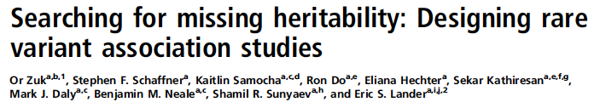
Implication of
PNAS
Dec. 2013
General European Population:
An allele with an OR of only 1.5 has essentially
no chance to reach a frequency of .001
In Finland, Ashkenazi Jews (and other bottlenecked populations):
Such alleles could exist at up to 5% frequency
if boosted through bottleneck – selection has not had time to
tamp frequencies back down! (empirical evidence: recessive lethals)

Slide 13
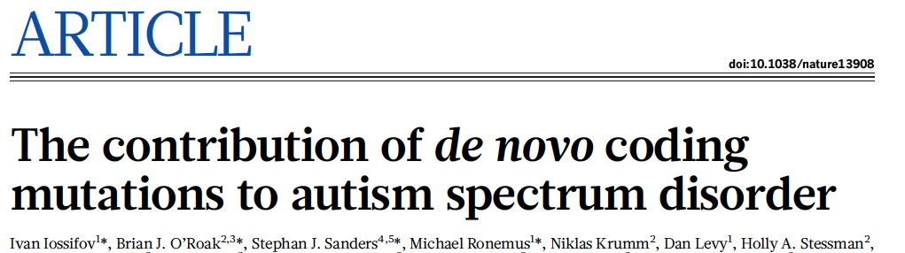
Genome-wide excess in both missense and loss-of-function variants in ASD cases
Unaffected
Mutation Type | Observed de novo events per exome | Expected de novo events per exome | p-value
Synonymous | 0.256 | 0.274 | 0.111
missense | 0.605 | 0.620 | 0.398
LoF | 0.091 | 0.086 | 0.196
n = 2078 families
Affected
Mutation Type | Observed de novo events per exome | Expected de novo events per exome | p-value
Synonymous | 0.263 | 0.274 | 0.179
missense | 0.707 | 0.620 | 1.33E-11
Loss-of-Function | 0.145 | 0.086 | 8.61E-32
n = 3982 families
+
Joint analysis: ASC + Simons Simplex studies published Oct 2014 Nature Kaitlin Samocha

Slide 14
Probabilities of Mutation
P(synonymous)
Same amino acid
P(miss)
Protein-altering
P(nonsense)
Premature stop
P(splice site)
Disrupts splice donor/acceptor site
P(frameshift)
Disrupts reading frame
Global
Gene Specific
Rates of mutation types
Overlaps with gene sets
Single gene significance
Constrained genes

Slide 15
Places where selection is acting will tend to reduce gene variation

Slide 16
Model accurately predicts synonymous variation and identifies genes intolerant of functional variants
Assessed variants from the ~63,000 individuals in the ExAC dataset
Correlation of number of rare synonymous variants in a gene with:
  The gene’s length 0.9198
  The expected number of synonymous variants 0.9794
Synonymous
Missense
Loss-of-function
Observed
LoF variants not tolerated
Expected
Notes:
Quality control steps:
1. When combining data across a transcript, if an exon had median depth < 1, I did not include its observed or expected count information.
2. I removed 1,141 transcripts that had no observed or expected count information, indicating terrible coverage across the transcript.
3. Used only those transcripts whose synonymous Z values fell in between -5 and 5 to determine the standard deviation used to correct the synonymous Z scores.
4. Corrected the missense, LoF, and mis+LoF Z scores by finding the standard deviation of the negative half of the distribution (Z > -5).
5. Removed 347 genes that had corrected Z for synonymous and missense both above 3.09 or below 3.09.
6. Removed 178 genes that had 5 or few observed synonymous variants. Genes are too small or too poorly sequenced; they can only contribute to a set of falsely constrained genes.
Started with 19638 transcripts.

Slide 17
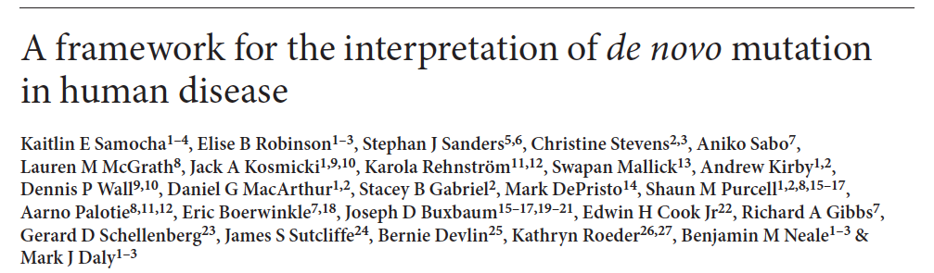

ExAC data allow recognition of genes under exceptional constraint
p < 10⁻³
Model predicts observed number of synonymous variants in ExAC with
R = 0.98
5-10% of genes with exceptionally
reduced rates of missense variation
heavily enriched for:
OMIM dominant/X-linked hits
autism/ID de novo LoF hits
Aug 2014
Kaitlin Samocha
3.09
Notes:
1276 genes cross for missense (syn < 3.09, mis > 3.09)
Can evaluate 99.9% of genes for missense

Slide 18
Constraint example: tubulin family
Gene | Predicted Missense | Observed Missense | % Missing | Missense Z | OMIM Phenotype | Mode of Inheritance
TUBB | 186 | 9 | 95% | 6.26 | cortical dysplasia/brain malf. | de novo het missense
TUBA1A | 166 | 1 | 99% | 6.17 | lissencephaly 3 | de novo het missense
TUBB3 | 240 | 45 | 81% | 6.06 | cortical dysplasia/brain malf. | de novo het missense
TUBA1B | 165 | 6 | 96% | 5.97
TUBB4A | 240 | 54 | 78% | 5.79 | hypomyelinating leukodystrophy | het missense
TUBB4B | 208 | 41 | 80% | 5.58
TUBG1 | 192 | 39 | 80% | 5.31 | cortical dysplasia/brain malf. | de novo het missense
 |  |  | …
TUBA8 | 182 | 167 | 8% | 0.54
TUBB1 | 193 | 183 | 5% | 0.36
Notes:
Some of the tubulin family genes sorted by their missense Z score

Slide 19
Constraint example: tubulin family
Gene | Predicted Missense | Observed Missense | % Missing | Missense Z | OMIM Phenotype | Mode of Inheritance
TUBB | 186 | 9 | 95% | 6.26 | cortical dysplasia/brain malf. | de novo het missense
TUBA1A | 166 | 1 | 99% | 6.17 | lissencephaly 3 | de novo het missense
TUBB3 | 240 | 45 | 81% | 6.06 | cortical dysplasia/brain malf. | de novo het missense
TUBA1B | 165 | 6 | 96% | 5.97
TUBB4A | 240 | 54 | 78% | 5.79 | hypomyelinating leukodystrophy | het missense
TUBB4B | 208 | 41 | 80% | 5.58
TUBG1 | 192 | 39 | 80% | 5.31 | cortical dysplasia/brain malf. | de novo het missense
 |  |  | …
TUBA8 | 182 | 167 | 8% | 0.54
TUBB1 | 193 | 183 | 5% | 0.36
Notes:
We see that the disease-associated genes fall towards the top of the list/more constrained

Slide 20
Constraint example: tubulin family
Gene | Predicted Missense | Observed Missense | % Missing | Missense Z | OMIM Phenotype | Mode of Inheritance
TUBB | 186 | 9 | 95% | 6.26 | cortical dysplasia/brain malf. | de novo het missense
TUBA1A | 166 | 1 | 99% | 6.17 | lissencephaly 3 | de novo het missense
TUBB3 | 240 | 45 | 81% | 6.06 | cortical dysplasia/brain malf. | de novo het missense
TUBA1B | 165 | 6 | 96% | 5.97
TUBB4A | 240 | 54 | 78% | 5.79 | hypomyelinating leukodystrophy | het missense
TUBB4B | 208 | 41 | 80% | 5.58
TUBG1 | 192 | 39 | 80% | 5.31 | cortical dysplasia/brain malf. | de novo het missense
 |  |  | …
TUBA8 | 182 | 167 | 8% | 0.54
TUBB1 | 193 | 183 | 5% | 0.36
Notes:
This score is a more principled way of evaluating potential pathogenicity.
These two genes look like they might be important.

Slide 21
Constraint example: tubulin family
Gene | Predicted Missense | Observed Missense | % Missing | Missense Z | OMIM Phenotype | Mode of Inheritance
TUBB | 186 | 9 | 95% | 6.26 | cortical dysplasia/brain malf. | de novo het missense
TUBA1A | 166 | 1 | 99% | 6.17 | lissencephaly 3 | de novo het missense
TUBB3 | 240 | 45 | 81% | 6.06 | cortical dysplasia/brain malf. | de novo het missense
TUBA1B | 165 | 6 | 96% | 5.97
TUBB4A | 240 | 54 | 78% | 5.79 | hypomyelinating leukodystrophy | het missense
TUBB4B | 208 | 41 | 80% | 5.58
TUBG1 | 192 | 39 | 80% | 5.31 | cortical dysplasia/brain malf. | de novo het missense
 |  |  | …
TUBA8 | 182 | 167 | 8% | 0.54
TUBB1 | 193 | 183 | 5% | 0.36
Notes:
These two genes are apparently tolerant of heterozygous missense changes overall.

Slide 22
Probabilities of Mutation
P(synonymous)
Same amino acid
P(miss)
Protein-altering
P(nonsense)
Premature stop
P(splice site)
Disrupts splice donor/acceptor site
P(frameshift)
Disrupts reading frame
ΣN*μ_{ij}
j = mutation class in gene
Global
Gene Specific
Rates of mutation types
Overlaps with gene sets
Single gene significance
Constrained genes

Slide 23
Seven ‘genome-wide significant’ genes for harboring excess de novo LoF mutations
Gene | de novo Mutations | #LoF | #mis | exp #LoF | ppois
CHD8 | FS, FS, FS, NON, m, NON, SPL, m, SPL | 7 | 2 | 0.075 | 2.53E-12
DYRK1A | FS, SPL, NON, FS, FS | 5 | 0 | 0.024 | 7.19E-11
SYNGAP1 | m, m, NON, FS, FS, NON, m, FS | 5 | 3 | 0.041 | 9.69E-10
ARID1B | NON, NON, FS, m, FS, FS, m | 5 | 2 | 0.061 | 6.59E-09
ADNP | FS, FS, FS, FS | 4 | 0 | 0.030 | 3.25E-08
SCN2A | m, m, m, m, FS, m, m, NON, NON, m, m, SPL | 4 | 8 | 0.060 | 5.32E-07
DSCAM | FS, SPL, FS, SPL | 4 | 0 | 0.065 | 6.99E-07
SUV420H1 | NON, m, SPL, m, FS | 3 | 2 | 0.027 | 3.32E-06
ANK2 | m, NON, NON, NON, m, m, FS | 4 | 3 | 0.114 | 6.47E-06
GRIN2B | SPL, NON, m, FS | 3 | 1 | 0.039 | 9.72E-06
POGZ | FS, NON, FS, m, m | 3 | 2 | 0.046 | 1.54E-05
KDM5B | NON, NON, m, FS, m, m | 3 | 3 | 0.060 | 3.49E-05
CHD2 | m, FS, m, m, NON, FS | 3 | 3 | 0.067 | 4.73E-05

Slide 24
Using LoF deficiency (ExAC) to separate de novo LoF variants in cases and controls
Oct 2014
0%
20%
40%
60%
80%
100%
Autism
n = 2297
p = 1.2 x 10⁻¹³
Unaffected
n = 510
p = n.s.
0%
20%
40%
60%
80%
100%
Percentage of Missing LoF Variation
Notes:
Allows us to more clearly look at level of constraint of genes hit by asd dnvs vs unaffected dnvs
Application of LoF data
Ratio LoF missing:
ASD vs all = 1.2e-13
Unaff vs all = 0.4397
ASD vs Unaff = 0.0291

Slide 25
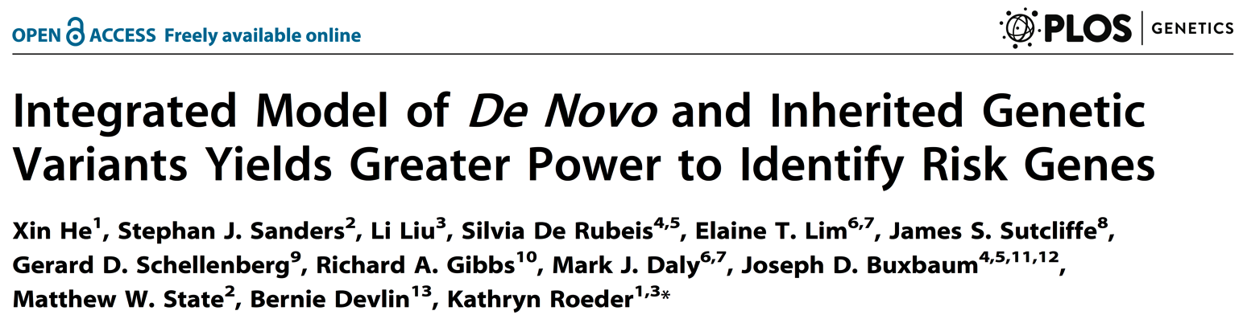
De novo mutations are just the start
De novo LoF mutations are in strong excess and flag some relevant genes
We also have inherited LoF mutations in those same trios (n ~ 2300)
We have an independent set of 1600 cases and 5400 controls from collections in US, UK and Sweden – cases and controls provide a tally that is the sum of de novo and inherited LoF mutations

Slide 26
Combining inherited and de novo LoF variation augments gene discovery
FDR < 0.1
SCN2A | GRIN2B | CACNA2D3 | ASXL3 | MYT1L
SYNGAP1 | ADNP | MIB1 | VIL1 | NR3C2
CHD8 | TBR1 | GABRB3 | MYO9B | APH1A
ARID1B | POGZ | CTTNBP2 | ETFB | SETD5
ANK2 | CUL3 | MLL3 | ASH1L | CDC42BPB
SUV420H1 | KATNAL2 | PTEN | TRIO
DYRK1A | BCL11A | RELN | NAA15
33 genes
18 (55%) have 2 or more de novo LoF variants
Expect ~90% of these genes to be true ASD risk factors
0.1 ≤ FDR < 0.3
None has more than one de novo LoF variant
Expect ~70% of these genes to be true ASD risk factors
74 genes
Notes:
These are all the genes with FDR < 0.1 (n=33). 107 genes associated in total. SIGNIFICANT OVERLAPS WITH DARNELL FMRP + CONSTRAINT. Some nomial significane with RBFOX targets, genes with de novo variants in SCZ, and human orthologs of the mouse synaptosome.

Slide 27
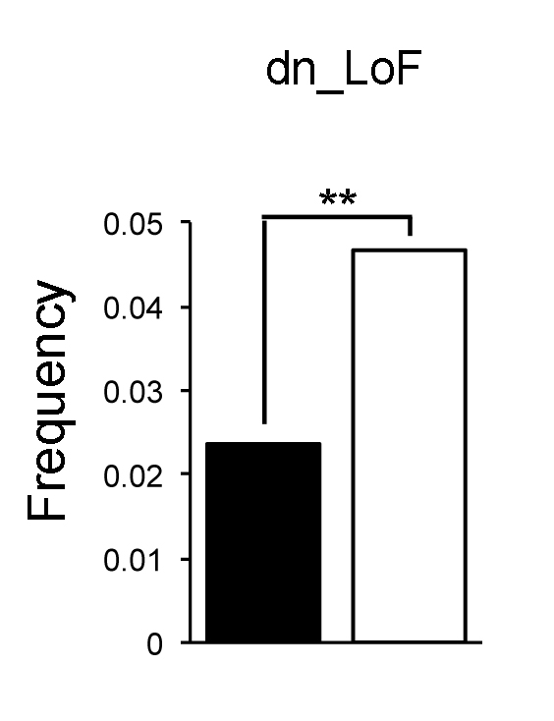
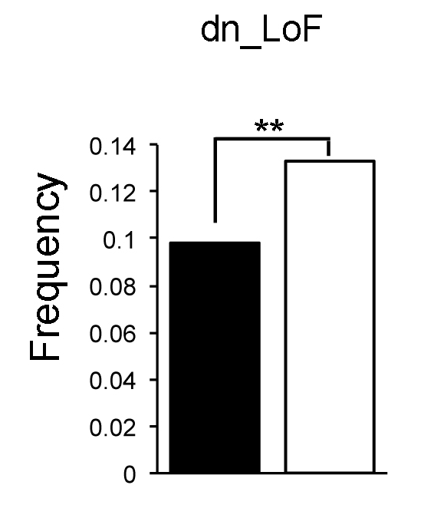
Few high-impact genes - many low-impact genes
Estimated
Gene set
Size
50
500
Top 20-30
Genes
>=2 DN LoF
FDR < 0.1
F:M > 2
Implied OR
20 to 100
53 DN LoF
9 inherited LoF
70 DN LoF
138 inherited LoF
Male Female
Next 75
Genes
FDR < 0.3
F:M ~1.3-1.4
Implied OR
3 to 5
Male Female

Slide 28
Few high-impact genes - many low-impact genes
Estimated
Gene set
Size
50
500
This set of genes:
highly constrained/intolerant of mutation
numerous genes overlap with IEEE, idiopathic ID
Severe and general neurodevelopmental hit list
Not contributing to heritability
Top 20-30
Genes
>=2 DN LoF
F:M > 2
Implied OR
20 to 100
53 DN LoF
9 inherited LoF
70 DN LoF
138 inherited LoF
Male Female
This set of genes:
Much lower impact on the individual
Contributing to heritability
Perhaps these will map better onto specific traits of autism?
Next 75
Genes
FDR < 0.3
F:M ~1.3-1.4
Implied OR
3 to 5
Male Female

Slide 29
Probabilities of Mutation
P(synonymous)
Same amino acid
P(miss)
Protein-altering
P(nonsense)
Premature stop
P(splice site)
Disrupts splice donor/acceptor site
P(frameshift)
Disrupts reading frame
Global
Gene Specific
Rates of mutation types
Overlaps with gene sets
Single gene significance
Constrained genes

Slide 30
Evaluating Genes with 2+ Hits
Example: Synonymous mutations – 296 variants; only 4 genes hit more than once
…
Observed
Empirical p-value to evaluate potential enrichment
Distribution of Simulated 2+ Hits
Simulated De Novo Mutations
…
Notes:
As the number of trios increases, it is inevitable that we will hit genes multiple times by chance. We want to evaluate whether we see excesses of genes hit multiple times.

