Slide 1
Superfast intro to R
Sarah Medland

Slide 2
What is it?
R is an interpreted computer language.
System commands can be called from within R
R is used for data manipulation, statistics, and graphics. It is made up of:
operators (+ - <- * %*% …) for calculations on arrays & matrices
large, coherent, integrated collection of functions
facilities for making unlimited types of publication quality graphics
user written functions & sets of functions (packages); 800+ contributed packages so far & growing
Notes:
2

Slide 3
Advantages
Fast** and free.
State of the art: Statistical researchers provide their methods as R packages. SPSS and SAS are years behind R!
2nd only to MATLAB for graphics.
Active user community
Excellent for simulation, programming, computer intensive analyses, etc.
Forces you to think about your analysis.
Interfaces with database storage software (SQL)
Notes:
3

Slide 4
Disadvantages
Not user friendly @ start - steep learning curve, minimal GUI.
No commercial support; figuring out correct methods or how to use a function on your own can be frustrating.
Easy to make mistakes and not know.
Working with large datasets is limited by RAM!!!
Data prep & cleaning can be messier & more mistake prone in R vs. SPSS or SAS
Hostility on the R listserve
Notes:
4

Slide 5
Learning R....
Notes:
5

Slide 6
R-help listserve....
Notes:
6

Slide 7
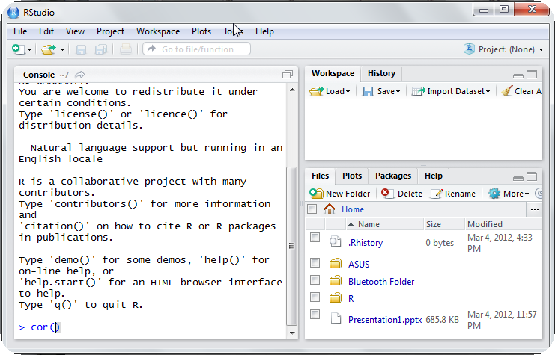
Using R this week
R-studio http://rstudio.org/

Slide 8
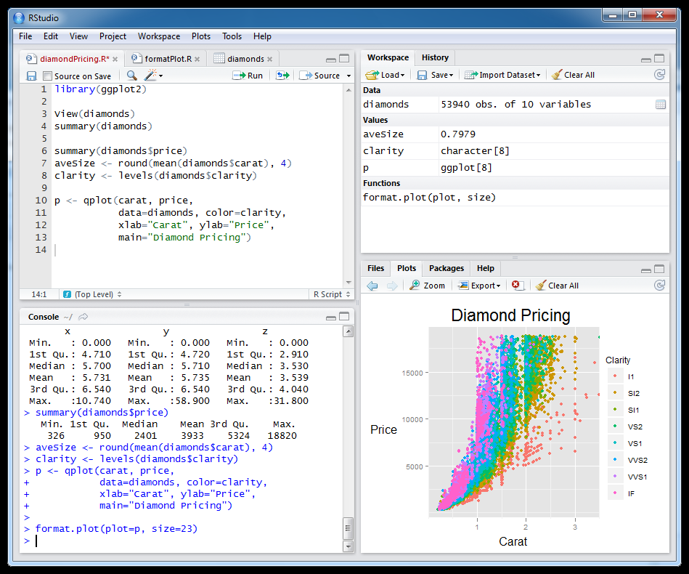
Setting this up at home
Install R first
Install R studio
Install packages

Slide 9
Start up R via R studio
4 windows:
Syntax – can be opened in regular txt file - saved
Terminal – output & temporary input - usually unsaved
Data manager – details of data sets and variables
Plots etc
Notes:
9

Slide 10
R sessions are interactive
Notes:
10

Slide 11
GETTING STARTED

Slide 12
How to use help in R?
R has a help system built in.
If you know which function you want help with simply use ?_______ or help(_____) with the function in the blank.
?hist.
help(hist)
If you don’t know which function to use, then use help.search(“_______”).
help.search(“histogram”).

Slide 13
Importing Data
First make sure your data is in an easy to read format such as space, tab or CSV
Use code:
D <- read.table(“ozbmi2.txt”,header=TRUE)
D <-read.table(“ozbmi2.txt”,na.strings=“-99”,header=TRUE)
D <- read.table(“ozbmi2.csv”, sep=“,”
header=TRUE)
D <- read.csv(“ozbmi2.csv”, header=TRUE)

Slide 14
Exporting Data
Tab delimited
write.table(D, “newdata.txt”,sep=“\t”)
To xls
library(xlsReadWrite) write.xls(D, “newdata.xls")

Slide 15
Checking data
#list the variables in D
names(D)
# dimensions of D
dim(D)
# print the first 10 rows of D
head(D, n=10)
#referring to variables in D
#format is Object$variable
head(D$age, n=10)

Slide 16
Basic Manipulation
#You can make new variables within an existing object
D$newage<- D$age*100
#Or overwrite a variable
D$age<- D$age*100
#Or recode a variable
#D$catage <- ifelse(D$age > 30, c("older"), c("younger"))

Slide 17
Checking data
#Mean and variance
mean(D$age, na.rm =TRUE)
var(D$age , na.rm =TRUE)
#For a number of variables
lapply(D, mean, na.rm=TRUE)
sapply(D, mean, na.rm=TRUE)

Slide 18
Checking data
A bit more info
summary(D$age)
summary(D$age[which(D$agecat==1)])
What about a categorical variable
table(D$agecat)
table(D$agecat,D$zyg)

Slide 19
Some basic analysis
typing D$ is getting annoying so we can attach the data
attach(D)
table(agecat,zyg)
#detach(D)
Correlations anyone?
cor(wt1,bmi1, use="complete")
cor(ht1,bmi1, use="complete")

Slide 20
regression
Multiple Linear Regression
fit <- lm(bmi1 ~ age + zyg, data=D) summary(fit)
# Other useful functions coefficients(fit) # model coefficients
confint(fit, level=0.95) # CIs for model parameters
anova(fit) # anova table
vcov(fit) # covariance matrix for model parameters

Slide 21
Basic plots
Histogram
#basic
hist(age)
#basic
hist(age, breaks=12, col=‘red’)
# Add labels
hist(age, breaks=12, col='red', xlab='age in years',main='Histogram of age‘)

Slide 22
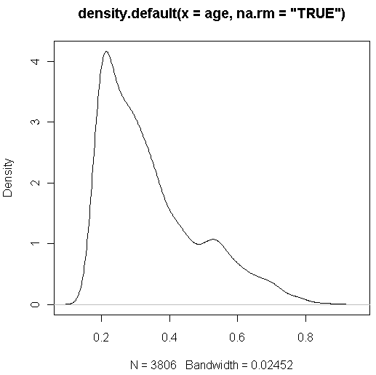
Looking at your data...
#Kernal density plot
d <- density(age, na.rm = "TRUE") # returns the density data
plot(d) # plots the results

Slide 23
Looking at your data...
#Kernal density plot by zyg?
library(sm)
# create value labels
zyg.f <- factor(zyg, levels= seq(1,5),
labels = c("MZF", "MZM", "DZF", "DZM", "DZOS"))
# plot densities
sm.density.compare(age, zyg, xlab="Years")
title(main="Years by ZYG")
# add legend
colfill<-c(2:(2+length(levels(zyg.f))))
legend(.8,3, levels(zyg.f), fill=colfill)

Slide 24
Huh what?
> library(sm)
Error in library(sm) : there is no package called 'sm'
> sm.density.compare(age, zyg, xlab="Years")
Error: could not find function "sm.density.compare"

Slide 25
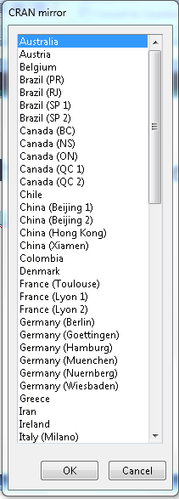
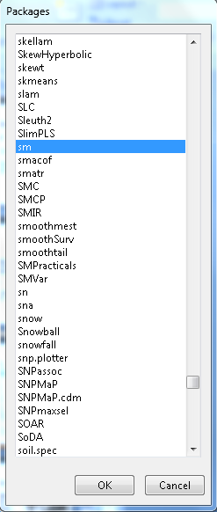
Adding a package...
install.packages()

Slide 26
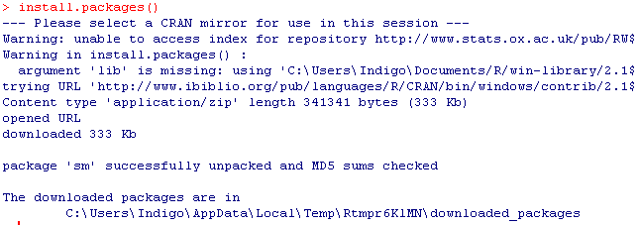

Slide 27
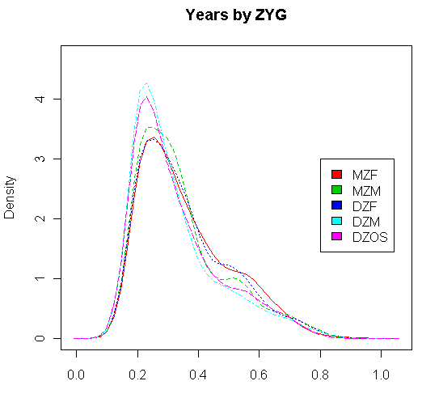
Looking at your data...
#Kernal density plot by zyg?
library(sm)
# create value labels
zyg.f <- factor(zyg, levels= seq(1,5),
labels = c("MZF", "MZM", "DZF", "DZM", "DZOS"))
# plot densities
sm.density.compare(age, zyg, xlab="Years”)
title(main="Years by ZYG")
# add legend
colfill<-c(2:(2+length(levels(zyg.f))))
legend(.8,3, levels(zyg.f), fill=colfill)

Slide 28
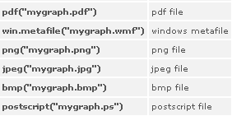
That’s great but how do I save it?
# make a png file to hold the plot
png("zygdensity.png")
# create value labels
zyg.f <- factor(zyg, levels= seq(1,5),
labels = c("MZF", "MZM", "DZF", "DZM", "DZOS"))
# plot densities
sm.density.compare(age, zyg, xlab="Years”)
title(main="Years by ZYG")
# add legend via mouse click
colfill<-c(2:(2+length(levels(zyg.f))))
legend(.8,3, levels(zyg.f), fill=colfill)
# close the png file to allow viewing
dev.off()
Notes:
28

Slide 29
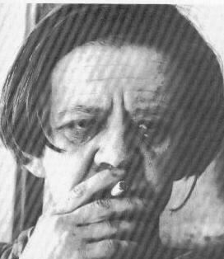
Final Words of Warning
“Using R is a bit akin to smoking. The beginning is difficult, one may get headaches and even gag the first few times. But in the long run, it becomes pleasurable and even addictive. Yet, deep down, for those willing to be honest, there is something not fully healthy in it.” --Francois Pinard
Notes:
29

Slide 30
Vienna

