Slide 1
(Re) introduction to Linux
Sarah Medland
Boulder 2015

Slide 2
Getting the most out of the workshop
Ask questions!!!
Don’t sit next to someone you already know
Work with someone with a different skillset and different experience level
Use the workshop laptop
  You will have access to your files after you leave
Come to the social functions
Ask questions!!!

Slide 3
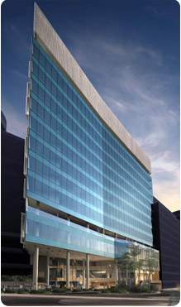
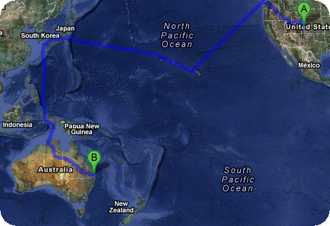


I work in Brisbane at QIMR
Sarah Medland

Slide 4

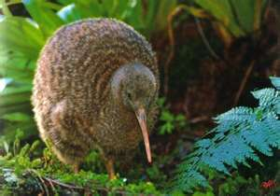
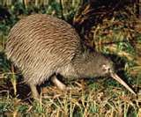
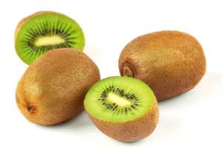
not

Slide 5
Morning sessions
Optional
  Feel free to wander in and out/check email etc
Topics
  Shift in response to feedback
  Tomorrow: R intro
  Wednesday: PCA
  Thursday: Family Based association
  Friday: TBA

Slide 6
Superfast intro to Linux

Slide 7

This year’s OS
Debian (linux)
  Free
  Many free software packages available
    Open office
    R
    PSPP
    Terminal
Based on Unix
  long and venerable history
  http://en.wikipedia.org/wiki/Unix

Slide 8




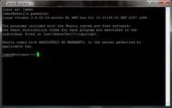
Close but not the same…
Most basic shortcuts will work
  crtl+C for copy crtl+V for paste etc
Supports folder based navigation
/\ BIG PROBLEM is \ vs /
You will have used some version of unix previously

Slide 9
File hygiene is very important
Files are stored in Unix format not DOS or Mac
  Changes the line ending characters
  Use dos2unix, unix2dos, mac2unix, unix2mac to change formats
  Can use the file command to check format
Unix systems are case sensitive!
NO SPACES in your file/directory names!!
Wildcards ie dos2unix *.dat

Slide 10
Working in the terminal
Input …. Output
Input
  Most commands don’t need input signifiers
  < can be used to specify
Output
  Without specifying most output will print to the screen
  > can be used to direct
    type: echo ‘this is a dummy file’
    echo ‘this is a dummy file’ > dummy.txt
    | (pipe) | more pauses the output after a screen worth of text has appeared hit the space bar to get the next screens worth

Slide 11
The manual
The man command can be used in conjunction with other commands to put up some basic instructions
type: man ls
  ls is the list command it pulls up a list of the files in the directory
  Also many many helpful webpages w examples

Slide 12

Permissions
the ability to read, write and execute files
type: ls –l
These are the permissions
1st a directory flag (d or -)
then 3 letters to define the owners permissions
3 letters to define the groups permissions
3 letters to define the everyone else's permissions

Slide 13
Permissions
the ability to read, write and execute files
read access
write access
execute
  to ‘run’ script or a program the file must be made executable

Slide 14
Permissions
the ability to read, write and execute files
To change the mode/permissions use chmod
  a number of ways to do this
  type: echo “this is a test” > dummy.txt
  ls –l
  chmod +x dummy.txt
  ls –l
  chmod -x dummy.txt
  ls –l
  what happened?

Slide 15
Useful ‘one liners’
cp copy
mv move = rename
rm remove
ls list
echo
head looks at the top 10 lines
tail looks at the last 10 lines
wc counts number of lines, words, characters
sed find and replace
grep find and report
awk restructure files
pwd find where you are
~/ get to your home directory
file reports type of file

Slide 16
Grep
search globally for lines matching the regular expression, and print them
  For association output for chromosome 2
  To extract the result for snp rs59831
  Type: grep ‘rs59831’ output.txt > summary.txt

Slide 17
Grep
Useful flags
  -v
    reverse grep select line that does not have the pattern
  -C x
    To x rows before and after the target
  -n
    Print the line number before the line
  Many more…

Slide 18
Awk
derived from the surnames of its authors — Alfred Aho, Peter Weinberger, and Brian Kernighan
Many functions
Very useful for restructuring data

Slide 19
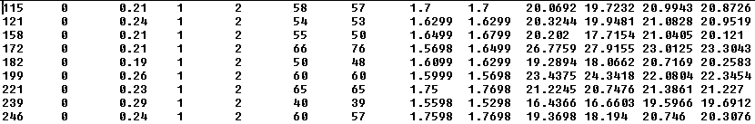
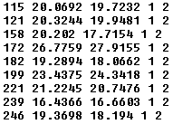
Awk
Ozbmi2.rec
awk ‘{ print $1, $10, $11, $4, $5 }’ ozbmi2.rec > new.rec

Slide 20
Awk
$1 = column 1
Print $0 = print whole line
add subtract multiply etc
change number of decimals
Many functions

Slide 21
Sort
Useful flags
  -f ignore case
  -n numeric sort
  -r reverse
  -c check if a file is sorted
  -u prints only unique lines
  -k2 sort starting at column2

Slide 22
Zipping and unzipping
zip
  zip my1st.zip *txt
  zip –mTr my1st.zip *txt
unzip
  unzip my1st.zip
gzip
  gzip example.txt
Un-gzip
  gzip –d example.txt.gz

Slide 23
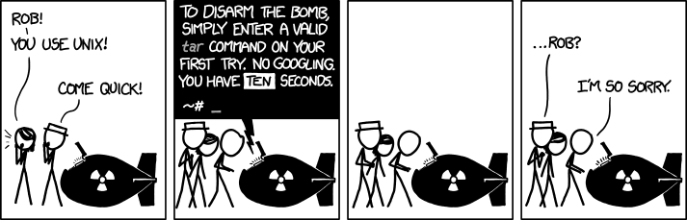
tar
Unzipping tar.gz files
  tar -xzvf example.tar.gz
Make Tar files
  tar cvf MyProject.tar MyProject
List contents
  tar tvf my-archive.tar
  tar tzvf my-archive.tar.gz

Slide 24
Nano (text editor)
Nano filename
  Commands at bottom of screen
  Save = crtl+O
  Exit = crtl +X

Slide 25
Putting it together
Making a ‘shell’ script to automate analyses
<contents of imaginary file inefficient.sh>
pedstats –p 1.ped –d 1.dat –pdf --prefix:1
merlin –p 1.ped –d 1.dat –m 1.map --vc --pdf --prefix:1
pedstats –p 2.ped –d 2.dat –pdf --prefix:2
merlin –p 2.ped –d 2.dat –m 2.map --vc --pdf --prefix:2
pedstats –p 3.ped –d 3.dat –pdf --prefix:3
merlin –p 3.ped –d 3.dat –m 3.map --vc --pdf --prefix:3
To run this make inefficient.sh executable then type ./inefficient.sh

Slide 26
Loops 1
<contents of imaginary file loop_a.sh>
for $i in 1 2 3 4 5 6 7 8 9 10 11 12 13 14 15 16 17 18 19 20 21 22
do
pedstats –p $i.ped –d $i.dat --pdf --prefix:$i
merlin –p $i.ped –d $i.dat –m $i.map --vc --pdf --prefix:$i
done

Slide 27
Loops 2
<contents of imaginary file loop_b.sh>
for (( i = 1 ; i <= 22 ; i++ ))
do
pedstats –p $i.ped –d $i.dat --pdf --prefix:$i
merlin –p $i.ped –d $i.dat –m $i.map --vc --pdf --prefix:$i
done

Slide 28
Other bits
When working on servers
  bg &
  fg
  nohup
  crtl+c
  crtl+z
  which

Slide 29
Shutting down you unix session
exit
logout
quit
q

Slide 30
Superfast intro to R

Slide 31
What is it?
R is an interpreted computer language.
  System commands can be called from within R
R is used for data manipulation, statistics, and graphics. It is made up of:
  operators (+ - <- * %*% …) for calculations on arrays & matrices
  large, coherent, integrated collection of functions
  facilities for making unlimited types of publication quality graphics
  user written functions & sets of functions (packages); 800+ contributed packages so far & growing
Notes:
31

Slide 32
Advantages
Fast** and free.
State of the art: Statistical researchers provide their methods as R packages. SPSS and SAS are years behind R!
2nd only to MATLAB for graphics.
Active user community
Excellent for simulation, programming, computer intensive analyses, etc.
Forces you to think about your analysis.
Interfaces with database storage software (SQL)
Notes:
32

Slide 33
Disadvantages
Not user friendly @ start - steep learning curve, minimal GUI.
No commercial support; figuring out correct methods or how to use a function on your own can be frustrating.
Easy to make mistakes and not know.
Working with large datasets is limited by RAM!!!
Data prep & cleaning can be messier & more mistake prone in R vs. SPSS or SAS
Hostility on the R listserve
Notes:
33

Slide 34

Learning R....
Notes:
34

Slide 35

R-help listserve....
Notes:
35

Slide 36
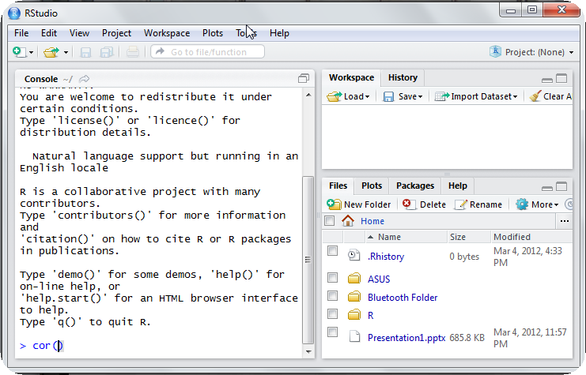
Using R this week
R-studio http://rstudio.org/

Slide 37
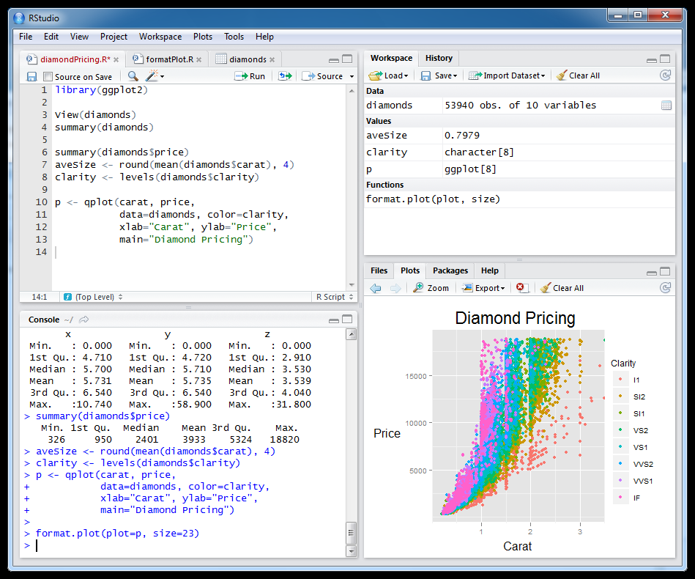
Setting this up at home
Install R first
Install R studio
Install packages

Slide 38
Start up R via R studio
4 windows:
  Syntax – can be opened in regular txt file - saved
  Terminal – output & temporary input - usually unsaved
  Data manager – details of data sets and variables
  Plots etc
Notes:
38

Slide 39
R sessions are interactive
Notes:
39

Slide 40
GETTING STARTED

Slide 41
How to use help in R?
  R has a help system built in.
  If you know which function you want help with simply use ?_______ or help(_____) with the function in the blank.
    ?hist.
    help(hist)
  If you don’t know which function to use, then use help.search(“_______”).
    help.search(“histogram”).

Slide 42
Importing Data
First make sure your data is in an easy to read format such as space, tab or CSV
Use code:
  D <- read.table(“ozbmi2.txt”,header=TRUE)
  D <-read.table(“ozbmi2.txt”,na.strings=“-99”,header=TRUE)
  D <- read.table(“ozbmi2.csv”, sep=“,”
  header=TRUE)
  D <- read.csv(“ozbmi2.csv”, header=TRUE)

Slide 43
Exporting Data
Tab delimited
  write.table(D, “newdata.txt”,sep=“\t”)
  To xls
  library(xlsReadWrite)
  write.xls(D, “newdata.xls")

Slide 44
Checking data
#list the variables in D
  names(D)
# dimensions of D
  dim(D)
# print the first 10 rows of D
  head(D, n=10)
#referring to variables in D
#format is Object$variable
  head(D$age, n=10)

Slide 45
Basic Manipulation
#You can make new variables within an existing object
  D$newage<- D$age*100
#Or overwrite a variable
  D$age<- D$age*100
#Or recode a variable
  #D$catage <- ifelse(D$age > 30,
  c("older"), c("younger"))

Slide 46
Checking data
#Mean and variance
  mean(D$age, na.rm =TRUE)
  var(D$age , na.rm =TRUE)
#For a number of variables
  lapply(D, mean, na.rm=TRUE)
  sapply(D, mean, na.rm=TRUE)

Slide 47
Checking data
A bit more info
  summary(D$age)
  summary(D$age[which(D$agecat==1)])
What about a categorical variable
  table(D$agecat)
  table(D$agecat,D$zyg)

Slide 48
Some basic analysis
typing D$ is getting annoying so we can attach the data
  attach(D)
  table(agecat,zyg)
  #detach(D)
  Correlations anyone?
  cor(wt1,bmi1, use="complete")
  cor(ht1,bmi1, use="complete")

Slide 49
regression
Multiple Linear Regression
  fit <- lm(bmi1 ~ age + zyg, data=D)
  summary(fit)
  # Other useful functions
  coefficients(fit) # model coefficients
  confint(fit, level=0.95) # CIs for model parameters
  anova(fit) # anova table
  vcov(fit) # covariance matrix for model parameters

Slide 50
Basic plots
Histogram
#basic
  hist(age)
#basic
  hist(age, breaks=12, col=‘red’)
  # Add labels
  hist(age, breaks=12, col='red', xlab='age in years',main='Histogram of age‘)

Slide 51
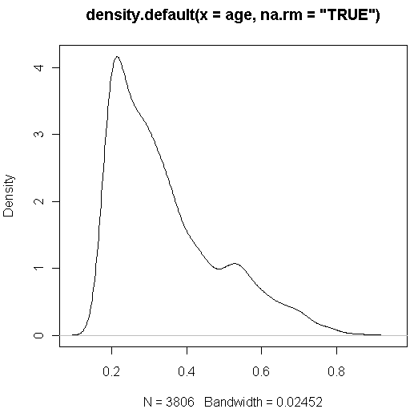
Looking at your data...
  #Kernal density plot
  d <- density(age, na.rm = "TRUE") # returns the density data
  plot(d) # plots the results

Slide 52
Looking at your data...
  #Kernal density plot by zyg?
  library(sm)
  # create value labels
  zyg.f <- factor(zyg, levels= seq(1,5),
  labels = c("MZF", "MZM", "DZF", "DZM", "DZOS"))
  # plot densities
  sm.density.compare(age, zyg, xlab="Years")
  title(main="Years by ZYG")
  # add legend
  colfill<-c(2:(2+length(levels(zyg.f))))
  legend(.8,3, levels(zyg.f), fill=colfill)

Slide 53
Huh what?
  > library(sm)
  Error in library(sm) : there is no package called 'sm'
  > sm.density.compare(age, zyg, xlab="Years")
  Error: could not find function "sm.density.compare"

Slide 54
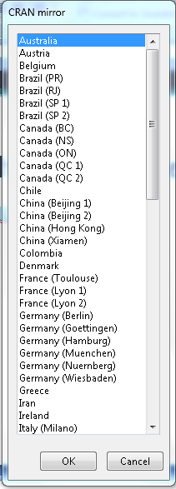
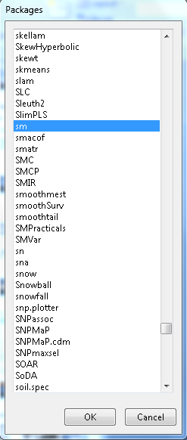
Adding a package...
  install.packages()

Slide 55
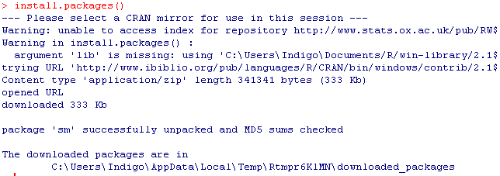

Slide 56
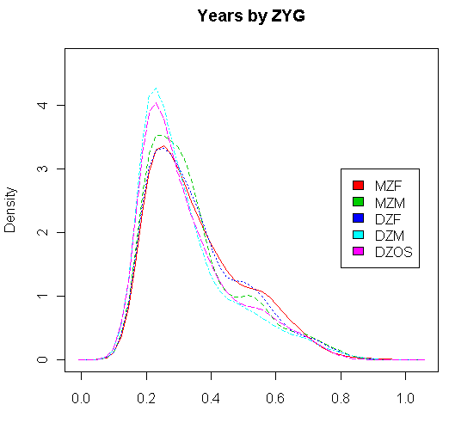
Looking at your data...
  #Kernal density plot by zyg?
  library(sm)
  # create value labels
  zyg.f <- factor(zyg, levels= seq(1,5),
  labels = c("MZF", "MZM", "DZF", "DZM", "DZOS"))
  # plot densities
  sm.density.compare(age, zyg, xlab="Years”)
  title(main="Years by ZYG")
  # add legend
  colfill<-c(2:(2+length(levels(zyg.f))))
  legend(.8,3, levels(zyg.f), fill=colfill)

Slide 57
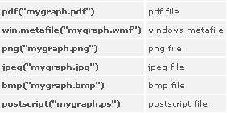
That’s great but how do I save it?
  # make a png file to hold the plot
  png("zygdensity.png")
  # create value labels
  zyg.f <- factor(zyg, levels= seq(1,5),
  labels = c("MZF", "MZM", "DZF", "DZM", "DZOS"))
  # plot densities
  sm.density.compare(age, zyg, xlab="Years”)
  title(main="Years by ZYG")
  # add legend via mouse click
  colfill<-c(2:(2+length(levels(zyg.f))))
  legend(.8,3, levels(zyg.f), fill=colfill)
  # close the png file to allow viewing
  dev.off()
Notes:
57

Slide 58
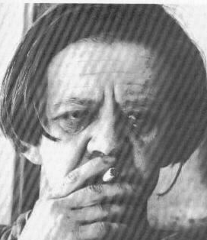
Final Words of Warning
“Using R is a bit akin to smoking. The beginning is difficult, one may get headaches and even gag the first few times. But in the long run, it becomes pleasurable and even addictive. Yet, deep down, for those willing to be honest, there is something not fully healthy in it.” --Francois Pinard
Notes:
58

Slide 59


explodingdog.com
Time for coffee

Slide 60
Vienna

