Slide 1
Imputation
Sarah Medland
Boulder 2015

Slide 2
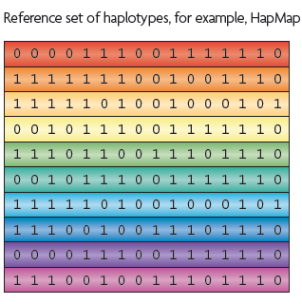
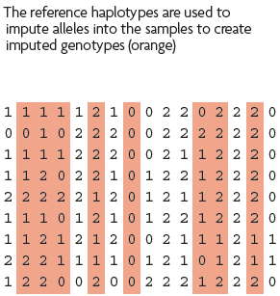
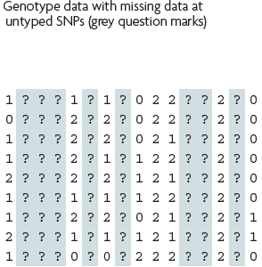
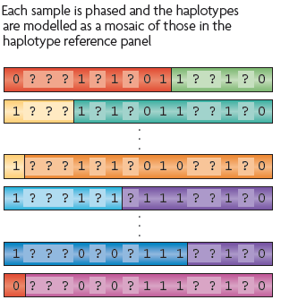
What is imputation? (Marchini & Howie 2010)

Slide 3
3 main reasons for imputation
Meta-analysis
Fine Mapping
Combining data from different chips
Other less common uses
sporadic missing data imputation
correction of genotyping errors
imputation of non-SNP variation

Slide 4
Combining data from different chips
Example
750 individuals typed on the 370K
550 individuals typed on the 610K
Power
MAF .2
SNP explaining 1% total variance
alpha 5e-08
N=1300, NCP 13.07, power .0331
N=750, NCP 7.54 , power .0034
N=550, NCP 5.53 , power .0009

Slide 5
Another way of looking at this

Slide 6
QQ-plot

Slide 7
Solution
Impute all individuals to a single reference based on the SNPs that overlap between the chips
Single distribution of NCP and power across all SNP
qq plot and manhattan describes the full sample with the same degree of accuracy

Slide 8
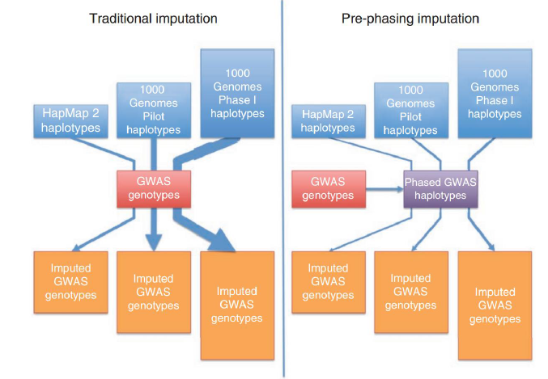
Ways to approach imputation

Slide 9
Imputation programs
Mach/MiniMac
Impute/Impute2
Beagle
SHAPEIT2 (phasing only)
never use plink for imputation!

Slide 10
How do they compare
Similar accuracy
Similar features
Different data formats
Mach/minimac –> individual=row snp=column
minimac3 –> vcf format
Impute* –> snp=row individual=column
Different philosophies
Frequentist vs Bayesian
Differences in time

Slide 11
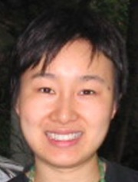
Mach/minimac
http://genome.sph.umich.edu/wiki/Minimac
http://genome.sph.umich.edu/wiki/Minimac:_1000_Genomes_Imputation_Cookbook
Built by Gonçalo Abecasis, Yun Li, Christian Fuchsberger and colleagues
Downstream analysis options
Mach2qtl (continuous phenotypes)
Mach2dat (binary phenotypes)
Merlin-offline (family/twin based samples)

Slide 12
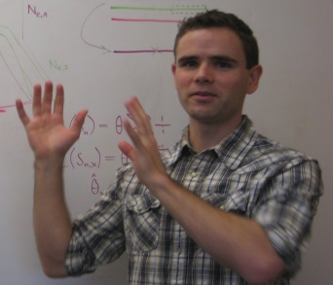
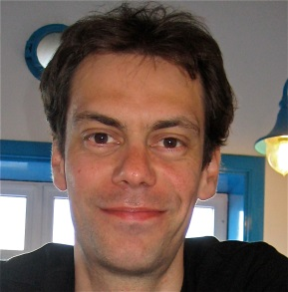
Impute2
https://mathgen.stats.ox.ac.uk/impute/impute_v2.html
http://genome.sph.umich.edu/wiki/IMPUTE2:_1000_Genomes_Imputation_Cookbook
Built by Jonathan Marchini, Bryan Howie and colleges
Downstream analysis options
SNPtest
Quicktest

Slide 13
SHAPEIT2
https://mathgen.stats.ox.ac.uk/genetics_software/shapeit/shapeit.html
Developed by Dr Olivier Delaneau through a collaborative project between the research groups of Prof Jean-Francois Zagury and Prof Jonathan Marchini
Linear complexity with the number of SNPs and conditioning haplotypes.
Whole chromosome GWAS scale datasets can be phased in a single run.
Phasing is multi-threaded to tailor computational times to your resources.

Slide 14
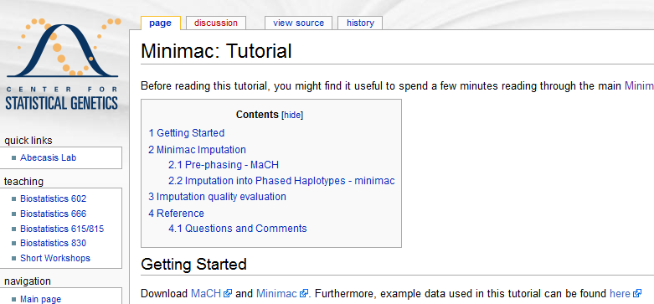
Files to practice with
http://genome.sph.umich.edu/wiki/Minimac:_Tutorial

Slide 15
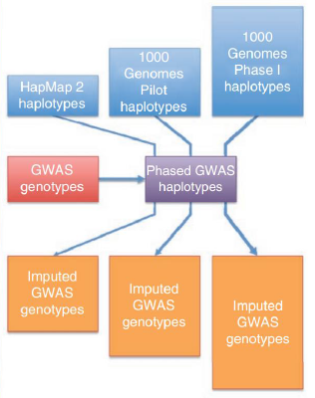
Today – discuss the 2 step approach
Step 1
Step 2

Slide 16
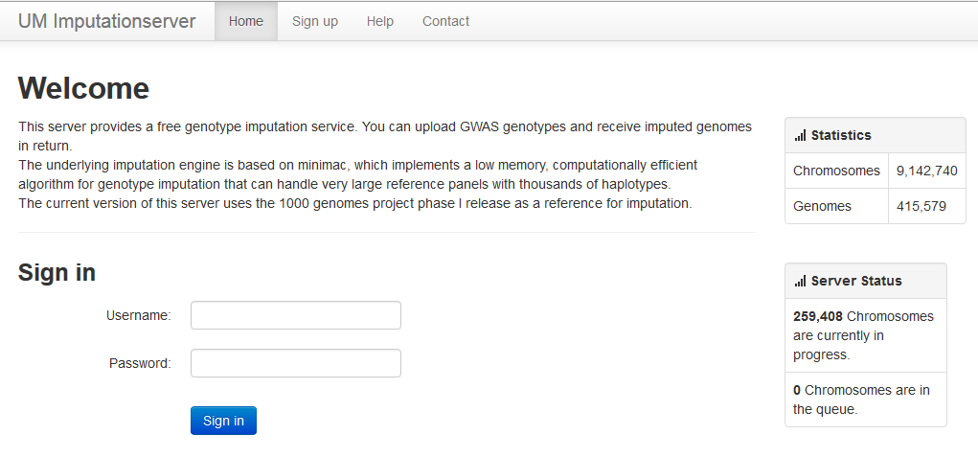
Options for imputation
DIY – Use a cookbook!
http://genome.sph.umich.edu/wiki/Minimac:_1000_Genomes_Imputation_Cookbook OR http://genome.sph.umich.edu/wiki/IMPUTE2:_1000_Genomes_Imputation_Cookbook
UMich Imputation Server
https://imputationserver.sph.umich.edu/

Slide 17
Step 0 – Chose your reference
Current Publically Available References
HapMapII (no phased X data officially released)
HapMapIII
1KGP – phase 1 version v3
1KGP – phase 1 version v3 SHAPEIT2
1KGP – phase 3 version v5
Future non-public references only available via custom imputation servers
All ethnicities vs specific

Slide 18
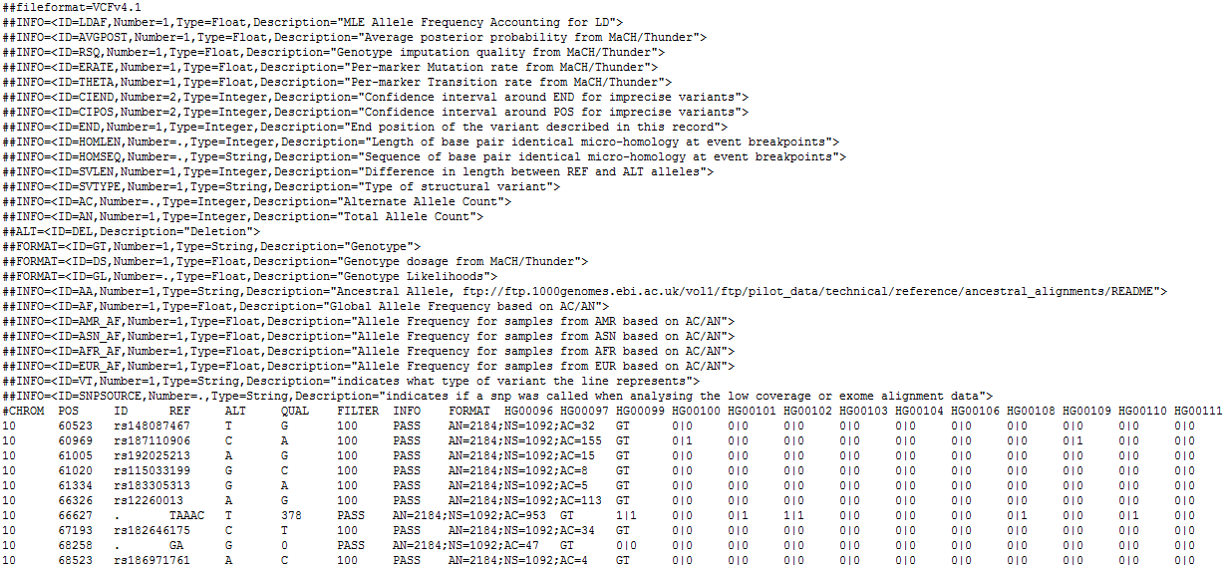
References are in vcf format
(more about this format tomorrow)

Slide 19
Not all references are equal!!
The Beagle and IMPUTE versions of the references contain variants that do not appear in the publically available 1KGP data!
The 1KGP references still contain multiple locations with more than 1 variant
&
Multiple variants in more than one place!

Slide 20
A Haplotype Reference Panel of 32,914 individuals
and Imputation Server
Sayantan Das
on behalf of
The Haplotype Reference Consortium
Department of Biostatistics,
University of Michigan,
Ann Arbor
USA

Slide 21
The Haplotype Reference Consortium
FORMED : Jonathan Marchini (Oxford)
Goncalo Abecasis (Michigan)
Richard Durbin (Sanger)
AIM : Create a large reference panel of human haplotypes by combining
data from whole genome sequencing studies
USE : Next-generation resource for phasing and rare-variant imputation into GWAS
BENEFITS :
Better catalogue of genetic variants.
Improve accuracy of rare variant imputation.
ANCESTRY : Predominantly European ancestry, but later releases will be more diverse.

Slide 22
The HRC - Studies
Study | #Samples
Crohn’s Disease | 4,514
UK10K | 3,788
Sardinia | 3,514
AMD | 3,368
GoT2D | 2,763
1K Genomes Phase3 | 2,535
BRIDGES | 2,489
Finland - Sisu | 1,564
MCTFR | 1,339
GECCO | 1,145
HUNT | 1,024
Project MinE, GPC, GoNL, inCHIANTI, Orkney, Finland – Kuusamo, Neptune, Italian and Greek Isolates | 5,041
20 studies.
Analysis done at Michigan, Sanger and Oxford.
32,914 Samples

Slide 23
The HRC Panel – Imputation Server
How to use the database?
Privacy Issues will hinder public sharing of data.
Imputation servers will allow imputation using the panel (thus enabling users to benefit from the data without having direct access to it).
Users will be able to upload (pre-phased or unphased) genotype data to the server. Imputation will be carried out remotely on the server, and the imputed data will then be made available to the user.
Subset of data accessible through dbGaP and EGA.
Michigan Imputation Server
https://imputationserver.sph.umich.edu/
Goal: 5,000 genomes per day
Pre-phasing engine: SHAPEIT2
Imputation engine: Minimac3
Screen Shot

Slide 24
Take Away Messages …
Large catalogue of variants (45M variants for ~33K samples).
HRC increases rare variant imputation accuracy over the 1000 Genomes for European ancestry.
Imputation servers will allow imputation using the panel (without having direct access to it).
Imputation Servers will handle 5,000 genomes per day.
Release1 available by mid 2015

Slide 26
Acknowledgements
Core Team
Goncalo Abecasis
Richard Durbin
Jonathan Marchini
Shane McCarthy
Warren Kretzschmar
Sayantan Das
Christian Fuchsberger
Olivier Delaneau
Hyun Min Kang
Petr Danecek
MTFS
Scott Vrieze
Matt McGue
Bill Iacono
Orcades
Jim Wilson
Richard Durbin
GoT2D
Mark McCarthy
David Altshuler
Mike Boehnke
Bipolar
Mike Boehnke
Richard Myers
BRIDGES Mike Boehnke Richard Myers
Crohn’s/UC
Jeff Barrett
Carl Anderson
Project MinE - NL Jan Veldink Leonard van den Berg
Italian Isolates
Paolo Gasparini
Nicole Soranzo
Daniela Toniolo
Nicola Piratsu
Helic
Eleftheria Zeggini
WHI-GECCO Ulrike Peters Tabitha Harrison Kendra Blalock Keith Curtis
GoNL
Cisca Wijmenga
Paul I.W. de Bakker
Morris A. Swertz
Androniki Menelaou
UK10K
Richard Durbin
Nicole Soranzo
Nick Timpson
George Davey-Smith
Tim Spector
AMD
Anand Swaroop
Dwight Stambolian
Emily Chew
Xiaowei Zhan
HUNT
Cristen Willer
Kristian Hveem
inCHIANTI Tim Frayling Andrew Wood Michael Weedon
Sisu/Kuusamo
Aarno Palotie
Samuli Ripatti
Sardinia
Francesco Cucca
Serena Sanna
David Schlessinger
Carlo Sidore
GPC Carlos Pato Michele Pato Steven McCarroll NEPTUNE Matthias Kretzler CPROBE Crystal Gadegbeku

Slide 27
Step 0 – re-QC your data
Convert to PLINK binary format
Exclude snps with excessive missingness (>5%), low MAF (<1%), HWE violations (~P<10⁻⁴), Mendelian errors
Drop all strand ambiguous (palindromic) SNPs – ie A/T or C/G snps
Update build and alignment (b37)
Check strand!
Output your data in the expected format for the phasing program you will use
Check the naming convention for the program and reference you want to use
rs278405739 OR 22:395704

Slide 28
Strand, strand, strand
DNA is a double helix
A pairs with T and C pairs with G
There are two strands:
ATCTGGTACTCCAT
TAGACCATGAGGTA
Strand 1
Strand 2

Slide 29
Strand, strand, strand
What about SNPs?
ATCTGGT[A/C]CTCCAT
TAGACCA[T/G]GAGGTA
Strand 1
Strand 2

Slide 30
Strand, strand, strand
What’s the big/annoying problem?
ATCTGGT[A/T]CTCCAT
TAGACCA[T/A]GAGGTA
Strand 1
Strand 2

Slide 31
Strand, strand, strand
Two ambiguous SNP types
A/T and G/C
All others are resolved
How to check?
Allele frequencies [know your population]
LD [if you have raw data]
PLINK and METAL can re-orient strand
Remember the ambiguous ones!

Slide 32
Example data ready for MaCH

Slide 33
Questions?
Before we move on to talking about phasing

Slide 34
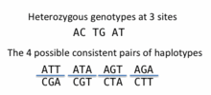
What is phasing
In this context it is really Haplotype Estimation
We take out genotype data and try to reconstruct the haplotypes
Can use reference data to improve this estimation

Slide 35
Step 1 - Phasing
The larger the reference panel the larger the improvement in power and resolution but the greater the computational burden
Solution - Pre-phase genotypes to produce best-guess haplotypes, then impute into these estimated haplotypes.
small loss of accuracy since the estimation uncertainty in the study haplotypes is ignored, but is much faster
The pre-phasing step needs to be performed just once per study dataset, so re-imputing is computationally cheap. .

Slide 36
Step 1 - Phasing
Approach by Impute* and MaCH
Inference is carried out using a Gibbs sampling approach in which the haplotypes of each individual are iteratively updated.
A hidden Markov model is used to model the conditional distributions of the Gibbs sampler
Individual's haplotypes are updated conditional upon the current haplotype estimates of all other samples.

Slide 37
Step 1 - Phasing
Need to make approximations
the number of HMM calculations involved in sampling an individual's haplotypes from the conditional distributions scales quadratically with the number of haplotypes being conditioned on
Complexity = O(N²)

Slide 38
Step 1 - Phasing
Need to make approximations
MaCH approximates the algorithm by choosing a random set of K haplotypes to condition on at each iteration.
Complexity = O(K²)
Impute2 chooses the most similar subset to the previous haplotype estimates of the individual
ShapeIT uses graph theory to “collapse the haplotypes” (see SHAPEIT2sup.pdf for details)

Slide 39
Step 1 – How to phase
If running MaCH or IMPUTE divide chromosome into chunks (with overlapping windows) and phase each chunk
If running SHAPEIT run whole chromosomes or chunks

Slide 40
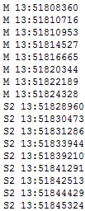
Phasing in Mach
Dividing the data sets into chunks
http://genome.sph.umich.edu/wiki/ChunkChromosome
Autochunk files
Chunked dat files

Slide 41
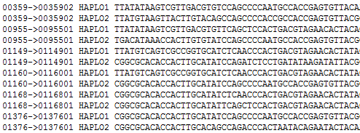
Phasing in Mach
Phasing each chunk (bash)

Slide 42
Questions?
Before we move on to talking about imputation

Slide 43
Step 2 - Imputation
If you used Mach for phasing you use minimac(3) for imputation
If you used IMPUTE2 for phasing you use IMPUTE2 for imputation
If you used SHAPEIT2 for phasing you can use either minimac or IMPUTE2 for imputation

Slide 44
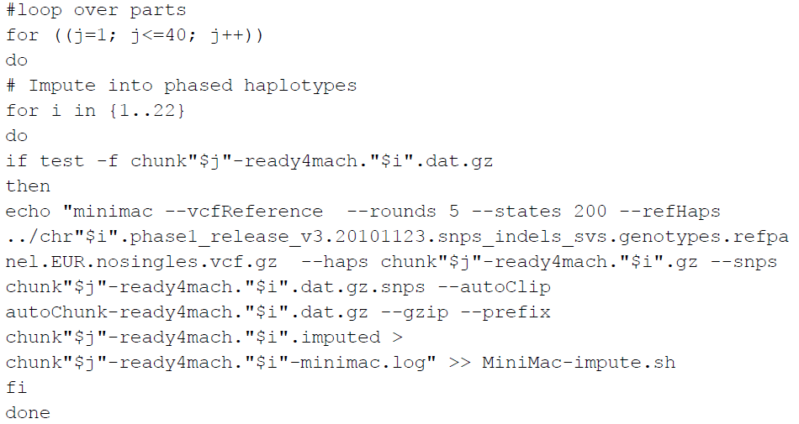
Imputing in minimac

Slide 45
Output
Info files

Slide 46
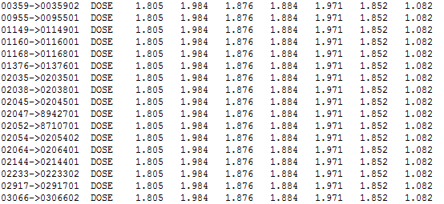
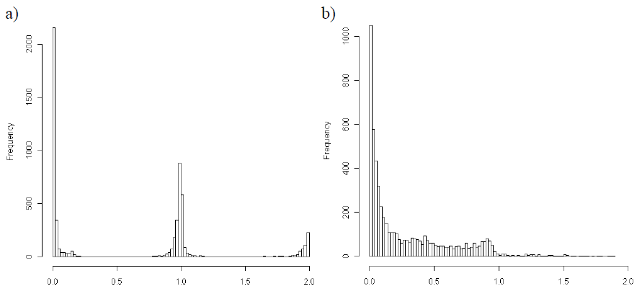
Output
3 main genotype output formats
Probs format (probability of AA AB and BB genotypes for each SNP)
Hard call or best guess (output as A C T or G allele codes)
Dosage data (most common – 1 number per SNP, 1-2)

Slide 47
Assessing accuracy of phasing
All phasing methods will make errors in the estimation of haplotypes - probability of error increases with length of imputed region
Problem – some programs are designed to run on small segments others on whole chromosomes
More work needed that compares like with like

Slide 48
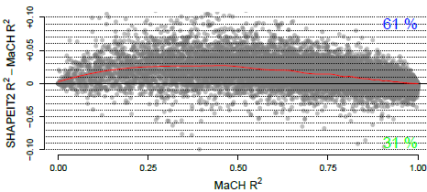
Assessing accuracy of phasing
Delaneau et al 2012.
1,229 phase known samples at 7,985 SNPs on chromosome 22, created from a set of Vietnamese father-mother-child trios
Mean distance between switch errors for the methods Fastphase 0.3Mb, Beagle 0.38Mb, MaCH 0.40Mb, Impute2 0.44Mb and SHAPEIT1 0.56Mb
SHAPEIT did best but is this because the whole chromosome was imputed and it is the only program specifically designed for this?

Slide 49
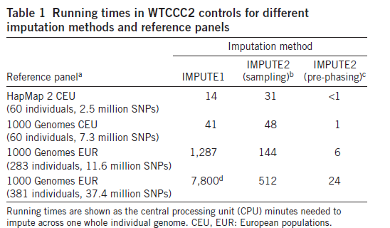
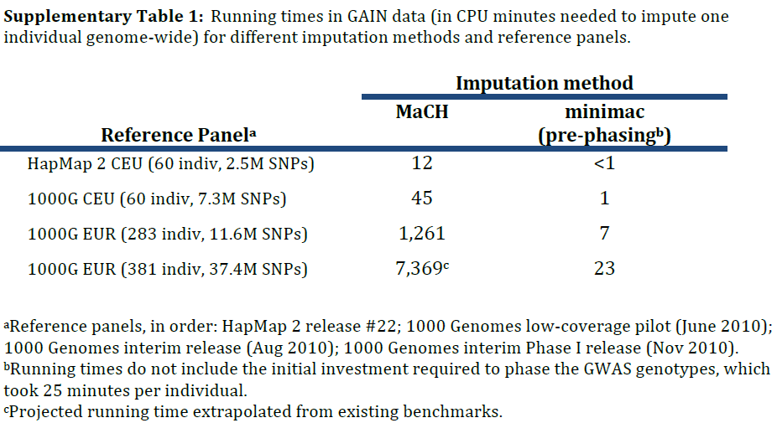
Timing
from
Howie et al 2012

Slide 50
Accuracy of imputation methods
More work needed that compares like with like

Slide 51
Questions?
Before we move on to talking about post imputation QC…

Slide 52
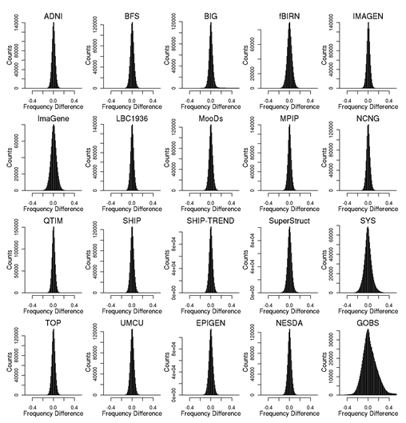
Post imputation QC
After imputation you need to check that it worked and the data look ok
Things to check
Plot r² across each chromosome look to see where it drops off
Plot MAF-reference MAF

Slide 53
Post imputation QC
For each chromosome check N and % of SNPs:
MAF <.5%
With r² 0-.3, .3-.6,.6-1
If you have hard calls or probs data HWE P < 10E-6
If you have families convert to hard calls and check for Mendelian errors (should be ~.2%)
% should be roughly constant across chromosomes

Slide 54
Post imputation QC
Next run GWAS for a trait – ideally continuous, calculate lambda and plot:
QQ
Manhattan
SE vs N
P vs Z
Run the same trait on the observed genotypes – plot imputed vs observed

Slide 55
However, if you are running analyses for a consortium they will probably ask you to analyse all variants regardless of whether they pass QC or not…
(If you are setting up a meta-analysis consider allowing cohorts to ignore variants with MAF <.5% and low r2 – it will save you a lot of time)

Slide 56
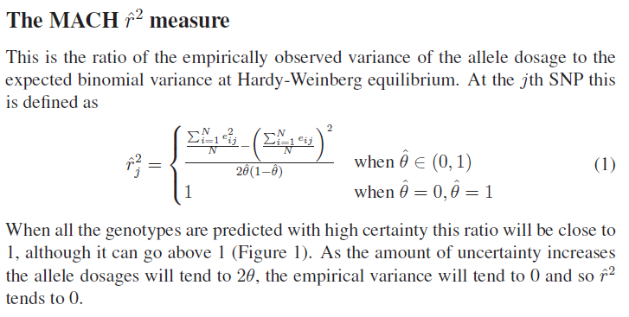
Issue – the r² metrics differ between imputation programs

Slide 57
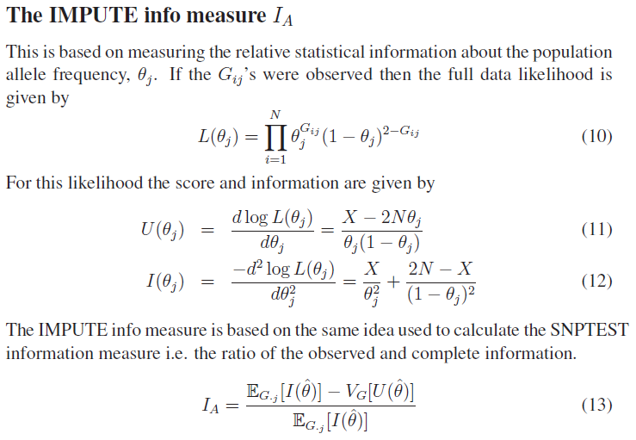
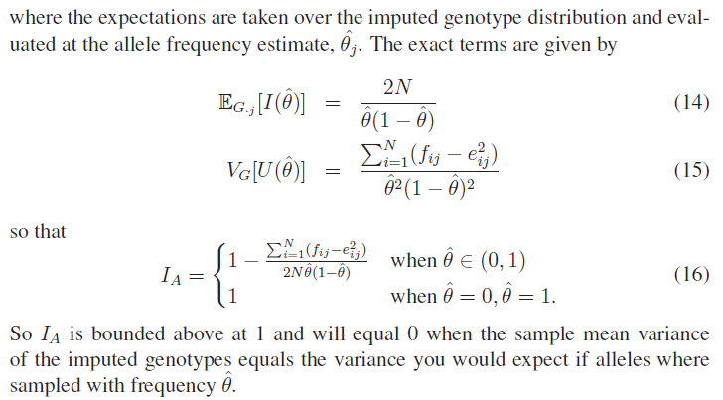

Slide 58
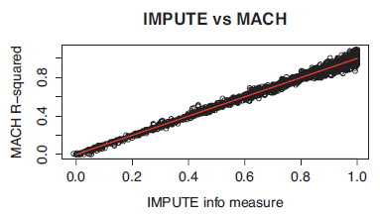
In general fairly close correlation
rsq/ ProperInfo/ allelic Rsq
1 = no uncertainty
0 = complete uncertainty
.8 on 1000 individuals = amount of data at the SNP is equivalent to a set of perfectly observed genotype data in a sample size of 800 individuals
Note Mach uses an empirical Rsq (observed var/exp var) and can go above 1

Slide 59
Questions?
Before we move on to talking about post imputation analysis

Slide 60
Choices of analysis methods

Slide 63
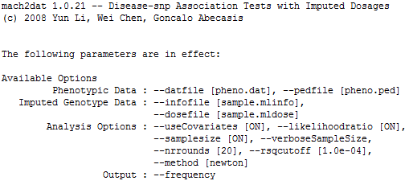
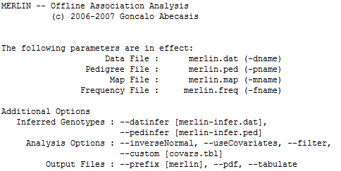
Analysis

Slide 64
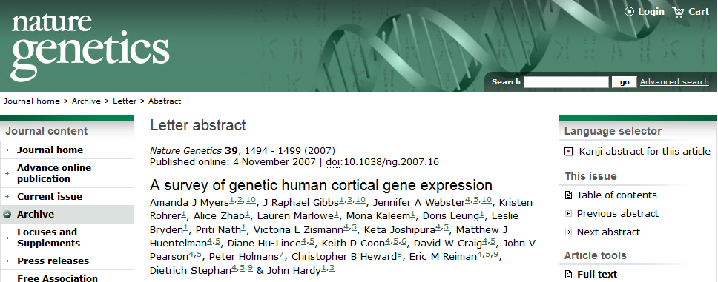
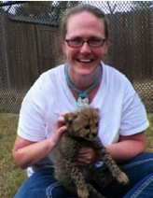
Todays practical
http://labs.med.miami.edu/myers/LFuN/LFuN.html
post-mortem gene expression in ‘brain’ tissue
N=193

Slide 65
Imputation
Chromosome 22 only – HapMapII- b36r22
MaCH phasing
(In real life with a sample this size include the reference in the phasing)
Minimac Imputation
Run twice
Once without stand alignment (badImp)
Once with strand alignment (goodImp)

Slide 66
How do we know there was no strand alignment from the output?
No way of telling from the phasing log
B/c we didn’t include a reference
Imputation log is FULL of errors
 | rs915677 -T | rs915677 -R | rs9617528-T | rs9617528-R
A | 0 | .08 | .72 | 0
C | .91 | 0 | 0 | .17
G | 0 | .92 | .28 | 0
T | .09 | 0 | 0 | .83

Slide 67
Take a look at the goodImp data
Look at the phased haplotypes
zless -S myers22flipped.hap.gz
Look at the dosage data
zless -S myers22flipped.dose.gz
Look at the info data
less -S myers22flipped.info

Slide 68
Plot the r2 for the 2 imputation runs (against index)
How do they compare?
badImp 17,908/39905 with r2 >=.6
goodImp 24,685/39905 with r2 >=.6
still quite bad b/c of small N
Should have compensated by including ref data in the phasing step
In a QIMR dataset N=19k 32296/33815

Slide 69
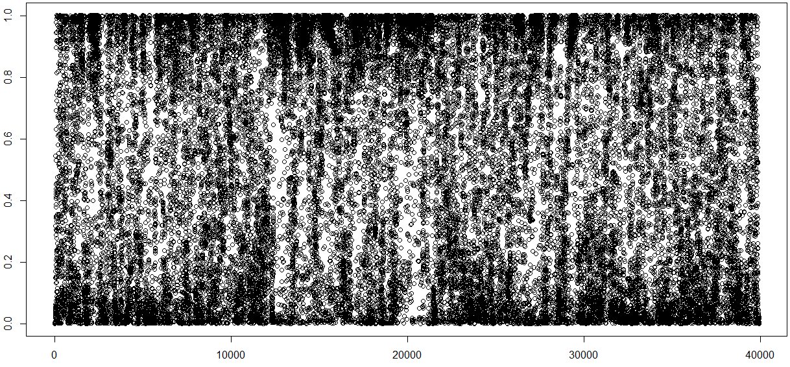
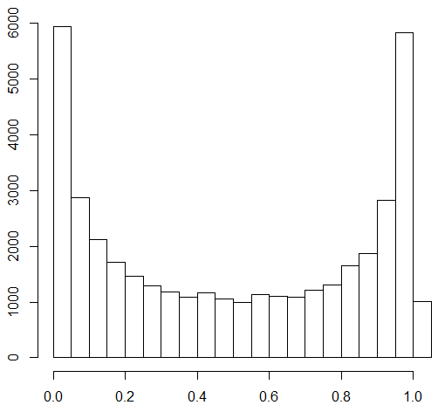
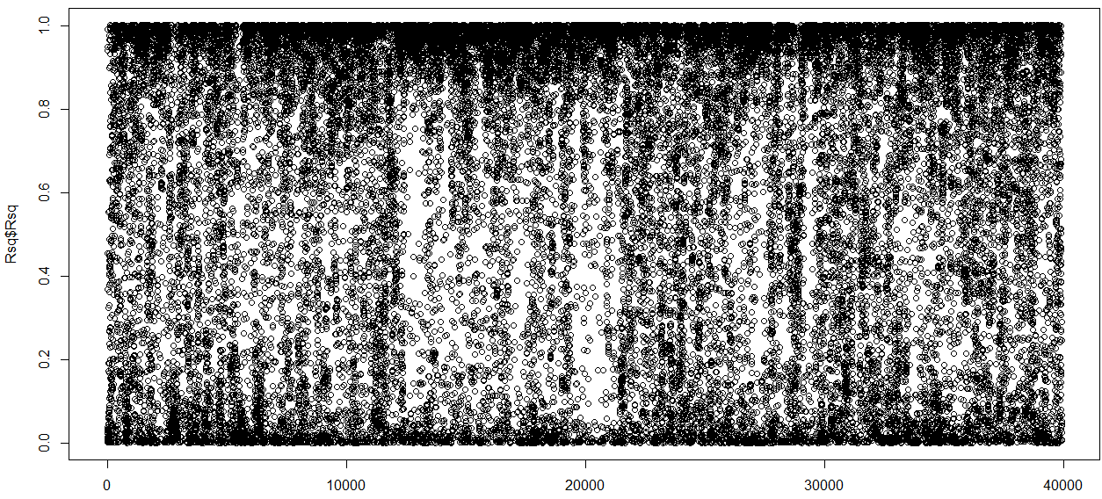
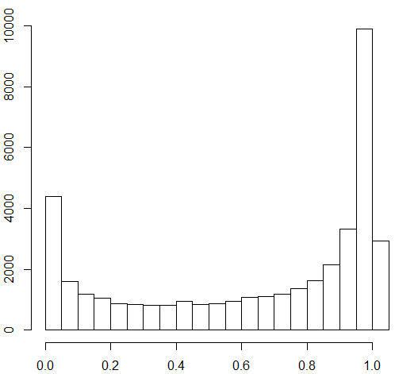
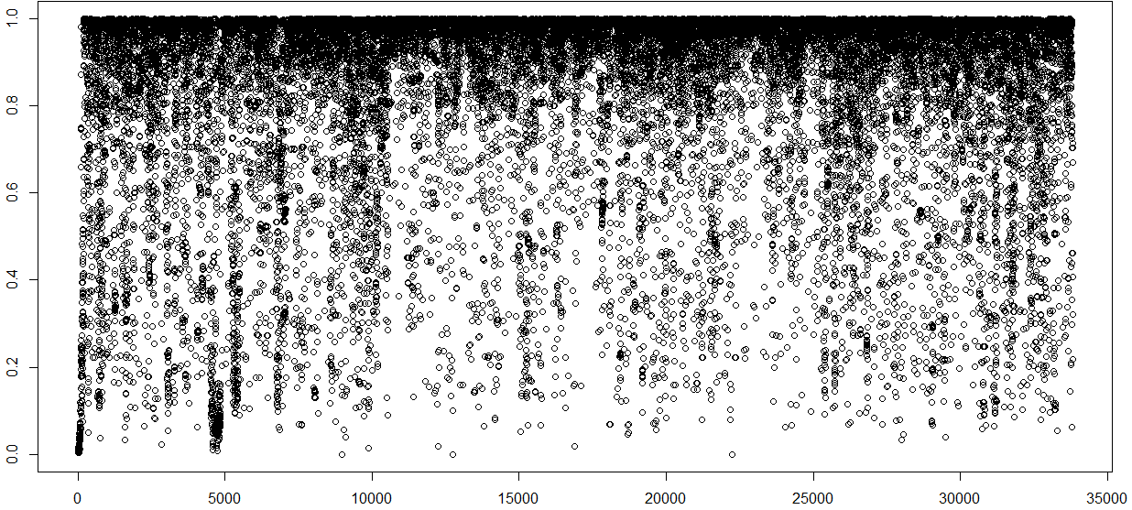
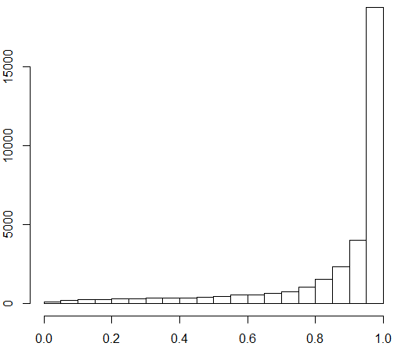
Bad
Imputation
Better Imputation
Good
Imputation

Slide 70
Run some association
Edit the exp.dat file
pick 4 probes
Skip the rest by changing T to S
mach2qtl --datfile exp.dat --ped exp.ped --info myers22flipped.info.gz --dosefile myers22flipped.dose.gz --samplesize > mach2qtl.log

Slide 71
Output

Slide 72
Extract results for one probe using grep
Plot –log₁₀P against index (in R)
Apply QC MAF >5% & R2 >=.6
Replot –log₁₀P against index (in R)
Extension exercise make QQ plots

Slide 73
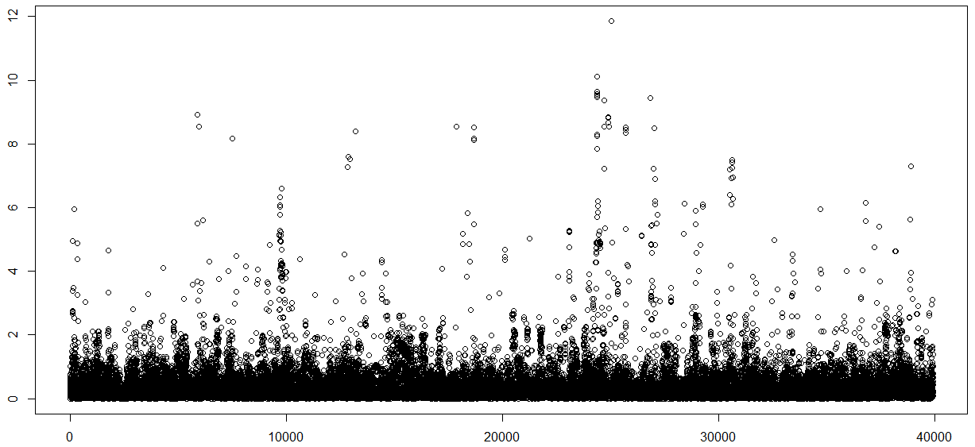
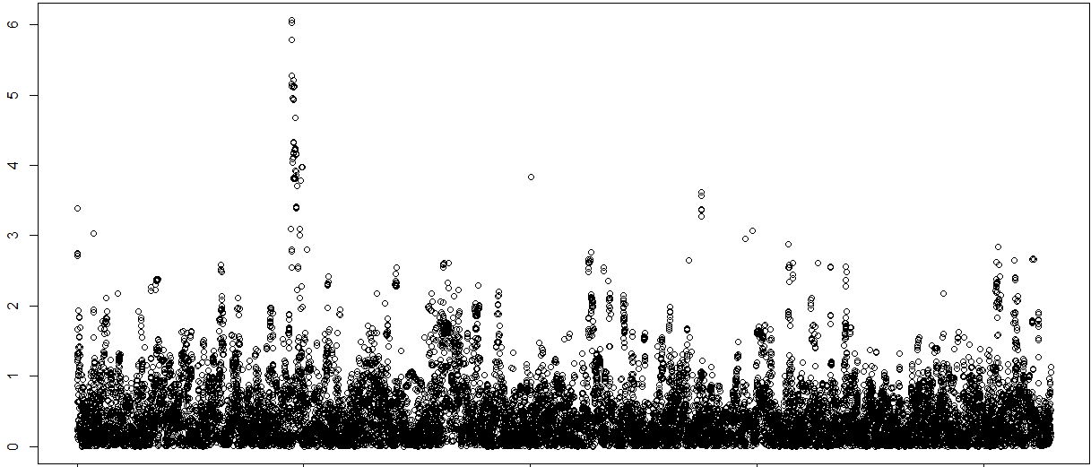
Before QC
After QC

