Slide 1














28th International Workshop on Methodology for Human Genomic Studies: “the Advanced course”
Ben Neale (director)
Lindon Eaves
Jeff Barrett
David Evans (codirector)
Pak Sham
Clara Tang
Mike Neale
Hermine Maes
Sarah Medland
Dorret Boomsma
Abdel Abdellaoui
Meike Bartels, Rick Jansen
Christian de Leeuw
John Hewitt (host)
Jeff Lessem
Matt Keller
Dan Howrigan
Stacey Cherny
Miaoxin Li
Shamil Sunyaev
Manuel Ferreira
Monkol Lek
Beata St Pourçain
Teresa de Candia
Rob Fitzpatrick
Doug Ruderfer

Slide 2
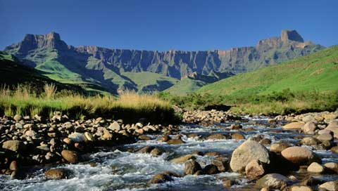
The genetics of complex traits: historical context and current challenges
Nick Martin
Queensland Institute
of Medical Research
Brisbane
Boulder workshop
March 3, 2015

Slide 3
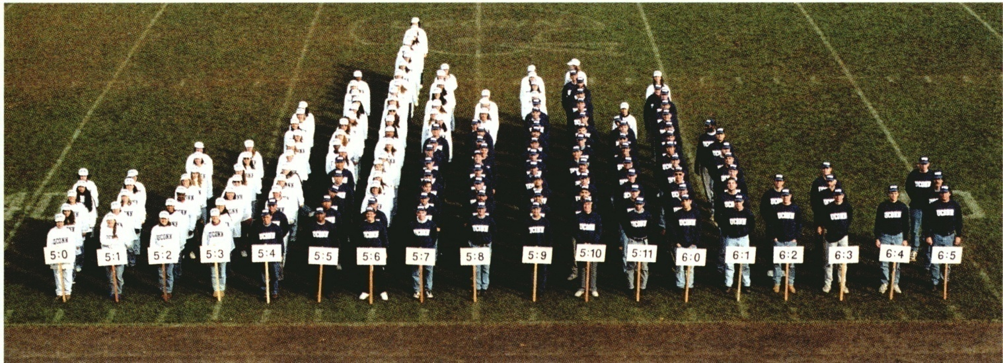
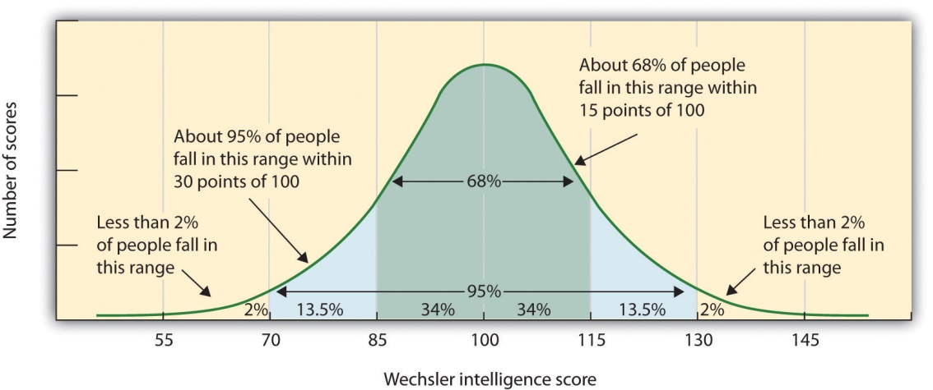
Human variation: Height
Human variation: IQ

Slide 4
Genetic Epidemiology:
Stages of Genetic Mapping
Are there genes influencing this trait?
  Genetic epidemiological (twin / family) studies OR heritability based on measured genetic variants
Where are those genes?
  Linkage analysis
What are those genes?
  Association analysis (meta-analysis / pathway)
How do they work beyond the sequence?
  Epigenetics, transcriptomics, proteomics
What can we do with them ?
  Translational medicine

Slide 5
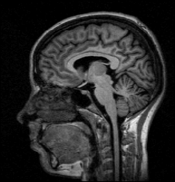
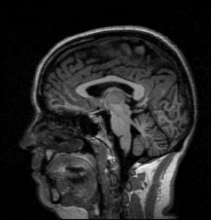
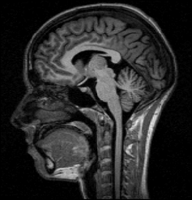
Brain volume (ml) in MZ twin pairs
Brain volume in DZ twin pairs
Twin 1
Twin 1
1400
1400
1200
1200
1000
1000
Twin 2
Twin 2
800
800
800
1000
1200
1400
800
1000
1200
1400

Slide 6
4 Stages of Genetic Mapping
Are there genes influencing this trait?
  Genetic epidemiological studies
Where are those genes?
  Linkage analysis
What are those genes?
  Association analysis
What can we do with them ?
  Translational medicine

Slide 7
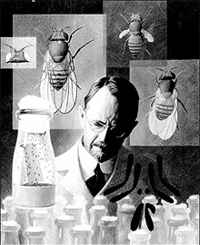
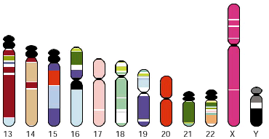
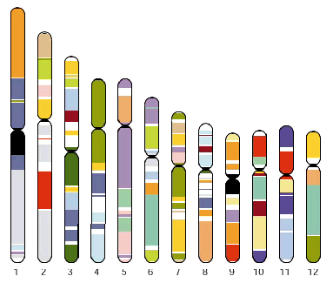
Linkage analysis
Thomas Hunt Morgan – discoverer of linkage

Slide 8
x
1/4
1/4
1/4
1/4

Slide 9
IDENTITY BY DESCENT
Sib 1
Sib 2
4/16 = 1/4 sibs share BOTH parental alleles IBD = 2
8/16 = 1/2 sibs share ONE parental allele IBD = 1
4/16 = 1/4 sibs share NO parental alleles IBD = 0

Slide 10
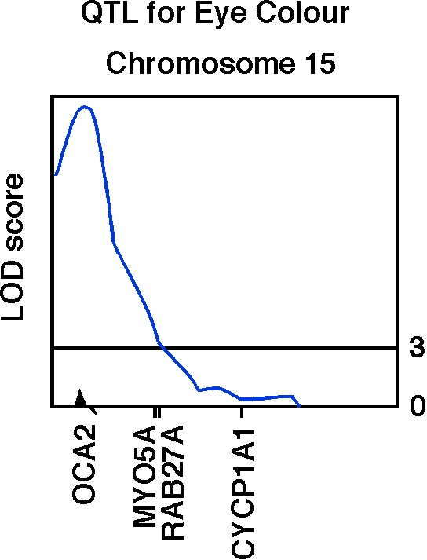
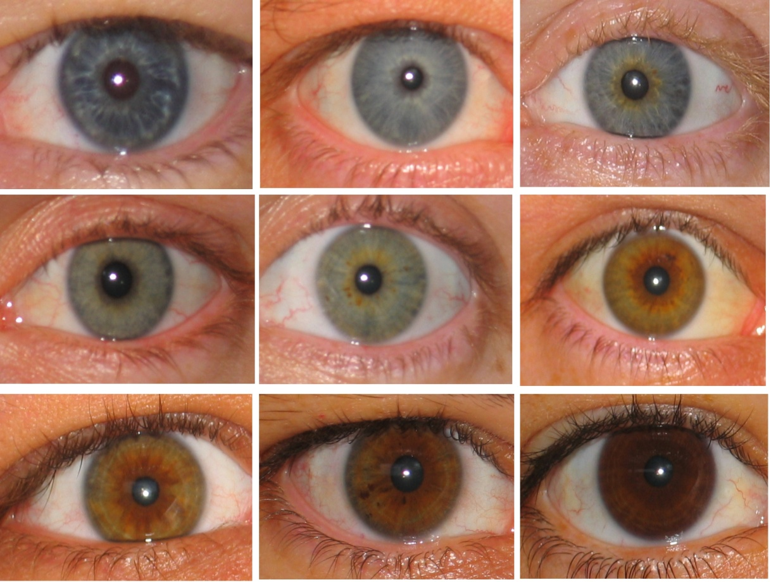
Human OCA2 and eye colour
Zhu et al., Twin Research 7:197-210 (2004)

Slide 11
Finding the genes - association
Looks for correlation between specific alleles and phenotype (trait value, disease risk)

Slide 12
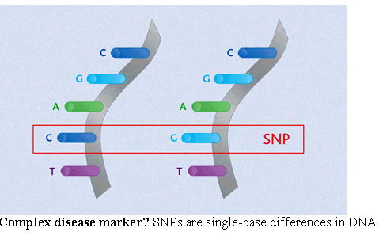
Variation: Single Nucleotide Polymorphisms

Slide 13
Linkage disequilibrium

Slide 14
Linkage disequilibrium
time

Slide 15
Indirect association
this SNP will be associated with disease

Slide 16
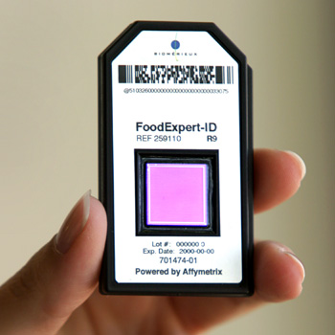

High density SNP arrays – up to 1 million SNPs

Slide 17
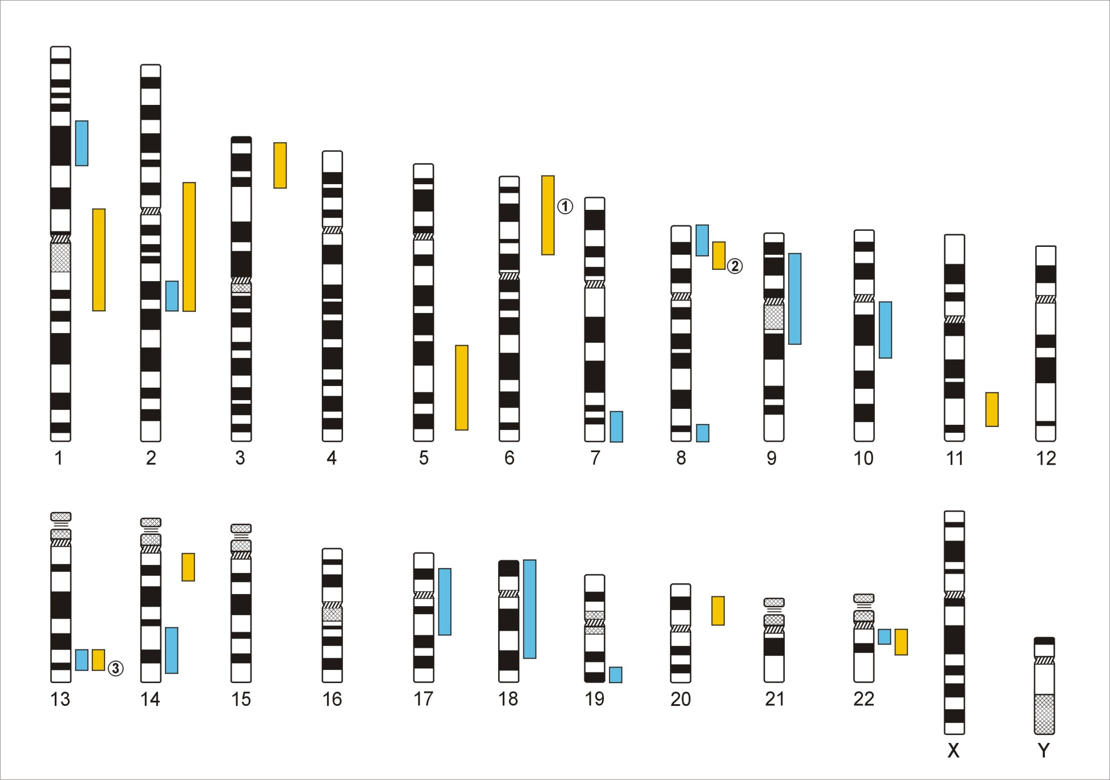
Genome-Wide Association Studies
500,000 – 5,000,000 SNPs
Human Genome - 3,1x10⁹ Base Pairs
Notes:
In a GWA the Genome which contains xx SNPs is examined using … SNPs

Slide 18
Genetic Case Control Study
Controls
Cases
G/T
G/G
T/T
T/T
T/T
T/G
T/G
T/T
T/G
T/G
G/G
T/G
T/G
T/T
Allele G is ‘associated’ with disease

Slide 19
Allele-based tests (case-control)
Each individual contributes two counts to 2x2 table.
Test of association
where
X² has χ² distribution with 1 degrees of freedom under null hypothesis.
 | Cases | Controls | Total
G | n_{1A} | n_{1U} | n_{1·}
T | n_{0A} | n_{0U} | n_{0·}
Total | n_{·A} | n_{·U} | n··

Slide 20
Simple Regression Model of Association
(continuous trait)
Y_{i} = α + βX_{i} + e_{i}
where
Y_{i} = trait value for individual i
X_{i} = number of ‘A’ alleles an individual has
1.2
1
0.8
Y
0.6
0.4
0.2
0
X
0
1
2
Association test is whether β > 0

Slide 21
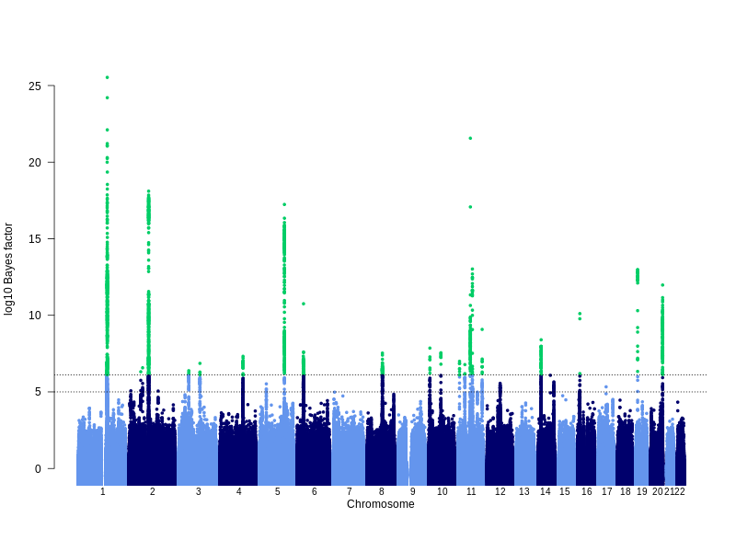
GWAS for eczema (21k cases, 98k controls, 27 hits)
Lavinia Paternoster
Notes:
Manhattan plot showing results of the trans-ethnic meta-analysis.
Explain bayes factor and cut-off equivalent to p-value 5x10-8

Slide 22
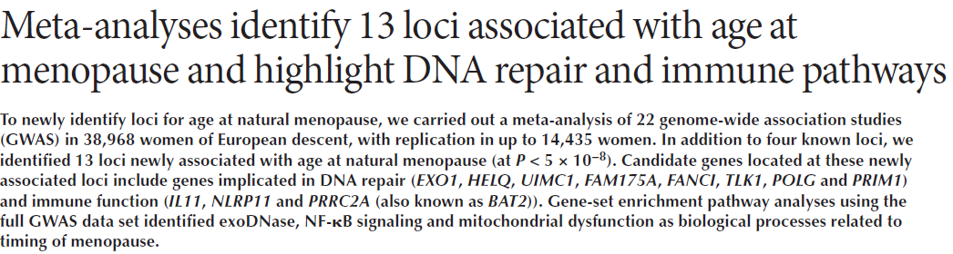
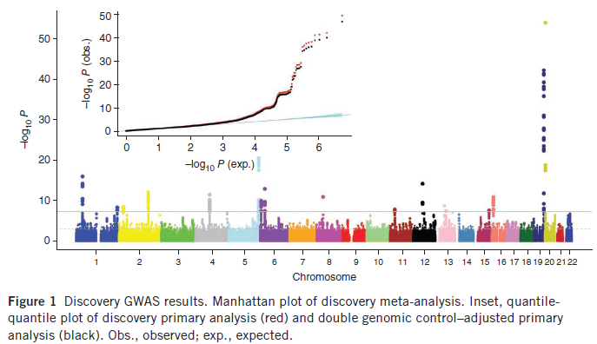

Slide 23
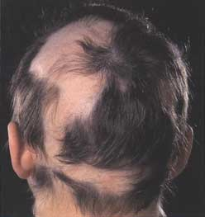
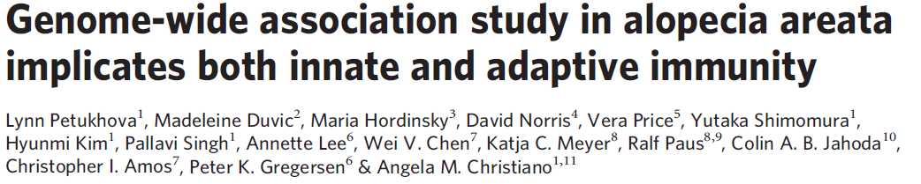
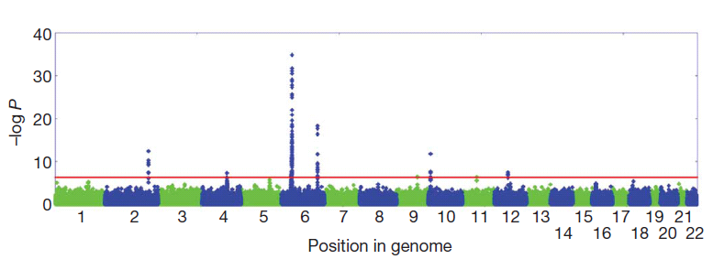

Slide 24
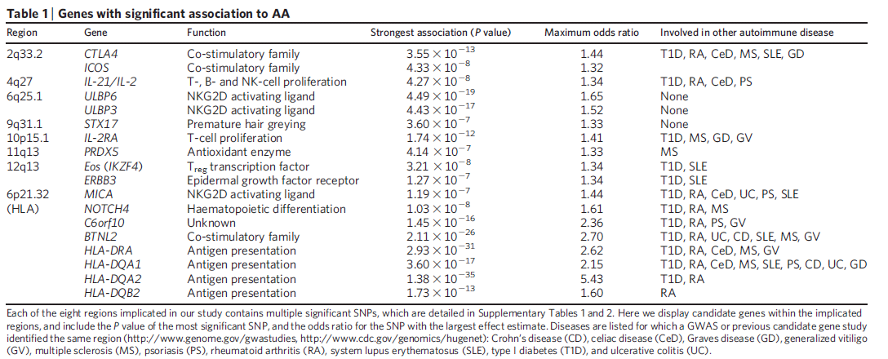
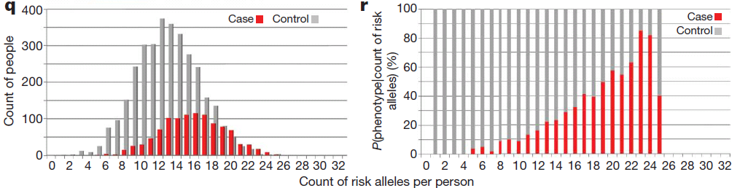

Slide 25
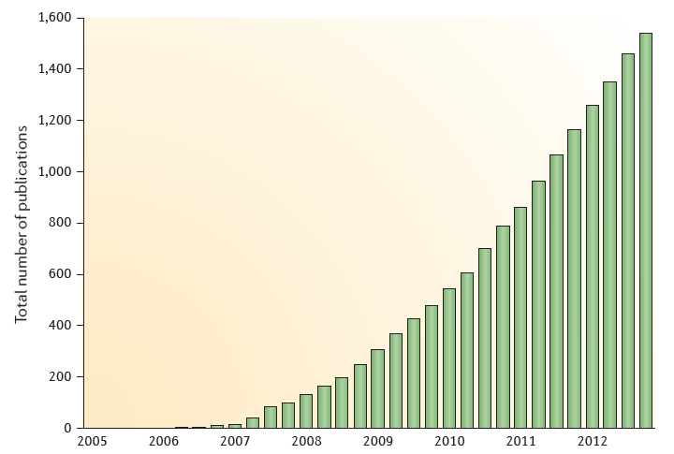
GWAS publications since 2005
Manolio, Nature Reviews Genetics, August 2013

Slide 26
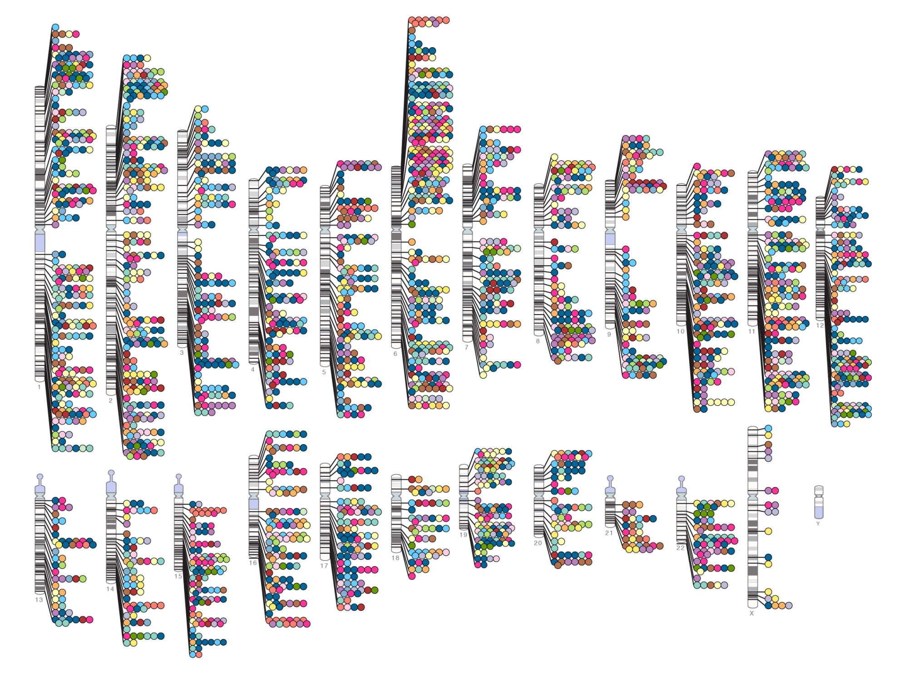
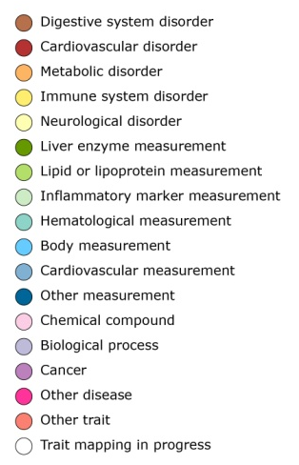

Published Genome-Wide Associations through 07/2012
Published GWA at p≤5X10⁻⁸ for 18 trait categories
NHGRI GWA Catalog
www.genome.gov/GWAStudies
www.ebi.ac.uk/fgpt/gwas/

Slide 27
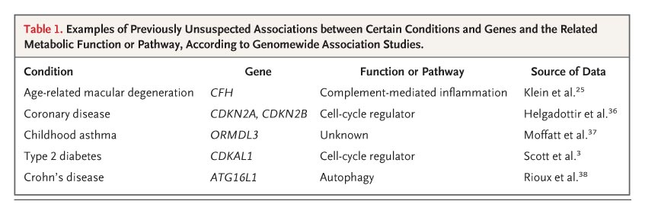

Examples of Previously Unsuspected Associations between Certain Conditions and Genes and the Related Metabolic Function or Pathway, According to Genomewide Association Studies
Manolio T. N Engl J Med 2010;363:166-176

Slide 28
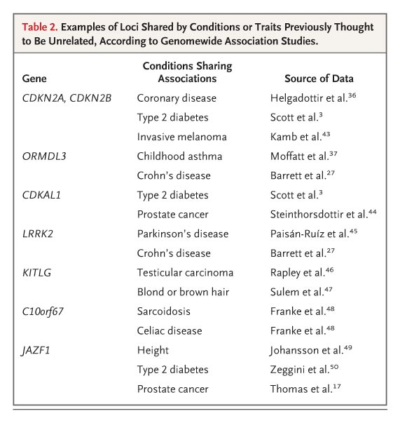
Examples of loci shared by conditions or traits previously thought to be unrelated, according to Genomewide Association Studies
Manolio T. N Engl J Med 2010;363:166-176

Slide 29
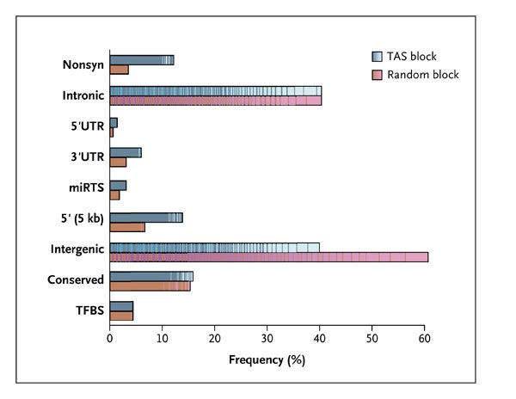
Functional classifications of 465 Trait-Associated SNPs and the SNPs in Linkage Disequilibrium with them
Manolio T. N Engl J Med 2010;363:166-176

Slide 30
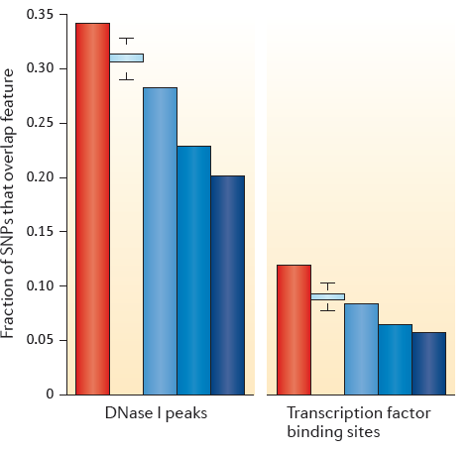
Correlations of presumed regulatory regions defined from GWAS
DNaseI peaks indicate regions of open chromatin accessible to the transcription apparatus and transcription factor binding sites where this this apparatus attached to the DNA
Manolio, Nature Reviews Genetics, August 2013

Slide 31
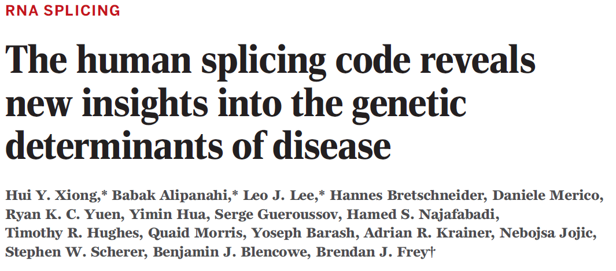
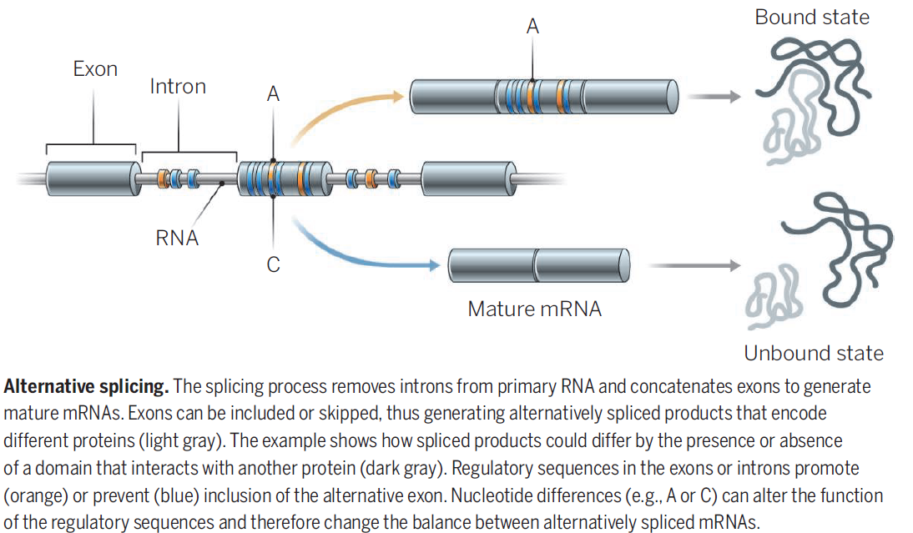


Slide 32
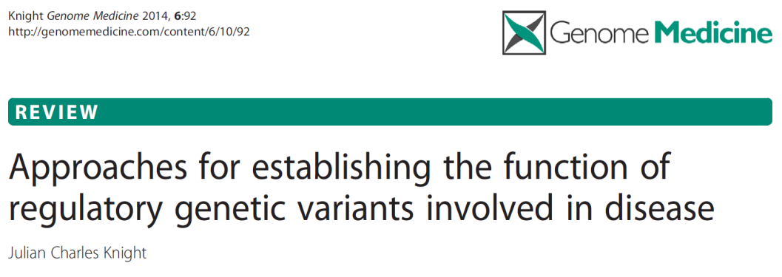
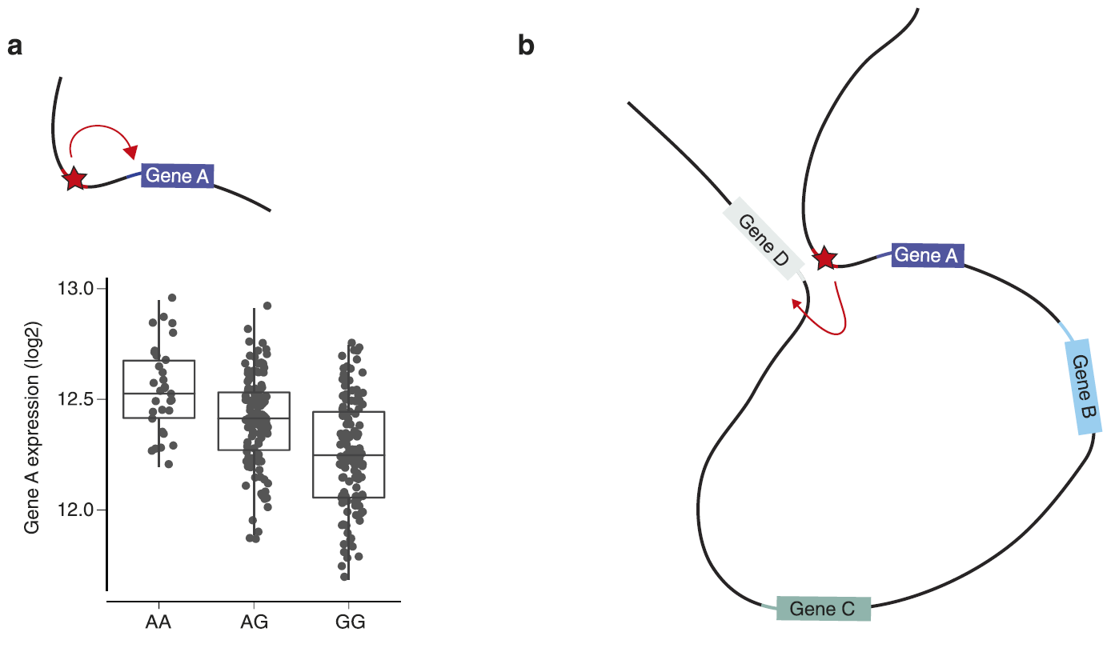
A local cis-acting variant in a regulatory element affects allele-specific transcription factor binding affinity and is associated with differential expression of gene A (see chart)

Slide 33
The same variant can modulate expression of gene D at a distance through DNA looping that brings the regulatory enhancer element close to the promoter of gene D on the same chromosome.

Slide 34
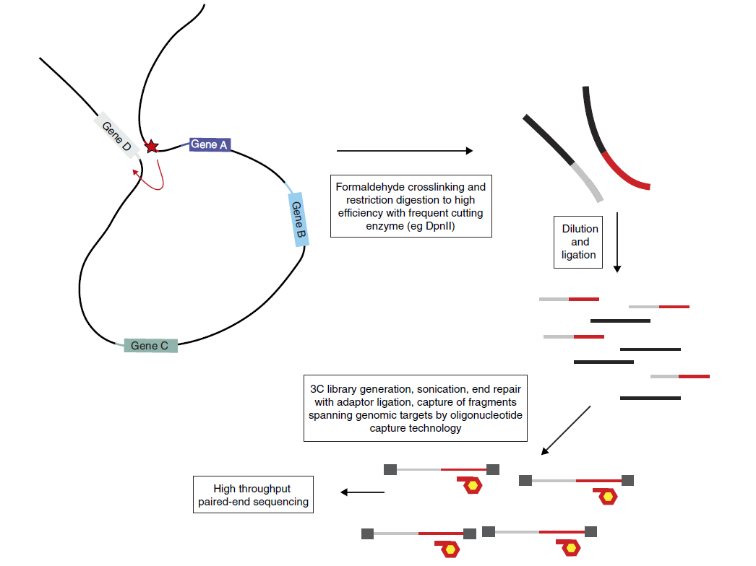
Chromatin conformation capture (3C) to find the target of a disease-associated SNP within an enhancer element
Can detect interactions from ~20kb to ~800kb

Slide 35
Fine-mapping identifies multiple independent sets of breast cancer risk SNPs at 10q21.2
tgSNP
SNPs in Region 2 regulate NRBF2, 600 kb away
 | Region 1 | Region 2 | Region 3 | Region 4
SNP | rs10995201 | chr10:64258684:D | rs7922449 | rs9971363
OR (overall br ca) | 0.85 (0.83,0.88) | 0.93 (0.91,0.95) | 1.06 (1.04.1.08) | 0.94 (0.92,0.97)
P value | 1.05 x 10⁻²⁹ | 4.24 x 10⁻¹⁴ | 1.68 x 10⁻⁷ | 1.2 x 10⁻⁵
Putative causal SNPs | 11 | 6 | 17 | 17
Darabi et al, under review

Slide 36
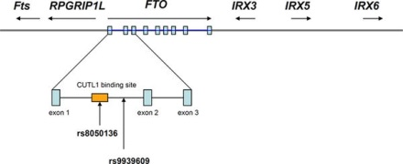
Obesity-associated variants within FTO form long-range functional connections with IRX3
Smemo et al 2014

Slide 37
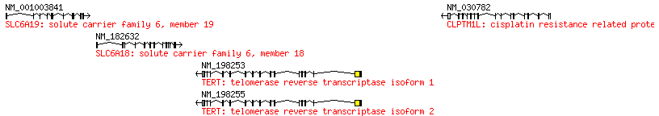
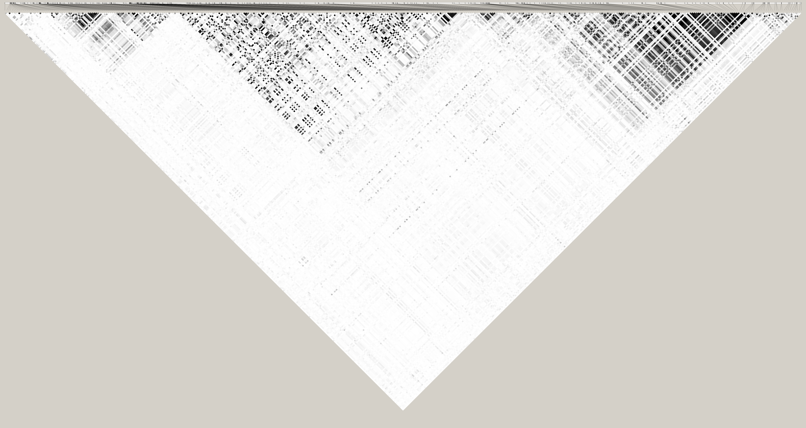
Some regions with low LD are poorly tagged (and imputed) on GWAS chips e.g. TERT region
Notes:
The reason for this is probably quite clear – although there is an LD block over CLPTM1L, the LD is rather poor over TERT, and so the gene is not well tagged on the commercial chips.

Slide 38
Is dense genotyping necessary for ‘fine mapping’?
Of 50 putative causal SNPs over ~20 loci identified through dense genotyping and fine mapping on iCOGS customized genotyping chip:
  5 are very poorly imputed from GWAS chips (imputation r²<0.5)
  17 are moderately imputed from GWAS chips (imputation r²<0.9)
  only for 56% could the putative causal SNPs have been found by imputation
  Need to identify the putative causal SNPs before embarking on functional studies

Slide 39
Selected quantitative traits Selected diseases
Number of Loci Identified is a Function of Sample Size
Visscher PM, et.al. (2012) Am J Hum Genetics

Slide 40
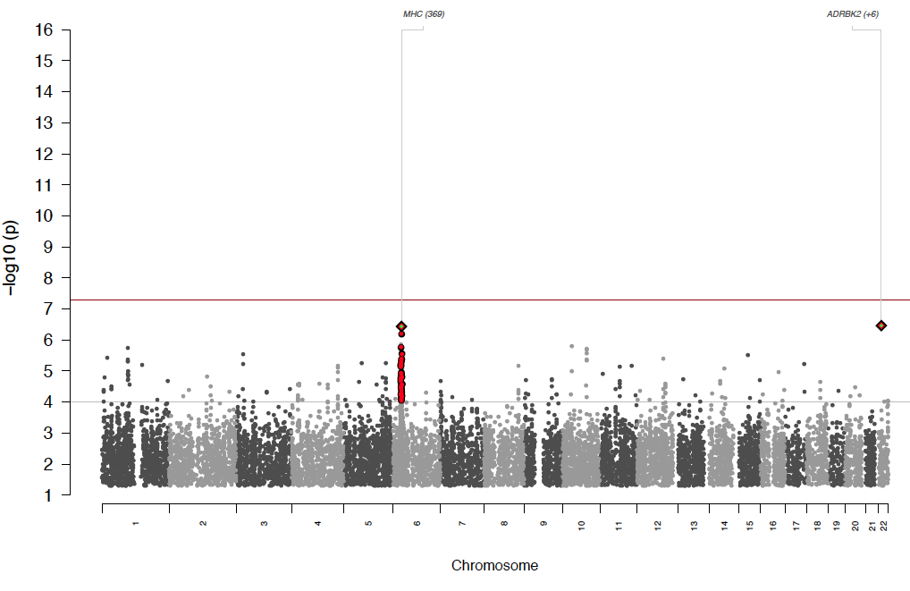
Schizophrenia 2009
ISC 2009
3K cases
Dramatic progress in GWAS for Schizophrenia

Slide 41
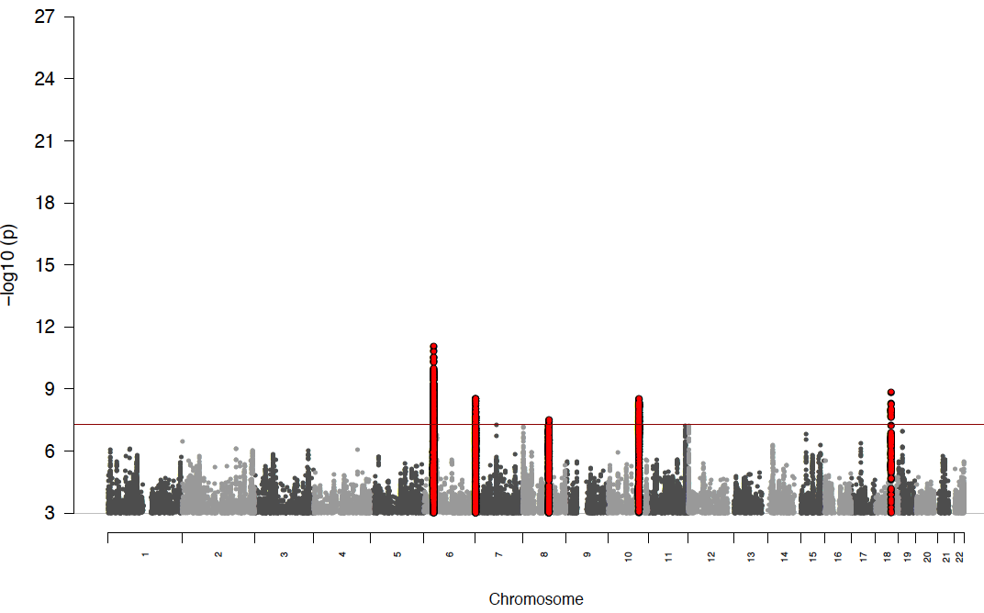
ISC 2009
3K cases
PGC1 - 2011
9K cases
5 loci

Slide 42
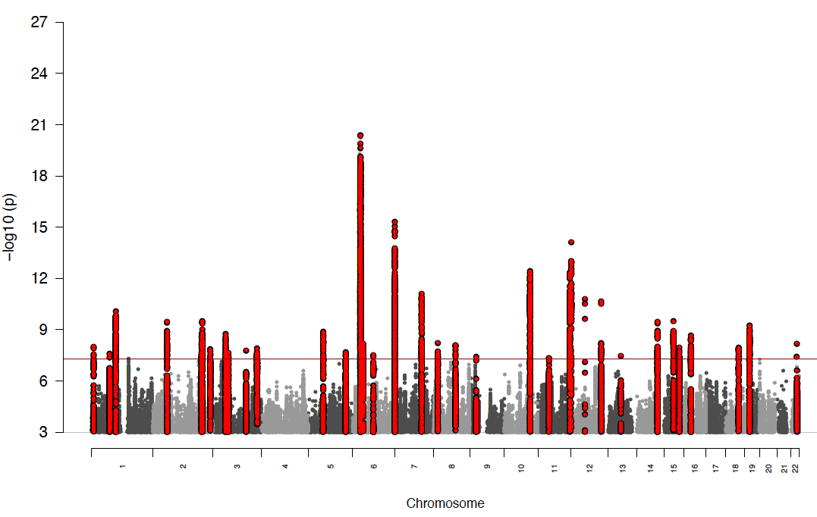
ISC 2009
3K cases
PGC1
9K cases
5 loci
PGC1 + Sweden
2012 - 14K cases
22 loci

Slide 43
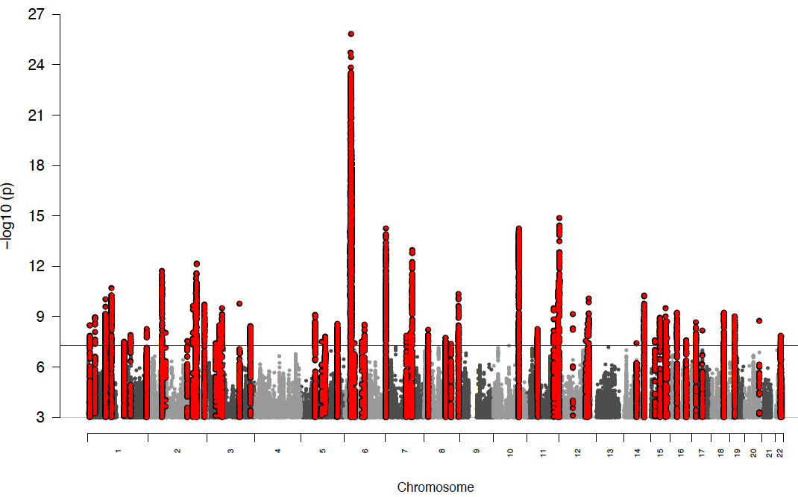
ISC 2009
3K cases
PGC1
9K cases
5 loci
PGC1 + Sweden
14K cases
22 loci
PGC2 2013
31K cases
78 loci
Rank #3

Slide 44
ISC 2009
3K cases
PGC1
9K cases
5 loci
PGC1 + Sweden
14K cases
22 loci
PGC2 2013
31K cases
78 loci
Rank #3

Slide 45
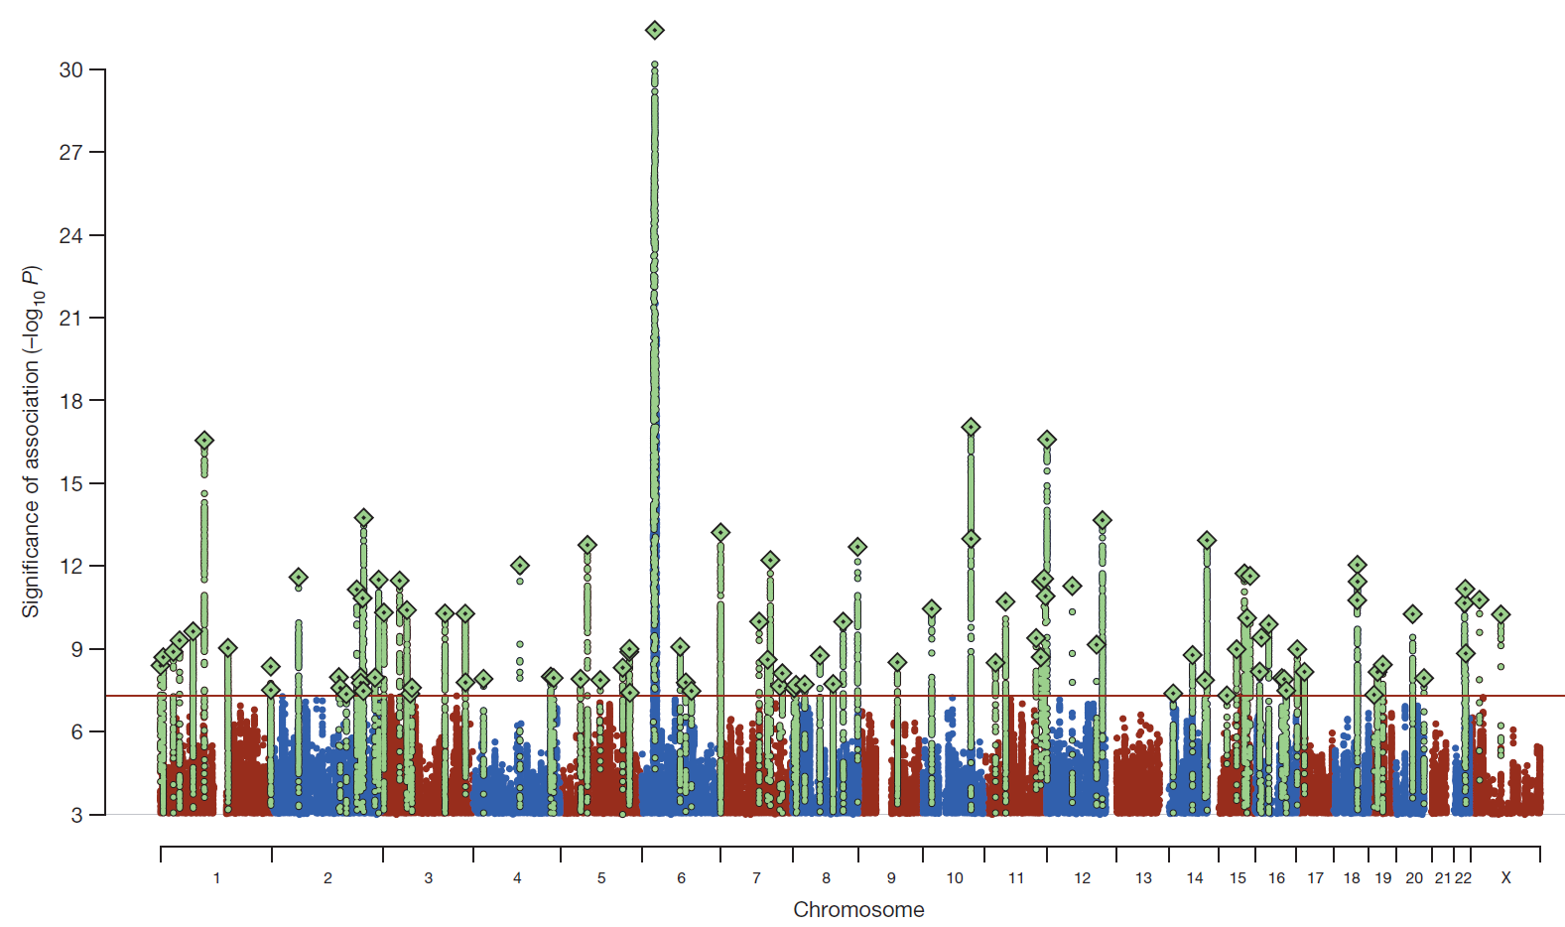
Schizophrenia: meta-analysis of 49 case control samples (34,241 cases and 45,604 controls)
JULY 2014
128 independent SNPs
(P<5e-8, r²<0.1, 3Mb windows)
108 different regions (conservative)
2 4 J U LY 2 0 1 4 | VO L 5 1 1 | N AT U R E | 4 2 1

Slide 46
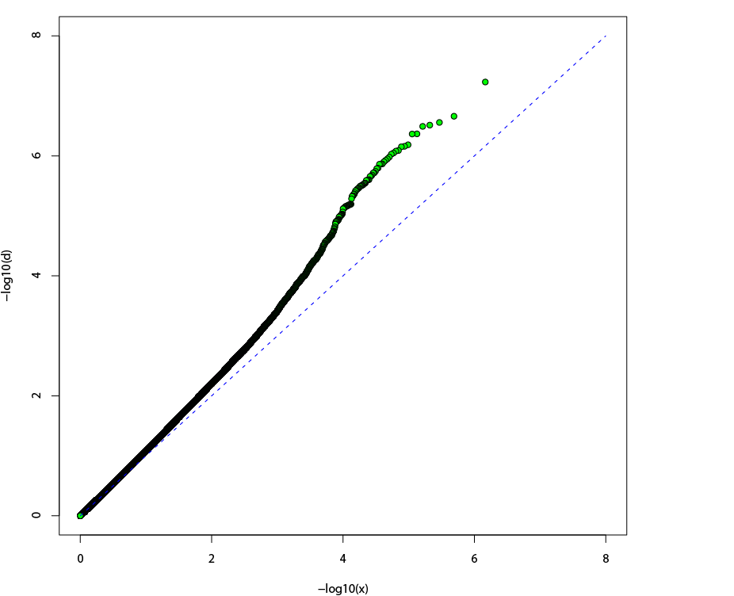
Schizophrenia (ISC) Q-Q plot
Consistent with:
Stratification?
Genotyping bias?
Distribution of true
polygenic effects?
Observed -log10(p)
λ = 1.092
Expected -log10(p)

Slide 47
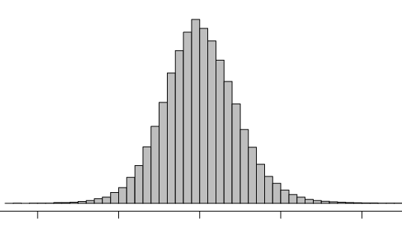
Indexing polygenic variance with large sets of weakly associated alleles
Discovery
set
Target
set
Do target cases
have a higher
allele load?
Top 20% independent SNPs
Score # of
“nominal risk alleles”
Individuals’
“polygenic scores”
ISC
→ ISC
→ Independent SCZ studies (MGS, O’Donovan)
→ Bipolar disorder (STEP-BD, WTCCC)
→ Non-psychiatric disease (WTCCC)
Douglas Levinson, Pablo Gejman,
Jianxin Shi and colleagues

Slide 48
P=2×10⁻²⁸
ISC
X
Test
R²
A greater load of “nominal”
schizophrenia alleles (from ISC)?
5×10⁻¹¹
1×10⁻¹²
Predictive information on
Risk from up to 50% of
SNPs in a GWAS !
7×10⁻⁹
Can predict bipolar from Sz
SNPs, but not other diseases
0.008
0.71
0.05
0.65
0.23
0.06
0.30
MGS
Euro.
MGS
Af-Am
O’Donovan
STEP-BD
WTCCC
CAD
CD
HT
RA
T1D
T2D
Schizophrenia
Bipolar disorder
Non-psychiatric (WTCCC)

Slide 49
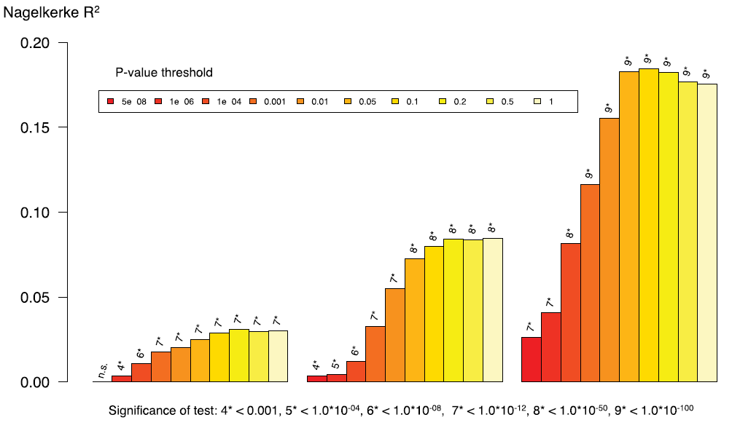
Polygenic risk score for schizophrenia using MGS sample as target
and ISC, PGC1, and PGC2 as prediction samples (minus MGS!)
PGC2
32,838 cases
44,357 controls
PGC1
9,320 cases
10,228 controls
ISC
2,615 cases
3,338 controls

Slide 50
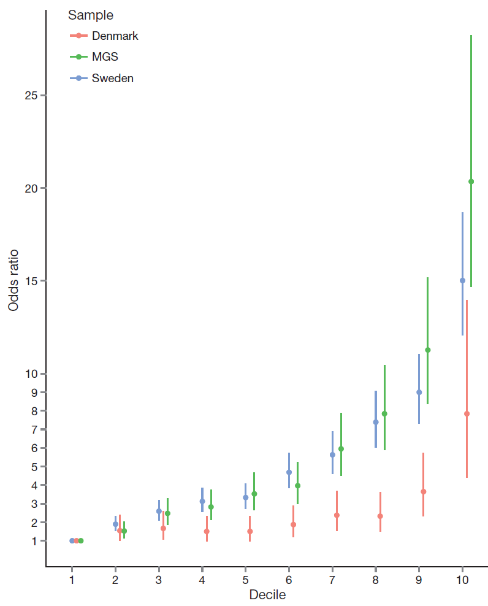
Odds ratio for schizophrenia by
polygenic risk score (PRS) decile in the Sweden, Denmark, and Molecular Genetics of Schizophrenia (US+Oz) studies.
includes Oz
“Given the need for measures that index liability to schizophrenia, the ability to stratify individuals by PRS offers new opportunities for clinical and epidemiological research.”
Risk alleles and weights were derived from ‘leave one out’ analyses in which those samples were excluded from the GWAS meta-analysis. The threshold for selecting risk alleles was P<0.05.

Slide 51
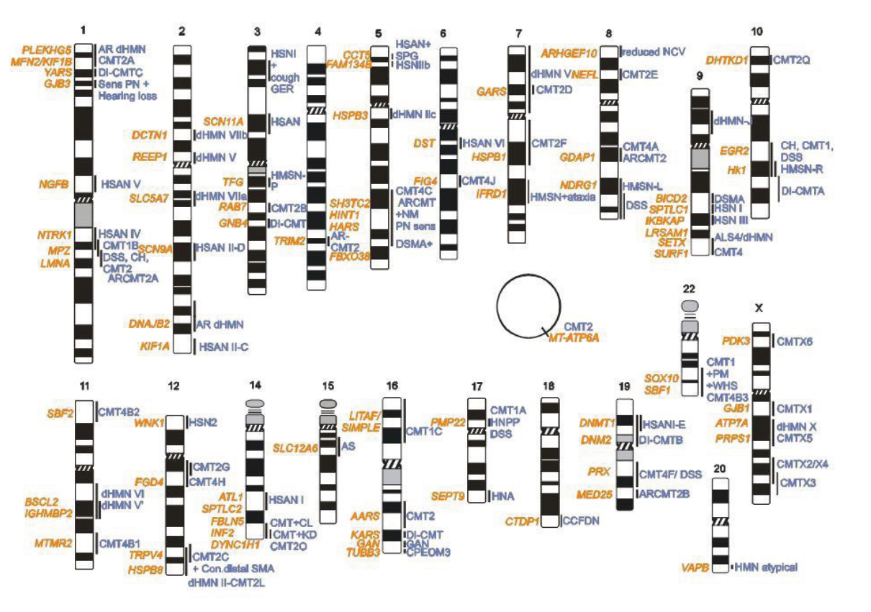
Charcot Marie Tooth disease – neurological disorder
CMT is genetically heterogeneous with over 1000 mutations in 80 genes identified to date
Timmerman…Zuchner (2014) Genes

Slide 52
Schizophrenia (ISC) Q-Q plot
Consistent with:
Stratification?
Genotyping bias?
Distribution of true
polygenic effects?
Observed -log10(p)
λ = 1.092
Expected -log10(p)

Slide 53
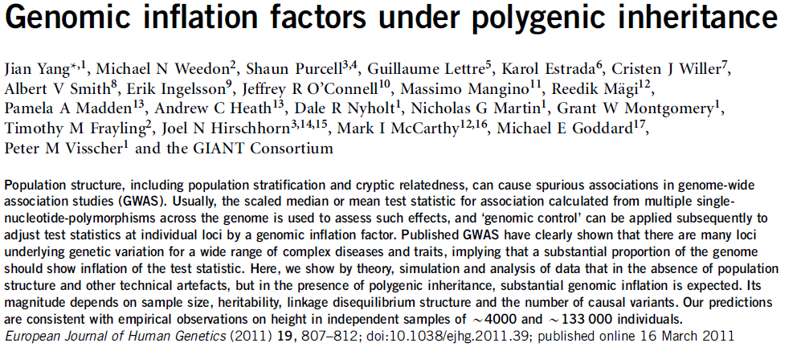
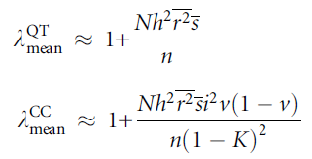

Slide 54
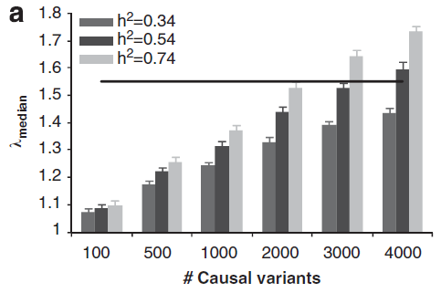

Slide 56


The value of DZ twins for within-pair association tests for ruling out population stratification
Within-family regression results of the polygenic scores on College and EduYears in the QIMR and Swedish Twin Registry cohorts using SNPs selected from the meta-analysis excluding the QIMR and STR cohorts.
Analyses for QIMR are based on 572 full-sib pairs from independent 572 families. Analyses for STR are based on 2,774 DZ twins from 2,774 independent families.
Science. 2013 Jun 21;340:1467-71

Slide 57

Education SNPs predict IQ
Philip Koellinger et al

Slide 58


Personality Consortium
GWA meta-analysis for
IRT-based Neuroticism and Extraversion
28 cohorts
Marleen de Moor
Stephanie van den Berg

Slide 59


Slide 60
Phenotypes
Neuroticism and Extraversion scores
  Estimated latent scores, from Item Response Theory Analysis
Personality inventories:
  NEO-PI-R, NEO-FFI, NEO-PI-3, NEO-FFI-3
  EPQ-R, EPI, JEPQ, ABV
  TCI
  IPIP
  MPQ
Scores based on 440 different items
  220 items for Neuroticism
  220 items for Extraversion

Slide 61


Slide 62
Participating studies
11 studies HAPMAP imputed (b36) +
 |  | N_Individuals | N_SNPs after cleaning
1 | BLSA | 820 | 1976657
2 | FINTWIN | 567 | 1888504
3 | HBCS | 1456 | 2062829
4 | LBC1921 | 437 | 1784943
5 | LBC1936 | 952 | 2029276
6 | MCTFR | 7099 | 2315074
7 | NBS | 1832 | 2156122
8 | QIMRadol | 2842 | 2218829
9 | QIMRadul | 7210 | 2286192
10 | STR | 4903 | 2311611
11 | SardiNIA | 4332 | 1951815
 | SUBTOTAL | 32450
17 studies 1000G imputed (b37)
 |  | N_Individuals | N_SNPs after cleaning
12 | ALSPAC | 4705 | 6454028
12 | ORCADES | 1650 | 5335299
14 | NESDA | 2227 | 4707464
15 | NTR | 6416 | 5339687
16 | CILENTO | 627 | 1123075
17 | COGA | 647 | 5127011
18 | COGEND | 1279 | 5932753
19 | KORCULA | 808 | 5093938
20 | VIS | 909 | 5327571
21 | EGCUT | 1184 | 5574577
22 | PAGES | 476 | 4547210
23 | ERF | 2300 | 5651449
24 | YFS | 1737 | 5914579
25 | MGS | 2101 | 5900775
26 | CHICAGO | 311 | 3755409
27 | BRESCIA | 177 | 3549872
28 | SHIP | 2213 | 5913309
 | SUBTOTAL | 29767
 | TOTAL | 62217 | 7139963
These data went into the first meta-analysis

Slide 63

Neuroticism: n=63k
meta-analysis with mixed Hapmap / 1000G imputation
This manuscript is well written and the collection of data is very impressive. While I have high regard for the efforts that all authors made, and the results presented, I am eager to see all data are imputed using the current version of 1000 genome data. Otherwise, the readers are only getting half of a story.

Slide 64

Meta-analysis with 1000G imputation for all 28 studies
A genome-wide significant SNP was found on 3p14 in the MAGI1 gene (rs35855737; P=9.26 x 10⁻⁹) in the discovery meta-analysis. JAMA Psychiatry, in press

Slide 65

Polygenic score prediction: from Neu to Neu and from Neu to MDD

Slide 66
How much variance have
GWAS studies explained?

Slide 67



GWAS’ greatest success: T1D

Slide 68

Variance explained
by GWAS for
selected complex traits
Visscher PM, et.al. (2012) Am J Hum Genetics

Slide 69


Very distant relatives that share more of their genome by descent are phenotypically more similar than those that share less
Estimating heritability from ‘unrelated’ individuals
Yang et al. Nature Genetics 2010

Slide 70

Proportion of variance in height tagged by SNPs ~ 0.55 (SE 0.1)
[Yang et al. Nature Genetics 2010]

Slide 71
Genome-wide Complex Trait Analysis: Heritability on measured SNPs
 | Major Depression | Smoking Initiation | Current Smoking | Fasting Glucose | Height
Number of Ss | N=3245 N_{case}=1620 N_{control}=1625 | N=4181 N_{case}=2602 N_{control}=1579 | N=4181 N_{case}=1189 N_{control}=2992 | N=3723 | N=4199
Method Yang et al. | .32 (.086) p= 1.071x10⁻⁴ | .19 (.087) p= 0.024 | .24 (.096) p= 0.011 | .22 (.059) p=5.41x10⁻⁵ | .42 (.052) p=0
Method So et al. | .28 (.058) | .28 (.084) | .44 (.063) | .19 (.036) | .29 (.035)
Heritability twin studies | .36 | .44 | .79 | .53 | .90

Slide 72

The White House - June 26, 2000
Venter
Clinton
Collins

Slide 73

It took 4 months, a handful of scientists and ~ US$1.5 mil to sequence the genome of DNA pioneer James Watson

Slide 74


Slide 75



Slide 76




Slide 77

We also run two journals (1)
Editor: John Hewitt
Editorial assistant Christina Hewitt
Publisher: Kluwer /Plenum
Fully online
http://www.bga.org

Slide 78

Editor: Nick Martin
Publisher: Cambridge University Press
Fully online
Fast turnaround
First submission free to workshop participants!!!!!☺

