Slide 1
Pathogenic prioritization of non-synonymous variants in exome sequencing studies
Miaoxin Li
IBG 2015
Centre for Genomics Sciences & Department of Psychiatry
The University of Hong Kong
mxli@hku.hk

Slide 2
Non-synonymous variants [nsSNPs] (Mutations altering amino acids)
Not equally important
Deleterious: affecting functions of proteins
Being pathogenic: causing a disease
Neutral:
The more deleterious, higher pathogenic potential

Slide 3
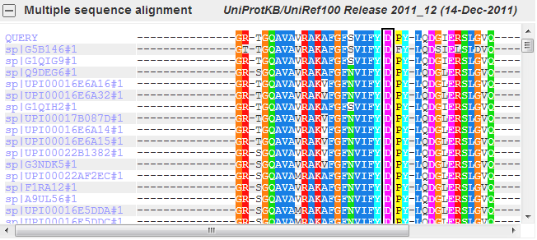
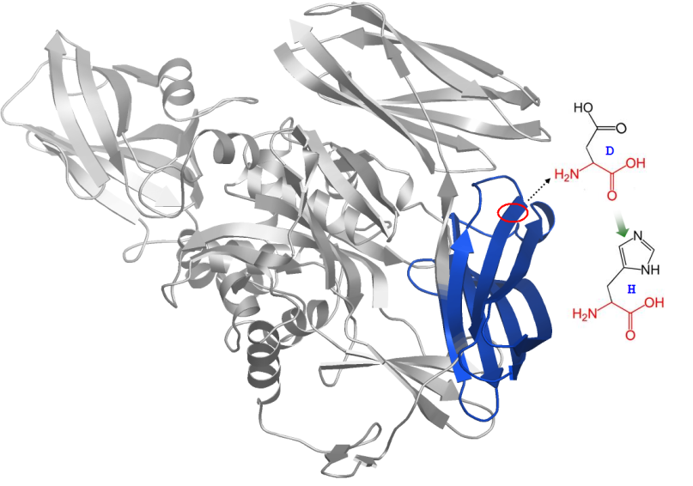
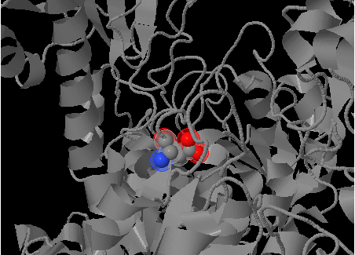
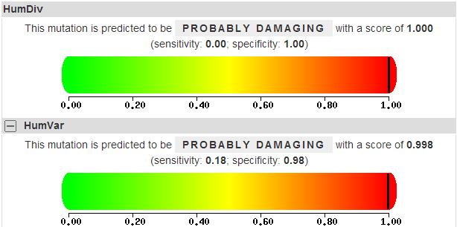
General principle of deleteriousness prediction

Slide 4
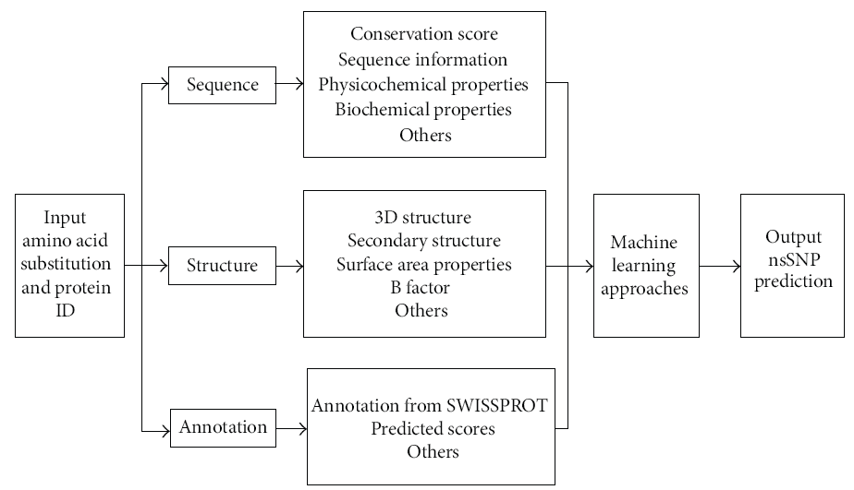
Procedure for deleterious nsSNPs
vv
vv
Wu and Jiang (2012)The Scientific World Journal Volume 2013, Article ID 675851

Slide 5
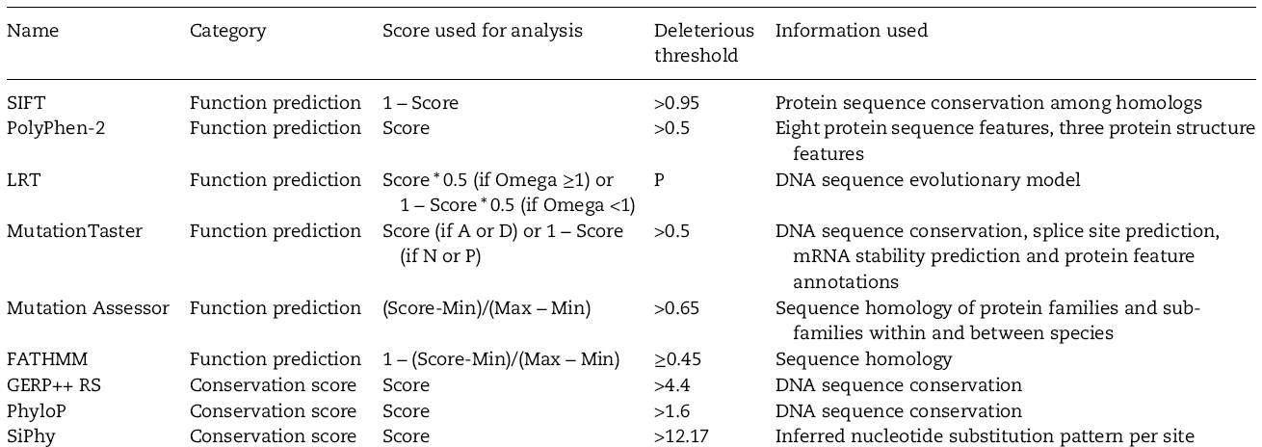
Tools for deleteriousness prediction
Dong et al. Human Molecular Genetics, 2015, 1–13 doi: 10.1093/hmg/ddu733

Slide 6
Spearman's rank correlation matrix for the scores

Slide 7
Inconsistent prediction
Chromosome | StartPosition | ReferenceAlternativeAllele | GeneSymbol | Polyphen2_HDIV_pred | Polyphen2_HVAR_pred | LRT_pred | MutationTaster_pred | MutationAssessor_pred
8 | 133251794 | A/C | KCNQ3 | D;D | D;D | D | D | medium
1 | 68669602 | G/C | RPE65 | B | B | N | D | low
17 | 7517842 | A/G | TP53 | P;P;P;P | P;P;D;P | N | D | medium
18 | 45817276 | C/T | MYO5B | B;P | B;B | D | D | medium
10 | 127412194 | C/T | C10orf137 | D;D;D | D;D;P | D | D | low
3 | 170968107 | C/T | ACTRT3 | D | D | N | D | high
D: porobably damaging, P:possibly damaging, B: benign, N:neutral
predicted functional (high, medium),
predicted non-functional (low, neutral)

Slide 8
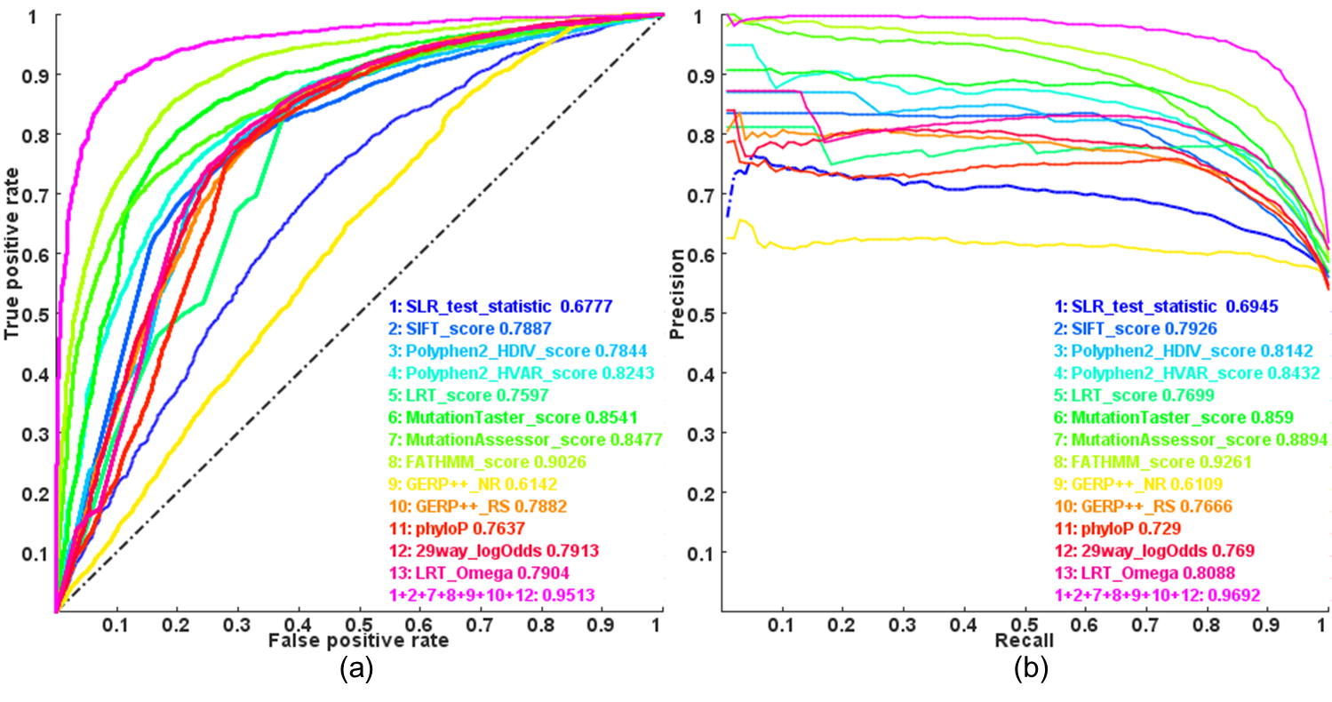


Distinguishing pathogenic nsSNVs from other rare nsSNVs
FATHMM
receiver operating characteristic (ROC) curve

Slide 9
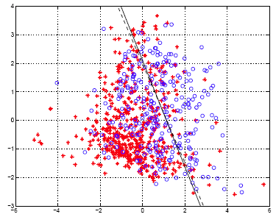
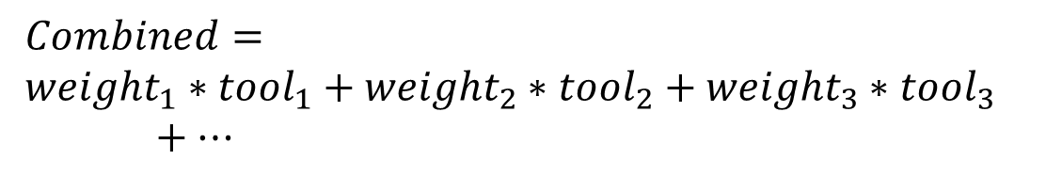
Solution?
--Combined prediction
$$Combined=$$
$${weight}_{1}∗{tool}_{1}+{weight}_{2}∗{tool}_{2}+{weight}_{3}∗{tool}_{3}+…$$
Logistic regression model
Benchmark dataset
  5,340 disease-causal alleles vs. 4,752 rare non-disease-causal nsSNVs
Li et al. PLoS Genet. 2013;9(1):e1003143.

Slide 10
Criticisms
Related but not straightforward for pathogenicity
Maybe ineffective for unknown pathogenic mutations

Slide 11
dbNSFP database (v2.9)
Pre-compute scores
Over 13 deleteriousness or conservation prediction tools
87 347 044 possible nsSNPs in the whole-exome
Notes:
database for nonsynonymous SNPs' functional predictions

Slide 12

Practical with KGGSeq
Genotypes
In VCF/Pileup format
Statistic summaries from Plink/Seq
KGGSeq
Public domain knowledge in databases
Users’ knowledge on diseases/traits
A biological Knowledge-based mining system/platform for Genomic and Genetic studies using Sequence data
Pipelines on KGGSeq
Prioritized and annotated variants
Li et al. Nucleic Acids Res. 2012 Apr 1;40(7):e53

Slide 13
A multilayer automated filtration and prioritization framework
Variants and/or genotypes called from sequencing data in variants formats
Exclude variants outside identity by descent (IBD) regions
Genetic level
Exclude variants conflicting with disease inheritance patterns/modes
Exclude common variants (e.g., MAF 0.001) in dbSNP, 1K Genome Project and other datasets
Exclude variants not altering proteins
Variant level
Known disease genes
Exclude predicted non-disease variants
Disease names
Knowledge level
Explore variants whose genes have physical protein-protein interaction with candidate genes
Explore variants whose genes share the same biological pathways with candidate genes
Explore available literature in NCBI PubMed about genes/ideogram and interested diseases
Prioritized and annotated variants in an Excel or text file
Li MX, Gui HS, Kwan SH, Bao SY, Sham PC. A comprehensive framework for prioritizing variants in exome sequencing studies of Mendelian diseases. Nucleic Acids Research (Nucleic Acids Res. 2012 Apr 1;40(7):e53)

Slide 14

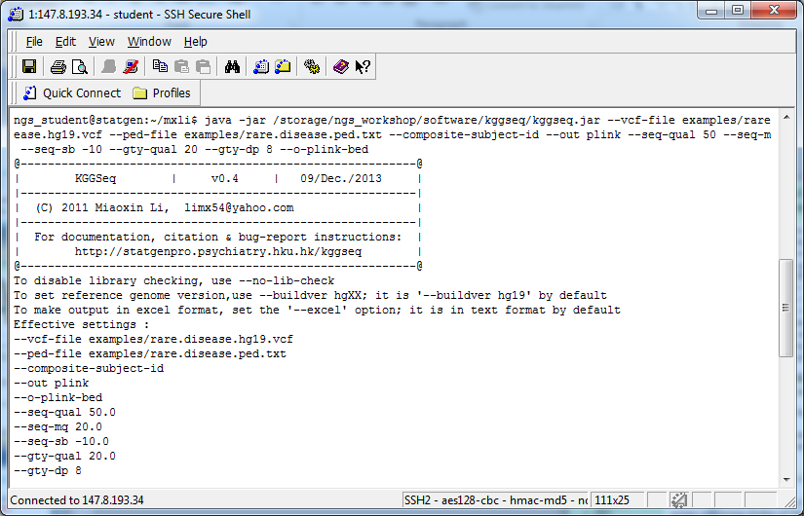
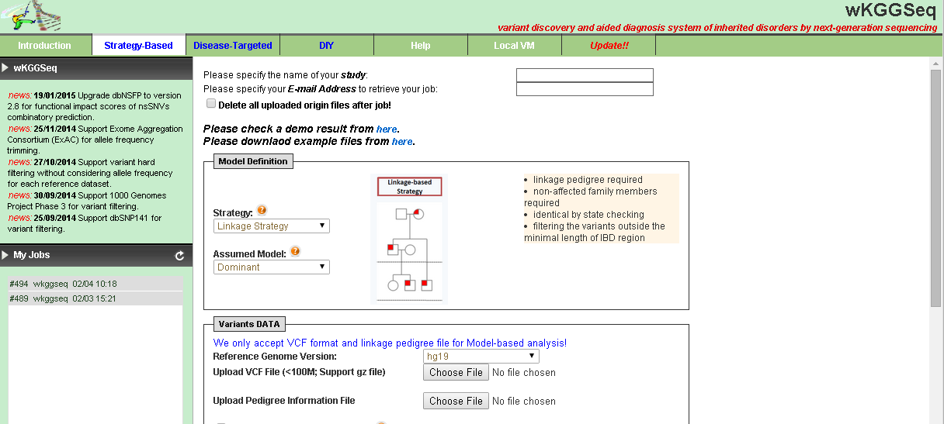
Li et al.
Hum Mutat. 2015 Feb 10. doi: 10.1002/humu.22766. [Epub ahead of print]

Slide 15
Why do we need kggseq?
Help you filter, prioritize and annotate sequence variants to identify disease-causal mutations
Advantage: integrative
Notes:
many effective resources and functions to

Slide 16
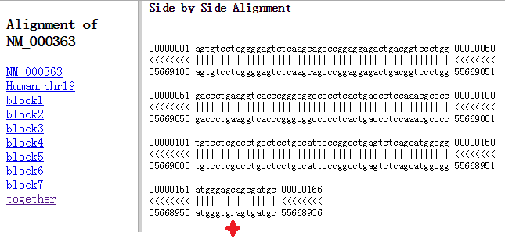
Gene feature annotation by KGGSeq, ANNOVAR and VEP based on RefGene database in an exome sequencing dataset of 66,272 called variants
vv
vv
 | KGGSeq vs. ANNOVAR |  |  |  | KGGSeq vs. VEP
 | KGGSeq Unique (#dbSNP) | overlapped | ANNOVAR Unique (#dbSNP) |  | KGGSeq Unique (#dbSNP) | overlapped | VEP Unique (#dbSNP)
stoploss | 22(14) ª | 13 | 0 |  | 22(11) | 13 | 2(1)
stopgain | 4(3) | 75 | 1(0) ^{b} |  | 15(11) | 64 | 7(1)
missense | 199(128) | 9210 | 0 |  | 1550(1345) | 7856 | 114(43)
synonymous | 112(77) | 10129 | 16(12) |  | 1637(1204) | 8604 | 92(26)
splicing | 3(1) | 81 | 0 |  | 49(20) | 35 | 1564(123)
#dbSNP: The number of variants supported by annotations in dbSNP. However, it should be noted that variants without support from dbSNP are not necessarily incorrect. ª: This includes some variants which have reversed reference and alternative alleles. ^{b}: This is actually a stopgain mutation by an 1-bp deletion frameshift, so it could be a frameshift as well.
TNNI3:NM_000363(7Exons)

Slide 17
The number of retained sequence variants by KGGSeq in the Neonatal-onset Crohn disease sample
Functions | #Sequence variants
 | De-novo mutation | Double-hit gene
Initial | 1,196,282
Quality control on genotype and variants levels | 68992
Inheritance pattern | 197ª | –
Rare in dbSNP + 1000 Genome + ESP^{b} | 133 | 1325
Not altering amino acid ^{c} | 7 | 253
Super-duplicate regions ^{d} | 1 | 228
Predicted to be non-pathogenic | 0 | 171
Hitting both copies of a gene | - | 3e
Note: a: the de-novo mutation based inheritance model filtration removes all sequence variants at which all alleles of a child are present in his or her parents; b The rare variants referred to variants with MAF≤3% in the datasets; c: this category includes missense, stopgain, stoploss and splicing single nucleotide variants and insertions/deletions causing frameshift, nonframeshift, stoploss, stopgain and splicing differences; d: variants in putative genomic duplications defined in a dataset (genomicSuperDups) from UCSC (http://hgdownload.cse.ucsc.edu/goldenPath/hg19/database/genomicSuperDups.txt.gz), which have higher genotyping error rate (http://blog.goldenhelix.com/?p=1153);e: double-hit gene filtration function it to only retain variants at which each parent has transmitted at least one mutation in the same gene to the child.

Slide 18
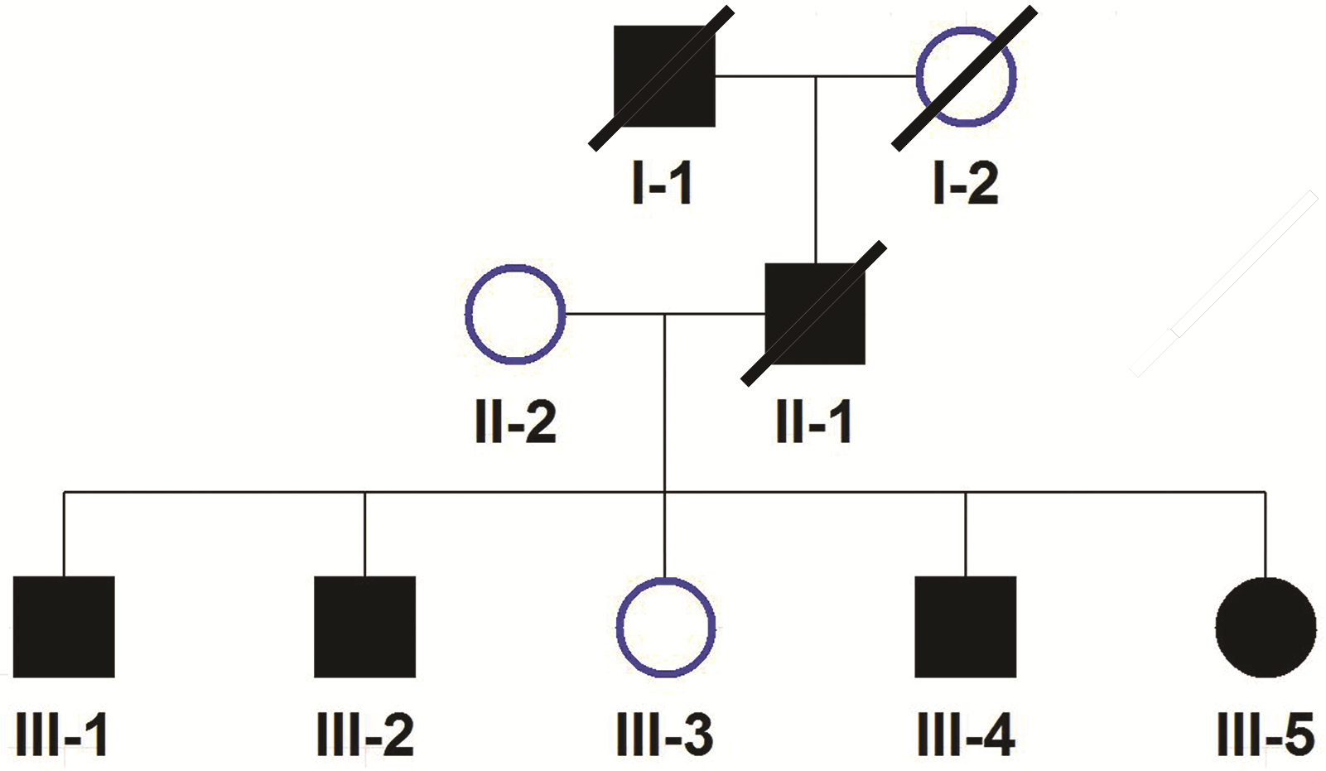
The number of retained sequence variants by KGGSeq in a dominant mode
Functions | Spinocerebellar ataxias | Familial spastic paraplegia
Initial | 1,417,935 | 1,017,018
Quality control on genotype and variants levels | 82543 | 84119
Inheritance patternª | 21122 | 937
Filter all variants in reference database | 268 | 74
Rare in dbSNP + 1000 Genome + ESP^{b} | 248 | 69
Protein altering variants^{c} | 39 | 4
Super-duplicate regions ^{d} | 36 | 4
Over 4 variants within the same gene | 17 | 4
Predicted to be non-pathogenic | 17 | 3
Notes: a: dominant mode only considered variants in heterozygous genotypes and with shared alleles between the two patients; b: The rare variants referred to variants with MAF≤1% in the datasets; c: this category includes missense, stopgain, stoploss and splicing single nucleotide variants and insertions/deletions causing frameshift, nonframeshift, stoploss, stopgain and splicing differences d: variants in putative genomic duplications defined in a dataset (genomicSuperDups) from UCSC (http://hgdownload.cse.ucsc.edu/goldenPath/hg19/database/genomicSuperDups.txt.gz), which have higher genotyping error rate (http://blog.goldenhelix.com/?p=1153).
Spinocerebellar ataxias
Familial spastic paraplegia
Notes:
run:
To disable library checking, use --no-lib-check.
To disable log function in a text file, use --no-log.
INFO 2015-03-04 12:39:55 -
@----------------------------------------------------------@
| KGGSeq | v0.7 | 28/Feb./2015 |
|----------------------------------------------------------|
| (C) 2011 Miaoxin Li, limx54@yahoo.com |
|----------------------------------------------------------|
| For documentation, citation & bug-report instructions: |
| http://statgenpro.psychiatry.hku.hk/kggseq |
@----------------------------------------------------------@
Effective settings :
--resource ./resources
--buildver hg19
--add-hg19
--vcf-file testdata\hg19.sca.env.vcf.gz
--ped-file testdata\sca.ped.txt
--out testdata\sca
--excel
--o-annovar
--o-vcf
--seq-qual 50.0
--seq-mq 20.0
--seq-sb -10.0
--gty-qual 20.0
--gty-sec-pl 20
--gty-dp 4
--gty-af-ref 0.05
--gty-af-het 0.25
--gty-af-alt 0.5
--min-obsa 2
--min-obsu 0
--min-obs 2
--genotype-filter 3,4,5,6
--gene-var-filter 4
--db-gene refgene
--gene-feature-in 0,1,2,3,4,5
--splicing 2
--neargene 1000
--db-filter 1kg201305,dbsnp138,ESP5400,ESP6500AA,ESP6500EA
--db-filter-hard dbsnp138nf
--rare-allele-freq 0.0101
--superdup-filter
--db-score dbnsfp
--mendel-causing-predict all
--filter-nondisease-variant
Checking the latest resources (to disable this checking, use --no-resource-check option)...
INFO 2015-03-04 12:39:56 - Encoding pedigree file testdata\sca.ped.txt ...
INFO 2015-03-04 12:39:56 - Reading variants in E:\home\mxli\MyJava\kggseq2\testdata\hg19.sca.env.vcf.gz
INFO 2015-03-04 12:39:56 - The following 2 subject(s) in pedigree file or (input subject list) are ignored:
B, C.
INFO 2015-03-04 12:40:06 -
854498 missing genotypes are ignored
1412785 genotypes are ignored due to low depth at the site with a genotype <4
39154 genotypes are ignored due to low quality of specific genotyping quality <20.0
11525 genotypes are ignored because the fraction of the reads carrying alternative allele >= 0.05 at a reference-allele homozygous genotype and that is <= 0.25 at a heterozygous genotype and that is <= 0.5 at an alternative-allele homozygous genotype
61989 genotypes are ignored because their second smallest Phred-scaled likelihoods (PL) are < 20.
117547 variants are ignored due to large strand bias (-10.0);
1217845 variants are ignored due to the number of non-null genotypes in sample <2
1417935 variant-lines (0 indels) are scanned; and 82543 variants of 2 individual(s) are valid in E:\home\mxli\MyJava\kggseq2\testdata\hg19.sca.env.vcf.gz
INFO 2015-03-04 12:40:06 - 82543 variant(s) are left after filtration according to minimal successful genotype calling rates in patients and healthy individuals!
INFO 2015-03-04 12:40:06 - 61421 variants are ignored by genotype-based hard-filtering;
21122 variant(s) are left after filtration according to inheritance mode at genotypes, 3,4,5,6!
INFO 2015-03-04 12:40:27 - 268 variant(s) are left after hard filtering in database dbsnp138nf!
INFO 2015-03-04 12:41:00 - 64 variant(s) exist in 1kg201305, which contains 81187322 effective variants.
INFO 2015-03-04 12:41:24 - 26 variant(s) exist in dbsnp138, which contains 63221683 effective variants.
INFO 2015-03-04 12:41:25 - 3 variant(s) exist in ESP5400, which contains 1680794 effective variants.
INFO 2015-03-04 12:41:26 - 4 variant(s) exist in ESP6500AA, which contains 1998204 effective variants.
INFO 2015-03-04 12:41:27 - 4 variant(s) exist in ESP6500EA, which contains 1998204 effective variants.
INFO 2015-03-04 12:41:27 - 248 variant(s) with minor allele frequency [0, 0.0101) in the reference datasets above are left!
INFO 2015-03-04 12:41:30 - 52259 transcripts of 25953 genes have been read in the dataset kggseq_hg19_refGene.txt.gz!
WARN 2015-03-04 12:41:30 - The reference allele T of chr1:2488153 in the sample data and database are not identical on NM_001297605 of TNFRSF14
WARN 2015-03-04 12:41:30 - The reference allele T of chr1:2488153 in the sample data and database are not identical on NM_003820 of TNFRSF14
WARN 2015-03-04 12:41:30 - The reference allele A of chr3:194062565 in the sample data and database are not identical on NM_001291988 of CPN2
WARN 2015-03-04 12:41:30 - The reference allele A of chr3:194062565 in the sample data and database are not identical on NM_001080513 of CPN2
WARN 2015-03-04 12:41:30 - The reference allele G of chr15:21040764 in the sample data and database are not identical on NM_001277304 of POTEB
WARN 2015-03-04 12:41:30 - The reference allele G of chr15:21040764 in the sample data and database are not identical on NM_001277303 of POTEB2
WARN 2015-03-04 12:41:30 - The reference allele G of chr15:21040764 in the sample data and database are not identical on NM_207355 of POTEB3
WARN 2015-03-04 12:41:30 - The reference allele T of chr15:21040862 in the sample data and database are not identical on NM_001277304 of POTEB
WARN 2015-03-04 12:41:30 - The reference allele T of chr15:21040862 in the sample data and database are not identical on NM_001277303 of POTEB2
WARN 2015-03-04 12:41:30 - The reference allele T of chr15:21040862 in the sample data and database are not identical on NM_207355 of POTEB3
WARN 2015-03-04 12:41:30 - The reference allele C of chr17:44067382 in the sample data and database are not identical on NM_016835 of MAPT
WARN 2015-03-04 12:41:30 - The reference allele C of chr17:44067382 in the sample data and database are not identical on NM_001123066 of MAPT
INFO 2015-03-04 12:41:30 -
0.frameshift: 0 (0%)
1.nonframeshift: 0 (0%)
2.stoploss: 0 (0%)
3.stopgain: 0 (0%)
4.missense: 39 (15.726%)
5.splicing: 0 (0%)
6.synonymous: 31 (12.5%)
7.exonic: 5 (2.016%)
8.5UTR: 3 (1.21%)
9.3UTR: 7 (2.823%)
10.intronic: 113 (45.565%)
11.upstream: 1 (0.403%)
12.downstream: 3 (1.21%)
13.ncRNA: 10 (4.032%)
14.intergenic: 36 (14.516%)
15.monomorphic: 0 (0%)
16.unknown: 0 (0%)
INFO 2015-03-04 12:41:30 - 39 variant(s) are left after filtering by gene features.
INFO 2015-03-04 12:41:31 - 41160 reference super duplicate regions have been read!
INFO 2015-03-04 12:41:31 - 36 variant(s) are left after filtering those in super-duplicated regions registered in a data set genomicSuperDups table of UCSC!
INFO 2015-03-04 12:42:11 - 35 coding nonsynonymous variants among 36 are assigned functional prediction scores.
INFO 2015-03-04 12:42:12 - The number of predicted disease-causal and non-disease-causal variants are 16(#gene 16) and 19 among 36 variants on the genome according to the Logistic regression prediction model trained by ExoVar dataset (http://statgenpro.psychiatry.hku.hk/limx/kggseq/download/ExoVar.xls)
INFO 2015-03-04 12:42:12 - 17 variant(s) are left after filtered by the disease mutation prediction.
INFO 2015-03-04 12:42:12 - 17 variant(s) are left after filtered by genes with 4 or over variants!
INFO 2015-03-04 12:42:12 - Final variants are saved in E:\home\mxli\MyJava\kggseq2\testdata\sca.flt.annovar with ANNOVAR format.
INFO 2015-03-04 12:42:15 - Final variants are saved in E:\home\mxli\MyJava\kggseq2\testdata\sca.flt.vcf with VCF format.
INFO 2015-03-04 12:42:17 - Final variants are saved in E:\home\mxli\MyJava\kggseq2\testdata\sca.flt.xlsx with Excel format.
INFO 2015-03-04 12:42:17 - 17 sequence variant(s) are left finally!
INFO 2015-03-04 12:42:17 - Elapsed time: 2 min. 22 sec.
The log information is save in testdata\sca.log
BUILD SUCCESSFUL (total time: 2 minutes 24 seconds)

Slide 19
Key functions of the three tools for filtration, prioritization and annotation
 | KGGSeq | ANNOVAR (Version2) | VEP
Quality control | Systematic QC on genotype, variant and subject levels | Only by depth and sequencing quality | No
Use disease mode | Recessive, dominant compound heterozygous, de novo and runs of homozygosity. | Too simple, cannot directly take genotypes of controls; it only works for recessive and dominant modes | No
Variants reference databases | dbSNP, 1000 Genomes Project and ESP | Similar to wKGGSeq | Similar to wKGGSeq
Gene annotation | RefGene GENCODE UCSC knownGene | RefGene GENCODE UCSC knownGene ENSEMBL | ENSEMBL RefGene
Functional prediction | SLR SIFT Polyphen2_HDIV Polyphen2_HVAR LRT MutationTaster MutationAssessor FATHMM_score CADD_score GERP++_NR GERP++_RS PhyloP100way_vertebrate 29way_logOdds | Same as wKGGSeq | SIFT Polyphen2_HDIV Polyphen2_HVAR
Protein-protein interaction and pathway | Yes | No | No
Literature | PubMed | No | No
Management of input data | Yes | No | No
Disease-targeted prioritization | Yes | No | No

Slide 20
The summary filtration and prioritization results of three tools in three pedigrees
 | KGGSeq | ANNOVAR | VEP
 | Neonatal-onset Crohn disease
Initial variants | 1196282 | 68992ª | 68992ª
Retained variants when the causal mutations were kept finally | 3 | 53 | 4232
Variant hit by PPIs, pathways or PubMed search | - | - | -
Additional evidences to highlight the causal mutations | PPI+Pathway+PubMed | - | -
 | Spinocerebellar ataxias
Initial variants | 1417935 | 82465ª | 82465ª
Retained variants when the causal mutations were kept finally | 17 | 29 | 6501
Variant hit by PPIs, pathways or PubMed search | 3 | - | -
Additional evidences to highlight the causal mutations | Pathway+PPI | - | -
 | Familial spastic paraplegia
Initial variants | 1017018 | 63207ª | 63207ª
Retained variants when the causal mutations were kept finally | 3 | 7 | 5109
Variant hit by PPIs, pathways or PubMed search | 2 | - | -
Note: a: as wANNOVAR cannot effectively map variants on VCF data, KGGSeq was used to do the basic quality control on VCF data of affected samples.

Slide 21
Main inputs of KGGSeq
Sequence variants in VCF format
##fileformat=VCFv4.1
##fileDate=20090805
##source=myImputationProgramV3.1
##reference=file:///seq/references/1000GenomesPilot-NCBI36.fasta
##contig=<ID=20,length=62435964,assembly=B36,md5=f126cdf8a6e0c7f379d618ff66beb2da,species="Homo sapiens",taxonomy=x>
##phasing=partial
##INFO=<ID=NS,Number=1,Type=Integer,Description="Number of Samples With Data">
##INFO=<ID=DP,Number=1,Type=Integer,Description="Total Depth">
##INFO=<ID=AF,Number=A,Type=Float,Description="Allele Frequency">
##INFO=<ID=AA,Number=1,Type=String,Description="Ancestral Allele">
##INFO=<ID=DB,Number=0,Type=Flag,Description="dbSNP membership, build 129">
##INFO=<ID=H2,Number=0,Type=Flag,Description="HapMap2 membership">
##FILTER=<ID=q10,Description="Quality below 10">
##FILTER=<ID=s50,Description="Less than 50% of samples have data">
##FORMAT=<ID=GT,Number=1,Type=String,Description="Genotype">
##FORMAT=<ID=GQ,Number=1,Type=Integer,Description="Genotype Quality">
##FORMAT=<ID=DP,Number=1,Type=Integer,Description="Read Depth">
##FORMAT=<ID=HQ,Number=2,Type=Integer,Description="Haplotype Quality">
#CHROM POS ID REF ALT QUAL FILTER INFO FORMAT NA00001 NA00002 NA00003
20 14370 rs6054257 G A 29 PASS NS=3;DP=14;AF=0.5;DB;H2 GT:GQ:DP:HQ 0|0:48:1:51,51 1|0:48:8:51,51 1/1:43:5:.,.
20 17330 . T A 3 q10 NS=3;DP=11;AF=0.017 GT:GQ:DP:HQ 0|0:49:3:58,50 0|1:3:5:65,3 0/0:41:3
20 1110696 rs6040355 A G,T 67 PASS NS=2;DP=10;AF=0.333,0.667;AA=T;DB GT:GQ:DP:HQ 1|2:21:6:23,27 2|1:2:0:18,2 2/2:35:4
20 1230237 . T . 47 PASS NS=3;DP=13;AA=T GT:GQ:DP:HQ 0|0:54:7:56,60 0|0:48:4:51,51 0/0:61:2
20 1234567 microsat1 GTC G,GTCT 50 PASS NS=3;DP=9;AA=G GT:GQ:DP 0/1:35:4 0/2:17:2 1/1:40:3
Sequence variants in ANNOVAR format
Chr | Start | End | Ref | Obs | Comments
1 | 161003087 | 161003087 | C | T | a
1 | 84647761 | 84647761 | C | T | b
1 | 13133880 | 13133881 | TC | - | v
1 | 11326183 | 11326183 | - | AT | f
1 | 105293754 | 105293754 | A | ATAAA | d

Slide 22
Let’s start the practical
Follow the instructions
Everything can be found in the online user manual
The short tutorial will help you known what you are doing
Question!

