Slide 1
Secondary association analyses for genes, gene-pairs, and pathways on KGG
IBG 2015
Miaoxin Li, Department of Psychiatry & Centre for Genomics Sciences
The University of Hong Kong
mxli@hku.hk

Slide 2
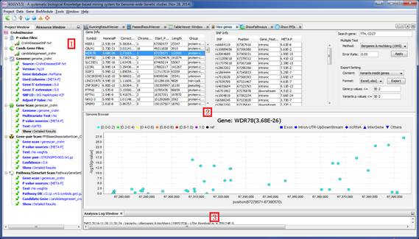

Slide 3
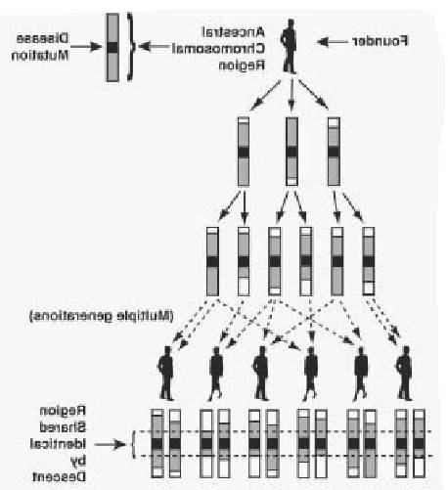

Sample + genotypes
statistical genetic mapping
http://www.ncbi.nlm.nih.gov/bookshelf
Bioinformatics and Statistical Framework
Integration!!!
Boost power!!!
functional knowledge

Slide 4

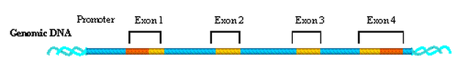
Set-based association tests on KGG
GATES: A rapid and powerful gene-based association test using extended Simes procedure. Am J Hum Genet. 2011 Mar 11;88(3):283-293.
HYST: A HYbrid Set-based Test for genome-wide association studies,... Am J Hum Genet. 2012 Sep 7;91(3):478-88. (=GATES+ Scaled chi-square test)
MGAS: a powerful tool for multivariate gene-based genome-wide association analysis. Bioinformatics. 2014 Nov 26. pii: btu783. [Epub ahead of print] (---Multiple phenotypes)
Notes:
lead

Slide 5

Why do we consider summary statistics?
Make use advantages of existing statistic tests at SNPs.
Easer to be obtained from public domains
GWAS meta-analysis p-values for over 25 complex diseases and traits!!!

Slide 6
GATES
Extended Simes’ test (known as GATES) (Li et al. 2011)
where
  P_{(j)}= sorted SNP p value
  m_{e} = effective number of independent test
  w_{(k)} = weight for SNP j
Desirable properties
Dependent p values
Not resort to permutation and simulation
TATES: Association Test that uses Extended Simes procedure for multiple traits (van der Sluis S,et al. PLoS Genet. 2013 Jan;9(1):e1003235)
Notes:
Assume…
So we proposed … we hope this mathematical hybridization could …
Specifically, it is
The GATES is a representative of the best snp picking tests. The set-based p-value is equal to the p value multiplying a factor related to the effective number of independent tests
The scaled chi-square test is a representative of the all snp aggregating tests. It use a scale C to adjust for the dependency between p values. Here the C is relevant to the covariance of p values
An important reason why we choose the two tests is because both can accurately account for .. without using …
Brown, M.B. (1975). A method for combining non-independent, one-sided tests of significance. Biometrics 31, 987-992.

Slide 7
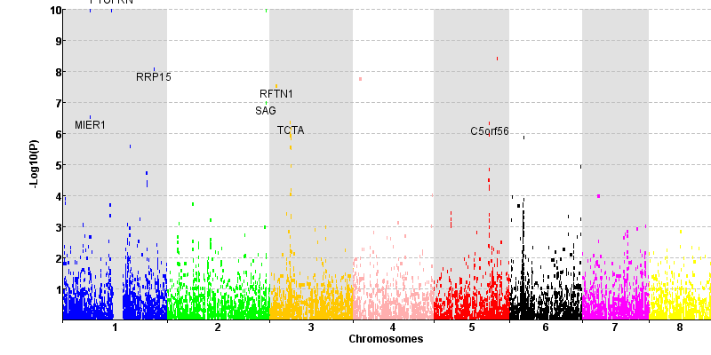
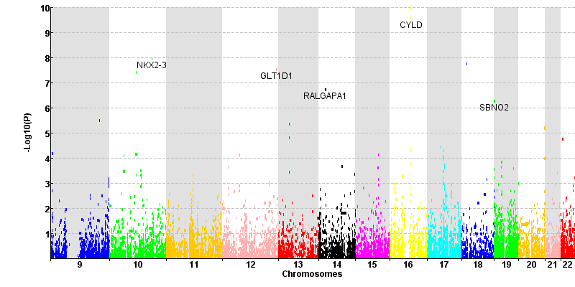
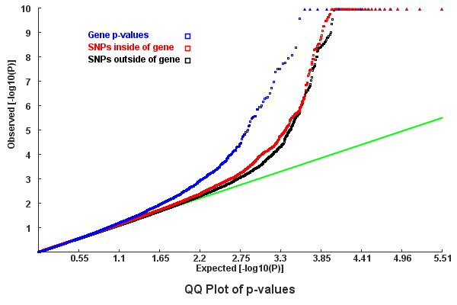
Gene-based association test by GATES Crohn’s Disease GWAS data set

Slide 8

HYST:
A set of SNPs on multiple genomic regions
Block 1
Block 2
…
Block n
Step 1
Step 2
Block-based P_{B1} by GATES
Block-based P_{B2} by GATES
…
Block-based P_{Bn} by GATES
Step 3
Hybridization!!!
← LD r² of n key SNPs of n blocks
Set-based P by scaled chi-square test, accounting for r²
cov(-2lnP_{Bi}, -2lnP_{Bj})≈8.6 r² （Improved)
Li et al. Am J Hum Genet. 2012; 7;91(3):478-88.
Notes:
Starting
The critical point is to

Slide 9
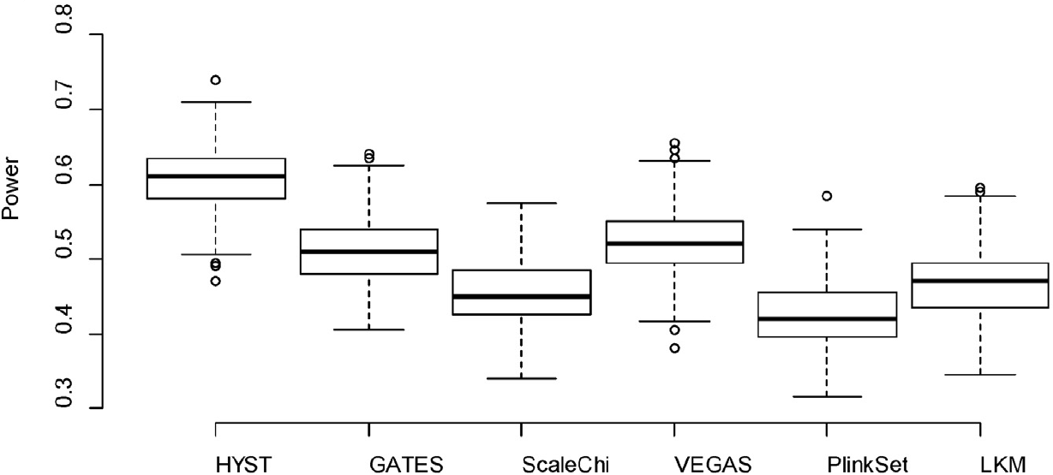
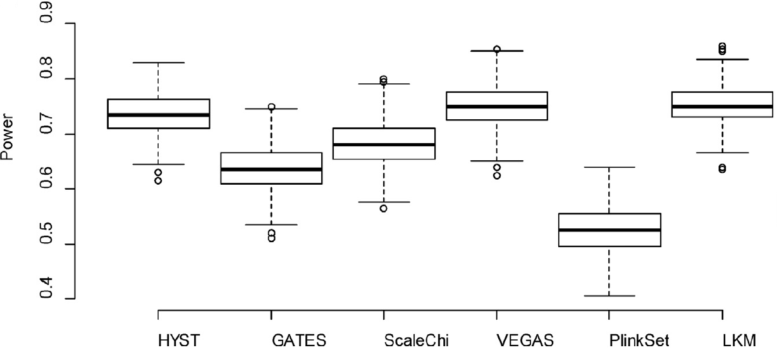
Power in simulation under Alternative Hypotheses
ScaleChi, scaled chis-square test;
VEGAS: A versatile gene-based test for genome-wide association studies
LKM: the Logistic Kernel Machine Test. (SKAT)
GATES: A Rapid and Powerful Gene-Based Association Test Using Extended Simes Procedure
Notes:
Better than its parental tests

Slide 10

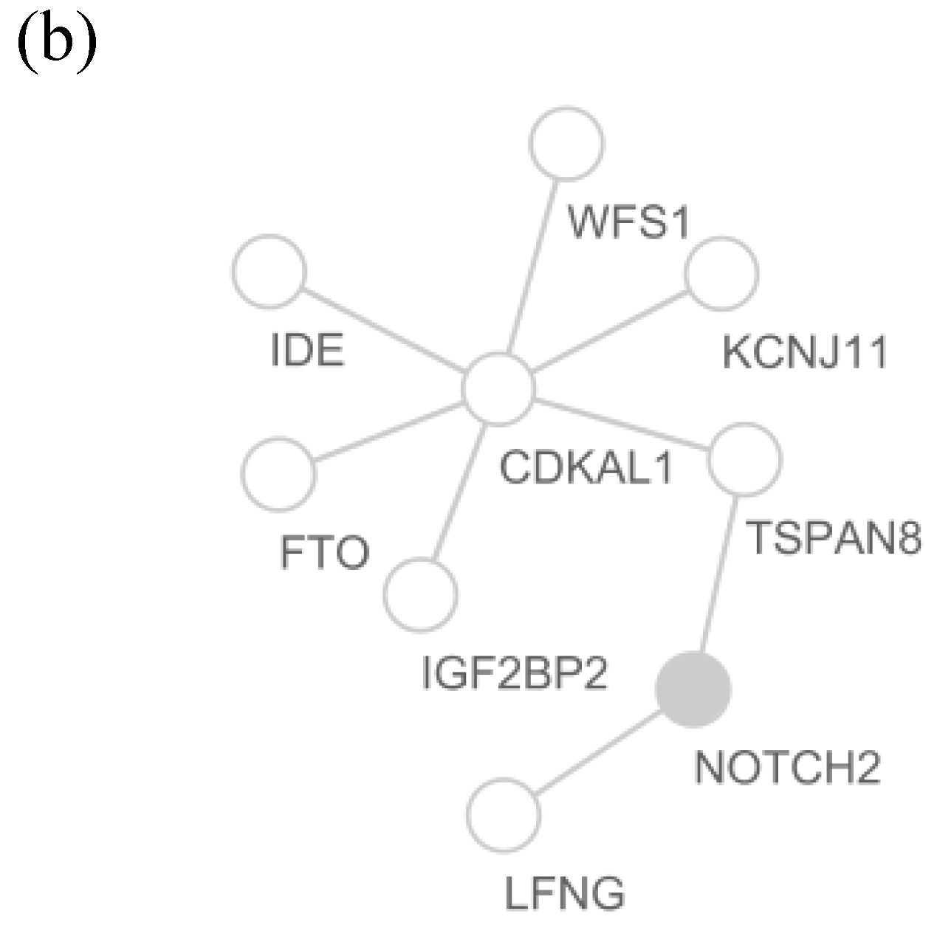
The significant PPI pairs in Type-2 diabetes GWAS data set
Seven(IGF2BP2, WFS1, CDKAL1, IDE, KCNJ11, TSPAN8 and FTO) out of the Eight were confirmed susceptibility genes
WFS1
even has a SNP-based and gene-based p value as large as
as 8.2×10⁻³and 2.4×10⁻²
Filled: genes significant in either the SNP-based, the gene-based analysis, or both tests
Notes:
Stahl, E.A. et al. Genome-wide association study meta-analysis identifies seven new rheumatoid arthritis risk loci. Nature genetics 42, 508-514 (2010).

Slide 11
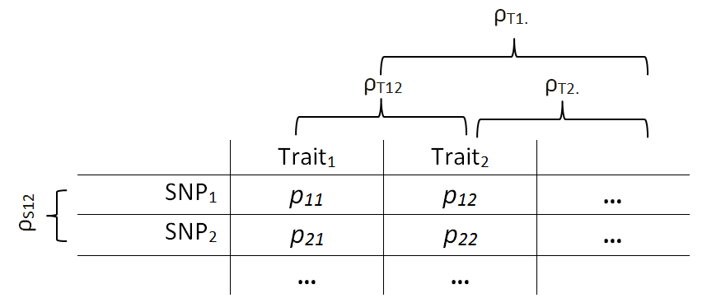
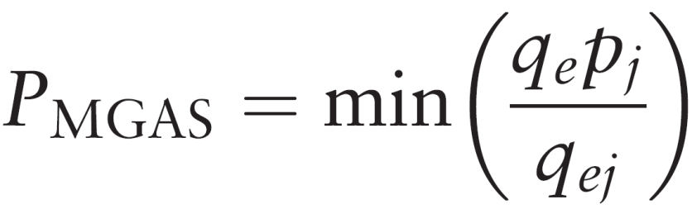
MGAS: a multivariate gene-based test
?

Slide 12
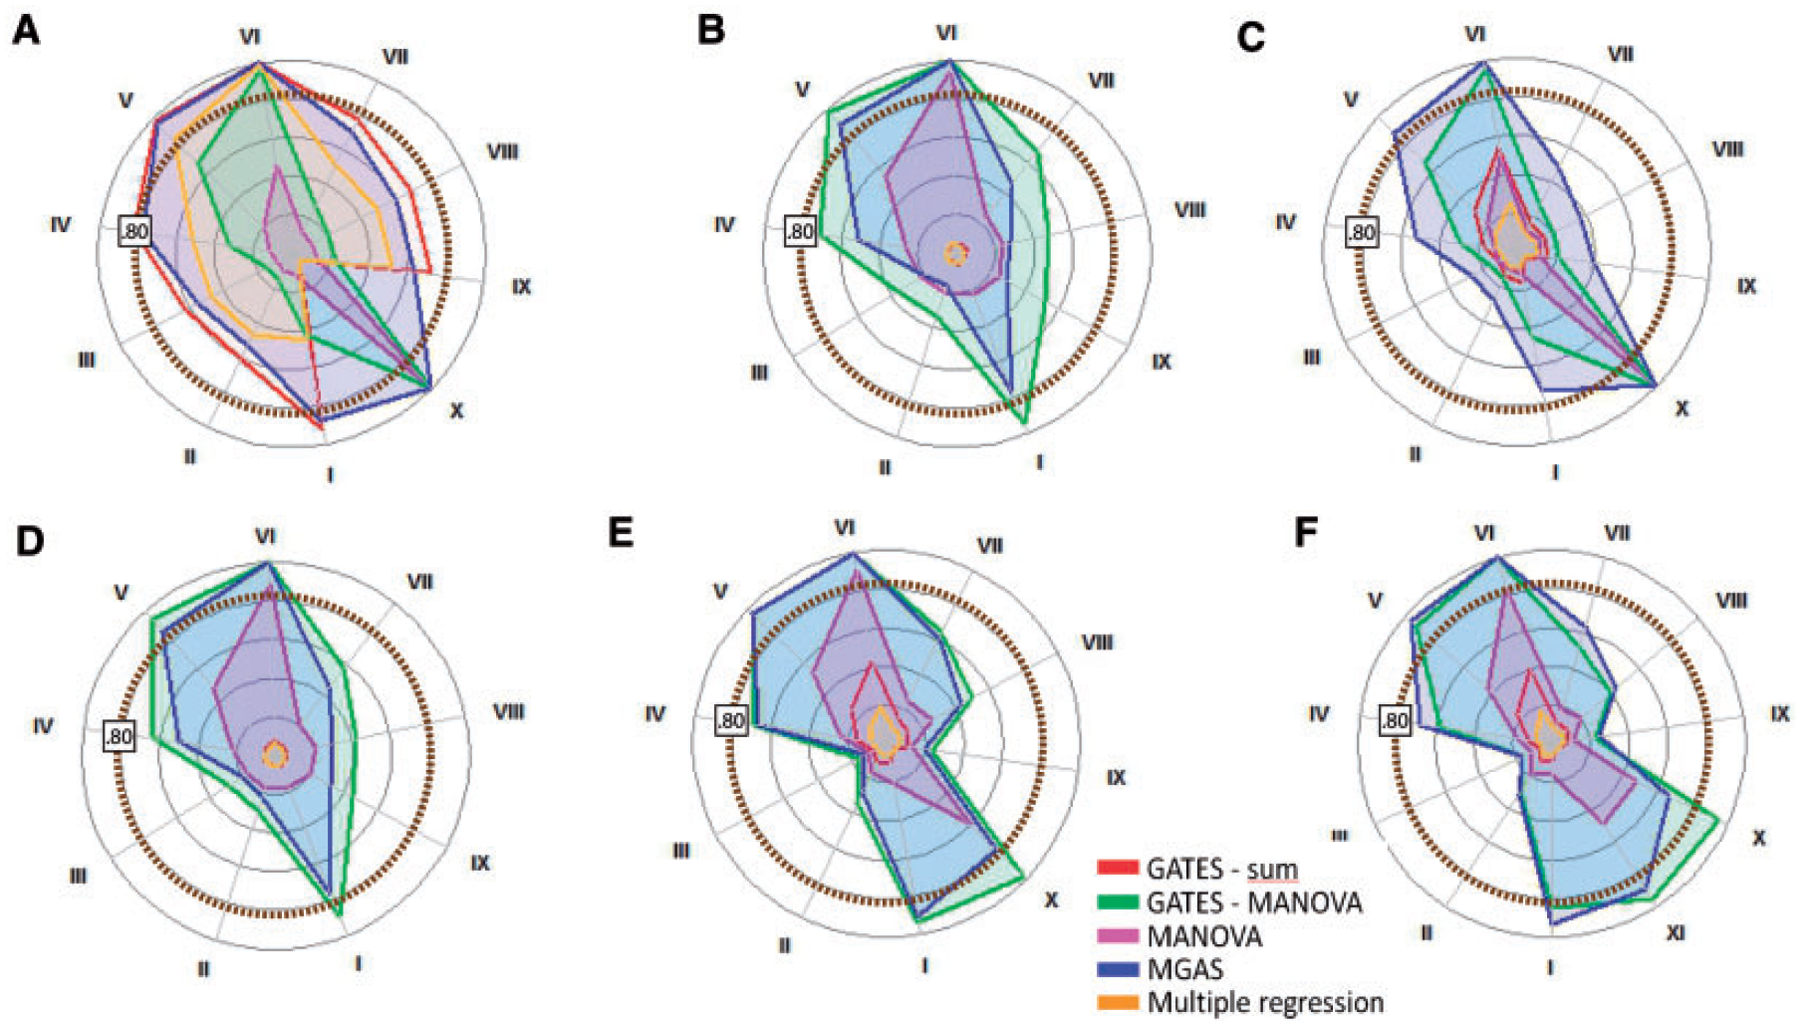
Power plots for six trait-generating genotype–phenotype models
Notes:
Fig. 2. Radial power plots for six trait-generating genotype–phenotype models
(A–F) and various genetic situations (I–XI). (A) 1-factor model with gene
effects on the latent factor. (B) 1-factor model with gene affecting only one
phenotype directly. (C) 4-factor model with gene effect on only one of four
latent factors. (D) 4-factor model with gene affecting only one phenotype
directly. (E) Network model mimicking 1-factor model with gene affecting one
phenotype directly and all related phenotypes indirectly. (F) Network model
mimicking 4-factor model with gene affecting one phenotype directly and all
related phenotypes indirectly. I–III represent results for the large gene (60
SNPs): (I): eight LD blocks, one DSL; (II): eight LD blocks, eight DSL; (III): eight
LD blocks, eight DSL of opposite effect. IV–XI represent result for a small
gene (10 SNPs): (IV): one LD block, one DSL; (V): one LD block, two DSL; (VI):
one LD block, four DSL; (VII): two LD blocks, one DSL; (VIII): two LD blocks,
two DSL; (IX): two LD block, two DSL of opposite effect; (X): one LD block,
one DSL conveying opposite effects on different phenotypes (that in network
models resided in the same cluster); (XI): one LD block, one DSL conveying
opposite effects on phenotypes in different clusters. Specific power results
and Type I error rates for all scenarios are in Supplementary Tables S2–S7.
Because MGAS has less power to detect larger genes (see Supplementary
Material), small genes and large genes were simulated to explain 0.5 and 1%
of the variance, respectively. Power results of the five methods are thus not
directly comparable between scenarios (see Supplementary Material)

Slide 13
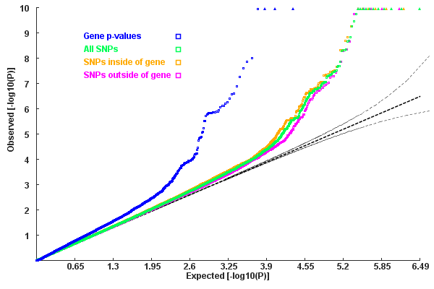
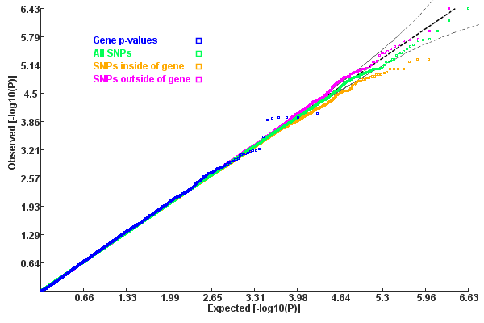
Multivariate gene-based test for Nine quantitative metabolic traits
Randomly simulated multivariate phenotypes with the same covariance matrix (null hypotheses)
Notes:
nine quantitative metabolic traits measured in the population-based NFBC1966
(N?4763; Sabatti et al., 2009), obtained from the dbGaP database.
Data were available for triglycerides (TG), high-density lipoprotein
(HDL), low-density lipoprotein (LDL), glucose (GLU), insulin
(INS), C-reactive protein (CRP), body mass index (BMI) and systolic
and diastolic blood pressure (SBP, DBP),

Slide 14
Beyond association
Gene-pair: heterogeneity checking
Gene-set: enrichment checking by hypergeometric test

Slide 15
Future development of KGG
Integrate epigenomic data
Integrate tissue specific expression/co-expression and eQTL data

Slide 16
Inputs and function modules of KGG
2
Multivariate
Gene-Association
Results
Reference LD or
genotypes of SNPs
6
Annotated
Results
GWAS results
1
Analysis
Genome
4
Gene-set Association
Results
Candidate Genes
3
Gene-Association
Results
7
External online
annotation
Optional
5
Gene-pair-Association
Results
Performance: ~10 million SNP with 12GB RAM Intel(R)
Core(TM) i7-3770, CPU 3.40 GhZ in ~40Min

Slide 17
Main inputs of KGG
p-value sets
CHR | SNP | P-value1 | P-value2 | P-value3 | …
4 | rs1513559 | 0.02301 | 0.8815 | 0.007688 | …
4 | rs294755 | 0.4384 | 0.9575 | 0.006112 | …
4 | rs835316 | 0.002688 | 0.007688 | 0.4893 | …
4 | rs1841043 | 0.01115 | 0.006112 | 0.119 | …
4 | rs11726946 | 0.005892 | 0.4893 | 0 | …
… | … | … | … | … | …
CHR | SNP | P-value1 | Test-Mode | P-value2 | …
4 | rs1513559 | 0.02301 | additive | 0.007688 | …
4 | rs1513559 | 0.4384 | recessive | 0.006112 | …
4 | rs1513559 | 0.002688 | dominant | 0.4893 | …
4 | rs1841043 | 0.01115 | additive | 0.119 | …
4 | rs1841043 | 0.005892 | recessive | 0 | …
… | … | … | … | … | …
Gene_Symbol
IL23R
NKX2-3
TNFSF15
SAG
..
Candidate gene list (optional)
Pair-wise linkage-disequilibrium coefficients (optional)
Genotype of reference samples (Plink bed file format and VCF)
Available local LD SNP coefficients (calculated by third-party tool like Plink).

Slide 18
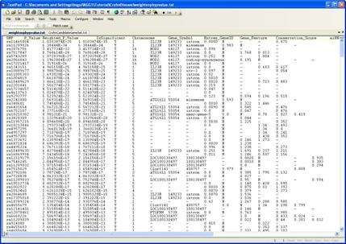
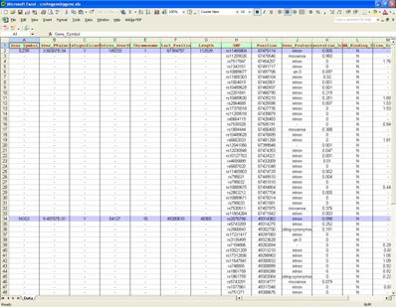
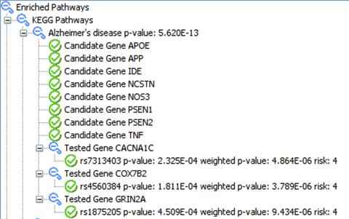
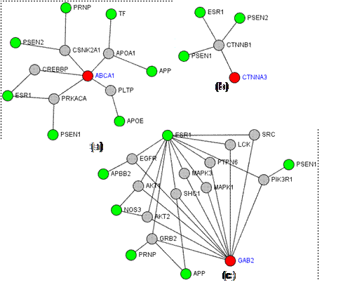
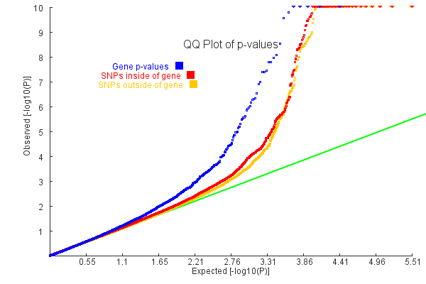
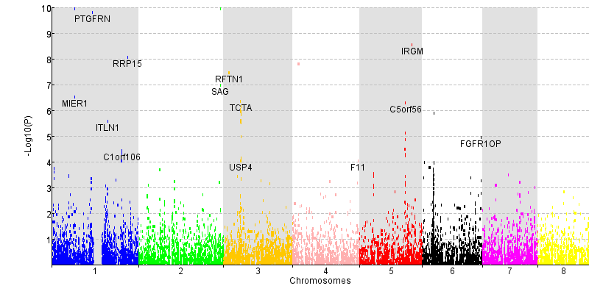
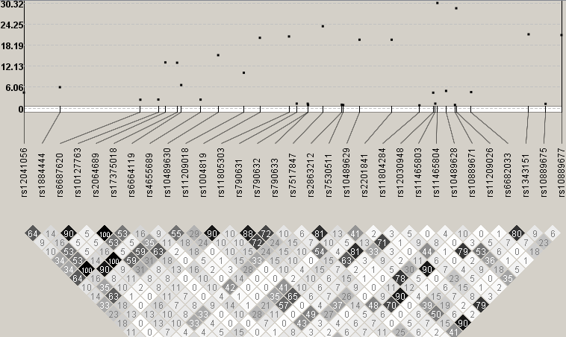
Versatile outputs of KGG

Slide 19
Input data:
/miaoxin/2015/KGG/KGGSample
For single phenotype
  Meta-analysis test statistics of Crohn's disease (http://www.broadinstitute.org/~jcbarret/ibd-meta/)
    CrohnMetaPValueSetChr1.txt
  Known risk gene list of Crohn's disease
    CrohnCandidateGeneSet.txt
For multiple phenotypes
  P-values of 9 quantitative metabolic traits measured in NFBC1966 (Sabatti et al., 2009)
    9MetabolicPhenotypesPhg19.txt
  Pearson phenotype correlation of 9 phenotypes
    9MetabolicPhenotypesCorr.txt
Tutorial file: /miaoxin/2015/KGG/
ShortTutorialKGG.docx

Slide 20
Practical on KGG
Univariate gene-based association analysis for Crohn's disease
Univariate PPI-based association analysis for Crohn's disease
Univariate pathway-based association analysis for Crohn's disease
Multivariate gene-based association analysis for 9 quantitative metabolic traits
Power calculation of set-based association test (Optional)

Slide 21
Step by step procedure
Create a KGG project
Build an analysis Genome
Gene-based association analysis by GATES
Gene-based association analysis by HYST
Protein-protein interaction-based association analysis by HYST
Pathway gene set-based association analysis by HYST

