Slide 1
Genome-wide Complex Trait Analysis and extensions
Matthew Keller
Teresa de Candia
University of Colorado at Boulder

Slide 2
Outline
Issues and extensions of GCTA (de Candia)
SNP variance estimates and heritability
Estimating multiple genetic variances (e.g., two groups of SNPs)
Bivariate models (e.g., two traits)
Practical

Slide 3
Outline
Issues and extensions of GCTA (de Candia)
SNP variance estimates and heritability
Estimating multiple genetic variances
Bivariate models
Practical

Slide 4
Estimating Multiple Genetic Variances
Just as we can simultaneously estimate partial or independent effects of several predictors in standard linear regression:
Y = β₀ + β₁X₁ + β₂X₂ + β₃X₃+ .. + ε
We can similarly estimate the independent effects of several groups of SNPs:
Var(Y) = G₁σ²_{g1} + G₂σ²_{g2} + G₃σ²_{g3} + … + Iσ²_{e}
Notes:
GRMs don’t allow us to examine independent effects of SNPs since SNP effects are estimated in aggregate

Slide 5
Estimating Multiple Genetic Variances
Advantages:
Ability to question specific categories of CVs, by grouping similar SNPs together. Some examples of SNP categories: chromosome, expression, pathway, allele frequency, etc.
Increase robustness of model to overestimates due to confounding of GRM due to:
Stratification when environmental influences DO differ by ethnicity: π-hats confounded w/ environmental effects,
Systematic plate effects (e.g., case control data): π-hats confounded w/ genotyping artifacts,
Cryptic relatedness: π-hats confounded w/ rare or non-additive genetic variance, or shared environmental effects
Notes:
Systematic plate effects and other biases are more likely to occur in ascertained case/control samples.
When there are environmental differences that effect phenotype, stratification can lead to overestimates because the GRM is confounded with some other variable such as environmental main effects

Slide 6
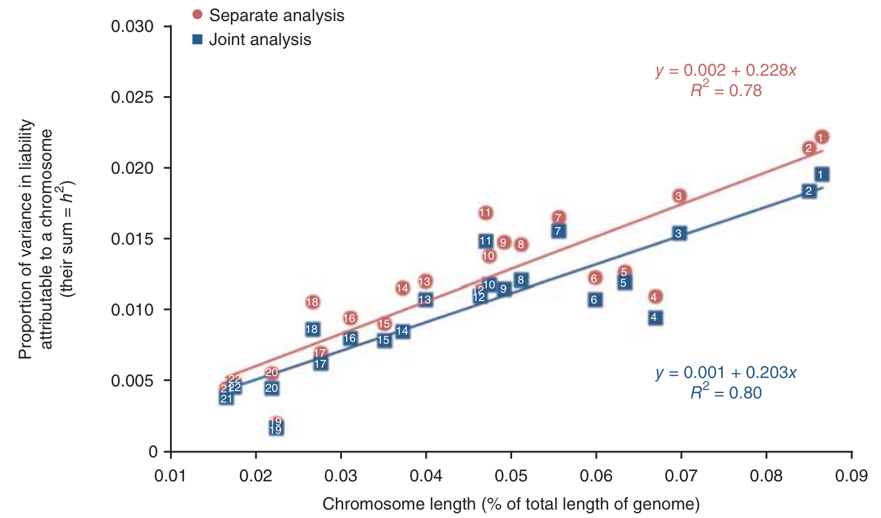
SNP variances for schizophrenia, by chromosome in ethnically homogeneous sample
Lee et al., 2012
Notes:
This shows us evidence for polygeneity

Slide 7
SNP variances for schizophrenia, by chromosome in ethnically homogeneous sample
SEs are large
So, comparisons aren’t usually feasible
Lee et al., 2012
Notes:
SEs on specific GRMs (e.g. chromosomal) can be quite large

Slide 8
SNP variances for schizophrenia, by chromosome in ethnically homogeneous sample
Look at Difference
In Sums of
Point Estimates
Lee et al., 2012
Notes:
Difference between MGRM and GRM-sum tells you that confounds exist here, even though effect is relatively small.

Slide 9
Outline
Issues and extensions of GCTA (de Candia)
SNP variance estimates and heritability
Estimating multiple genetic variances
Bivariate models
Practical

Slide 10
Bivariate Models
Can be used to examine genetic overlap between two separate measures thought to be related, such as:
Different phenotypes
Same phenotype across different datasets or genotyping procedures
Same phenotype across different populations or environments
Importantly, model estimation does not require individuals to be assessed on both measures
Useful for examining rare traits

Slide 11
Bivariate Models
Trait1 Trait2
Trait2 Trait1
For 2 measures, using all available pairs of individuals i and j, we use the following 3 different parts of the G & Y matrices:
1 matrix for each of measures 1 and 2
1 matrix for covariances between measures 1 and 2
This model simultaneously estimates 3 genetic parameters: σ²_{g1}, σ²_{g2}, σ_{g12}
Using these we can calculate a SNP correlation: r_{SNP} = σ_{g12} / (σ_{g1}σ_{g2})

Slide 12
Bivariate Models
SNP correlations (r_{SNP}) are only our best estimates of underlying genetic correlations (r_{g}):
They will reflect the extent to which more common CVs are shared between traits
r_{SNP} is not a direct estimate of the correlation of effect sizes of causal alleles. Systematic genotyping artifacts and population structure (distinct populations with MAF and background LD differences) will produce underestimates of r_{g}
If we look across different traits, each of which is measured in separate datasets, then r_{SNP} between traits can be biased downward. It is important to make apples to apples comparisons (different traits, same dataset), and/or to use benchmarks (e.g., same trait, different datasets)
Notes:
Expect rSNP to be biased downward for the same reasons that SNP heritabilities are

Slide 13
Outline
Issues and extensions of GCTA (de Candia)
SNP variance estimates and heritability
Estimating multiple genetic variances
Bivariate models
Practical

Slide 14
SNP-h² < Narrow-sense h^{2*}
1. Estimates rely on LD between SNPs and causal variants (CVs), and are therefore imperfect:
Datasets with lower SNP density will capture less heritability
Estimates are biased if background LD around CVs does not mirror that around SNPs. LDAK has been used to correct for this but may over-adjust (Speed et al., 2013)
If allele frequency spectrum of SNPs is different than that of CVs, estimate will be too low. Rarer CVs are not well represented by SNP panels
*usually, maybe
Notes:
Denser == closer together

Slide 15
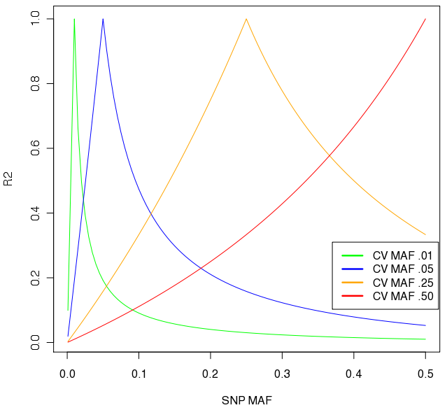
Max R² as function of SNP MAF for several CV allele frequencies
Notes:
Figure is of upper bound of how much V_{A} GWAS can detect. We only have SNPs to the right of the dashed line, so really rare CVs are not going to be tagged at all. A common CVs will be well detected by a variety of SNP MAFs. Lower MAF phenotypes will give lower h2 estimates because poorly tagged by common SNPs. Therefore, heritability estimates reflect aggregate importance of COMMON causal variants.

Slide 16
SNP-h² < Narrow-sense h^{2*}
2. Noise in SNP calls (thus, π-hats) and phenotypes tends to bias SNP-h² downward when:
Random plate effects inflate variance across π-hats compared with πs. This seems to be a problem with ascertained case-control samples as well (Golan et al., 2014)
G_{SNP} = cG_{CV}
Var(Y) = cG_{CV1}σ²_{g} + Iσ²_{e}
h² is underestimated when c is a scalar >1 on G_{CV}, inflating var(π-hat)
Stratification is present, but environmental influences DO NOT differ by ethnicity
Genetic heterogeneity exists, such that two “phenotypes” that are genetically quite different are regarded as the same thing
*usually, maybe

Slide 17
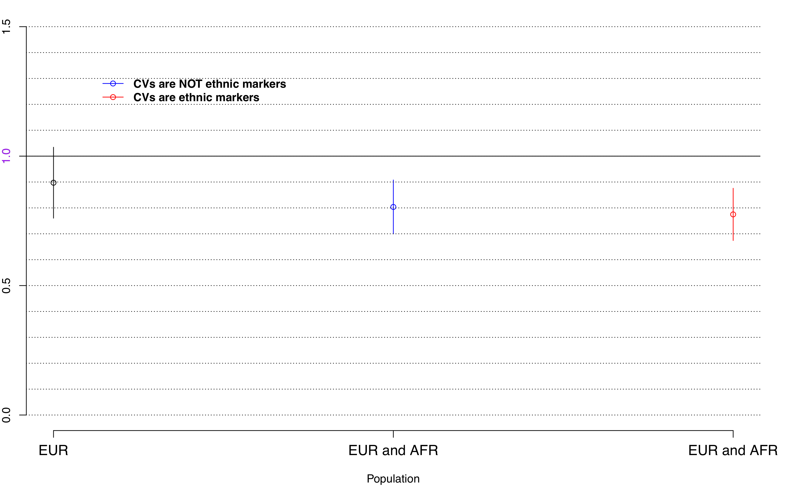
SNP variances for simulated trait, as a function of stratification
Proportion of Genetic Variance Detected

Slide 18
SNP-h² < Narrow-sense h^{2*}
But, not so shabby. Overall, things seem to work:
SNPs pick up a substantial proportion of variance for a lot of tested traits, and simulations of phenotypes using real data confirm that methods are relatively robust to most assumptions
Given published SNP h², amount of missing heritability is not surprising, especially if we take into account that estimates from family studies include rare and non-additive heritability as well as shared environmental effects
*usually, maybe

Slide 19
Outline
Issues and extensions of GCTA (de Candia)
SNP variance estimates and heritability
Estimating multiple genetic variances
Bivariate models
Practical

Slide 20
Practical Objectives
Let’s estimate some univariate and bivariate models using simulated genotype and phenotype data.
Suppose we have plink binary files for two studies - dat1 and dat2. (We also have merged these plink files into a single file - dat.)
Suppose the first dataset (dat1) is of 2k females measured on height, the second (dat2) is of 2k females measured on BMI. Each individual is only present in one dataset.
Our aim is to first estimate heritability separately for each of the two traits in univariate models, and then to jointly estimate two heritabilities and a genetic correlation in a bivariate model.
To do this we will be a) calculating GRMs, and b) running REML to estimate model parameters.
Notes:
This is simulated GWA data covering 20Mb, so less than 1% of the genome. We have 6500 SNPs in this region, and that is roughly equivalent to a SNP chip with a genome-wide density of ~1M SNPs; QC already done

Slide 21
GCTA Software
Can be used for:
Data management (similar to PLINK)
Calculation of GRM from genome-wide SNPs (this can also be done in PLINK)
Model estimation by REML
PCA, simulations, etc.

Slide 22
Input Files
Binary PLINK files
Fam file (.fam)
Bim file (.bim)
Bed file (.bed)

Slide 23
Data management
Inclusion criteria
--keep mylist.txt, --remove mylist.txt
--extract mysnps.txt, --exclude mysnps.txt
--chr 6, --autosome
Using phenotypes files
--pheno,
Using covariate files
--covar, --qcovar

Slide 24
Calculating GRM
GRM:
gcta –bfile dat1 --make-grm-gz -–thread-num 2 --out dat1.gcta
Generates:
dat1.gcta.grm.gz
dat1.gcta.grm.id
Notes:
thread-num allows for parallelizing if you’re on a multi-threaded machine

Slide 25
Genetic Relationship Matrix (GRM)
example.grm.id 10 01 10 02 17 01 28 01 33 01 33 02 37 50 38 01 45 50 46 01 | example.grm.gz 1 1 273588 0.99629 2 1 273566 0.47804 2 2 273600 0.99192 3 1 269152 0.00656 3 2 269164 0.00215 3 3 269192 0.99075 4 1 273582 0.00004
Notes:
ID file contains FID and IID. GZ file contains row number for ind 1, row number for ind 2, non-missing SNPs, pihat.

Slide 26
Estimating SNP h²
Estimate SNP h² for trait1 (and then do the same for trait 2):
gcta –grm-gz dat1.gcta –pheno dat.pheno --mpheno XXX --reml –out dat1.results
Jointly estimate SNP h2 for both measures as well as SNP-correlation:
gcta –grm-gz dat.gcta –pheno dat.pheno –reml-bivar XXX XXX –out dat.results
"XXX" will be 1 for phenotype data in 3rd column, 2 for phenotype data in 4th column. Exactly two columns must be specified for bivariate model
Both traits are in phenotype file dat.pheno. Height is in column 3 and BMi is in column 2.
Extension of results files is “.hsq”

Slide 27
Phenotype File
 | example.pheno fdfs1 fdfs1 0.99629 NA absd2 absd2 -0.47804 NA edgg3 edgg3 0.49192 NA rkls4 rkls4 0.00656 NA eedf1 eedf1 NA 0.00215 aaaa2 aaaa2 NA -0.99075 bbbb3 bbbb3 NA 0.00004
Dataset 1
Dataset 2
Notes:
ID file contains FID and IID. GZ file contains row number for ind 1, row number for ind 2, non-missing SNPs, pihat.

Slide 28
Help and Questions
Go to your desktop’s “Home” directory, create a directory called “GCTA”, and copy everything from Matt’s subdirectory “Boulder2015” into it
Use “GCTA_2015.Practical.R” to do all this
GCTA website: http://www.complextraitgenomics.com/software/gcta/
What is SNP h² for measure1? Measure2? And what are the SEs on those point estimates?
How genetically correlated are they?
What SNP r would you expect across datasets assessed on the same exact measure?

Slide 29
Results
Pretty different SNP h² between traits: SNP h² estimated for height: ~.78
(simulated h² was .8)
SNP h² for BMI: ~.36
(simulated h² was .4)
Relatively high SNP r between traits: ~.64
Are these simulated SNP h² estimates realistic?

Slide 30
From Wikipedia “Apples and Oranges”
“At least two tongue-in-cheek scientific studies have been conducted on the subject, each of which concluded that apples can be compared with oranges fairly easily and on a low budget and the two fruits are quite similar. …[One] study … concluded: ‘…the comparing apples and oranges defense should no longer be considered valid. This is a somewhat startling revelation. It can be anticipated to have a dramatic effect on the strategies used in arguments and discussions in the future.’”
“In many languages, oranges are, implicitly or explicitly, referred to as a type of apple”.
“Oranges, like apples, grow on trees.”
Additionally, one figure with the subtitle “Not all apples are alike”, at the very least, possibly calls into question the use of the phrase “apples-with-apples comparison”.

