Slide 1
Practical: De novo mutation identification and analysis
Instructor: Daniel P Howrigan
Massachusetts General Hospital, Boston, MA
Broad Institute, Cambridge, MA
2015 International workshop on statistical genetic methods for human complex traits

Slide 2
Overview
De novo identification
Visualizing a de novo variant
Using genotype information from the VCF
Assessing potential errors in de novo identification
De novo analysis
Modeling the expectation of de novo mutations
Testing individual genes
Testing for enrichment in gene sets

Slide 3
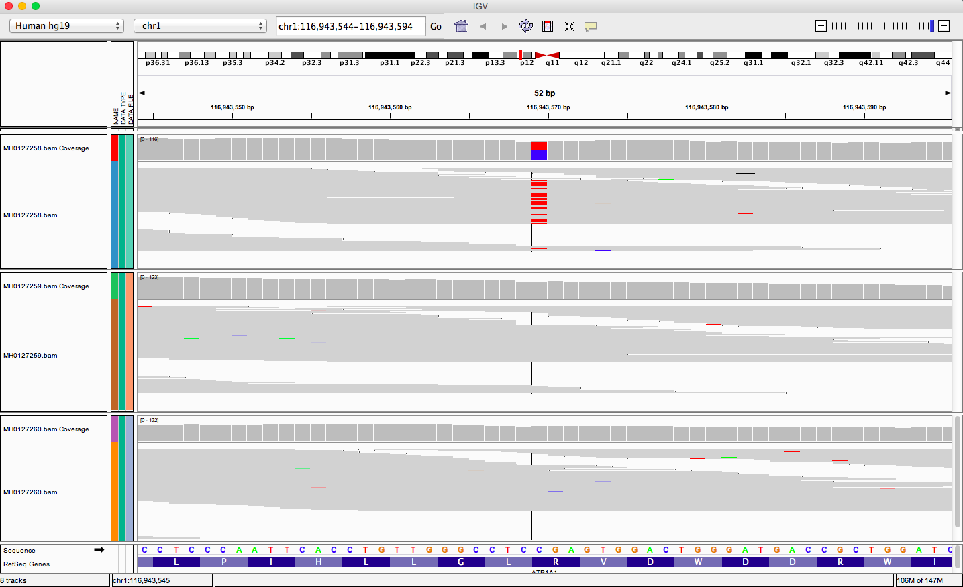
Visualizing a de novo variant
Child
Mother
Father

Slide 4
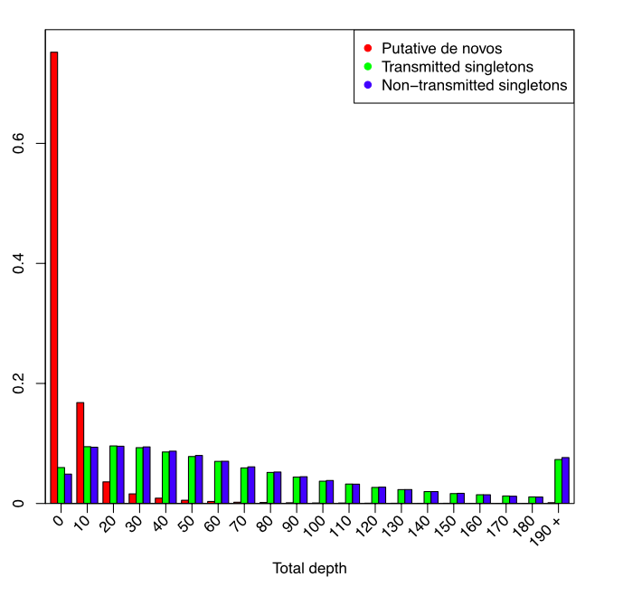
De novo calling is highly susceptible to sequencing errors
All variants have passed quality control in GATK
Slide courtesy of Fromer et al. 2014 Nature

Slide 5
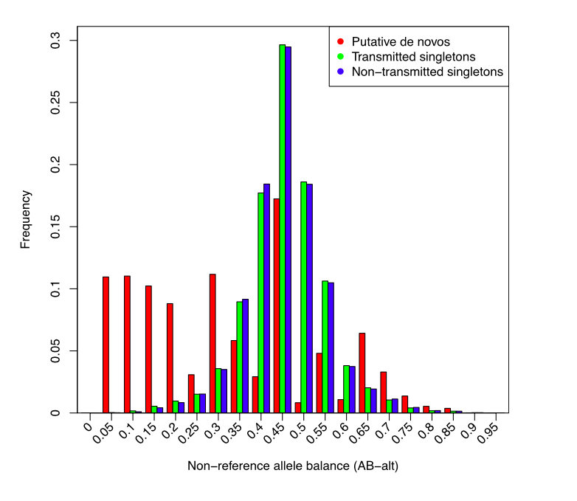
De novo calling is highly susceptible to sequencing errors
All variants have passed quality control in GATK
Slide courtesy of Fromer et al. 2014 Nature

Slide 6
Calling De Novo Variants
AA
AA
GT :AD :DP : GQ : PL
0/0 :25,0 :23 : 99 : 0,135,931
GT :AD :DP : GQ : PL
0/0 :19,1 :17 : 33 : 0,35,121
GT = Genotype
AD = Allelic Depth
DP = Overall Depth
GQ = Geno quality
PL = Phred Likelihood
AT
GT :AD :DP : GQ : PL
0/1 :6,9 :13 : 34 : 0,34,81

Slide 7
Calling De Novo Variants
AA
AA
GT :AD :DP : GQ : PL
0/0 :25,0 :23 : 99 : 0,135,931
GT :AD :DP : GQ : PL
0/0 :19,1 :17 : 35 : 0,35,121
GT = Genotype
AD = Allelic Depth
DP = Overall Depth
GQ = Geno quality
PL = Phred Likelihood
Parent Max up to 5%
AT
GT :AD :DP : GQ : PL
0/1 :6,9 :13 : 34 : 34,0,81
Child Min down to 20%

Slide 8
Calling De Novo Variants
AA
AA
GT :AD :DP : GQ : PL
0/0 :25,0 :23 : 99 : 0,135,931
GT :AD :DP : GQ : PL
0/0 :19,1 :17 : 35 : 0,35,121
GT = Genotype
AD = Allelic Depth
DP = Overall Depth
GQ = Geno quality
PL = Phred Likelihood
Total Parent Depth = 40
Total Child Depth = 13
AT
Depth Comparison (13/40) = 32.5%
Our Minimum level = 10%
GT :AD :DP : GQ : PL
0/1 :6,9 :13 : 34 : 34,0,81

Slide 9
Calling De Novo Variants
AA
AA
GT :AD :DP : GQ : PL
0/0 :25,0 :23 : 99 : 0,135,931
GT :AD :DP : GQ : PL
0/0 :19,1 :17 : 35 : 0,35,121
GT = Genotype
AD = Allelic Depth
DP = Overall Depth
GQ = Geno quality
PL = Phred Likelihood
Minimum Parent PL AB : NONE
AT
Minimum Child PL AA >= 20
GT :AD :DP : GQ : PL
0/1 :6,9 :13 : 34 : 34,0,81

Slide 10
practical: de novo identification
data directory: /faculty/dan/practical_2015/
Family file: denovo-example.fam
2 families
Child/proband diagnosed with disorder and parents are unaffected
File format identical to PLINK
VCF file: denovo-example.vcf
Header has a lot of “meta-information” on the file
1st 853 variants in Chromosome 1
Command line:
mkdir denovo
cp -r /faculty/dan/practical_2015/* denovo
cd denovo
less denovo-example.fam
less -S denovo-example.vcf
press q to exit the ‘less’ program

Slide 11
.fam file
fam1 child1 father1 mother1 1 2
fam1 father1 0 0 1 1
fam1 mother1 0 0 2 1
fam2 child2 father2 mother2 2 2
fam2 father2 0 0 1 1
fam2 mother2 0 0 2 1
.vcf file
##fileformat=VCFv4.1
##FILTER=<ID=LowQual,Description="Low quality">
##FORMAT=<ID=AD,Number=.,Type=Integer,Description="Allelic depths for the ref and alt alleles in the order listed">
##FORMAT=<ID=DP,Number=1,Type=Integer,Description="Approximate read depth (reads with MQ=255 or with bad mates are filtered)">
##FORMAT=<ID=GQ,Number=1,Type=Integer,Description="Genotype Quality">
##FORMAT=<ID=GT,Number=1,Type=String,Description="Genotype">
##FORMAT=<ID=PL,Number=G,Type=Integer,Description="Normalized, Phred-scaled likelihoods for genotypes as defined in the VCF specification">
##INFO=<ID=AC,Number=A,Type=Integer,Description="Allele count in genotypes, for each ALT allele, in the same order as listed">
##INFO=<ID=MQ,Number=1,Type=Float,Description="RMS Mapping Quality">
##reference=file:///seq/references/Homo_sapiens_assembly19/v1/Homo_sapiens_assembly19.fasta
#CHROM POS ID REF ALT QUAL FILTER INFO FORMAT mother1 child1 father1 child2 father2 mother2
1 69511 rs75062661 A G 3582006634117.21 VQSRTrancheSNP99.50to99.90 AC=6815... 1/1:1,245:246:99:3752,354,0 1/1:0,235:235:99:3866,325,0

Slide 12
practical: de novo identification
data directory: /faculty/dan/practical_2015/
Python program: de_novo_finder_3.py
Scans through VCF for de novo variants that pass thresholds
Returns a tab delimited list of de novo variants and genotype information
Using MAF as an additional QC parameter: all_ESP_counts_5.28.13.txt
Exonic variants and allele frequencies from 5K+ exomes
Command line:
less -S de_novo_finder_3.py
less -S all_ESP_counts_5.28.13.txt
press q to exit the ‘less’ program

Slide 13
all_ESP_counts_5.28.13.txt
Genome position and basic annotation
European MAF
Non-European MAF
1 69428 T G OR4F5 missense CYS/PHE 113/306 probably-damaging 313 6848 0.04571 14 3822 0.00366
1 69476 T C OR4F5 missense THR/MET 129/306 probably-damaging 2 7022 0.00028 0 3908 0.00000
1 69496 G A OR4F5 missense SER/GLY 136/306 benign 2 6766 0.00030 23 3808 0.00604
1 69511 A G OR4F5 missense ALA/THR 141/306 benign 5337 6014 0.88743 1937 3560 0.54410
1 69590 T A OR4F5 missense ASP/VAL 167/306 probably-damaging 0 6214 0.00000 1 3556 0.00028
...

Slide 14
Combining call quality and population frequency for better calls
Prob of DNM: P(true DNM | data) /
(P(true DNM | data) + P(one parent het | data))
P(true DNM | data) = P(data | true DNM) * P(true DNM)
P(data | true DNM) = Pdad_ref * Pmom_ref * Pchild_het (our observed DNM call quality)
P(true DNM) = 1/30 Mb (theoretical DNM rate)
We want High numbers for this probability
P(one parent het | data) = (Pdad_ref*Pmom_het + Pdad_het*Pmom_ref) * Pchild_het
P(one parent het) = 1 - (1-F)^4 (population MAF applied to parents)
F = Maximum MAF in either ESP or current data
We want Low numbers for this probability

Slide 15
Combining call quality and population frequency for better calls
Prob of DNM: P(true DNM | data) /
(P(true DNM | data) + P(one parent het | data))
P(true DNM | data) = P(data | true DNM) * P(true DNM)
P(data | true DNM) = Pdad_ref * Pmom_ref * Pchild_het (our observed DNM call quality)
P(true DNM) = 1/30 Mb (theoretical DNM rate)
We want High numbers for this probability
P(one parent het | data) = (Pdad_ref*Pmom_het + Pdad_het*Pmom_ref) * Pchild_het
P(one parent het) = 1 - (1-F)^4 (population MAF applied to parents)
F = Maximum MAF in either ESP or current data
We want Low numbers for this probability

Slide 16
Combining call quality and population frequency for better calls
Prob of DNM: P(true DNM | data) /
(P(true DNM | data) + P(one parent het | data))
P(true DNM | data) = P(data | true DNM) * P(true DNM)
P(data | true DNM) = Pdad_ref * Pmom_ref * Pchild_het (our observed DNM call quality)
P(true DNM) = 1/30 Mb (theoretical DNM rate)
We want High numbers for this probability
P(one parent het | data) = (Pdad_ref*Pmom_het + Pdad_het*Pmom_ref) * Pchild_het
P(one parent het) = 1 - (1-F)^4 (population MAF applied to parents)
F = Maximum MAF in either ESP or current data
We want Low numbers for this probability

Slide 17
practical: de novo identification
running de_novo_finder_3.py
Command line:
python de_novo_finder_3.py \
denovo-example.vcf \
denovo-example.fam \
all_ESP_counts_5.28.13.txt -q > example.denovo.txt
Command line:
less -S example.denovo.txt
column -t example.denovo.txt | less -S

Slide 18
example.denovo.txt
## Run start date and time: Mon Mar 2 11:09:45 2015
## Script version: 3.75
## Command given: python /Users/daniel/Dropbox/Scripts/TTRIO/python_scripts/de_novo_finder_3.py /Users/daniel/Downloads/denovo-example.vcf /Users/daniel
Chr Pos rsID Ref Alt Child_ID Child_PL_AA Dad_PL_AB Mom_PL_AB Child_AD_Ratio
1 866477 . C TRUE child1 200 229 241 0.4166667
1 901901 rs146478061 C TRUE child2 120 57 54 0.2500000
Dad_AD_Ratio Mom_AD_Ratio DP_Child DP_Dad DP_Mom DP_Ratio Prob_dn Validation_Likelihood
0 0 120 76 84 0.7500000 1.0000000 HIGH_SNV
0 0 20 19 18 0.5405405 0.1025394 LOW_SNV

Slide 19
Overview
De novo identification
Visualizing a de novo variant
Using genotype information from the VCF
Assessing potential errors in de novo identification
De novo analysis
Modeling the expectation of de novo mutations
Testing individual genes
Testing for enrichment in gene sets / pathways

Slide 20
A model for interpreting de novo mutation
mutation probability estimated at each base position
Tri-nucleotide context of mutation
Aggregate probabilities across various contexts
Whole exome
Annotation classes (synonymous, missense, etc..)
Individual genes and gene sets
Utilize a Poisson model informed by trio size
…CACGTA…
AAG
ACG
AGG
ATG

Slide 21
practical: single gene de novo enrichment
running multiple_hits_onelist.py and overlap2mutprobs_1.2.py
less -S fixed_mut_prob_fs_adjdepdiv.txt
view the gene model
python multiple_hits_onelist.py \
Neale_2012_denovo.txt > Neale_2012_genes.txt
select genes with recurrent mutations
python overlap2mutprobs_1.2.py \
Neale_2012_genes.txt \
fixed_mut_prob_fs_adjdepdiv.txt \
175 > Neale_2012_gene_results.txt
Test genes against model
perl -pe 's{, }{:}g' Neale_2012_gene_results.txt \
| column -t | less -S
view the results

Slide 22
Neale _2012_denovo.txt
Neale _2012_genes.txt
SMARCC2 esplice
ST3GAL6 esplice
C20orf111 frameshift
PLXNB1 frameshift
POGZ frameshift
SPAST frameshift
SPP2 frameshift
TCF3 frameshift
.
.
.
ABCA12 missense
ABCA13 missense
FAT1 missense/missense
BRCA2 missense/missense
KCNMA1 missense/silent
expectation and significance
Neale _2012_gene_results.txt
#gene mutations #LoF #mis p(LoF) p(mis) p(L+m) 2*prob exp#[175] ppois compared_to
FAT1 missense:missense 0 2 1.47e-05 0.0001 0.00014 0.0003 0.054 0.001 LoF+mis
BRCA2 missense:missense 0 2 1.17e-05 7.7-05 8.9e-05 0.0001 0.031 0.0004 LoF+mis

Slide 23
practical: gene set de novo enrichment
running listcrusher_3.5.py
General framework
The [mutation model] tests for an enrichment of our [observed de novos] in a given [gene set of interest]
Enrichment dependent not on the number of trios, but on the number of de novo mutations
python list_crusher3_5.py \
fixed_mut_prob_fs_adjdepdiv.txt \
Neale_2012_denovo.txt \
JOINT_CONSTRAINT_829.set -p

Slide 24
Neale _2012_denovo.txt
JOINT_CONSTRAINT_829.set
SMARCC2 esplice
ST3GAL6 esplice
C20orf111 frameshift
PLXNB1 frameshift
POGZ frameshift
SPAST frameshift
SPP2 frameshift
TCF3 frameshift
.
.
.
ABCA12 missense
ABCA13 missense
ABCA2
ABCC5
ABCC8
ABCC9
ABCG1
.
.
.
ZNF592
ZNF618
ZNF668
ZSWIM4
ZZEF1
vs.
listcrusher output
Significance for LoF overlap: 0.249137767316
3 overlapping LoF mutations: PLXNB1, POGZ, RELN
Expected overlap: 0.116131677887
Actual LoF overlap: 0.2
Fold enrichment: 1.72218298778
Significance for missense overlap: 0.275458125581
15 overlapping missense mutations: C3, CHD2, DENND5A, FN1, KCNMA1, MLL, NISCH, POLR2A, SBF1, SCRIB, SMARCC1, SMCHD1, STXBP1, TBR1, TRAF7
Expected overlap: 0.123549756925
Actual missense overlap: 0.147058823529
Fold enrichment: 1.19028015263
Significance for synonymous overlap: 0.432423474624
7 overlapping synonymous mutations: CACNA1E, CADPS, CLTC, KCNMA1, PLEC, UPF1, ZFC3H1
Expected overlap: 0.12454556094
Actual synonymous overlap: 0.14
Fold enrichment: 1.12408663098

