Slide 1
Practical: De novo mutation identification and analysis
Instructor: Daniel P Howrigan
Massachusetts General Hospital, Boston, MA
Broad Institute, Cambridge, MA
2015 International workshop on statistical genetic methods for human complex traits

Slide 2
Overview
De novo identification
Visualizing a de novo variant
Using genotype information from the VCF
Assessing potential errors in de novo identification
De novo analysis
Modeling the expectation of de novo mutations
Testing individual genes
Testing for enrichment in gene sets

Slide 3
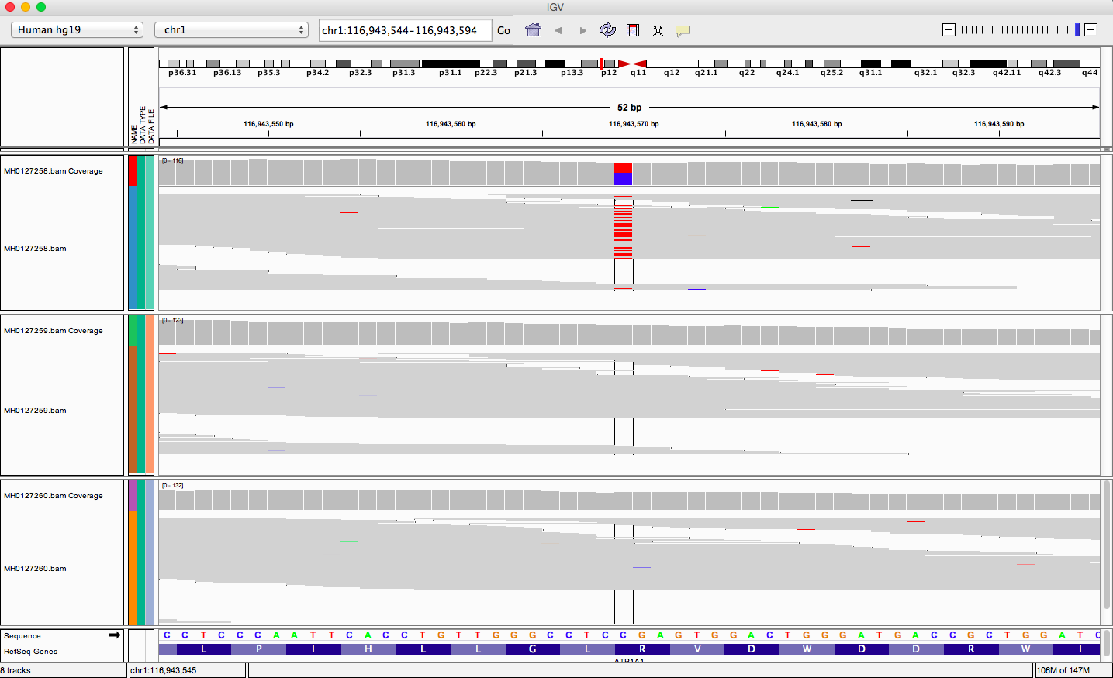
Visualizing a de novo variant
Child
Mother
Father

Slide 4
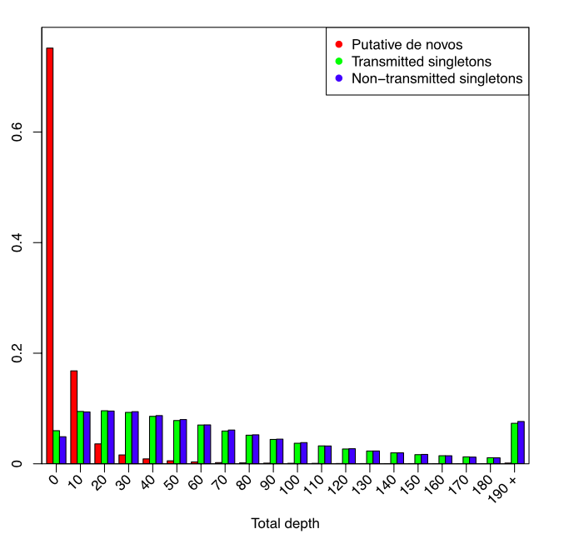
De novo calling is highly susceptible to sequencing errors
All variants have passed quality control in GATK
Slide courtesy of Fromer et al. 2014 Nature

Slide 5
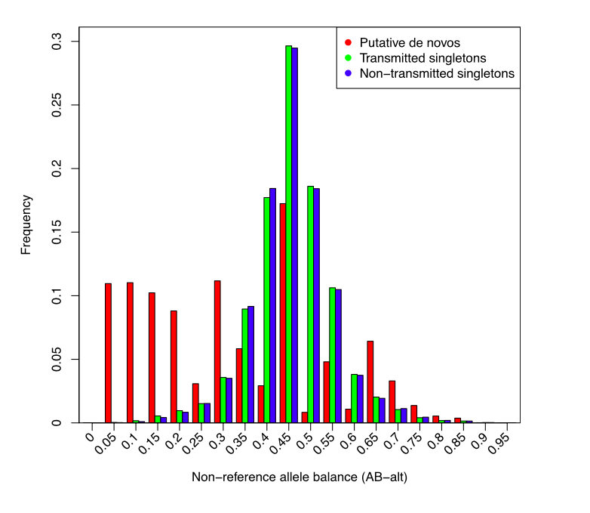
De novo calling is highly susceptible to sequencing errors
All variants have passed quality control in GATK
Slide courtesy of Fromer et al. 2014 Nature

Slide 6
Calling De Novo Variants
AA
AA
GT :AD :DP : GQ : PL
0/0 :25,0 :23 : 99 : 0,135,931
GT :AD :DP : GQ : PL
0/0 :19,1 :17 : 33 : 0,35,121
GT = Genotype
AD = Allelic Depth
DP = Overall Depth
GQ = Geno quality
PL = Phred Likelihood
AT
GT :AD :DP : GQ : PL
0/1 :6,9 :13 : 34 : 0,34,81

Slide 7
Calling De Novo Variants
AA
AA
GT :AD :DP : GQ : PL
0/0 :25,0 :23 : 99 : 0,135,931
GT :AD :DP : GQ : PL
0/0 :19,1 :17 : 35 : 0,35,121
GT = Genotype
AD = Allelic Depth
DP = Overall Depth
GQ = Geno quality
PL = Phred Likelihood
Parent Max up to 5%
AT
GT :AD :DP : GQ : PL
0/1 :6,9 :13 : 34 : 34,0,81
Child Min down to 20%

Slide 8
Calling De Novo Variants
AA
AA
GT :AD :DP : GQ : PL
0/0 :25,0 :23 : 99 : 0,135,931
GT :AD :DP : GQ : PL
0/0 :19,1 :17 : 35 : 0,35,121
GT = Genotype
AD = Allelic Depth
DP = Overall Depth
GQ = Geno quality
PL = Phred Likelihood
Total Parent Depth = 40
Total Child Depth = 13
AT
Depth Comparison (13/40) = 32.5%
Our Minimum level = 10%
GT :AD :DP : GQ : PL
0/1 :6,9 :13 : 34 : 34,0,81

Slide 9
Calling De Novo Variants
AA
AA
GT :AD :DP : GQ : PL
0/0 :25,0 :23 : 99 : 0,135,931
GT :AD :DP : GQ : PL
0/0 :19,1 :17 : 35 : 0,35,121
GT = Genotype
AD = Allelic Depth
DP = Overall Depth
GQ = Geno quality
PL = Phred Likelihood
Minimum Parent PL AB : NONE
AT
Minimum Child PL AA >= 20
GT :AD :DP : GQ : PL
0/1 :6,9 :13 : 34 : 34,0,81

Slide 10
practical: de novo identification
data directory: /faculty/dan/practical_2015/
Family file: denovo-example.fam
2 families
Child/proband diagnosed with disorder and parents are unaffected
File format identical to PLINK
VCF file: denovo-example.vcf
Header has a lot of “meta-information” on the file
1st 853 variants in Chromosome 1
Command line:
mkdir denovo
cp -r /faculty/dan/practical_2015/* denovo
less denovo-example.fam
less -S denovo-example.vcf
press q to exit the ‘less’ program

Slide 11
practical: de novo identification
data directory: /faculty/dan/practical_2015/
Python program: de_novo_finder_3.py
Scans through VCF for de novo variants that pass thresholds
Returns a tab delimited list of de novo variants and genotype information
Using MAF as an additional QC parameter: all_ESP_counts_5.28.13.txt
Exonic variants and allele frequencies from 5K+ exomes
Command line:
less -S de_novo_finder_3.py
less -S all_ESP_counts_5.28.13.txt
press q to exit the ‘less’ program

Slide 12
Combining call quality and population frequency for better calls
Prob of DNM: P(true DNM | data) /
(P(true DNM | data) + P(one parent het | data))
P(true DNM | data) = P(data | true DNM) * P(true DNM)
P(data | true DNM) = Pdad_ref * Pmom_ref * Pchild_het (our observed DNM call quality)
P(true DNM) = 1/30 Mb (theoretical DNM rate)
We want High numbers for this probability
P(one parent het | data) = (Pdad_ref*Pmom_het + Pdad_het*Pmom_ref) * Pchild_het
P(one parent het) = 1 - (1-F)^4 (population MAF applied to parents)
F = Maximum MAF in either ESP or current data
We want Low numbers for this probability

Slide 13
Combining call quality and population frequency for better calls
Prob of DNM: P(true DNM | data) /
(P(true DNM | data) + P(one parent het | data))
P(true DNM | data) = P(data | true DNM) * P(true DNM)
P(data | true DNM) = Pdad_ref * Pmom_ref * Pchild_het (our observed DNM call quality)
P(true DNM) = 1/30 Mb (theoretical DNM rate)
We want High numbers for this probability
P(one parent het | data) = (Pdad_ref*Pmom_het + Pdad_het*Pmom_ref) * Pchild_het
P(one parent het) = 1 - (1-F)^4 (population MAF applied to parents)
F = Maximum MAF in either ESP or current data
We want Low numbers for this probability

Slide 14
Combining call quality and population frequency for better calls
Prob of DNM: P(true DNM | data) /
(P(true DNM | data) + P(one parent het | data))
P(true DNM | data) = P(data | true DNM) * P(true DNM)
P(data | true DNM) = Pdad_ref * Pmom_ref * Pchild_het (our observed DNM call quality)
P(true DNM) = 1/30 Mb (theoretical DNM rate)
We want High numbers for this probability
P(one parent het | data) = (Pdad_ref*Pmom_het + Pdad_het*Pmom_ref) * Pchild_het
P(one parent het) = 1 - (1-F)^4 (population MAF applied to parents)
F = Maximum MAF in either ESP or current data
We want Low numbers for this probability

Slide 15
practical: de novo identification
running de_novo_finder_3.py
Command line:
python de_novo_finder_3.py \
denovo-example.vcf \
denovo-example.fam \
all_ESP_counts_5.28.13.txt -q > example.denovo.txt
Command line:
less -S example.denovo.txt
column -t example.denovo.txt | less -S

Slide 16
Overview
De novo identification
Visualizing a de novo variant
Using genotype information from the VCF
Assessing potential errors in de novo identification
De novo analysis
Modeling the expectation of de novo mutations
Testing individual genes
Testing for enrichment in gene sets / pathways

Slide 17
A model for interpreting de novo mutation
mutation probability estimated at each base position
Tri-nucleotide context of mutation
Aggregate probabilities across various contexts
Whole exome
Annotation classes (synonymous, missense, etc..)
Individual genes and gene sets
Utilize a Poisson model informed by trio size
…CACGTA…
AAG
ACG
AGG
ATG

Slide 18
practical: single gene de novo enrichment
running multiple_hits_onelist.py and overlap2mutprobs_1.2.py
less -S fixed_mut_prob_fs_adjdepdiv.txt
view the gene model
python multiple_hits_onelist.py \
Neale_2012_denovo.txt > Neale_2012_genes.txt
select genes with recurrent mutations
python overlap2mutprobs_1.2.py \
Neale_2012_genes.txt \
fixed_mut_prob_fs_adjdepdiv.txt \
175 > Neale_2012_gene_results.txt
Test genes against model
perl -pe 's{, }{:}g' Neale_2012_gene_results.txt \
| column -t | less -S
view the results

Slide 19
practical: gene set de novo enrichment
running listcrusher_3.5.py
General framework
The [mutation model] tests for an enrichment of our [observed de novos] in a given [gene set of interest]
Enrichment dependent not on the number of trios, but on the number of de novo mutations
python list_crusher3_5.py \
fixed_mut_prob_fs_adjdepdiv.txt \
Neale_2012_denovo.txt \
JOINT_CONSTRAINT_829.set -p

