Slide 1



From genetic associations to clinical interventions
Manuel Ferreira
Asthma Genetics lab
QIMR Berghofer Medical Research Institute
Brisbane, Australia
Manuel.Ferreira@qimr.edu.au

Slide 2
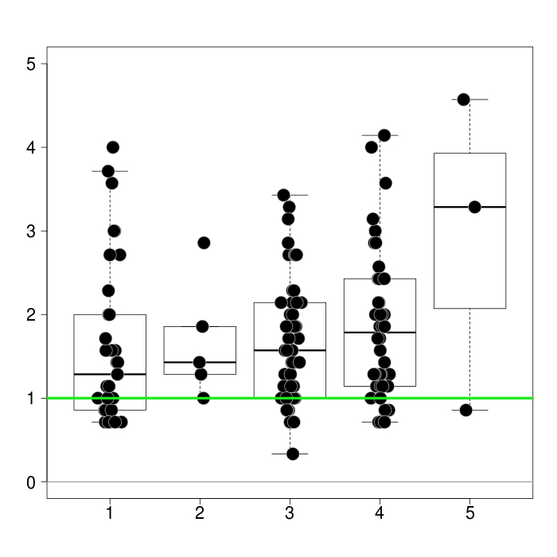
N=140
Asthma symptoms
18%
Strength of asthma medication

Slide 3
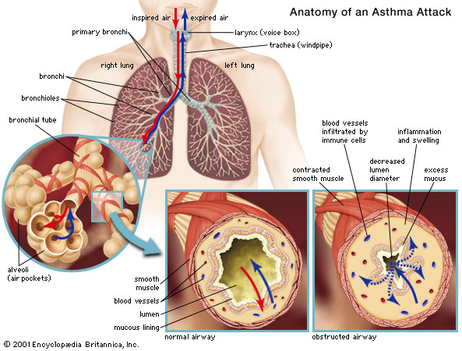
Improve Understanding and Treatment of Asthma
GENES
ENVIRONMENT
LIFESTYLE
DRUGS
10% prevalence in Australia
Only 13% with well controlled symptoms (Gold 2014, Respir Med)
  Non-compliant
  Non-respondent
36,000 hospital admissions, 400 deaths / year
Logistic, financial & personal burden
60% heritable

Slide 4
PRIOR TO 2006
SINCE 2006
Humans
Mouse
Genome-Wide Association Studies (GWAS)
Functional studies
“Candidate-Genes”
“Candidate-Genes”
Mouse
Functional studies
Validate in humans?
Genetic association studies
Clinical trials
Humans
Clinical trials

Slide 5
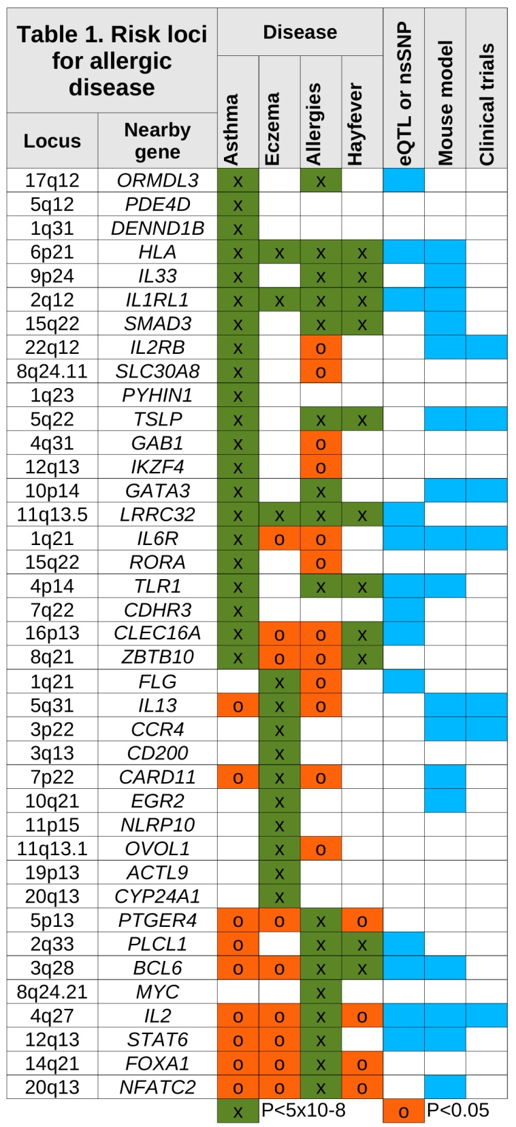
GWAS can point us to genes with therapeutic potential for asthma
Daclizumab
AMG157
SB010
Tocilizumab (our work)
Lebrikizumab and tralokinumab
Mogamulizumab
Daclizumab

Slide 6
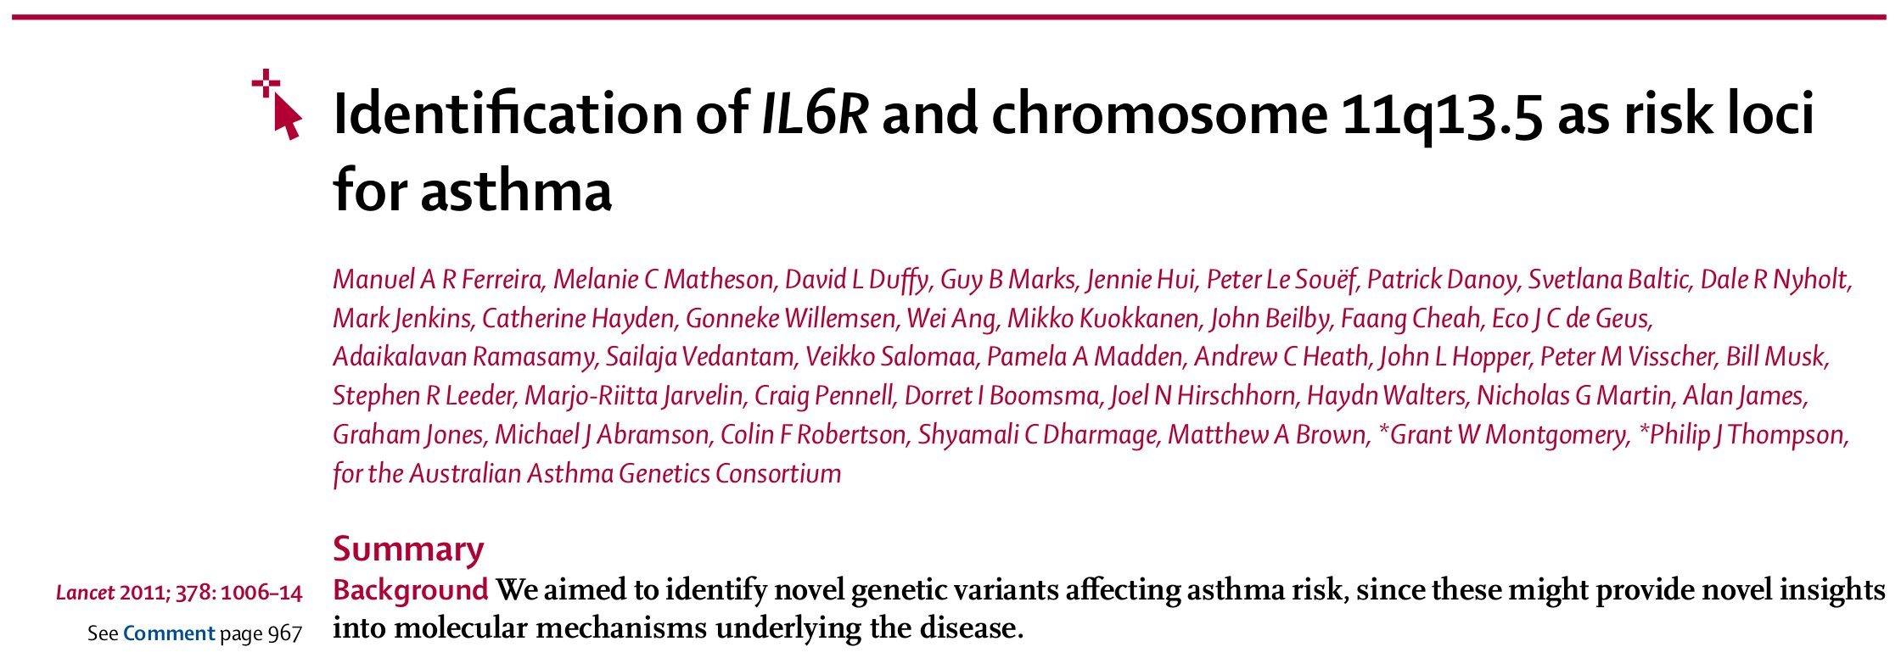
Translating GWAS findings into clinically useful knowledge
rs2228145

Slide 7
Asthma risk allele increases sIL-6R levels
Classical
RA, AS, CHD
Trans
Asthma
rs2228145:C

Slide 8
Tocilizumab inhibits both IL-6 signalling pathways
Classical
Rheum
Trans
Asthma
rs2228145:C
Tocilizumab
?

Slide 9


Pre-clinical studies of tocilizumab
Can tocilizumab prevent asthma exacerbations?
Is there a group of patients more likely to respond to tocilizumab?
Is it feasible and effective to deliver tocilizumab as an aerosol?
Ashik Ullah
Simon Phipps
UQ
in press, J Allergy Clin Immunology

Slide 10
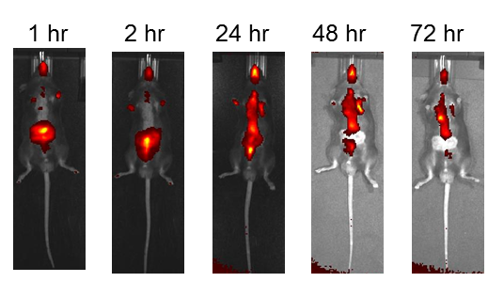
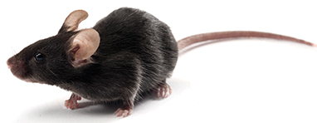

Experimental model of allergic asthma
i.n.
CHALLENGE
TREATMENT
ENDPOINTS
Mucus production and airway obstruction
Immune response in the airways:
  Cellular infiltration
  Cytokine production
G1: Vehicle None
G2: HDM Control IgG Ab
G3: HDM anti-IL-6R mAb
ie. tocilizumab

Slide 11
Anti-IL-6R treatment in HDM-induced asthma
Mucus production and airway obstruction:
Immune response:
HDM
Anti IL-6R
- + +
- - +

Slide 12
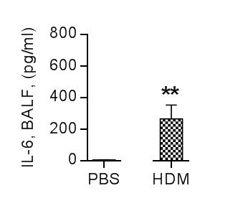
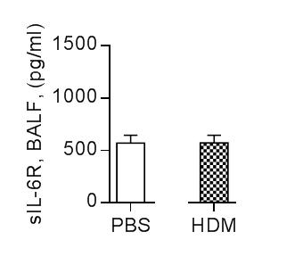
rs2228145:C increases sIL-6R
HDM induces IL-6 expression
HDM does not induce sIL-6R expression
NO ACTIVATION OF IL-6 TRANS-SIGNALLING PATHWAY

Slide 13
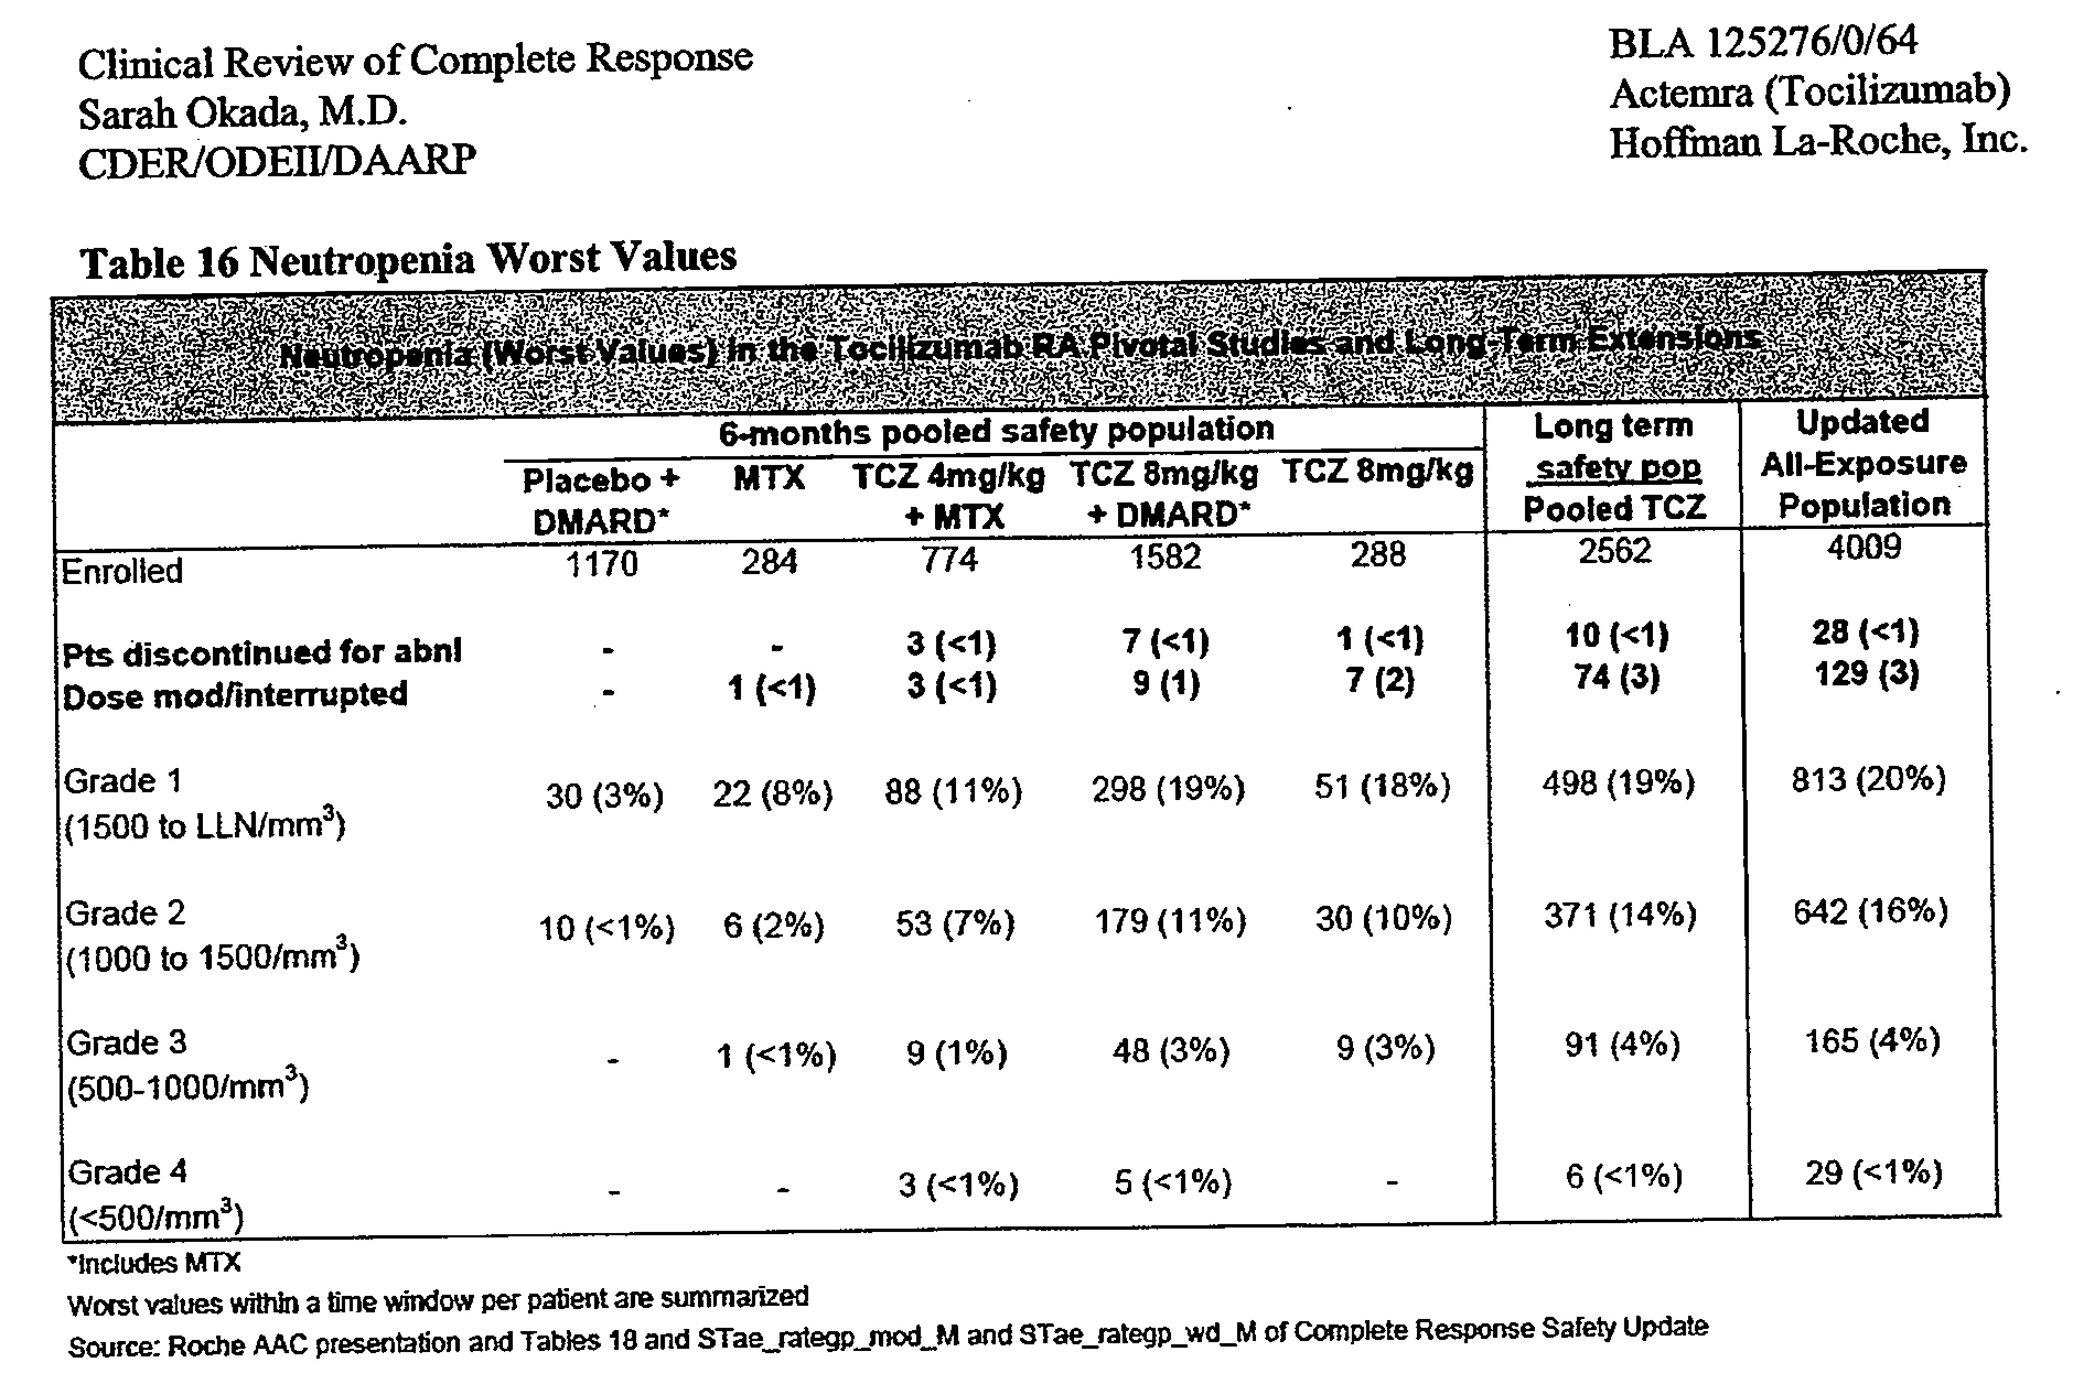
In humans, tocilizumab treatment reduces neutrophil counts

Slide 14
Anti-IL-6R treatment in Cockroach-induced asthma
Mucus production and airway obstruction: POSITIVE EFFECT AS FOR HDM
Immune response:
CR
CR

Slide 15
rs2228145:C increases sIL-6R
CR induces IL-6 expression
CR does induces sIL-6R expression
ACTIVATION OF IL-6 TRANS-SIGNALLING PATHWAY

Slide 16
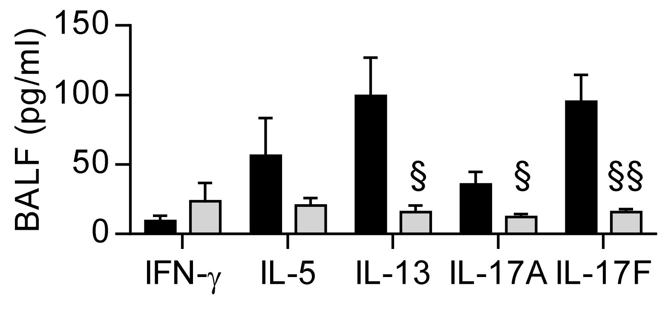
Is selective inhibition of IL-6 trans-signalling effective?
sgp130Fc instead of anti-IL-6R mAb
sIL-6R
sgp130Fc
m
Stefan Rose-John, University of Kiel
CR + PBS
CR + sgp130Fc

Slide 17
What did we learn from pre-clinical studies?
Allergic immune responses that induce both IL-6 and sIL-6R expression in the airways are most likely to respond to tocilizumab
Effectiveness of tocilizumab will likely be due to inhibition of IL-6 trans-signalling pathway, not classical signalling pathway.

Slide 18
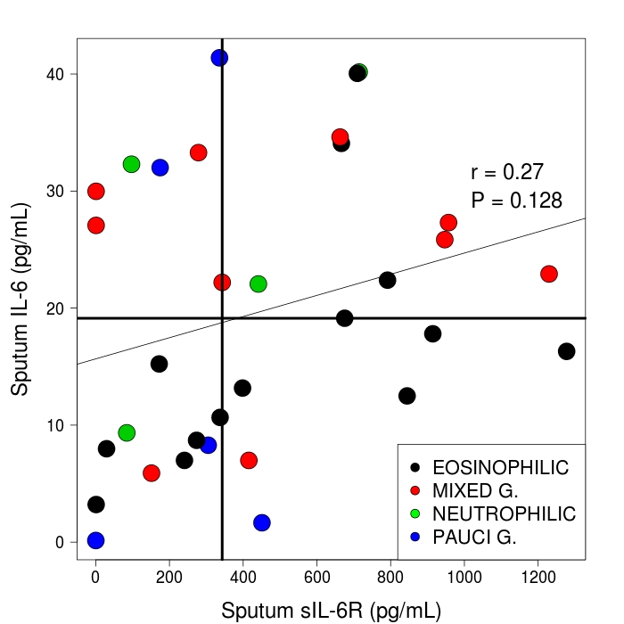
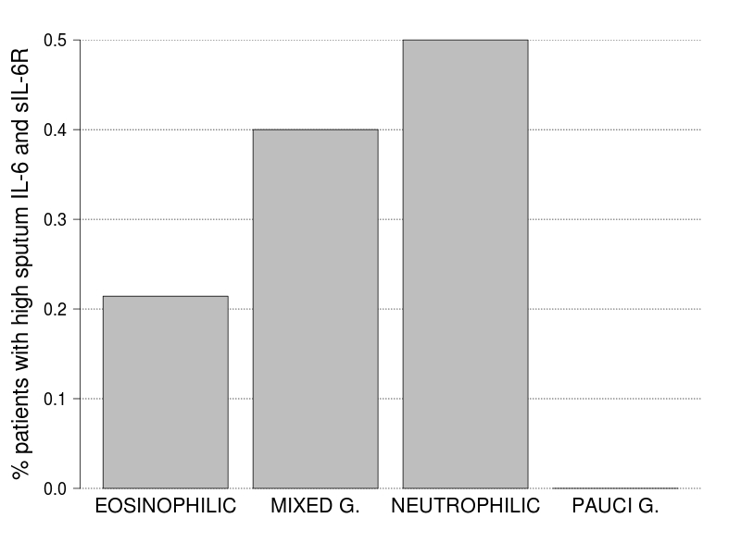
Results likely to extend to humans?
Mixed
60%
Eosinophilic
39%
Neutrophilic
33%
Pauci
31%

Slide 19
Clinical trial of tocilizumab in participants with asthma
sIL-6R > 415 pg/mL
Allergen challenge

Slide 20
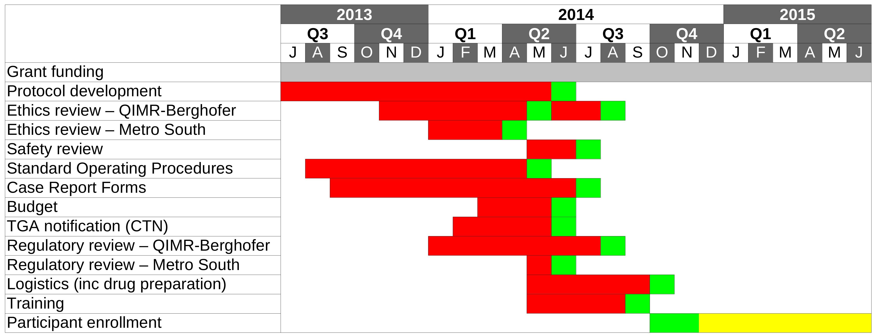
Progress on clinical trial

Slide 21

Acknowledgements
Ferreira lab
Cristina Vicente
Joana Revez
Grant Montgomery
Molecular Epidemiology Lab
Antiopi Varelias
David McNeilly
Alicia Rooney
Sashika Naidoo
Mark Smyth
Geoff Hill
Lisa Bain
Phipps lab, UQ
Zhixuan Loh
Jennifer Simpson
Vivian Zhang
Ashik Ullah
Simon Phipps
Tocilizumab trial
Gail Gauvreau, Rick Watson and Paul O’Byrne: McMaster University
John Upham, Michelle Towers: Translational Research Institute, UQ

