Slide 1
Biometrical model and introduction to genetic analysis
Manuel Ferreira
Queensland Institute of Medical Research
Australia
Boulder, 2015

Slide 2
Gene mapping
LOCALIZE and then IDENTIFY a locus that regulates a trait
Linkage analysis
Association analysis

Slide 3
If a locus regulates a trait:
Trait Mean in the population will be influenced by this locus.
And so will the Trait Variance and Covariance between relatives.
Association
Linkage

Slide 4
Revisit common genetic parameters - such as allele frequencies, genetic effects, dominance, variance components, etc
Use these parameters to construct a biometric genetic model
Model that expresses the:
Mean
Variance
Covariance between individuals
for a quantitative phenotype as a function of the genetic parameters of a given locus.
See how the biometric model provides a useful framework for linkage and association methods.

Slide 5
Outline
1. Genetic concepts
2. Very basic statistical concepts
3. Biometrical model
4. Introduction to genetic analysis

Slide 6
1. Genetic concepts

Slide 7
A. DNA level
DNA structure, organization
recombination
G
G
G
B. Population level
G
G
G
G
G
G
Allele and genotype frequencies
G
G
G
G
G
G
G
G
G
G
G
C. Transmission level
Mendelian segregation
G
G
Genetic relatedness
G
G
D. Phenotype level
Biometrical model
Additive and dominance components
P
P

Slide 8
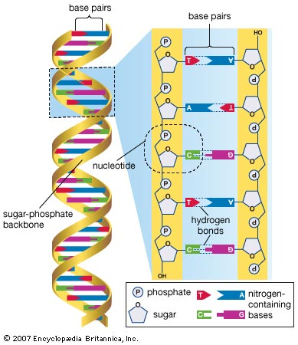
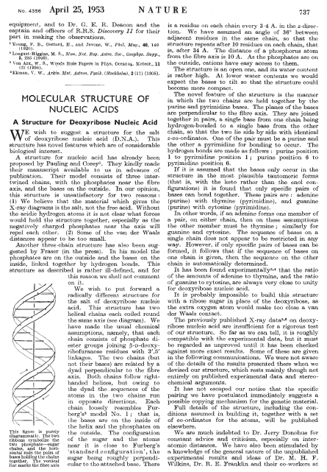
A. DNA level
Structure
1953 Watson & Crick
Bases: A, C, G, T
Notes:
W & C were the first to propose the correct structure of DNA in a short paper in 1953.
A DNA molecule contains two helical chains, held together side-by-side through hydrogen bonds.
The building block of each chain is a nucleotide, which contains a sugar residue, a phosphate group and a nitrogen-containing base.
The first two elements do not change between nucleotides. However, nucleotides can differ with respect to the base that they carry: Adenosine, cytosine, guanine and thymine.
It is the sequence of these 4 letters throughout our DNA that encodes all the necessary information to make all the proteins in our body.

Slide 9
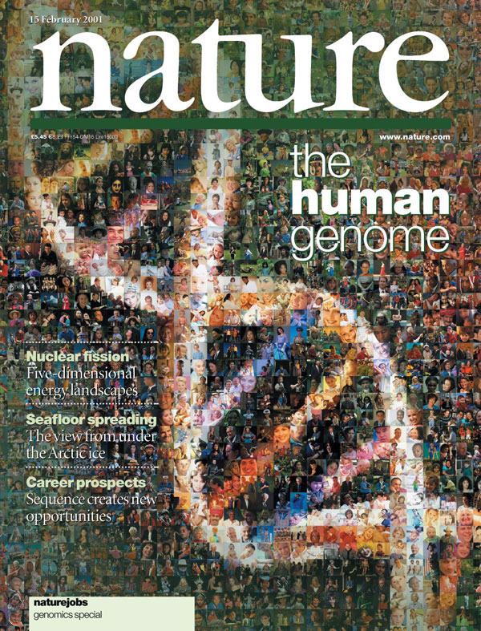
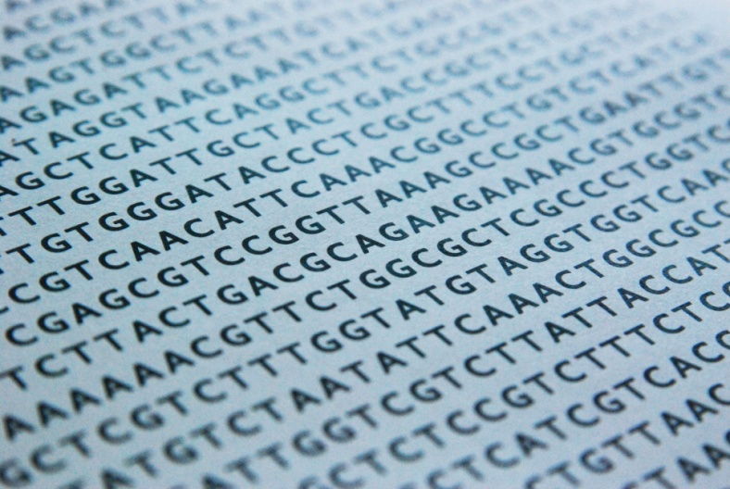
A. DNA level
Sequence
10 years
USD $3 billion
Sequence DNA of one single person
~ 3,000,000,000 nucleotides
2001
http://genome.ucsc.edu/cgi-bin/hgGateway
Notes:
It is therefore not surprising that one of the major scientific goals in the 1990s was to determine the entire sequence of our DNA.
This was achieved in 10 years, at a cost of $3 billion USD, involving researchers from all over the world.
What they did was to isolate the DNA from a single person, put it through very expensive machines and determine for one nucleotide after another, what was the base attached to it: and A, C, G or T.
They found that our DNA has ~3 billion nucleotides, and so 3 billion bases or letters whose sequence encodes ~20,000 genes.
This sequence was made freely available for anyone to use.

Slide 10
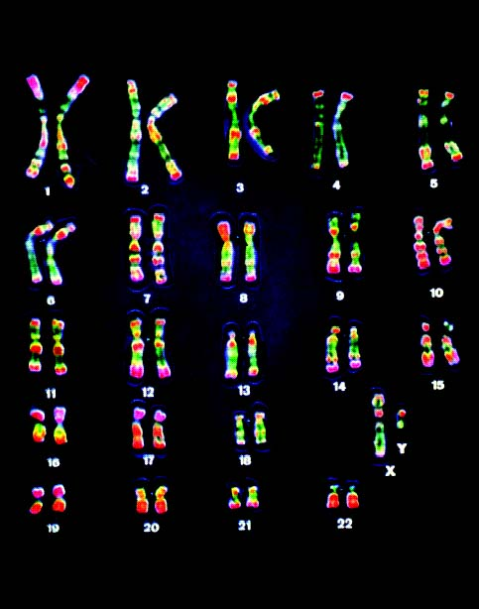
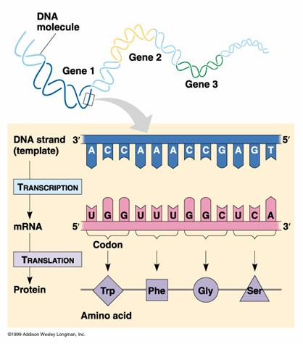
A. DNA level
Organization
23 pairs of chromosomes
“pairs”: one copy from father, one mother
~20,000 genes

Slide 11
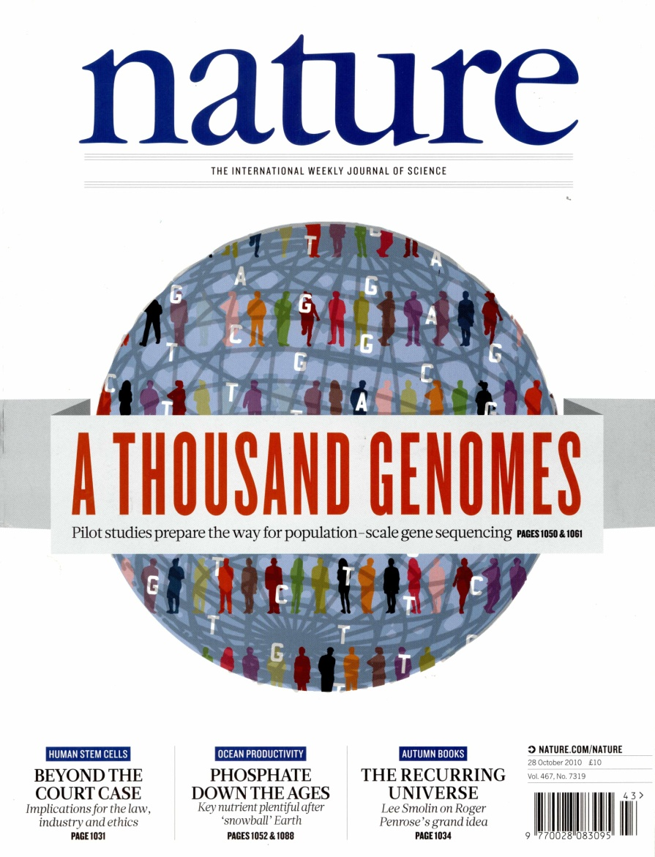
A. DNA level
Variation
Sequenced DNA of >1,000 individuals
5 years
Less than $5,000 per individual
~3,000,000,000 bases
~30,000,000
different
Contribute to making us different:
how we look
behave,
diseases,
etc
2010

Slide 12
A. DNA level
30,000,000 nucleotides where the base can differ between people
  Single Nucleotide Polymorphism, SNP
Genotype
Chrom.
DNA sequence
SNP 2
SNP 1
Mat
GTAACTTGGGATCTAGACCAGATAGAT
GTAACTTGGGATCTAGACCAGATAGAT
GTAACTTGGGATCTAGACCAGATAGAT
GTAACTTGGGATCTCGACCAGATAGAT
GTAACTTGGGATCTCGACCAGATAGAT
GTAACTTGGGATCTCGACCATATAGAT
Person 1
A A
G G
Pat
Mat
Person 2
A C
G G
Pat
Mat
Person 3
C C
G T
Pat
SNP 1
SNP 2
  Mutation that arose at some point in evolution
  Typically, each SNP has two alleles (bases)
  Each SNP is referred to by an “rs” number, eg. rs1006737

Slide 13
Other DNA
Polymorphisms:

Slide 14
B. Population level
1. Allele frequencies
A single locus, with two alleles
- Biallelic
- Single nucleotide polymorphism, SNP
A
a
a
a
a
A
a
a
A
A
A
Alleles A and a
- Frequency of A is p
- Frequency of a is q = 1 – p
A
a
a
A
A
A
A
A
a
A
A
a
A
A
a
a
A genotype is the combination of the two alleles
A
a
Aa

Slide 15
B. Population level
2. Genotype frequencies (Random mating)
Allele 1
A (p)
a (q)
A (p)
AA (p²)
Aa (pq)
Allele 2
a (q)
aA (qp)
aa (q²)
Hardy-Weinberg Equilibrium frequencies
P (AA) = p²
P (Aa) = 2pq
p² + 2pq + q² = 1
P (aa) = q²

Slide 16
C. Transmission level
Mendel’s law of segregation
eg CC
Mother (A₃A₄)
Segregation (Meiosis)
A₃ (½)
A₄ (½)
Gametes
A₁ (½)
A₁A₃ (¼)
A₁A₄ (¼)
Father
(A₁A₂)
A₂ (½)
A₂A₃ (¼)
A₂A₄ (¼)
eg CT

Slide 17
D. Phenotype level
1. Classical Mendelian traits
Dominant trait
- AA, Aa 1
- aa 0
Huntington’s disease
(CAG)n repeat, huntingtin gene
Recessive trait
- AA 1
- aa, Aa 0
Cystic fibrosis
3 bp deletion exon 10 CFTR gene

Slide 18
D. Phenotype level
2. Complex Quantitative traits
AA
Aa
aa
e.g. cholesterol levels

Slide 19
D. Phenotype level
3. Complex Disease traits
AA
Aa
aa
Disease liability
Controls
Cases

Slide 20
D. Phenotype level
Aa
P(X)
aa
AA
X
aa
Aa
AA
m

Slide 21
D. Phenotype level
P(X)
Aa
Biometric Model
aa
AA
X
aa
Aa
AA
m
– a
d
+a
Genotypic effect

Slide 22
2. Very basic statistical concepts

Slide 23
Mean, variance, covariance
1. Mean (X)
aa
aA
AA
0
1
2

Slide 24
Mean, variance, covariance
2. Variance (X)

Slide 25
Mean, variance, covariance
3. Covariance (X,Y)

Slide 26
3. Biometrical model

Slide 27
Biometrical model for single biallelic QTL
Biallelic locus
- Genotypes: AA, Aa, aa
- Genotype frequencies: p², 2pq, q²
Alleles at this locus are transmitted from P-O according to Mendel’s law of segregation
Genotypes for this locus influence the expression of a quantitative trait X (i.e. locus is a QTL)
Biometrical genetic model that estimates the contribution of this QTL towards the (1) Mean, (2) Variance and (3) Covariance between individuals for this quantitative trait X

Slide 28
Biometrical model for single biallelic QTL
1. Contribution of the QTL to the Mean (X)
e.g. cholesterol levels in the population
Genotypes
AA
Aa
aa
Effect, x
a
d
-a
Frequencies, f(x)
p²
2pq
q²
Mean (X)
= a(p²) + d(2pq) – a(q²)
= a(p-q) + 2pqd
Overall trait mean result of the contribution of hundreds of loci and environmental factors

Slide 29
Biometrical model for single biallelic QTL
2. Contribution of the QTL to the Variance (X)
Genotypes
AA
Aa
aa
Effect, x
a
d
-a
Frequencies, f(x)
p²
2pq
q²
Var (X)
= (a-m)²p² + (d-m)²2pq + (-a-m)²q²
= V_{QTL}
Heritability of X at this locus = V_{QTL} / V _{Total}
eg. SNP rs1234 explains 3% of the variation in cholesterol levels in the population.

Slide 30
Biometrical model for single biallelic QTL
Var (X)
= (a-m)²p² + (d-m)²2pq + (-a-m)²q²
m = a(p-q) + 2pqd
= 2pq[a+(q-p)d]² + (2pqd)²
= V_{AQTL} + V_{DQTL}
Demonstration: final 3 slides
Additive effects: the main effects of individual alleles
Dominance effects: represent the interaction between alleles

Slide 31
Biometrical model for single biallelic QTL
Var (X)
= 2pq[a+(q-p)d]² + (2pqd)²
d = 0 (no dominance)
= 2pqa²
– a
d
+a
+a
+a
m = 0
aa
Aa
AA
Additive model

Slide 32
Biometrical model for single biallelic QTL
d > 0 (dominance)
– a
d
+a
+a+d
+a-d
m = 0
aa
Aa
AA
Dominant model

Slide 33
Biometrical model for single biallelic QTL
d < 0 (dominance)
– a
d
+a
+a-d
+a+d
m = 0
aa
Aa
AA
Recessive model

Slide 34
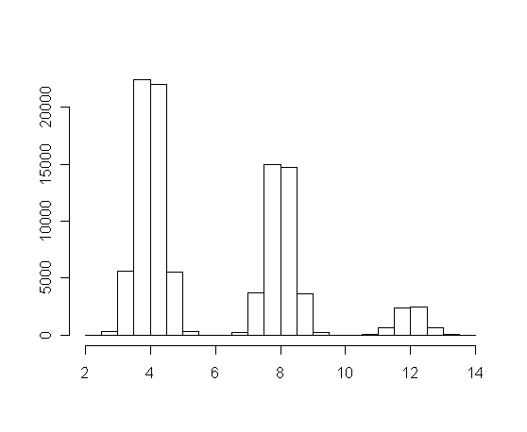
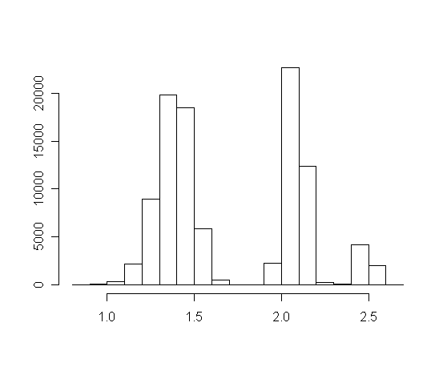
Statistical definition of dominance is scale dependent
+4
+4
+0.7
+0.4
log (x)
aa
Aa
AA
aa
Aa
AA
No departure from additivity
Significant departure from additivity

Slide 35
Biometrical model for single biallelic QTL
a
0
Genotypic mean
-a
aa
Aa
AA
aa
Aa
AA
aa
Aa
AA
aa
Aa
AA
Additive
Dominant
Recessive
Var (X) = Regression Variance + Residual Variance
= Additive Variance + Dominance Variance
= V_{AQTL} + V_{DQTL}

Slide 36
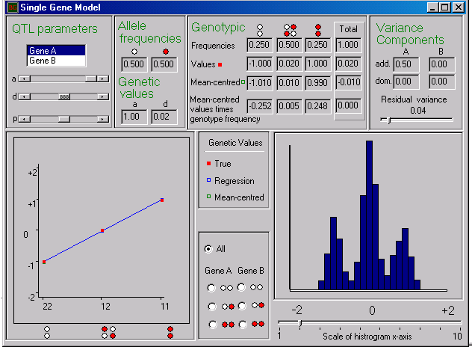
SGENE Practical
Shaun Purcell

Slide 37
Practical
Aim
Visualize graphically how allele frequencies, genetic effects, dominance, etc, influence trait mean and variance
Ex1
a=0, d=0, p=0.4, Residual Variance = 0.04, Scale = 2.
Vary a from 0 to 1.
Ex2
a=1, d=0, p=0.4, Residual Variance = 0.04, Scale = 2.
Vary d from -1 to 1.
Ex3
a=1, d=0, p=0.4, Residual Variance = 0.04, Scale = 2.
Vary p from 0 to 1.
Look at scatter-plot, histogram and variance components.

Slide 38
Some conclusions
Additive genetic variance depends on
allele frequency p
& additive genetic value a
as well as
dominance deviation d
Additive genetic variance typically greater than dominance variance

Slide 39
Biometrical model for single biallelic QTL
1. Contribution of the QTL to the Mean (X)
2. Contribution of the QTL to the Variance (X)
3. Contribution of the QTL to the Covariance (X,Y)

Slide 40
Biometrical model for single biallelic QTL
3. Contribution of the QTL to the Cov (X,Y)
AA
(a-m)
Aa
(d-m)
aa
(-a-m)
AA
(a-m)
(a-m)²
Aa
(d-m)
(a-m)
(d-m)
(d-m)²
aa
(-a-m)
(a-m)
(-a-m)
(d-m)
(-a-m)
(-a-m)²

Slide 41
Biometrical model for single biallelic QTL
3A. Contribution of the QTL to the Cov (X,Y) – MZ twins
AA
(a-m)
Aa
(d-m)
aa
(-a-m)
AA
(a-m)
p²
(a-m)²
Aa
(d-m)
0
(a-m)
(d-m)
2pq
(d-m)²
aa
(-a-m)
0
(a-m)
(-a-m)
0
(d-m)
(-a-m)
q²
(-a-m)²
Cov(X,Y)
= (a-m)²p² + (d-m)²2pq + (-a-m)²q²
= 2pq[a+(q-p)d]² + (2pqd)²
= V_{AQTL} + V_{DQTL}

Slide 42
Biometrical model for single biallelic QTL
3B. Contribution of the QTL to the Cov (X,Y) – Parent-Offspring
AA
(a-m)
Aa
(d-m)
aa
(-a-m)
AA
(a-m)
p³
(a-m)²
Aa
(d-m)
p²q
(a-m)
(d-m)
pq
(d-m)²
aa
(-a-m)
0
(a-m)
(-a-m)
pq²
(d-m)
(-a-m)
q³
(-a-m)²

Slide 43
e.g. given an AA father, an AA offspring can come from either AA x AA or AA x Aa parental mating types
AA x AA will occur p² × p² = p⁴
and have AA offspring Prob()=1
AA x Aa will occur p² × 2pq = 2p³q
and have AA offspring Prob()=0.5
and have Aa offspring Prob()=0.5
Therefore, P(AA father & AA offspring) = p⁴ + 2p³q x 0.5
= p³(p+q)
= p³

Slide 44
Biometrical model for single biallelic QTL
3B. Contribution of the QTL to the Cov (X,Y) – Parent-Offspring
AA
(a-m)
Aa
(d-m)
aa
(-a-m)
AA
(a-m)
p³
(a-m)²
Aa
(d-m)
p²q
(a-m)
(d-m)
pq
(d-m)²
aa
(-a-m)
0
(a-m)
(-a-m)
pq²
(d-m)
(-a-m)
q³
(-a-m)²
Cov (X,Y)
= (a-m)²p³ + … + (-a-m)²q³
= pq[a+(q-p)d]²
= ½V_{AQTL}

Slide 45
Biometrical model for single biallelic QTL
3C. Contribution of the QTL to the Cov (X,Y) – Unrelated individuals
AA
(a-m)
Aa
(d-m)
aa
(-a-m)
AA
(a-m)
p⁴
(a-m)²
Aa
(d-m)
2p³q
(a-m)
(d-m)
4p²q²
(d-m)²
aa
(-a-m)
p²q²
(a-m)
(-a-m)
2pq³
(d-m)
(-a-m)
q⁴
(-a-m)²
Cov (X,Y)
= (a-m)²p⁴ + … + (-a-m)²q⁴
= 0

Slide 46
Biometrical model for single biallelic QTL
3D. Contribution of the QTL to the Cov (X,Y) – DZ twins and full sibs
¼ genome
¼ genome
¼ genome
¼ genome
# identical alleles inherited from parents
2
1
(father)
1
(mother)
0
¼ (2 alleles) + ½ (1 allele) + ¼ (0 alleles)
MZ twins
P-O
Unrelateds
Cov (X,Y)
= ¼ Cov(MZ) + ½ Cov(P-O) + ¼ Cov(Unrel)
= ¼(V_{AQTL}+V_{DQTL}) + ½ (½ V_{AQTL}) + ¼ (0)
= ½ V_{AQTL} + ¼V_{DQTL}

Slide 47
Summary so far…

Slide 48
Biometrical model predicts contribution of a QTL to the mean, variance and covariances of a trait
Association analysis
Mean (X)
= a(p-q) + 2pqd
Var (X)
= 2pq[a+(q-p)d]² + (2pqd)²
= V_{AQTL} + V_{DQTL}
Cov (MZ)
= V_{AQTL} + V_{DQTL}
Linkage analysis
Cov (DZ)
= ½V_{AQTL} + ¼V_{DQTL}
On average!
0, 1/2 or 1
0 or 1
For a given locus, do two sibs have 0, 1 or 2 alleles in common?
IBD estimation / Linkage

Slide 49
4. Introduction to genetic analysis

Slide 50
For a heritable trait...
Linkage:
localize region of the genome where a variant that regulates the trait is likely to be harboured
Family-specific phenomenon:
Affected individuals in a family share the same
ancestral predisposing DNA segment at a given locus
Can only detect very large effects
Association:
identify a variant that regulates the trait
Population-specific phenomenon:
Affected individuals in a population share the same
predisposing DNA segment at a given locus
Can detect weaker effects

Slide 51
Families
Cases
Controls
No Linkage
No Association
Linkage
No Association
Linkage
Association

Slide 52
Linkage analysis: tests co-segregation between an allele
and a trait in a family
If a locus truly regulates the expression of a phenotype, then two
relatives with similar phenotypes should have inherited from a common
ancestor the same DNA segment (allele) at a marker near the trait locus.
Interest: correlation between phenotypic similarity and genetic similarity at a locus

Slide 53
Phenotypic similarity between relatives
Squared trait differences
Squared trait sums
Trait cross-product
Trait variance-covariance matrix
Affection concordance
T₂
T₁

Slide 54
Genotypic similarity between relatives
IBS Alleles shared Identical By State “look the same”, may have the
same DNA sequence but they are not necessarily derived from a
known common ancestor
M₁
M₂
M₃
M₃
IBD Alleles shared
Identical By Descent
are a copy of the
same
ancestor
allele
Q₁
Q₂
Q₃
Q₄
M₁
M₂
M₃
M₃
Q₁
Q₂
Q₃
Q₄
IBS
IBD
M₁
M₃
M₁
M₃
2
1
Q₁
Q₃
Q₁
Q₄
Inheritance vector (M)
0
0
0
1
1

Slide 55
Genotypic similarity between relatives -
Inheritance vector (M)
Number of alleles shared IBD
Proportion of alleles shared IBD -
M₁
M₃
M₂
M₃
0
0
1
1
0
0
Q₁
Q₃
Q₂
Q₄
M₁
M₃
M₁
M₃
0
0
0
1
1
0.5
Q₁
Q₃
Q₁
Q₄
M₁
M₃
M₁
M₃
0
0
0
0
2
1
Q₁
Q₃
Q₁
Q₃

Slide 56
Var (X)
= V_{AQTL} + V_{DQTL}
Cov (MZ)
= V_{AQTL} + V_{DQTL}
Cov (DZ)
= ½V_{AQTL} + ¼V_{DQTL}
On average!
Cov (DZ) =
V_{AQTL} + V_{DQTL}
For a given locus
Cov (DZ) =
V_{AQTL}

Slide 58
Should we still use linkage analysis?
Given dense SNP data
Rare genetic variants (not covered by the genotyping platform)
... or allelic heterogeneity (multiple disease variants in the same gene)
*AND* strong effect on phenotype...
Linkage analysis can complement association and provide an additional approach to localise a disease locus (with no loss).

Slide 59
Association analysis: tests co-occurrence between an allele
and a trait in the population
If a locus truly regulates the expression of a phenotype, then unrelated individuals with the same phenotype will often have the same predisposing DNA segment (allele) at a given locus.
Interest: relationship between phenotype status and DNA variation at a locus

Slide 60
What is the question we want to answer?
Does DNA variation associate significantly with disease status?
eg. SNP with
T or C alleles
Allele T
vs
Allele C
Asthmatics
vs
Non-asthmatics
Measure of association:
a/b
Odds Ratio =
c/d
OR = 1
No association
OR > 1
T increases risk
Allelic test of association
OR < 1
T decreases risk

Slide 61
SNP with 2 alleles:
Asthmatics
Non-asthmatics
400
600
400
600
450
550
400
600
Level of significance:
1000
1000
P-value (X²=5.12, df=1) = 0.024
850
1150
2000

Slide 62
Other tests of association for disease traits
Logistic regression include covariates
Fisher’s exact test rare variants
Genotypic tests dominant, recessive
etc
Common test of association for continuous traits
Linear regression Trait = α + β x SNP
SNP: 0, 1 or 2 copies of minor allele (a)
β = 0
No association
Trait levels
β > 0
a increases trait levels
β < 0
a decreases trait levels
0
1
2
AA
Aa
aa

Slide 63
Biometrical model for single biallelic QTL
1/3
2A. Average allelic effect (α)
The deviation of the allelic mean from the population mean
Allele a
Population
Allele A
Mean (X)
?
a(p-q) + 2pqd
?
a
A
α_{a}
α_{A}
AA Aa aa
a d -a
Allelic mean Average allelic effect (α)
A p q ap+dq q(a+d(q-p))
a p q dp-aq -p(a+d(q-p))

Slide 64
Biometrical model for single biallelic QTL
2/3
Denote the average allelic effects
- α_{A} = q(a+d(q-p))
- α_{a} = -p(a+d(q-p))
If only two alleles exist, we can define the average effect of allele substitution
- α = α_{A} - α_{a}
- α = (q-(-p))(a+d(q-p)) = (a+d(q-p))
Therefore:
- α_{A} = qα
- α_{a} = -pα

Slide 65
Biometrical model for single biallelic QTL
3/3
2A. Average allelic effect (α)
2B. Additive genetic variance
The variance of the average allelic effects
α_{A} = qα
α_{a} = -pα
Freq.
Additive effect
AA
p²
2α_{A}
= 2qα
Aa
2pq
α_{A} + α_{a}
= (q-p)α
aa
q²
2α_{a}
= -2pα
V_{AQTL}
= (2qα)²p² + ((q-p)α)²2pq + (-2pα)²q²
= 2pqα²
= 2pq[a+d(q-p)]²
d = 0, V_{AQTL}= 2pqa²
p = q, V_{AQTL}= ½a²

