Slide 1
Mendelian Randomization: Genes as Instrumental Variables
David Evans

Slide 2
Some Criticisms of GWA Studies…
So you have a new GWAS hit for a disease… so what!?
You can’t change people’s genotypes (at least not yet)
You can however modify people’s environments…
Mendelian Randomization is a method of using genetics to inform us about associations in traditional observational epidemiology

Slide 3
RCTs are the Gold Standard in Inferring Causality
RANDOMISED CONTROLLED TRIAL
RANDOMISATION METHOD
EXPOSED:
INTERVENTION
CONTROL:
NO INTERVENTION
CONFOUNDERS EQUAL BETWEEN GROUPS
OUTCOMES COMPARED BETWEEN GROUPS

Slide 4
Observational Studies
RCTs are expensive and not always ethical or practically feasible
Association between environmental exposures and disease can be assessed by observational epidemiological studies like case-control studies or cohort studies
The interpretation of these studies in terms of causality is problematic

Slide 5
CHD risk according to duration of current Vitamin E
supplement use compared to no use
RR
Rimm et al NEJM 1993; 328: 1450-6

Slide 6
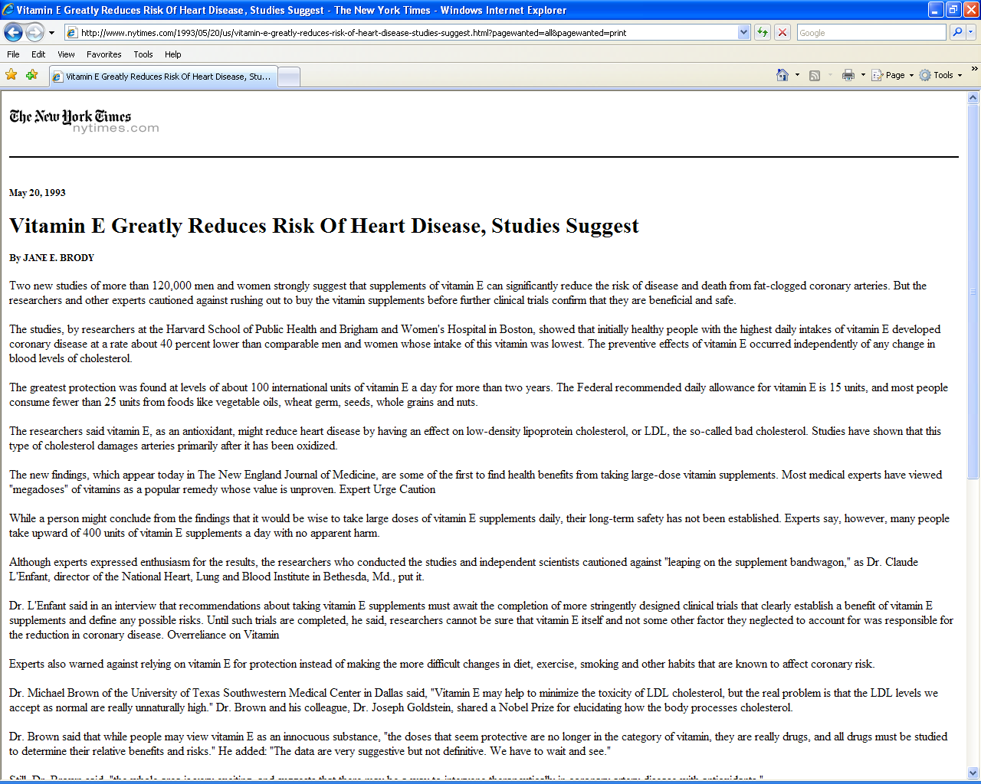

Slide 8
Use of vitamin supplements by US adults, 1987-2000
Percent
Source: Millen AE, Journal of American Dietetic Assoc 2004;104:942-950

Slide 9
Vitamin E levels and risk factors: Women’s Heart Health Study
Childhood SES
Manual social class
No car access
State pension only
Smoker
Daily alcohol
Exercise
Low fat diet
Obese
Height
Leg length
Lawlor et al, Lancet 2004

Slide 10
Vitamin E supplement use and risk of Coronary Heart Disease
1.0
Stampfer et al NEJM 1993; 328: 144-9; Rimm et al NEJM 1993; 328: 1450-6; Eidelman et al Arch Intern Med 2004; 164:1552-6

Slide 11
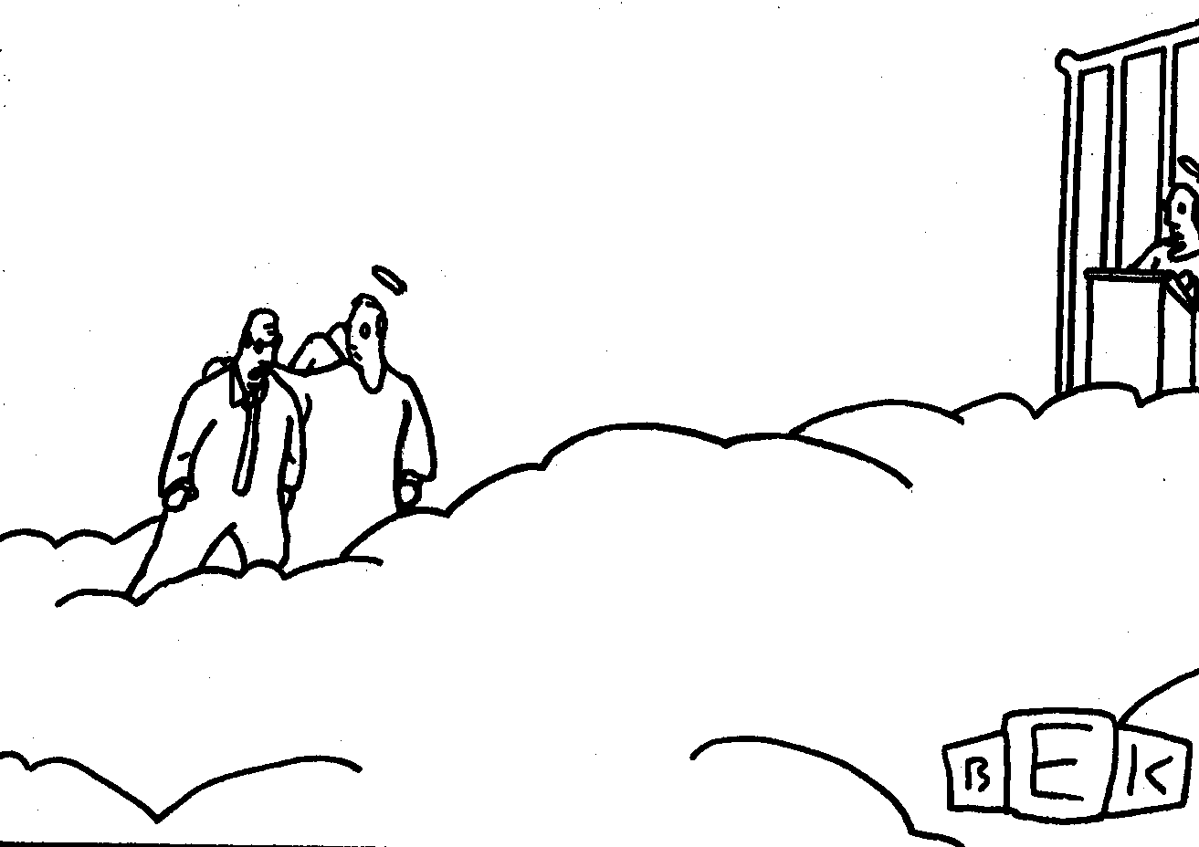
“Well, so much for antioxidants.”

Slide 12
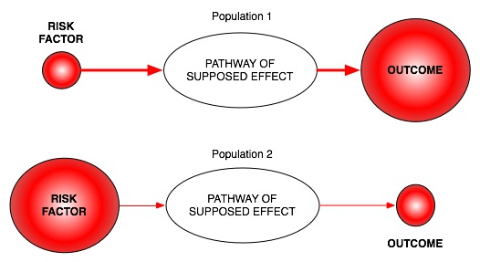
Classic limitations to “observational” science
Confounding
Reverse Causation
Bias

Slide 13
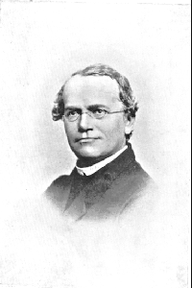
An Alternative to RCTs: Mendelian randomization
In genetic association studies the laws
of Mendelian genetics imply that
comparison of groups of individuals
defined by genotype should only differ
with respect to the locus under study
(and closely related loci in linkage
disequilibrium with the locus under study)
Genotypes can proxy for some modifiable
risk factors, and there should
be no confounding of genotype by
behavioural, socioeconomic or
physiological factors (excepting those
influenced by alleles at closely proximate
loci or due to population stratification)
Mendel in 1862

Slide 14
Mendelian randomisation and RCTs
MENDELIAN RANDOMISATION
RANDOMISED CONTROLLED TRIAL
RANDOM SEGREGATION OF ALLELES
RANDOMISATION METHOD
EXPOSED: FUNCTIONAL ALLELLES
CONTROL: NULL ALLELLES
EXPOSED:
INTERVENTION
CONTROL:
NO INTERVENTION
CONFOUNDERS EQUAL BETWEEN GROUPS
CONFOUNDERS EQUAL BETWEEN GROUPS
OUTCOMES COMPARED BETWEEN GROUPS
OUTCOMES COMPARED BETWEEN GROUPS

Slide 15
LDL and Coronary Heart Disease
MENDELIAN RANDOMISATION
RANDOMISED CONTROLLED TRIAL
RANDOM SEGREGATION OF ALLELES
RANDOMISATION METHOD
EXPOSED:
Genotype AA
(LDL LOW)
CONTROL:
Genotype aa
(LDL HIGH)
EXPOSED:
STATIN
(LDL LOW)
CONTROL:
PLACEBO
(LDL HIGH)
CONFOUNDERS EQUAL BETWEEN GROUPS
CONFOUNDERS EQUAL BETWEEN GROUPS
RISK OF CORONARY HEART DISEASE
RISK OF CORONARY HEART DISEASE

Slide 16
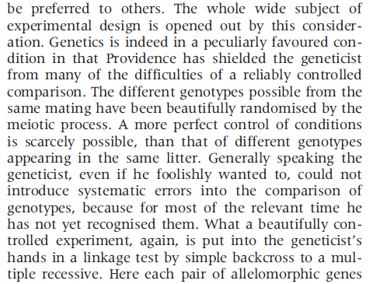
MR - History
Fisher (1951) Bateson Lecture

Slide 17
Why Perform MR?
To “prove” a causal relationship
Useful in genomics studies
To estimate the magnitude of a causal association
Useful in drug development
Useful in public health

Slide 18
MR Core Assumptions
U
Z
X
Y
(1) Z is associated with X
(2) Z is not associated with U
(3) Z is only associated with Y possibly through X
(4) Structural assumption

Slide 19
Estimation
“Wald” Estimator
Z
X
Y
SEs by e.g. Fieller’s Theorem
Two stage least square (2SLS)
Regress X on Z, regress Y on predicted values from
the first regression, adjust standard errors

Slide 20
MR Example- CRP and BMI
C-Reactive Protein (CRP) is a biomarker of inflammation
It is associated with BMI, metabolic syndrome, CHD and a number of other diseases
It is unclear whether these observational relationships are causal or due to confounding or reverse causality
This question is important from the perspective of drug development

Slide 21
MR Example – CRP and BMI
U
FTO
BMI
CRP

Slide 22
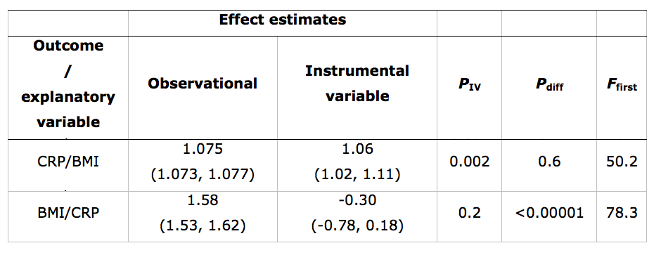
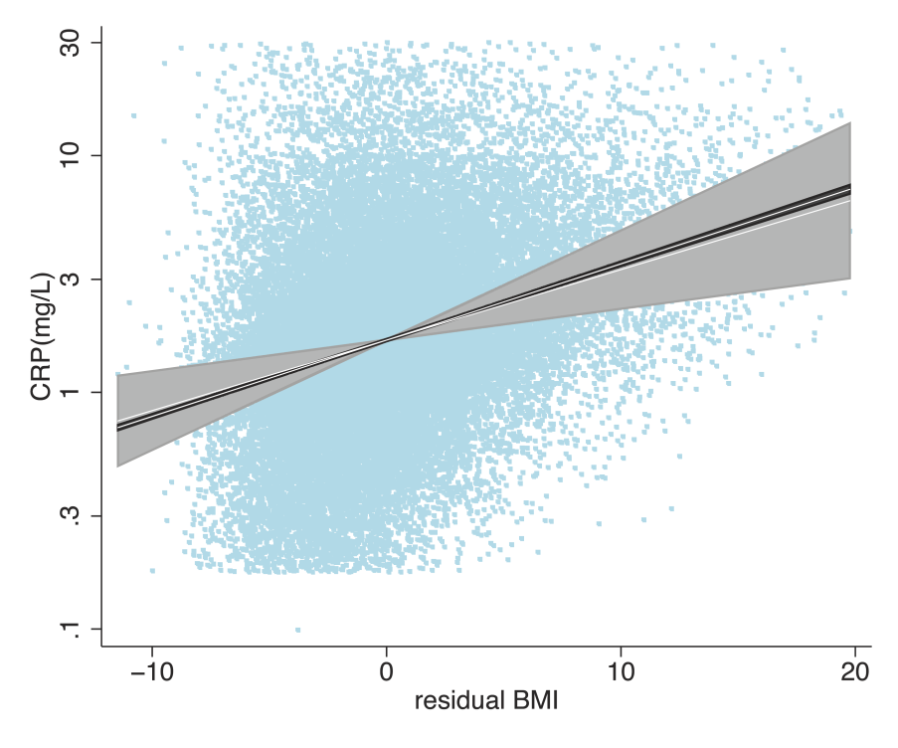

Slide 23
MR Example – CRP and BMI (Bidirectional MR)
U
CRP
variant
CRP
BMI

Slide 24
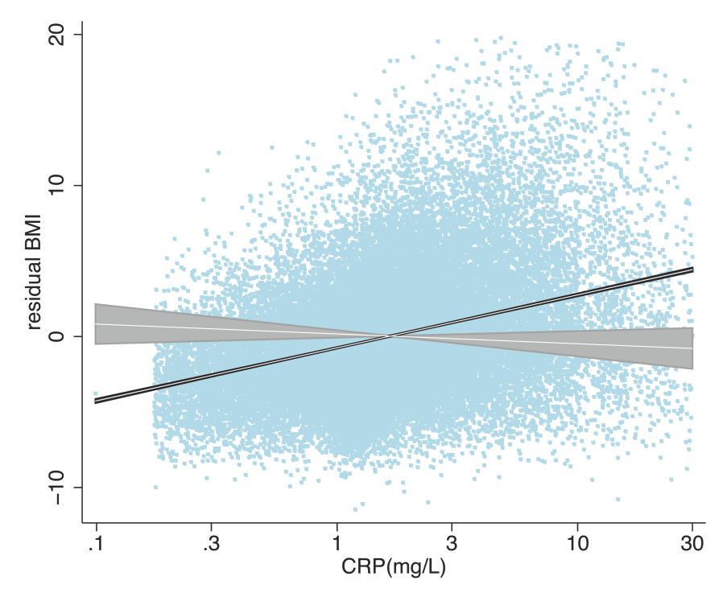

Slide 25
Limitations to Mendelian Randomisation
(and how to overcome them)
1- The existence of instruments
2- Power/weak instruments (Increase N; multiple instruments)
3- Population stratification (methods to control this)
4- Canalization (animal models?)
5- Pleiotropy (cis variants; IV estimate heterogeneity)

Slide 26
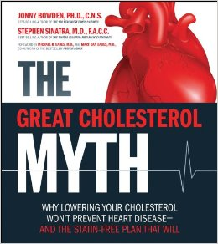
LDL and CHD Risk

Slide 27
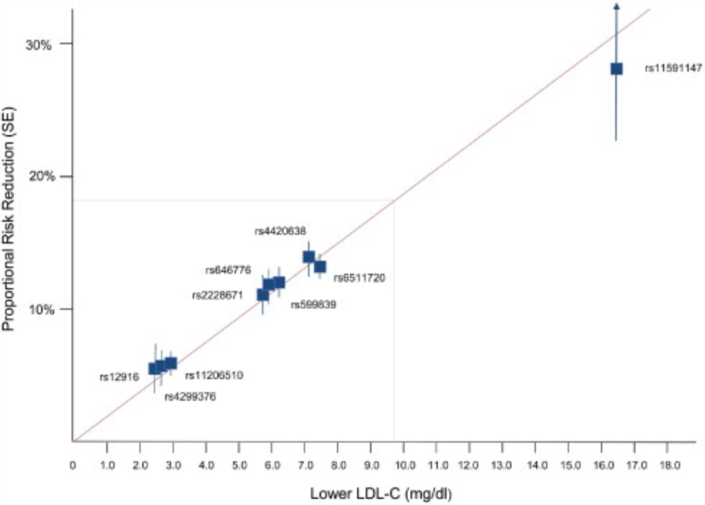
LDL and CHD Risk
Ference et al, JACC 2012

Slide 28
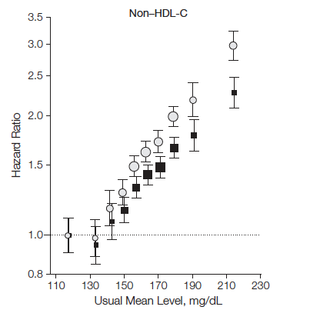
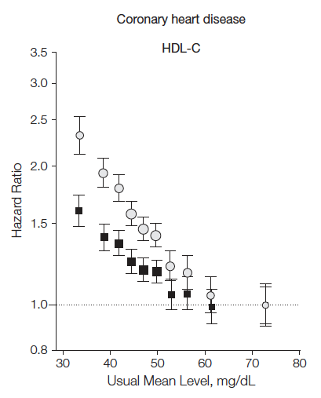
HDL and CHD (with thanks Sek Kathiresan)
LDL-C
HDL-C
‘Bad’ cholesterol
‘Good’ cholesterol
302K participants in 68 prospective studies
Emerging Risk Factors Collaboration, JAMA 2009

Slide 29
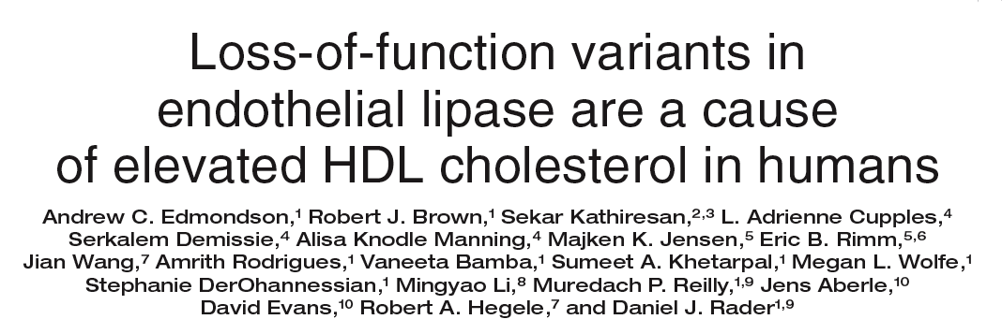
HDL: endothelial lipase Asn396Ser
2.6% of population carry Serine allele
higher HDL-C
No effect on other lipid fractions
No effect on other MI risk factors
Edmondson, J Clin Invest 2009

Slide 30
LIPG N396S and plasma HDL-C
HDL Difference
396S carriers have
5.5 mg/dl higher HDL-C
P<10⁻⁸

Slide 31
How is this experiment “nature’s randomized trial”?
Variable | 396S Non-carrier | 396S Carrier | P value
Male sex | 45% | 45% | NS
Age | 54.2 | 54.3 | NS
Current smoker | 24% | 19% | NS
Body-mass index | 27 | 27 | NS
LDL-C mg/dl | 138 | 141 | NS
HDL-C mg/dl | 51 | 57 | <0.0001
Carriers and non-carriers are alike in every characteristic except biomarker of interest
396S carriers are analogous to having received a “drug” lifelong that raises HDL by ~6 mg/dl

Slide 32
Test LIPG 396Ser for association with MI in the population

Slide 33
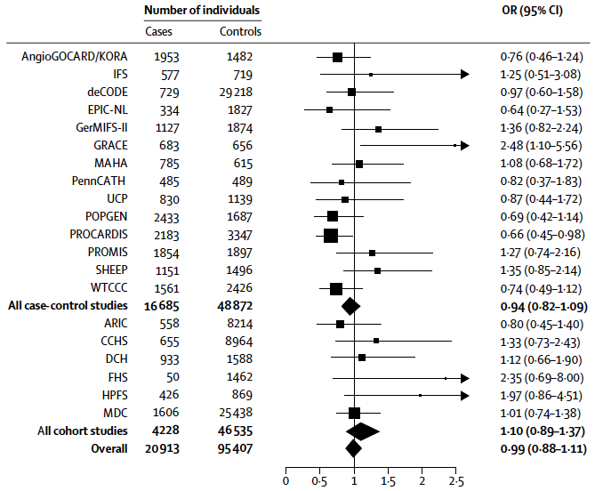
After testing in 116,320 people, summary OR for LIPG Asn396Ser is 0.99

Slide 34
Treatment with dalcetrapib raised HDL-C by 30% but did NOT lower risk for MI
Dalcetrapib
Randomized Control Trial
Sample
Randomisation
Dalcetrapib
Control
HDL cholesterol
30% higher
HDL cholesterol
unchanged
CV event
rate
CV event
rate

Slide 35
May 7, 2012: Dalcetrapib trial suspended due to futility
16,000-person randomized controlled trial

Slide 36
HDL cholesterol remains a useful marker of MI risk and should continue to be measured routinely to assess risk

Slide 37
MR Future Directions
Drug development
Prioritizing compounds for development
On versus off target effects
Two-step MR / Network / Mediation analysis
Two sample MR

Slide 38
Mini-Practical Fitting 2SLS in R

Slide 39
Simulation
U
-0.9
0.9
Z
X
Y
0.1

