Slide 1
GCTA: Extensions and Challenges
International Workshop on Statistical Methods for Human Complex Traits
Boulder, CO, March 2015
Lindon Eaves, Beate St. Pourcain, Teresa de Candia, Matt Keller, Rasool Tahmasabi,
Greg Carey, Rob Kirkpatrick, Mike Neale, David Evans

Slide 2
“Quantitative Genetics”
Estimates genetic (and environmental) contribution to variation by regressing measures of phenotypic similarity on genetic (and environmental) similarity

Slide 3
Classical Approach (Fisher, Wright, Falconer, Mather etc.)
Estimates genetic correlation from expected genetic resemblance based on genetic relatedness (MZ, DZ twins, siblings, half-siblings, cousins etc.)

Slide 4
“GCTA”
“Genome-Wide Complex Trait Analysis”
Visscher, Yang, Lee, Goddard
Estimates genetic correlation from empirical genetic resemblance of “unrelated” individuals based on identity by state across using genome-wide single nucleotide polymorphisms (“SNPs”)

Slide 5
Basic GCTA Model
V = G + E
V=Phenotypic variance between individuals
G=(Additive) genetic variance
E=(Unique) environmental variance
Σ= AG + IE
Where Σ = expected phenotypic covariance matrix between individuals; A = empirical genetic relatedness matrix between individuals

Slide 6
BUT….
Humans are “More than” individual packets of DNA – have families, feet, brains and communities
Genetic Effects on Behavioral phenotype extend beyond individual

Slide 7
Causes of Family Resemblance
r
r
Mother
E
Father
G
E
G
h
e
1/2
h
e
1/2
m
P
P
b
b
G=Genotype
E=Environment
P=Phenotype
E
G
h’
e’
Offspring
P

Slide 8
Extending the Phenotype
World
Parents
Me
Spouse
Siblings
Child
Extended Phenotype
Eaves et al., 2005,
In Kendler and Eaves, 2005.

Slide 9
Can analyze in family studies e.g. twins and kinships of twins (Workshop “Year 1”)

Slide 10
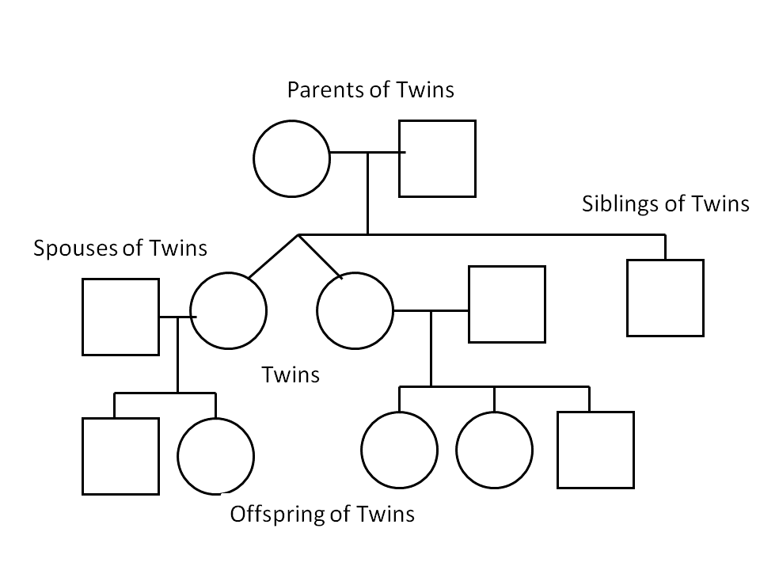

Slide 11
Questions for GCTA:
1. What can go wrong with GCTA if you ignore other genetic and environmental processes known to affect variation in natural populations and human traits? [Negative heuristic]
2 How might GCTA be enhanced to encompass some of the subtleties of quantitative inheritance recognized in plant and animal species and human kinship studies? [Positive heuristic]

Slide 12
This afternoon
1. Including genotypes of relatives in GCTA: Eaves, St. Pourcain, Evans
2. Multivariate structural models in GCTA (development, causal models, family data)
St. Pourcain, Carey
3. Implementing more advanced GCTA models in OpenMx. Kirkpatrick, Neale.
4. The effects of assortative mating. De Candia, Keller, Tahmasabi, Carey.
ALL IS “WORK IN PROGRESS”

Slide 13
Environmental Effects of the Maternal Genotype Lindon Eaves, Dave Evans, Beate St. Pourcain.

Slide 14
Reference:
Eaves LJ, St. Pourcain B, Davey-Smith G, York TP, Evans DM. (2014) Resolving the effects of maternal and offspring genotype on dyadic outcomes in Genome Wide Complex Trait Analysis (“M-GCTA”). Behavior Genetics, 44:445-555.

Slide 15
“The Genetic Environment” A Place to Start: M-GCTA Include effects of the Maternal Genotype on Offspring Behavior (“Genetic Maternal Effects”)
Extensive background in plant and animal genetics (reciprocal crosses, diallels, dam and sire effects)
Good models and examples from human studies (extended kinships of twins, maternal and paternal half-sibships)
Extensively measured and genotyped mother-child pairs (e.g. “ALSPAC”)

Slide 16
Path model for offspring and maternal effects in mother-child dyads.
G_{CM}
Maternal genotype
P
Phenotype
¹/₂
e
h
E
G_{CC}
Environment
Offspring genotype
Offspring

Slide 17
Path model for offsrpring and maternal effects in mother-child dyads.
Maternal
G_{MM}
G_{CM}
Maternal genotype
m
P
Phenotype
(Dyadic)
¹/₂
¹/₂
e
h
E
G_{MC}
G_{CC}
Environment
Maternal
Offspring genotype
Offspring

Slide 18
Path model for offspring and maternal effects in mother-child dyads.
Maternal
Offspring
G_{MM}
G_{CM}
Maternal genotype
m
P
Phenotype
(Dyadic)
¹/₂
¹/₂
e
c
h
E
G_{MC}
G_{CC}
Environment
Maternal
Offspring genotype
Offspring

Slide 19
Basic model for components of variance
V = h² + c² + m² + mc + e² (path model)
Or:
V = G + M + Q + E
(Biometrical-genetic model where:
M=m², G=(c² + h²) and Q = mc)
V=Phenotypic variance
G=(Additive) genetic variance (“A” in ACE model)
M=Shared environmental variance due to indirect effects of maternal genotype on offspring phenotype (“genetic maternal effects”)
Q=Covariance arising from overlap between genes with direct and indirect effect (“passive rGE”, +ve or –ve) (M+Q->”C” in ACE model)

Slide 20
Pattern of Genetic Relatedness Within and Between
Typical Unrelated Mother-Child Pairs
Pair i
Pair j
α_{ij}
G_{Mi}
G_{Mj}
Mother
γ_{i}
δ_{ij}
δ_{ji}
γ_{j}
G_{Ci}
G_{Cj}
Offspring
β_{ij}
Εγ_{i}=¹/₂

Slide 21
Including Offspring Phenotype in Genetic Model
Genes with offspring-specific effects
α_{ij}
Mother-child
Pair “I”
CM_{i}
CM_{j}
Mother-child
Pair “j”
α_{ij}
MM_{i}
γ_{i}
γ_{j}
MM_{j}
δ_{ji}
δ_{ij}
CC_{i}
CC_{j}
m
m
h
β_{ij}
γ_{j}
γ_{i}
P_{i}
h
P_{j}
δ_{ji}
δ_{ij}
c
Environment
“Residuals”
c
e
E_{i}
E_{j}
e
MC_{i}
MC_{j}
β_{ij}
Genes with maternal effects (may also have direct expression in child)

Slide 22
Components of genetic relatedness matrix
for mothers and offspring
Notes: Key to genetic components (c.f. Figure 2): MM=maternal copies of genes having indirect maternal effects (m) when present in the mother; CM = maternal copies of genes having direct effects (h) when present in offspring; MC= offspring copies of genes having indirect maternal effects (m) when present in the mother (may also have a direct effect, c>0, on offspring when present in offspring); CC = offspring copies of genes having direct effects (h) when present in offspring. Component matrices are NxN where N=number of mother-child pairs in the sample.

Slide 23
Covariance structure of unrelated individuals
given empirical estimates of genetic relatedness
= AM + BG + ΔQ + IE
where Δ=D+D’
Given phenotypes of N subjects and genetic relatedness matrices, A, M and D estimated from SNPs, can estimate genetic parameters by FIML (openMX) or REML (GCTA using Yang et als. program).

Slide 24
Can Fudge it in GCTA Package Because Yang et al’s GCTA program allows total covariance to be partitioned among multiple (independent) sources (chromosomes) Thus: Σ = B₁ G₁ + B₂ G₂ + B₃ G₃ + ….+IE where G_{i} is the genetic variance contributed by the ith chromosome and B_{i} the genetic relatedness derived from SNPs on that chromosome. Our M-GCTA model has a similar linear form.

Slide 25
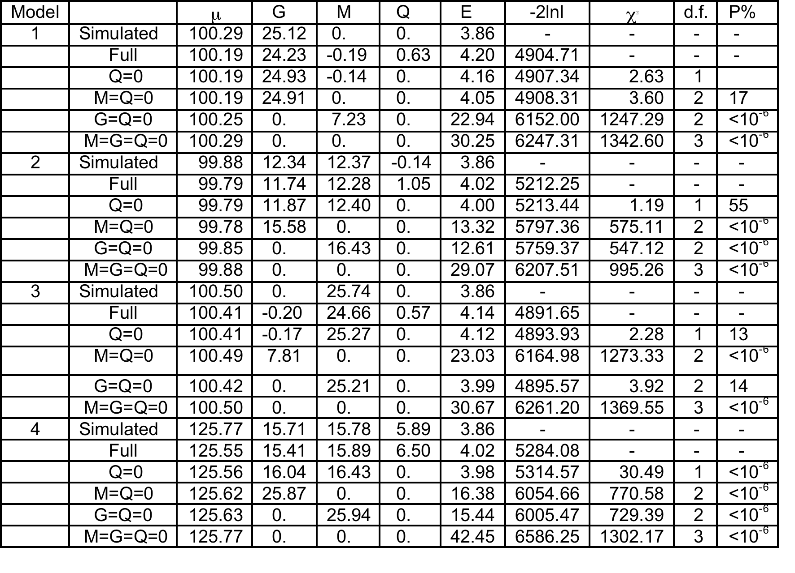
Results of fitting “GCTA” model (OpenMx) for direct and maternal effects to simulated offspring phenotypes in random samples of 1000 genotyped mother-child pairs

Slide 26
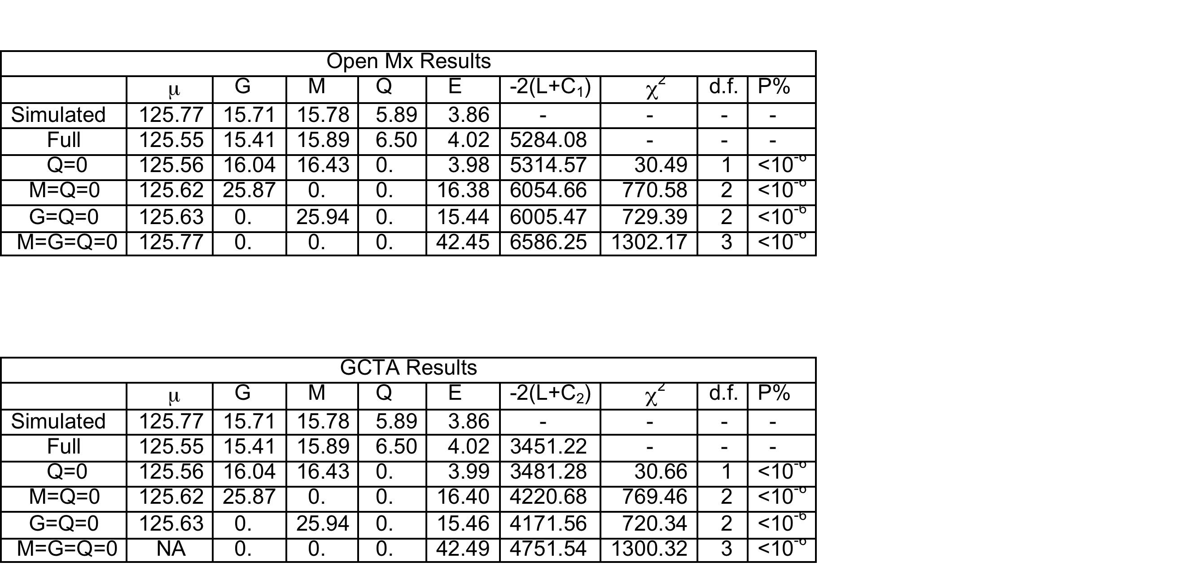
Comparison of estimates obtained from simulated data by
FIML in OpenMx and REML in GCTA.

Slide 27
Application to Real Data

Slide 28
“ALSPAC” The Avon Longitudinal Study of Parents and Children (“ALSPAC”) UK Medical Research Council Wellcome Trust University of Bristol http://www.bris.ac.uk/alspac/researchers/data-access/data-dictionary

Slide 29
ALSPAC
Early 1990’s
Avon County, UK
Population-based
Birth cohort study
Longitudinal follow-up
14,541 women and children
Mothers genotyped on the Illumina 660K SNP chip.
Children genotyped on the Illumina 550K SNP chip.
After cleaning etc. genetic relatedness computed for 4761 unrelated mother-offspring pairs

Slide 30
Proof of Principle
Maternal, self-reported, stature - should be no effects of offspring genotype.
Neonatal birth length (crown-heel) – might show effects of both maternal and fetal genotype

Slide 31
Results of fitting “GCTA” model for direct and maternal effects to maternal stature and birth length data in the ALSPAC cohort. Results are presented as standardized variance components.

Slide 32
Conclusions?
It seems to work – so far
Subject to all the ifs and buts that go with using genome-wide SNPs to estimate genetic relatedness (?assortative mating – parental behavior affects organization of genome – “top-down causality”).

