Slide 1
Assortative Mating
Teresa de Candia
University of Colorado at Boulder

Slide 2
Assortative Mating (AM)
Occurs when individuals choose mates that resemble them
Height: spousal phenotypic correlation ~0.2.
If a trait is heritable, then breeding values will be correlated across spouses. Assuming spousal r ~0.2 and h² ~.7, breeding values r ~.14
For polygenic traits, individual with an increasing allele at locus x will be more likely to mate with an individual with an increasing allele at that or any other causal locus
This leads to gene effects being correlated within offspring
This, in turn, leads to increases of actual genetic (and total phenotypic) variance in the population
Notes:
After assortative mating for 15-20 generations, correlations between alleles within individuals have reached equlibrium and so there is a direct relationship between those correlations and correlations of breeding values

Slide 3
Broken Assumptions
As long as gene effects are correlated with one another or with environmental effects within individuals, assumptions of GCTA, HE regression, and other such models do not hold

Slide 4
Broken Assumptions
As long as gene effects are correlated with one another or with environmental effects within individuals, assumptions of GCTA, HE regression, and other such models do not hold
rGE within individuals: For a special case of assortative mating in which there is vertical cultural transmission, GRM is confounded with unmodeled environmental similarity. This cofound results in overestimates of genetic variance. This is similar to confounds occurring when environmental effects correlate with genes in samples with stratification or cryptic relatedness.

Slide 5
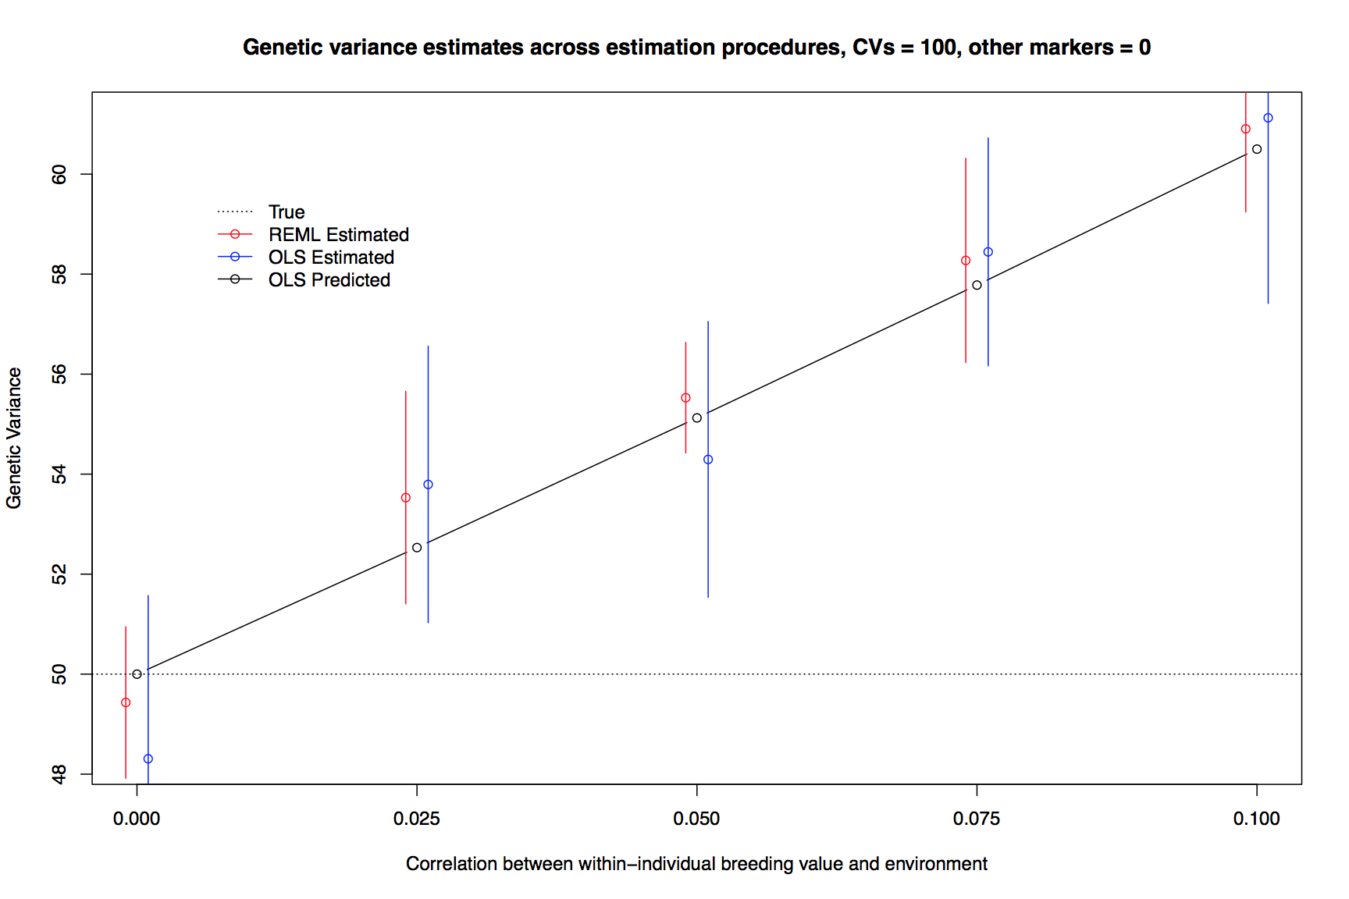
Using Simulated Genes and Phenotyopes: Overestimates due to rGE (not specific to AM)

Slide 6
Broken Assumptions
As long as gene effects are correlated with one another or with environmental effects within individuals, assumptions of GCTA, HE regression (HE-r), and other such models do not hold
rGE within individuals: rGE within individuals: For a special case of assortative mating in which there is vertical cultural transmission, GRM is confounded with unmodeled environmental similarity. This cofound results in overestimates of genetic variance. This is similar to confounds occurring when environmental effects correlate with genes in samples with stratification or cryptic relatedness.
rGG within individuals: Assortative mating for heritable traits induces correlations among genetic effects. Parametrization of GRM does not properly account for these. This results in variance across pi-hats that is too low compared with variance across phenotypic cross-products

Slide 7
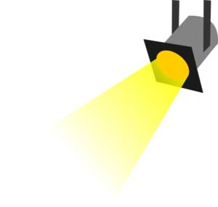
Broken Assumptions
As long as gene effects are correlated with one another or with environmental effects within individuals, assumptions of GCTA, HE regression (HE-r), and other such models do not hold
rGE within individuals: rGE within individuals: For a special case of assortative mating in which there is vertical cultural transmission, GRM is confounded with unmodeled environmental similarity. This cofound results in overestimates of genetic variance. This is similar to confounds occurring when environmental effects correlate with genes in samples with stratification or cryptic relatedness.
rGG within individuals: Assortative mating for heritable traits induces correlations among genetic effects. Parametrization of GRM does not properly account for these. This results in variance across pi-hats that is too low compared with variance across phenotypic cross-products

Slide 8
Pi-hats compared with cross-products of breeding values
Let’s assume a polygenic trait under AM with a heritability of 1 and equal amounts of variance explained by each CV. Individual i will have phenotype CV_{1i} + CV_{2i} + CV_{3i} +… and
P_{ij} = (CV_{1i} + CV_{2i} + CV_{3i} + …) * (CV_{1j} + CV_{2j} + CV_{3j} + …)
= ΣCV_{i}ΣCV_{j}
Π_{ij} = CV_{1i}CV_{1j} + CV_{2i}CV_{2j} + CV_{3i}CV_{3j} + … = ΣCV_{i}CV_{j}
For each pair of alleles m and n,
If r(CV_{mi},CV_{ni}) = 0, then V(ΣCV_{i}ΣCV_{j}) = V(ΣCV_{i}CV_{j})
Else, V(ΣCV_{i}ΣCV_{j}) > V(ΣCV_{i}CV_{j})
By quantifying this relationship (at equilibrium), we can predict overestimates expected from fitting OLS

Slide 9
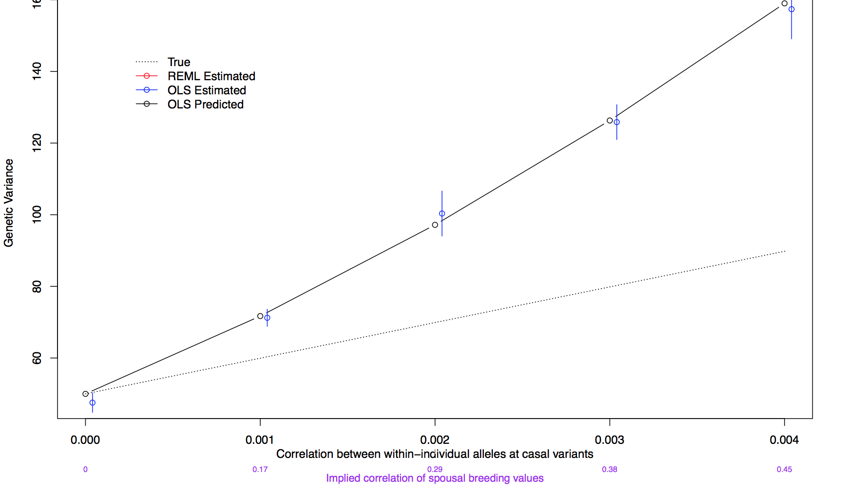
Using Simulated Genes and Phenotyes: OLS (HE-r) Overestimates Predictable CVs=100, other markers=0

Slide 10
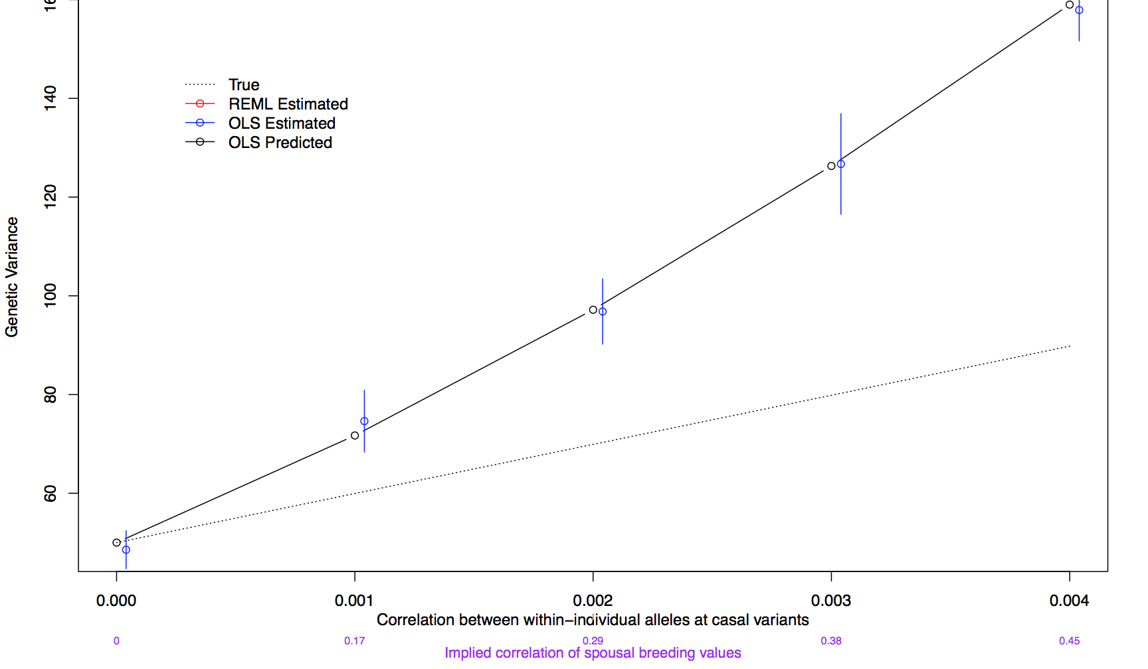
Using Simulated Genes and Phenotyes: OLS (HE-r) Overestimates Predictable CVs=100, other markers=10k

Slide 11
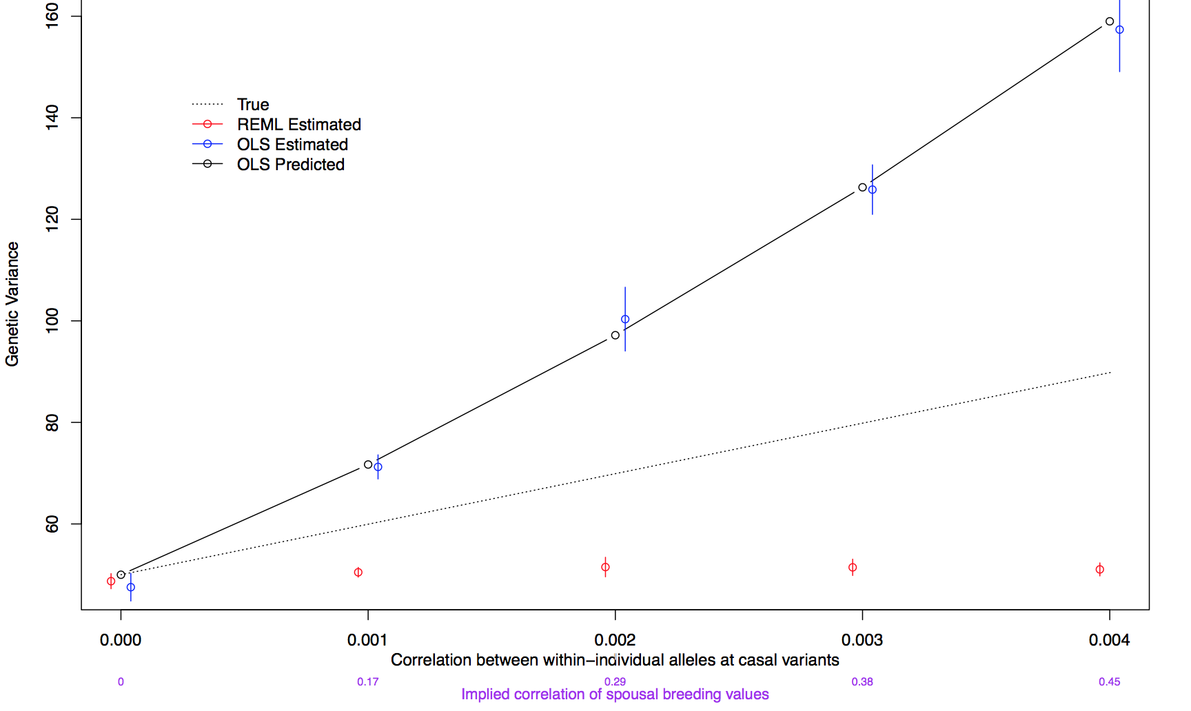
Using Simulated Genes and Phenotyes: REML/FIML (e.g., GCTA) Estimates CVs=100, other markers=0

Slide 12
Using Simulated Genes and Phenotyes: REML/FIML (e.g., GCTA) Estimates CVs=100, other markers=0
Vg in absence of AM

Slide 13
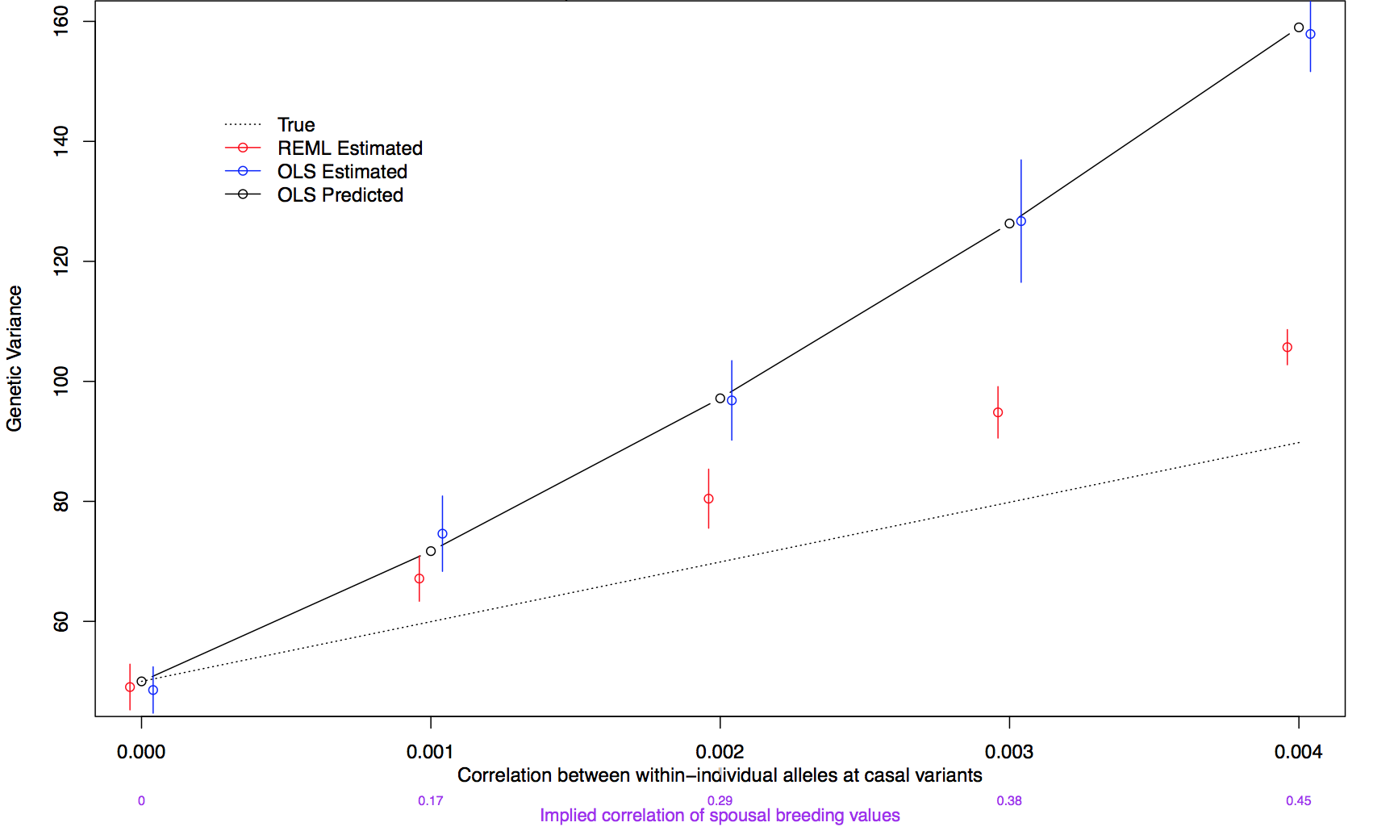
Using Simulated Genes and Phenotyes: REML/FIML (e.g., GCTA) Estimates CVs=100, other markers=10k

Slide 14
Using Simulated Genes and Phenotyes: REML/FIML (e.g., GCTA) Estimates CVs=100, other markers=10k
With > markers, REML/FIML estimates ⬆

Slide 15
Differences Between OLS and REML/FIML
While we can predict biases using OLS, we don’t know how to predict biases in REML/FIML, nor why the latter estimates depend on the number of markers included in the analysis
REML/FIML methods model within-person genetic effects and estimate environmental variance directly, while OLS does not
REML/FIML assume that breeding values and environmental values each follow a normal distribution while OLS does not. Under AM, are breeding value distributions leptokurtic (fat tailed)?

Slide 16
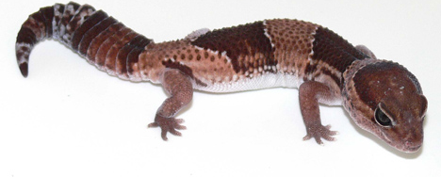
Acknowledgments
Rasool Tahmasbi
Matt Jones
Greg Carey
Lindon Eaves
Matt Keller
Notes:
This slide needs to be updated. Goes before or after practical?

