Slide 1
Bivariate M-GCTA models Concepts and applications using structural equation modelling International Workshop on Statistical Genetic Methods for Human Complex Traits Boulder, Colorado
gregory.carey@colorado.edu
Beate St Pourcain, Lindon Eaves, Dave Evans, Greg Carey Beate.StPourcain@Bristol.ac.uk
gregory.carey@colorado.edu
5 March 2015

Slide 2
Univariate M-GCTA
The covariance (ρ_{ij}) between the offspring of the i^{th} and j^{th} family is
ρ_{ij} = α_{ij} m² + β_{ij} (c² + h²) + (δ_{ij} + δ_{ji}) mc
Maternal GRM
Maternal Genetic Variance
Children’s GRM
Offspring Genetic Variance
Maternal-Offspring
Genetic Covariance
Maternal –Offspring GRM
Identity Matrix
Residual Variance

Slide 3
Univariate M-GCTA
The covariance (ρ_{ij}) between the offspring of the i^{th} and j^{th} family is
ρ_{ij} = α_{ij} m² + β_{ij} (c² + h²) + (δ_{ij} + δ_{ji}) mc
CMi
αij
CMi
Genes with off-spring specific effects
δji
δij
MMi
MMj
αij
Genes with maternal effect
CCi
CCj
m
h
βij
h
m
P_{i}
Pj
ϒj
ϒi
δji
δij
c
e
e
c
Ei
Ej
MCi
MCj
Genes with maternal effect through inheritance
βij

Slide 4
Our study participants
Avon Longitudinal Study of Parents and Children (ALSPAC)
Birth cohort
Resident in Bristol, South West England
>10,000 mothers and children
Notes:
14,541 pregnancies with an expected due date 1.4.91-31.12.92

Slide 5
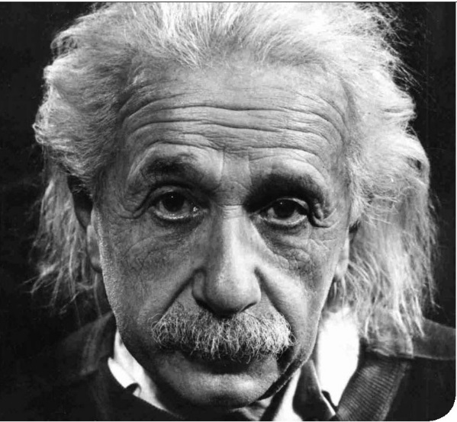
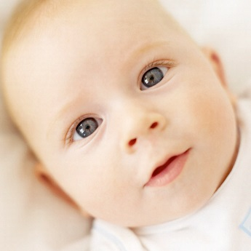
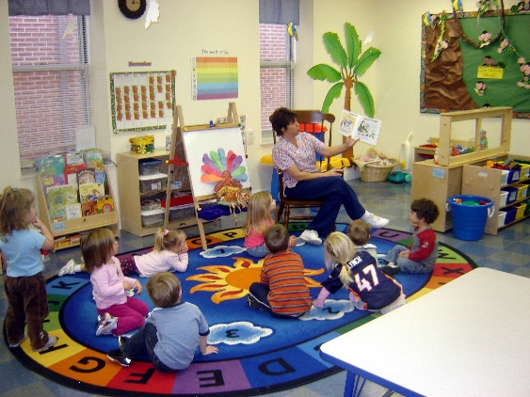
Expressive language development
0 words
~60,000 words
~1,000,000 words
~13,000 words
~120,000 words
Notes:
5

Slide 6
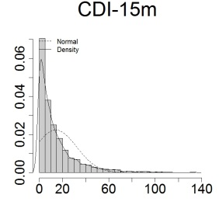
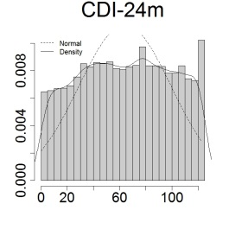
Expressive vocabulary scores in ALSPAC

Slide 7
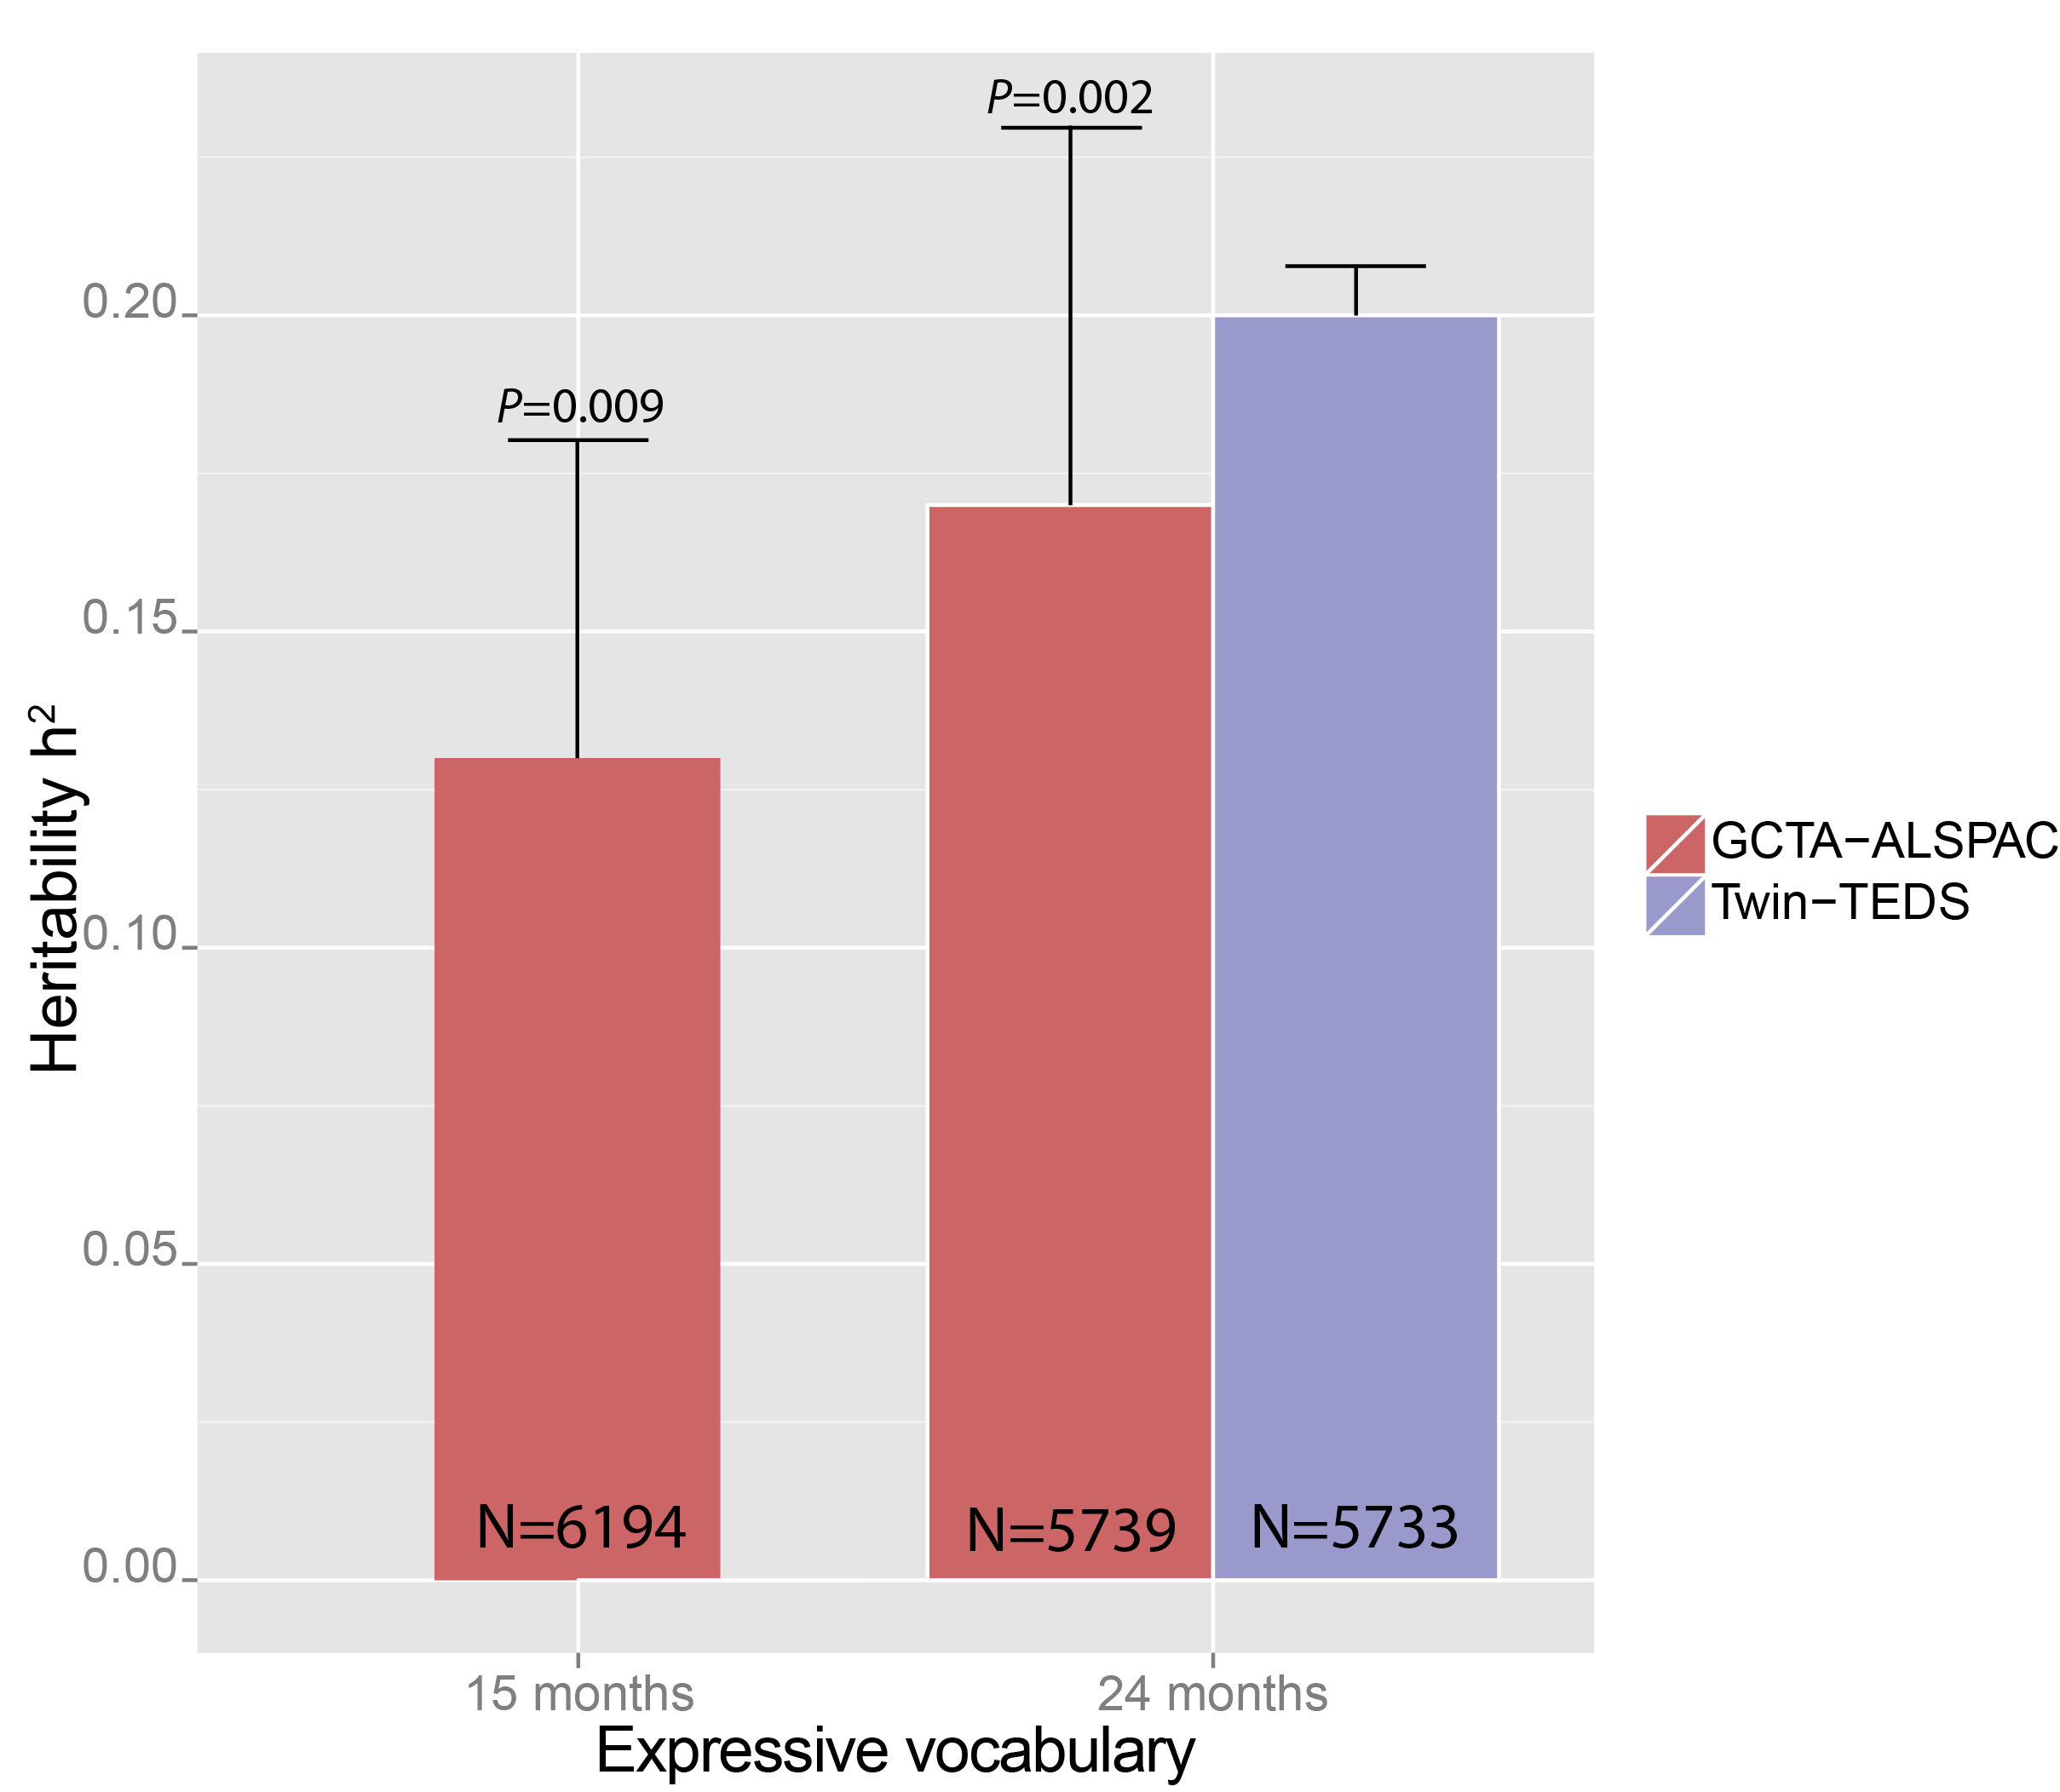
Heritability of expressive vocabulary
Concordance of twin and large-sample SNP h² = little missing heritability
Large shared environmental effects in twin model (TEDS)
 | A | C | E
24m | 0.20 (.19, .22) | 0.74 (.72, .75) | 0.06 (.06, .06)
ACE is best fitting model.
0.13
0.17

Slide 8
Univariate M-GCTA – Early language

Slide 9
Molecular evidence
GWAS signal near ROBO2 at 3p12.3 (15-18 months of age), age-specific
ROBO2 encodes a conserved axon binding receptor
Key role in axon guidance and cell migration
Single cell gene expression, especially during perinatal development
Predominantly in newborn, not mature neurons
St Pourcain, B. et al. Nat Commun 5, (2014)

Slide 10
Bivariate M-GCTA
Trait 1 (Expressive language 15 m)
Trait 2 (Expressive language 24m)
G_{M1M}
G_{C1M}
G_{M2M}
G_{C2M}
0.5
P₁
0.5
0.5
P₂
G_{M1C}
G_{C1C}
G_{M2C}
G_{C2C}
E₁
E₂
Single mother-child dyad model

Slide 11
Bivariate M-GCTA
Structural equations for two phenotypes 1 and 2
$$P_{1}=m_{1}{\text{G}}_{\text{mm}\text{1}}{+c}_{1}{\text{G}}_{\text{mc}\text{1}}{+h}_{1}{\text{G}}_{\text{cc}\text{1}}\text{ +}e_{1}E_{1}$$
$$P_{2}=m_{2}{\text{G}}_{\text{mm}\text{2}}{+c}_{2}{\text{G}}_{\text{mc}\text{2}}{+h}_{2}{\text{G}}_{\text{cc}\text{2}}\text{ +}e_{2}E_{2}$$
Lower triangular decomposition of phenotypes in [2,2] matrix
$$P_{1}=m_{11}{\text{G}}_{\text{mm}\text{1}}{+c}_{11}{\text{G}}_{\text{mc}\text{1}}{+h}_{11}{\text{G}}_{\text{cc}\text{1}}\text{ +}e_{1}E_{1}$$
$$P_{2}=m_{21}{\text{G}}_{\text{mm}1}{+c}_{21}{\text{G}}_{\text{mc}\text{1}}{+h}_{21}{\text{G}}_{\text{cc}\text{1}}$$
$${ + m}_{22}{\text{G}}_{\text{mm}2}{+c}_{22}{\text{G}}_{\text{mc}\text{2}}{+h}_{22}{\text{G}}_{\text{cc}\text{2}}\text{+}e_{2}E_{2}$$
Matrix representation
$$\begin{matrix}V_{11} & V_{12} \\ V_{21} & V_{22}\end{matrix}$$

Slide 12
Variances and covariances
For i≠j
$$cov\left(P_{1i},P_{1j}\right)=m_{11}^{2}α_{ij}+\left(c_{11}^{2}+h_{11}^{2}\right)β_{ij}+m_{11}c_{11}\left(δ_{ij}+δ_{ji}\right)+e_{1}^{2}$$
$$cov\left(P_{2i},P_{2j}\right)={{(m}_{21}^{2}+m_{22}^{2})α}_{ij}+\left(c_{21}^{2}+h_{21}^{2}+c_{22}^{2}+h_{22}^{2}\right)β_{ij}$$
$+\left(m_{21}c_{21}+m_{22}c_{22}\right)\left(δ_{ij}+δ_{ji}\right)+e_{2}^{2}$
$$cov\left(P_{1i},P_{2j}\right)={{(m}_{11}m_{21})α}_{ij}+\left(c_{11}c_{21}+h_{11}h_{21}\right)β_{ij}$$
$$+m_{11}c_{21}δ_{ij}+m_{21}c_{11}δ_{ji}+e_{1}e_{2}{cor}_{e1e2}$$
Matrix representation
$$\begin{matrix}V_{11} & V_{12} \\ V_{21} & V_{22}\end{matrix}$$
12 parameters

Slide 13
Variances and covariances
For i=j
$$cov\left(P_{1i},P_{1j}\right)=m_{11}^{2}+\left(c_{11}^{2}+h_{11}^{2}\right)+m_{11}c_{11}+e_{1}^{2}$$
$=1$
$$cov\left(P_{2i},P_{2j}\right)={{(m}_{21}^{2}+m_{22}^{2})}_{ }+\left(c_{21}^{2}+h_{21}^{2}+c_{22}^{2}+h_{22}^{2}\right)$$
$+(m_{21}c_{21}+m_{22}c_{22})+e_{2}^{2}$
$=1$
$$cov\left(P_{1i},P_{2j}\right)=\left(m_{11}m_{21}\right)+\left(c_{11}c_{21}+h_{11}h_{21}\right)$$
$+{0.5m}_{11}c_{21}δ_{ij}+{0.5m}_{21}c_{11}$ $+e_{1}e_{2}{cor}_{e1e2}$

Slide 14
Bivariate model
Trait 1
Trait 2
G_{M1M}
m₁₁
G_{C1M}
G_{M2M}
m₂₂
G_{C2M}
m₂₁
0.5
P₁
0.5
0.5
P₂
0.5
c₂₁
c₁₁
h₁₁
c₂₂
h₂₂
G_{M1C}
e₁₁
G_{C1C}
h₂₁
G_{M2C}
e₂₂
G_{C2C}
E₁
E₂
e₁e₂Cor(e₁e₂)
Single mother-child dyad model

Slide 15
Deriving the Likelihood
FIML
$$\log\left(L\right)=−\frac{1}{2}\left|\hat{V}\right| −\frac{1}{2}{(p−μ)}^{′}{\left|\hat{V}\right|}^{−1}(p−μ)$$
with $μ=0$

Slide 16
Computational requirements
R Atlas
Core algorithms of GCTAx
If available use parallel cores (e.g. 16 cores) for gradient calculation using parallel processing
Example calculation bivariate model, 16 cores, ~4000 mother-chid dyads, 12 parameters

Slide 17
Summary
Maternal GCTA can be utilised to explain further phenotypic variation in children
Maternal GCTA can capture developmentally changing genetic architectures
Bivariate models can be utilised to reduce the multiple testing burden

Slide 18
Acknowledgements
George Davey Smith
Greg Carey
QIMR Berghofer Medical Research Institute
Dave Evans
Lindon Eaves

