Slide 1

Common variation, GWAS & PLINK
Jeff Barrett

Slide 2
Challenges to GWAS?
Data quality control
No common, single SNP main effects (all epistasis or rare variants or …)
Sample size too small to detect effects
Computational burden
Multiple testing correction will drown signal
Unmatched controls / population structure
SNP chips don’t cover enough of the genome

Slide 3
Challenges to GWAS?
Data quality control
No common, single SNP main effects (all epistasis or rare variants or …)
Sample size too small to detect effects
Computational burden
Multiple testing correction will drown signal
Unmatched controls / population structure
SNP chips don’t cover enough of the genome

Slide 4
Challenges to GWAS?
Data quality control
No common, single SNP main effects (all epistasis or rare variants or …)
Sample size too small to detect effects
Computational burden
Multiple testing correction will drown signal
Unmatched controls / population structure
SNP chips don’t cover enough of the genome

Slide 5
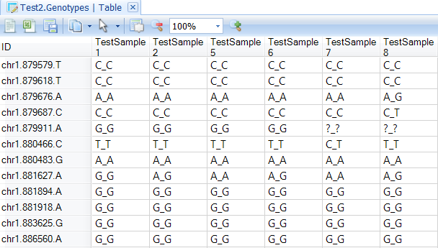
What we want to work with

Slide 6
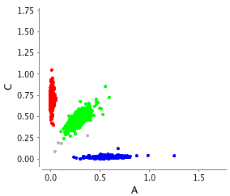
Getting from intensities to genotypes

Slide 7
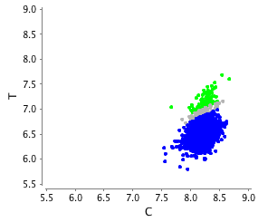
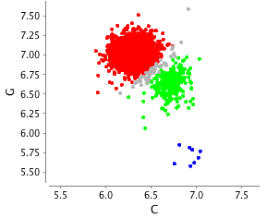
Getting from intensities to genotypes

Slide 8
SNP QC
SNP QC for GWAS aims to systematically identify these problems:
Hardy-Weinberg equilibrium (expected frequency of three possible genotypes)
Fraction of missing genotypes
Frequency differences in separate controls (if available)
…but the scale is huge: biggest meta-analyses involve > 1 trillion genotypes!

Slide 9
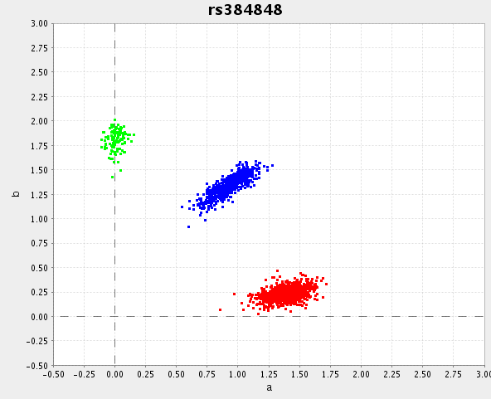
Genotype calling
Notes:
basic problem
affy uses BRLMM
we use chiamo++

Slide 10
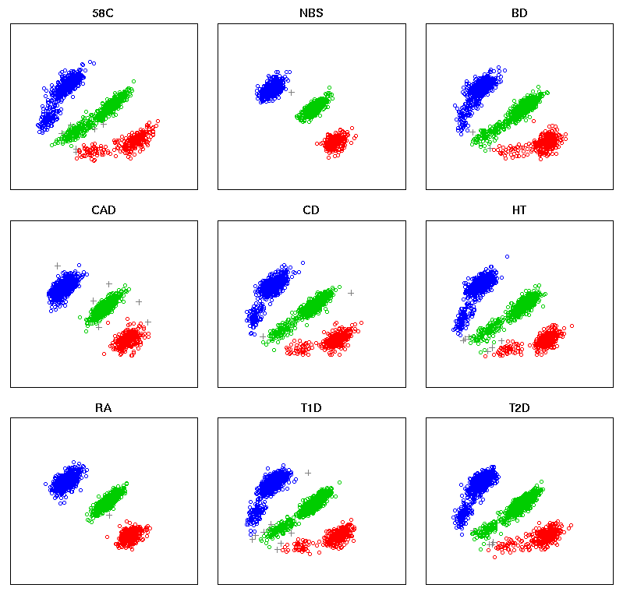
Calling wrinkles: > 3 clusters

Slide 11
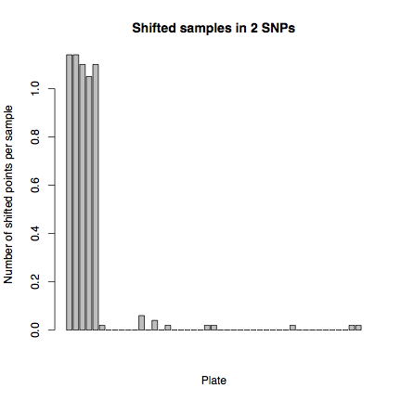
Plate effects
Transition to SSF site

Slide 12
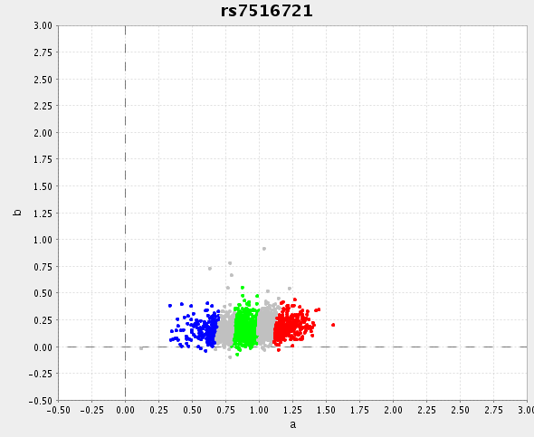
Calling wrinkles: monomorphics

Slide 13
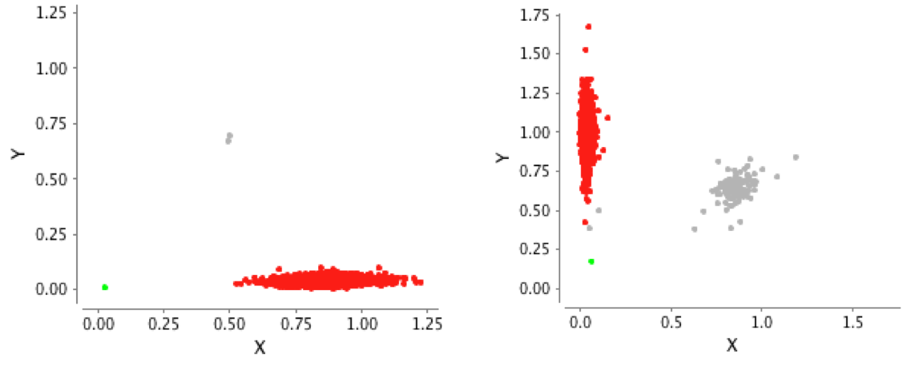
Calling wrinkles: rare SNPs

Slide 14
Missing data a good predictor of bad calling

Slide 15
Sample QC
Collecting, processing and genotyping thousands of samples (often from many different clinicians, hospitals, countries. . . ) is difficult.
Duplicates
Unexpected relatives
Samples with different ancestry
Low quality DNA samples
Sample mix-ups
The good news is that simple analyses at scale are very informative.

Slide 16
Heterozygosity locally and globally
A key advantage of GWAS is the sheer volume of data, which allows simple analyses.
A heterozygous sample at one SNP isn’t particularly interesting, but what about across the entire genome?

Slide 17
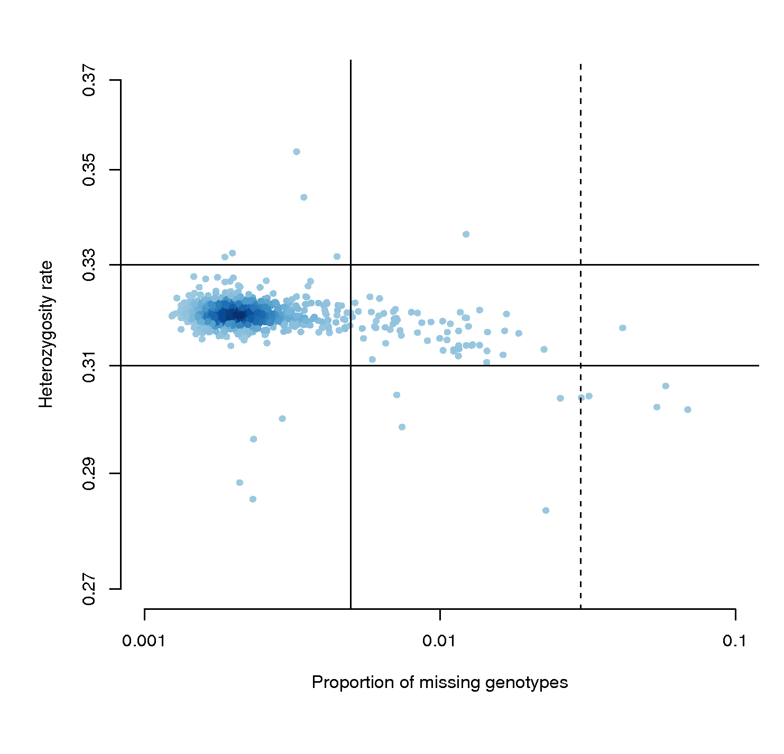
Bad samples: call rate & heterozygosity

Slide 18
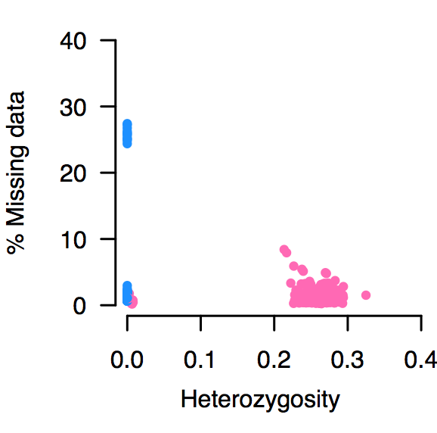
Data cleaning on X: gender

Slide 19
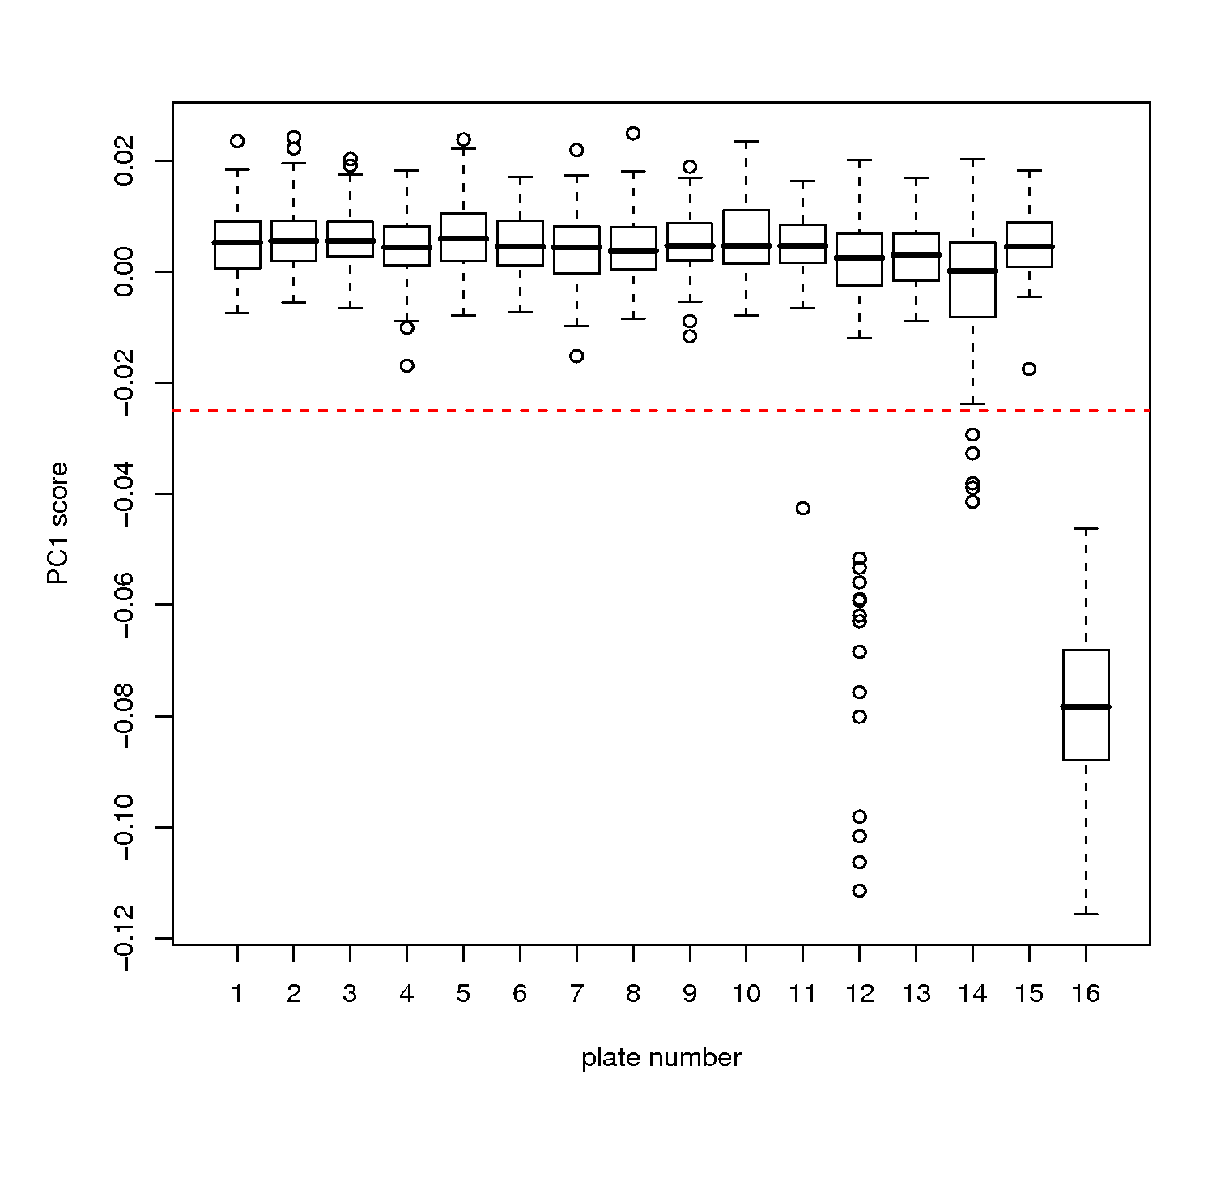
Bad samples: plate effects

Slide 20
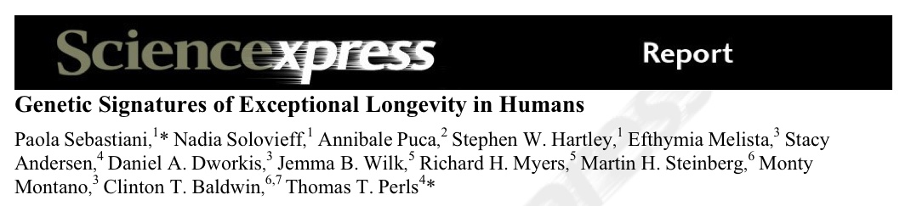
Clean data matters!

Slide 21
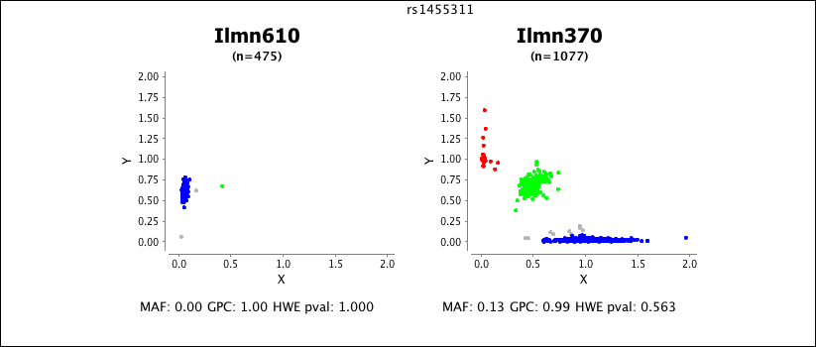
Hit SNP 1

Slide 22
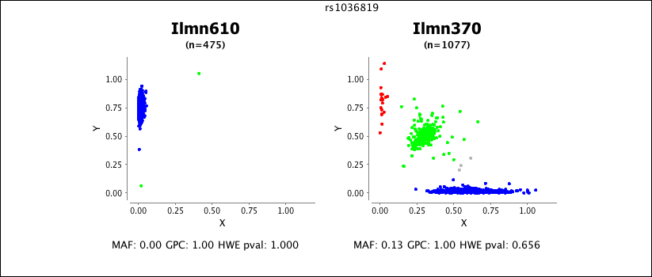
Hit SNP 2

Slide 24
The missed warning signs

Slide 25
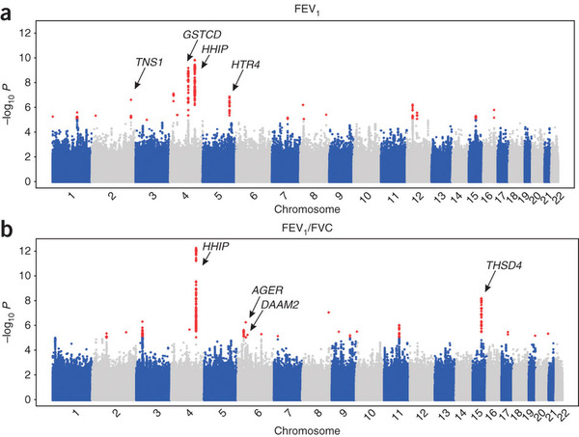
The missed warning signs

Slide 26
The missed warning signs

Slide 27
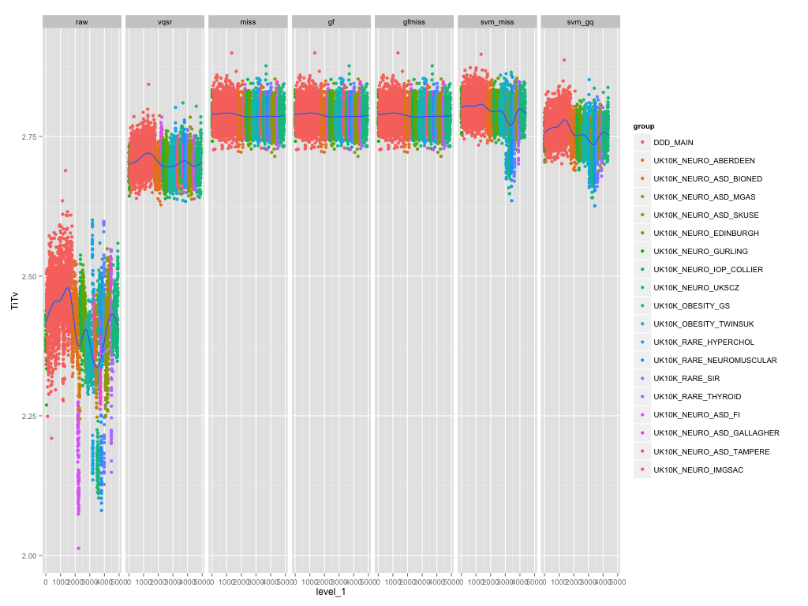
The need for QC never dies

Slide 28
Useful references
Genome-wide association study of 14,000 cases of seven common diseases and 3,000 shared controls. Wellcome Trust Case Control Consortium. Nature. 2007 Jun;447(7145):661-78.
Data quality control in genetic case-control association studies. Anderson CA, Pettersson FH, Clarke GM, Cardon LR, Morris AP, Zondervan KT. Nat. Protoc. 2010 Sep;5(9):1564-73.

