Slide 1

Common variation, GWAS & PLINK
Jeff Barrett

Slide 2
Two parallel goals in disease genetics
For a given disease, we would like to:
  Predict if someone will get sick, how bad it will be, and what treatment will work.
  Understand the biology of the disease so we can design better treatments and diagnostics.

Slide 3
Humans are related to other species

Slide 4
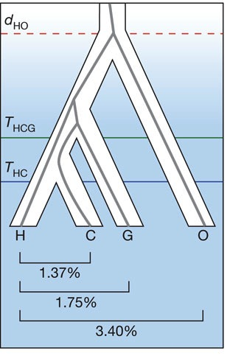
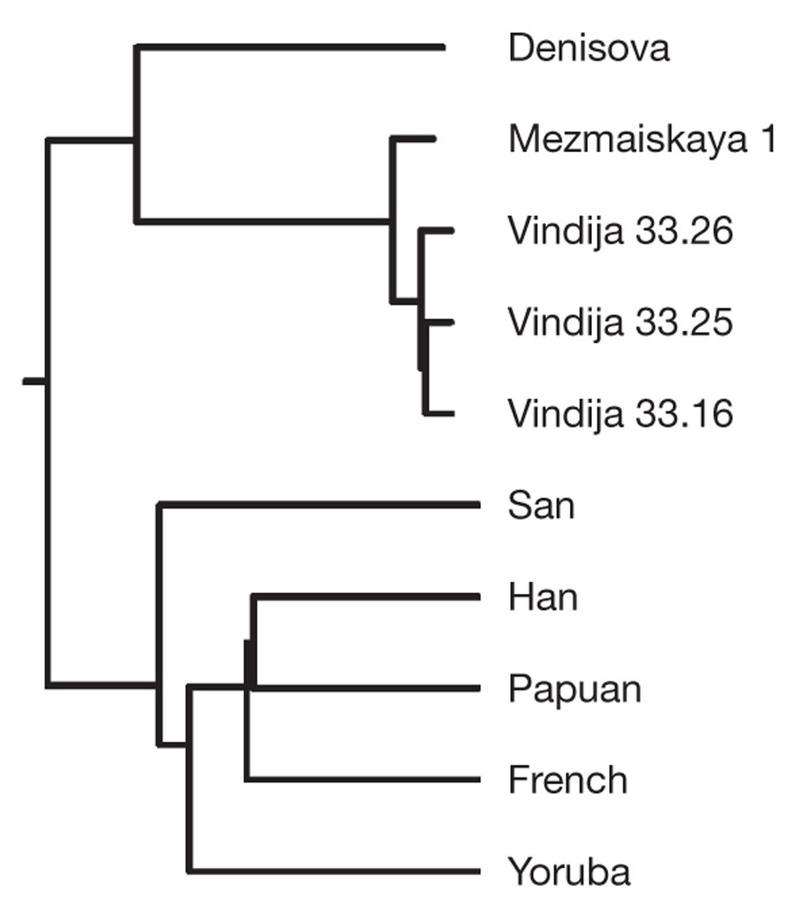
Our closer relatives

Slide 5
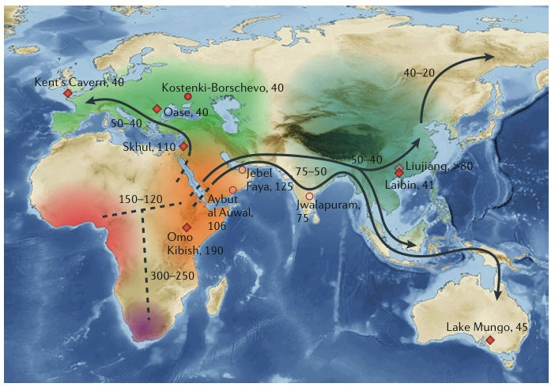
The history of human populations

Slide 6
The history of human populations

Slide 7
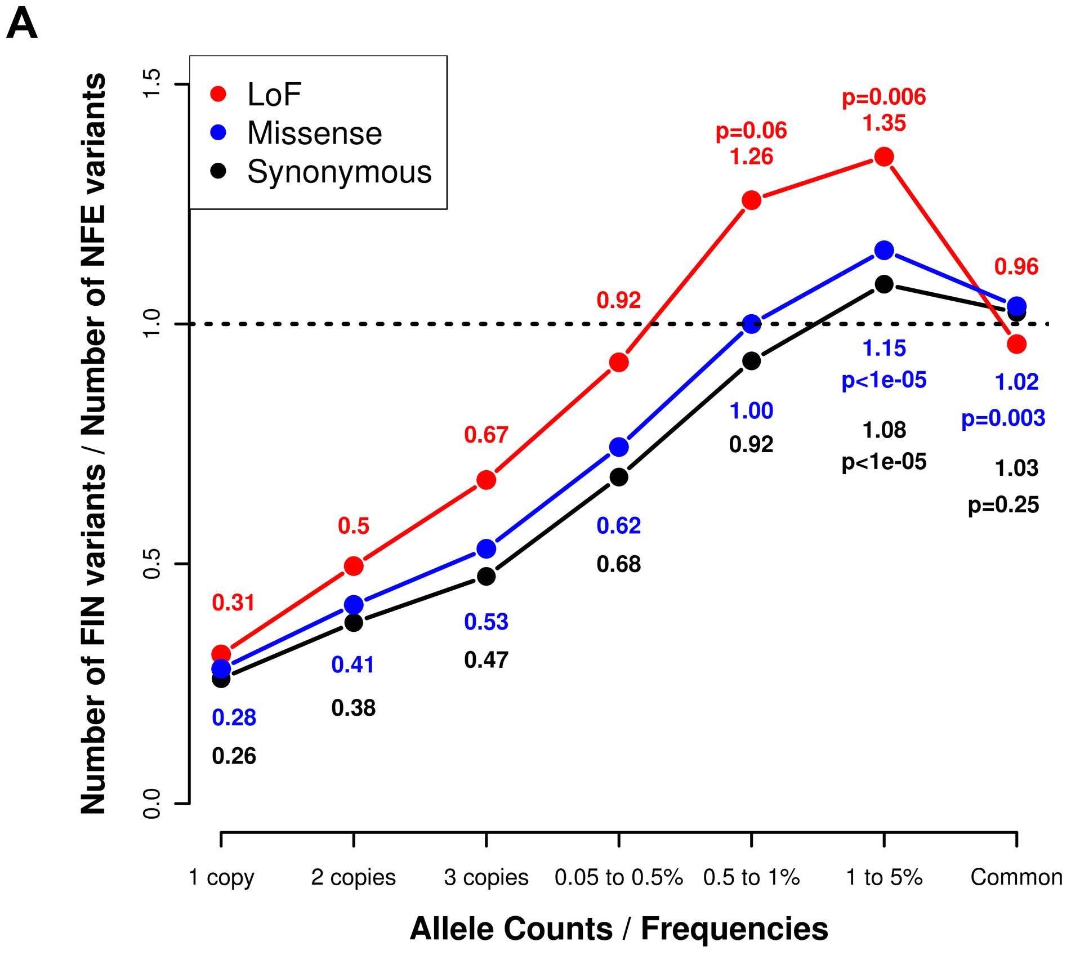
The history of human populations

Slide 8
What creates genetic variation?
The two processes that increase genetic diversity in a population are mutation, which introduces novel variants into the population, and recombination, which re-shuffles the existing patterns of variation.
The fate of new mutations is affected by drift, selection and population history. We care about the patterns left behind by these forces, and their affect on disease studies.

Slide 9
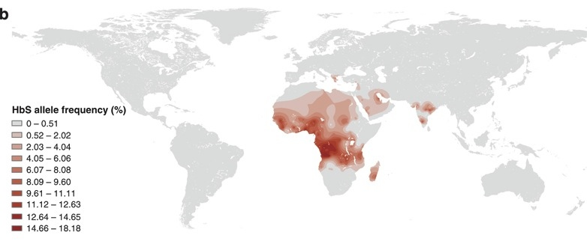
Population variant frequency example

Slide 10
Consequences of mutation & recombination
Genetic variants are correlated because they share a history of inheritance.
In the absence of recombination this correlation would extend a great distance along chromosomes.
Recombination breaks down this correlation over successive generations, leaving a narrower and narrower window of correlation.

Slide 11
Quantifying LD

Slide 12
Quantifying LD

Slide 13
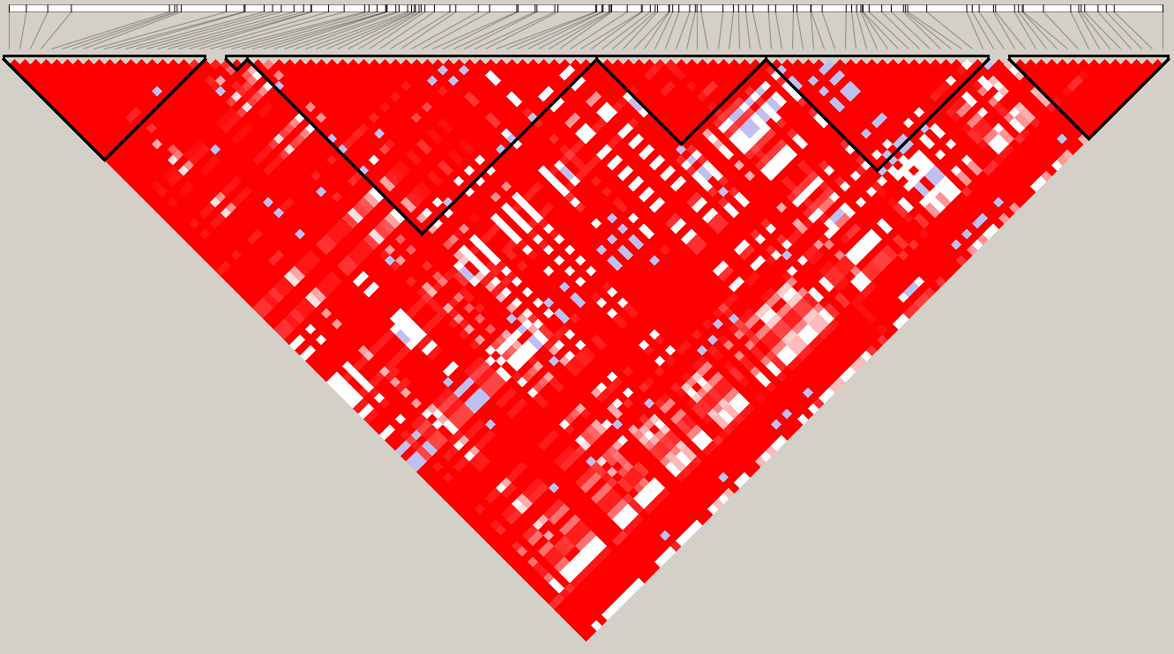
D’ for common SNPs in 100kb

Slide 14
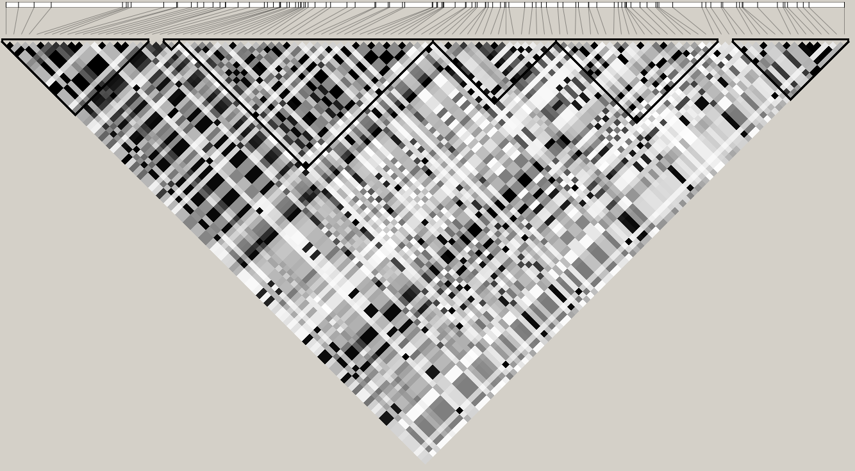
r² for common SNPs in 100kb

Slide 15
LD patterns as historical record

Slide 16

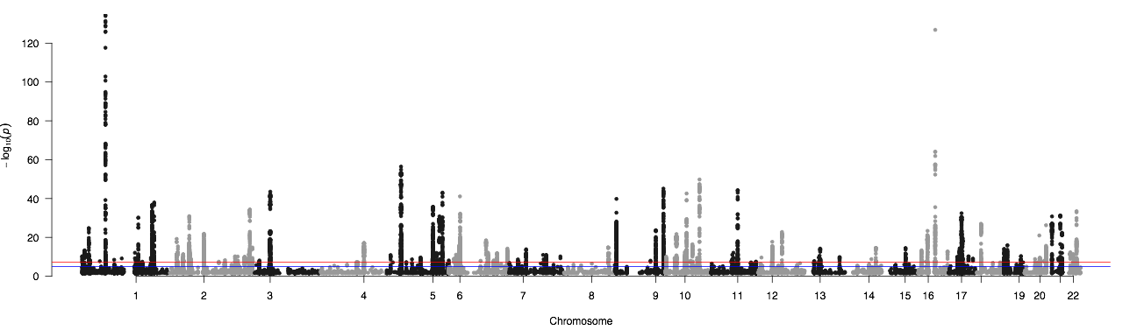


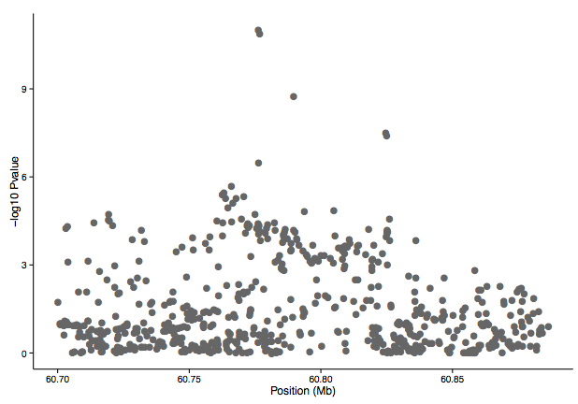
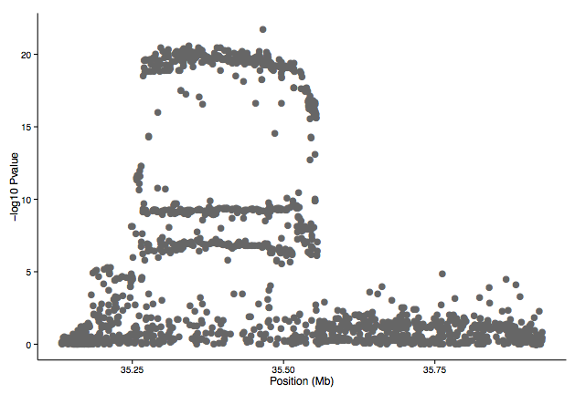

Slide 17
Consequences of mutation & recombination
Genetic variants are correlated because they share a history of inheritance.
In the absence of recombination this correlation would extend a great distance along chromosomes.
Recombination breaks down this correlation over successive generations, leaving a narrower and narrower window of correlation.
Under certain assumptions (random mating, neutral evolution, homogenous recombination) we can model exactly how narrow this is.

Slide 18
Theoretical vs. empirical correlation
Reich et al, Nature 2001

Slide 19
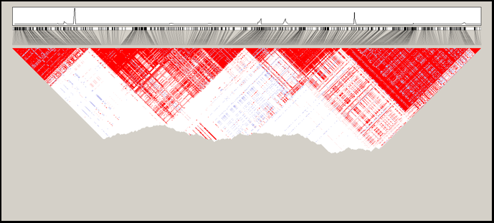
Correlation pattern driven by heterogeneous recombination

Slide 20

An LD map of the human genome

Slide 21
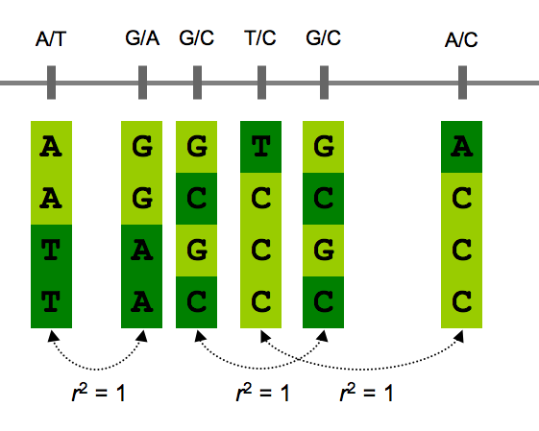
How can we use the HapMap to design disease studies?

Slide 22
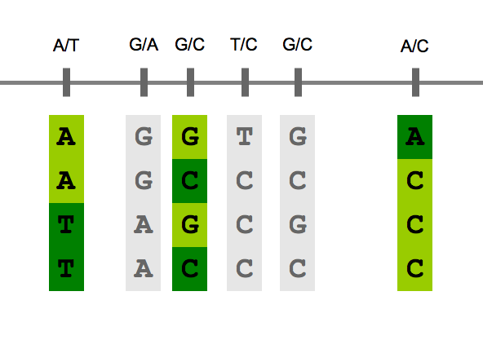
How can we use the HapMap to design disease studies?

Slide 23
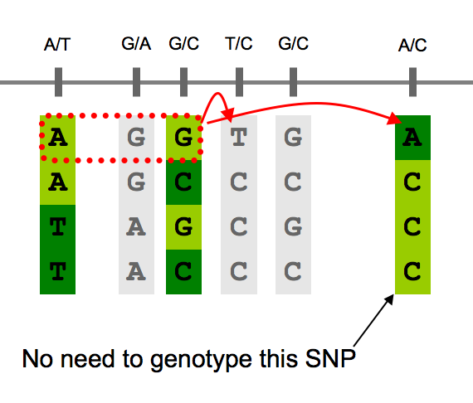
Can also combine information from multiple SNPs

Slide 24
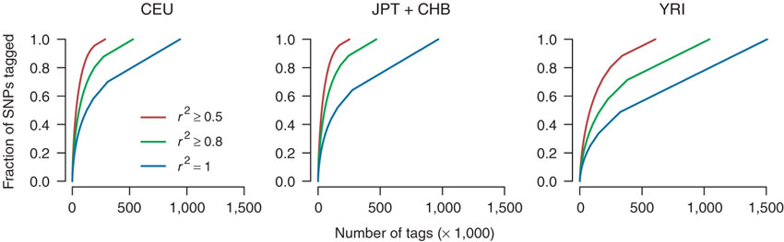
Correlation used to design genome-wide association studies
Barrett and Cardon, Nat Genet, 2006

Slide 25
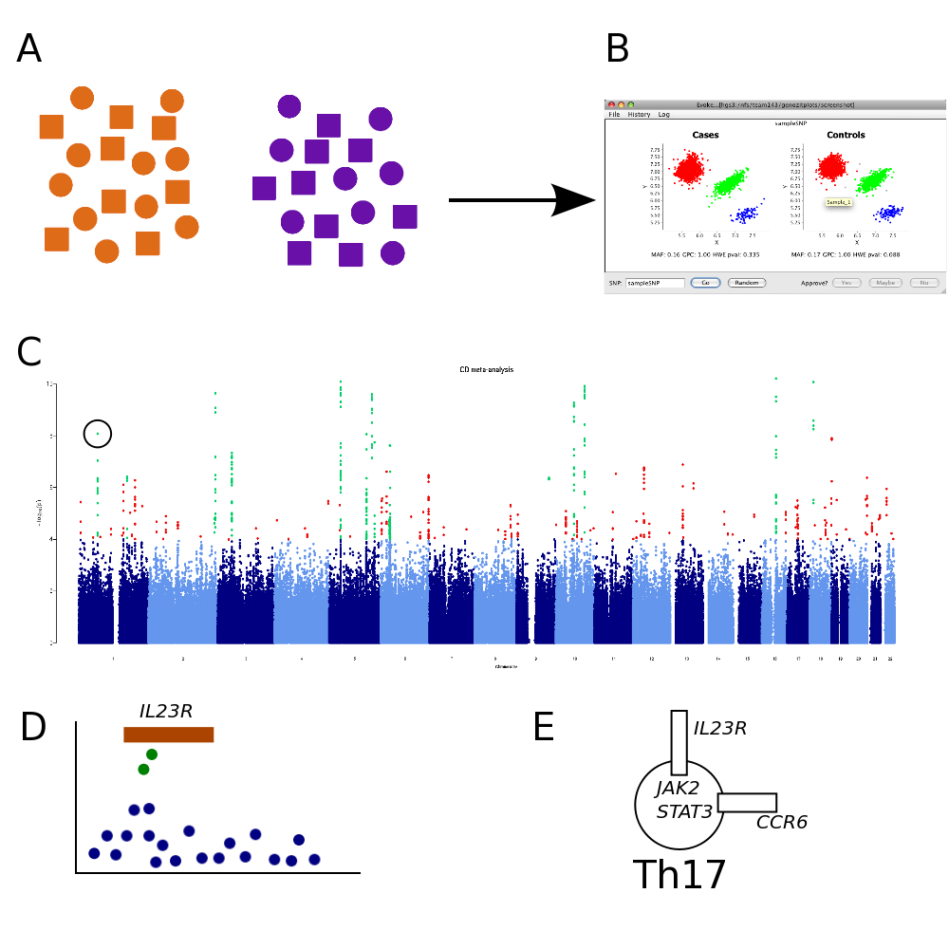
Genome-wide association studies (GWAS)
Notes:
CA, IB, JCB, NS, EZ

Slide 26
 | Common variation | Rare variation
Abundance | ~ 10⁷ | 10⁹?
Population specific? | No | Often
Correlation | High | Low
Selection | Unlikely | Possible
Best technology | Array genotyping | Sequencing

Slide 27
Matching biological questions to technologies
In my disease what role does…
common variation in Europeans play? GWAS
common variation in non-European populations? GWAS 2.0
low frequency variation play? low coverage sequencing
rare or private variation play? high coverage sequencing

Slide 28
Power ∝ Nβp(1-p)r²
N = sample size
β = effect size
p = frequency
r² = correlation to true cause

Slide 29
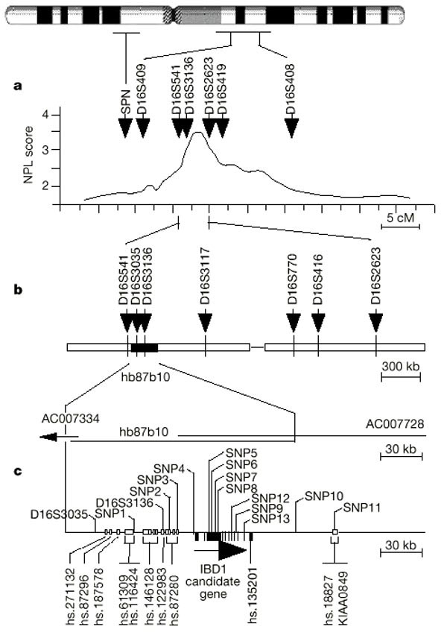
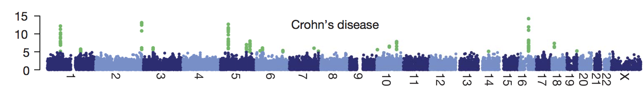
History of IBD gene mapping
Notes:
Describe immunochip, dozen diseases, ~100 confirmed fine-mapping loci (complete as of 2010)

Slide 30
/faculty/barrett/2015/gwas-practical

