Slide 1
Sex-limitation Models
Brad Verhulst, Elizabeth Prom-Wormley (Sarah, Hermine, and most of the rest of the faculty that has contributed bits and pieces to various versions of this talk)

Slide 2
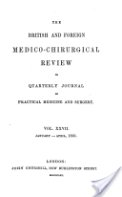



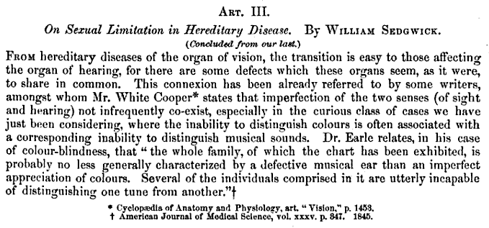
The language of heterogeneity
Sex differences = Sex limitation
1861
1948
1840

Slide 3
Terminology
Serious issue with Sex-Limitation Models:
    The terminology is fungible and can (often) be reversed (Moderation, confounding, GxE)
Solution: Be very, very, very clear about what you are testing.

Slide 4
Two primary differences between Males and Females.
Means Differences between the sexes
Regression coefficients (β) capture the differences between the mean levels of the trait between sexes
Not generally what we are talking about when discussion of Sex limitation, but very important nonetheless.

Slide 5
Two primary differences between Males and Females.
Variance Differences between the sexes
The key question is why there is more or less variation in one sex rather than the other
σ² capture the differences between the variation around the mean across the sexes

Slide 6
Both Mean and Variance Differences
If mean differences exist, but are ignored, they can induce variance differences
Makes it very important to include covariates/definition variables for sex when looking at sex limitation models
Including mean effects is analogous to including constituent terms in an interaction model

Slide 7
How can you have differences is variance?
Independent variables (millions of them) can influence the trait to different extents in different groups
or
Different independent variables can influence the trait in the different groups.

Slide 8
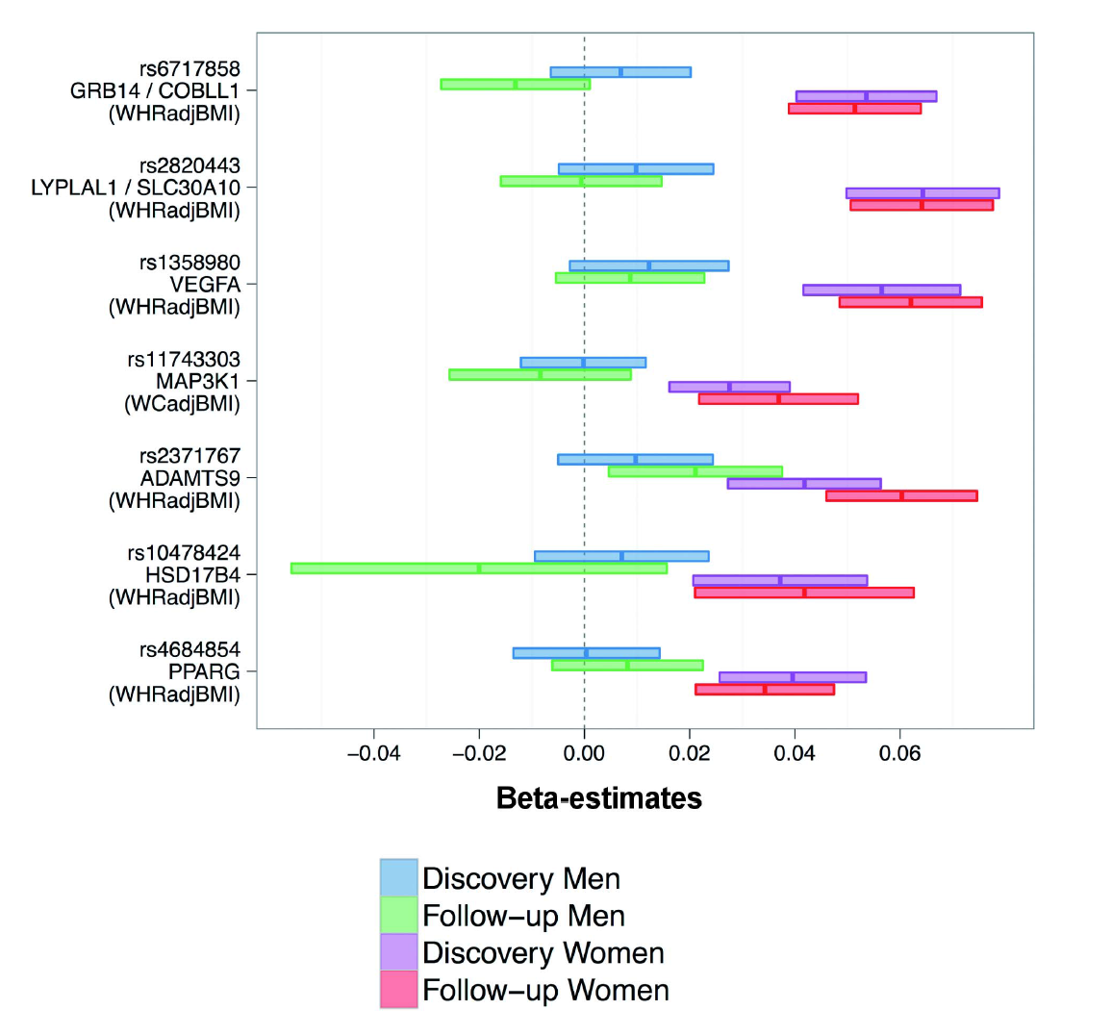

On all of the SNPs presented, women are affected by the polymorphism, while men are not.
Ergo, different genes “cause” the trait in males and females!
Or
Molecular evidence of qualitative sex limitation

Slide 10
Heterogeneity Questions
Univariate Analysis:
  What are the contributions of additive genetic, dominance/shared environmental and unique environmental factors to the variance?
Heterogeneity:
  Are the contributions of genetic and environmental factors equal for different groups,
  sex, race, ethnicity, SES, environmental exposure, etc.?

Slide 11
The language of heterogeneity
Are these differences due to differences in the magnitude of the effects (quantitative)?
  Is the contribution of genetic/environmental factors greater/smaller in males than in females?
Are the differences due to differences in the nature of the effects (qualitative)?
  Are there different genetic/environmental factors influencing the trait in males and females?

Slide 12
The language of heterogeneity
Quantitative - differences in the magnitude of the effects | Qualitative - differences in the source/nature of the effects
Models Scalar Non-scalar with OS twins | Models Non-scalar without OS twins General Non-scalar

Slide 13
Potential (Genetic) Groups
Comparison | Concordant for group membership | Discordant for group membership
Sex | MZ & DZ: MM & FF pairs | DZ: opposite sex pairs
Age | MZ & DZ: young & old pairs
Nationality | MZ & DZ: OZ & US pairs
Environment | MZ & DZ: urban & rural pairs | MZ & DZ: urban & rural pairs

Slide 14
Look at the Bloody Correlations!

Slide 15
Homogeneity Model

Slide 16
Homogeneity
No heterogeneity
The same proportion (%) of variance due to A, C, E equal between groups
Total variance equal between groups
  V_{m} = V_{f}
Variance Components are equal between groups
  A_{m} = A_{f}
  C_{m} = C_{f}
  E_{m} = E_{f}

Slide 17
Scalar Heterogeneity Model

Slide 18
Scalar Heterogeneity
Scalar sex-limitation (Quantitative)
The proportion (%) of variance due to A, C, E alters by a scalar (single value
total variance not equal between groups
  Vm = k* Vf
  Am = k* Af
  Cm = k* Cf
  Em = k* Ef
k is scalar

Slide 19
Heterogeneity Model

Slide 20
Non-Scalar Heterogeneity
Non-Scalar sex-limitation, can be estimated without opposite sex pairs (Quantitative/Qualitative), but…
  Reduced power
The total variance and proportion (%) of variance due to A, C, E not equal between groups
  Vm ≠ Vf
  Am ≠ Af
  Cm ≠ Cf
  Em ≠ Ef
Parameters estimated separately

Slide 21
 | Male | Male
Male | ½ a_{m}² + c_{m}² + e_{m}² | ½ a_{m}² + c_{m}²
Male | ½ a_{m}² + c_{m}² | ½ a_{m}² + c_{m}² + e_{m}²

Slide 22
General Heterogeneity
Non-Scalar sex-limitation with opposite sex pairs (Quantitative & Qualitative)
The total variance and proportion (%) of variance due to A, C, E is not equal between groups
  Vm ≠ Vf
  Am ≠ Af
  Cm ≠ Cf
  Em ≠ Ef
Parameters estimated jointly,
linked via opposite sex correlations
r(Am,Af)=.5; r(Cm,Cf)=1, r(Em,Ef)=0

Slide 23
What twin groups are needed for each Sex Limitation Model
Model Type | Data Requirements
Classical Twin Design | MZ & DZ Twins (Sex doesn’t matter)
Scalar Sex Limitation Model (Quantitative/Qualitative) | MZm, MZf, DZm & DZf Twins
General Sex Limitation Model (Qualitative & Quantitative) | MZm, MZf, DZm, DZf & DZo Twins

Slide 24
Qualitative Sex Limitation:
Notes of Caution and Friendly Suggestions
Collect data of Opposite Sex Twins.
  The power to detect qualitative sex differences is relatively low, but it might be important for your trait
If you find qualitative sex differences, STOP!
  It is incredibly difficult to make heads or tails of quantitative sex differences in the presence of qualitative sex differences

