Slide 1

Genetic Epidemiology in the Genomic Age:
The Role of Twin Studies in the Genomic Era & Missing Heritability
Nick Martin
Queensland Institute
of Medical Research
Brisbane
Intro Workshop
Boulder
March 7, 2014

Slide 2
Genetic Epidemiology:
Stages of Genetic Mapping
Are there genes influencing this trait?
  Twin family studies of some genomic phenotypes
Where are those genes?
  Linkage analysis
What are those genes?
  Association analysis
How do they work beyond the sequence?
  Epigenetics, transcriptomics, proteomics
What can we do with them ?
  Translational medicine

Slide 3
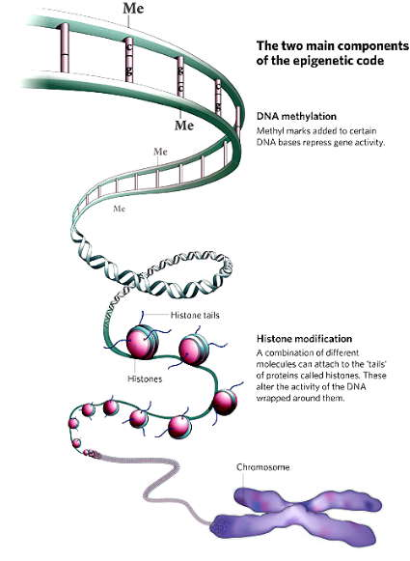
Epigenetic mechanisms
- DNA methylation
- Histone binding
Modifications of genome other than nucleotide changes that regulate gene expression (e.g. methylation of cytosines, histone modifications, microRNAs, …)

Slide 4


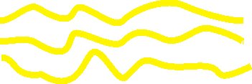

How DNA methylation affects gene transcription (gene expression)
No Transcription
No Protein
Notes:
Camp response element binding protein

Slide 5
Average correlation across all probes of normalised methylation measurements between relative pairs
Relationship | # Pairs | Correlation | Expected
MZ twin | 67 | 0.200 | h²
DZ twin | 111 | 0.109 | h²/2
Sibling | 262 | 0.090 | h²/2
Parent – Offspring | 362 | 0.089 | h²/2
Parent – Parent | 58 | 0.023 | 0
Unrelated | 187331 | -0.002 | 0
Allan McRae

Slide 6
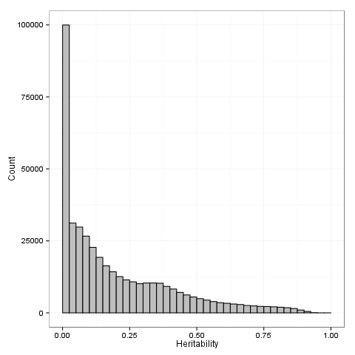
Distribution of heritability estimates for DNA methylation levels
Allan McRae

Slide 7
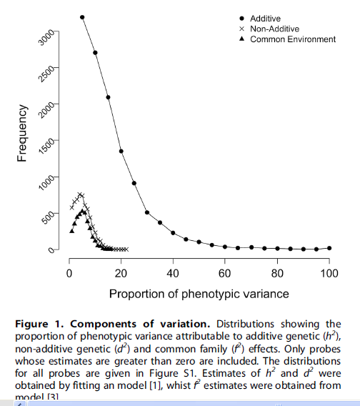
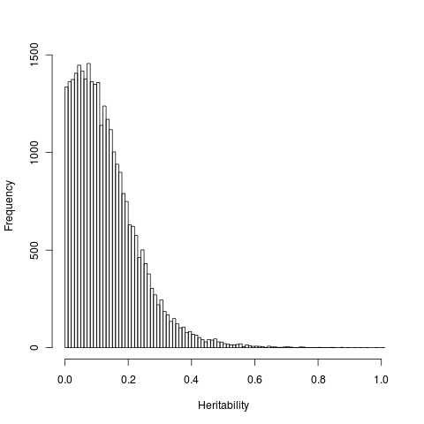
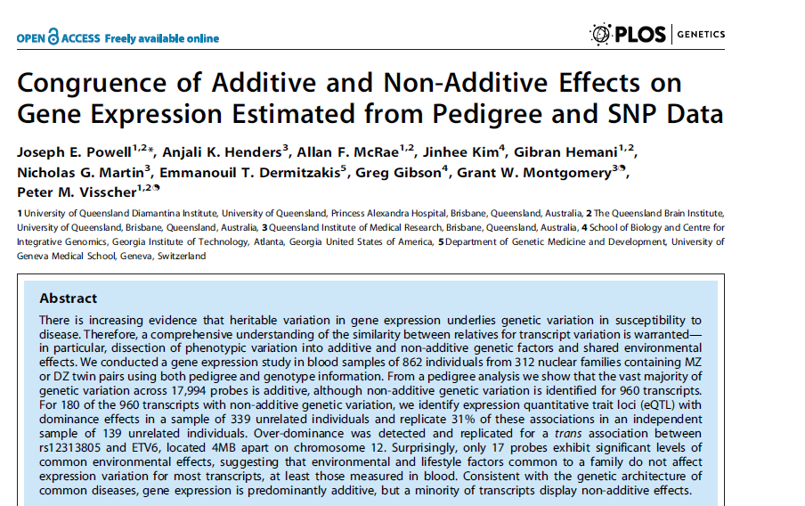
Distribution heritability estimates across 47,585 transcripts (~700 MZ & 600 DZ Dutch pairs)

Slide 8
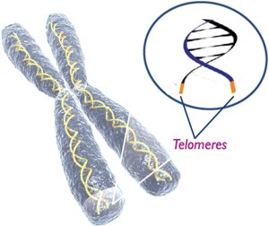
Meta-analysis of telomere length in 19,713 subjects
Linda Broer et al. (ENGAGE consortium)
 | n | r | p-value
Siblings | 1,553 | 0.49 | 3.46*10⁻⁹⁶
Monozygotic twins | 2,534 | 0.69 | 0*
Dizygotic twins | 1,940 | 0.25 | 2.82*10⁻³⁰
Spouses (<55) | 962 | 0.20 | 3.24*10⁻¹⁰
Spouses (>55) | 977 | 0.31 | 4.27*10⁻²³
Parent offspring |  | n | r | p-value
Father-son |  | 791 | 0.34 | 2.57*10⁻²³
Father-daughter |  | 882 | 0.33 | 3.99*10⁻²⁴
Mother-son |  | 850 | 0.42 | 5.06*10⁻³⁷
Mother-daughter |  | 1,005 | 0.42 | 2.99*10⁻⁴⁵
Heritability ~70%
Eur J Hum Genet. 2013 Oct;21(10):1163-8.

Slide 9
Genetic Epidemiology:
Stages of Genetic Mapping
Are there genes influencing this trait?
  Genetic epidemiological studies
Where are those genes?
  Linkage analysis
What are those genes?
  Association analysis
How do they work beyond the sequence?
  Epigenetics, transcriptomics, proteomics
What can we do with them ?
  Translational medicine

Slide 10
Linkage analysis
Thomas Hunt Morgan – discoverer of linkage

Slide 11
x
1/4
1/4
1/4
1/4

Slide 12
IDENTITY BY DESCENT
Sib 1
Sib 2
4/16 = 1/4 sibs share BOTH parental alleles IBD = 2
8/16 = 1/2 sibs share ONE parental allele IBD = 1
4/16 = 1/4 sibs share NO parental alleles IBD = 0

Slide 13
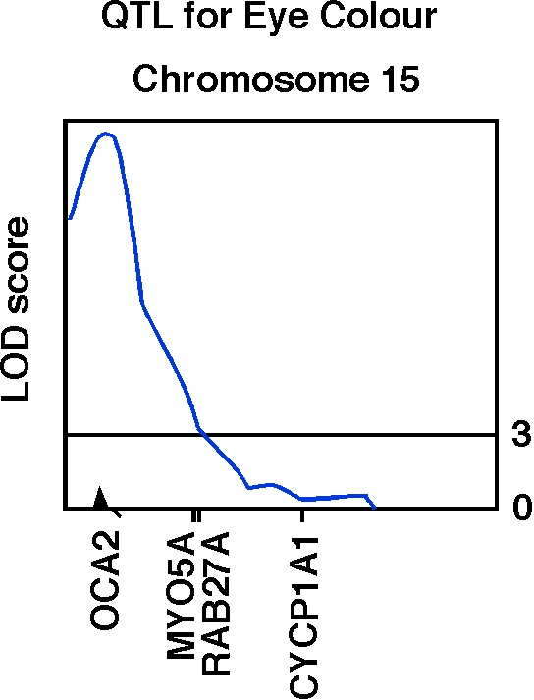
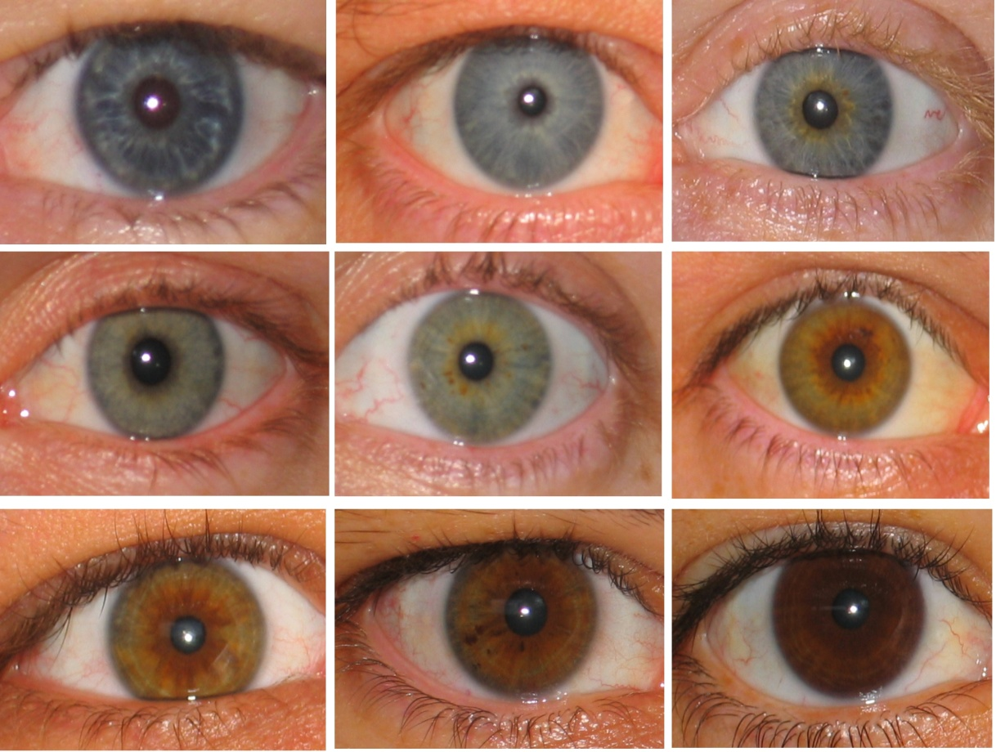
Human OCA2 and eye colour
Zhu et al., Twin Research 7:197-210 (2004)

Slide 14
Finding the genes - association
Looks for correlation between specific alleles and phenotype (trait value, disease risk)

Slide 15
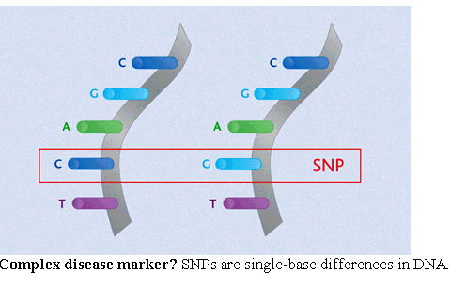
Variation: Single Nucleotide Polymorphisms

Slide 16
Linkage disequilibrium

Slide 17
Linkage disequilibrium
time

Slide 18
Indirect association
this SNP will be associated with disease

Slide 19
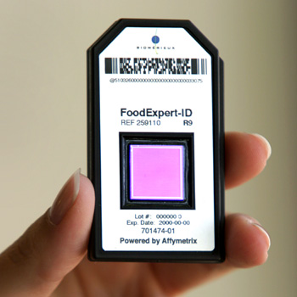
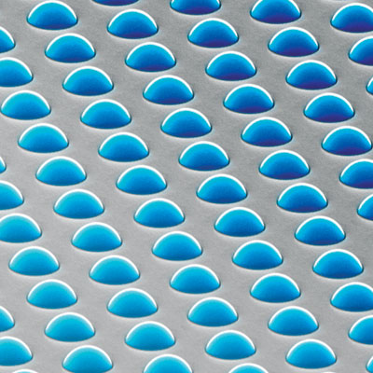
High density SNP arrays – up to 1 million SNPs

Slide 20
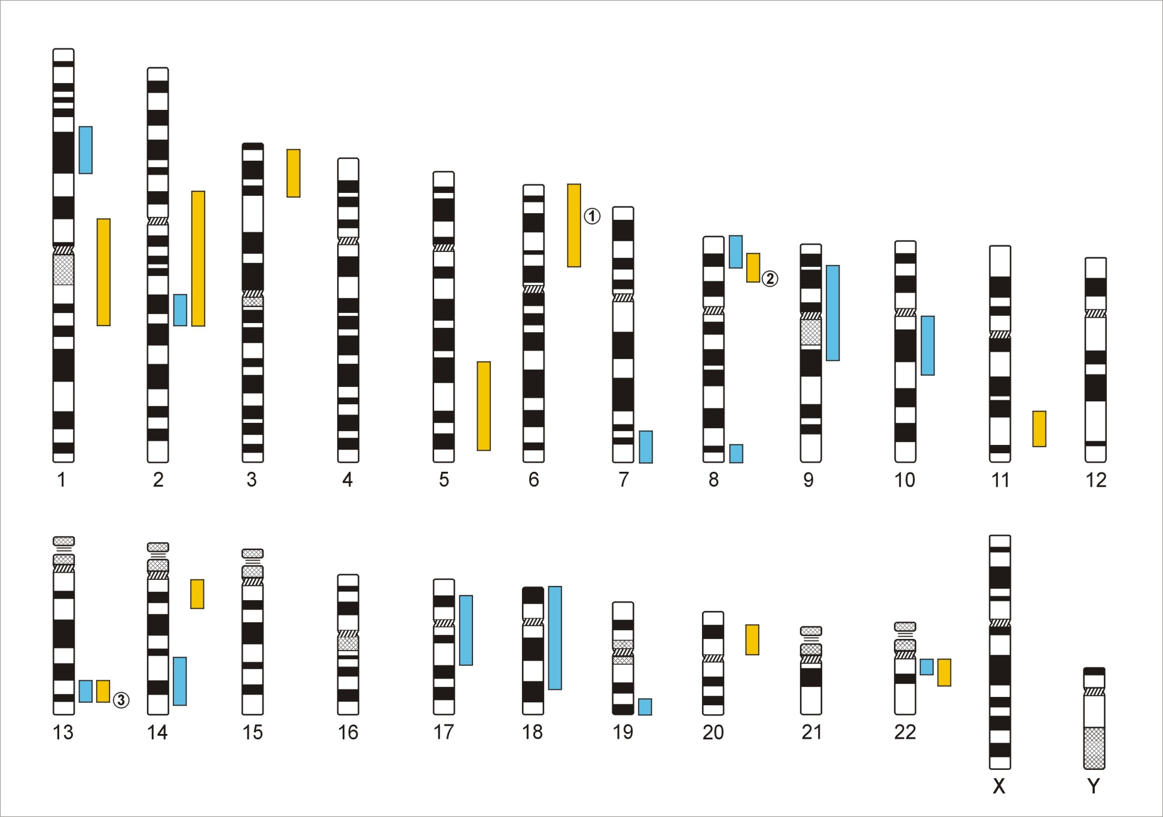
Genome-Wide Association Studies
500,000 – 5,000,000 SNPs
Human Genome - 3,1x10⁹ Base Pairs
Notes:
In a GWA the Genome which contains xx SNPs is examined using … SNPs

Slide 21
Genetic Case Control Study
Controls
Cases
G/T
G/G
T/T
T/T
T/T
T/G
T/G
T/T
T/G
T/G
G/G
T/G
T/G
T/T
Allele G is ‘associated’ with disease

Slide 22
Allele-based tests (case-control)
Each individual contributes two counts to 2x2 table.
Test of association
where
X² has χ² distribution with 1 degrees of freedom under null hypothesis.
 | Cases | Controls | Total
G | n_{1A} | n_{1U} | n_{1·}
T | n_{0A} | n_{0U} | n_{0·}
Total | n_{·A} | n_{·U} | n··

Slide 23
Simple Regression Model of Association
(continuous trait)
Y_{i} = α + βX_{i} + e_{i}
where
Y_{i} = trait value for individual i
X_{i} = number of ‘A’ alleles an individual has
1.2
1
0.8
Y
0.6
0.4
0.2
0
X
0
1
2
Association test is whether β > 0

Slide 24
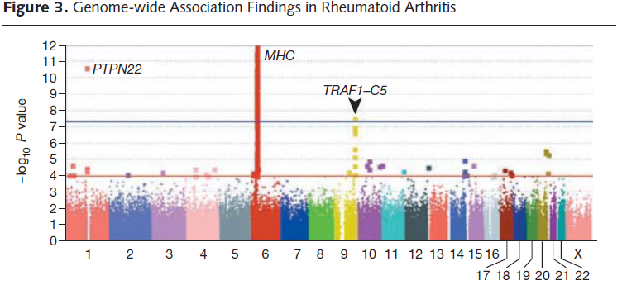
We define genome-wide significance as .05/1 million effective tests = 5 x 10⁻⁸

Slide 25
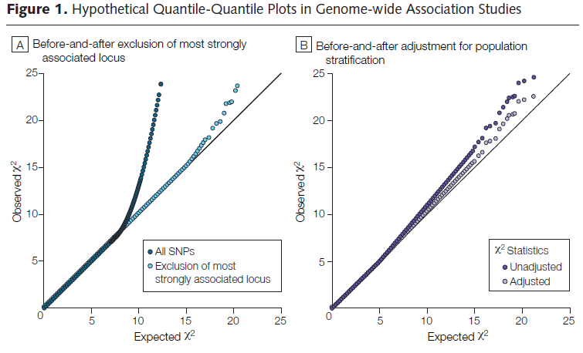

Slide 26
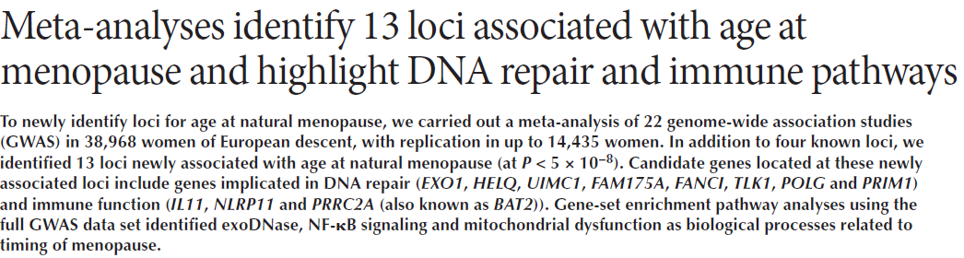
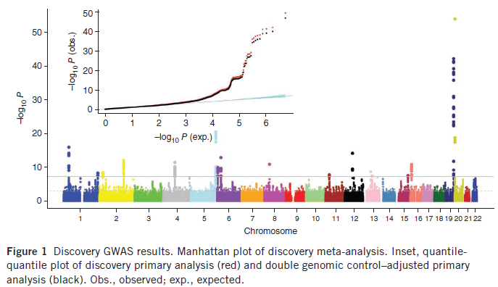

Slide 27
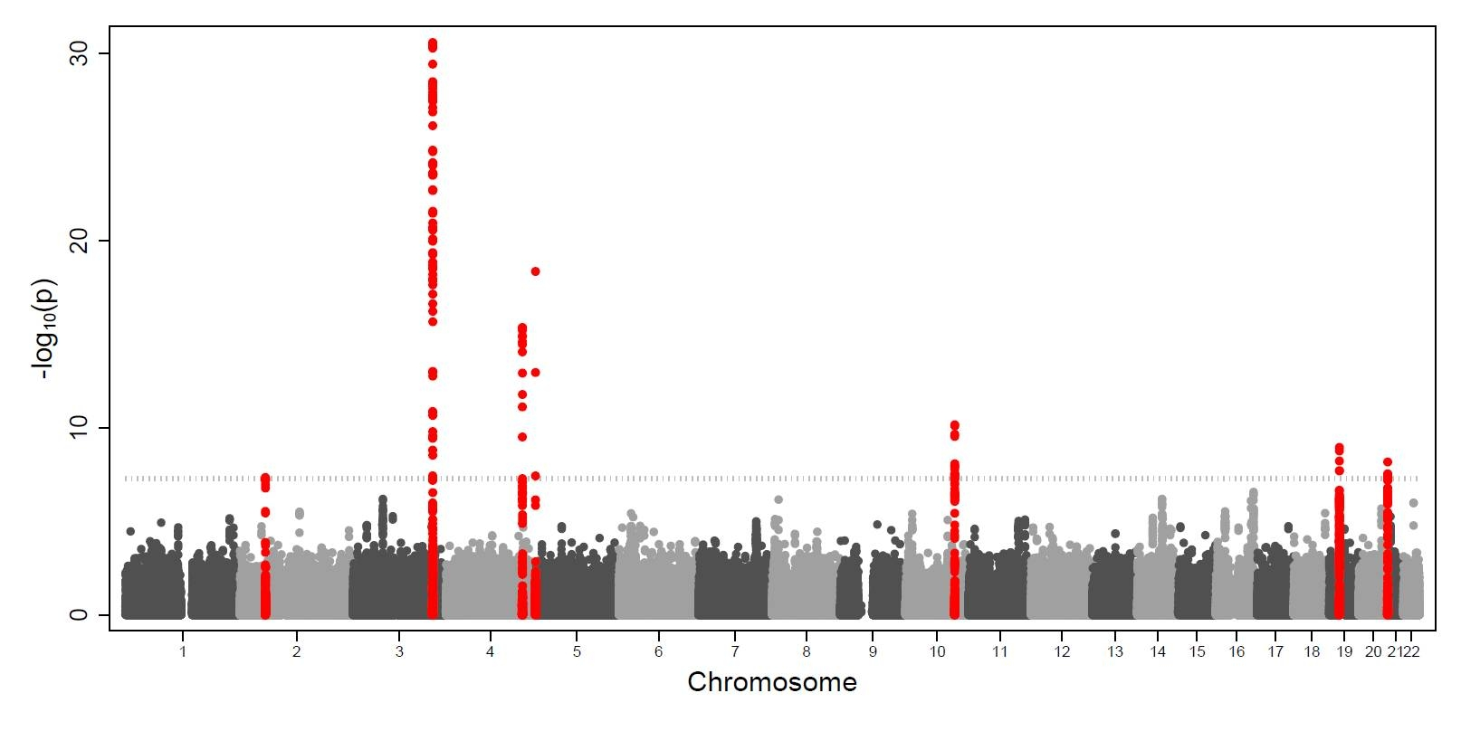
Identification of seven loci affecting mean telomere length and their association with disease
Veryan Codd et al. (ENGAGE consortium) NG, 2013
Twin registries supplied 34% of samples
TERC
TERT
NAF1
OBFC1
ZNF208
RTEL1
ACYP2

Slide 28
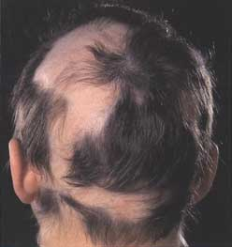
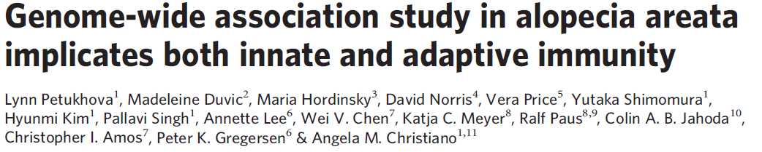
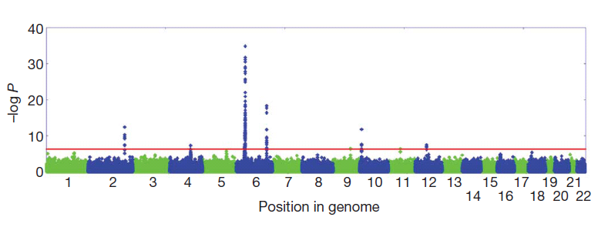

Slide 29
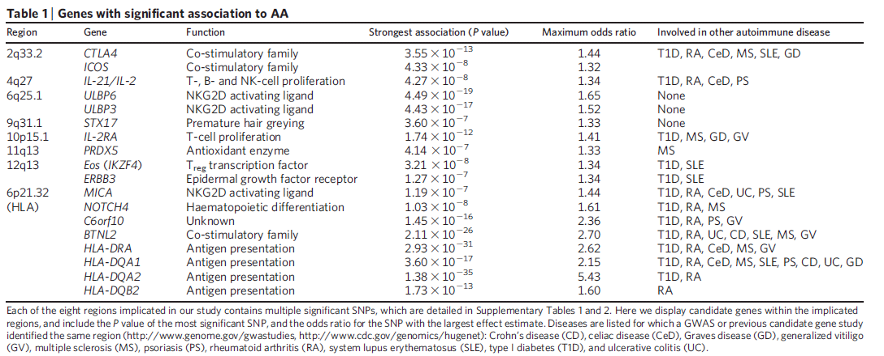
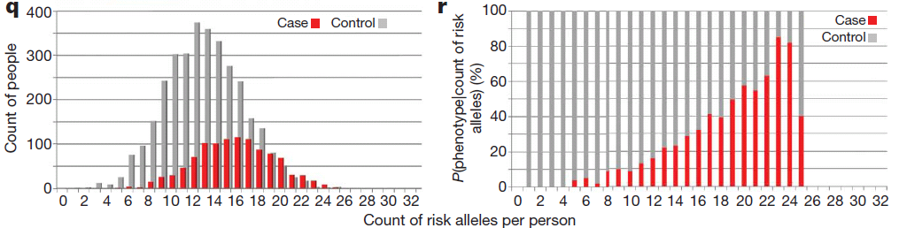

Slide 30
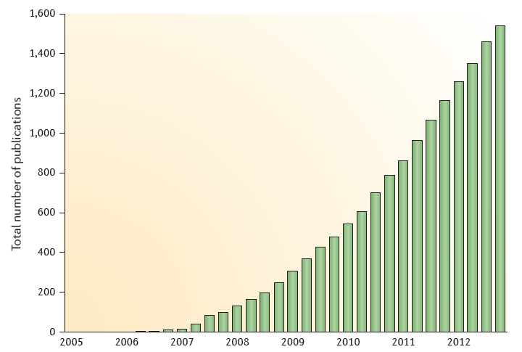
GWAS publications since 2005
Manolio, Nature Reviews Genetics, August 2013

Slide 31
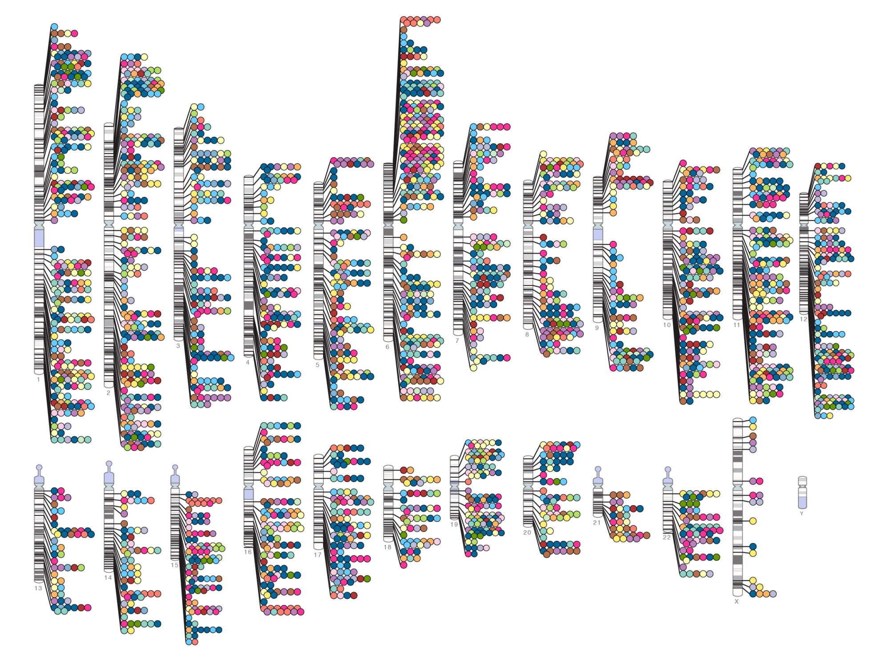
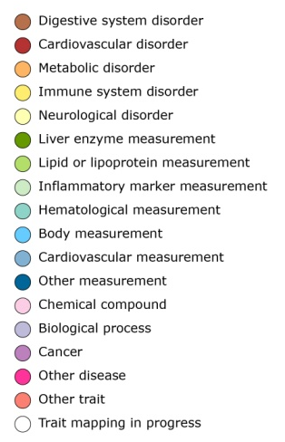

Published Genome-Wide Associations through 07/2012
Published GWA at p≤5X10⁻⁸ for 18 trait categories
NHGRI GWA Catalog
www.genome.gov/GWAStudies
www.ebi.ac.uk/fgpt/gwas/

Slide 32
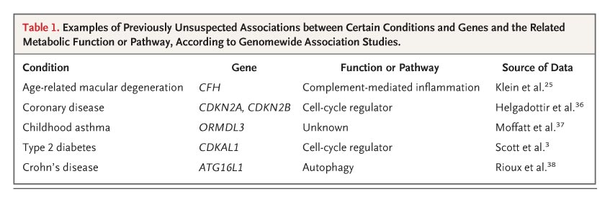

Examples of Previously Unsuspected Associations between Certain Conditions and Genes and the Related Metabolic Function or Pathway, According to Genomewide Association Studies
Manolio T. N Engl J Med 2010;363:166-176

Slide 33
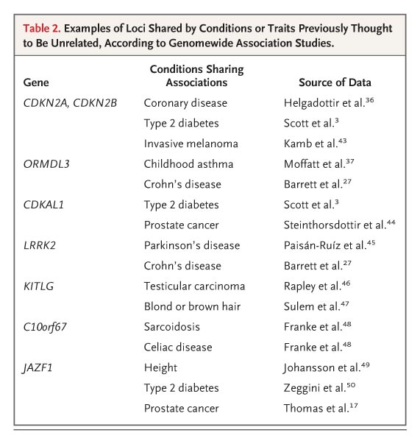
Examples of loci shared by conditions or traits previously thought to be unrelated, according to Genomewide Association Studies
Manolio T. N Engl J Med 2010;363:166-176

Slide 34
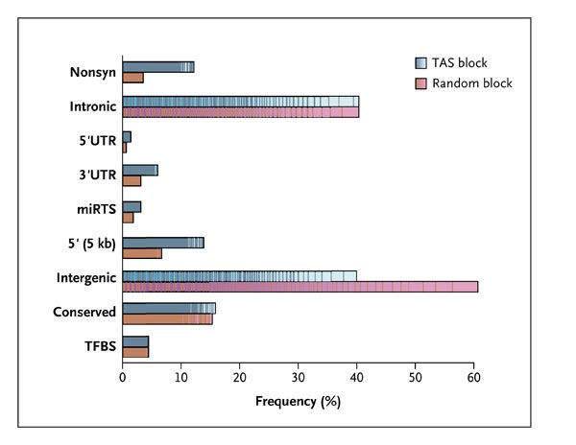
Functional classifications of 465 Trait-Associated SNPs and the SNPs in Linkage Disequilibrium with them
Manolio T. N Engl J Med 2010;363:166-176

Slide 35
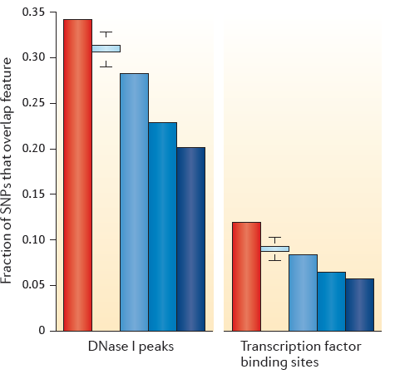
Correlations of presumed regulatory regions defined from GWAS
DNaseI peaks indicate regions of open chromatin accessible to the transcription apparatus and transcription factor binding sites where this this apparatus attached to the DNA
Manolio, Nature Reviews Genetics, August 2013

Slide 36
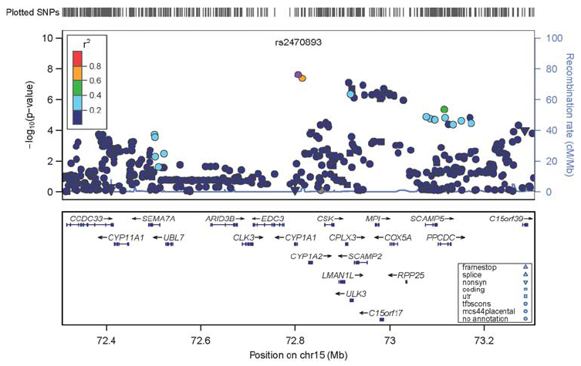

Slide 37
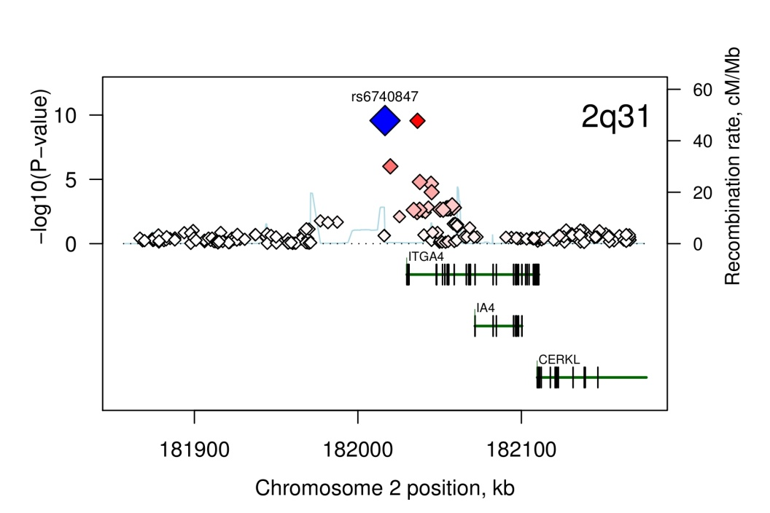
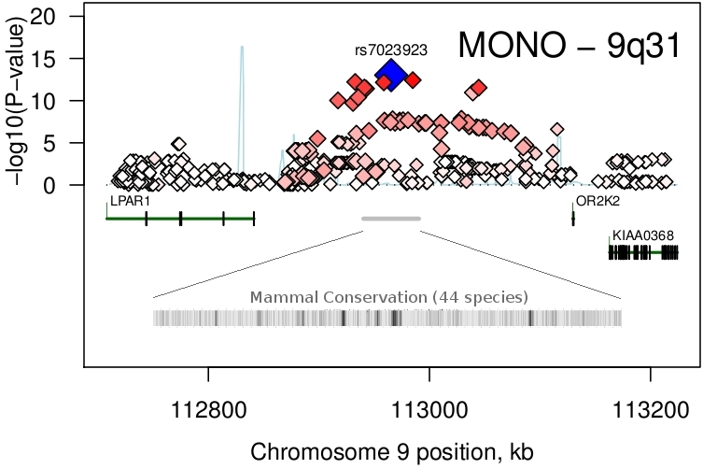
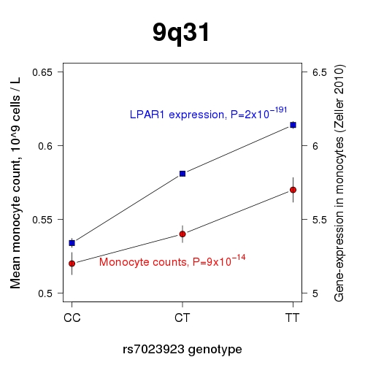
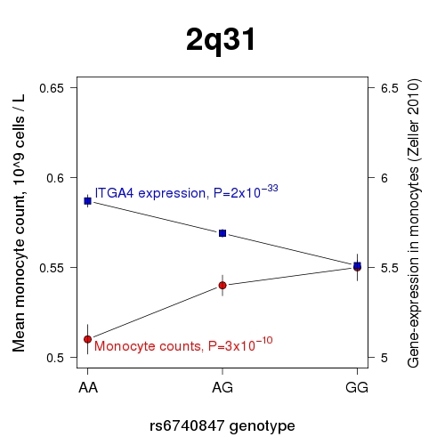
GWAS of monocyte counts – help from expression data
Discovery N=4,225 (QIMR+NTR), replication N=1,517 (Busselton, GenomEUtwin)
Ferreira et al. (2009) AJHG 85: 745; Zeller et al. (2010) PLoS One 5: e10693.

Slide 38
Selected quantitative traits Selected diseases
Number of Loci Identified is a Function of Sample Size
Visscher PM, et.al. (2012) Am J Hum Genetics

Slide 39
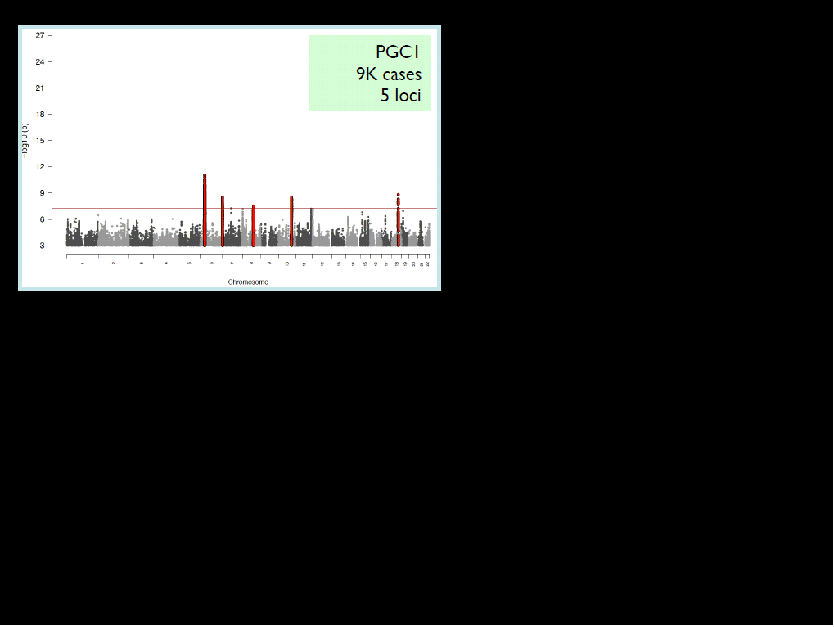
October 2011
Dramatic progress in GWAS for Schizophrenia

Slide 40
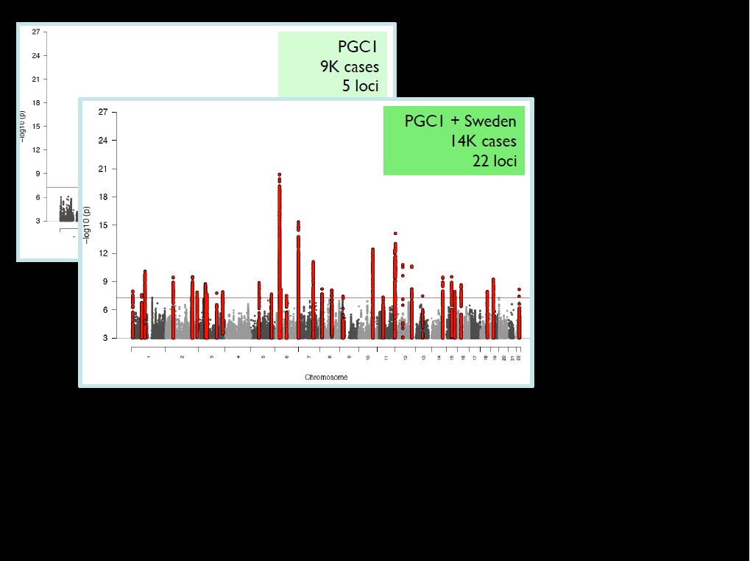
July 2012

Slide 41
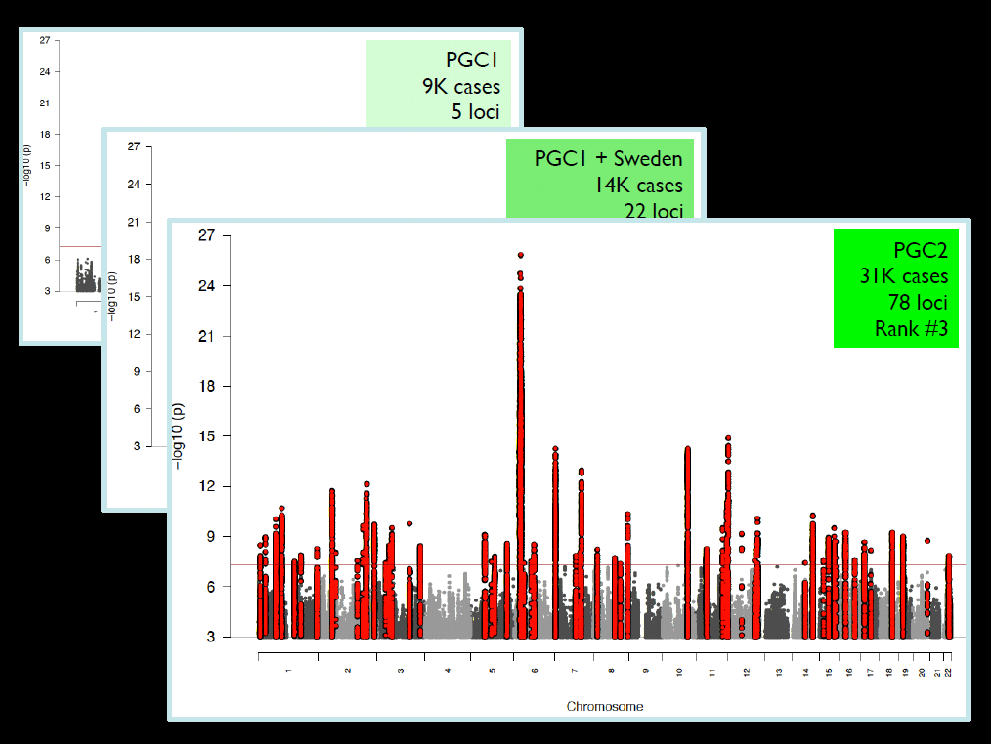
April 2013

Slide 42
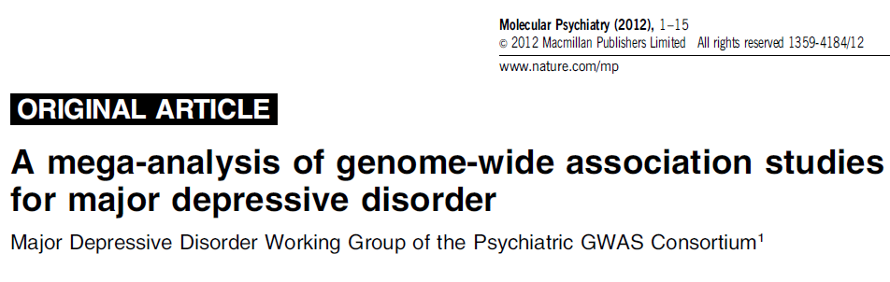
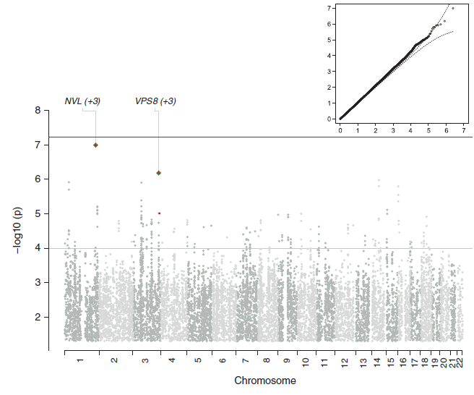
9240 MDD cases
9519 controls
….Nothing ☹
In the MDD-bipolar cross-disorder analysis, 15 SNPs exceeded GWS, and all were in a 248 kb interval of high LD on 3p21.1(rs2535629)

Slide 43
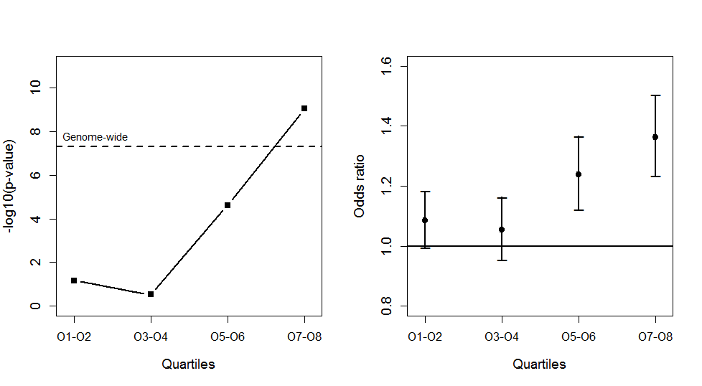
Significance and effect size for the top hit with cases split into
non-overlapping quartiles by age-at-onset within their study

Slide 44
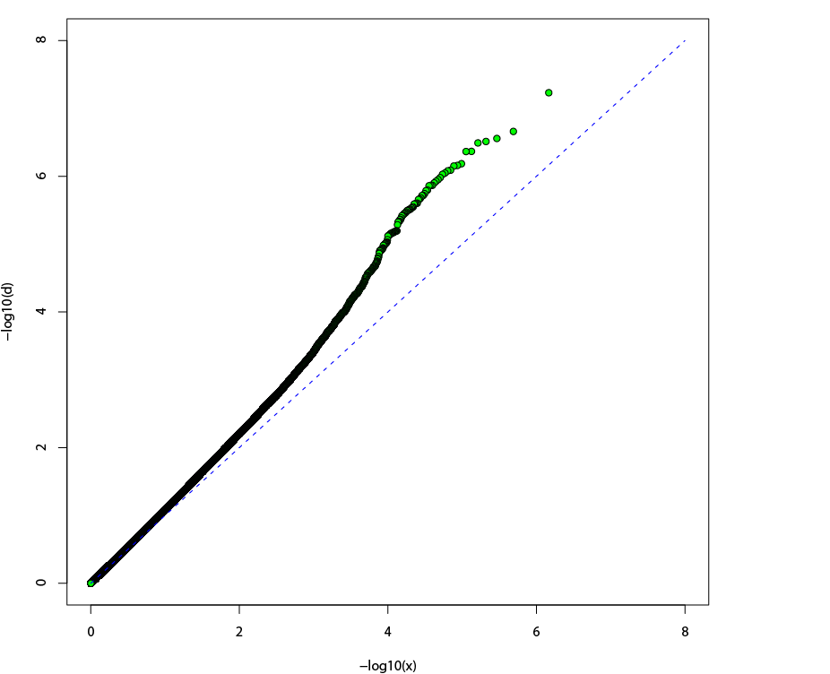
Schizophrenia (ISC) Q-Q plot
Consistent with:
Stratification?
Genotyping bias?
Distribution of true
polygenic effects?
Observed -log10(p)
λ = 1.092
Expected -log10(p)

Slide 45
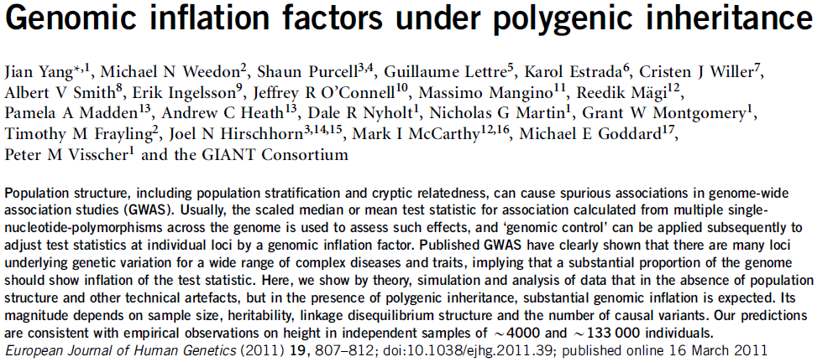
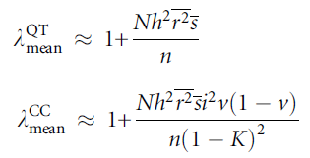

Slide 46
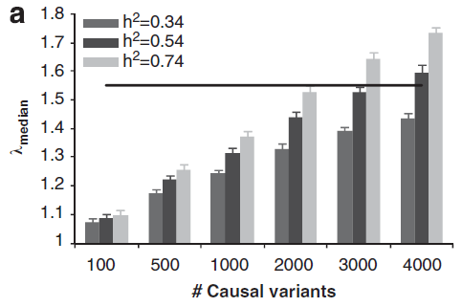

Slide 47
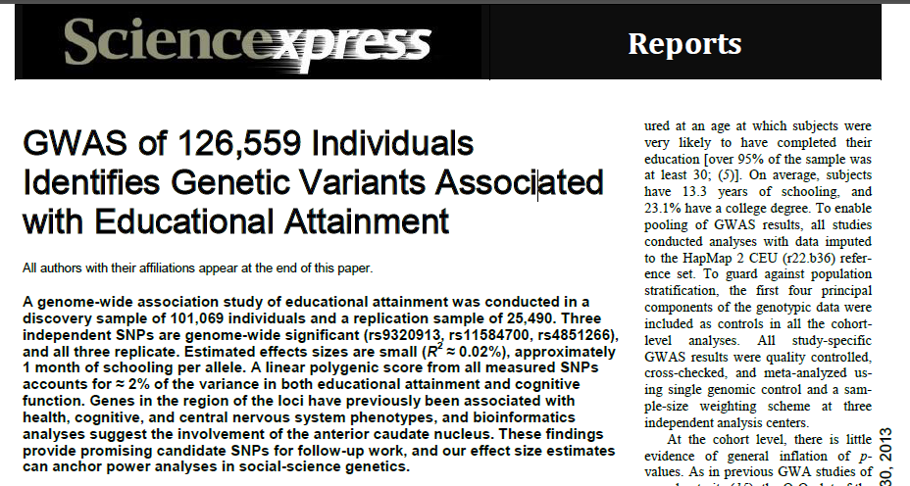
Finnish twin cohort
Netherlands twin register
QIMR (Australian twin register)
Swedish twin register
TwinsUK
Minnesota Twin – family study
Twin registers supply 44,751 Ss (i.e. >35% of total sample size)
There are 6 twin cohorts and total of 52 cohorts (11%)

Slide 48
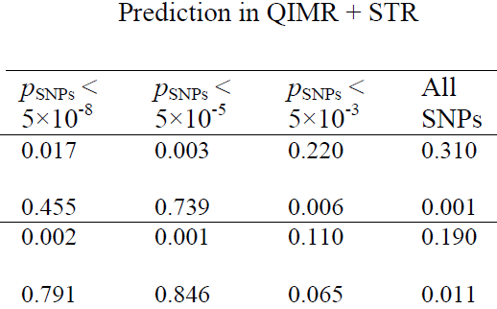
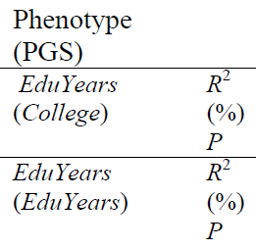
The value of DZ twins for within-pair association tests for ruling out population stratification
Within-family regression results of the polygenic scores on College and EduYears in the QIMR and Swedish Twin Registry cohorts using SNPs selected from the meta-analysis excluding the QIMR and STR cohorts.
Analyses for QIMR are based on 572 full-sib pairs from independent 572 families. Analyses for STR are based on 2,774 DZ twins from 2,774 independent families.
Science. 2013 Jun 21;340:1467-71

Slide 49
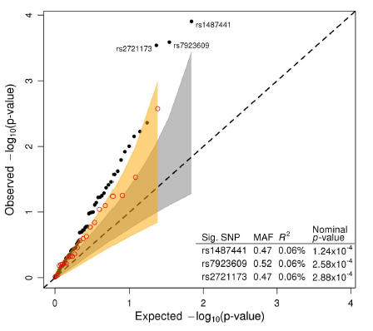
Education SNPs predict IQ
Koellinger, submitted

Slide 50
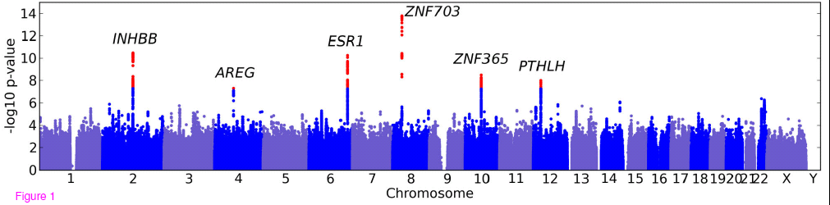
GWAS of Bra cup size on 16,000 women (23andMe)

Slide 51
How much variance have
GWAS studies explained?

Slide 52



GWAS’ greatest success: T1D

Slide 53

Variance explained
by GWAS for
selected complex traits
Visscher PM, et.al. (2012) Am J Hum Genetics

Slide 54
Possible explanations for missing heritability
(not mutually exclusive, but in order of increasing plausibility ?)
Heritability estimates are wrong
Nonadditivity of gene effects – epistasis, GxE
Epigenetics – including parent-of-origin effects
Low power for common small effects
Disease heterogeneity – lots of different diseases with the same phenotype
Poor tagging (1)
  rare mutations of large effect (including CNVs)
Poor tagging (2)
  common variants in problematic genomic regions

Slide 55
Possible explanations for missing heritability
(in order of increasing plausibility ?)
Heritability estimates are wrong
Nonadditivity of gene effects – epistasis, GxE
Epigenetics – including parent-of-origin effects
Low power for common small effects
Disease heterogeneity – lots of different diseases with the same phenotype
Poor tagging (1)
  rare mutations of large effect (including CNVs)
Poor tagging (2)
  common variants in problematic genomic regions

Slide 56

Non-additive variance?

Slide 57
Estimates of chromosomal heritabilities for height
No epistasis?

Slide 58
EVIDENCE FOR POLYGENIC EPISTATIC INTERACTIONS
IN MAN?
A. C. HEATH, N. G. MARTIN, L. J. EAVES AND D. LOESCH
Genetics 106: 719-727,1984

Slide 59



Slide 60

Contribution to heritability of gene–gene interactions varies among traits, from ~0 to ~50%

Slide 61
Possible explanations for missing heritability
(in order of increasing plausibility ?)
Heritability estimates are wrong
Nonadditivity of gene effects – epistasis, GxE
Epigenetics – including parent-of-origin effects
Low power for common small effects
Disease heterogeneity – lots of different diseases with the same phenotype
Poor tagging (1)
  rare mutations of large effect (including CNVs)
Poor tagging (2)
  common variants in problematic genomic regions

Slide 62


Effects sizes of validated variants from 1st 16 GWAS studies
Most effect sizes are very small <1.1

Slide 63
…and will need huge sample sizes to detect
Mendelian
Disorders
Not possible
Large
Linkage studies
Candidate association studies: Effect size RR ~2
sample size- hundreds
Effect
size
Genome-wide association studies Effect size RR ~1.2
Sample size - thousands
Next Generation GWAS Effect size RR ~1.05
Sample size –tens of thousands
Very
very
Small
Not detectable/
Not useful
Very
very
Rare
Common
Allele Frequency

Slide 64
Possible explanations for missing heritability
(in order of increasing plausibility ?)
Heritability estimates are wrong
Nonadditivity of gene effects – epistasis, GxE
Epigenetics – including parent-of-origin effects
Low power for common small effects
Disease heterogeneity – lots of different diseases with the same phenotype
Poor tagging (1)
  rare mutations of large effect (including CNVs)
Poor tagging (2)
  common variants in problematic genomic regions

Slide 65
What if our “disease” is actually dozens (hundreds, thousands) of different diseases that all look the same?

Slide 66

Loci for Inherited Peripheral Neuropathies
Multiple causal loci for Charcot Marie Tooth disease (CMT)
MFN2
GARS
HSPB1
SH3TC2
DMN2
CTDP

Slide 67
Possible explanations for missing heritability
(in order of increasing plausibility ?)
Heritability estimates are wrong
Nonadditivity of gene effects – epistasis, GxE
Epigenetics – including parent-of-origin effects
Low power for common small effects
Disease heterogeneity – lots of different diseases with the same phenotype
Poor tagging (1)
  rare mutations of large effect (including CNVs)
Poor tagging (2)
  common variants in problematic genomic regions

Slide 68
Genetic diversity is larger than differences in DNA sequence
When we take into account:
Structural variation [e.g. copy number variants (CNV)]
Epigenetic differences (DNA methylation status)

Slide 69
Duplication
...CG
ATG...
1bp - Mb
...CG
ATG...
...GTG
GGG...
...TT
GAA...
Deletion
...CG
ATG...
Translocation
...CG
ATG...
...GTG
GGG...
...CG
ATG...
...GTG
GGG...
...TT
GAA...
Insertion
...CG
ATG...
...TT
GAA...
Inversion
...CG
ATG...
...TT
GAA...
...CG
ATG...
...GTG
GGG...
...TT
GAA...
Segmental Duplication
...CG
ATG...
...GTG
GGG...
...TT
GAA...
With no CNV
...CG
ATG...
...GTG
GGG...
...TT
GAA...
Notes:
69

Slide 70

For example: Bipolar disorder
… we present a genome-wide copy number variant (CNV) survey of 1001 cases and 1034 controls ... Singleton deletions (deletions that appear only once in the dataset) more than 100 kb in length are present in 16.2% of BD cases and in 12.3% of controls (permutation P = 0.007).
Our results strongly suggest that BD can result from the effects of multiple rare structural variants.

Slide 71
Possible explanations for missing heritability
(in order of increasing plausibility ?)
Heritability estimates are wrong
Nonadditivity of gene effects – epistasis, GxE
Epigenetics – including parent-of-origin effects
Low power for common small effects
Disease heterogeneity – lots of different diseases with the same phenotype
Poor tagging (1)
  rare mutations of large effect (including CNVs)
Poor tagging (2)
  common variants in problematic genomic regions

Slide 72

50% of human genome is repetitive DNA.
Only 1.2% is coding

Slide 73

Types of repetitive elements and their chromosomal locations

Slide 74
Summary
Huge amount of repetitive sequence
Highly polymorphic
Some evidence that it has functional significance
Earlier studies too small (100s) to detect effect sizes now known to be realistic
Much (most?) such variation poorly tagged with current chips
Current CNV arrays only detect large variants; no systematic coverage of the vast number of small CNVs (including microsatellites)

Slide 75
Editor: Nick Martin
Publisher: Cambridge University Press
Fully online
Fast turnaround
First submission free to workshop participants!!!!!☺

Slide 76

Editor: John Hewitt
Editorial assistant Christina Hewitt
Publisher: Springer
Fully online
http://www.bga.org

