Slide 1

The genetics of brain structure and function
Nick Martin
Queensland Institute
of Medical Research
Brisbane
(edits Sarah Medland)

Slide 2
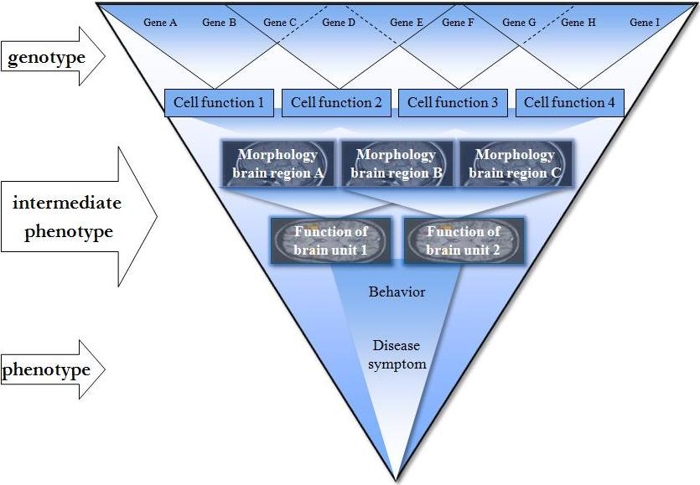
Pathways from gene to disease
Franke et al., Hum. Genet. 2009

Slide 3
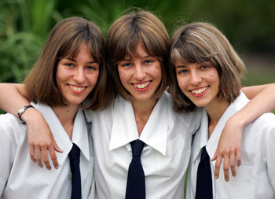
QLD Twin Imaging Study (QTIMS)
Heritability of brain structure and function and its relation to cognition
Australia
Greig de Zubicaray (UQ)
Nick Martin (QIMR)
Katie McMahon (UQ)
Margie Wright (QIMR)
USA
Paul Thompson (UCLA)
Arthur Toga (UCLA)
Xavier Castellanos (NYU)
Mike Millham (NYU)
Supported by NIH (2007-2012) and NHMRC (2008-2013)
Notes:
Building on this work the next step is to do GWAStudies

Slide 4
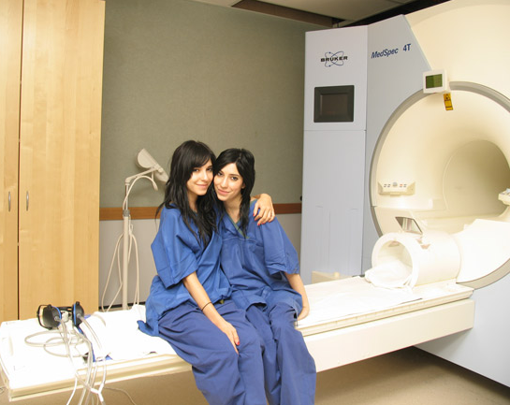
Data Acquisition
4 Tesla MRI scanner
Wesley Hospital
Brisbane, Australia
  Structural MRI
  Functional MRI (fMRI) - n-back working memory task; resting state
  Diffusion Tensor Imaging(DTI)
Notes:
We are applying these models in a large-scale twin study in Brisbane.
The twins come in for a 1 hour scan session consisting of structural, functional and diffusion magnetic resonance imaging.
Right now I’m focusing on the functional MRI and am trying to map the genetic influences on brain activation during the N-back Working Memory Task.

Slide 5


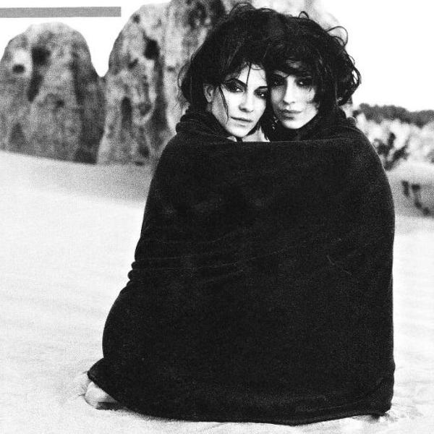
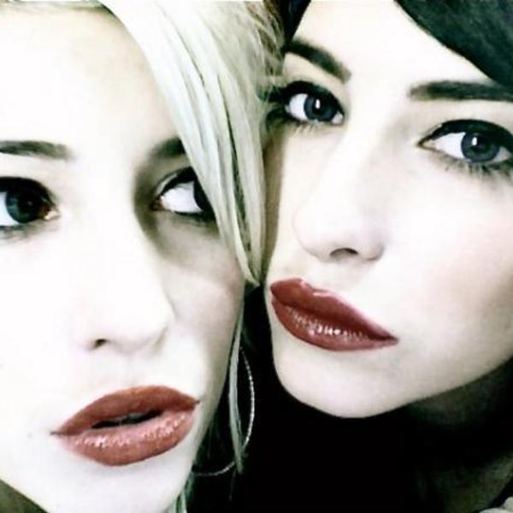

Slide 6
Sample
1089 twins/sibs from 611 families (tested 2007-12)
  Aged 18-30yrs; 62% females; all right handed
  Includes 401 complete twin pairs (173 MZ, 227 DZ)
  And 287 single twins/ non-twin siblings
  80 twins/sibs were retested ~3 months later
  Most participated in the cognition study at age 16y
  All GW genotyped(Illumina 610k/core+exome 720k)
Plus 156 younger twins
    36 pairs at age 12 years
    42 pairs at age 16 years

Slide 7
Psychometric IQ
  Full-scale IQ (MAB)
  Verbal ability (info, arith, vocab)
  Performance ability (spatial, obj ass)
  WAIS digit span/symb, LNS, matrix
Processing speed
  Inspection time
  Reaction time
  N200 latency
  P300 latency
Working memory (DRT, nBack)
  Performance accuracy
  P300 amplitude
  Slow wave amplitude
Relational Complexity
  N-term, Latin square, Sentence
Psychophysiological
  alpha frequency
  EEG power
  EEG coherence
Academic achievement
  Queensland Core Skills
Reading
  NART
  Schonell
  CORE reading and spelling
Cognitive Battery:
Extensive battery of cognitive tests at 16 yrs
3.5 hr in-person assessment
Short battery of cognitive tests at MRI if no cognitive testing available at 16 yrs
current, old, new

Slide 8
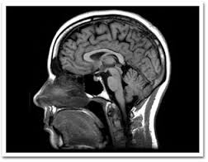
Genetics of brain structure

Slide 9
ACE Model for twin data
1
MZ=1.0 / DZ=0.5
E
C
A
A
C
E
e
c
a
a
c
e
P_{T1}
P_{T2}

Slide 10
For neuroimaging phenotypes we can fit the ACE model to every voxel – up to 2M. Very computer intensive!

Slide 11
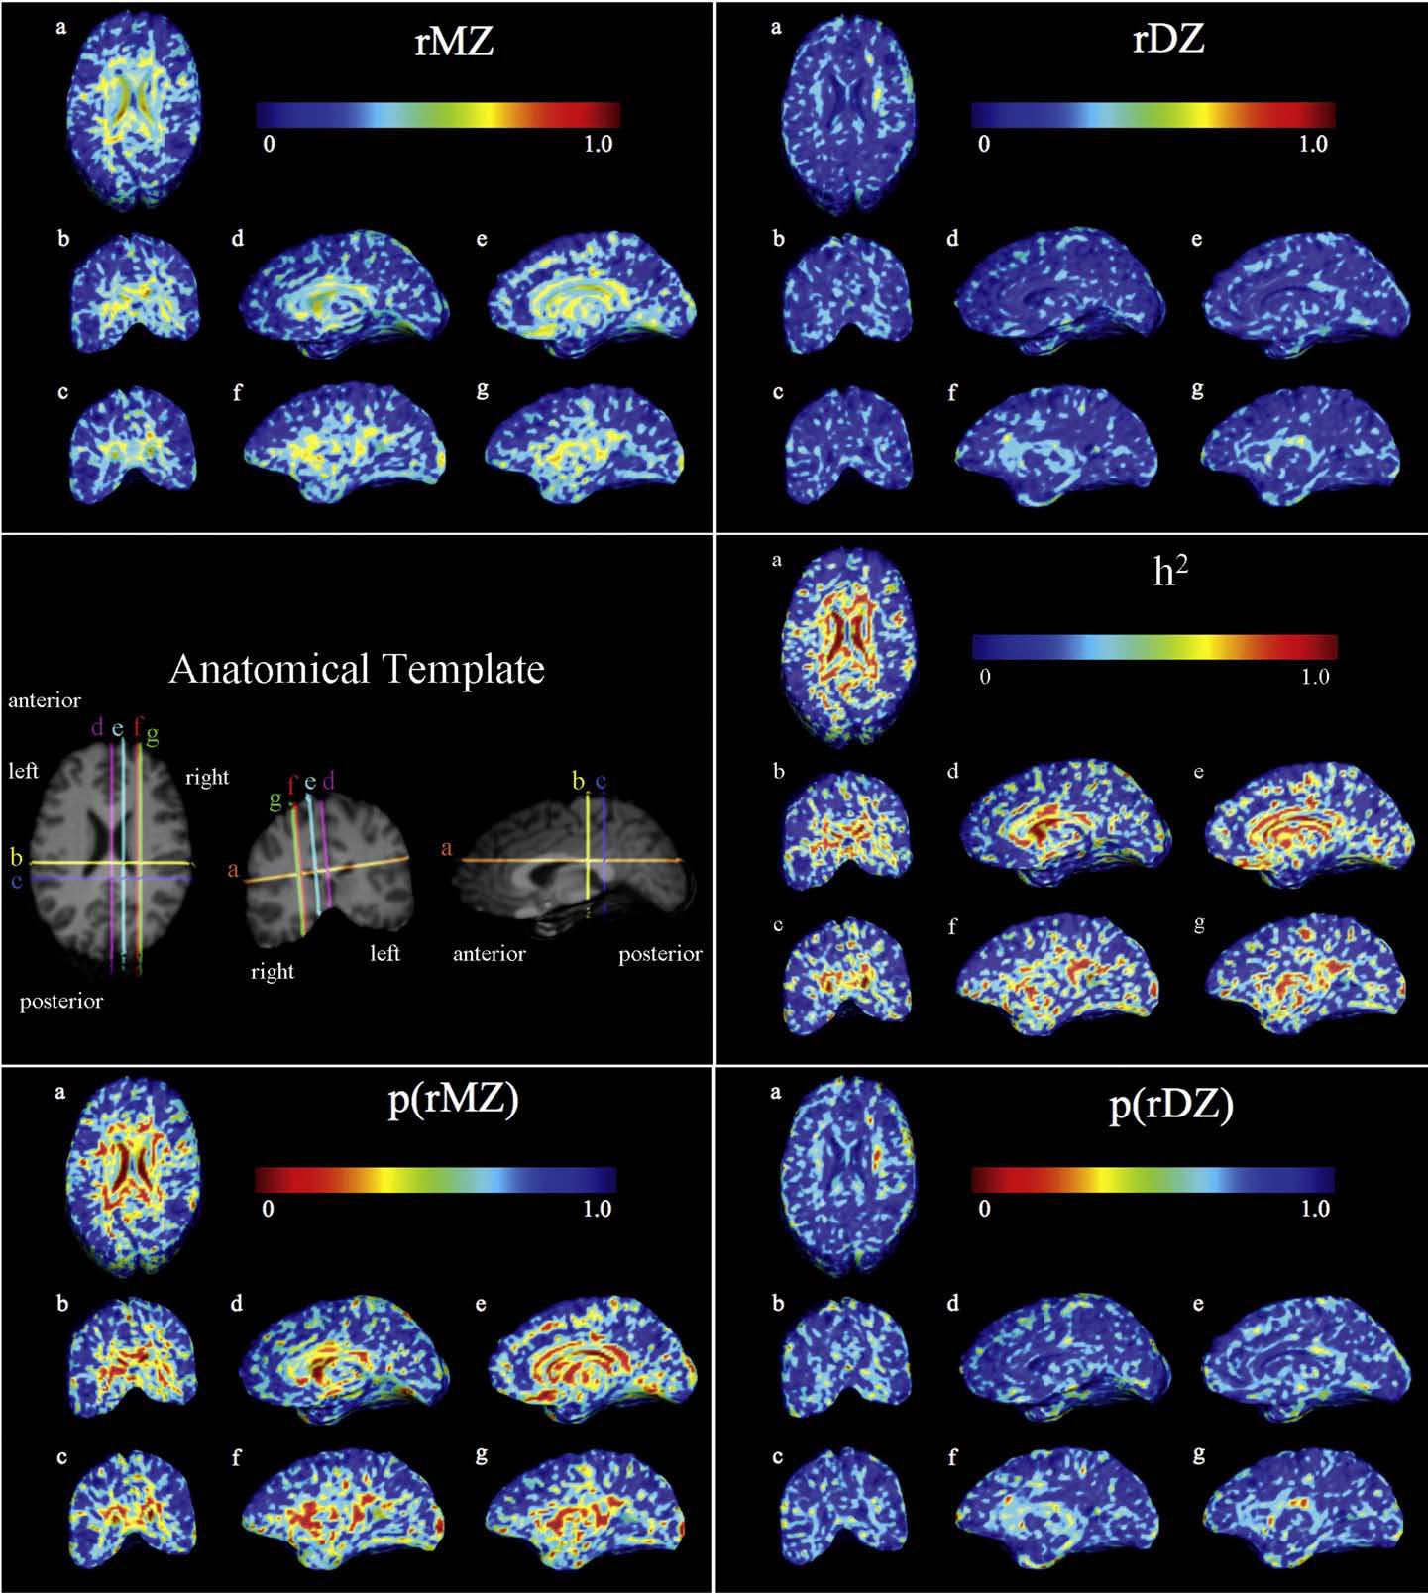
MZ twins show
greater
resemblance
in morphometry
than DZ twins
Heritability:-
20% in white matter
75% in subcortical structures (corpus callosum, ventricles)
20–40% in basal
ganglia, thalamus
50% occipital lobes
voxelwise maps define a more
detailed spatial pattern for the
different influences
Neuroimage 48:37- 49, 2009

Slide 12
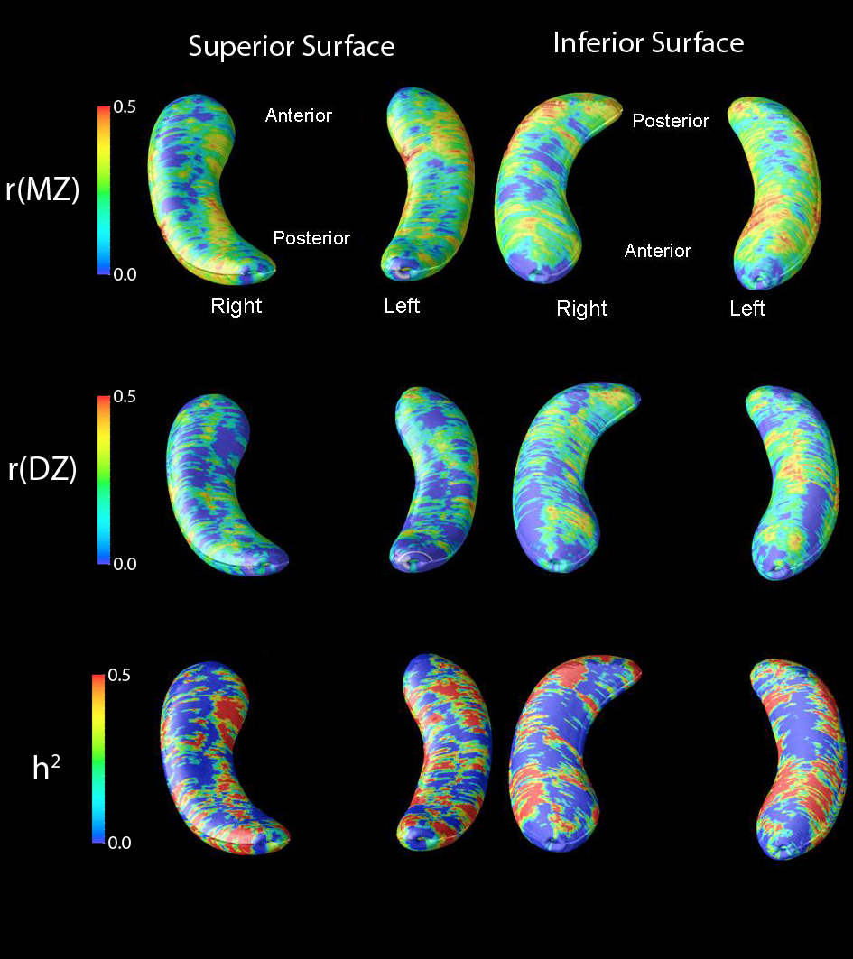
3D profile of genetic influences on the hippocampus
81 MZ & 44 DZ twin pairs
maps show hotspots of genetic influence
substantial variance due to unique environment - hippocampus is highly plastic, adapting in response to individual experiences
confirms previous studies - h² of hippocampal vol.~40-69%
(Peper et al. Human Brain Mapping, 2007; Sullivan et al. Hippocampus, 2001)

Slide 13
Heritability of cortical thickness (CT)
Research has shown that patterns of cortical thinning is associated with diseases such as schizophrenia, bipolar, depression, and Alzheimer’s.
In this study, we estimated the heritability of cortical thickness from 28 regions of interest (ROIs).
Genome-wide association (GWA) scans were performed on each ROI in order to identify variants associated with the thickness of the cortex.

Slide 14
Voxel-by-voxel CT brain map for one individual

Slide 15
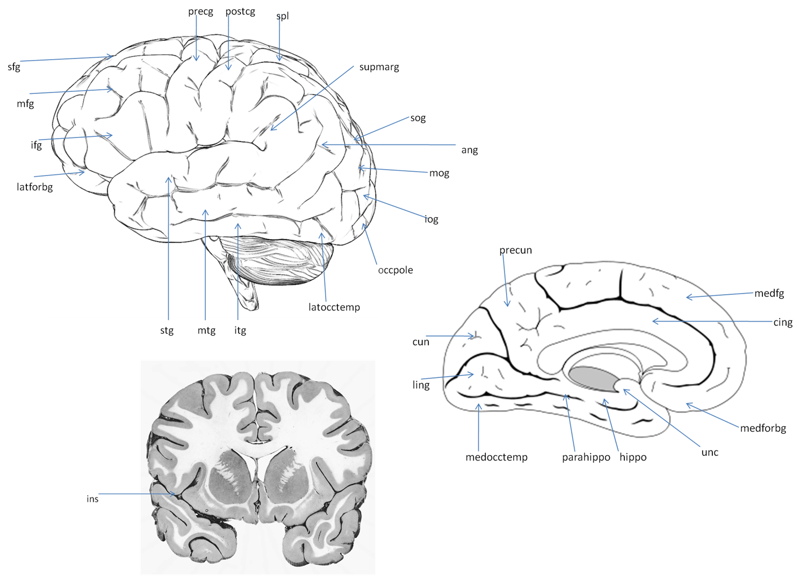
28 ROIs

Slide 16
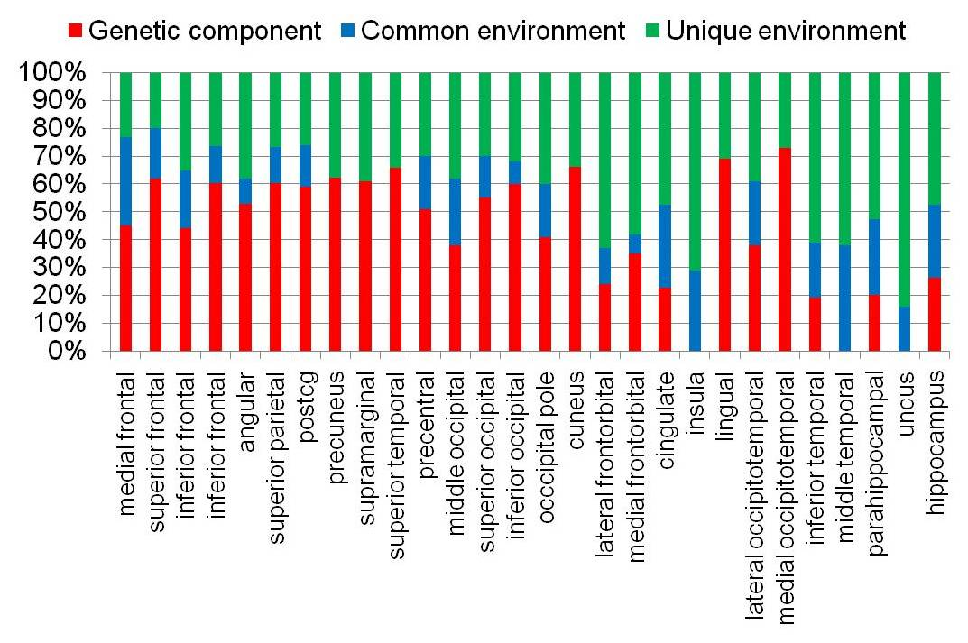
Variance components estimates on CT

Slide 17
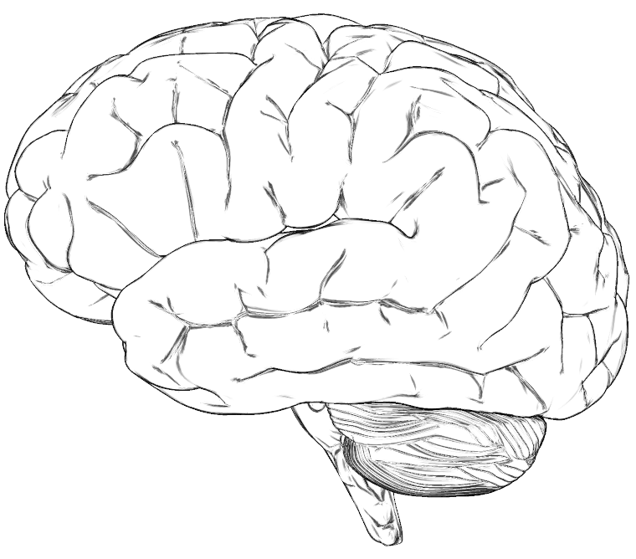
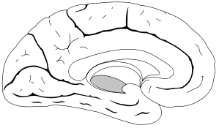
Heritability ranges by lobe
Parietal:
52%-61%
Frontal:
24%-62%
Occipital:
38%-69%
Limbic/Insular:
0%-26%
Temporal:
0%-73%

Slide 18
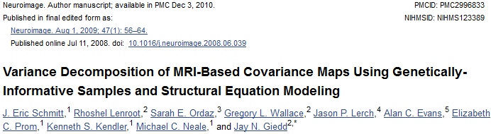
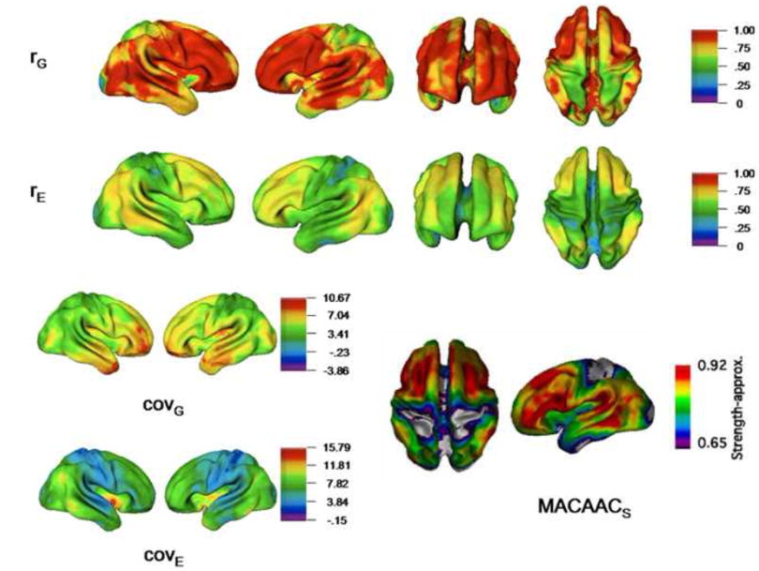

Slide 19
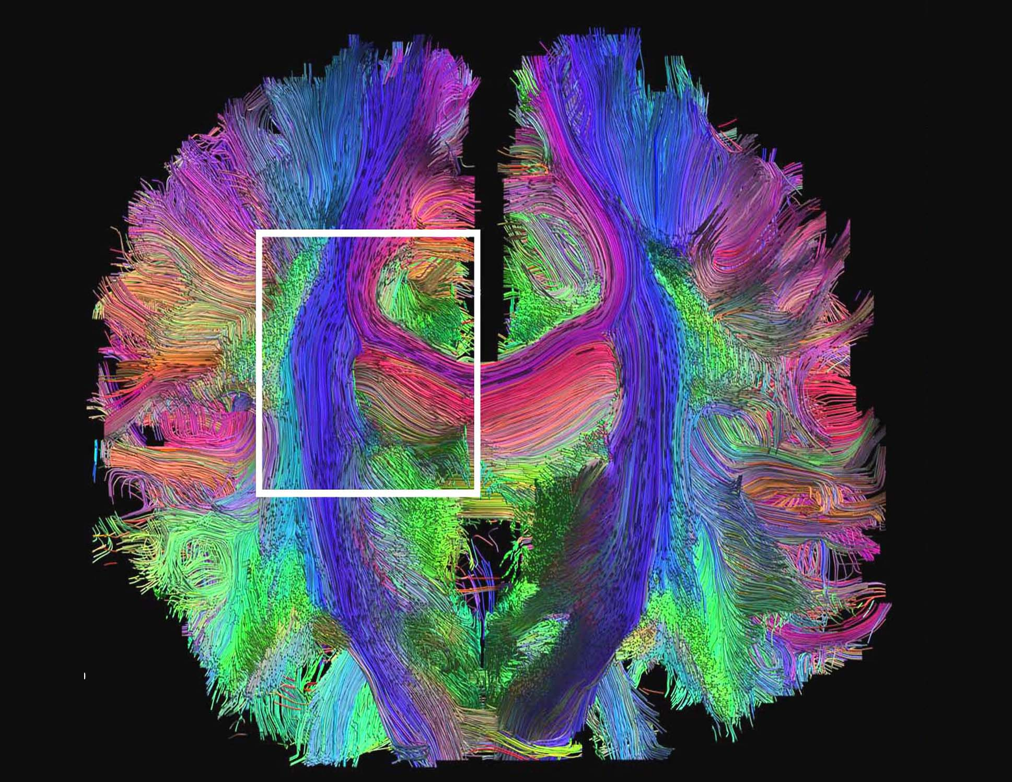
Genetics of brain connectivity

Slide 20

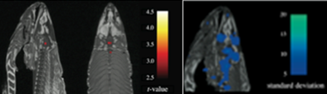
Challenges in Neuro Imaging Genetics
Scope and scale of studies
  Small N & candidate approaches
Strong hypotheses re effect sizes
  Common variants with large effects...
Data harmonization
Multiple testing

Slide 21
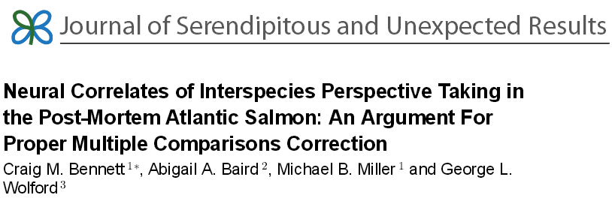
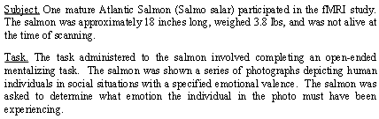
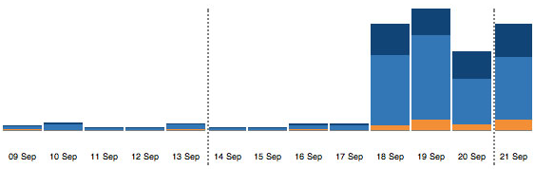
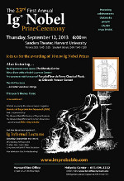
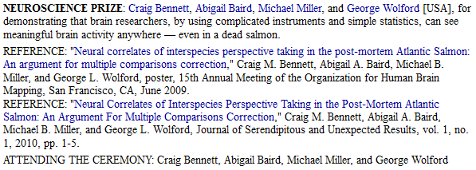

Slide 22
White matter integrity
DTI - diffusion tensor images
i) 30 gradient directions (27 high b values and 3 b=0 repetitions)
ii)105 gradient directions (94 high b-values and 11 b=0 repetitions)
Fractional Anisotropy (FA) = White Matter integrity
FA=0 – isotropic - in areas where water diffuses freely
FA=1 – anisotropic- in highly myelinated WM fibres

Slide 23
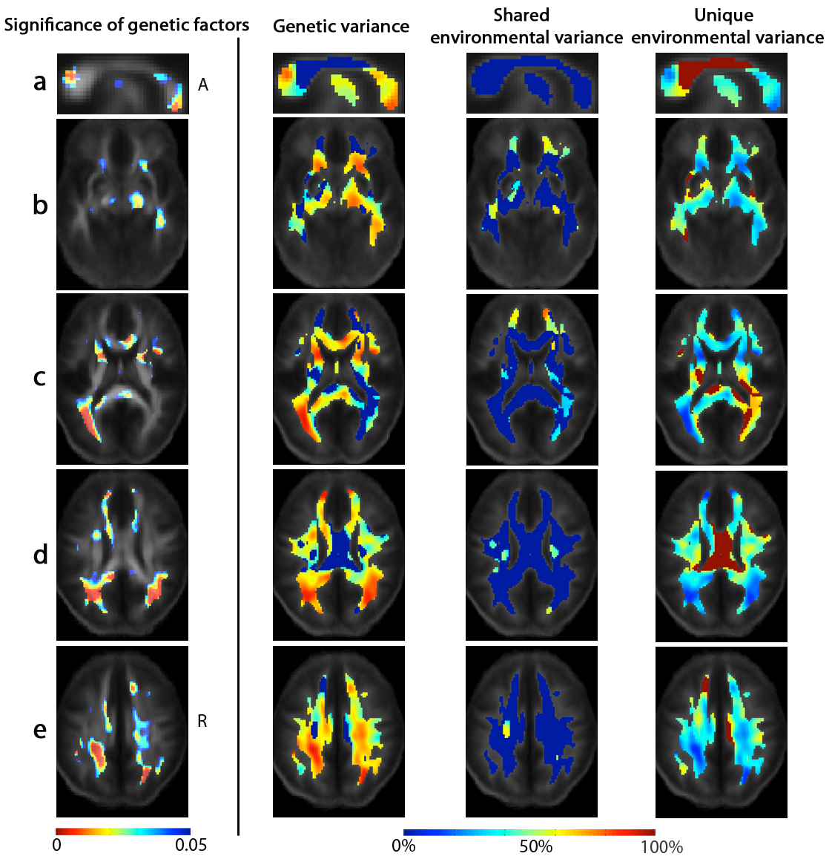
Genetic Influences on White Matter Integrity (FA)
genetic factors explain 75 - 90% of the variance in FA in almost all white matter regions Chiang et al. 2009 J Neurosci. 29: 2212-24
splenium &
part of CC
L cerebral peduncle, fornix, R inf. longitudinal fasc. / inf. fronto-occipital fasc.
Anterior internal capsule & L post. thalamic / optic radiation
sup. longitudinal fasc.
sup. & post. corona radiata

Slide 24
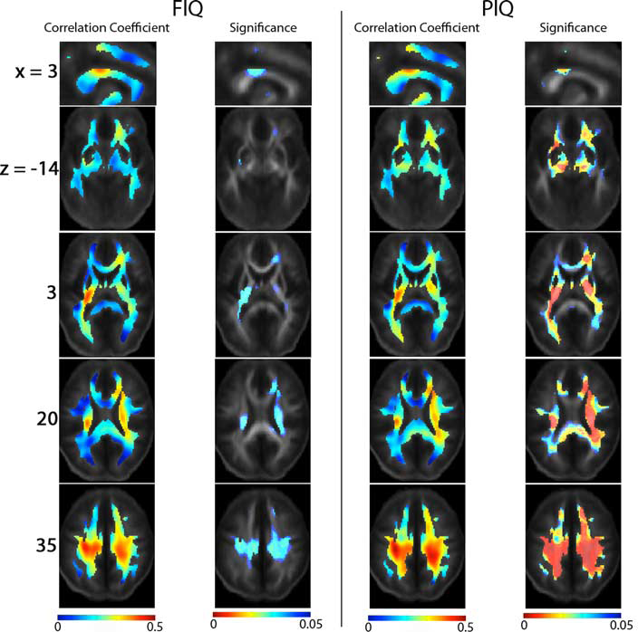
White matter integrity correlated with IQ
correlated with PIQ
r = 0.3 - 0.4
Chiang et al. 2009
J Neurosci. 29: 2212-24

Slide 25
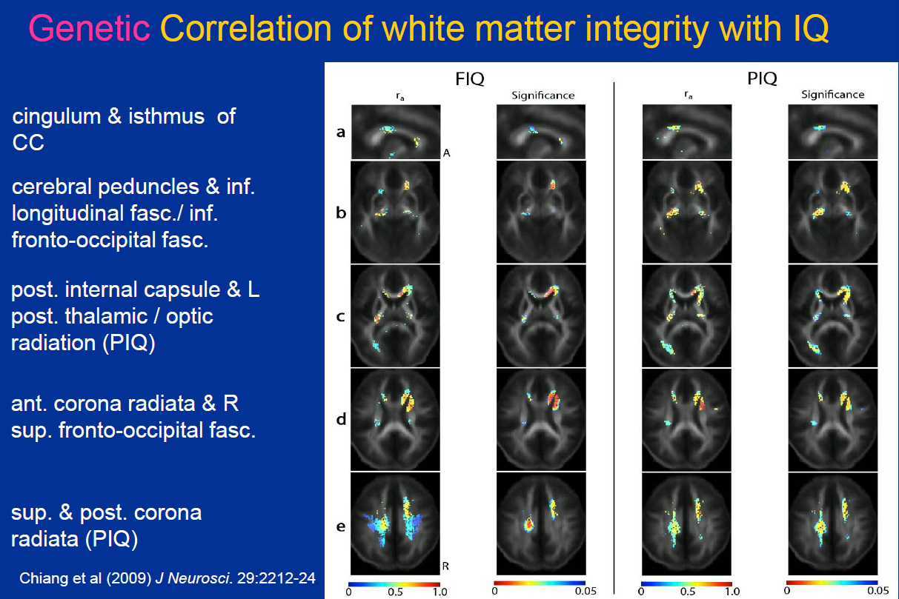
Genetic correlation of white matter integrity (FA) with IQ
Genes (partly) moderate the correlation between fibre integrity and IQ common physiological mechanism
Chiang et al. 2009
J Neurosci. 29: 2212-24

Slide 26
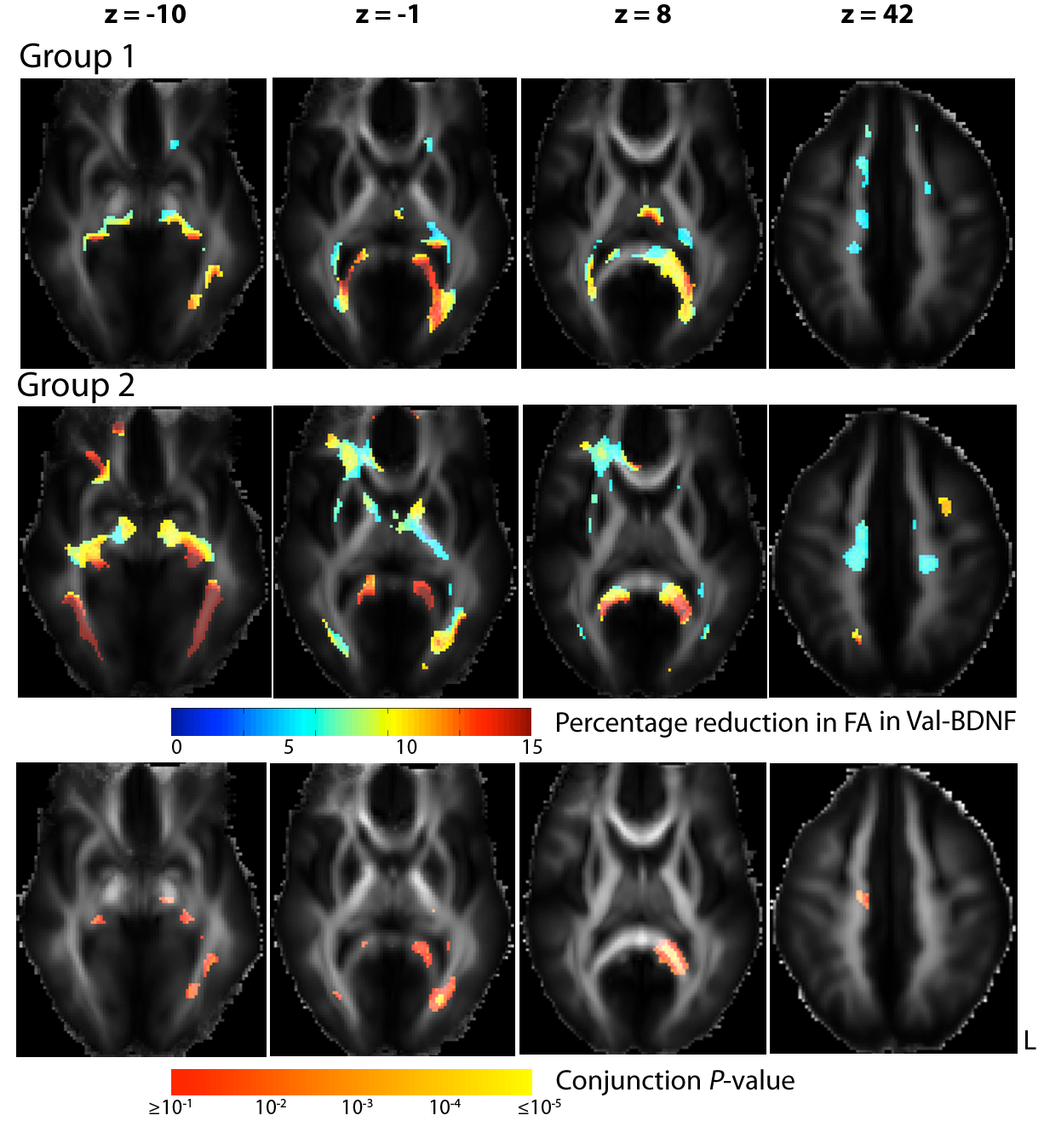
BDNF Val66Met polymorphism effects on white matter
Group 1: 99M /135F (110 fam) age: 23.7±1.9 years.
Group 2: 89M /132F (128 fam) age: 23.7±2.2 years
Val allele associated with up to 15% reduction in FA in major fiber tracts (splenium of the corpus callosum, left optic radiation)
replicated in both samples

Slide 27

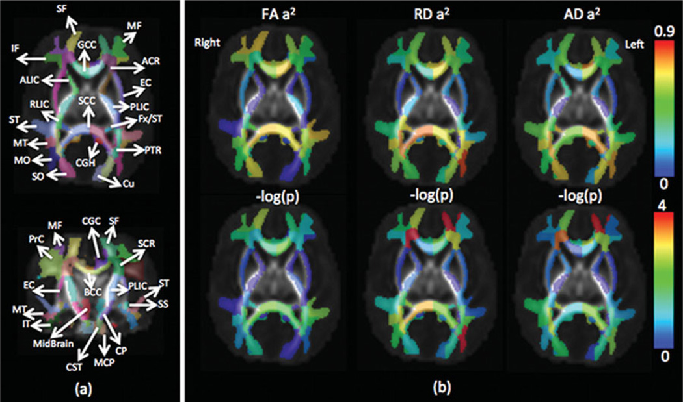

Slide 28
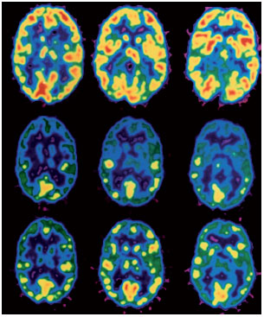
Genetics of brain function

Slide 29
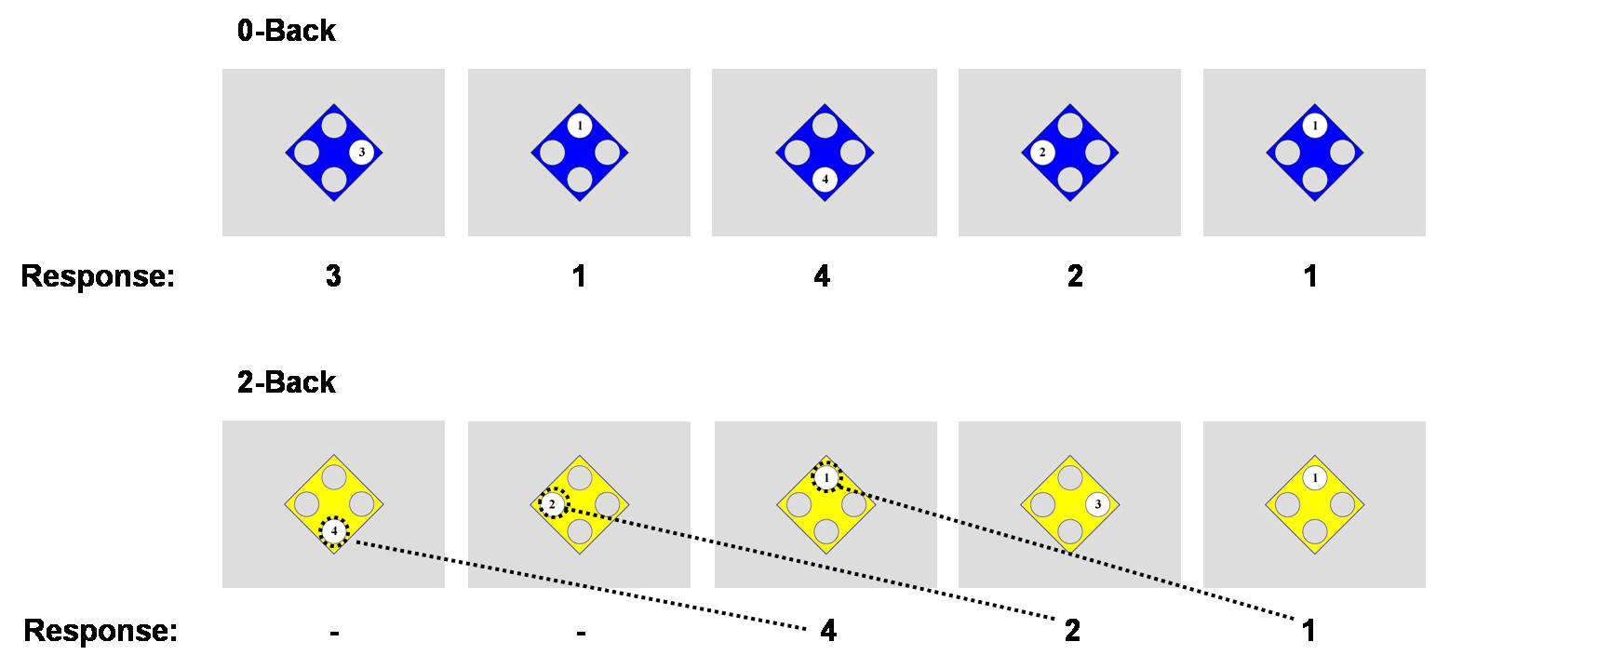
BOLD fMRI during n-back working memory task

Slide 30
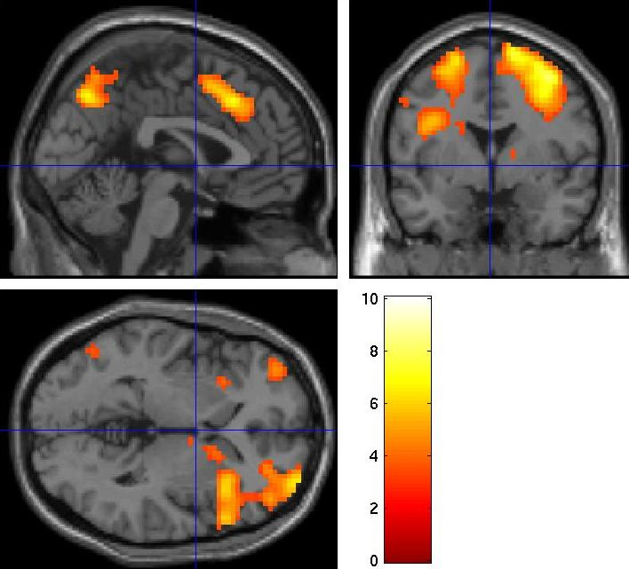
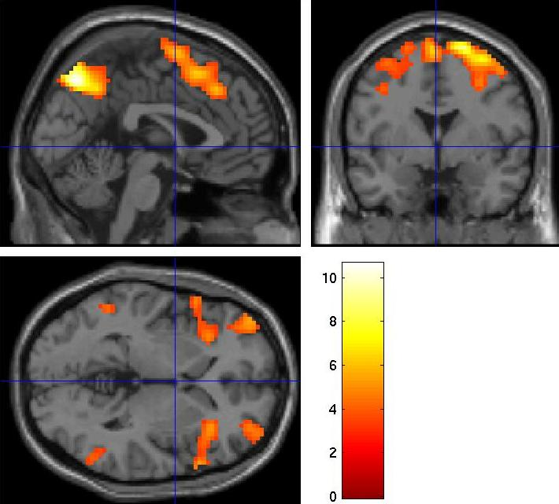
MZ co-twins showing similar brain activation patterns during the N-back task
Twin 1
Twin 2

Slide 31
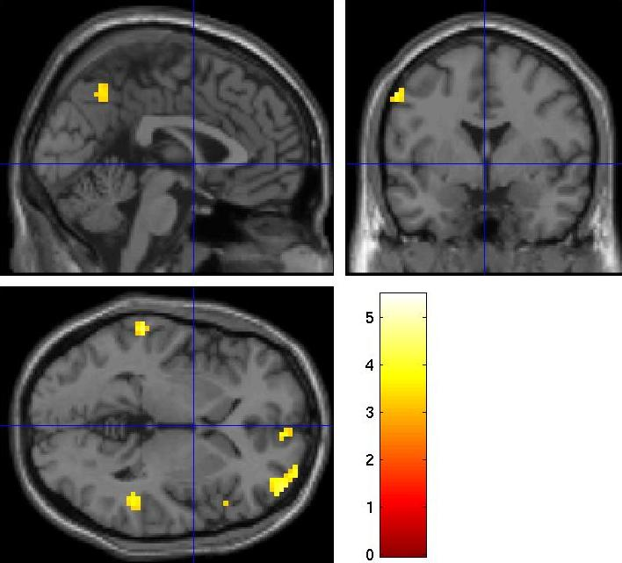
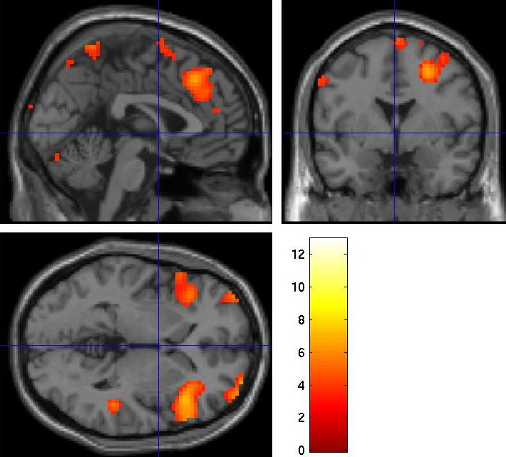
DZ co-twins showing different brain activation patterns during the N-back task
Twin 1
Twin 2

Slide 32
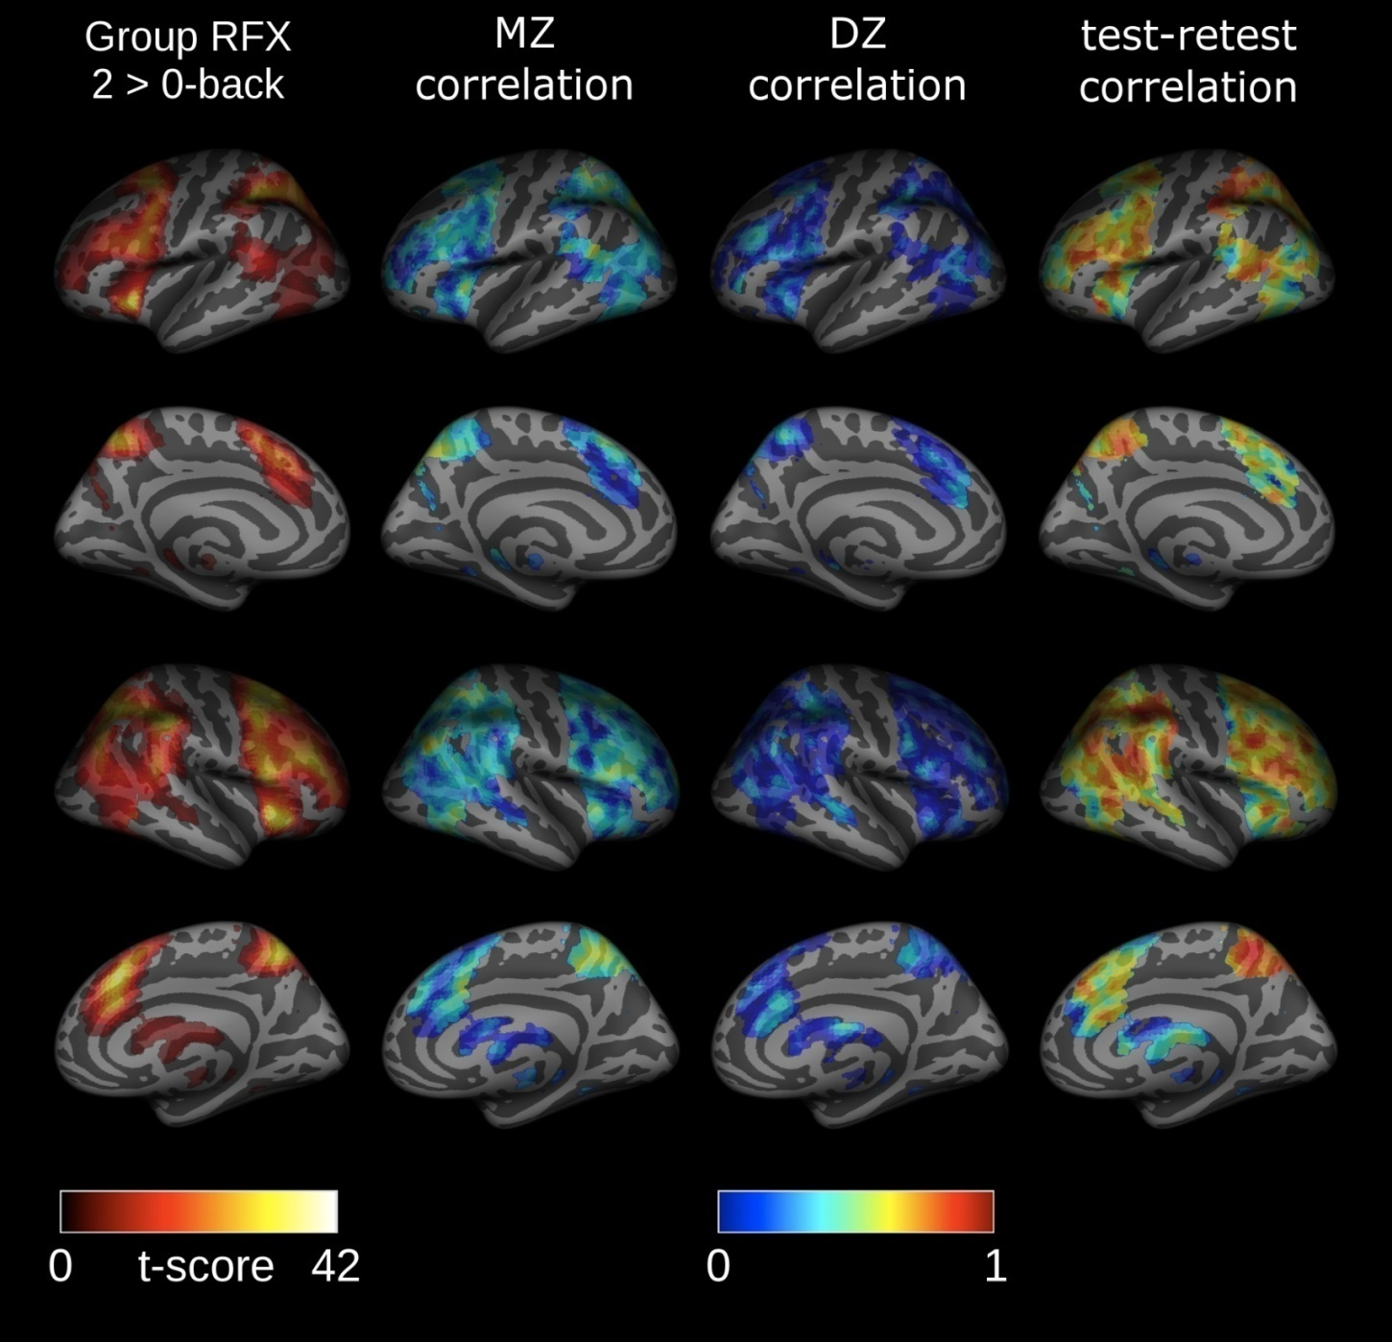
fMRI during working memory
fMRI study of 315 twins
74 MZ pairs (29M/45F)
63 DZ pairs (11M /27F /25MF)
41 unpaired subjects
voxel analysis
Blokland et al. J Neurosci. 2011
regions of interest analysis (N=75 pairs)
Blokland et al. 2008 Biol. Psychology

Slide 33
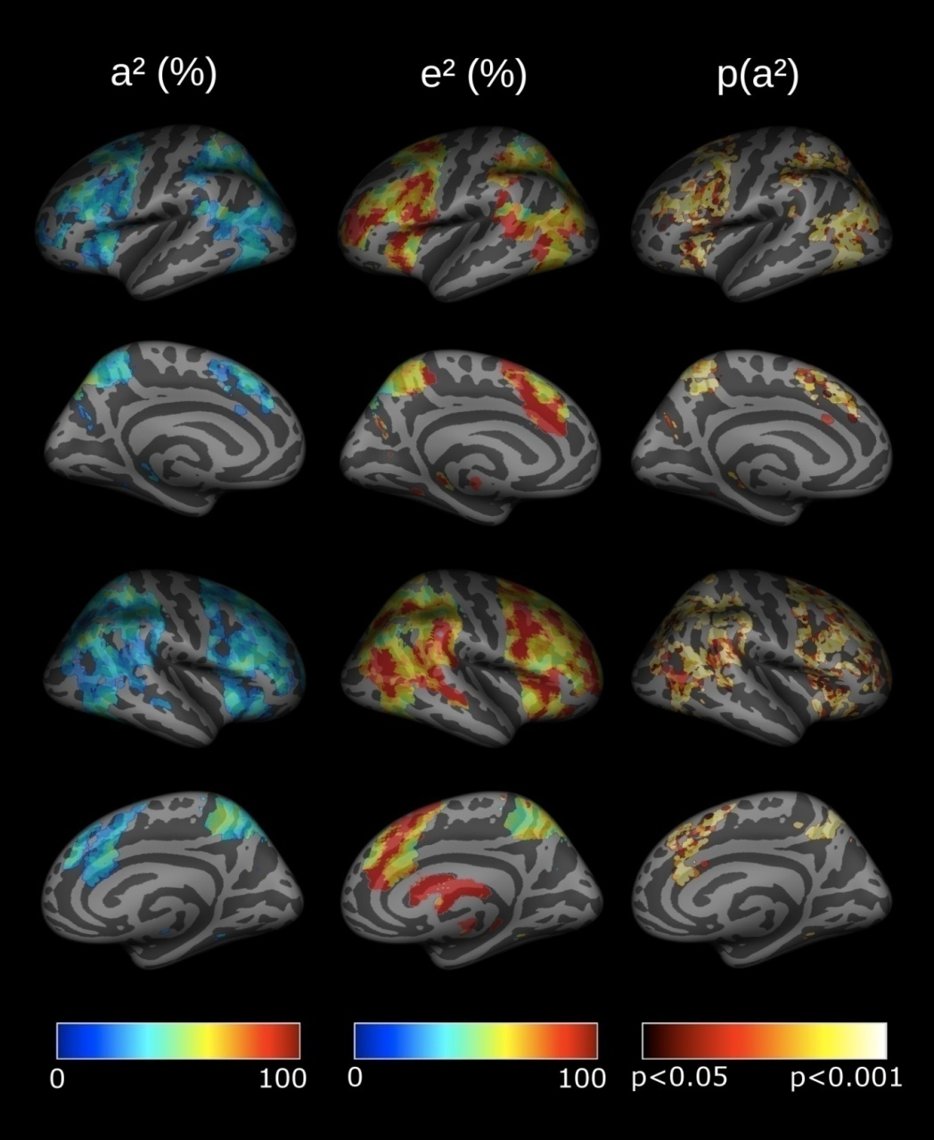
Maps showing genetic influences on brain activation during working memory
significant genetic influences on WM related brain activation, especially in frontal and parietal brain regions
genetic influences highest in the parietal lobe (60-70%)
sizeable unique environmental effects - NOT all measurement error (reliability = 0.7 – 0.9 in most activated areas)

Slide 34
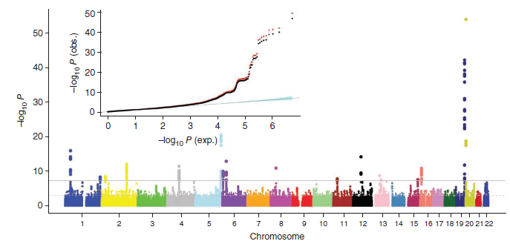
GWAS for neuroimaging phenotypes

Slide 35
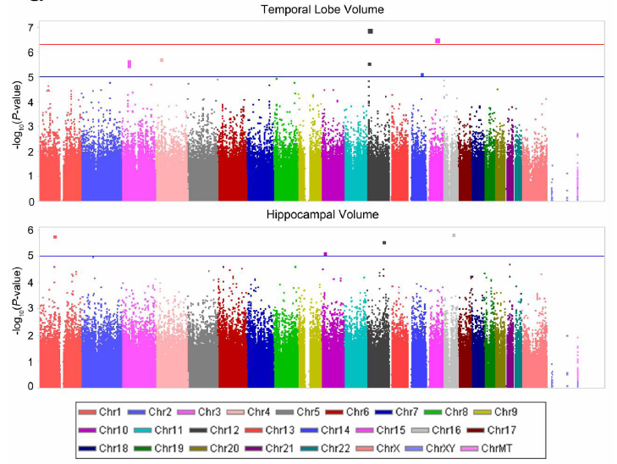
GWAS of brain volumes (ADNI sample)
Alzheimer’s Disease Neuroimaging Iniative (ADNI) - mixed sample of healthy controls, MCI, AD
N = 742 (temporal)
N = 698 (hippo)
610K Illumina SNP
Genome –wide evidence or support - chrm. 12
Lower temporal lobe vols were most assoc. with a common variant in GRIN2B .
Risk allele over-represented in AD and MCI vs elderly controls
Stein et al. Neuroimage, 2010

Slide 36

Enhancing Neuroimaging Genetics through Meta-Analysis

Slide 37
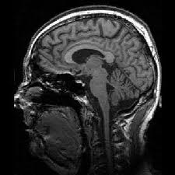
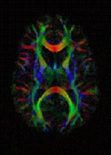
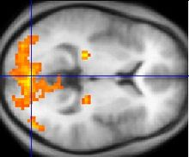
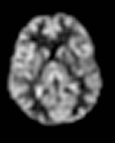
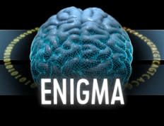
ENIGMA
Drawing together groups conducting brain imaging studies
  both patient and population samples
  with MRI, DTI, fMRI, and ASL
  with or collecting GWAS data
Predominantly imaging groups moving into genetics

Slide 38
Meta not Mega analysis
3 main reasons (in order of increasing importance)
  Cultural Barriers
  Practical constraints
    Size of data
    Processing time
  Scientific obstacles
    Insurmountable phenotypic heterogeneity?

Slide 39
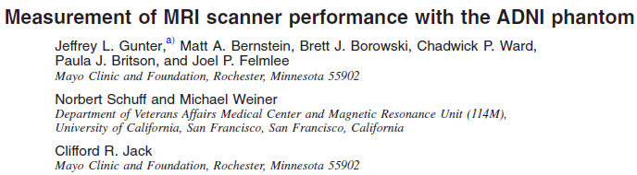
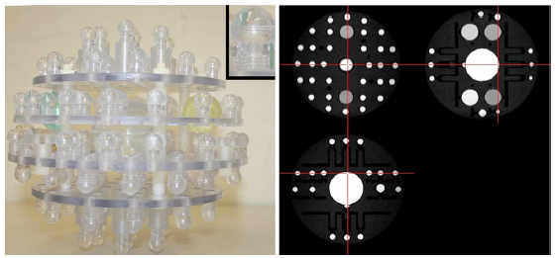
Insurmountable phenotypic heterogeneity

Slide 40
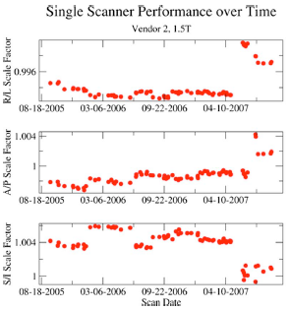
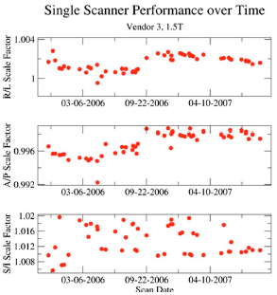
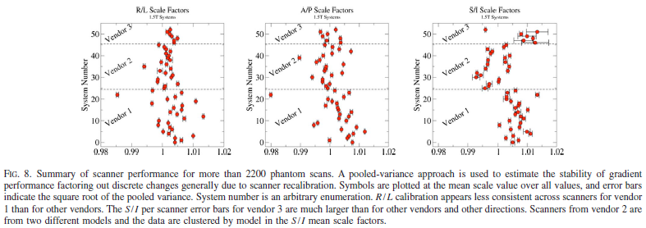

Slide 41
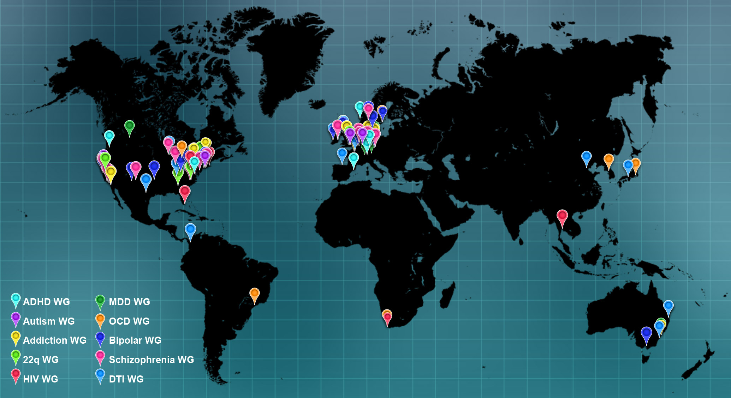

Slide 42
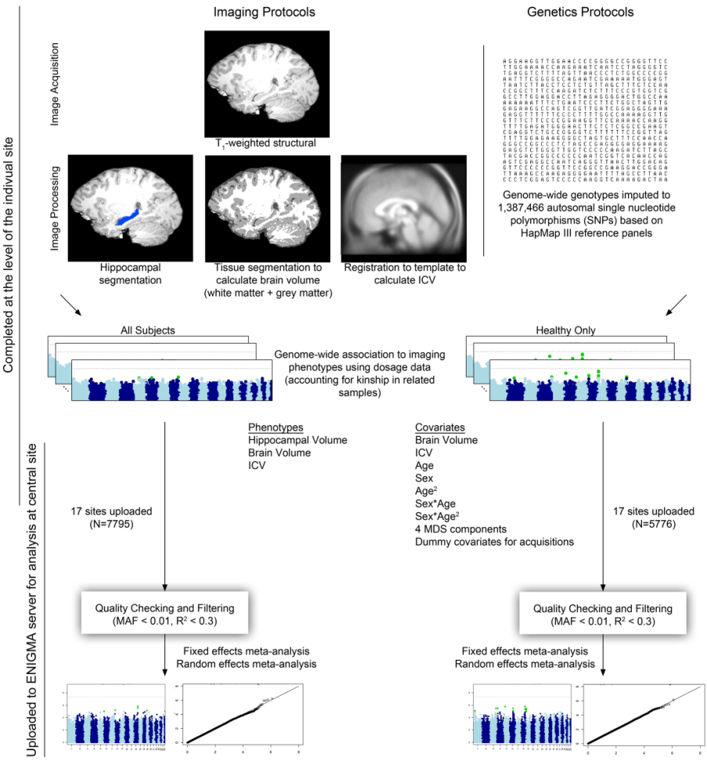
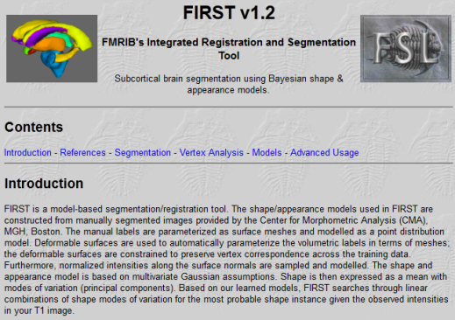
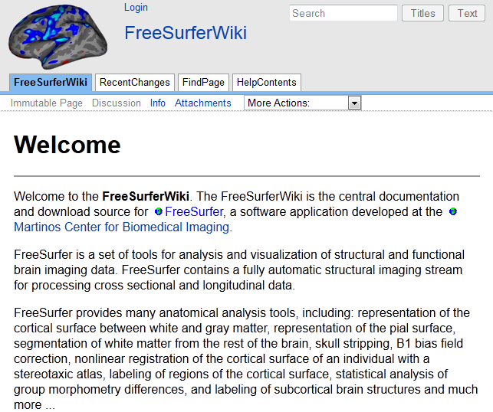
Protocols
FSL FIRST/ FREESURFER
HapMap III
Full sample vs healthy controls only

Slide 43

First ENIGMA project
Which genes contribute to hippocampus volume (HV) and measures of total brain volume (ICV)?

Slide 44

ENIGMA project: the approach
MA: sample-size weighted

Slide 45


Custom built QC pipelines

Slide 46



QC protocols

Slide 47


Custom built QC pipelines

Slide 48










Imaging QC

Slide 49


Did the consortium approach work?
All studies underpowered
Within ‘normals’ no sig results in any individual study
206 authors vs effect of 22 underpowered null papers on the literature?

Slide 50

First ENIGMA project: the findings
N = 21,151; P = 6.70 × 10⁻¹⁶
N = 15,782; P = 1.12 × 10⁻¹²

Slide 51


Hippocampal Volume
Intergenic region 12q24.22
between HRK and FBXW8
Significant within ENIGMA
Reciprocal replication with the CHARGE consortium
  N=20,797; P=3.43x10⁻¹⁶ , MAF =.10

Slide 52


Hippocampal Volume
Signal present in healthy and patient samples
Independent of brain or head size
variant is associated with decreased HV of 50.6 mm³ or 1.3% of the average hippocampal volume per risk allele.

Slide 53

Hippocampal Volume
TESC - cis eQTL in brain tissue
UCL resected temporal lobe
SNPExpress
UK Brain Expression Database
Fetal Brain Expression
Adult Brain Expression
Notably tissue specific eQTLS
cis eQTLs for HRK and FBXW8 in blood (PBMC)

Slide 54


Intracranial Volume
HMGA2 12q14.3
  rs10784502 intronic SNP near the 3’ UTR
  high mobility group AT-hook 2 protein
  chromatin-associated protein that regulates stem-cell renewal
  role in neural precursor cells
  Increase of 8637.0 mm³ or 0.56% of ICV per risk allele
Replication with the CHARGE consortium
  N=15,622; P=8.50x10⁻¹², MAF =.48

Slide 55



Pleiotropic effects?
HMGA2 & rs10784502 previously associated with height

Slide 56
Pleiotropic effects?
rs10784502 is also associated with PIQ
  P=0.0044
N ‘increasing’ risk alleles
0 1 2

Slide 57
Endophenotypes/Attenuated functional consequences/ Pleiotropy...
ICV known to correlate with body size and IQ
Height and IQ correlated r² ~4%
  r² _{G} ~1.4%

Slide 58


Brain regions do not act in isolation: connectivity is essential for proper communication
D. Shattuck, K. Ugurbil, P. Thompson (2013)

Slide 59

ENIGMA-DTI
Create a common template
  100 healthy adult subjects from each of 4 sites around the world
Find mean white matter fiber integrity values in the full brain and 14 standard tracts of interest along the WM skeleton
Multi-site heritability analysis
  Are heritability measures stable and reliable across cohorts in regions
  If not, then they are not good targets for multi-site GWAS-MA
E
C
C
E
Jahanshad & Kochunov et al, NIMG 2013

Slide 60







GWAS to be conducted on full brain and 12 regional WM integrity values
Single –site Q-Q plots
20+ sites interested
8000+ images available
http://enigma.ini.usc.edu/ongoing/dti-working-group/

Slide 61


Prioritize the most heritable connections from a comparison of MZ and DZ twins
Carry forward the most heritable connections into a full Genome-Wide Screen (GWAS)….
Jahanshad/Thompson, PNAS, March 5 2013

Slide 62
Multi-site heritability analysis
    5 sites DIFFERENT: Family structures (twins/pedigrees) / Image acquisition methods / Age groups (only children/only elderly/wide range) / Ethnicities (European/Mexican-American)
Compare 2 meta-analysis approaches
  Weight by N and SE
13/15 regions found to be highly reliable and heritable in all cohorts
Kochunov & Jahanshad et al, submitted

Slide 63

SPON1 influences regional brain volumes in AD
Ventricular regions, particularly surrounding the temporal lobes, were significantly reduced in size, whereas grey matter around the posterior cingulate cortex was increased with each additional copy of the minor T allele at rs2618516.
Older people who carried the connectivity variant had significantly milder dementia scores and risk of AD

Slide 64



Slide 65

ENIGMA2
Accumbens
Putamen
GWASMA of subcortical region volumes - Caudate, Putamen, Pallidum, Thalamus, Accumbens, Amygdala and Hippocampus
29,000 brain scans from 47 centres
Genetics protocols
  1000 Genomes imputation – April 2012 release – minus singletons
  EUR or ALL-Ethnicities versions
Caudate
Amygdala
Pallidum
Thalamus
Hippocampus

Slide 66
Shared and region-specific genetic factors influence subcortical volumes: multivariate variance component analysis of 1090 twins
Miguel Renteria

Slide 67



Slide 68



ENIGMA2 preliminary results: Putamen

Slide 69



ENIGMA2 preliminary results: Hippocampus

Slide 70

CHARGE-ENIGMA HV – Manhattan plot
N=25,889; several GW-hits, p~10⁻¹⁰-10⁻²³

Slide 71

CHARGE-ENIGMA ICV – Manhattan plot
N=26,378; several GW-hits, p~10⁻¹⁰-10⁻²⁰

Slide 72


Putamen association (KTN1, chr 14; p ~ 10⁻²⁰) is a cross-species QTL
In BXD mice, the expression of this gene predicts putamen volume (r = 0.47)
(collaboration: Rob Williams lab, UT Memphis)
HUMANS
MICE

Slide 73

Development of ENIGMA working groups…
Phenotypic Meta-Analyses of case control differences in subcortical volumes
  Schizophrenia, Bipolar, Major Depression, ADHD
  Where should we look for endo-phenotypes?

Slide 74



Slide 75

Oct 1 2013:
1149 BP patients
1523 CTLs

Slide 76


Slide 77
…and finally, do gene variants affecting neuroimaging phenotypes also affect risk of psychiatric disease ?

Slide 78

Alzheimer’s risk gene carriers (CLU-C) have lower fiber integrity even when young (N=398), 50 years before disease typically hits [News covered in 20 countries]
Voxels where CLU allele C (at rs11136000) is associated with lower FA after adjusting
for age, sex, and kinship in 398 young adults
(68 T/T; 220 C/T; 110 C/C). FDR critical p = 0.023. Left hem. on Right
Braskie et al., Journal of Neuroscience, May 4 2011
Notes:
Effects occurred in multiple regions, including several known to degenerate in AD. Such regions included the corpus callosum, fornix, cingulum, SLF and ILF (Liu et al., 2009; Stricker et al., 2009). This suggests that the CLU-C related variability found here might create a local vulnerability important for disease onset.

Slide 79

Some of ENIGMA’s “hippocampal” genes may be Alzheimer’s Disease risk genes
GERAD-ENIGMA-CHARGE
Perhaps you can screen images and find disease risk genes
*Genetic & Environmental Risk in AD Consortium

Slide 80



Slide 81
Can PGC Cross Disorder GWAS results predict subcortical structure volumes ?
i.e. are the same SNPs that cause psychiatric disease also affecting brain volumes ?
Results
SNPs in the most strongly associated region in PGC’s cross-disorder mega-analysis (chr3p21.1) also show low P-values for amygdala and pallidum volumes
SNP ID | Chr:Pos | OR | P-values in PGC-CD | Association P-values in QTIM
 |  |  |  | Caudate | Accumb. | Amygdala | Hippocam | Pallidum | Putamen | Thalamus
rs2535629 | 3:52808259 | 0.91 | 2.5e-12 |  |  | 4.7e-03 | 0.04 | 6.3e-04 | 0.02 | 6.9e-03
rs3617 | 3:52808845 | 0.92 | 1.4e-11 |  | 0.04 | 5.3e-03 |  | 2.6e-04
rs2071044 | 3:52822641 | 0.92 | 5.5e-11 |  |  | 3.1e-03 | 0.04 | 5.0e-04
rs1075653 | 3:52800568 | 1.08 | 5.9e-09 |  |  | 9.7e-03 | 0.04 | 5.9e-03 |  | 0.04
rs1076425 | 3:52800502 | 1.08 | 6.7e-09 |  |  | 9.7e-03 | 0.04 | 5.9e-03 |  | 0.04
rs2071506 | 3:52801316 | 1.08 | 7.1e-09 |  |  | 9.7e-03 | 0.04 | 5.8e-03 |  | 0.04
rs2239547 | 3:52830269 | 1.08 | 7.1e-09 |  |  | 0.02 |  | 0.01 |  | 0.02
rs9324 | 3:52800625 | 1.08 | 7.8e-09 |  |  | 9.7e-03 | 0.04 | 5.9e-03 |  | 0.04
rs2071508 | 3:52801886 | 0.93 | 8.4e-09 |  | 0.03 | 9.7e-03 | 0.04 | 5.8e-03 |  | 0.04
rs4687657 | 3:52827578 | 0.92 | 8.6e-09 |  |  | 0.02 |  | 0.01 |  | 0.02
rs4687551 | 3:52798488 | 1.08 | 9.7e-09 |  | 0.03 | 9.7e-03 | 0.04 | 5.9e-03 |  | 0.04
Next step: ENIGMA → PGC: can brain volume SNPs predict psychiatric disease ?

Slide 82

Are ‘brain-related’ genes also psychiatric risk genes?
If so, we could discover new psychiatric risk genes by screening images, and we’d also know what they do. ENIGMA-PGC2-SZ: SNPs affecting hippocampus DO affect SZ risk (p=10⁻¹⁶⁵)
Jason Stein for the ENIGMA-PGC2-SZ Working Group

Slide 83
Thanks to…
The ENIGMA Consortium: Large-scale Collaborative Analyses of Neuroimaging and Genetic Data. (ENIGMA1 and ENIGMA2 Support Groups) Paul M. Thompson1a,2a, Jason L. Stein1a,3a, Sarah E. Medland4a, Alejandro Arias Vasquez5a,6a, Derrek P. Hibar1a, Miguel Renteria4a,7a, Roberto Toro8a,9a,10a, Gunter Schumann11a, Barbara Franke5a,6a, Margaret J. Wright4a, Nicholas G. Martin4a ENIGMA PIs and their Teams Derrek P. Hibar1, Miguel E. Renteria2, Sarah E. Medland2,3,4, Alejandro Arias Vasquez5,6, Roberto Toro7,8,9, Jason L. Stein1, Neda Jahanshad1, Anderson M. Winkler10,11,12, Katharina Wittfeld13, Christopher R. K. Ching1, Ingrid Agartz14,15, Saud Alhusaini16, Laura Almasy17, Nancy C. Andreasen18, Ole A. Andreassen14, Liana G. Apostolova19, Katja Appel13, Nicola J. Armstrong20,21, Benjamin Aribisala22,23,24, Mark E. Bastin22,23,24,25, Ørjan Bergmann14, Elisabeth B. Binder26, John Blangero17, Jeremy Bockholt27, Dorret I. Boomsma28, Janita Bralten5,29, Rachel M. Brouwer30, Han G. Brunner5, Randy L. Buckner31,32,33, Jan Buitelaar6,34, Kazima Bulayeva35, Juan R. Bustillo36, Vince D. Calhoun27,37, Dara M. Cannon38, Rita M. Cantor39, Melanie A. Carless17, Gianpiero L. Cavalleri16, M. Mallar Chakravarty40, Andrea Christoforou41,42, Sven Cichon43,44,45,46, Vincent P. Clark27,36, Giovanni Coppola19,47, Benedicto Crespo-Facorro48,49, Joanne E. Curran17, Michael Czisch26, Ian J. Deary22,50, Eco J.C. de Geus28, Anouk den Braber28, Chantal Depondt51, Greig I. de Zubicaray52, Srdjan Djurovic14,53, Gary Donohoe54, Thomas D. Dyer17, Stefan Ehrlich55,56, Susanne Erk57, Thomas Espeseth14,58, Guillén Fernández29, Simon E. Fisher6,59, Peter T. Fox60, Clyde Francks59, Vincent Frouin61, Sudheer Giddaluru41,42, David C. Glahn10,12, Randy L. Gollub55,62, Hans J. Grabe13,63, Oliver Grimm64, Oliver Gruber65, Tulio Guadalupe59, Harald H.H. Göring17, Jeremy Hall66, John Hardy67, Johanna Hass56, Katrin Hegenscheid68, Andreas Heinz57, Beng-Choon Ho18, David Hoehn26, Pieter J. Hoekstra69, Marisa Hollinshead55,31,32, Avram J. Holmes31,33, Georg Homuth70, Martine Hoogman59, Jouke-Jan Hottenga28, Hilleke E. Hulshoff Pol30, Kristy S. Hwang19, Caroline Johnston71,72, Erik G. Jönsson73, René S. Kahn30, Dalia Kasperaviciute74, Sungeun Kim75,76, Peter Kochunov60,77, Bernd Krämer65, John Lauriello36, Stephen M. Lawrie66, Phil H. Lee78,62, Stephanie Le Hellard41,42, David C. Liewald22, Xinmin Liu79,80, Lorna M. Lopez22,50, Anbarasu Lourdusamy81, Michelle Luciano22,50, Fabio Macciardi82, René Mandl30, Mar Matarin74, Karen A. Mather83, Manuel Mattheisen43,84,85, Morten Mattingsdal14,86, Andreas Meyer-Lindenberg64, Colm McDonald38, Andrew M. McIntosh66, Francis J. McMahon79, Katie L. McMahon87, Eva Meisenzahl88, Ingrid Melle14, Yuri Milaneschi89, Sebastian Mohnke57, Holger Mohr65, Grant W. Montgomery2, Derek W. Morris54, Eric K. Moses90,91, Bryon A. Mueller92, Susana Muñoz Maniega22,23,24, Thomas W. Mühleisen43,44, Bertram Müller-Myhsok26, Kwangsik Nho76,93, Thomas E. Nichols89, Lars-Göran Nilsson94, Allison C. Nugent37, Lars Nyberg95, Carol O’Brien54, Rene L. Olvera96, Roel A. Ophoff30,39, Massimo Pandolfo51, Martina Papmeyer66, Tomas Paus97, Zdenka Pausova98, Brenda W. Penninx69,89,99, G. Bruce Pike100, Steven G. Potkin82, Benno Pütz26, Adaikalavan Ramasamy101, Jerod Rasmussen82, Marcella Rietschel64, Mark Rijpkema6, Shannon L. Risacher76, Joshua L. Roffman62, Roberto Roiz-Santiañez48,49, Emma J. Rose54, Dan Rujescu88, Mina Ryten67, Perminder S. Sachdev83,102, Jonathan Savitz103,79, Andrew J. Saykin75,104,76, Lianne Schmaal89,105, Hugo G. Schnack30, Remmelt Schür30, Larry Seidman106, Nina Seiferth57, Li Shen75,76, Jody M. Shoemaker27, Andrew Simmons107,108,109, Sanjay M. Sisodiya74, Colin Smith110, Jordan W. Smoller78,62, Scott R. Sponheim111,92, Emma Sprooten12, Vidar M. Steen41,42, Lachlan Strike2, Jessika Sussmann66, Philipp G. Sämann26, Alexander Teumer70, Arthur W. Toga1, Diana Tordesillas-Gutierrez48,49, Daniah Trabzuni67, Jessica Turner27, Martijn Van den Heuvel30, Nic J. van der Wee99, Kristel van Eijk112, Theo G.M. van Erp82, Neeltje E.M. Van Haren30, Dennis van ’t Ent28, Marie-Jose van Tol113,99, Maria C. Valdés Hernández22,23,24, Dick J. Veltman89, Henry Völzke114, Robert Walker110, Henrik Walter57,115, Joanna M. Wardlaw22,23,24, Michael E. Weale101, Michael W. Weiner116,117, Wei Wen83,102, Lars T. Westlye14,58, Christopher D. Whelan16, Tonya White118, Christiane Wolf26, Marcel P. Zwiers6,119, Manon Bernard89**, Marc Bohlken30**, Stefan Brauns55**, David G. Brohawn78, Andrew A. Brown14,120**, Aiden Corvin54**, Anders M. Dale121,122**, Norman Delanty16,123**, Wayne C. Drevets124,103**, Jesen Fagerness33, Iryna Fedko28**, Nelson B. Freimer39**, Michael Gill54**, Catharina Hartman125**, Wolfgang Hoffmann63**, Norbert Hosten68**, Deborah Janowitz13**, Mark Jenkinson126, Matthew P. Johnson17**, Ryota Kanai127**, Maria Keil65**, Jack W. Kent Jr.17**, Margaret D. King27**, John B. J. Kwok128, Gonzalo Laje79**, Camilla Langan38**, Eva Loth81, Vince Magnotta129**, Dara S. Manoach55,62, Matthias Nauck130**, Markus M. Nöthen43,44**, Jaap Oosterlaan131**, Daniel O’Leary18**, Jean Baptiste Poline61**, Ralf Puls68**, Nanda Rommelse6,89**, Ivar Reinvang11,132**, J. Cooper Roddey121**, Natalie A. Royle22,23,24**, Knut Schnell133,115**, S. Charles Schulz92**, Eric Strengman112**, Suzanne Swagerman28**, Hans van Bokhoven5,29**, Saskia Woudstra89**, Rolf Adolfsson134**, Andre Aleman113**, David Ames135**, Gail Davies50**, Martin Domin68**, Ravi Duggirala17**, Tatiana M. Foroud75,104**, Peter Hagoort6,59**, Narelle K. Hansell2**, Clifford R. Jack Jr.136**, Jack L. Lancaster60**, Kelvin O. Lim92**, David J. Porteous22,137**, Bruce R. Rosen55**, John M. Starr22,138**, Uwe Völker70**, the Alzheimer’s Disease Neuroimaging Initiative, IMAGEN Consortium, Saguenay Youth Study Group, Gunter Schumann81, Margaret J. Wright2, Barbara Franke5,6, Nicholas G. Martin2, Paul M. Thompson1 ENIGMA Schizophrenia Working Group Jessica A. Turner1c,2c, Derrek P. Hibar1a, Jerod Rasmussen4c, Ole A. Andreassen5c, Lars T. Westlye5c,20c, Unn Kristin Haukvik5c,4d, Ingrid Agartz5c,14c, Steven G. Potkin4c, Roel Ophoff3c, Hilleke Hulshoff Pol6c, Neeltje van Haren6c, Oliver Gruber7c, Bernd Krämer7c, David Zilles7c, Stefan Ehrlich8c,,9c, Johanna Hass8c, Kathryn Alpert10c, Lei Wang10c, Erik G. Jönsson14c, Godfrey D. Pearlson11c,,12c, David C. Glahn11c,12c, (Marise W. J. Machielsen, Laura Koenders, Lieuwe de Haan)15c, Dick J. Veltman18c, Raquel E . Gur16c, Ruben C. Gur16c, Theodore D. Satterthwaite16c, (Gary Donohoe, Sinead Kelly)17c, Beata Godlewska17e (Rali Dimitrova, Stephen Lawrie, Cathy Bois, Heather Whalley, Andrew McIntosh)19c, Paul M. Thompson1a, Theo G. van Erp4c, as the ENIGMA-Schizophrenia Working Group ENIGMA­ Bipolar Disorder Working Group Derrek P. Hibar1d, Lars T. Westlye2d,3d, Theo G. M. van Erp4d, Jerod Rasmussen4d, Cassandra D. Leonardo1d, Unn K. Haukvik2d, 5d, Ingrid A. Agartz2d,5d, Oliver Gruber6d, Bernd Krämer6d, Sarah Trost6d, Benny Liberg7d, Carl Johan Ekman7d, Mikael Landen27d, Kiki D. Chang8d, Allison C. Nugent9d, Wayne C. Drevets10d**, Scott Fears11d**, Nelson Freimer11d, Carrie E. Bearden12d, and the Costa Rica­/Colombia Consortium for Genetic Investigation of Bipolar Endophenotypes, David C. Glahn13d, Godfrey D. Pearlson13d, Louise Emsell14d, Joanne Kenney14d**, Cathy Scanlon14d, Colm McDonald14d, Dara M. Cannon14d, Jorge Almeida15d, Amelia Versace15d, Xavier Caseras16d, Natalia Lawrence16d**, Mary Phillips15,16d, Melissa DelBello17d**, Stephen Strakowski17d, Caleb Adler17d**, Danai Dima18d,26d, Giuseppe Delvecchio26d, Sophia Frangou18d, Ulrik F. Malt28d,29d, Erlend Bøen28d,29d, Torbjørn Elvsåshagen28d,29d, Neeltje E. M. van Haren19d, Roel Ophoff20d,21d, Rene Kahn21d, Michael Bauer22d, Andrea Pfennig22d, Martin Alda23d, Tomas Hajek23d, Benson Mwangi24d, Jair C. Soares24d, Rali Dimitrova25d, Jessika Sussmann25d, Saskia Hagenaars25d, Heather C. Whalley25d, Andrew M. McIntosh25d, Paul M. Thompson1d, Ole A. Andreassen2d as the ENIGMA­ Bipolar Disorder Working Group ENIGMA Major Depressive Disorder Working Group Lianne Schmaal1e, Dick J. Veltman1e, Marie-José van Tol2e, Hans Jörgen Grabe3e,4e,5e, Katharina Wittfeld5e, Oliver Gruber6e, Bernd Krämer6e, Andreas Meyer-Lindenberg7e, Andreas Heinz8e, Nina Seiferth8e, Henrik Walter8e, Andrew Simmons 9e,10e,11e , Eva Maria Frey12e, Thomas Frodl12e,13e, Jim Lagopoulos14e, Sean Hatton14e, Ian Hickie14e, Martina Papmeyer15e, Jessika Sussmann15e, Meilina Papalampropoulou-tsiridou15e, Heather Whalley15e, Andrew M. McIntosh15e, Philipp G. Sämann16e, Beata Godlewska17e, Philip J Cowen17e as the ENIGMA-Major Depressive Disorder Working Group ENIGMA DTI Working Group Neda Jahanshad 1f, Peter V. Kochunov 2f, Emma Sprooten 3f,4f, René C. Mandl 5f, Thomas E. Nichols 6f,7f,? Tom Booth 8f, Herve Lemaitre 9f,? Rali Dimitrova 4f, Laura Almasy 10f, John Blangero 10f, Rachel M. Brouwer 5f, Joanne E. Curran 10f, Greig I. de Zubicaray 11f, Ravi Duggirala 10f**, Peter T. Fox 10f,17f, L. Elliot Hong 2f, Bennett A. Landman 13f, Nicholas G. Martin 14f, Jean-Luc Martinot9f, Katie L. McMahon 15f,? Sarah E. Medland 14f, Rene L. Olvera 12f, Diana Tordesillas-Gutierrez19f,20f, Charles P. Peterson 10f, Gunter Schumann18f, Jessika E. Sussmann 4f, Arthur W. Toga 1f, Joanna M. Wardlaw 8f,16f, Margaret J. Wright 14f, Marcel P. Zwiers22f, Barbara Franke 21f,22f, Hilleke E. Hulshoff Pol 5f, Mark E. Bastin 8f,16f, Andrew M. McIntosh 4f, Ian J. Deary 8f, Paul M. Thompson 1f, David C. Glahn 3f as the ENIGMA-Diffusion Tensor Imaging Working Group

Slide 84



Acknowledgements
Gabriella Blokland (QIMR, UQ)
Meredith Braskie (UCLA)
Caroline Brun (UCLA)
Ming-Chan Chiang (UCLA)
Narelle Hansell (QIMR)
Neda Jahanshad (USC)
Kori Johnson (QIMR)
Mitzy Kennis (QIMR, UQ, Utrecht)
Baptiste Couvy-Duchesne (QIMR)
Aaron Quiggle (QIMR)
Miguel Renteria (QIMR, UQ)
Ben Sinclair (QIMR, UQ)
Xavier Castellanos (NYU)
Greig de Zubicaray (UQ)
Nick Martin (QIMR)
Katie McMahon (UQ)
Mike Milham (NYU)
Paul Thompson (USC)
Jason Stein (USC)
Derek Hibar (USC)
Barbara Francke (Nijmegen)
Sarah Medland (QIMR – ENIGMA1/2)
Margie Wright (QIMR)
Radiographers, RAs, IT
Thanks to twins and sibs
Notes:
And lastly I’d like to acknowledge all CIs, PhD students, Post-docs/Ros, the many radiographers, RAs and IT, and thank all the twins/sibs who have participated.

