Slide 1
Mendelian Randomization: Genes as Instrumental Variables
David Evans
University of Queensland

Slide 2
This Session
What is Mendelian Randomization (MR)?
Examples of MR in research
Some ideas
Using R to perform MR

Slide 3
Some Criticisms of GWA Studies…
So you have a new GWAS hit for a disease… so what!?
You can’t change people’s genotypes (at least not yet)
You can however modify people’s environments…
Mendelian Randomization is a method of using genetics to inform us about associations in traditional observational epidemiology

Slide 4
RCTs are the Gold Standard in Inferring Causality
RANDOMISED CONTROLLED TRIAL
RANDOMISATION METHOD
EXPOSED:
INTERVENTION
CONTROL:
NO INTERVENTION
CONFOUNDERS EQUAL BETWEEN GROUPS
OUTCOMES COMPARED BETWEEN GROUPS

Slide 5
Observational Studies
RCTs are expensive and not always ethical or practically feasible
Association between environmental exposures and disease can be assessed by observational epidemiological studies like case-control studies or cohort studies
The interpretation of these studies in terms of causality is problematic

Slide 6
CHD risk according to duration of current Vitamin E
supplement use compared to no use
RR
Rimm et al NEJM 1993; 328: 1450-6

Slide 7
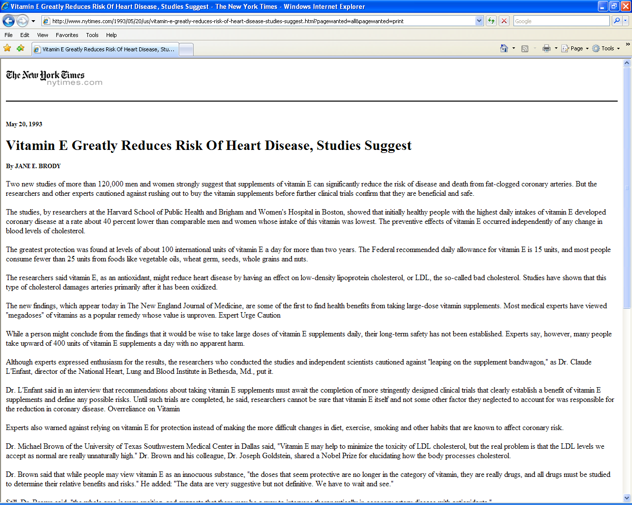

Slide 9
Use of vitamin supplements by US adults, 1987-2000
Percent
Source: Millen AE, Journal of American Dietetic Assoc 2004;104:942-950

Slide 10
Vitamin E levels and risk factors: Women’s Heart Health Study
Childhood SES
Manual social class
No car access
State pension only
Smoker
Daily alcohol
Exercise
Low fat diet
Obese
Height
Leg length
Lawlor et al, Lancet 2004

Slide 11
Vitamin E supplement use and risk of Coronary Heart Disease
1.0
Stampfer et al NEJM 1993; 328: 144-9; Rimm et al NEJM 1993; 328: 1450-6; Eidelman et al Arch Intern Med 2004; 164:1552-6

Slide 12
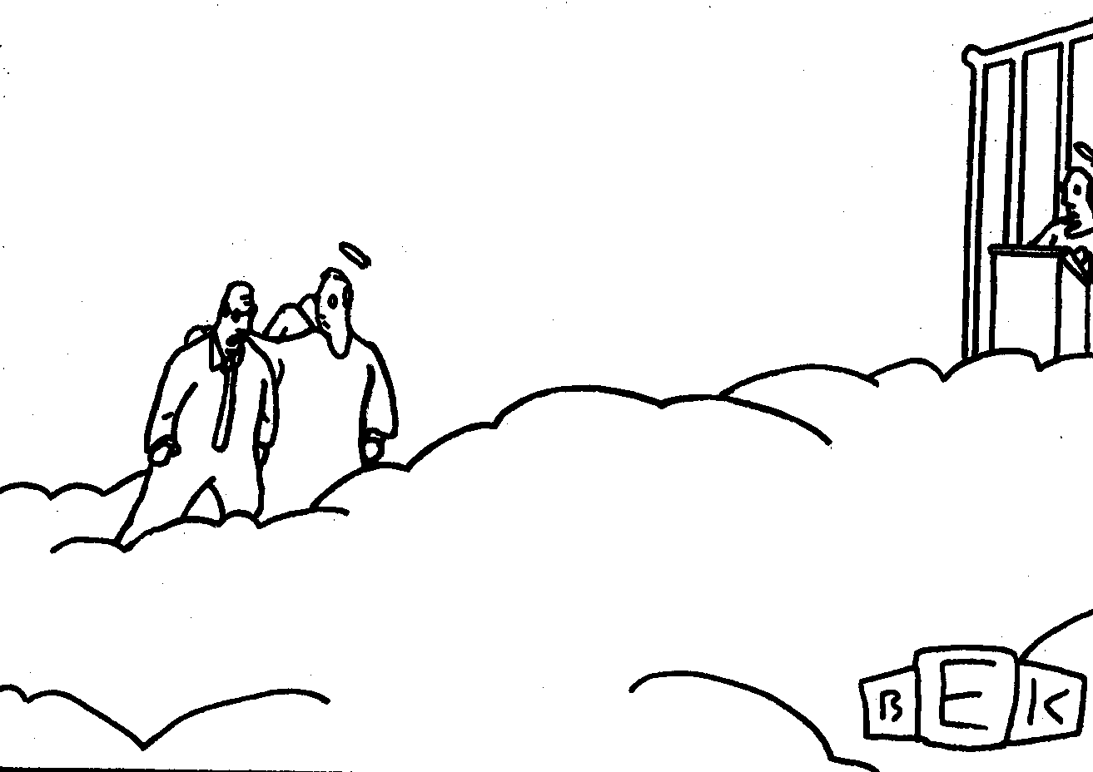
“Well, so much for antioxidants.”

Slide 13
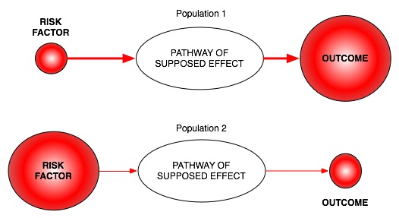
Classic limitations to “observational” science
Confounding
Reverse Causation
Bias

Slide 14
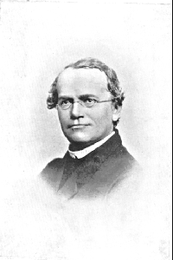
An Alternative to RCTs: Mendelian randomization
In genetic association studies the laws
of Mendelian genetics imply that
comparison of groups of individuals
defined by genotype should only differ
with respect to the locus under study
(and closely related loci in linkage
disequilibrium with the locus under study)
Genotypes can proxy for some modifiable
risk factors, and there should
be no confounding of genotype by
behavioural, socioeconomic or
physiological factors (excepting those
influenced by alleles at closely proximate
loci or due to population stratification)
Mendel in 1862

Slide 15
Mendelian randomisation and RCTs
MENDELIAN RANDOMISATION
RANDOMISED CONTROLLED TRIAL
RANDOM SEGREGATION OF ALLELES
RANDOMISATION METHOD
EXPOSED: FUNCTIONAL ALLELLES
CONTROL: NULL ALLELLES
EXPOSED:
INTERVENTION
CONTROL:
NO INTERVENTION
CONFOUNDERS EQUAL BETWEEN GROUPS
CONFOUNDERS EQUAL BETWEEN GROUPS
OUTCOMES COMPARED BETWEEN GROUPS
OUTCOMES COMPARED BETWEEN GROUPS

Slide 16
Assumptions of Mendelian randomisation analysis
U
Z
X
Y
Z associated with X
Z is independent of U
Z is independent of Y given U and X

Slide 17
Examples – using instruments for adiposity
U
Adiposity
Z
X
Y
FTO

Slide 18
Examples – using instruments for adiposity
U
Adiposity
Traits of metabolism
CRP/BMI
FTO

Slide 19
In a Nutshell
If adiposity DOES NOT causally affect metabolic traits, then the FTO variant should NOT be related to these metabolic traits
If adiposity causally affects metabolic traits, then the FTO variant should also be related to these metabolic traits
In this situation, the causal effect of adiposity can be estimated using an “instrumental variables analysis” as fitted by two stage least squares

Slide 20
Do intermediate metabolic traits differ as one would expect
given a FTO-BMI effect?
Given the per allele FTO effect of ~0.1SD and known observational
estimates one can derive an expected, per allele, effect on metabolic traits
Phenotype | Expected Change | Observed Change | Observed Change (BMI adjusted)
Fasting insulin | 0.038 (0.033, 0.043) | 0.039 (0.013,0.064) | -0.005 (-0.027, 0.018)
Fasting Glucose | 0.018 (0.014, 0.021) | 0.024 (0.001, 0.048) | 0.006 (-0.017, 0.029)
Fasting HDL | -0.026 (-0.029, -0.023) | -0.032 (-0.057, -0.008) | -0.004 (-0.027, 0.019)
…
N~12,000 samples of European ancestry

Slide 21
Examples – using instruments for adiposity
U
Adiposity
Traits of metabolism
CRP
FTO

Slide 22
Bidirectional MR

Slide 23
CRP and BMI
C-Reactive Protein (CRP) is a biomarker of inflammation
It is associated with BMI, metabolic syndrome, CHD and a number of other diseases
It is unclear whether these observational relationships are causal or due to confounding or reverse causality
This question is important from the perspective of drug development

Slide 24
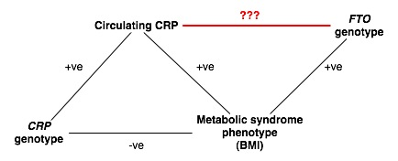
“Bi-directional Mendelian Randomization”
???

Slide 25
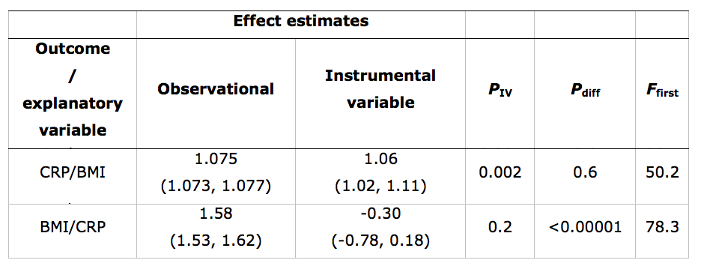
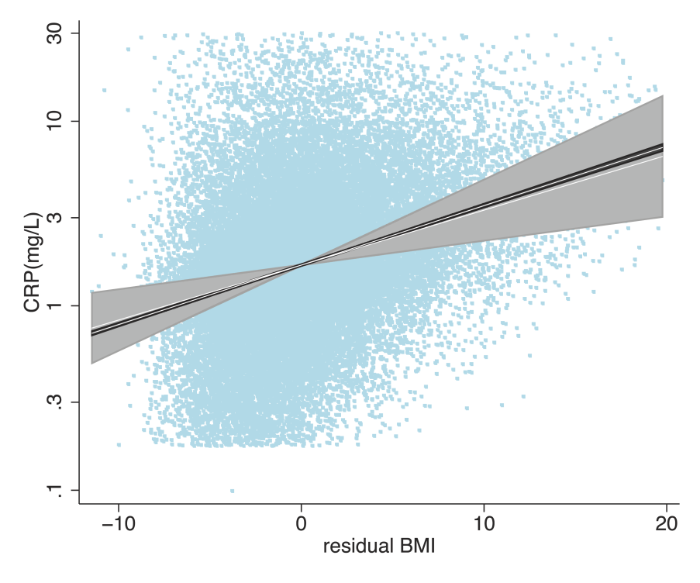
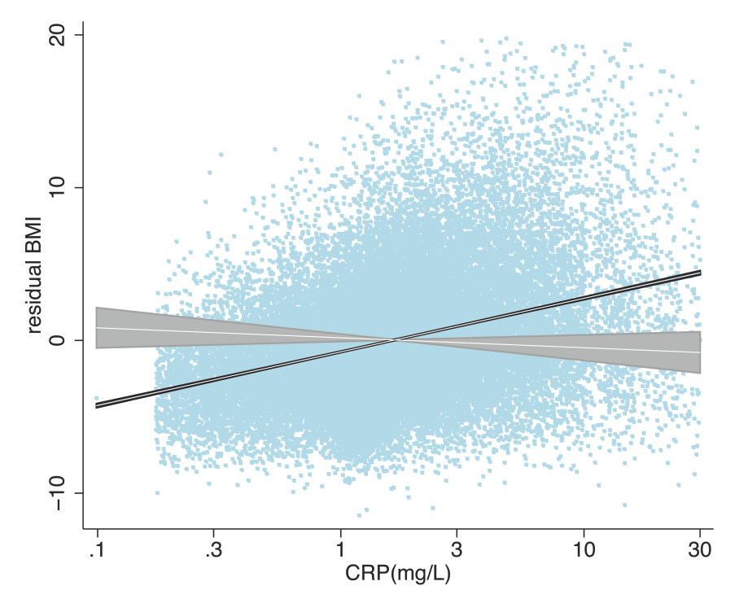

Slide 26
Informative Interactions

Slide 27
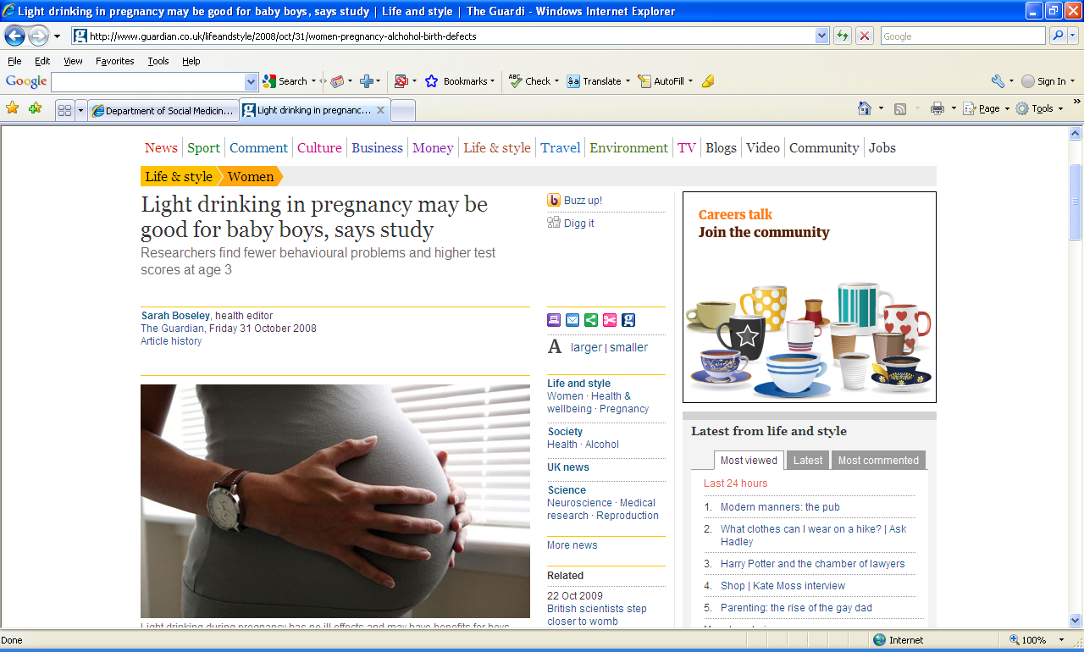

Slide 28
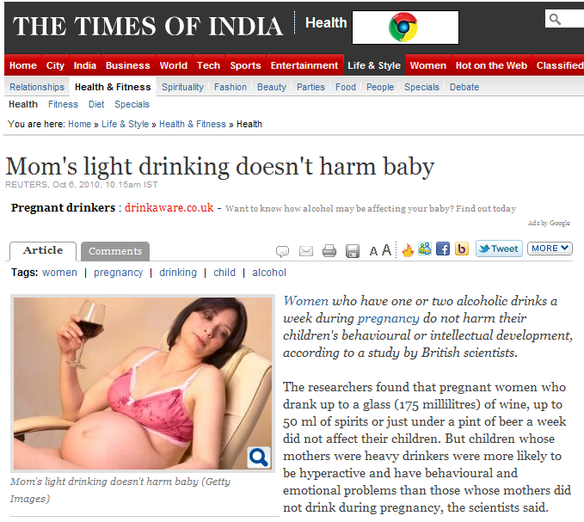

Slide 29
Kelly Y, Sacker A, Gray R et al. J Epidemiol Community Health (2010), doi:10.1136/jech.2009.103002

Slide 30
Kelly Y, Sacker A, Gray R et al. J Epidemiol Community Health (2010), doi:10.1136/jech.2009.103002

Slide 31
Kelly Y, Sacker A, Gray R et al. J Epidemiol Community Health (2010), doi:10.1136/jech.2009.103002

Slide 32
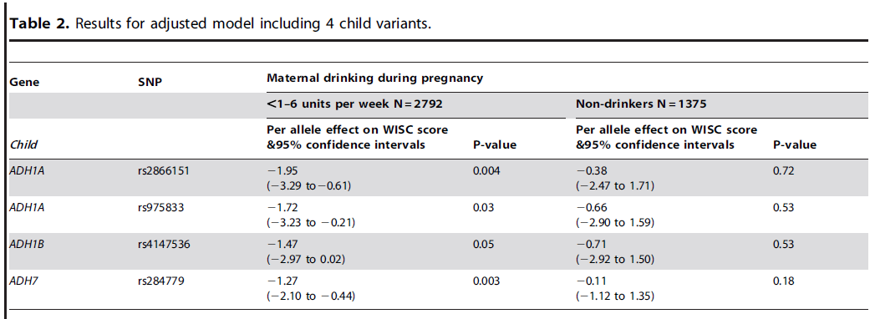
Maternal Alcohol Dehydrogenase and Offspring IQ

Slide 33
Alcohol dehydrogenase (ADH) risk allele score in offspring and offspring IQ, stratified by maternal alcohol intake during pregnancy
IQ Change
Women not drinking in pregnancy
All women
Women drinking during pregnancy
P value for interaction of risk allele score and drinking during pregnancy equals 0.009
Lewis S et al, PLoS One Nov 2012.

Slide 34
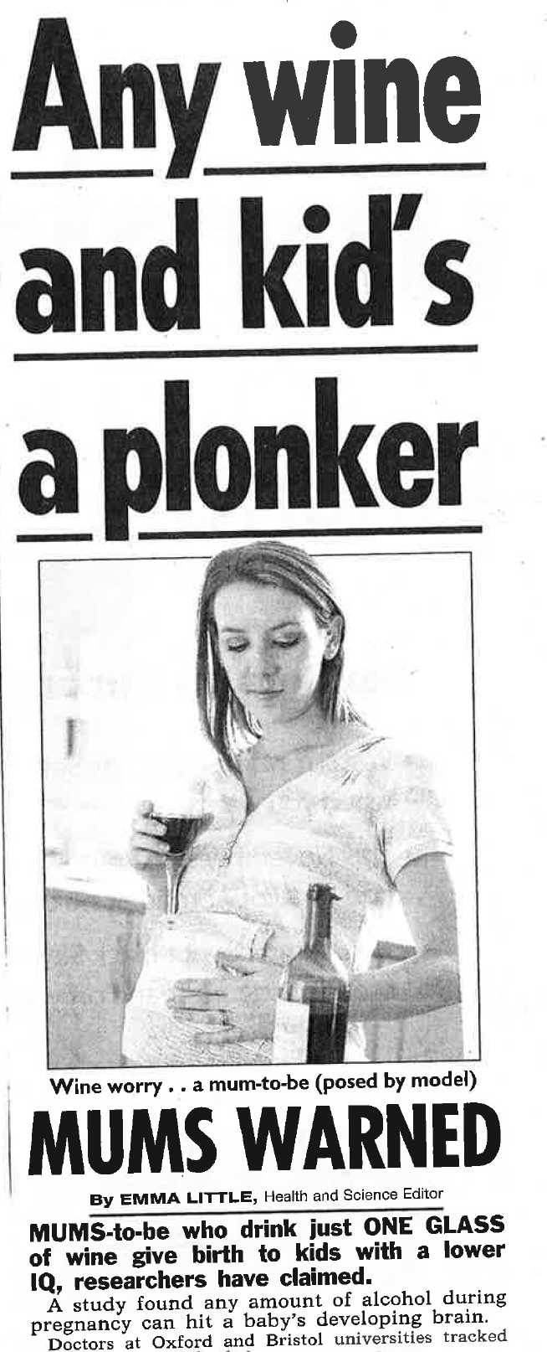

Slide 35
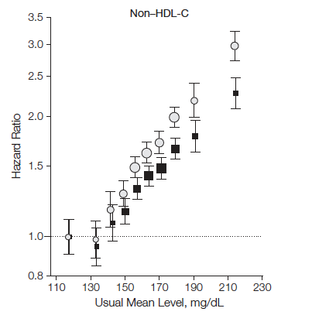
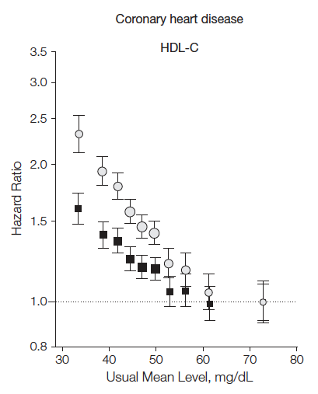
Association of LDL-C, HDL-C, and risk for coronary heart disease (CHD)
LDL-C
HDL-C
302K participants in 68 prospective studies
Emerging Risk Factors Collaboration, JAMA 2009
Notes:
The original total cholesterol association has been refined to show that:
higher plasma LDL-C and TG increases risk for MI whereas higher HDL-C decreases risk for MI

Slide 36
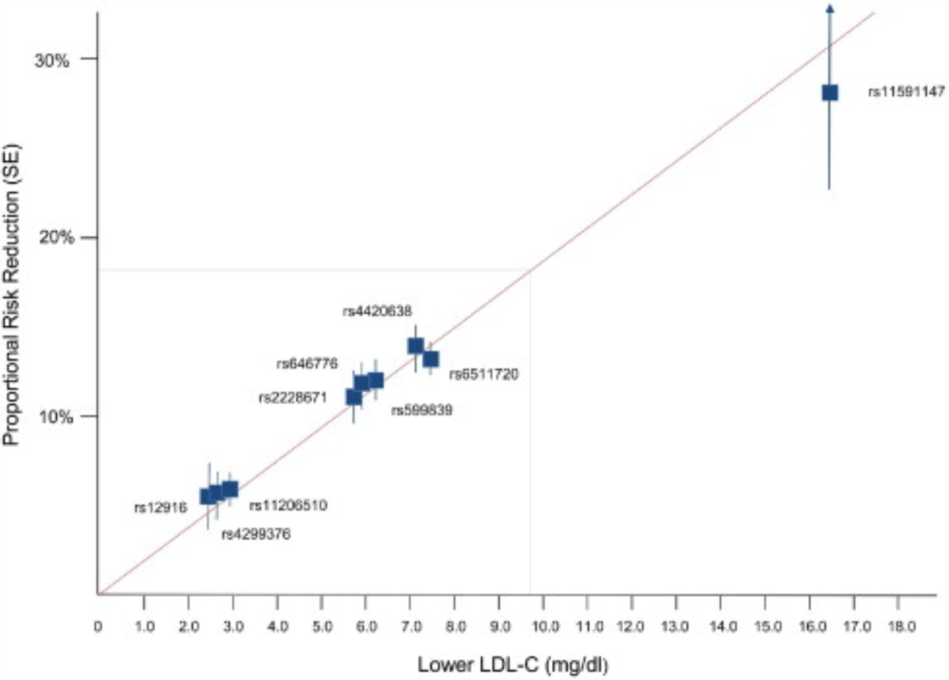
LDL and CHD Risk
Ference et al, JACC 2012

Slide 37
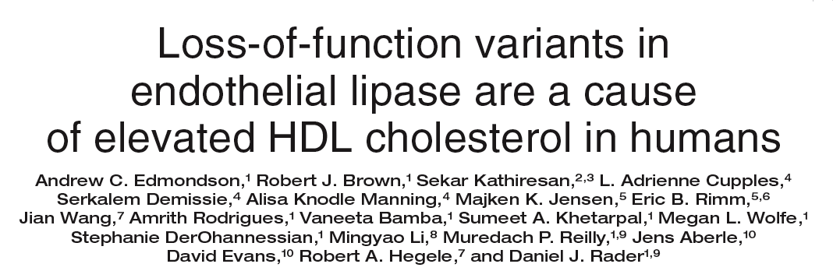
HDL: endothelial lipase Asn396Ser
2.6% of population carry Serine allele
higher HDL-C
No effect on other lipid fractions
No effect on other MI risk factors
Edmondson, J Clin Invest 2009

Slide 38
LIPG N396S and plasma HDL-C
HDL Difference
396S carriers have
5.5 mg/dl higher HDL-C
P<10⁻⁸
Notes:
Odds Ratio for MI:
0.54 (0.40 – 0.72)
P=2x10⁻⁵
N=3490 cases,
3497 controls

Slide 39
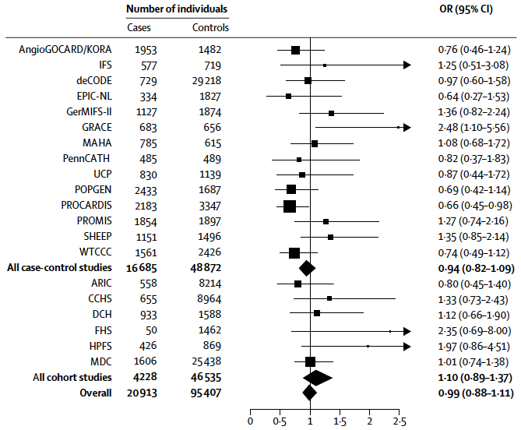
After testing in 116,320 people, summary OR for LIPG Asn396Ser is 0.99

Slide 40
Individuals who carry the HDL-boosting variant have the same risk for heart attack
as those who do not carry the variant

Slide 41
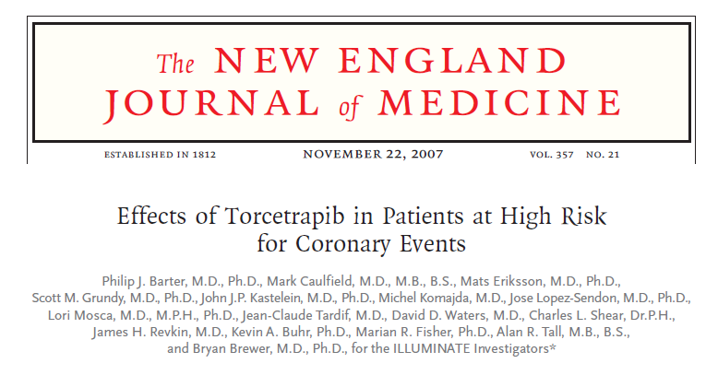
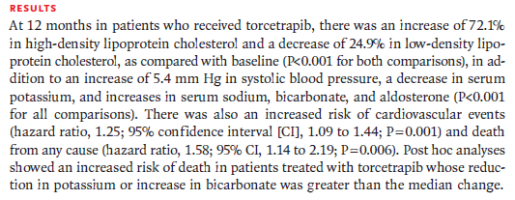

Slide 42
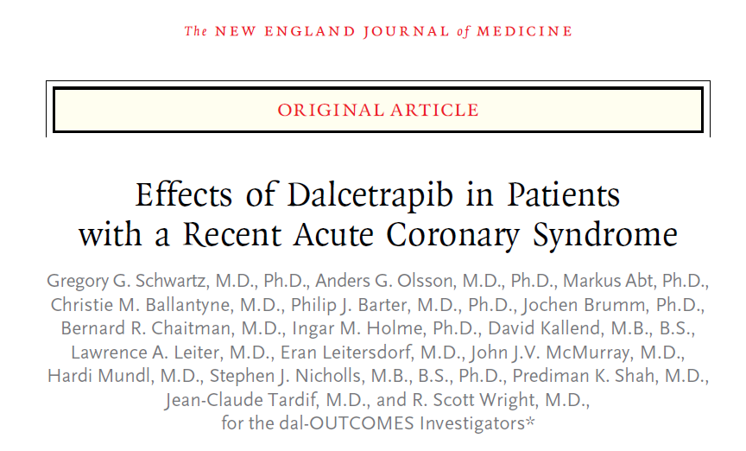
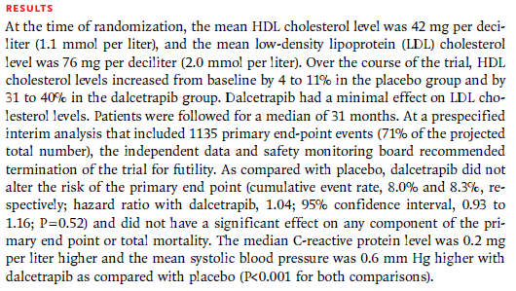

Slide 43
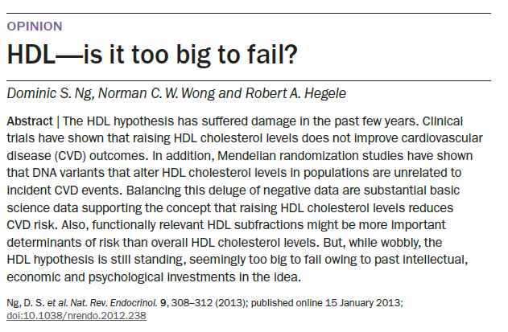

Slide 44
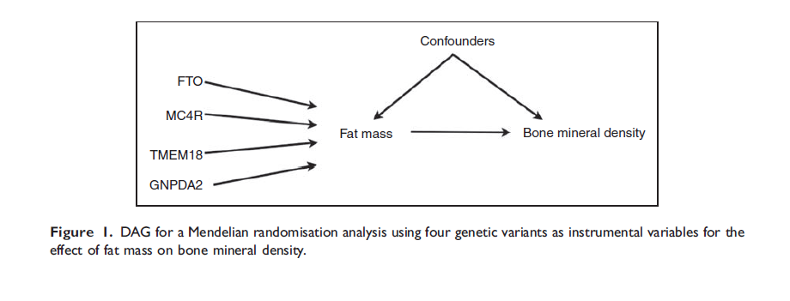
Using Multiple Genetic Variants as Instruments
Allelic scores
Palmer et al (2011) Stat Method Res
Testing multiple variants individually

Slide 45
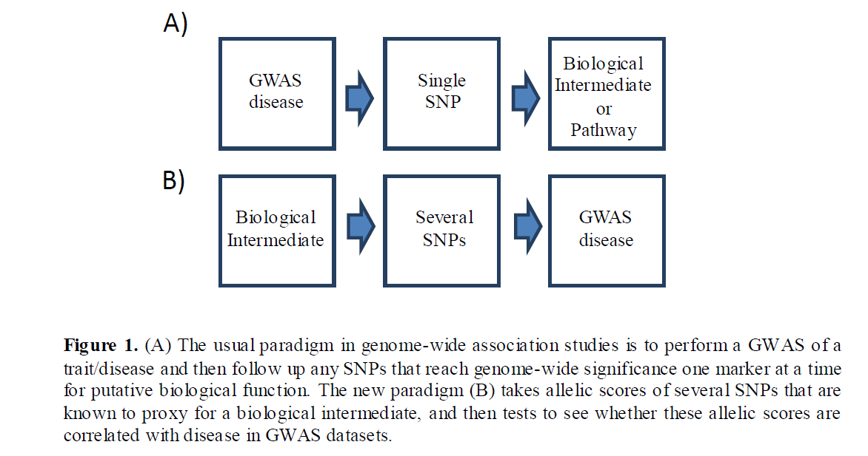

Slide 46
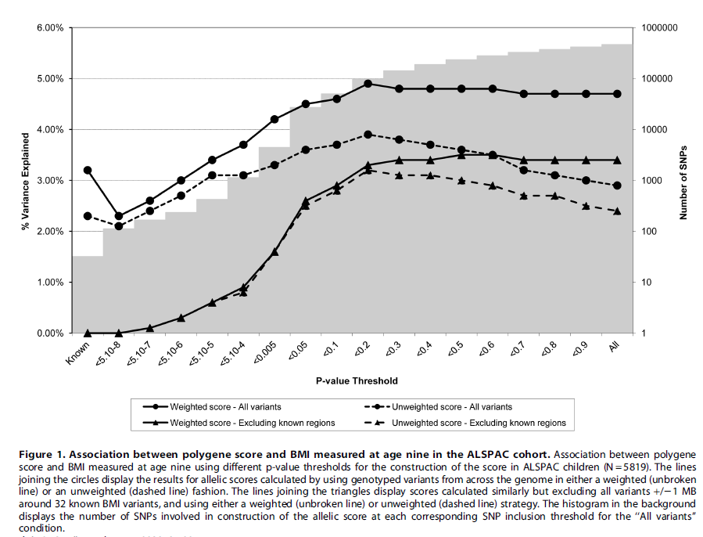

Slide 47
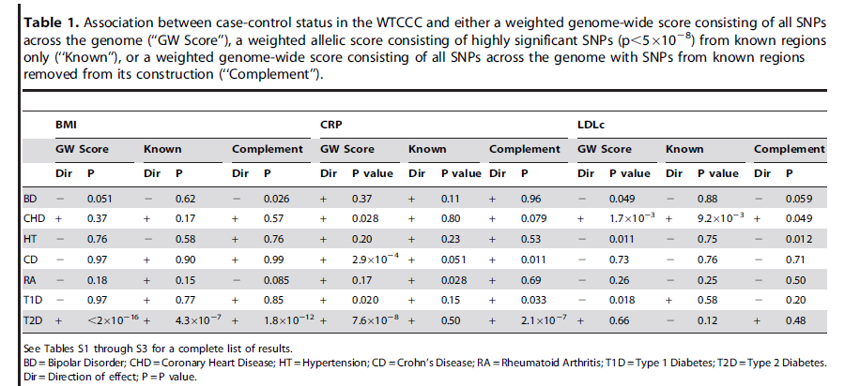
Mining the Phenome Using Allelic Scores
Could be applied to hundreds of thousands of molecular phenotypes simultaneously (gene expression, methylation, metabolomics etc)

Slide 48
Limitations to Mendelian Randomisation
1- Pleiotropy
2- Population stratification
3- Canalisation
4- Power (also “weak instrument bias”)
5- The existence of instruments

Slide 49
Mendelian Randomization in R
There is a positive observational association between body mass index (BMI) and bone mineral density (BMD)
It is unclear whether this represents a causal relationship
We will use two stage least squares as implemented in R to address this question and estimate the causal effect of BMI on BMD

Slide 50
Fitting in R - Datafile
BMI BMD BMI_SCORE
.371031158022524 .860471934 0.0554687
-.77975167453452 .862923791 0.06125
-.697738302042461 .86130172 0.0684375
...

Slide 51
Fitting in R
library(sem)
#Load BMI and BMD Data
x <- read.table(file="BMI_BMD_known.txt", header=TRUE, na.strings=-9)
#Observational regression of BMD on BMI
print("Observational regression of BMD on BMI")
summary(lm(x$BMD ~ x$BMI))
#Regression of BMI on BMI score – Check Instrument Strength
print("Regression of BMI on BMI score")
summary(lm(x$BMI ~ x$BMI_SCORE))
#Perform two stage least squares analysis
print("Two stage least squares analysis of BMD on BMI score")
summary(tsls(x$BMD ~ x$BMI, ~ x$BMI_SCORE))

Slide 52
COMMAND:
#Observational regression of BMD on BMI
print("Observational regression of BMD on BMI")
summary(lm(x$BMD ~ x$BMI))
OUTPUT:
[1] "Observational regression of BMD on BMI"
Call:
lm(formula = x$BMD ~ x$BMI)
Coefficients:
Estimate Std. Error t value Pr(>|t|)
(Intercept) 0.9020479 0.0006254 1442.38 <2e-16 ***
x$BMI 0.0195233 0.0006458 30.23 <2e-16 ***

Slide 53
COMMAND:
#Regression of BMI on BMI score – Check Instrument Strength
print("Regression of BMI on BMI score")
summary(lm(x$BMI ~ x$BMI_SCORE))
OUTPUT:
[1] "Regression of BMI on BMI score"
Call:
lm(formula = x$BMI ~ x$BMI_SCORE)
Coefficients:
Estimate Std. Error t value Pr(>|t|)
(Intercept) -1.30067 0.09708 -13.4 <2e-16 ***
x$BMI_SCORE 20.56254 1.53438 13.4 <2e-16 ***
Residual standard error: 0.9532 on 5552 degrees of freedom
Multiple R-squared: 0.03133, Adjusted R-squared: 0.03116
F-statistic: 179.6 on 1 and 5552 DF, p-value: < 2.2e-16

Slide 54
COMMAND:
#Perform two stage least squares analysis
print("Two stage least squares analysis of BMD on BMI score")
summary(tsls(x$BMD ~ x$BMI, ~ x$BMI_SCORE))
OUTPUT:
[1] "Two stage least squares analysis of BMD on BMI score"
2SLS Estimates
Model Formula: x$BMD ~ x$BMI
Instruments: ~x$BMI_SCORE
Estimate Std. Error t value Pr(>|t|)
(Intercept) 0.90199 0.0006302 1431.368 0.000e+00
x$BMI 0.01442 0.0036687 3.931 8.551e-05

Slide 55
Acknowledgments
George Davey Smith
Nic Timpson
Sek Kathiresan

