Slide 1
Extending GCTA: Effects of the Genetic Environment
2014 International Workshop on Statistical Genetic Methods
for Human Complex Traits
Boulder, CO.
Lindon Eaves, David Evans

Slide 2
Thanks also:
Beate St. Pourcin – Bristol U.
Tim York - VCU
George Davey-Smith – Bristol U
Mike Neale - VCU
Peter Visscher and Matthew Robinson – UQLD
See: Eaves LJ, St. Pourcain B, Davey-Smith G, York TP, Evans DM. (2014) Resolving the effects of maternal and offspring genotype on dyadic outcomes in Genome Wide Complex Trait Analysis (“M-GCTA”). Behavior Genetics (under revision).

Slide 3
Funding
“We have no money. We will have to think.”
(Rutherford)
University of Bristol UK:
Benjamin Meaker Visiting Professorship
Virginia Retirement System
United States Social Security Administration

Slide 4
“Quantitative Genetics”
Estimates genetic (and environmental) contribution to variation by regressing measures of phenotypic similarity on genetic (and environmental) similarity

Slide 5
Regression of phenotypic correlation on genetic correlation (modified from Fulker, 1979)
1
E
Reared together
r
r=C+bA
Reared apart
Phenotypic
Correlation
A
r=bA
C
0
0
0.5
b
1
Genetic Correlation

Slide 6
Classical Approach (Fisher, Wright, Falconer, Mather etc.)
Estimates genetic correlation from expected genetic resemblance based on genetic relatedness (MZ, DZ twins, siblings, half-siblings, cousins etc.)

Slide 7
“GCTA”
“Genome-Wide Complex Trait Analysis”
Visscher, Yang, Lee, Goddard
Estimates genetic correlation from empirical genetic resemblance of “unrelated” individuals based on identity by state across using genome-wide single nucleotide polymorphisms (“SNPs”)

Slide 8
Basic GCTA Model
V = G + E
V=Phenotypic variance between individuals
G=(Additive) genetic variance
E=(Unique) environmental variance
Σ= AG + IE
Where Σ = expected phenotypic covariance matrix between individuals; A = empirical genetic relatedness matrix between individuals

Slide 9
GCTA
Plusses
Minusses
Doesn’t need special samples (e.g. twins)
Aggregate across genome
Uses all possible pairs of unrelateds (smallish Ns yield lots of pairs)
Uses real genomic information to estimate genetic resemblance
Can partition genetic effects among e.g. chromosomes
No problem with “special twin environments”
Ignores lots of stuff at this point (social interaction, non-additive genetic effects)
Assumes SNPs yield unbiased estimate of genetic correlation (? assortative mating)
Estimates have large s.e.’s
Lots of other stuff still being figured out (environmental stratification......?)

Slide 10
BUT….
Humans are “More than” individual packets of DNA – have families, feet, brains and communities
Behavioral phenotype extends beyond individual

Slide 11
Extending the Phenotype
World
Parents
Me
Spouse
Siblings
Child
c.f. Dawkins, R. (1983)

Slide 12
A Place to Start: M-GCTA Include effects of the Maternal Genotype on Offspring Behavior (“Genetic Maternal Effects”)
Extensive background in plant and animal genetics (reciprocal crosses, diallels, dam and sire effects)
Good models and examples from human studies (extended kinships of twins, maternal and paternal half-sibships)
Extensively measured and genotyped mother-child pairs (e.g. “ALSPAC”)

Slide 13
Basic path model for fetal and maternal effects in mother-child dyads.
Maternal
Fetal
G_{MM}
G_{CM}
Maternal genotype
m
P
Phenotype
(Dyadic)
¹/₂
¹/₂
e
c
h
E
G_{MC}
G_{CC}
Environment
Maternal
Offspring genotype
Fetal

Slide 14
Basic model for components of variance
V = h² + m² + mc + e² (path model)
Or:
V = G + M + Q + E
(Biometrical-genetic model where:
M=m², G=(c² + h²) and Q = mc)
V=Phenotypic variance
G=(Additive) genetic variance (“A” in ACE model)
M=Shared environmental variance due to indirect effects of maternal genotype on offspring phenotype (“genetic maternal effects”)
Q=Covariance arising from overlap between genes with direct and indirect effect (“passive rGE”, +ve or –ve) (M+Q->”C” in ACE model)

Slide 15
Pattern of Genetic Relatedness Within and Between
Typical Unrelated Mother-Child Pairs
Pair i
Pair j
α_{ij}
G_{Mi}
G_{Mj}
Mother
γ_{i}
δ_{ij}
δ_{ji}
γ_{j}
G_{Ci}
G_{Cj}
Offspring
β_{ij}
Εγ_{i}=¹/₂

Slide 16
Components of genetic relatedness matrix
for mothers and offspring
Notes: Key to genetic components (c.f. Figure 2): MM=maternal copies of genes having indirect maternal effects (m) when present in the mother; CM = maternal copies of genes having direct effects (h) when present in offspring; MC= offspring copies of genes having indirect maternal effects (m) when present in the mother (may also have a direct effect, c>0, on offspring when present in offspring); CC = offspring copies of genes having direct effects (h) when present in offspring. Component matrices are NxN where N=number of mother-child pairs in the sample.

Slide 17
Including Offspring Phenotype in Genetic Model
Genes with offspring-specific effects
α_{ij}
Mother-child
Pair “I”
CM_{i}
CM_{j}
Mother-child
Pair “j”
α_{ij}
MM_{i}
γ_{i}
γ_{j}
MM_{j}
δ_{ji}
δ_{ij}
CC_{i}
CC_{j}
m
m
h
β_{ij}
γ_{j}
γ_{i}
P_{i}
h
P_{j}
δ_{ji}
δ_{ij}
c
Environment
“Residuals”
c
e
E_{i}
E_{j}
e
MC_{i}
MC_{j}
β_{ij}
Genes with maternal effects (may also have direct expression in child)

Slide 18
Covariance structure of unrelated individuals
given empirical estimates of genetic relatedness
= AM + BG + ΔQ + IE
where Δ=D+D’
Given phenotypes of N subjects and genetic relatedness matrices, A, M and D estimated from SNPs, can estimate genetic parameters by FIML (openMX) or REML (GCTA using Yang et als. program).

Slide 19
Can Fudge it in GCTA Package Because Yang et al’s GCTA program allows total covariance to be partitioned among multiple (independent) sources (chromosomes) Thus: Σ = B₁ G₁ + B₂ G₂ + B₃ G₃ + ….+IE where G_{i} is the genetic variance contributed by the ith chromosome and B_{i} the genetic relatedness derived from SNPs on that chromosome. Our M-GCTA model has a similar linear form.

Slide 20
OpenMX vs GCTA for extended models
openMX
GCTA (Yang et al)
(Currently) FIML. Impossibly slow with large N (>2000)
Handles non-linear (path) models and constraints
Need external programming to compute relatedness matrices
Extends to multivariate models
“Ours” – Easier to mess with
REML very fast with large enough N (5000+)
Unconstrained linear (variance components) model
Computes relatedness matrices (rapidly)
Limited extension to multi(bi-)variate case
“Someone else’s” – Harder to mess with.

Slide 21
Outline of simulation
Simulation done in R on MAC. Model fitted in OpenMx
1000 trios (mother, father, child); 500 SNPS.
Decide which SNPs have direct or maternal effects, both or neither.
Sample direct and maternal effects for each SNP.
Simulate SNPs for parents and offspring trios
Generate offspring phenotypes from maternal and offspring SNPs and residuals
Compute genetic relatedness matrices (A,B and D) across all mother-child pairs (see Yang et al. for algebra).
Recover ML estimates of G, M and Q using OpenMx
Fit-reduced models and compare

Slide 22
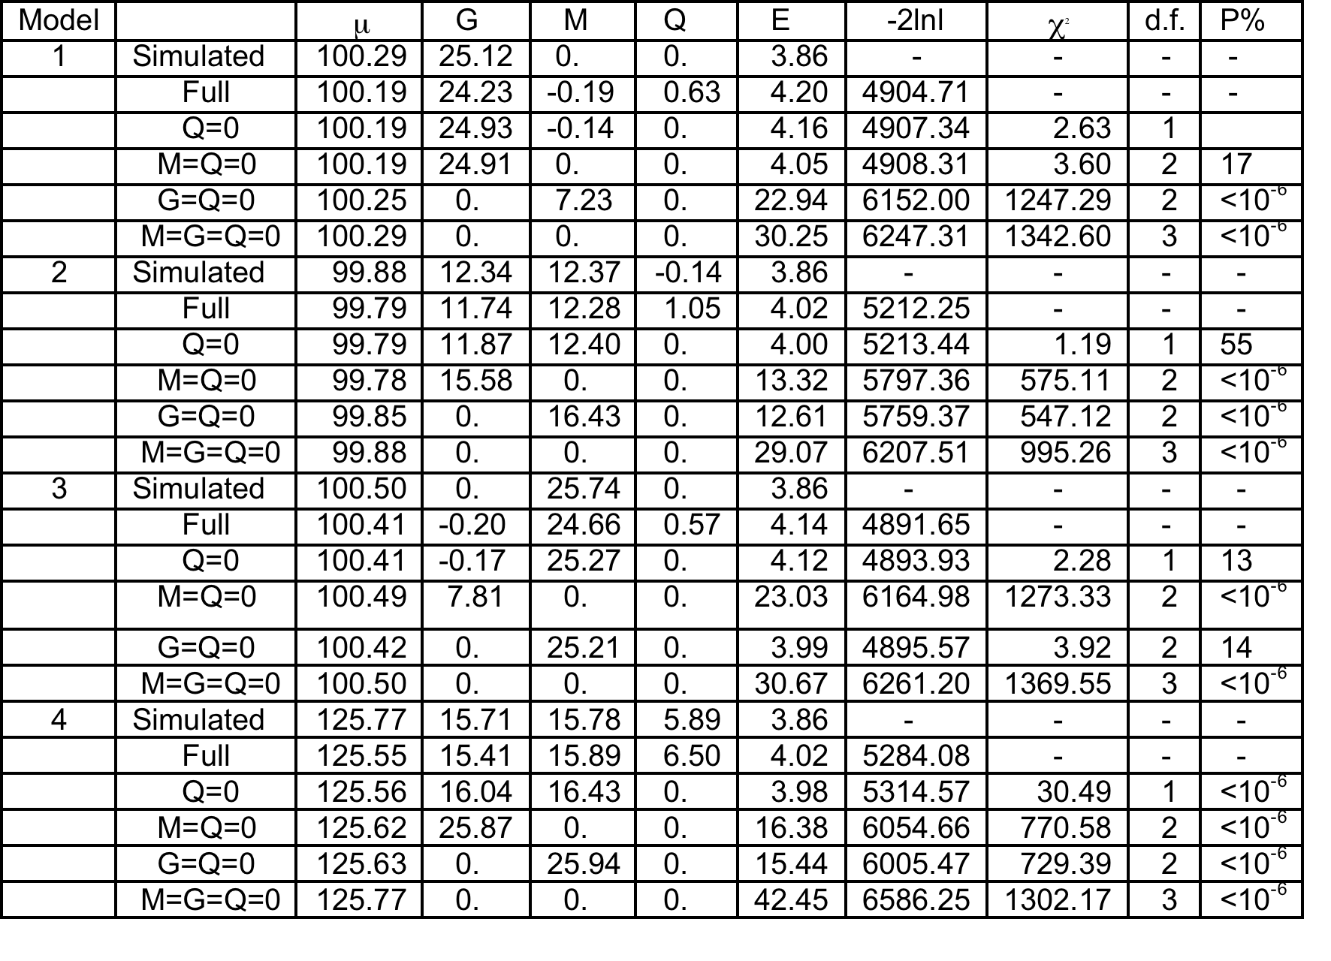
Results of fitting “GCTA” model for direct and maternal effects to simulated offspring phenotypes in random samples of genotyped mother-child pairs (N=1000)

Slide 23
Comparison of estimates obtained from simulated data by FIML in OpenMx and REML in GCTA.

Slide 24
Application to Real Data

Slide 25
“ALSPAC” The Avon Longitudinal Study of Parents and Children (“ALSPAC”) UK Medical Research Council Wellcome Trust University of Bristol http://www.bris.ac.uk/alspac/researchers/data-access/data-dictionary

Slide 26
ALSPAC
Early 1990’s
Avon County, UK
Population-based
Birth cohort study
Longitudinal follow-up
14,541 women and children
Mothers genotyped on the Illumina 660K SNP chip.
Children genotyped on the Illumina 550K SNP chip.
After cleaning etc. genetic relatedness computed for 4761 unrelated mother-offspring pairs

Slide 27
ALSPAC
Boyd A, Golding J, Macleod J, Lawlor DA, Fraser A, Henderson J, Molloy L, Ness A, Ring S, Davey Smith G (2013) Cohort Profile: the 'children of the 90s'--the index offspring of the Avon Longitudinal Study of Parents and Children. Int J Epidemiol. 42(1):111-27.
Fraser A, Macdonald-Wallis C, Tilling K, Boyd A, Golding J, Davey Smith G, Henderson J, Macleod J, Molloy L, Ness A, Ring S, Nelson SM, Lawlor DA (2013) Cohort Profile: the Avon Longitudinal Study of Parents and Children: ALSPAC mothers cohort. Int J Epidemiol. 42(1):97-110.

Slide 28
Proof of Principle
Maternal, self-reported, pre-pregnancy BMI - should be no effects of offspring genotype.
Neonatal birth length (crown-heel) – might show effects of both maternal and fetal genotype

Slide 29
Results of fitting “GCTA” model for direct and maternal effects to maternal BMI and birth length data in the ALSPAC cohort. Results are presented as standardized variance components.

Slide 30
Conclusions?
It seems to work – so far
Subject to all the ifs and buts that go with using genome-wide SNPs to estimate genetic relatedness

Slide 31
Next Steps
Extend to other dyadic relationships: other relatives, social networks (peers etc.)
Multivariate systems
Causal models and intermediate pathways
Implications of assortative mating?
Non-additive genetic effects
Get it to work properly in OpenMx to capitalize on flexible modeling capabilities (MIKE et al.!!!!!)

