Slide 1
The Causes of Variation
2014 International Workshop on Statistical Genetic Methods
for Human Complex Traits
Boulder, CO.
Lindon Eaves,
VIPBG, Richmond VA.
March 2014

Slide 2
“Genetics”
The Study of
Variation and Heredity

Slide 3
“Variation”
“Why aren’t we all the same?”

Slide 4
“Heredity”
“Why do things run in families?”

Slide 5
“VARIATION”

Slide 6
Continuous variation

Slide 7
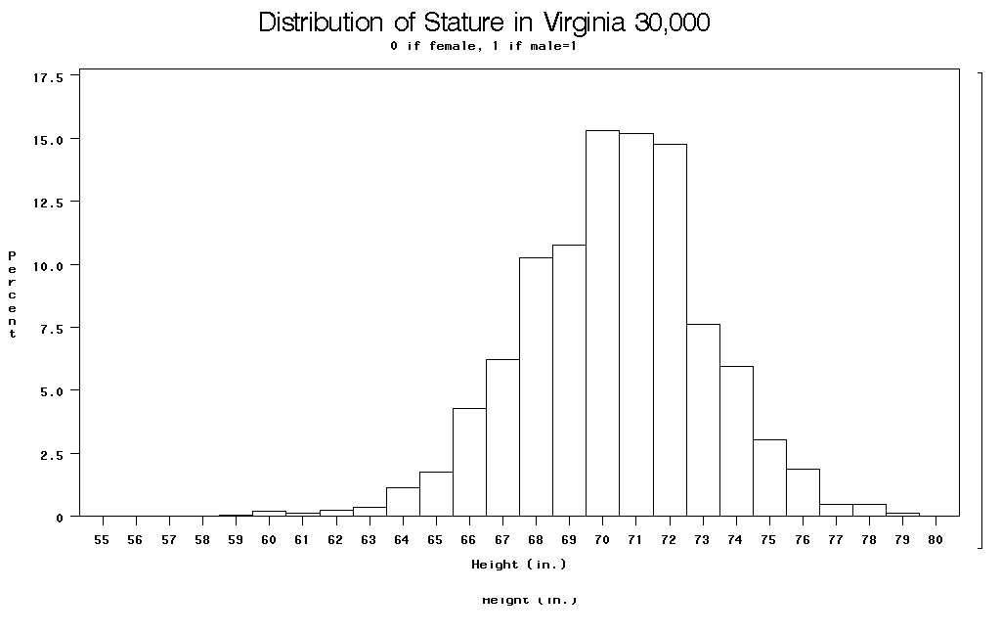

Slide 8
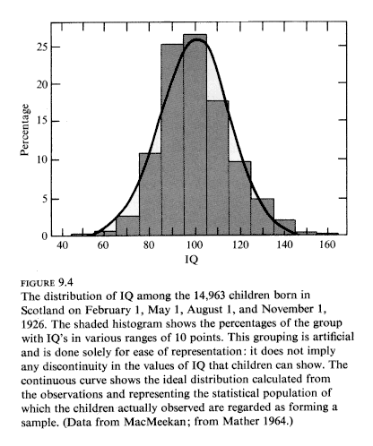

Slide 9
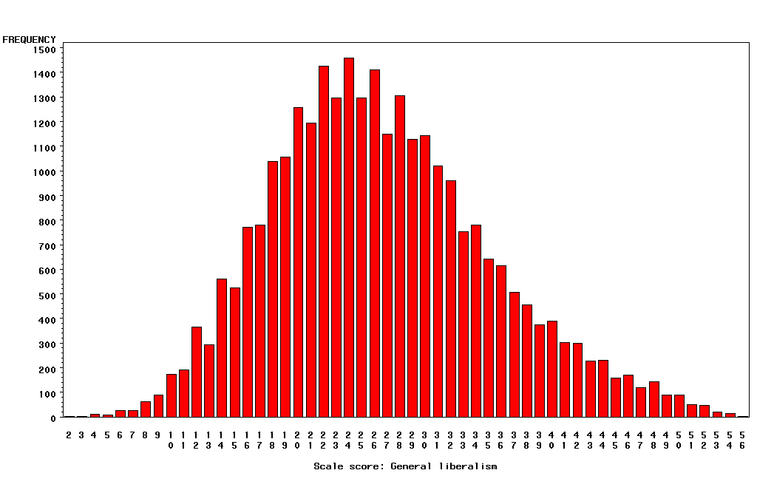
“Liberalism”

Slide 10
Categorical Outcomes
Often called “threshold traits” because people “affected” if they fall above some level (“threshold”) of a measured or hypothesized continuous trait.

Slide 11
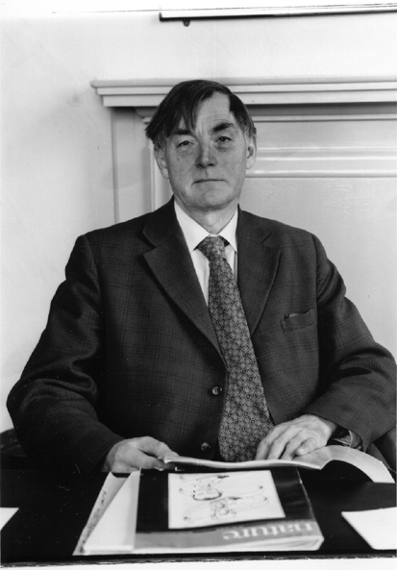
Douglas Scott Falconer, FRS, FRSE (1913-2004)
1965 Inheritance of liability to certain diseases estimated from
incidence among relatives., Ann. Hum. Genet.29:51ff.
1960 Introduction to Quanitative Genetics. Edinburgh: Oliver and Boyd.

Slide 12
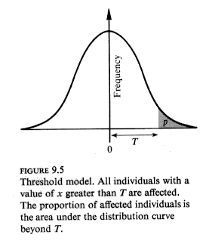

Slide 13
∞
Relationship between continuous normal “liability”
and risk of “diagnosis”
Probability
of
Diagnosis
1
0.5
0
-∞
0
t
+∞
Liability
(Trait Value)
Notes:
Consider e.g. “hypertension”: liability is blood pressure (contininous measure); diagnosis is doctor deciding you are “hypertension”.
Also, e.g. “diabetes” and “fasting glucose”; “republican” and “conservatism”. “Genius” and “IQ”. Etc.

Slide 14
Question that bugs me:
How do you get from “liability” to “catastrophe”?

Slide 15
“Heredity”

Slide 16
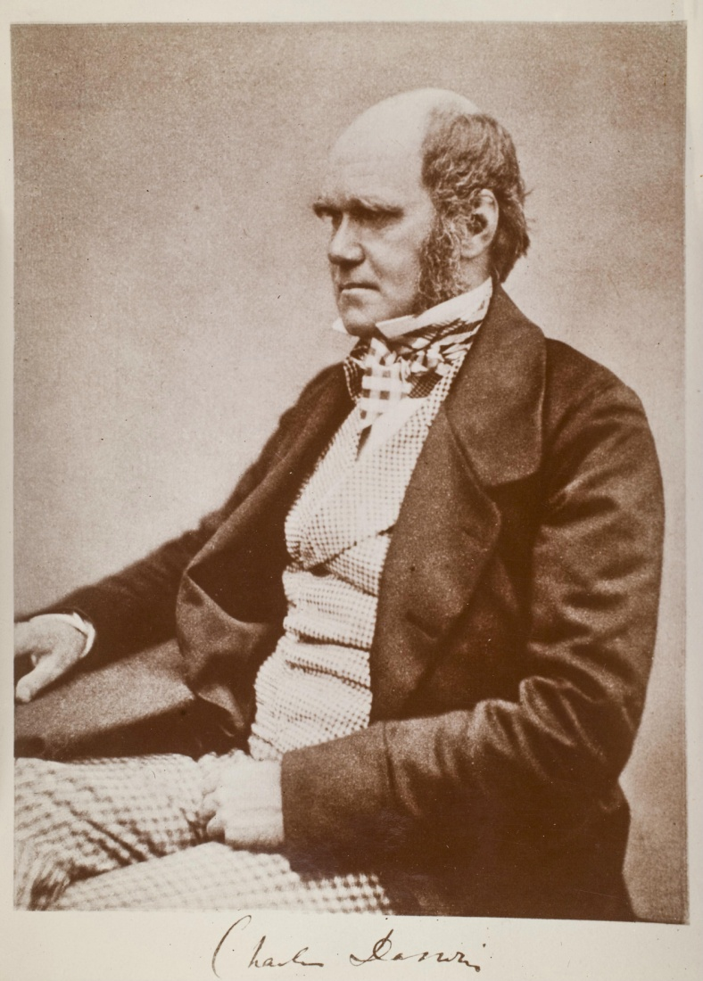

Slide 17
Charles Darwin (1809-1882)
1865: On the Origin of Species

Slide 18
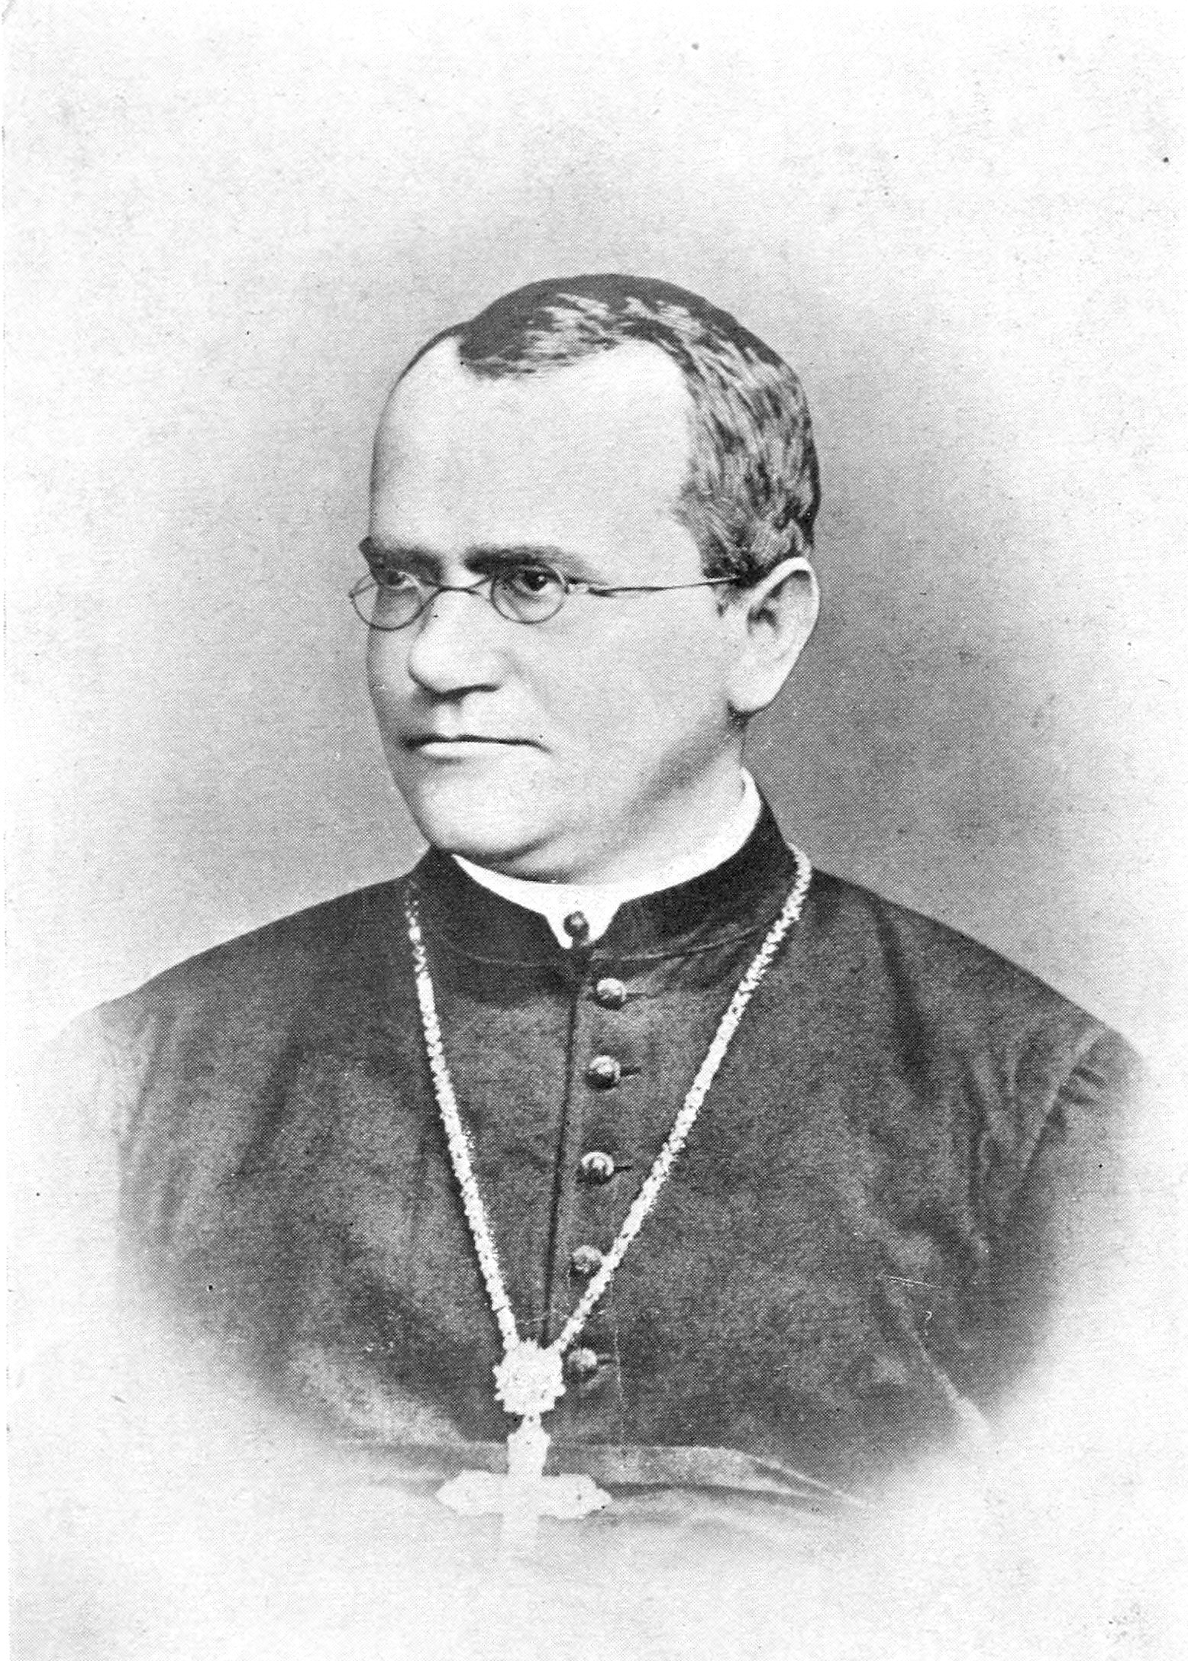

Slide 19
Gregor Mendel (1822-1885)
1865: Experiments in Plant Hybridisation

Slide 20
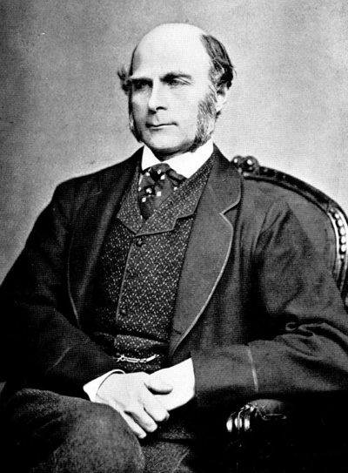
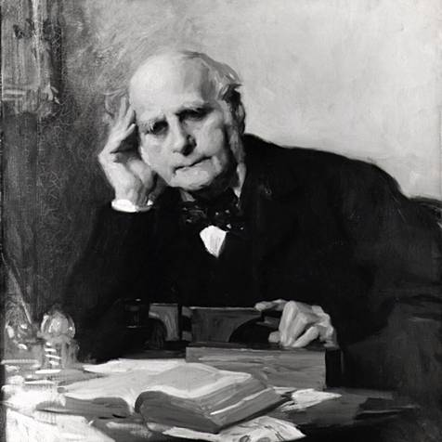
Notes:
Astonishing intellectual curiosity: 3-volume biography by his graduate student (Karl Pearson). Self-styled “gentleman”
i.e. didn’t need to earn his living. Could afford to do research. Many interests: numbers (devised vest with grid of pockets to accumulate contingency table from observations); finger-prints; composite photographs; family history (pedigree methods); statistics (devised correlation coefficient);
Measured family resemblance; collected first “twin” data (though Augustine hit on the method in the 4th Cent. Ch. 5 of Civitas Dei.)

Slide 21
Francis Galton (1822-1911)
1869: Hereditary Genius
1883: Inquiries into Human Faculty and its Development
1884-5: Anthropometic Laboratory at “National Health Exhibition”
Notes:
Astonishing intellectual curiosity: 3-volume biography by his graduate student (Karl Pearson). Self-styled “gentleman”
i.e. didn’t need to earn his living. Could afford to do research. Many interests: numbers (devised vest with grid of pockets to accumulate contingency table from observations); finger-prints; composite photographs; family history (pedigree methods); statistics (devised correlation coefficient);
Measured family resemblance; collected first “twin” data (though Augustine hit on the method in the 4th Cent. Ch. 5 of Civitas Dei.)

Slide 22
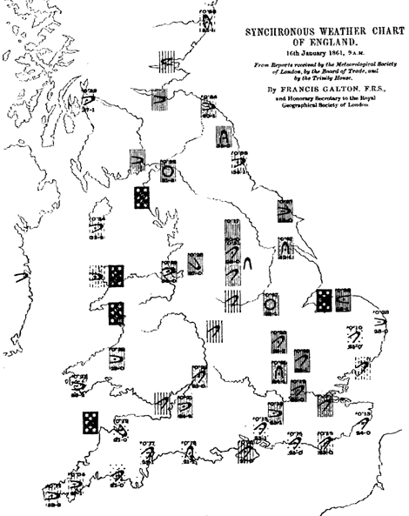
Galton’s Other Work e.g. Meteorology

Slide 23
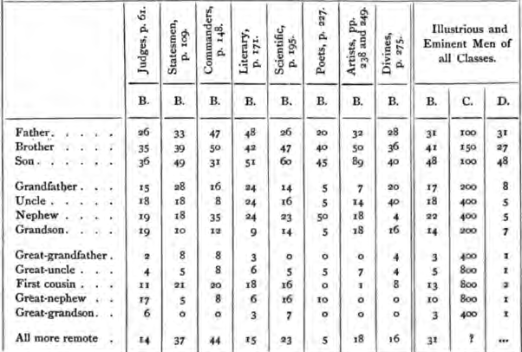
Hereditary Genius (1869, p 317)

Slide 24
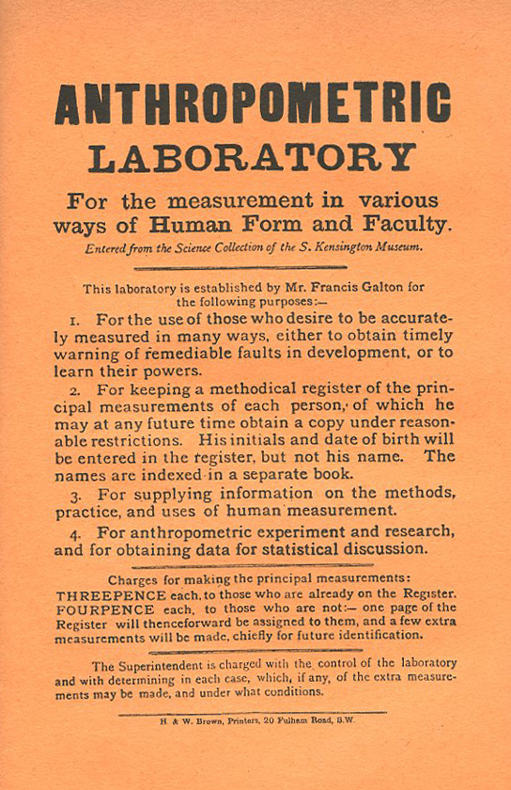
Galton’s Anthropometric Laboratory (1884-1885)

Slide 25
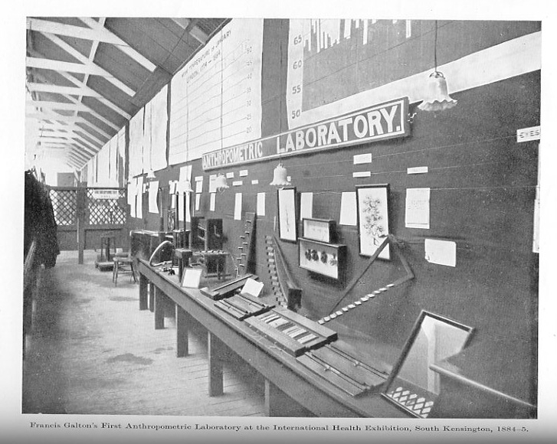

Slide 26
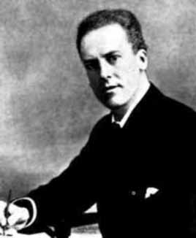
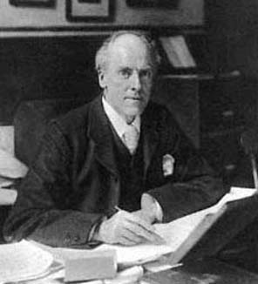

Slide 27
Karl Pearson (1857-1936)
1903: On the Laws of Inheritance in Man: I Physical Characteristics (with Alice Lee)
1904: II Mental and Moral Characteristics
1914: The Life, Letters and Labours of Francis Galton

Slide 28
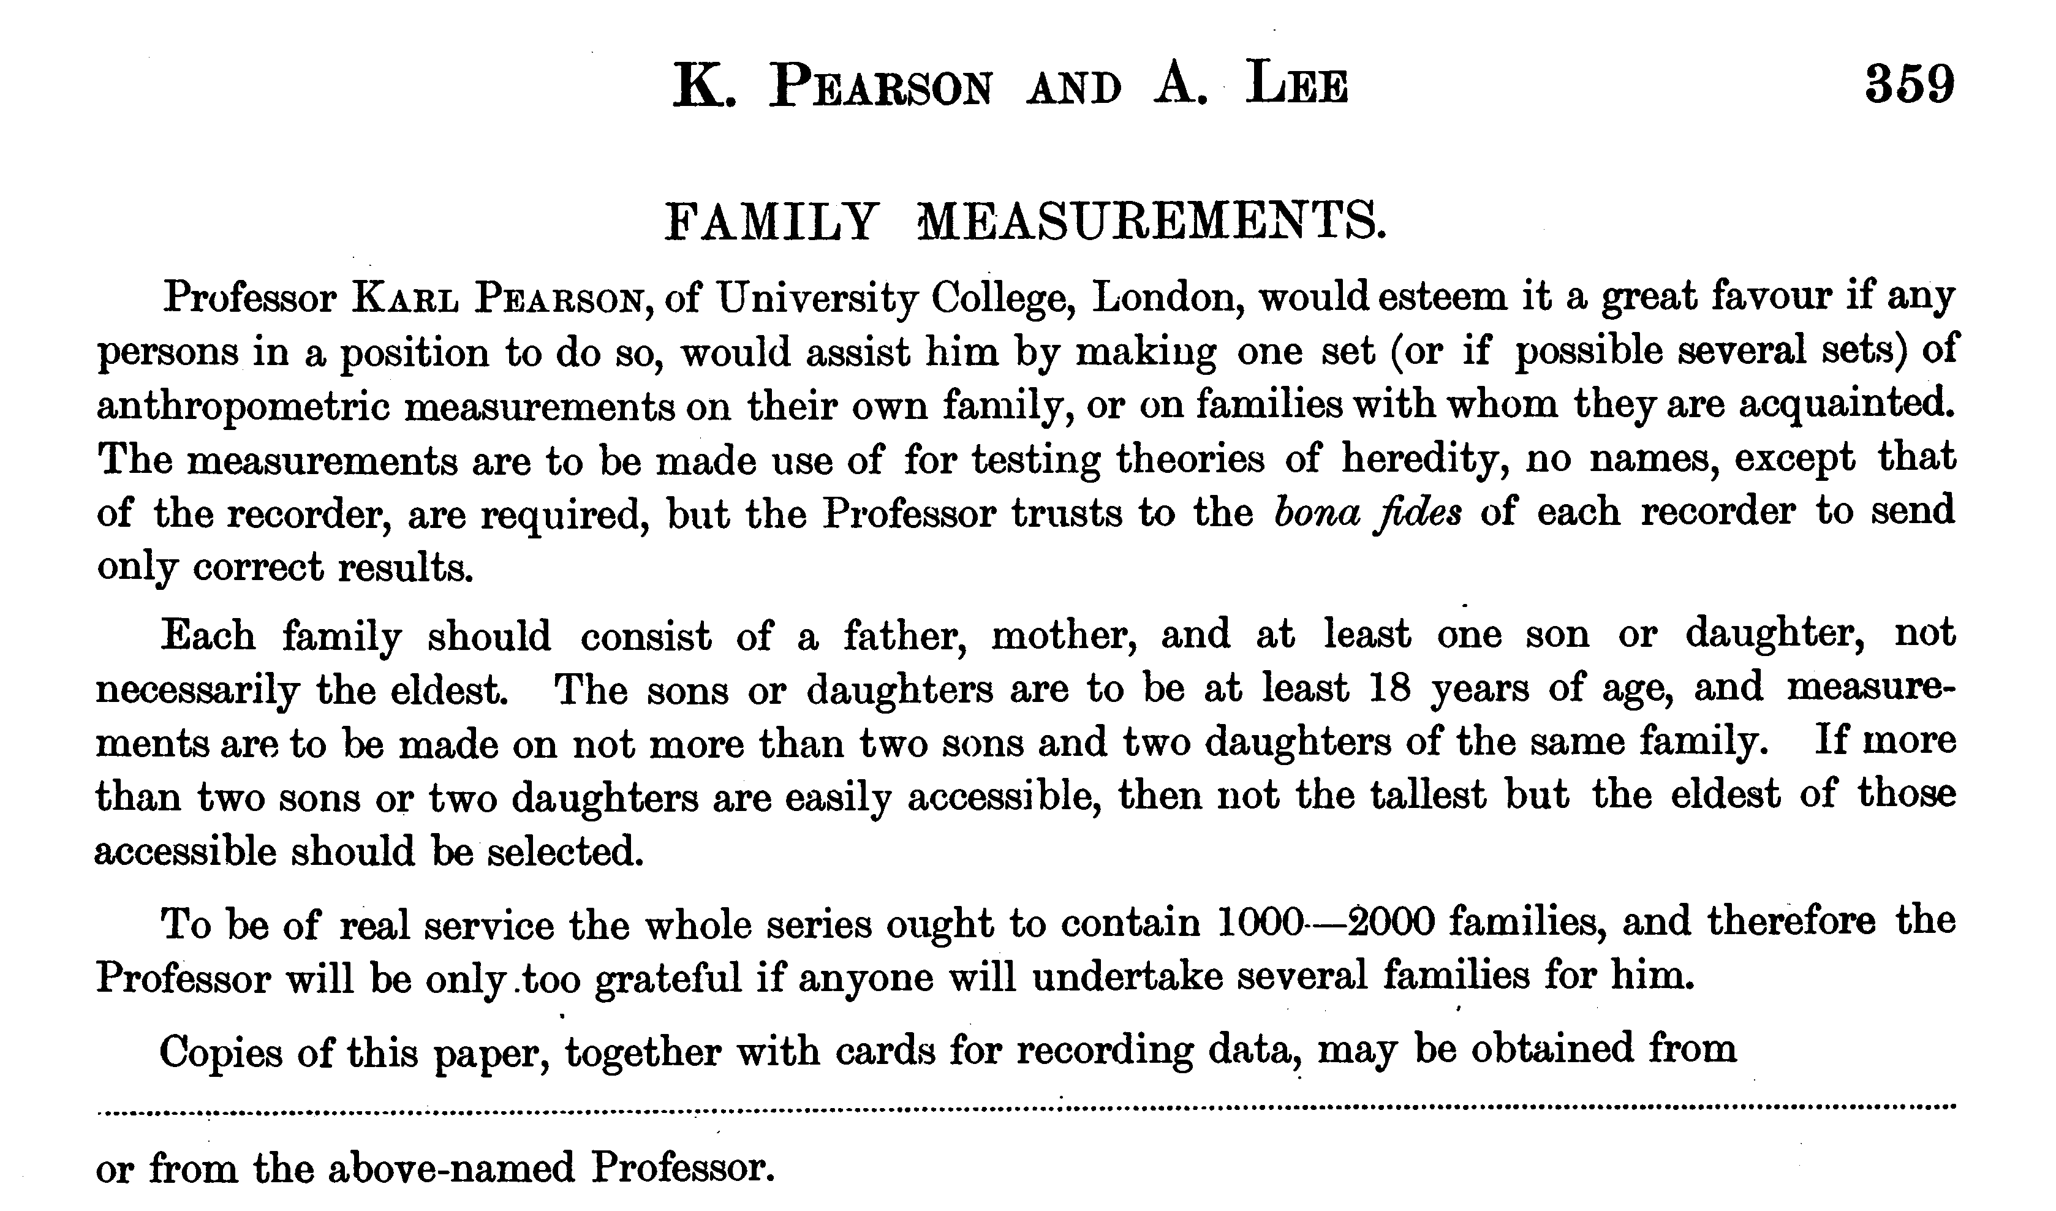

Slide 29
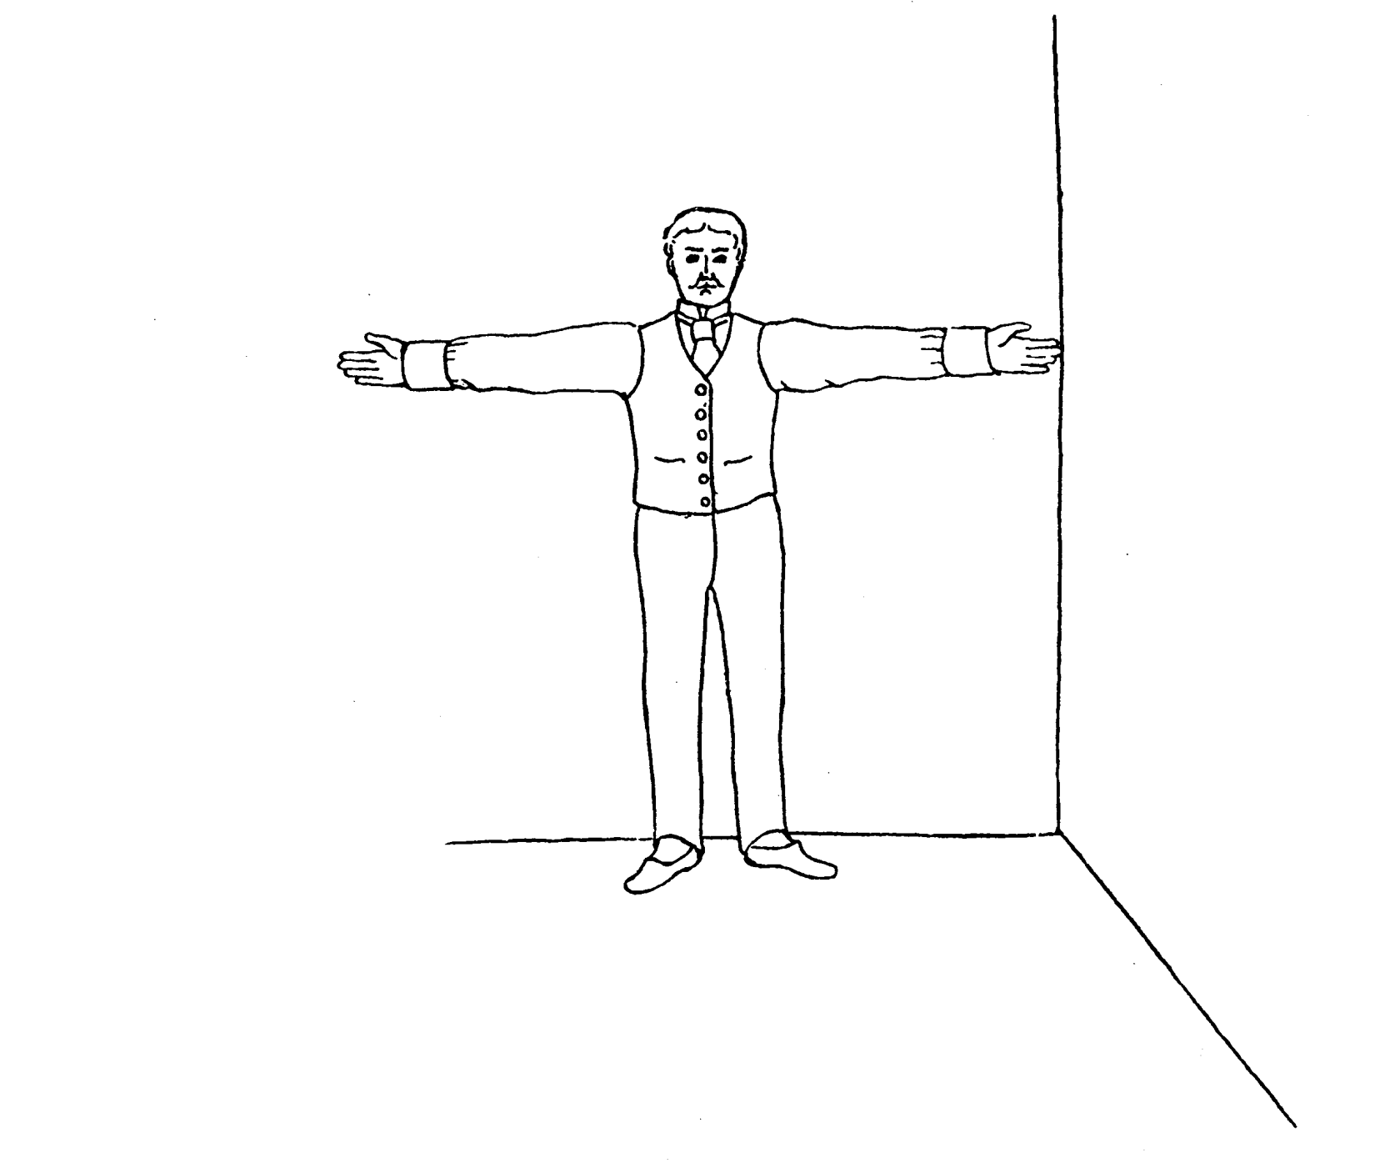
Pearson and Lee’s diagram for measurement of “span” (finger-tip to finger-tip distance)

Slide 30
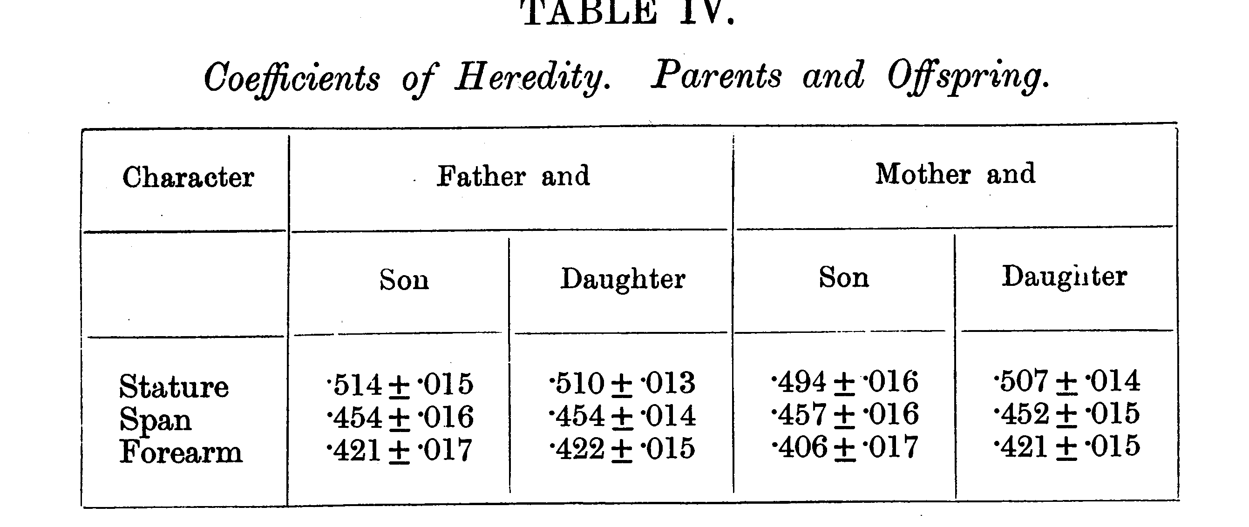
From Pearson and Lee (1903) p.378

Slide 31
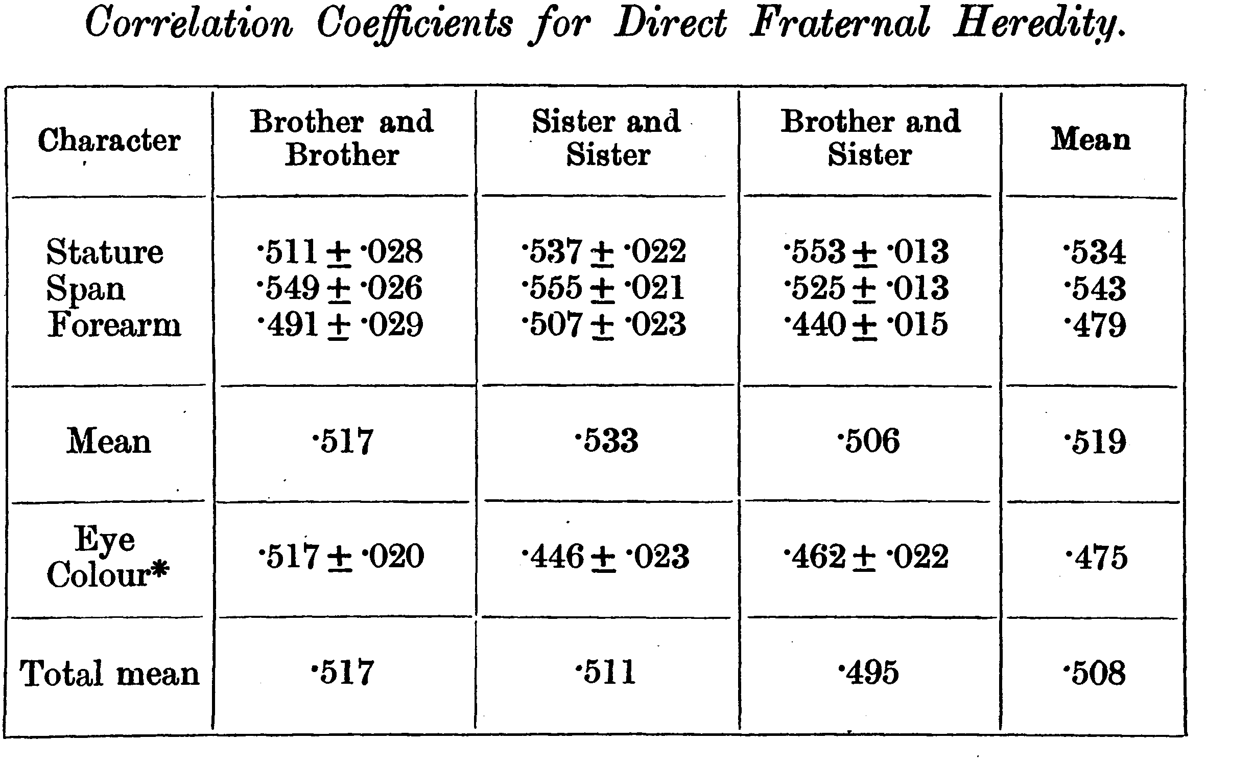
From Pearson and Lee (1903) p.387

Slide 32
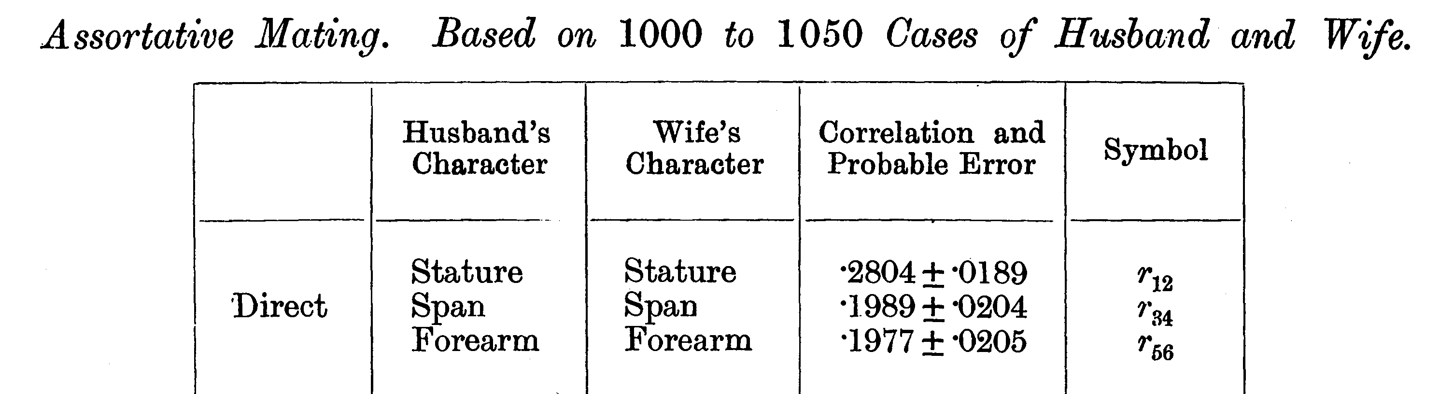
From Pearson and Lee (1903) p. 373

Slide 33
Modern Data
The Virginia 30,000 (N=29691)
The Australia 22,000
(N=20480)

Slide 34
ANZUS 50K: Extended Kinships of Twins
Parents of Twins
Siblings of Twins
Spouses of Twins
Twins
Offspring of Twins
© Lindon Eaves, 2009

Slide 35
Overall sample sizes
Relationship | # of pairs
Parent-offspring Siblings | 25018 18697
Spouses | 8287
DZ Twins MZ Twins | 5120 4623

Slide 36
Nuclear Family Correlations for Stature
(Virginia 30,000 and OZ 22,000)
© Lindon Eaves, 2009
Notes:
Notice: effects of mother and father equal; correlations for sibs close to parents;
Slight correlation between mates (assortative mating).

Slide 37
Nuclear Family Correlations for Stature and Liberalism/Conservatism
(Virginia 30,000)
© Lindon Eaves, 2009
Notes:
Compare with stature: notice how much greater assortative mating.

Slide 38
Nuclear Family Correlations for Liberalism/Conservatism
(Virginia 30,000 and Australia 22,000)
© Lindon Eaves, 2009

Slide 39
Nuclear Family Correlations for Stature and EPQ Neuroticism
(Virginia 30,000)
© Lindon Eaves, 2009

Slide 40
Nuclear Family Correlations for Socially Significant Variables
(Virginia 30,000)
© Lindon Eaves, 2009

Slide 41
Nuclear Family Correlations for Socially Significant Variables
(Australia 22K)
© Lindon Eaves, 2009

Slide 42
The (Really!) BIG Problem
Families are a mixture of genetic and social factors

Slide 43
The Extended Phenotype
World
Parents
Me
Spouse
Siblings
Child
Extended Phenotype

Slide 44
A Basic Model
Phenotype=Genotype+Environment
P=G+E {+f(G,E)}
f(G,E) = G-E “Interplay”
i.e. Genotype-environment interaction (GxE) and G-E correlation (rGE)

Slide 45
GxE Interaction and Correlation
GxE: SENSITIVITY to E controlled by G
rGE: EXPOSURE to E correlated with (“depends on”) G
Lots of good plant and animal models for both

Slide 46
Sources of rGE
Environment is “caused by” (“selected by”) genetic characteristics of subject (“active/evocative”)
Environment is “affected by” genetic characteristics of relatives (mothers, fathers, siblings, “passive”)
Both are (may be) dynamic, temporal, developmental

Slide 47
Galton’s Solution:
      Twins
      (Though Augustine may have got there first – 5th cent.)

Slide 48
One (?ideal) solution
Twins separated at birth

Slide 49
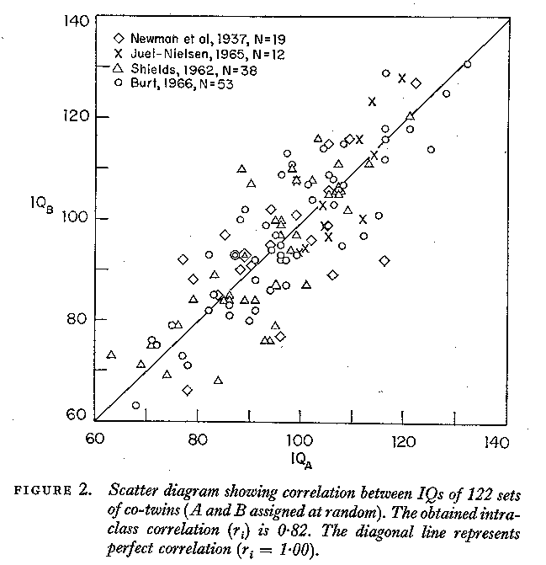

Slide 50
But separated MZs are rare

Slide 51
An easier alternative:
Identical and non-identical twins reared together:
Galton (Again!)

Slide 52
IDENTICAL TWINS
MONOZYGOTIC: Have IDENTICAL genes (G)
Come from the same family (C)
Have unique experiences during life (E)

Slide 53
FRATERNAL TWINS
DIZYGOTIC: Have DIFFERENT genes (G)
Come from the same family (C)
Have unique experiences during life (E)

Slide 54
Figure 9. The correlation between twins for stature (data from the Virginia Twin Study of Adolescent Behavioral Development).
Data from the Virginia Twin Study of Adolescent Behavioral Development

Slide 55
Data from the Virginia Twin Study of Adolescent Behavioral Development

Slide 56
Twin Correlations for Adult Stature
(Virginia 30,000 and Australia 22,000)
© Lindon Eaves, 2009

Slide 57
Twin Correlations for Stature and Liberalism
(Virginia 30,000 and Australia 22,000)
© Lindon Eaves, 2009

Slide 58
Twin Correlations for Stature and Liberalism
(Virginia 30,000 and Australia 22,000)
© Lindon Eaves, 2009

Slide 59
Twin Correlations for Socially Significant Variables
(Virginia 30,000)
©
Lindon Eaves,
2009

Slide 60
Twin Correlations for Socially Significant Variables
(Australia 22,000)
© Lindon Eaves, 2009

Slide 61
Twin correlations for gene expression
York et al.

Slide 62
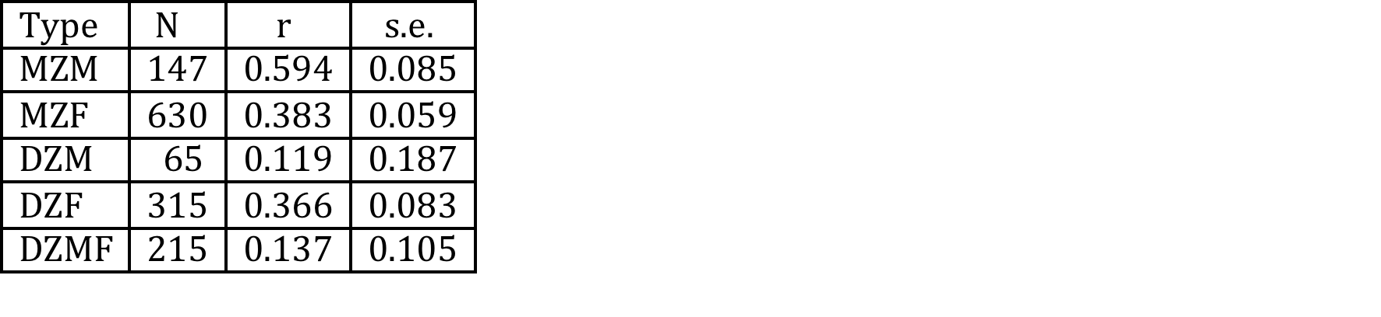
Twin correlations for attitudes to gun control

Slide 63
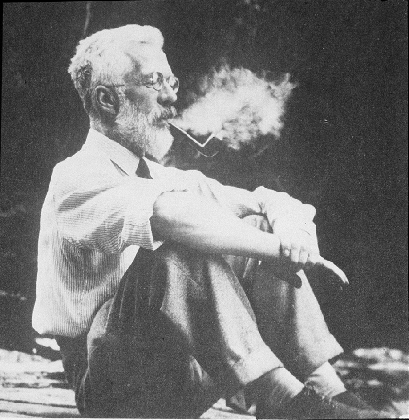

Slide 64
Ronald Fisher (1890-1962)
1918: On the Correlation Between Relatives on the Supposition of Mendelian Inheritance
1921: Introduced concept of “likelihood”
1930: The Genetical Theory of Natural Selection
1935: The Design of Experiments

Slide 65
Fisher developed mathematical theory that reconciled Mendel’s work with Galton and Pearson’s correlations

Slide 66
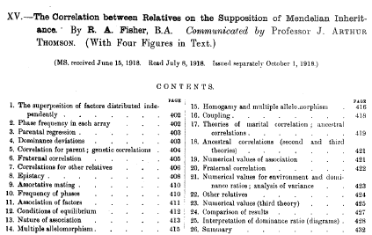

Slide 67
a.
b.
c.

Slide 68
Fisher (1918): Basic Ideas
Continuous variation caused by lots of genes (“polygenic inheritance”)
Each gene followed Mendel’s laws
Environment smoothed out genetic differences
Genes may show different degrees of “dominance”
Genes may have many forms (“mutliple alleles”)
Mating may not be random (“assortative mating”)
Showed that correlations obtained by e.g. Pearson and Lee were explained well by polygenic inheritance

Slide 69
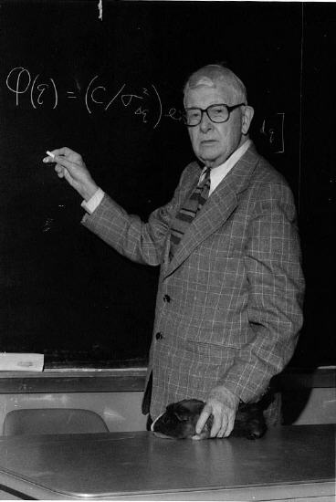

Slide 70
Sewall Wright (1889-1988
1984. Evolution and the Genetics of Populations:
Genetics and Biometric Foundations (4 vols.)
1934. The method of path coefficients. Ann. Math. Staiist. 5: 161-215

Slide 71
Path diagram for the effects of genes and environment on phenotype
Genotype
Environment
G
r
Latent variables
E
h
e
P
Measured variable
Phenotype

Slide 72
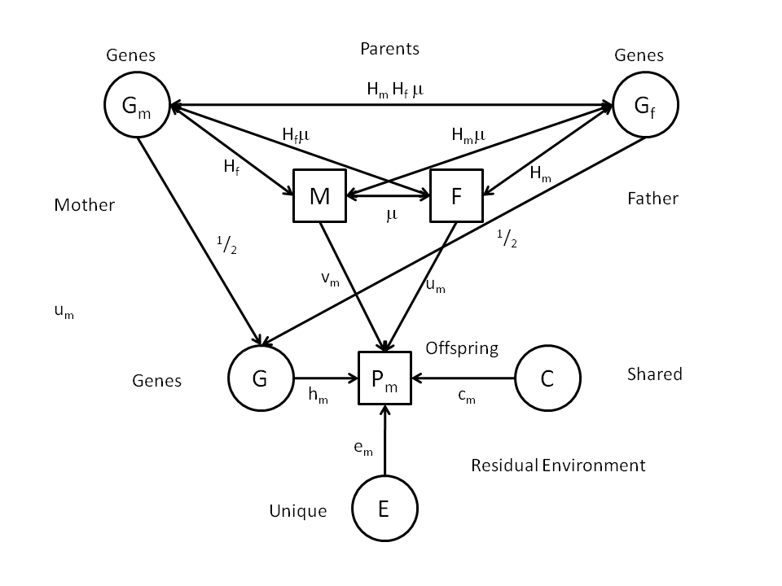
Genetic AND Cultural inheritance?
Notes:
Diagram shows possible causes – called “Path Diagram” (Sewall Wright, 1921).
Will deal with these later in the course.

Slide 73
Development

Slide 74
a. Genetic variation in developmental change: time series with common genes and time-specific environmental “innovations”
Genes
G
h
h
h
h
h
Phenotype
T0
b
T1
b
T2
b
T4
b
T5
Age
e
e
e
e
e
E1
E2
E3
E4
E5
Environment

Slide 75
Attitudes over the life-span

Slide 76
Children of Twins (“COT”)
Parents of Twins
Siblings of Twins
Spouses of Twins
Twins
Offspring of Twins

Slide 77
Gestational Age
Racial Differences in Genetic and Environmental Risk to Preterm Birth
Timothy P. York, Jerome F. Strauss,
Michael C. Neale, Lindon J. Eaves
PLoS One. 2010 Aug 25;5(8):e12391.

Slide 78
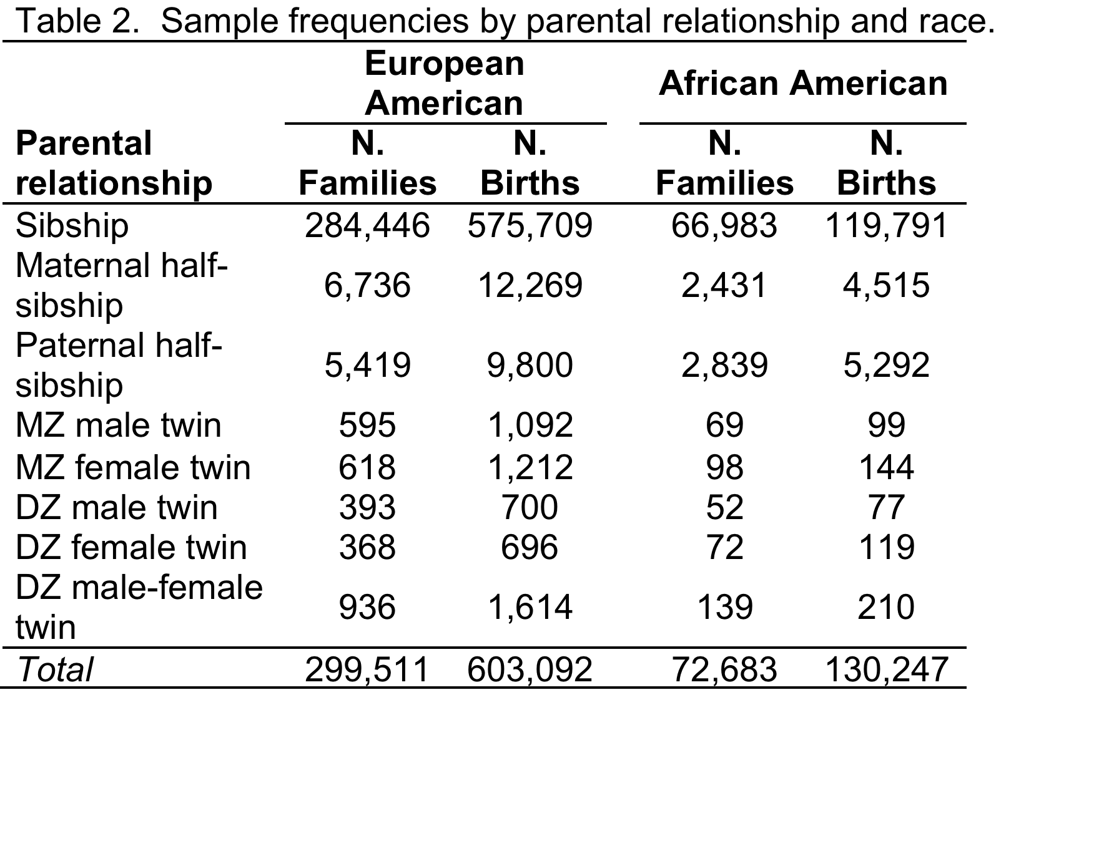

Slide 79
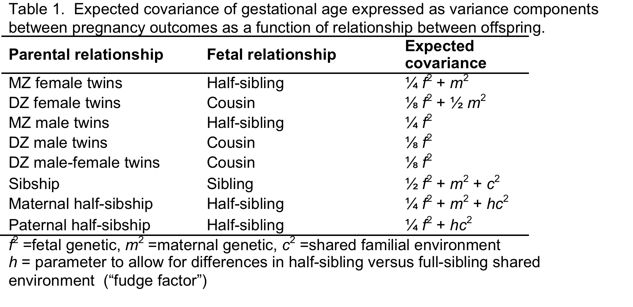

Slide 80
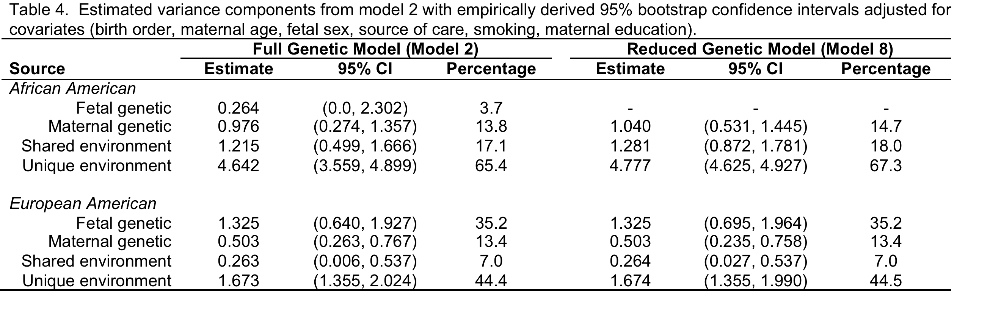

Slide 81
“Mating”

Slide 82
Spouses of Twins (“SPOT”)
Parents of Twins
Siblings of Twins
Spouses of Twins
Twins
Offspring of Twins
© Lindon Eaves, 2009

Slide 83
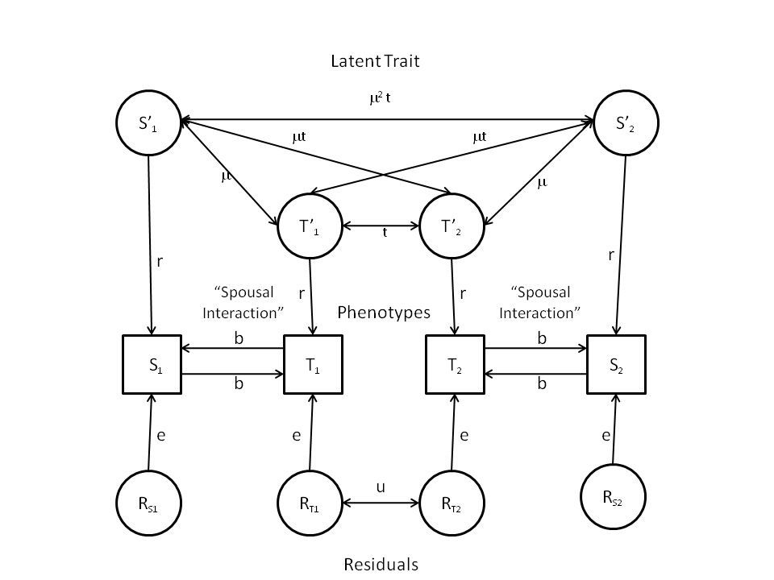
“Twins and Spouses”

Slide 84
f(G,E)
Genotype x Environment Interaction (“GxE”)
Genotype-Environment Correlation
(“rGE”)

Slide 85
(“Passive”) rGE

Slide 86
Twins and Parents

Slide 87
Twins and Parents (“TAP”)
Parents of Twins
Siblings of Twins
Spouses of Twins
Twins
Offspring of Twins
© Lindon Eaves, 2009

Slide 88
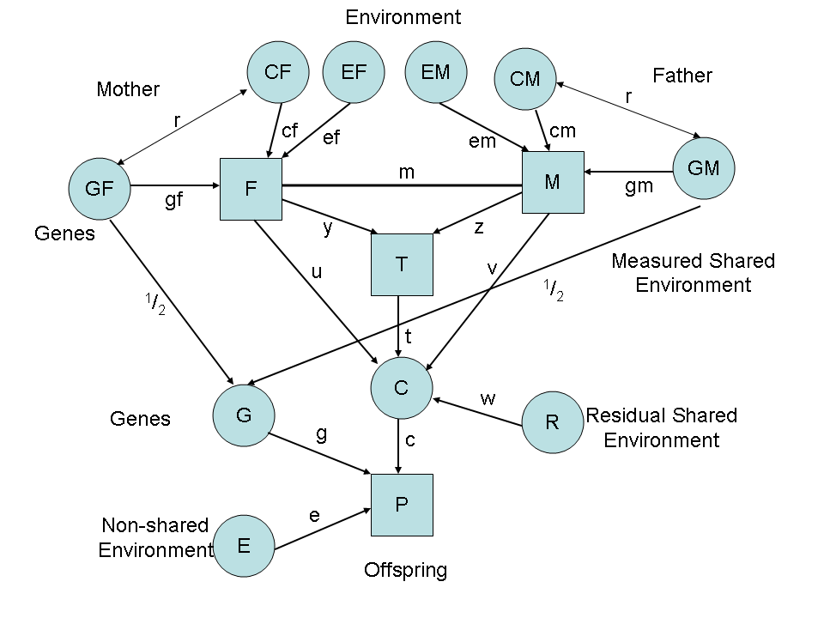
Parental Neglect and Anti-Social Behavior
Eaves et al., 2010

Slide 89
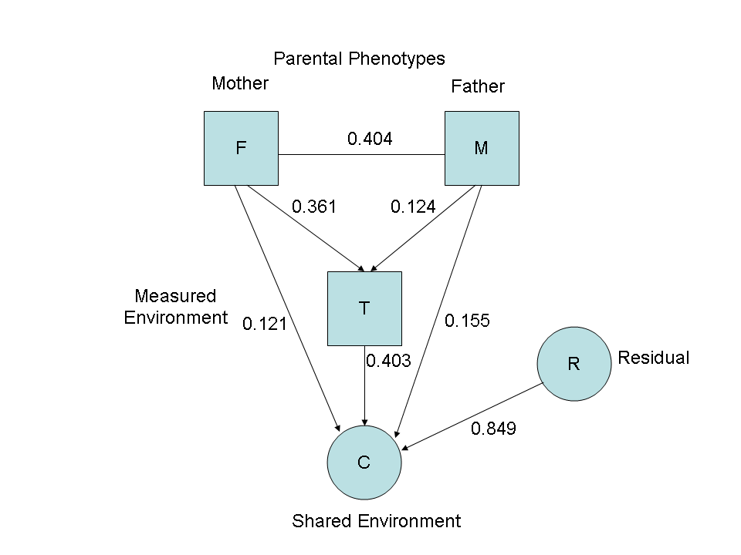
Environmental pathways

Slide 90
GxE

Slide 91
Genetic Variance and Shared Life Events in Adolescent Females

Slide 92
Putting it all together?

Slide 93
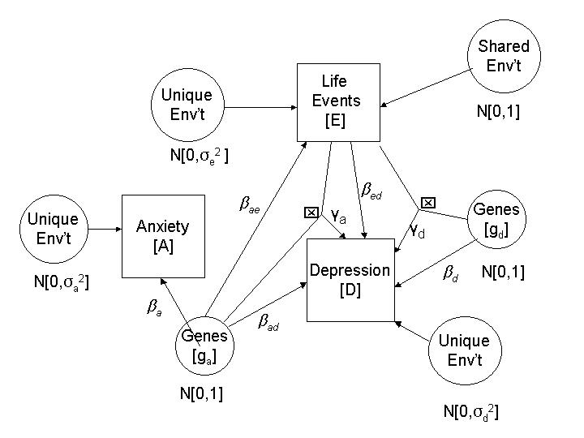
Multiple Genetic Pathways to Depression
Eaves et al. 2003

