Slide 1
JM de Kort, BOULDER, 6 march 2014
1
Extending Simplex model to model Ph →E transmission
JANNEKE m. de kort & C.V. DolAn
Contact: j.m.de.kort@vu.nl, C.v.dolan@vu.nl

Slide 2
JM de Kort, twin workshop boulder 6 march 2014
2
Nature versus Nurture Role GEcov in Psychopathology
ADHD diagnosis
GE covariance: Genotypic control over environmental exposures
Evocative: Behavior of individual evokes reaction from environment consistent with genotype
Do people with ADHD evoke different behavior in others?
ADHD child : Intrudes on games more often
ADHD adolescent : Has more frequent school disciplinary actions
ADHD adult: more often has work conflicts
Active: Individuals actively seek out environments consistent with their phenotype (e.g. Niche Picking)
Do people diagnosed with ADHD seek more risky environments
ADHD child : climb more trees
ADHD adolescent : does more binge drinking and has casual sex more often
ADHD adults: has more driving violations, uses more drugs

Slide 3
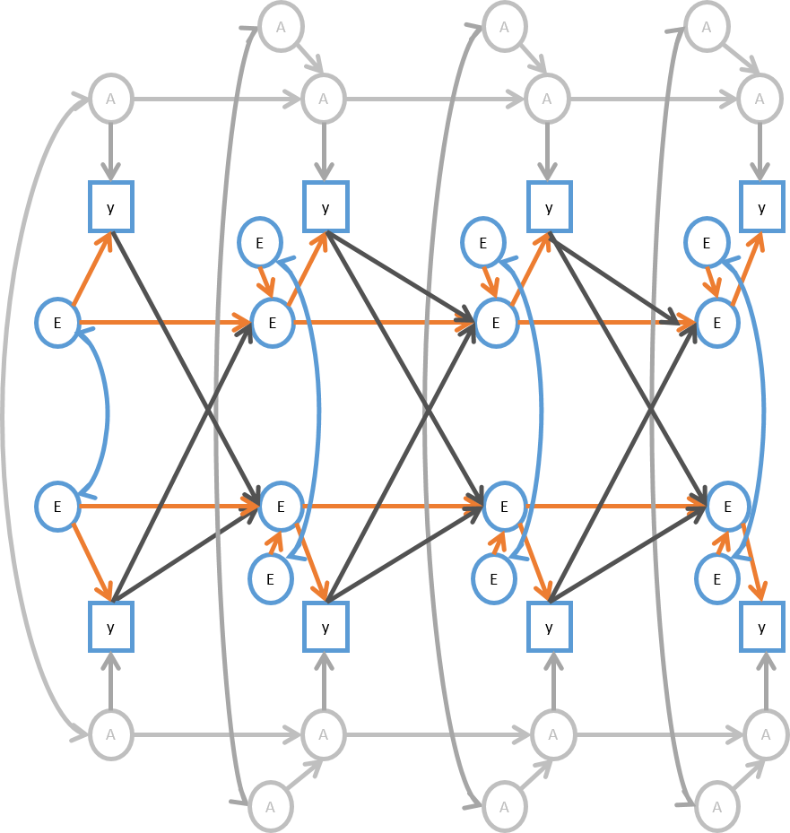
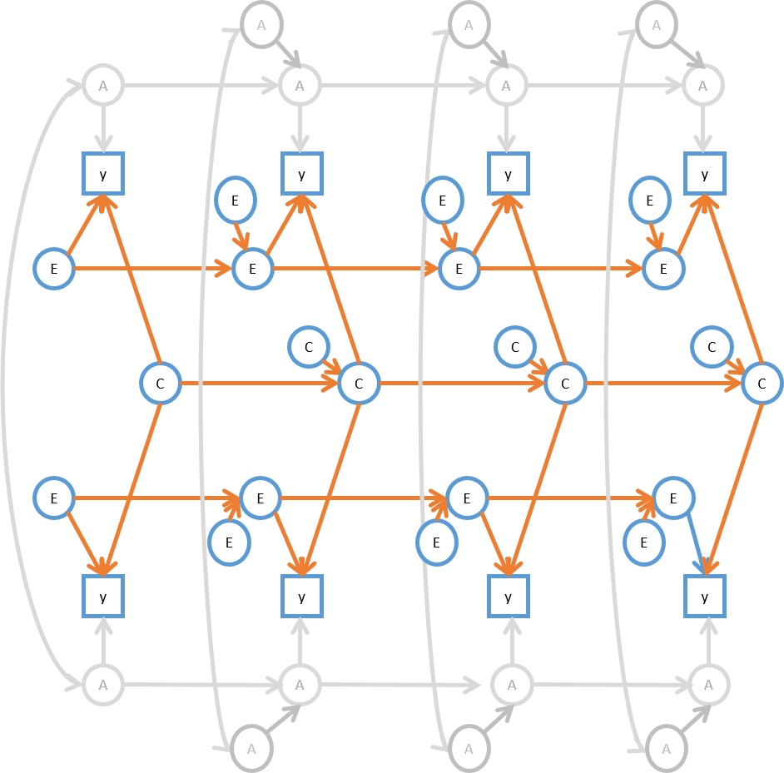
Translate path diagram into matrices ACE SIMPLEX Ph->E SIMPLEX
Competing models
twin 1
twin 2
Notes:
Beta e en c
3

Slide 4
OBJECTIVE: model the observed covariance matrix
S = 4 observed variables for twin 1, 4 for twin 2, thus 8 x 8
twin 1 twin 2
t = 1 t = 2 t = 3 t = 4 t = 1 t = 2 t = 3 t = 4
varP11
covP11P12 varP12
covP11P13 covP12P13 varP13
covP11P14 covP12P14 covP13P14 varP14
covP11P21 covP12P21 covP13P21 covP14P21 varP21
covP11P22 covP12P22 covP13P22 covP14P22 covP21P22 varP22
covP11P23 covP12P23 covP13P23 covP14P23 covP21P23 covP22P23 varP23
covP11P24 covP12P24 covP13P24 covP14P24 covP21P24 covP22P23 covP23P24 varP24

Slide 5
Matrices used in Model
Σ = Λ(Ι−Β)-Ψ (Ι−Β) -t Λ t + Θ
ne = number of latent variables in the model
ny = number of observed variables
∑ = Sigma = Expected covariance matrix observed variables y = ny x ny
Λ = Lambda = Factor Loading Matrix = ny x ne
Β = Beta = Matrix with regression coefficients between latent variables = ne x ne
ϴ = Theta = Matrix with residuals = ny x ny
Ψ = Psy = Matrix with variances and covariance between latent variables = ne x ne

Slide 6
Dimensions of matrices for 4 time points in normal simplex specification
∑MZ = Λ * solve(I- Β) * ΨMZ * t(solve(I- Β)) * t(Λ) + ϴMZ
∑DZ = Λ * solve(I- Β) * ΨDZ * t(solve(I- Β)) * t(Λ) + ϴDZ
Twins = 2
Time points = 4
ny = 4 time points for 2 twins = 8
ne = latent variables A, C, E at each timepoint for each twin: 3 x 4 x 2 = 24
∑ = Sigma = 8 x 8 = ny x ny
Λ = Lambda = 8 x 24 = ny x ne
Β = Beta = 24 x 24 = ne x ne
Ψ = Psy = 24 x 24 = ne x ne
ϴ = Theta = 8 x 8 = ny x ny
Does not allow us to regress E on P

Slide 7
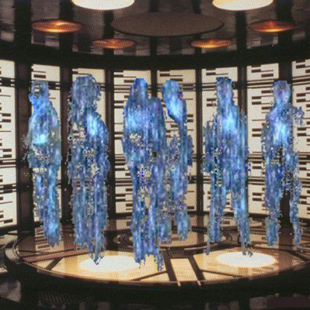
7
PROBLEM: Regression from Observed to Latent variable
Normally
PSY matrix only has latent variables.
In case of twin modeling: the variables A, C, and E ➔ 24 x 24
Problem
Impossible to regress from observed to latent
For that we need all variables in Ψ, thus P, A, C, and E.
Solution: Change dimensions of matrices
Beam observed variables into Ψ space

Slide 8
Dimensions of matrices for 4 time points in our simplex specification
∑MZ = Λ * solve(I- Β) * ΨMZ * t(solve(I- Β)) * t(Λ) + ϴMZ
∑DZ = Λ * solve(I- Β) * ΨDZ * t(solve(I- Β)) * t(Λ) + ϴDZ
Twins = 2
Time points = 4
ny = 4 time points for 2 twins = 8
ne = latent variables A, C, E plus observed P at each time point for each twin: 4 x 4 x 2 = 32
∑ = Sigma = 8 x 8 = ny x ny
Λ = Lambda = 8 x 32 = ny x ne
Β = Beta = 32 x 32 = ne x ne
Ψ = Psy = 32 x 32 = ne x ne
ϴ = Theta = 8 x 8 = ny x ny
SIMPLEX
matrix explanation

Slide 9
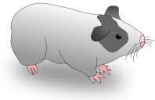
9
Specification SIMPLEX in OpenMx

Slide 10
10
General code
Open:
SIMPLEX practical

Slide 11
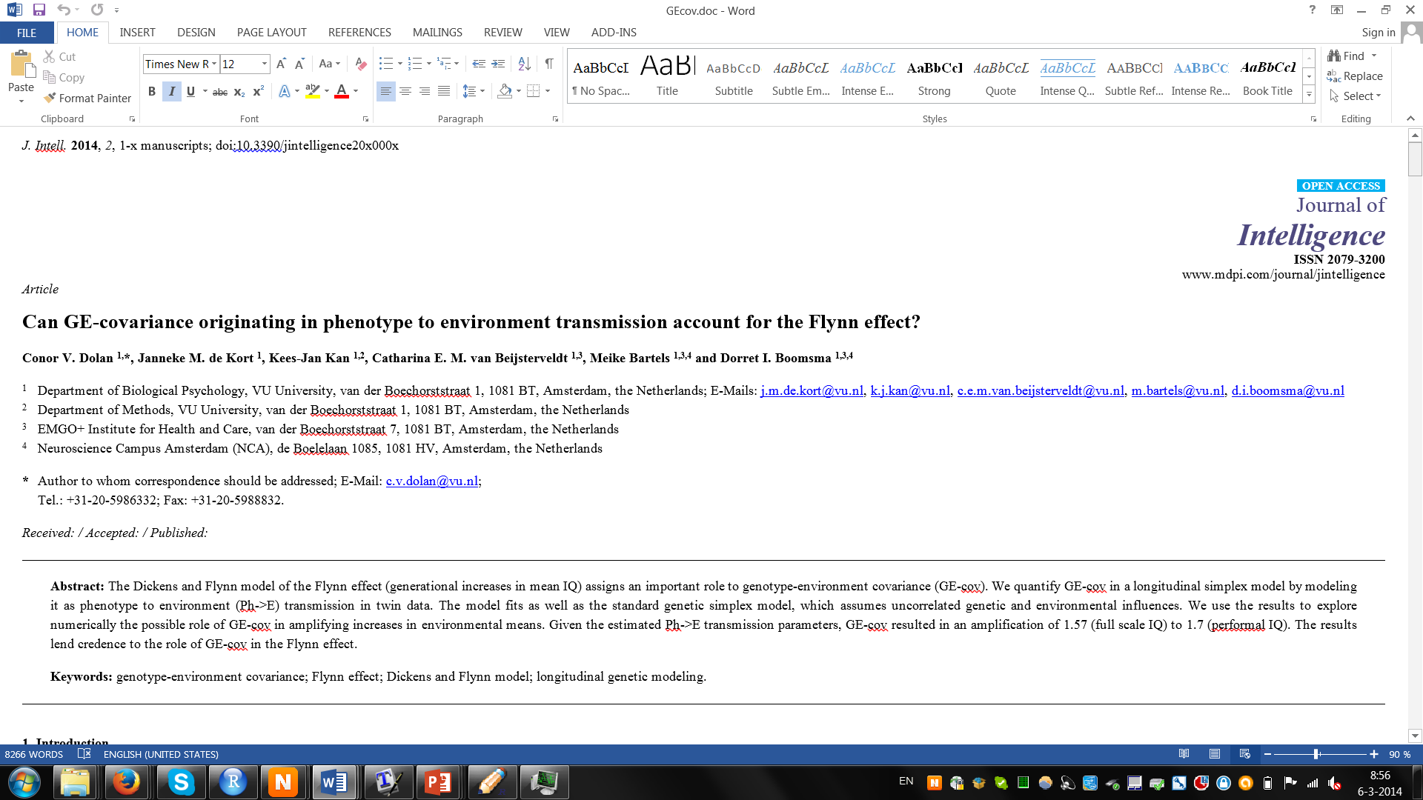
11
PRACTICAL Replicate findings in following article
Notes:
11

Slide 12
12
Model fitting: Ph -> E SIMPLEX MODEL
DATA: Full scale Intelligence
In MZ and DZ twins
Measured 4 time points
NTR data
Return to:
SIMPLEX practical

Slide 13
13
FIT 0

Slide 14
14
ζA
A12
a2
DROP a time specific
y12
c2
ζE
E12
e2
ζC
C2
E22
a2
ζE
y22
c2
FIT 1
A22
e2
ζA

Slide 15
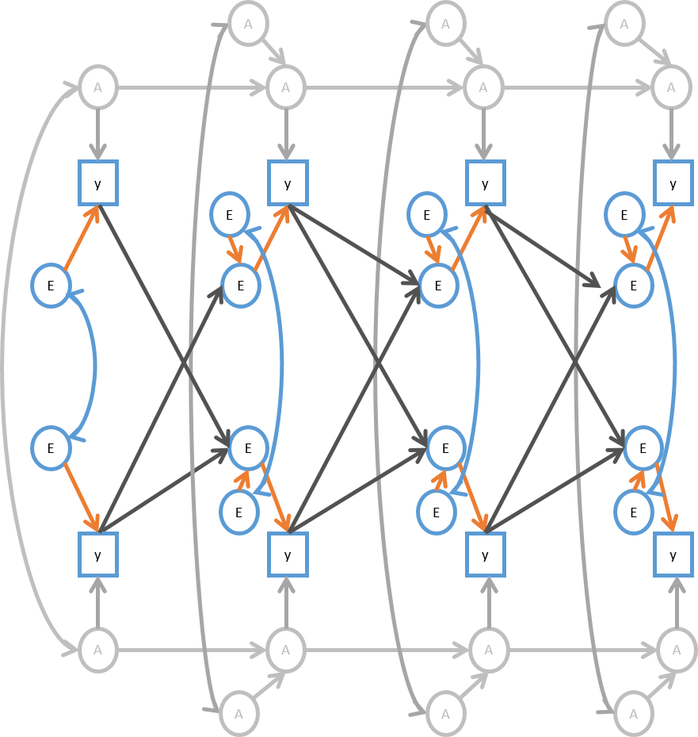
15
DROP E TRANSMISSION
FIT 2

Slide 16
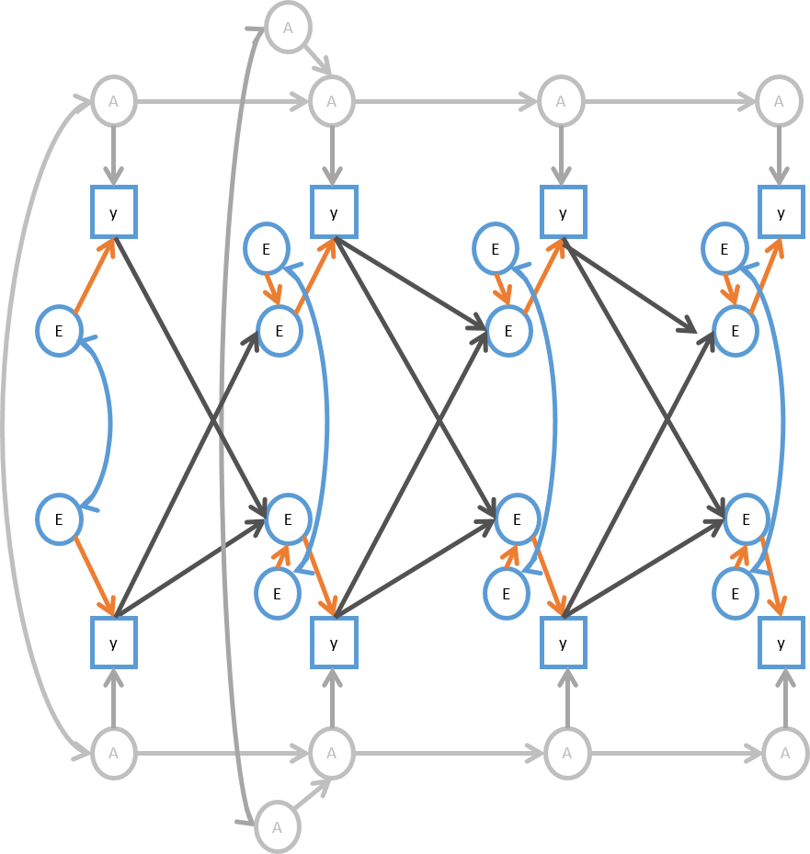
16
DROP A innovation
Time 3 and time 4
FIT 3

Slide 17
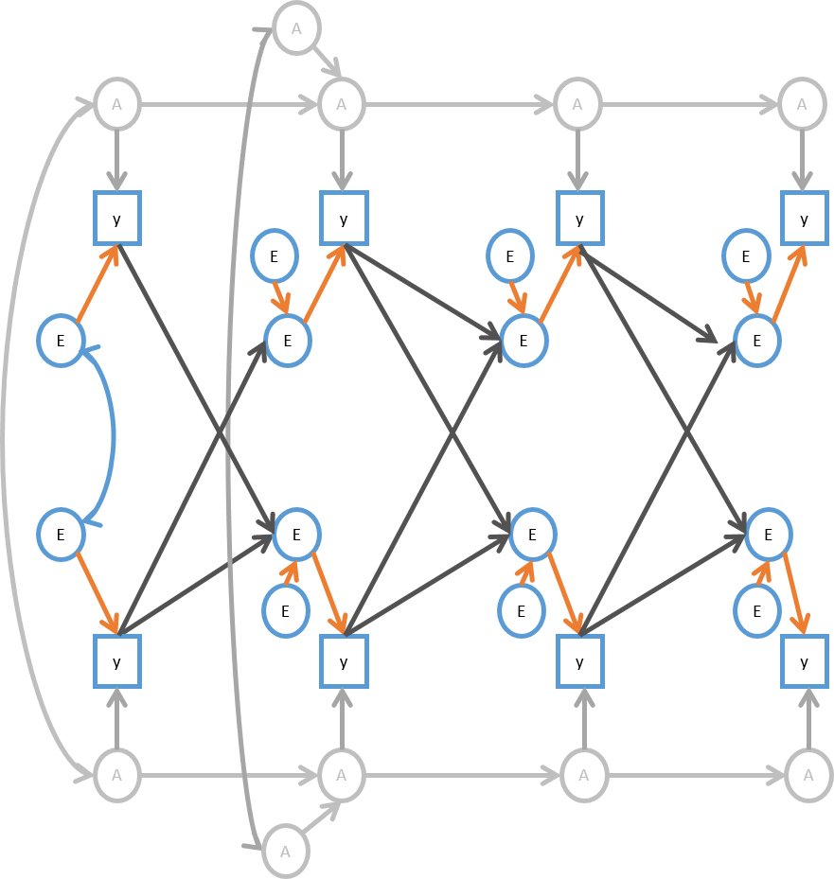
17
DROP covariance
between E
FIT 4

Slide 18
JM de Kort, introdunction Notre Dame, 30 january 2014
18
SET bA equal over time
FIT 5

Slide 19
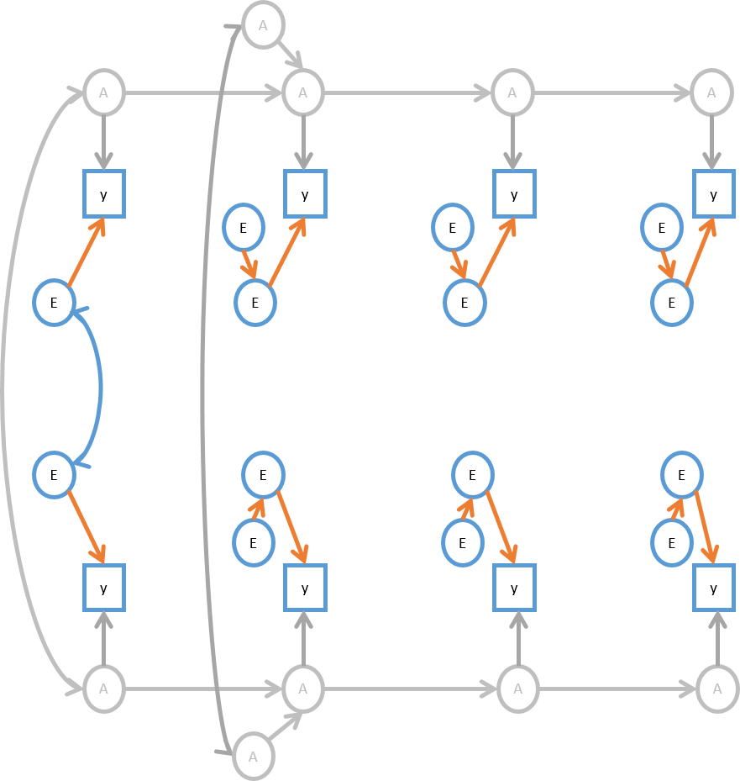
19
TEST PH->E transmission
FIT 6

Slide 20
20
Final model
A
A
A
A
A
1
y
y
y
y
1
E
E
E
E
E
E
E
E
E
E
E
1
E
E
E
y
y
y
y
1
A
A
A
A
A

Slide 21
21
A1 E1
1
0.86 | 1
0.86 | 1.00 | 1
0.86 | 1.00 | 1.00 | 1
A1
within
G-E covariance
0.00 | 0.00 | 0.00 | 0.00
0.35 | 0.30 | 0.30 | 0.30
0.50 | 0.53 | 0.53 | 0.53
0.53 | 0.59 | 0.59 | 0.59
1
0.41 | 1
0.20 | 0.43 | 1
0.09 | 0.30 | 0.47 | 1
E1
Correlated E – But not C!
0.50 | 0.43 | 0.43 | 0.43
0.43 | 0.50 | 0.50 | 0.50
0.43 | 0.50 | 0.50 | 0.50
0.43 | 0.50 | 0.50 | 0.50
A2
between
0.00 | 0.00 | 0.00 | 0.00
0.22 | 0.19 | 0.19 | 0.19
0.33 | 0.35 | 0.35 | 0.35
0.36 | 0.40 | 0.40 | 0.40
0.63 | 0.36 | 0.18 | 0.09
0.36 | 0.29 | 0.26 | 0.21
0.18 | 0.26 | 0.30 | 0.31
0.09 | 0.21 | 0.31 | 0.32
E2
Notes:
Red A-E cov, Green is not C! DZ twins
There is no C in this model, but are there correlated environments, YES but it is not C. This is interesting because if this is the true model ACE will still give you an estimate. Therefor we enter into philosophical discussion
21

