Slide 1
Standard genetic simplex models
in the classical twin design
with phenotype to E transmission
Conor Dolan & Janneke de Kort
Biological Psychology, VU

Slide 2
Two general approaches to longitudinal modeling
Markov models:
(Vector) autoregressive models for continuous data
(Hidden) Markov transition models discrete data
(Mixtures thereof)
Growth curve models (Brad Verhulst, Lindon Eaves):
Focus on linear and non-linear growth curves
Typically multilevel or random effects model
(Mixtures thereof)
Which to use?
Use the model that fit the theory / data / hypotheses

Slide 3
First order autoregression model. A (quasi) simplex model (var(e)>0).
ζx
ζx
ζx
b2,1
b3,2
b4,3
x1
x2
x3
x4
1
1
1
1
y1
y2
y3
y4
1
1
1
1
e1
e2
e3
e4
b₀₂
b₀₃
b₀₁
b₀₄
1
Notes:
Ar(1) as a phenotypic model. Interest in stability, not interest in individual growth curves

Slide 4
First order autoregression model. A quasi simplex model (var(e)>0).
ζx
ζx
ζx
b2,1
b3,2
b4,3
x1
x2
x3
x4
1
1
1
1
y1
y2
y3
y4
1
1
1
1
e1
e2
e3
e4
y_{ti} = b_{0t} + x_{ti} + e_{ti}
x_{1i} = x_{1i}= ζx_{1i}
x_{ti} = b_{t-1,t} x_{t-1i} + ζx_{ti}
var(y₁) = var(x₁) + var(e₁)
var(x_{t}) = b_{t-1,t}² var(x_{t}) + var(ζx_{t})
cov(x_{t},x_{t-1}) = b_{t-1,t}var(x_{t})
Notes:
Ar(1) as a phenotypic model. Regression models. Regression info

Slide 5
First order autoregression model. A quasi simplex model (var(e)>0).
ζx
ζx
ζx
b2,1
b3,2
b4,3
x1
x2
x3
x4
1
1
1
1
y1
y2
y3
y4
1
1
1
1
e1
e2
e3
e4
Identification issue: var(e₁) and var(e_{t}) are not identified. Solution set to zero, or equate
var(e₁) = var(e₂) , var(e₃) = var(e₄)
Notes:
Ar(1) as a phenotypic model

Slide 6
var(y₁) = var(x₁) + var(e₁)
var(x_{t}) = b_{t-1,t}² var(x_{t}) + var(ζx_{t})
cov(x_{t},x_{t-1}) = b_{t-1,t}var(x_{t})
Standardized stats I:
Reliability at each t, rel(t) :
rel(x₁) = var(x₁) / {var(x₁) + var(e₁)}
Interpretation:
% of variance in y at t due to latent x at t

Slide 7
var(y₁) = var(x₁) + var(e₁)
var(x_{t}) = b_{t-1,t}² var(x_{t}) + var(ζx_{t})
cov(x_{t},x_{t-1}) = b_{t-1,t}var(x_{t})
Standardized stats II:
Stability at each t,t-1, stab(t,t-1):
b_{t-1,t}² var(x_{t}) / {b_{t-1,t}² var(x_{t}) + var(ζx_{t})}
Interpretation:
% of the variance in x at t explained by regression on x at t-1 (latent level!)

Slide 8
var(y₁) = var(x₁) + var(e₁)
var(x_{t}) = b_{t-1,t}² var(x_{t}) + var(ζx_{t})
cov(x_{t},x_{t-1}) = b_{t-1,t}var(x_{t})
Standardized stats III:
Correlation t,t-1, cor(t,t-1):
b_{t-1,t}² var(x_{t}) / {sd(y_{t-1}) * sd(y_{t})}
sd(y_{t}) = sqrt(var(x_{t}) + var(e_{t}))
var(x_{t}) = b_{t-1,t}² var(x_{t}) + var(ζx_{t})
Interpretation:
strength of linear relationship

Slide 9
.288
.288
.288
ζx
ζx
ζx
.8
.8
.8
.8
x1
x2
x3
x4
1
1
1
1
y1
y2
y3
y4
1
1
1
1
e1
.2
e2
.2
e3
.2
e4
.2
1.0000
0.6400 1.000
0.5120 0.640 1.000
0.4096 0.512 0.640 1.0000

Slide 10
Special case: factor model var(ζx_{t}) (t=2,3,4) = 0
b2,1
b3,2
b4,3
x1
x2
x3
x4
1
1
1
1
y1
y2
y3
y4
1
1
1
1
e1
e2
e3
e4
x1
b_{2,1} b_{3,2}b_{4,3}
1
b_{2,1}
y1
y2
b_{2,1}b_{3,2}
y3
y4
1
1
1
1
e1
e2
e3
e4

Slide 11
1.0000
0.6400 1.000
0.5120 0.640 1.000
0.4096 0.512 0.640 1.0000
var(ζx_{t}) (t=2,3,4) = 0
1.000
0.758 1.000
0.705 0.668 1.000
0.640 0.607 0.564 1.000

Slide 12
Multivariate decomposition of phenotypic covariance matrix:
Σ_{ph} = Σ_{A} + Σ_{C} + Σ_{E}
Σ_{ph1}
Σ_{ph12} Σ_{ph2} =
Σ_{A} + Σ_{C} + Σ_{E}
rΣ_{A} + Σ_{C} + Σ_{E} Σ_{A} + Σ_{C} + Σ_{E}

Slide 13
Σ_{ph} = Σ_{A} + Σ_{C} + Σ_{E}
Estimate Σ_{A} using a Cholesky-decomp
Σ_{A} = Δ_{A} Δ_{A}^{t}
Δ_{A} = δ₁₁ 0 0 0
δ₂₁ δ₂₂ 0 0
δ₃₁ δ₃₂ δ₃₃ 0
δ₄₁ δ₄₂ δ₄₃ δ₄₄

Slide 14
Σ_{ph} = Σ_{A} + Σ_{C} + Σ_{E}
Model Σ_{A} a simplex model
Σ_{A} = (Ι−Β)_{A} Ψ_{A} (Ι−Β)_{A}^{t} + Θ_{A}

Slide 15
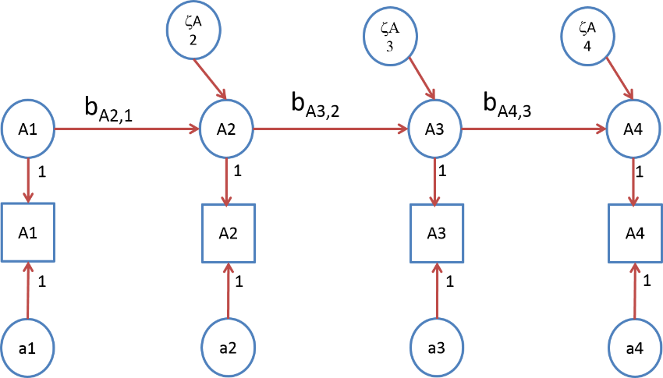
Σ_{A} = (Ι−Β_{A}) Ψ_{A} (Ι−Β_{A}) ^{t} + Θ_{A}
Β_{A} = 0 0 0 0
b_{A21} 0 0 0 0 b_{A32} 0 0
0 0 b_{A43} 0

Slide 16
Σ_{A} = (Ι−Β_{A}) Ψ_{A} (Ι−Β_{A}) ^{t} + Θ_{A}
Ψ_{A} = var(A₁) 0 0 0
0 var(ζ_{A2}) 0 0 0 0 var(ζ_{A3}) 0
0 0 0 var(ζ_{A4})

Slide 17
Σ_{A} = (Ι−Β_{A}) Ψ_{A} (Ι−Β_{A}) ^{t} + Θ_{A}
Θ_{A} = var(a₁) 0 0 0
0 var(a₂) 0 0 0 0 var(a₃) 0
0 0 0 var(a₄)

Slide 18
ζA2
ζΑ3
ζA4
b_{A2,1}
b_{A3,2}
b_{A4,3}
A1
A2
A3
A4
1
1
1
1
A1
A2
A3
A4
1
1
1
1
a1
a2
a3
a4
The genetic simplex (note my scaling)

Slide 19
ζA
ζA
ζA
A11
A12
A13
A14
1
y11
y12
y13
y14
ζE
ζE
ζE
1
E11
E12
E13
E14
1
ζC
ζC
ζC
C1
C2
C3
C4
1
E21
E22
E23
E24
1
ζE
ζE
ζE
y21
y22
y23
y24
1
A21
A22
A23
A24
ζA
ζA
ζA

Slide 20
ζA
A12
a2
y12
c2
ζE
E12
e2
Occasion specific effects
ζC
C2
E22
a2
ζE
y22
c2
A22
e2
ζA

Slide 21
Question: h², c², and e² at each time point?
var(y_{t}) =
{var(A_{t}) + var(a_{t})} + {var(C_{t}) + var(c_{t})} + {var(E_{t}) + var(e_{t})}
h²= {var(A_{t}) + var(a_{t})} / var(y_{t})
c²= {var(C_{t}) + var(c_{t})} / var(y_{t})
e²= {var(E_{t}) + var(e_{t})} / var(y_{t})
ζA
A12
a2
y12
c2
ζE
e2
E12
ζC
C2

Slide 22
Question: contributions to stability t-1 to t
b_{At-1,t}² var(A_{t}) / {b_{At-1,t}² var(A_{t}) + var(ζA_{t})+var(a_{t})}
b_{Ct-1,t}² var(C_{t}) / {b_{Ct-1,t}² var(C_{t}) + var(ζC_{t})+var(c_{t}}
b_{Et-1,t}² var(E_{t}) / {b_{Et-1,t}² var(E_{t}) + var(ζE_{t})+var(e_{t})}
ζA
ζA
A13
A14
y13
y14
ζE
ζE
E13
E14
ζC
ζC
C3
C4

Slide 23
Question: contributions to stability t-1 to t
{b_{At-1,t}² var(A_{t})+ b_{Ct-1,t}² var(C_{t})+ b_{Et-1,t}² var(E_{t})}
[{b_{At-1,t}² var(A_{t}) + var(ζA_{t})+var(a_{t})}
+ {b_{Ct-1,t}² var(C_{t}) + var(ζC_{t})+var(c_{t}}
+ {b_{Et-1,t}² var(E_{t}) + var(ζE_{t})+var(e_{t})}]
Decompose the phenotypic covariance into A,C,E components

Slide 24
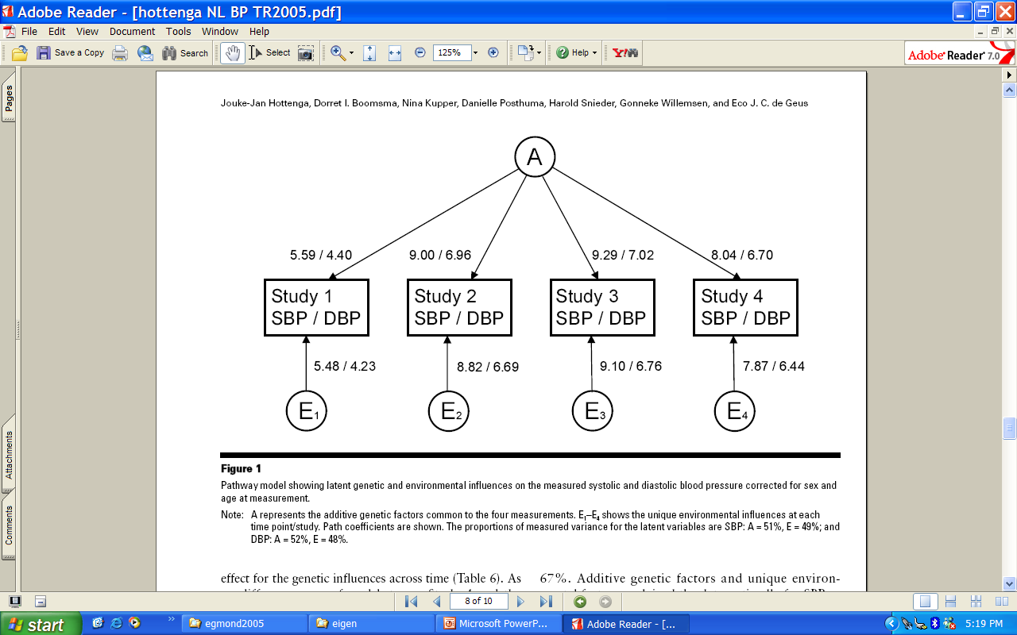
Hottenga, etal. Twin Research and Human Genetics, 2005

Slide 25
Birley et al. Behav Genet 2005 (alternative: growth curve modeling)

Slide 26
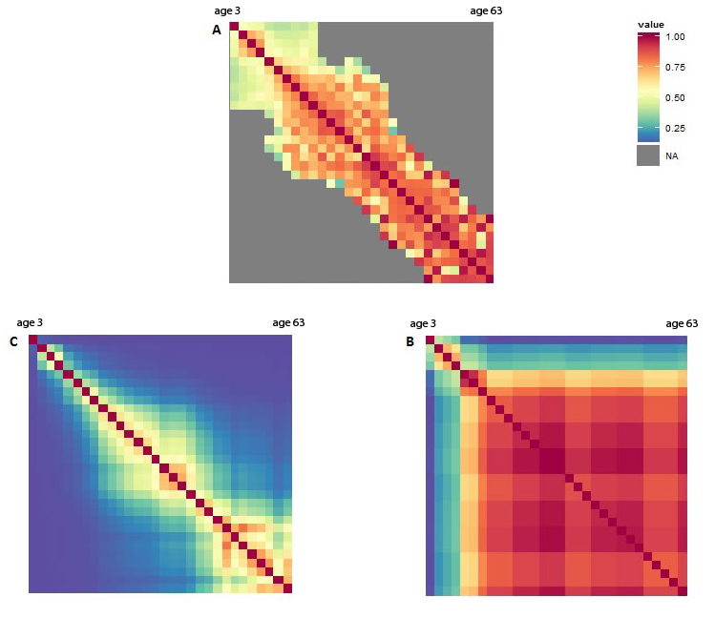
Nivard et al, 2014
Anx/dep stability due to A and E from 3y to 63 years

Slide 27
Variations on the theme

Slide 28
ζA
ζA
ζA
A11
A12
A13
A14
1
y11
y12
y13
y14
ζE
ζE
ζE
1
E11
E12
E13
E14
1
ζC
ζC
ζC
C1
C2
C3
C4
1
E21
E22
E23
E24
1
ζE
ζE
ζE
y21
y22
y23
y24
1
A21
A22
A23
A24
ζA
ζA
ζA
Phenotype-to-phenotype transmission (Eaves etal. 1986)

Slide 29
ζA
ζA
ζA
A11
A12
A13
A14
1
y11
y12
y13
y14
ζE
ζE
ζE
1
E11
E12
E13
E14
1
ζC
ζC
ζC
C1
C2
C3
C4
1
E21
E22
E23
E24
1
ζE
ζE
ζE
y21
y22
y23
y24
1
A21
A22
A23
A24
ζA
ζA
ζA
Sibling “interaction” mutual direct phenotypic influence (Eaves, 1976; Carey, 1986)

Slide 30
a
a
a
A
A
A
A
y
y
y
y
e
e
e
E
E
E
E
c
c
c
C
C
C
C
E
E
E
E
e
e
e
y
y
y
y
A
A
A
A
a
a
a
Niching picking (Eaves et al., 1977)

Slide 31
a
a
a
A
A
A
A
y
α₁
y
α₂
y
α₃
y
e
e
e
E
E
β₂
E
β₃
E
β₁
c
c
c
C
C
C
C
E
E
E
E
β₁
β₂
β₃
e
e
e
α₁
α₂
α₃
y
y
y
y
A
A
A
A
a
a
a
Niching picking (Eaves et al., 1977)

Slide 32
“Niche-picking”
During development children seek out and create and are furnished surrounding (E) that fit their phenotype.
A smart child growing up will pick the niche that fits her/her phenotypic intelligence.
A anxious child growing up may pick out the niche that least aggrevates his / her phenotypic anxiety.
Phenotype of twin 1 at time t -> environment of twin 1 at time t+1 (parameters α_{t})

Slide 33
Mutual influences
During development children’s behavior may contribute to the environment of their siblings.
A smart child growing up will pick the niche that fits her/her phenotypic intelligence and in so doing may influence (contriibute to) the environment of his or her sibling.
A behavior of an anxious child may be a source of stress for his or her siblings.
Phenotype of twin 1 at time t -> environment of twin 2 at time t+1 (parameters β_{t})

Slide 34
ACE simplex T=4
Identification in ACE simplex with no additional constraints.
Except: Occasion specific residual variance decomposition:
Var[y(t)|A(t), E(t), C(t)] = var[ε(t)]
Var[ε(t)] = var[a(t)]+var[e(t)], t=1,…,4

Slide 35
Identification #1 T=4
ph_{ti}→E_{(t+1)j} (i=j) ph_{ti}→E_{(t+1)j} (i≠j)
α₁, α₂, α₃ β₁, β₂, β₃ (not ID)
α₁, α₂=α₃ β₁, β₂=β₃
α_{k}=b_{0α}+(k-1)*b_{1α} β_{k}=b_{0β}+(k-1)*b_{1β} (k=1,2,3)
but
α₁=α₂,α₃ β₁= β₂,β₃ (not ID)
Presence of C not relevant to this results
Good…..?

Slide 36
a
a
a
A
A
A
A
y
α₁
y
α₂
y
α₃
y
e
e
e
E
E
β₂
E
β₃
E
β₁
c
c
c
C
C
C
C
E
E
E
E
β₁
β₂
β₃
e
e
e
α₁
α₂
α₃
y
y
y
y
A
A
A
A
a
a
a

Slide 37
N required given plausible values ACE α₁, α₂=α₃ & β₁, β₂=β₃
α_{k} β_{k} ~N (power=.80)
.10 .10 11700
.10 .15 4700
.15 .10 12100
.15 .15 4800
Hypothesis: α₁=α₂=α₃=0 & β₁= β₂=β₃ =0 (4df)
Good....?

Slide 38
ζA
ζA
ζA
A11
A12
A13
A14
1
y*11
y*12
y*13
y*14
α₁
E
α₂
ζE
α₃
ζE
1
β₁
β₂
β₃
E11
E12
E13
E14
1
ζC
ζC
ζC
Not Good!
C1
C2
C3
C4
1
E21
E22
E23
E24
1
β₁
β₂
β₃
ζE
ζE
ζE
α₁
α₂
α₃
y*21
y*22
y*23
y*24
1
A21
A22
A23
A24
ζA
ζA
ζA

Slide 39
ζA
ζA
ζA
A11
A12
A13
A14
1
y*11
α₁
y*12
α₂
y*13
α₃
y*14
ζE
ζE
ζE
1
β₁
β₂
β₃
E11
E12
E13
E14
E21
E22
E23
E24
β₁
β₂
β₃
1
ζE
ζE
ζE
y*21
α₁
y*22
α₂
y*23
α₃
y*24
1
A21
A22
A23
A24
ζA
ζA
ζA

Slide 40
N required given plausible values AE α₁, α₂=α₃ & β₁, β₂=β₃
α_{k} β_{k} ~N (power=.80)
.10 .10 620
.10 .15 260
.15 .10 580
.15 .15 240
Good...?
Hypothesis: α₁=α₂=α₃=0 & β₁= β₂=β₃ =0 (4df)

Slide 41
True AE+α_{k} & β_{k} (Nmz=Ndz=1000)
α_{k} b_{k} ACE simplex
df=61
.10 .10 5.44
.10 .15 11.22
.15 .10 5.62
.10 .15 11.54
Good...?
(approximate model equivalence)
Notes:
Overall chi2 fit of false model to true model. Not a ratio test of specific hypothesis.

Slide 42
ζA
ζA
ζA
A11
A12
A13
A14
1
y*11
α₁
y*12
α₂
y*13
α₃
y*14
ζE
ζE
ζE
1
β₁
β₂
β₃
E11
E12
E13
E14
E21
E22
E23
E24
β₁
β₂
β₃
1
ζE
ζE
ζE
y*21
α₁
y*22
α₂
y*23
α₃
y*24
1
A21
A22
A23
A24
ζA
ζA
ζA

Slide 43
Full scale IQ.
261 MZ and 301 DZ twin pairs.
mean (std) ages
5.5y (.30), 6.8y (.19), 9.7y (.43), and 12.2y (.24).
The proportions of observed FSIQ data
0.812, 0.295, 0.490, 0.828 (MZ twin 1)
0.812, 0.295, 0.490, 0.828 (MZ twin 2)
0.774, 0.379, 0.598, 0.797 (DZ twin1)
0.774, 0.379, 0.598, 0.797 (DZ twin 2)

Slide 44
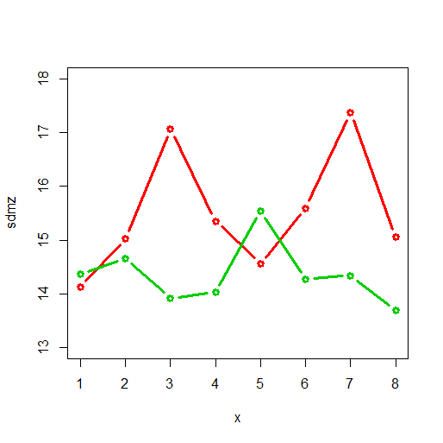
5.5y 6.8y 9.7y 12.2y
0.770 0.674 0.840 0.802 MZ FSIQ correlation
0.641 0.482 0.481 0.500 DZ FSIQ correlation
Red: MZ stdevs
Green: DZ stdevs

Slide 45
Fitted standard simplex
Var(a_{t}) = zero time specific A zero
Var(ζ_{A3}) = var(ζ_{A4}) = 0 A inno at t=3,4 zero
Chi2(63) = 76.8, p= 0.11

Slide 46
FSIQ
5.5y | 6.8y | 9.7y | 12.2y
A
1.000
0.801 | 1.000
0.801 | 1.000 | 1.000
0.801 | 1.000 | 1.000 | 1.000
variance
59.1 | 104.3 | 140.1 | 110.8
h²=.27 | h²=.48 | h²=.60 | h²=.54

Slide 47
E
1.000
0.112 | 1.000
0.056 | 0.212 | 1.000
0.030 | 0.115 | 0.119 | 1.000
variance
49.3 | 62.9 | 46.2 | 46.0
e²=.23 | e²=.29 | e²=.20 | e²=.22

Slide 48
C
1.000
0.756 | 1.000
0.457 | 0.478 | 1.000
0.400 | 0.418 | 0.675 | 1.000
variance
107.8 | 50.1 | 46.0 | 49.8
c²=.50 | c²=.23 | c²=.20 | c²=.24

Slide 49
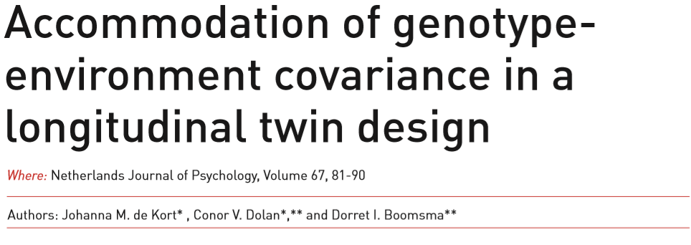
OPEN ACCESS
Dolan, C.V, Janneke M. de Kort, Kees-Jan Kan, C. E. M. van Beijsterveldt, Meike Bartels and Dorret I. Boomsma (2014). Can GE-covariance originating in phenotype to environment transmission account for the Flynn effect? Journal of Intelligence. Submitted.
Dolan, C.V., Johanna M. de Kort, Toos C.E.M. van Beijsterveldt, Meike Bartels, & Dorret I. Boomsma (2014). GE Covariance through phenotype to environment transmission: an assessment in longitudinal twin data and application to childhood anxiety. Beh. Gen. In Press.

Slide 50
A
A
A
A
A
A
A
1
y
α₁
y
α₂
y
α₃
y
E
E
E
1
β₁
β₂
β₃
E
E
E
E
E
E
E
E
1
β₁
β₂
β₃
E
E
E
α₁
α₂
α₃
y
y
y
y
1
A
A
A
A
A
A
A

Slide 51
Anxious depression
Twins aged 3,7,10,12 Netherlands Twin Register (NTR), which includes the Young NTR (YNTR; van Beijsterveldt, Groen-Blokhuis, Hottenga, et al., 2013)
ASEBA CBCL instruments (Achenbach), maternal ratings
Observed 89%, 54%, 45%, 37% (NMZ=3480)
Observed 89%, 50%, 39%, 32% (NDZ=3145)

Slide 52
Phenotypic correlations
FIML phenotypic twin correlations
MZ: .71 (3), .58 (7), .58 (10), and .63 (12).
DZ: .31 (3), .36 (7), .35 (10), and .40 (12).
From 7y onwards looks like ACE model

Slide 53
Model logl npar AIC BIC
1 ACE -69528.5 28 139113 139303
3 AE -69537.9 20 139115 139251
4 AE + α_{k}, β_{k} -69519.3 24 139086 139249
5 AE + β_{k} -69522.1 22 139088 139237
6 ACE ph1->ph2 (2)-69522.0 24 139093 139256
7 ACE ph->ph (1) -69537.1 22 139119 139268

Slide 54
a
a
a
A
A
A
A
1
y
y
y
y
β₁
e
β₂
e
β₂
e
1
E
E
E
E
E
E
E
E
1
β₁
β₂
β₂
e
e
e
y
y
y
y
1
A
A
A
A
a
a
a
β₁=0.123 (s.e. .041) and β₂ = β₃ = 0.062 (s.e. .027)

Slide 55
Parameter estimates in the analysis of Anxiety from 3y to 12y. ML estimates and robust standard errors in parentheses in the AE simplex with parameter β_{k}, logl = -69522.1).
t=1 (3y) t=2 (7y) t=3 (10y) t=4 (12y)
b_{At,t-1} - 0.277 (.062) 0.886 (.099) 0.790 (.100)
σ[ζ_{At}] 2.450 (.098) 1.881 (.152) 1.189 (.302) 1.214 (.277)
b_{Et,t-1 -} 0.414 (.182) 1.017 (.232) 0.799 (.125)
σ[ζ_{Et}] 1.034 (.240) 1.173 (.229) 1.212 (.307) 0.728 (.477)
σ[a_{t}] 0.956 (.227) 0.956 (.227) 0.956 (.227) 0.956 (.227)
σ[e_{t}] 1.375 (.173) 1.375 (.173) 1.375 (.173) 1.375 (.173)
β₁ 0.123 (.041)
β₂=β₃ 0.062 (.027)

Slide 56
A1 E1
1.00 A1
0.34 1.00
0.28 0.83 1.00
0.23 0.67 0.81 1.00
0.00 0.00 0.00 0.00 1.00 E1
0.12 0.04 0.03 0.03 0.33 1.00
0.11 0.07 0.06 0.04 0.25 0.74 1.00
0.12 0.10 0.10 0.08 0.22 0.66 0.89 1.00
0.50 0.17 0.14 0.11 A2
0.17 0.50 0.42 0.34 Correlated E – But not C!
0.14 0.42 0.50 0.41
0.11 0.34 0.41 0.50
0.00 0.00 0.00 0.00 0.00 0.10 0.09 0.09 E2
0.23 0.08 0.07 0.05 0.10 0.09 0.11 0.15
0.20 0.13 0.11 0.09 0.09 0.11 0.12 0.18
0.20 0.18 0.18 0.14 0.09 0.15 0.18 0.22
G-E covariance
Notes:
Red A-E cov, Green is not C! DZ twins

Slide 57
Identification #2 T=4 b_{A2,1} =b_{A3,2} =b_{A4,3} OR b_{C2,1} =b_{C3,2} =b_{C4,3} OR b_{E2,1} =b_{E3,2} =b_{E4,3} OR (of course) b_{C2,1} =b_{C3,2} =b_{C4,3} = b_{E2,1}=b_{E3,2} =b_{E4,3}
ph_{ti}→E_{(t+1)j} (i=j) ph_{ti}→E_{(t+1)j} (i≠j)
α₁, α₂, α₃ β₁, β₂, β₃

