Slide 1
Phenotypic factor analysis: Small practical
Big 5 dimensions N & E in males and females
Script: fa2efa
- Efa using R (factanal)

Slide 2
# read the data
datf=read.table('rdataf') # read the female data
datm=read.table('rdatam') # read the male data
datb5=rbind(datf,datm) # into 1 data matrix
datb5[,1]=datb5[,1]-1 # recode sex from 1->0(m) and 2->1(f)
# assign variable names
colnames(datb5)=c('sex',
'n1', 'n2', 'n3', 'n4', 'n5', 'n6',
'e1', 'e2', 'e3', 'e4', 'e5', 'e6',
'o1', 'o2', 'o3', 'o4', 'o5', 'o6',
'a1', 'a2', 'a3', 'a4', 'a5', 'a6',
'c1', 'c2', 'c3', 'c4', 'c5', 'c6')
Mean = b0 + b1*sex
Sex=0 -> mean=b0
Sex=1 -> mean=b0+b1
So b1=sex difference

Slide 3
# select the variables of interest
isel=c(1:13) # selection of variables sex, n1-n6, e1-e6
datb2=datb5[,isel]
sex=datb5[,1] # sex in a separate vector for convenience
table(sex)
sex
0 1
139 361

Slide 4
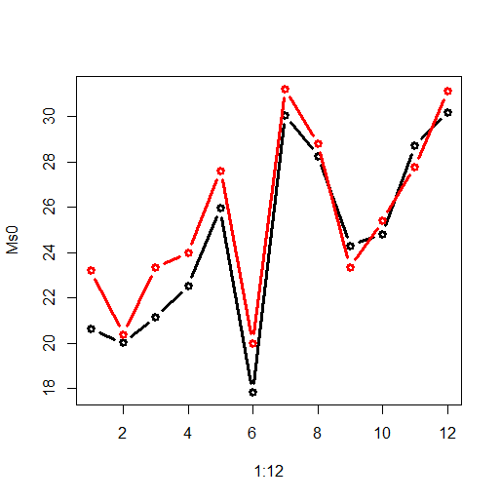
Ss0=cov(datb2[sex==0,2:13]) # calculate the covariance matrix in males
Ss1=cov(datb2[sex==1,2:13]) # calculate the covariance matrix in females
Ms0=apply(datb2[sex==0,2:13],2,mean) # males means
Ms1=apply(datb2[sex==1,2:13],2,mean) # females means
#
mi=min(Ms0,Ms1)
ma=max(Ms0,Ms1)
plot(1:12,Ms0,type='b',col=1,lwd=3,ylim=c(mi,ma))
lines(1:12,Ms1,type='b',col=2,lwd=3,ylim=c(mi,ma))

Slide 5
alpha=.05/12; Stest=matrix(0,1,12)
for (j in 2:13) {
tmp=lm(datb2[,(j)]~(sex))
pval=summary(tmp)$coefficients[2,4]
Stest[1,j-1]=(pval<alpha)}
colnames(Stest)=colnames(datb2)[2:13]
print(Stest)
n1 n2 n3 n4 n5 n6 e1 e2 e3 e4 e5 e6
1 0 1 1 1 1 1 0 0 0 0 0

Slide 6
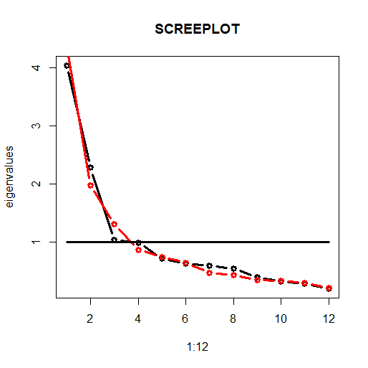

Slide 7
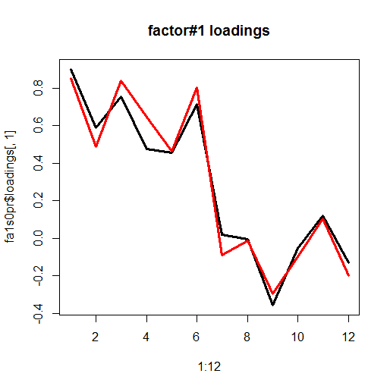
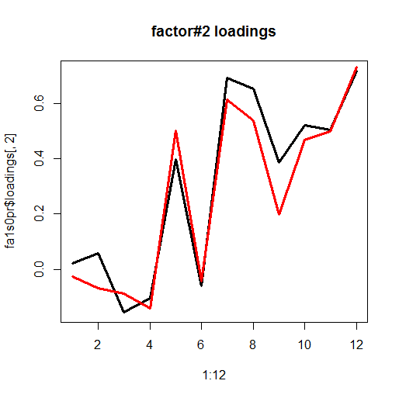

Slide 8
Uniquenesses:
n1 n2 n3 n4 n5 n6 e1 e2 e3 e4 e5 e6
0.199 0.670 0.339 0.736 0.738 0.461 0.528 0.571 0.645 0.709 0.766 0.413
Loadings:
Factor1 Factor2
n1 0.901
n2 0.588
n3 0.754 -0.156
n4 0.473 -0.106
n5 0.457 0.398
n6 0.714
e1 0.693
e2 0.653
e3 -0.357 0.385
e4 0.522
e5 0.120 0.505
e6 -0.130 0.718
Σ_{y} = ΛΨΛ^{t} + Θ
Factor Correlations:
Factor1 Factor2
Factor1 1.000 0.288
Factor2 0.288 1.000
MALES

Slide 9
Uniquenesses:
n1
0.199
Loadings:
Factor1 Factor2
n1 0.901 ~0
λ₁² σ²_{η} + σ²_{ε} =1
.901^2 * 1 + .199 ≈ 1
MALES

Slide 10
Uniquenesses:
n1 n2 n3 n4 n5 n6 e1 e2 e3 e4 e5 e6
0.259 0.735 0.237 0.496 0.705 0.330 0.574 0.707 0.831 0.738 0.780 0.321
Loadings:
Factor1 Factor2
n1 0.851
n2 0.486
n3 0.838
n4 0.647 -0.140
n5 0.464 0.501
n6 0.801
e1 0.614
e2 0.537
e3 -0.294 0.199
e4 0.466
e5 0.102 0.497
e6 -0.198 0.731
Σ_{y} = ΛΨΛ^{t} + Θ
λ₁²σ²_{η} + σ²_{ε} =1
Factor Correlations:
Factor1 Factor2
Factor1 1.000 -0.368
Factor2 -0.368 1.000
FEMALES

Slide 11
Ly=mxMatrix(type='Full',nrow=ny,ncol=ne,free=
matrix(c(
T,F,
T,F,
T,F,
T,F,
T,F, # T,T
T,F,
F,T,
F,T,
T,T, # F,T
F,T,
F,T,
F,T),ny,ne,byrow=T),
value=c(4,4,4,4,4,4,0,0,0,0,0,0,
0,0,0,0,0,0,4,4,4,4,4,4),name='Ly') # read colunm-wise
labels=matrix(c(
'f11','f12',
'f21','f22',
'f31','f32',
'f41','f42',
'f51','f52',
'f61','f62',
'f71','f72',
'f81','f82',
'f91','f92',
'f101','f102',
'f111','f112',
'f121','f122'),ny,ne,byrow=T)
Define factor loading matrix Λ
Σ_{y} = ΛΨΛ^{t} + Θ

Slide 12
Te=mxMatrix(type='Diag',nrow=ny,ncol=ny,free=TRUE,value=10,name='Te')
Define covariance matrix of residuals Θ
Σ_{y} = ΛΨΛ^{t} + Θ

Slide 13
## latent correlation matrix
Ps0=mxMatrix(type='Symm',nrow=ne,ncol=ne,
free=c(FALSE,TRUE,FALSE),
labels=c('v1_0','r12_0', 'v2_0'),values=c(1,-.1,1),name='Ps0')
Ps1=mxMatrix(type='Symm',nrow=ne,ncol=ne,
free=c(FALSE,TRUE,FALSE),
labels=c('v_1','r12_1', 'v2_1'),values=c(0,0,0),name='Ps1')
Define covariance matrix of factors Ψ
Σ_{y} = ΛΨΛ^{t} + Θ
Ψ = Ψ0 + sex* Ψ1

Slide 14
Ψ = Ψ0 + sex* Ψ1
Ψ0 = 1 ρ0
ρ0 1
Sex = 0: ρ0
Sex =1: ρ0 + ρ1
Ψ1= 0 ρ1
ρ1 0
Allows us to test whether the latent correlation is equal in males and females

Slide 15
r
N
E
n1
n2
n3
n4
n5
n6
e1
e2
e3
e4
e5
e6
e
e
e
e
e
e
e
e
e
e
e
e
Test whether the cross loadings are unequal zero
Using a likelihood ratio test

Slide 16
Test whether the correlations are equal
Using a likelihood ratio test
Factor Correlations:
Factor1 Factor2
Factor1 1.000 0.288
Factor2 0.288 1.000
Factor Correlations:
Factor1 Factor2
Factor1 1.000 -0.368
Factor2 -0.368 1.000

Slide 17
> mxCompare(CFM2_out,CFM1_out)
base comparison ep minus2LL df AIC diffLL diffdf p
1 CFM1 <NA> 46 33600.68 5954 21692.68 NA NA NA
2 CFM1 CFM1 44 33695.92 5956 21783.92 95.24373 2 2.080113e-21
> mxCompare(CFM2_out,CFM3_out)
base comparison ep minus2LL df AIC diffLL diffdf p
1 CFM1 <NA> 46 33600.68 5954 21692.68 NA NA NA
2 CFM1 CFM1 45 33600.90 5955 21690.90 0.2195677 1 0.6393695
Factor loadings are significant (alpha=0.01)
Sex difference in latent correlation is not significant (alpha=0.01)

