Slide 1



Analytic Issues Associated with Rare Variant Testing
Benjamin Neale
March 7th 2013
Boulder Workshop

Slide 2
Slide of Contents
Single Locus Testing
  Difficulties/asymptotics
Field-wide development of analytic approaches for sequence data
  Cohort Allelic Sum Test (CAST; Hobbs, Cohen and others)
  Li and Leal (AJHG)
  Madsen and Browning (PLoS Genetics)
  C-alpha (PLoS Genetics)
  SKAT/SKAT-O (AJHG)

Slide 3
Visual representation of sequence data testing
Cases
Controls
Genetic Variant
Haplotype

Slide 4
Visual representation of sequence data testing
Comparing phenotype based on the genotype: Single-locus classic association
Cases
Controls
Genetic Variant
Haplotype

Slide 5
Single Locus Association
Many different tests can be used for association
With few observations, the maximum significance achievable can be quite large
If I have a doubleton, even with 10,000 cases and 10,000 controls my best two-sided P-value is 0.5
We can explore this a bit further

Slide 6
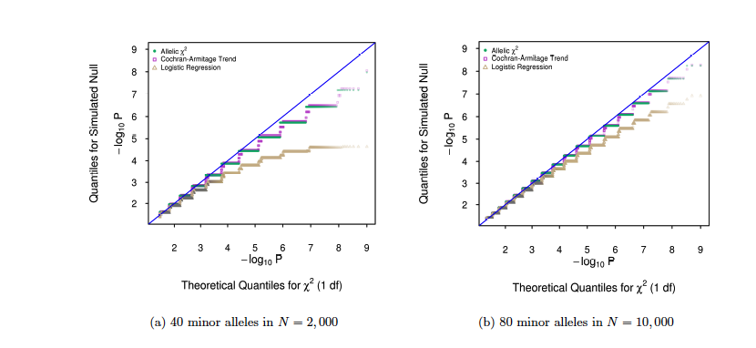
Difficulties of common tests
Tim Bigdeli

Slide 7
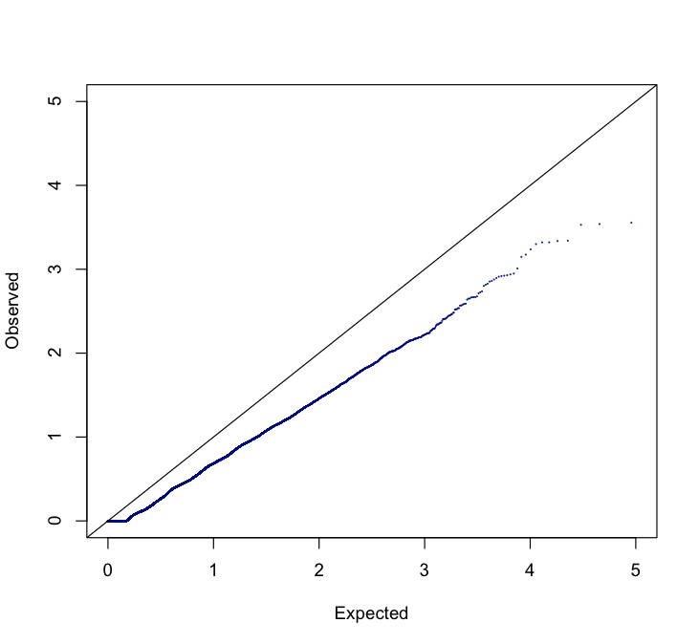
Motivation
Exome Chip:
MAF < 1%
2,883 cases
4,315 controls
Schizophrenia

Slide 8


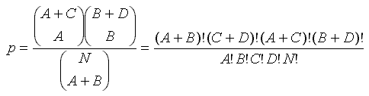

Tests examined
Pearson Chi-Square
Yates Correction
Fisher Exact
Cochran-Armitage Trend

Slide 9

Lambda Statistic
How well is our test statistic behaving?
Dan Howrigan
Notes:
----- Meeting Notes (1/14/13 14:36) -----
Notice how lambda increases at 99% despite deviating further from the expectation

Slide 10
Lambda Statistic
How well is our test statistic behaving?
Dan Howrigan
Notes:
----- Meeting Notes (1/14/13 14:36) -----
Notice how lambda increases at 99% despite deviating further from the expectation

Slide 11
Lambda Statistic
How well is our test statistic behaving?
Dan Howrigan
Notes:
----- Meeting Notes (1/14/13 14:36) -----
Notice how lambda increases at 99% despite deviating further from the expectation

Slide 12
Lambda Statistic
How well is our test statistic behaving?
Better asymptotic properties
vs.
More accurate probabilities
Dan Howrigan
Notes:
----- Meeting Notes (1/14/13 14:36) -----
Notice how lambda increases at 99% despite deviating further from the expectation

Slide 13
Problem:
We do not observe enough copies of rare variants to use traditional association testing approaches.

Slide 14
Solution:
We group variants together to increase the amount of testable variation and to improve power to detect association

Slide 15
Visual representation of sequence data testing
Rare variant yes/no test
Cases
Controls
Genetic Variant
Haplotype
Li and Leal AJHG

Slide 16
Visual representation of sequence data testing
Rare variant burden testing:
Case versus control counts
2
3
1
3
0
1
2
1
3
0
2
1
Cases
Controls
Genetic Variant
Haplotype
Li and Leal AJHG

Slide 17
Cohort Allelic Sum Test
Conduct a burden test
  # case alleles vs. # control alleles
For a gene stratify the variation
  ‘Functional’ vs. not [e.g. missense/nonsense vs. synonymous]
Test for difference in functional vs. not.

Slide 18
Combined Multivariate and Collapsing
Define an allele frequency threshold
  Variation above this gets modeled in regression
  Variation below gets collapsed into a single predictor [burden test]
Improves power over collapsing everything or testing all variation separately
Test the variants you can and collapse the ones you can’t

Slide 19
Observation:
Neutral variation reduces power to detect, so restricting to functional variation or weighting variation may yield improved power

Slide 20
Additional methods
Madsen and Browning (PLoS Genetics)
  Sum of allele count, weighted by inverse of the binomial variance (i.e. rarer alleles carry more weight)
  Functional weighting (e.g. POLYPHEN) may improve power
Variable Threshold (Alkes Price, Shamil Sunyaev)
  Adaptation of burden tests to optimally select allele frequency cut-off

Slide 21
Madsen & Browning Test
In a region sum rare variation in a weighted fashion
Derive these weights from the inverse of the control allele frequency
  In practice this is v. similar to pooled allele frequency
Conduct a rank sum test
  Similar to the Wilcoxon test

Slide 22
Variable Threshold
Identify threshold
that gives the
largest test statistic
Use permutation to
assess significance

Slide 23
Observation:
Variation in a region that influences phenotype is potentially a mixture of neutral, risk, and protective variation

Slide 24
It’s a mixture we’re looking for
Coin | 2/0 | 1/1 | 0/2
Mixed Coin | 0.625 | 0.25 | 0.125
Biased Coin | 0.5625 | 0.375 | 0.0625
Mixed Coin
50% 2/0
50% null
Biased Coin
100% 75/25

Slide 25
Problem:
What is the most powerful approach for testing whether a mixture of neutral, risk, and protective variants are present?

Slide 26
Solution: C-alpha
Neyman and Scott. On the use of c(α) optimal tests of composite hypotheses. 1966
  Developed a set of functions defined for testing for mixtures
Zelterman and Chen. Homogeneity tests against central-mixture alternatives. 1988
  Applied c(α) approach for binomial mixtures in a score test fashion

Slide 27
Visual representation of sequence data testing
Cases
Controls
Genetic Variant
Haplotype

Slide 28
C-alpha: variant distribution in cases versus controls
From our example the data can be reduced down to:
Case Count / Control Count
Singles : 1/0 0/1 0/1
Doubles: 1/1 2/0 1/1
Triples: 3/0 2/1
Quadruples: 0/4
Quintuples: -
….

Slide 29

Binomial Expectation
Each row shows a different number of copies of the rare variant [2-9]
We align the variation by counting # in cases vs. # controls

Slide 30
What does signal look like?
We are trying to find overdispersion, or increase in variance.
So we will observe more 2:0 and 0:2 than 1:1.

Slide 31
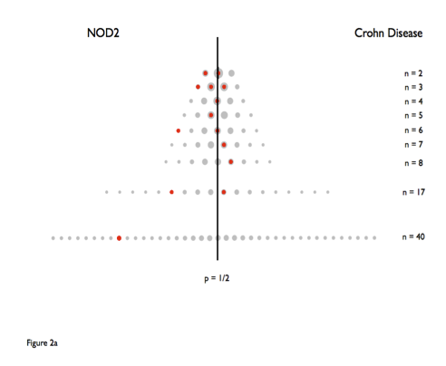
Real Data – Crohn’s Disease

Slide 32
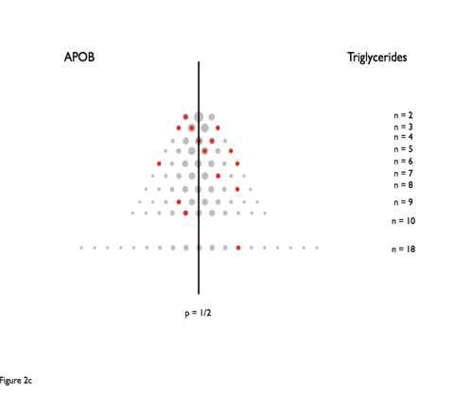
APOB – Triglycerides

Slide 33
APOB – Triglycerides
Two Variants:
6 copies in cases and none in controls
&
6 copies in controls and none in cases

Slide 34
Skat – a closer look
Var comp score statistic:
  Q = (y – m_hat)’ * K * (y - m_hat)
  Y = phenotype vector
  m_hat = mean correction [incorporate covariates]
  K = G * W * G’
  G = n x p matrix of n individuals p markers
  W = weight matrix for the markers

Slide 35
What about singletons?

Slide 36
Singletons
Much of the variation in exomes and genomes will be singletons [i.e. observed in one person]
C-alpha either excludes singletons or combines them into a single case/control measure [30 singletons -> 30-ton variant]
Madsen and Browning are most heavily defined by singletons
SKAT-O extends the VC framework to test jointly

Slide 37
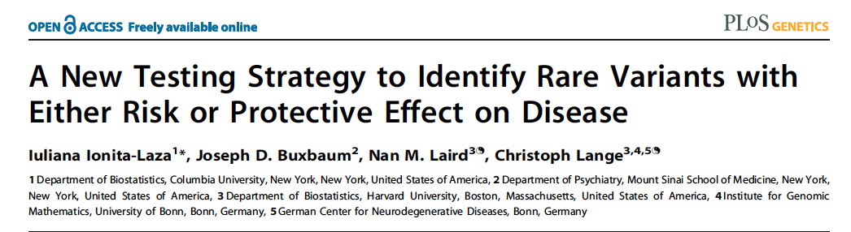
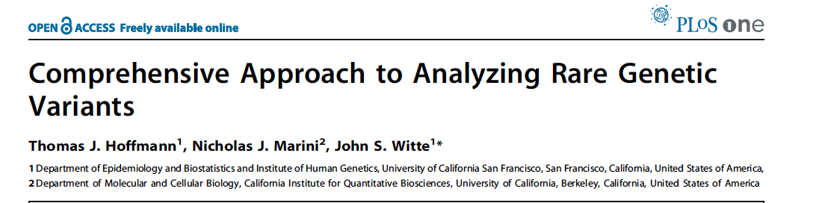
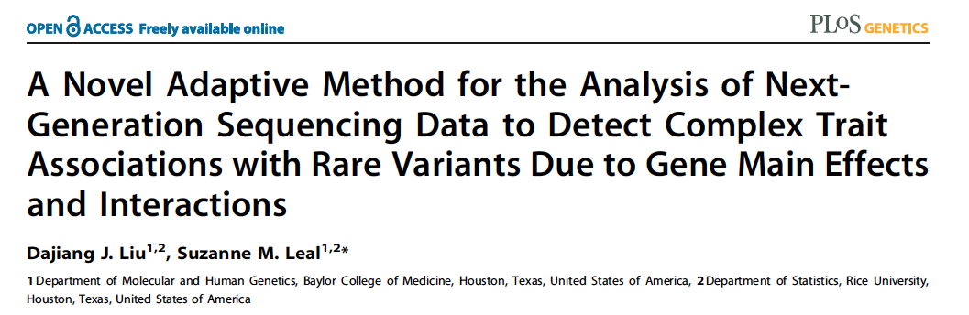
Other methods

Slide 38
Dimensionality of the exome or why I want more variants

Slide 39
C-alpha approach
Aims to identify overdispersion of distribution of allele gene-by-gene
Condition minor allele count between 2 and 40
Presented analysis on 701 passing sample
From real autism analysis data

Slide 40
QQ Plot of Gene Tests

Slide 41
Maximum Permutation P-values
For 10K permutations:
# ties for maximum score/#permutations
~10% P > 1e-1 ~22% P > 1e-2 ~34% P > 1e-3

Slide 42
QQ Plot I-stat reduced [1e-3]

Slide 43
Conclusions
Much work remains for defining the optimal approach
Different models perform well under different scenarios
Plenty of room for extending and developing the work
  E.g. families, pathways, etc.

Slide 44
References
C-alpha http://www.plosgenetics.org/article/info%3Adoi%2F10.1371%2Fjournal.pgen.1001322
Variable Threshold http://www.cell.com/AJHG/abstract/S0002-9297(10)00207-7
Madsen Browning http://www.plosgenetics.org/article/info%3Adoi%2F10.1371%2Fjournal.pgen.1000384
Li and Leal http://www.cell.com/AJHG/abstract/S0002-9297(08)00408-4
SKAT Wu et al.

