Slide 1
Multipoint association analyses using gene, protein interaction, and pathway on KGG
IBG 2013
Miaoxin Li, Pak. C. Sham
Department of Psychiatry & Centre for Genomics Sciences
The University of Hong Kong
mxli@hku.hk

Slide 2
Set-based tests
GATES: A rapid and powerful gene-based association test using extended Simes procedure. Am J Hum Genet. 2011 Mar 11;88(3):283-293.
HYST: A HYbrid Set-based Test for genome-wide association studies,... Am J Hum Genet. 2012 Sep 7;91(3):478-88. (=GATES+ Scaled chi-square test)
Notes:
lead

Slide 3
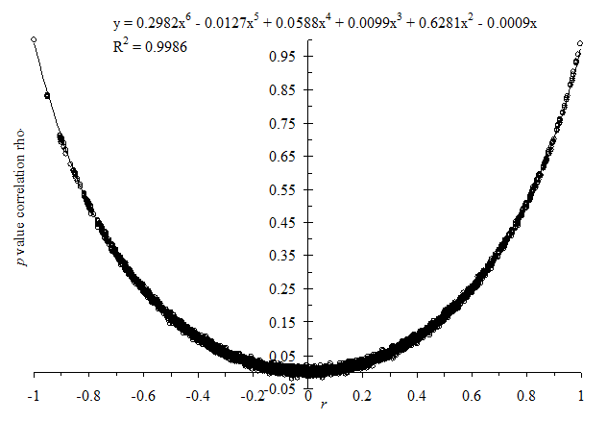
GATES
Extended Simes’ test (known as GATES) (Li et al. 2011)
where
P_{(j)}= sorted SNP p value
m_{e} = effective number of test
w_{(k)} = weight for SNP j
Desirable properties
Dependent p values
Not resort to permutation and simulation
TATES: Trait-based Association Test that uses Extended Simes procedure (van der Sluis S,et al. PLoS Genet. 2013 Jan;9(1):e1003235)
Notes:
Assume…
So we proposed … we hope this mathematical hybridization could …
Specifically, it is
The GATES is a representative of the best snp picking tests. The set-based p-value is equal to the p value multiplying a factor related to the effective number of independent tests
The scaled chi-square test is a representative of the all snp aggregating tests. It use a scale C to adjust for the dependency between p values. Here the C is relevant to the covariance of p values
An important reason why we choose the two tests is because both can accurately account for .. without using …
Brown, M.B. (1975). A method for combining non-independent, one-sided tests of significance. Biometrics 31, 987-992.

Slide 4
Set-based statistical tests for combining p values of SNPs
“Best-SNP picking” strategy
Bonferroni correction and Simes test
GATES (Li et al. 2011)
VEGAS Best statistics (Liu et al 2010)
“All-SNP aggregating” strategy
Fisher’s combination test (Curtis et al. 2008)
Scaled chi-square test(Moskvina et al. 2011)
VEGAS Summation statistics (Liu et al 2010)
Li et al, Am J Hum Genet. 2011 Mar 11;88(3):283-93
Notes:
According to …
In one group, the combined test statistics is derived from
In the other group, the combined test statistics is equal to the summation of all SNPs in a set..
According to our
Best snp picking test can be more powerful when the true risk SNP is limited
On the other hand, the all snp aggregating tests can outperform the best snp picking test when they are multiple ..
However, we usually do not know what will happed in a real case.
So the question is how to make the best of both
Curtis, D., Vine, A.E., and Knight, J. (2008). A simple method for assessing the strength of evidence for association at the level of the whole gene. Adv Appl Bioinform Chem 1, 115-120.
Dudbridge, F., and Koeleman, B.P. (2003). Rank truncated product of P-values, with application to genomewide association scans. Genet Epidemiol 25, 360-366.
Liu, J.Z., McRae, A.F., Nyholt, D.R., Medland, S.E., Wray, N.R., Brown, K.M., Investigators, A., Hayward, N.K., Montgomery, G.W., Visscher, P.M., et al. (2010). A versatile gene-based test for genome-wide association studies. Am J Hum Genet 87, 139-145.
Moskvina, V., O'Dushlaine, C., Purcell, S., Craddock, N., Holmans, P., and O'Donovan, M.C. (2011). Evaluation of an approximation method for assessment of overall significance of multiple-dependent tests in a genomewide association study. Genet Epidemiol 35, 861-866.
u, M.C., Kraft, P., Epstein, M.P., Taylor, D.M., Chanock, S.J., Hunter, D.J., and Lin, X. (2010). Powerful SNP-set analysis for case-control genome-wide association studies. Am J Hum Genet 86, 929-942.

Slide 5
A set of SNPs on multiple genomic regions
Block 1
Block 2
…
Block n
Step 1
Step 2
Block-based P_{B1} by GATES
Block-based P_{B2} by GATES
…
Block-based P_{Bn} by GATES
Step 3
Hybridization!!!
← LD r² of n key SNPs of n blocks
Set-based P by scaled chi-square test, accounting for r²
cov(-2lnP_{Bi}, -2lnP_{Bj})≈0.75 r²+3.25| r|.
Li et al. Am J Hum Genet. 2012; 7;91(3):478-88.
cov(-2lnP_{Bi}, -2lnP_{Bj})≈8.6 r² （Improved)
Notes:
Starting
The critical point is to

Slide 6
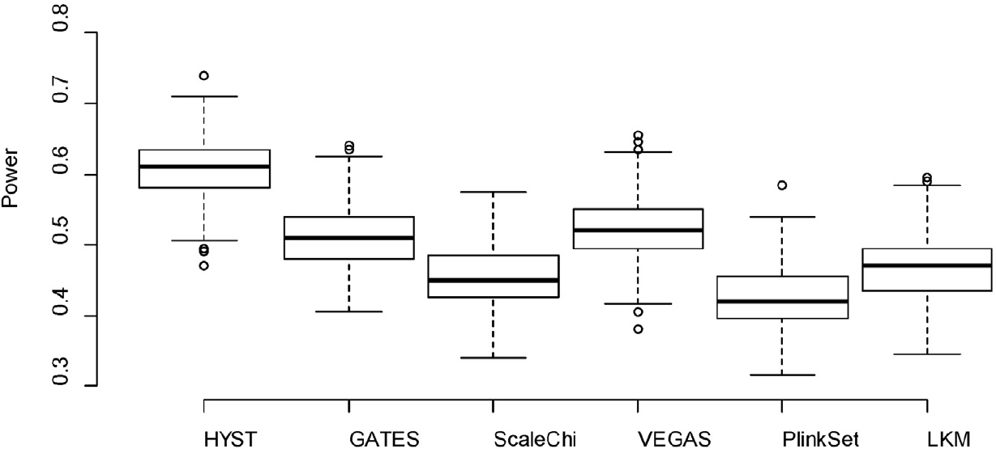
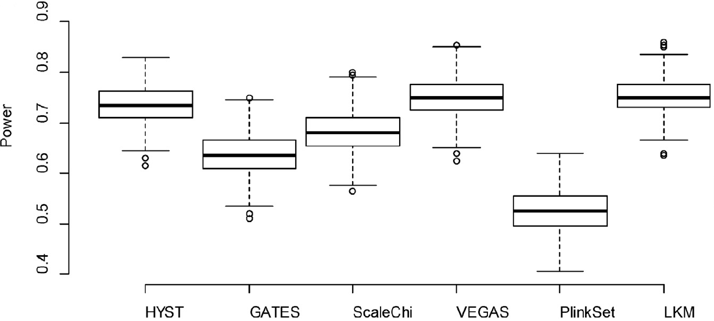
Power in simulation under Alternative Hypotheses
(A)
(B)
ScaleChi, scaled chis-quare test;
VEGAS: A versatile gene-based test for genome-wide association studies
LKM: the Logistic Kernel Machine Test.
GATES: A Rapid and Powerful Gene-Based Association Test Using Extended Simes Procedure
Notes:
Better than its parental tests

Slide 7
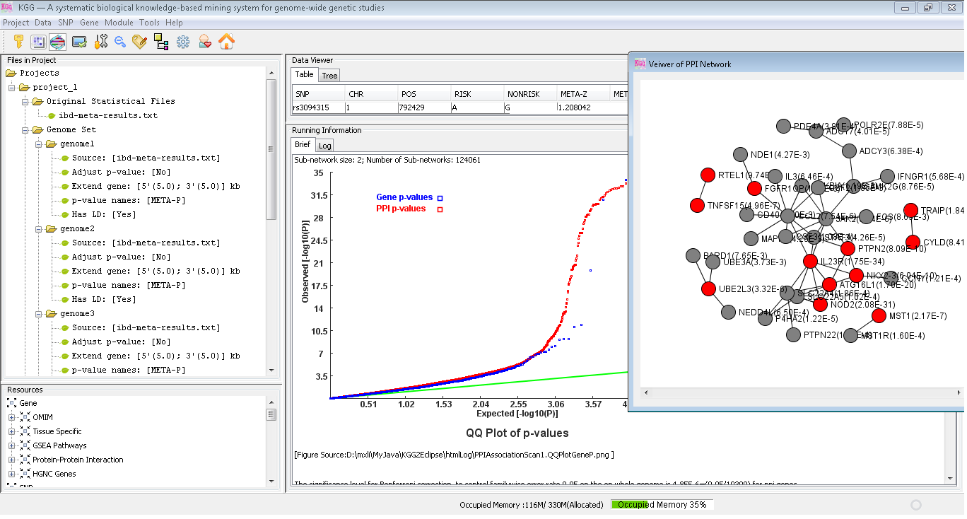
Website of KGG : http://bioinfo.hk.hk/kggweb
Graphic interface of KGG user client

Slide 8
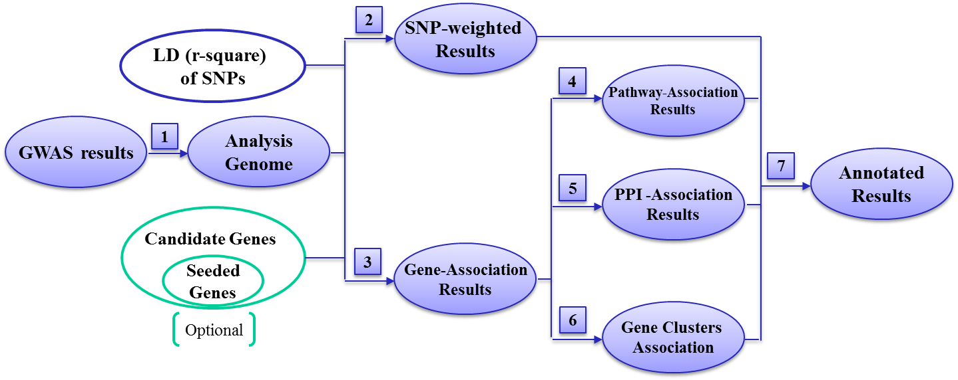
Inputs and function modules of KGG

Slide 9
Generate SNP-based p-values
Plink, SNPTTEST, PBAT, TDT, QTDT, Meta-analysis…
Example command of Plink
plink --file example --assoc

Slide 10
Gene-based association analysis
refGene.txt.gz from UCSC (with boundary extensions)
GATES or HSYT

Slide 11
Pathway/gene set-based association analysis
Datasets:
Gene sets provided by MSigDB, http://www.broadinstitute.org/gsea/msigdb
CP: Canonical pathways (1452 sets)
C2: curated gene sets (4850 sets)
C4: computational gene sets (858 sets)
C6: oncogenic signatures (189 sets)
Customized gene sets
Procedure
Gene-base association test
HYST
Hyper-geometric test

Slide 12
PPI-based association analysis
Data sets
String database (http://string-db.org/)
Customized gene sets
Procedure
Gene-base association test
HYST
Heterogeneity test

Slide 13
Main inputs of KGG
p-value sets
CHR | SNP | P-value1 | P-value2 | P-value3 | …
4 | rs1513559 | 0.02301 | 0.8815 | 0.007688 | …
4 | rs294755 | 0.4384 | 0.9575 | 0.006112 | …
4 | rs835316 | 0.002688 | 0.007688 | 0.4893 | …
4 | rs1841043 | 0.01115 | 0.006112 | 0.119 | …
4 | rs11726946 | 0.005892 | 0.4893 | 0 | …
… | … | … | … | … | …
CHR | SNP | P-value1 | Test-Mode | P-value2 | …
4 | rs1513559 | 0.02301 | additive | 0.007688 | …
4 | rs1513559 | 0.4384 | recessive | 0.006112 | …
4 | rs1513559 | 0.002688 | dominant | 0.4893 | …
4 | rs1841043 | 0.01115 | additive | 0.119 | …
4 | rs1841043 | 0.005892 | recessive | 0 | …
… | … | … | … | … | …
Gene_Symbol
IL23R
NKX2-3
TNFSF15
SAG
..
Candidate gene list (optional)
Pair-wise linkage-disequilibrium coefficients (optional)
HapMap LD SNP coefficients (downloaded from HapMap ftp)
Genotype of user samples (Plink bed file format)
Available local LD SNP coefficients (calculated by third-party tool like Plink).

Slide 14
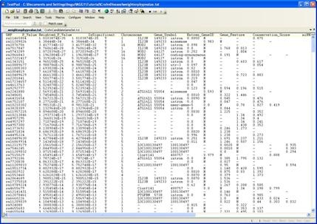
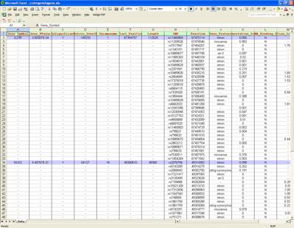
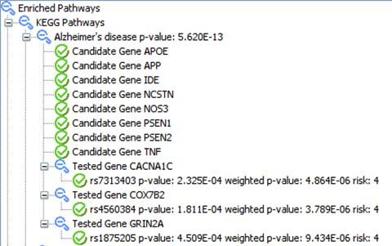
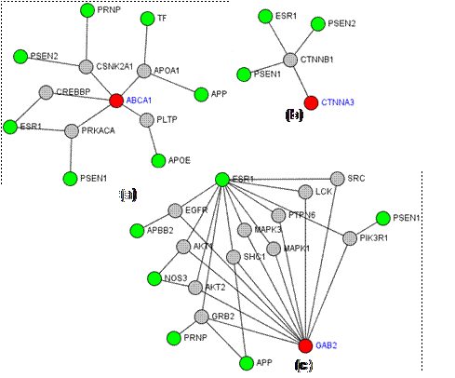
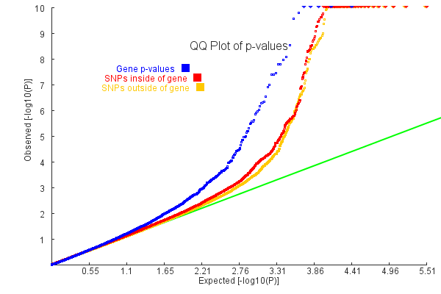
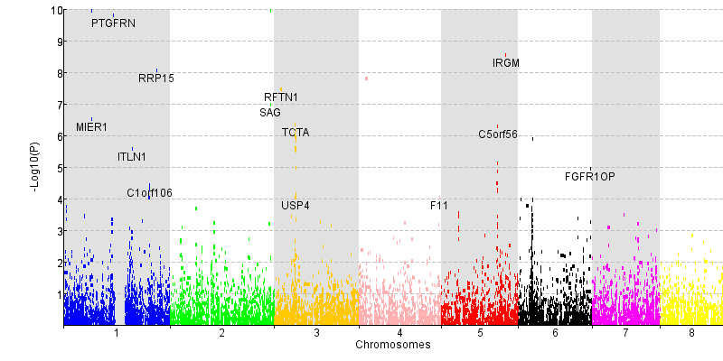
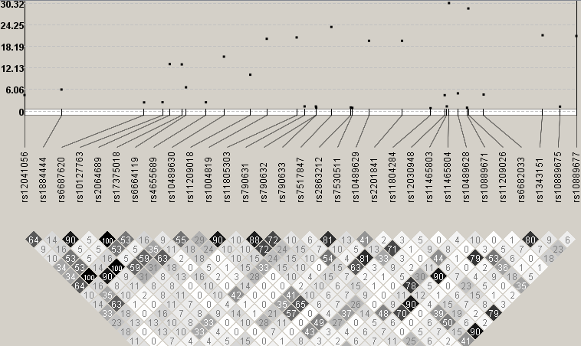
Versatile outputs of KGG

Slide 15
Step by step procedure
Create a KGG project
Build an analysis Genome by RSID
Gene-based association analysis by GATES
Gene-based association analysis by HYST
Pathway gene set-based association analysis by HYST
Protein-protein interaction-based association analysis by HYST

Slide 16
Input data: /miaoxin/IBG2013/KGG/KGGSample
Meta-analysis test statistics of Crohn's disease (http://www.broadinstitute.org/~jcbarret/ibd-meta/)
CrohnMetaPValueSetChr1.txt
Known risk gene list of Crohn's disease
CrohnCandidateGeneSet.txt
Tutorial file: /miaoxin/IBG2013/KGG/
ShortTutorialKGG.docx

Slide 17
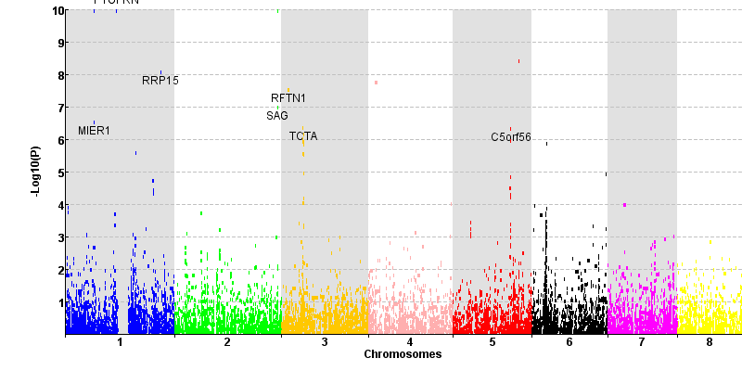
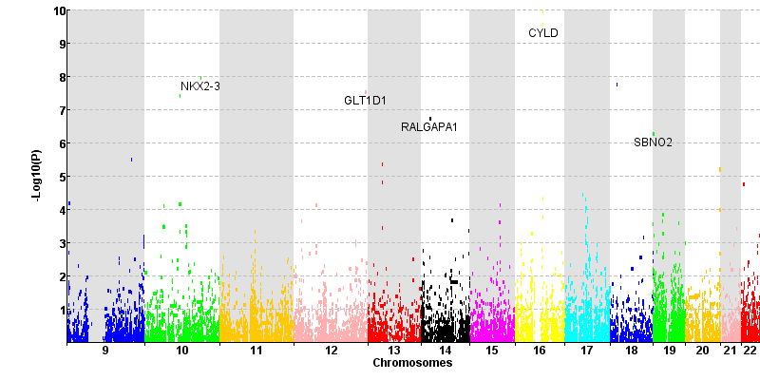
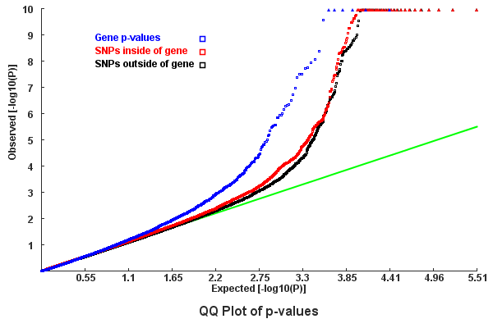
Gene-based association test by GATES

Slide 18
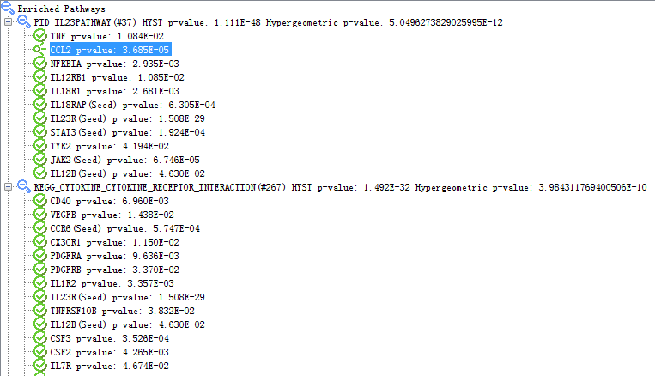
The significant pathways in Crohn’s Disease GWAS data set

Slide 19
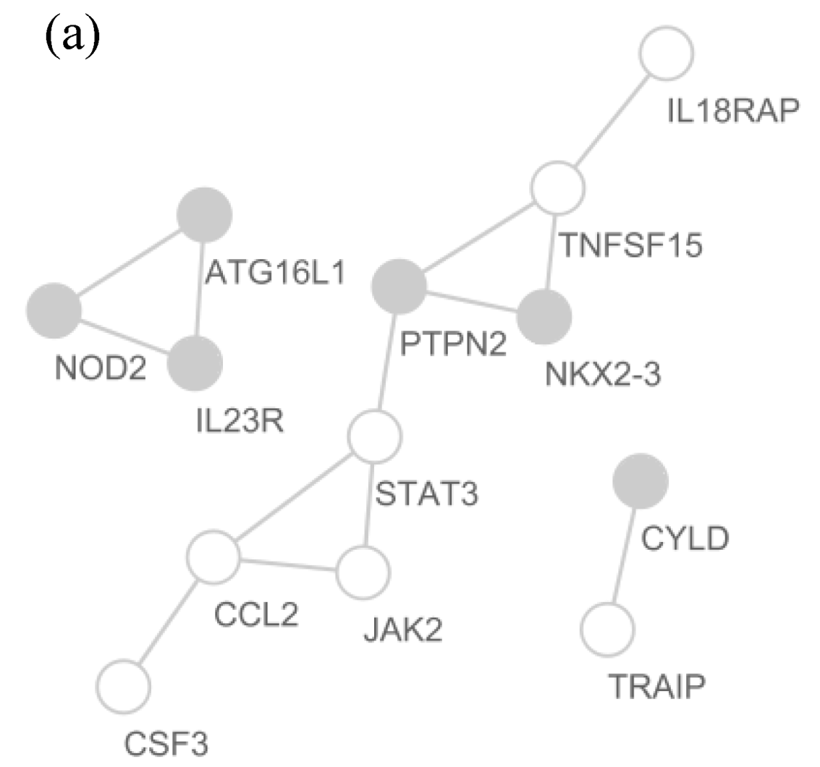
The significant PPI pairs in Crohn’s Disease GWAS data set
Five (IL18RAP, JAK2,
TNFSF15, CCL2, and STAT3) out of the seven were confirmed susceptibility genes
[1] Barrett, J.C. et al. Genome-wide association defines more than 30 distinct susceptibility loci for Crohn's disease. Nature genetics 40, 955-962 (2008).
Filed: genes significant in either the SNP-based, the gene-based analysis, or both tests

