Slide 1
Practical of KGGSeq
IBG 2013
Miaoxin Li, Pak. C. Sham
Department of Psychiatry & Centre for Genomics Sciences
The University of Hong Kong
mxli@hku.hk

Slide 2
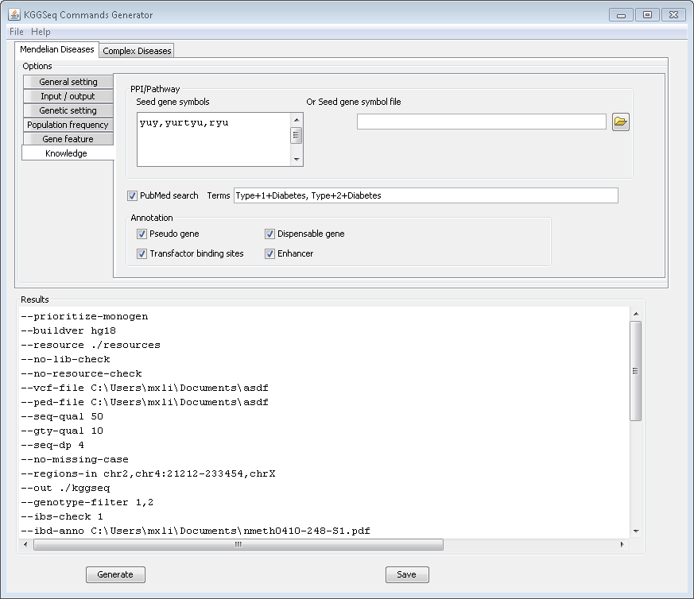
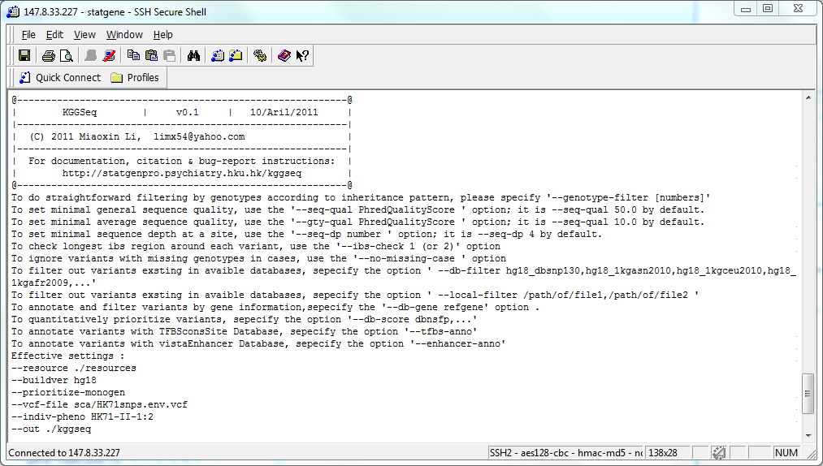

Slide 3
Main inputs of KGGSeq
Sequence variants in VCF format
##fileformat=VCFv4.1 ##fileDate=20090805 ##source=myImputationProgramV3.1 ##reference=file:///seq/references/1000GenomesPilot-NCBI36.fasta ##contig=<ID=20,length=62435964,assembly=B36,md5=f126cdf8a6e0c7f379d618ff66beb2da,species="Homo sapiens",taxonomy=x> ##phasing=partial ##INFO=<ID=NS,Number=1,Type=Integer,Description="Number of Samples With Data"> ##INFO=<ID=DP,Number=1,Type=Integer,Description="Total Depth"> ##INFO=<ID=AF,Number=A,Type=Float,Description="Allele Frequency"> ##INFO=<ID=AA,Number=1,Type=String,Description="Ancestral Allele"> ##INFO=<ID=DB,Number=0,Type=Flag,Description="dbSNP membership, build 129"> ##INFO=<ID=H2,Number=0,Type=Flag,Description="HapMap2 membership"> ##FILTER=<ID=q10,Description="Quality below 10"> ##FILTER=<ID=s50,Description="Less than 50% of samples have data"> ##FORMAT=<ID=GT,Number=1,Type=String,Description="Genotype"> ##FORMAT=<ID=GQ,Number=1,Type=Integer,Description="Genotype Quality"> ##FORMAT=<ID=DP,Number=1,Type=Integer,Description="Read Depth"> ##FORMAT=<ID=HQ,Number=2,Type=Integer,Description="Haplotype Quality"> #CHROM POS ID REF ALT QUAL FILTER INFO FORMAT NA00001 NA00002 NA00003 20 14370 rs6054257 G A 29 PASS NS=3;DP=14;AF=0.5;DB;H2 GT:GQ:DP:HQ 0|0:48:1:51,51 1|0:48:8:51,51 1/1:43:5:.,. 20 17330 . T A 3 q10 NS=3;DP=11;AF=0.017 GT:GQ:DP:HQ 0|0:49:3:58,50 0|1:3:5:65,3 0/0:41:3 20 1110696 rs6040355 A G,T 67 PASS NS=2;DP=10;AF=0.333,0.667;AA=T;DB GT:GQ:DP:HQ 1|2:21:6:23,27 2|1:2:0:18,2 2/2:35:4 20 1230237 . T . 47 PASS NS=3;DP=13;AA=T GT:GQ:DP:HQ 0|0:54:7:56,60 0|0:48:4:51,51 0/0:61:2 20 1234567 microsat1 GTC G,GTCT 50 PASS NS=3;DP=9;AA=G GT:GQ:DP 0/1:35:4 0/2:17:2 1/1:40:3
Sequence variants in ANNOVAR format
Chr | Start | End | Ref | Obs | Comments
1 | 161003087 | 161003087 | C | T | a
1 | 84647761 | 84647761 | C | T | b
1 | 13133880 | 13133881 | TC | - | v
1 | 11326183 | 11326183 | - | AT | f
1 | 105293754 | 105293754 | A | ATAAA | d

Slide 4
Main inputs of KGGSeq
Sequence variants in Pseq output format
VAR REF SAMPLES FILTER VMETA CONMETA ALT MAF HWE MINA MINU OBSA OBSU REFA HETA HOMA REFU HETU HOMU P OR PDOM ORDOM PREC ORREC chr1:1105366:rs111751804 T CEU TSI PASS PASS AA=T;BN=132;GP=1:1115503 . C 0.0286885 1 4 3 57 65 53 4 0 62 3 0 0.708391 1.53939 0.704253 1.55975 1 1.13913 chr1:1105411:rs114390380 G CEU TSI PASS PASS AA=G;BN=132;GP=1:1115548 . A 0.0127119 1 1 2 53 65 52 1 0 63 2 0 1 0.609524 1 0.605769 1 1.2243 chr1:1108138:rs61733845 C CEU TSI PASS PASS AA=c;BN=129;GP=1:1118275 . T 0.036 1 3 6 61 64 58 3 0 58 6 0 0.50094 0.512605 0.492564 0.5 1 1.04878 chr1:1110240:rs116321663 T CEU TSI PASS PASS AA=T;BN=132;GP=1:1120377 . A 0.00645161 1 1 1 89 66 88 1 0 65 1 0 1 0.740113 1 0.738636 1 0.743017 chr1:1110294:rs1320571 G CEU TSI PASS PASS AA=A;BN=88;GP=1:1120431;HM2;HM3 . A 0.0387324 1 6 5 77 65 71 6 0 60 5 0 1 1.01351 1 1.01408 1 0.845161 chr1:3537996:rs2760321 T CEU TSI PASS PASS AA=C;BN=100;GP=1:3548136;HM2;HM3 . C 0.845588 1 18 24 73 63 1 16 56 2 20 41 0.133643 1.6732 0.596225 2.36066 0.1829 1.76758
VAAST gene-based association output format
RANK Gene p-value Score Variants1
TEKT4 2.84070221452526e-12 47.62418618 chr2:94906054;47.62;T->A;M->K;0,82
HLA-C_DUP_02 2.84070221452526e-12 42.05922817 chr6:31345752;42.06;T->C;T->A;0,123
USP6 2.84070221452526e-12 41.80136081 chr17:4977987;41.80;G->A;V->I;0,84
HRNR 2.84070221452526e-12 38.67640424 chr1:150452457;38.68;C->T;G->S;0,106
SIGLEC10 2.84070221452526e-12 38.27357881 chr19:56611924;38.27;C->T;E->K;0,77
FRG2C 2.84070221452526e-12 37.42468630 chr3:75796666;37.42;C->G;S->*;0,68
KIAA1467 2.84070221452526e-12 35.79258874 chr12:13100123;35.79;A->G;S->G;0,7

Slide 5
Main inputs of KGGSeq
Linkage pedigree information (optional)
1 Y 0 0 1 1
1 Z 0 0 2 1
1 X Y Z 1 2 Pedigree Name
A unique alphanumeric identifier for this individual's family. Unrelated individuals should not share a pedigree name.
Individual ID
An alphanumeric identifier for this individual. Should be unique within his family (see above).
Father's ID
Identifier corresponding to father's individual ID or "0" if unknown father. Note
that if a father ID is specified, the father must also appear in the file.
Mother's ID
Identifier corresponding to mother's individual ID or "0" if unknown mother Note that if a mother ID is specified, the mother must also appear in the file.
Sex
Individual's gender (1=MALE, 2=FEMALE).
Affection status
Affection status to be used for association tests (0=UNKNOWN, 1=UNAFFECTED,2=AFFECTED).
Candidate gene list (optional)
Gene_Symbol
IL23R
NKX2-3
TNFSF15
SAG
..

Slide 6
Main outputs of KGGSeq
Sequence variants in Pseq output format
VAR REF SAMPLES FILTER VMETA CONMETA ALT MAF HWE MINA MINU OBSA OBSU REFA HETA HOMA REFU HETU HOMU P OR PDOM ORDOM PREC ORREC chr1:1105366:rs111751804 T CEU TSI PASS PASS AA=T;BN=132;GP=1:1115503 . C 0.0286885 1 4 3 57 65 53 4 0 62 3 0 0.708391 1.53939 0.704253 1.55975 1 1.13913 chr1:1105411:rs114390380 G CEU TSI PASS PASS AA=G;BN=132;GP=1:1115548 . A 0.0127119 1 1 2 53 65 52 1 0 63 2 0 1 0.609524 1 0.605769 1 1.2243 chr1:1108138:rs61733845 C CEU TSI PASS PASS AA=c;BN=129;GP=1:1118275 . T 0.036 1 3 6 61 64 58 3 0 58 6 0 0.50094 0.512605 0.492564 0.5 1 1.04878 chr1:1110240:rs116321663 T CEU TSI PASS PASS AA=T;BN=132;GP=1:1120377 . A 0.00645161 1 1 1 89 66 88 1 0 65 1 0 1 0.740113 1 0.738636 1 0.743017 chr1:1110294:rs1320571 G CEU TSI PASS PASS AA=A;BN=88;GP=1:1120431;HM2;HM3 . A 0.0387324 1 6 5 77 65 71 6 0 60 5 0 1 1.01351 1 1.01408 1 0.845161 chr1:3537996:rs2760321 T CEU TSI PASS PASS AA=C;BN=100;GP=1:3548136;HM2;HM3 . C 0.845588 1 18 24 73 63 1 16 56 2 20 41 0.133643 1.6732 0.596225 2.36066 0.1829 1.76758
VAAST gene-based association output format
RANK Gene p-value Score Variants1
TEKT4 2.84070221452526e-12 47.62418618 chr2:94906054;47.62;T->A;M->K;0,82
HLA-C_DUP_02 2.84070221452526e-12 42.05922817 chr6:31345752;42.06;T->C;T->A;0,123
USP6 2.84070221452526e-12 41.80136081 chr17:4977987;41.80;G->A;V->I;0,84
HRNR 2.84070221452526e-12 38.67640424 chr1:150452457;38.68;C->T;G->S;0,106
SIGLEC10 2.84070221452526e-12 38.27357881 chr19:56611924;38.27;C->T;E->K;0,77
FRG2C 2.84070221452526e-12 37.42468630 chr3:75796666;37.42;C->G;S->*;0,68
KIAA1467 2.84070221452526e-12 35.79258874 chr12:13100123;35.79;A->G;S->G;0,7

Slide 7
Input data: /miaoxin/IBG2013/KGGSeq/
Sequence variant in VCF format examples/rare.disease.hg19.vcf
Pedigree information
examples/rare.disease.ped.txt
Tutorial file: /miaoxin/IBG2013/KGGSeq/
ShortTutorialKGGSeq.docx

Slide 8
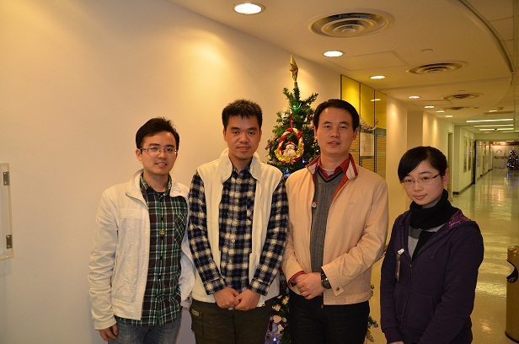
Acknowledgments
Allen Hongsheng Gui, Suying Bao, Johnny Kwan(KGGSeq team members)
Pak C Sham
Shirley YY Pang Youqiang Song, Michelle HW Kung, Shu-Leong Ho
Active users
BIOSUPPORT project (http://www.bioinfo.hku.hk)
HK RGC GRF Project Grant 774707
HKU SRT on Genomics
Small Project Funding HKU 201007176166

