Slide 1
Annotation, filtration, and prioritization of exome sequence variants for genetic mapping of human disease
Miaoxin Li, Pak C Sham
Department of Psychiatry & Centre for Genomics Sciences The University of Hong Kong
mxli@hku.hk

Slide 2
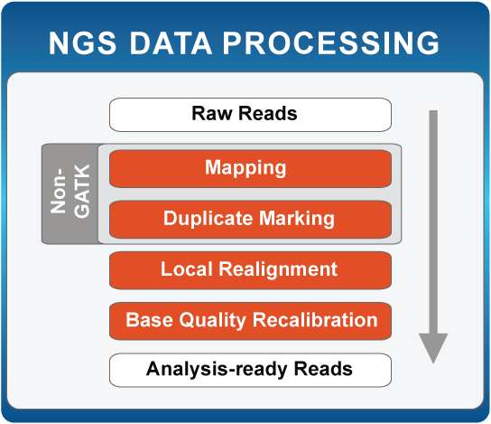
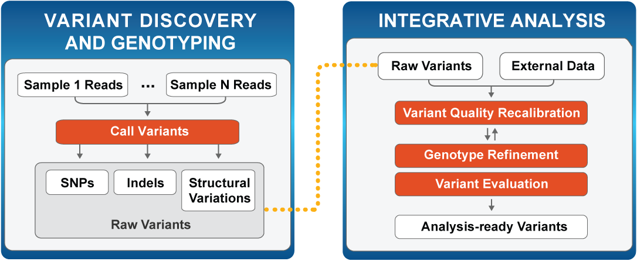
Upstream analysis
http://www.broadinstitute.org/gatk/about/#typical-workflows
Downstream analysis
Sequence variants
External data
….
….

Slide 3

Challenges
A few causal mutations from thousands of variants
Many private mutations are likely to be neutral and will not cause any severe disorders (Majewski, et al., 2011)
Seek a needle in haystack!

Slide 4
Available tools for downstream analysis
Statistical genetic analysis tools for genetic sharing or co-segregation (like BEAGLE, GERMLINE, PLINK IBD and MERLIN)
Computational biology tools to predict deleteriousness degree of non-synonymous (NS) single nucleotide variants (SNVs) [SIFT(Kumar, et al., 2009), Polyphen2(Adzhubei, et al., 2010), LRT(Chun and Fay, 2009), MutationTaster(Schwarz, et al., 2010) and PhyloP(Siepel, et al., 2006) ]
Bioinformatics annotation tools (SeattleSeq and ANNOVAR)

Slide 5
Issues
Limited power
Scattered
Inconsistent
Insufficient resources
Easy and powerful
downstream analysis!!
Notes:
方法和软件零散地分布在不同的地方，单个软件很难给出满意的候选序列

Slide 6
A multilayer automated filtration and prioritization framework
Variants and/or genotypes called from sequencing data in variants formats
Exclude variants conflicting with disease inheritance patterns/modes
Genetic level
Exclude variants outside identity by descent (IBD) regions
Exclude common variants (e.g., MAF 0.001) in dbSNP, 1K Genome Project and other datasets
Exclude variants not altering proteins
Variant-Gene level
Known disease genes
Exclude predicted non-disease variants
Disease names
Knowledge level
Explore variants whose genes have physical protein-protein interaction with candidate genes
Explore variants whose genes share the same biological pathways with candidate genes
Explore available literature in NCBI PubMed about genes/ideogram and interested diseases
Prioritized and annotated variants in an Excel or text file
Li MX, Gui HS, Kwan SH, Bao SY, Sham PC. A comprehensive framework for prioritizing variants in exome sequencing studies of Mendelian diseases. Nucleic Acids Research (Nucleic Acids Res. 2012 Apr 1;40(7):e53)

Slide 7
Inheritance model
  Autosomal recessive
  Autosomal dominant
  X-linked dominant
  X-linked recessive
  Y-linked
  Mitochondrial
Male

Slide 8
IBD regions: Variants within shared genetic regions found among the affected family members
Li MX et al. Clin Genet. 2013 Mar;83(3):269-73
IBS regions: Long regions made up of consecutive variants with IBS ≥ 1 among the affected family members! (Necessary but not sufficient!!!)
Runs of homozygosity/loss of heterozygosity ( IBS =2)

Slide 9
A multilayer automated filtration and prioritization framework
Variants and/or genotypes called from sequencing data in variants formats
Exclude variants outside identity by descent (IBD) regions
Genetic level
Exclude variants conflicting with disease inheritance patterns/modes
Exclude common variants (e.g., MAF 0.001) in dbSNP, 1K Genome Project and other datasets
Exclude variants not altering proteins
Variant-Gene level
Known disease genes
Exclude predicted non-disease variants
Disease names
Knowledge level
Explore variants whose genes have physical protein-protein interaction with candidate genes
Explore variants whose genes share the same biological pathways with candidate genes
Explore available literature in NCBI PubMed about genes/ideogram and interested diseases
Prioritized and annotated variants in an Excel or text file
Li MX, Gui HS, Kwan SH, Bao SY, Sham PC. A comprehensive framework for prioritizing variants in exome sequencing studies of Mendelian diseases. Nucleic Acids Research (Nucleic Acids Res. 2012 Apr 1;40(7):e53)

Slide 10
Population allele frequencies of casual mutations
  Autosomal dominant
Assumption: Hardy-Weinberg disequilibrium & Full penetrance!!!
  Autosomal recessive
Definition of rare diseases (http://en.wikipedia.org/wiki/Rare_disease)
Countries/Community | Prevalence | Dominant mutation frequency | Recessive mutation frequency
United States | ~1 in 1,500 | 0.000333 | 0.02582
Japan | ~1 in 2,500 | 0.0002 | 0.02
European Commission | ~1 in 2,000 | 0.00025 | 0.022361
Medical literature | ~1/1,000 to 1/200,000 | 0.0005 to 2.5E-06 | 0.031623 to 0.002236
http://www.orpha.net/orphacom/cahiers/docs/GB/Prevalence_of_rare_diseases_by_alphabetical_list.pdf
Prevalence of rare diseases in Europe

Slide 11
A multilayer automated filtration and prioritization framework
Variants and/or genotypes called from sequencing data in variants formats
Exclude variants outside identity by descent (IBD) regions
Genetic level
Exclude variants conflicting with disease inheritance patterns/modes
Exclude common variants (e.g., MAF 0.001) in dbSNP, 1K Genome Project and other datasets
Exclude variants not altering proteins
Variant-Gene level
Known disease genes
Exclude predicted non-disease variants
Disease names
Knowledge level
Explore variants whose genes have physical protein-protein interaction with candidate genes
Explore variants whose genes share the same biological pathways with candidate genes
Explore available literature in NCBI PubMed about genes/ideogram and interested diseases
Prioritized and annotated variants in an Excel or text file
Li MX, Gui HS, Kwan SH, Bao SY, Sham PC. A comprehensive framework for prioritizing variants in exome sequencing studies of Mendelian diseases. Nucleic Acids Research (Nucleic Acids Res. 2012 Apr 1;40(7):e53)

Slide 12
Deleteriousness scores
Risk prediction scores
  PhyloP [(RECOMB 2006), pp., 190-205]
  SIFT[Nat Protoc 4 (7):1073–1081]
  Polyphen2 [Nat Methods. 2010 Apr;7(4):248-9.]
  LRT Score [Genome Res 19 (9):1553–1561]
  MutationTaster [Nat Methods. 2010 Aug;7(8):575-6]
  MutationAssessor[Nucleic Acids Res. 2011 Sep 1;39(17):e118]
  …..
Notes:
SIFT Kumar et al., 2009 Predicting the effects of coding non-synonymous variants on protein function using the sift algorithm. Nat Protoc 4 (7):1073–1081
Polyphen2 Adzhubei et al., 2010 A method and server for predicting damaging missense mutations Methods 7 (4):248–249.
LRT Chun and Fay, 2009 Identification of deleterious mutations within three human genomes Genome Res 19 (9):1553–1561.
MutationTaster Schwarz et al., 2010Schwarz JM, R?delsperger C, Schuelke M, Seelow D. MutationTaster evaluates disease-causing potential of sequence alterations. Nat Methods. 2010 Aug;7(8):575-6
PhyloP Siepel et al.,2006 New methods for detecting lineage-specific selection.In Proceedings of the 10th International Conference on Research in Computational Molecular Biology (RECOMB 2006) pp. 190–205

Slide 13
Tools to predict deleterious mutations
Tools | Resources | algorithm
PhyloP | evolutional conservation from multiple alignments of placental mammal genomes to the human genome | phylogenetic hidden Markov model
SIFT | evolutional conservation at single amino acid substitution | Likelihood modeling
Polyphen2 | impact of an amino acid substitution on the structure and function of a human protein | iterative greedy algorithm
LRT | A comparative genomics data set of 32 vertebrate species | likelihood ratio test
MutationTaster | multiple resources such as evolutionary conservation, splice-site changes, loss of protein features and changes that might affect mRNA level | naive Bayes classifier
MutationAssessor | Evolutionary conservation patterns | combinatorial entropy formalism

Slide 14
Spearman's rank correlation matrix for the scores from the five individual algorithms

Slide 15
Questions
How effectively utilize multiple prediction results?
How useful to isolate disease-causative variants from RARE variants?

Slide 16
Benchmark datasets
ExoVar
  5,340 disease-causal alleles vs. 4,752 rare nsSNVs (at least one homozygous genotype) in the 1000 Genomes Project
HumVar
  22,196 human disease-causing or loss of activity/function mutations vs. 21,151 common (MAF>1%) nsSNVs
DomRec
  253 nsSNVs causing only autosomal dominant diseases and 389 nsSNVs causing only autosomal recessive diseases

Slide 17
Logit model for combining individual prediction tools
X: prediction scores from multiple prediction methods
Y: the nsSNV is pathogenic (Y=1) or no

Slide 18


Distinguishing pathogenic nsSNVs from other rare nsSNVs

Slide 19
Distinguishing pathogenic nsSNVs from common nsSNVs

Slide 20
Reduced prediction models

Slide 21
Total load of pathogenic derived alleles in 8 HapMap subjects
Population | Individual | Number of rare nsSNVs usedª | Number of rare variants predicted to be pathogenic | % of rare nsSNVs truly pathogenic | Total load of pathogenic derived alleles (95% CI) ^{b}
Caucasian | NA12156 | 384 | 78 | 5.5 | 21 (5, 36)
 | NA12878 | 426 | 104 | 12.0 | 51 (33, 68)
Japanese | NA18956 | 356 | 68 | 3.6 | 13 (0, 26)
Chinese | NA18555 | 424 | 90 | 6.9 | 29 (12, 46)
African | NA18517 | 660 | 113 | 0.4 | 3 (0, 28)
 | NA18507 | 623 | 130 | 6.4 | 40 (14, 64)
 | NA19129 | 629 | 110 | 1.0 | 6 (0, 31)
 | NA19240 | 688 | 126 | 2.3 | 16 (0, 42)
Average |  |  |  | ~5 | ~22
Notes:
80.2% averaged sensitivity and 82.8% averaged specificity

Slide 22
Number of homozygous pathogenic variants in the children of various relationships,
Relationship | Inbreeding coefficient, F | Expected number of homozygous pathogenic variants in children
Siblings | 1/4 | 2.8
Half siblings | 1/8 | 1.4
Uncle-niece, aunt-nephew | 1/8 | 1.4
First cousins | 1/16 | 0.7
First cousins once removed | 1/32 | 0.3
Second cousins | 1/64 | 0.2
Double first cousins | 1/8 | 1.4
Double second cousins | 1/32 | 0.3
Given that on average each individual carries 22 pathogenic derived alleles
Notes:
. Given the theoretical inbreeding coefficient (F) of a child of a consanguineous union [16], the corresponding number of homozygous pathogenic variants in the child equals F∙N/2, where N is the total load of pathogenic derived alleles in each common ancestor of the consanguineous couple

Slide 23
Unbiased estimate of (posterior) probability
Li MX, Kwan JS, Bao SY, Yang W, Ho SL, Song YQ, Sham PC.
PLoS Genet. 2013 Jan;9(1):e1003143

Slide 24
Relationship between prior and posterior probabilities of a rare nsSNV being pathogenic

Slide 25
Numbers and proportion of nsSNVs removed by hard-filtering and functional prediction
 | Patient 1ª | Patient 2ª | Patient 3^{b}
Missense, stop-loss and stop-gain variants | 8,383 | 8,563 | 7,969
MAF > 1% | -7,398 (-88.3%) | -7,552(-88.2%) | -6,751(-84.7%)
 | = 985 | = 1,011 | = 1,218
Predicted to be non-pathogenic | -569 (-57.8%) | -583 (-57.7%) | -702 (-57.6%)
 | = 416^{c} | = 428^{c} | = 516^{c}
a. Related cases with autosomal dominant spinocerebellar ataxia;
b. Case with neonatal-onset Crohn's disease
c. nsSNVs in which prediction is unavailable due to missing scores

Slide 26
A multilayer automated filtration and prioritization framework
Variants and/or genotypes called from sequencing data in variants formats
Exclude variants outside identity by descent (IBD) regions
Genetic level
Exclude variants conflicting with disease inheritance patterns/modes
Exclude common variants (e.g., MAF 0.001) in dbSNP, 1K Genome Project and other datasets
Exclude variants not altering proteins
Variant-Gene level
Known disease genes
Exclude predicted non-disease variants
Disease names
Knowledge level
Explore variants whose genes have physical protein-protein interaction with candidate genes
Explore variants whose genes share the same biological pathways with candidate genes
Explore available literature in NCBI PubMed about genes/ideogram and interested diseases
Prioritized and annotated variants in an Excel or text file
Li MX, Gui HS, Kwan SH, Bao SY, Sham PC. A comprehensive framework for prioritizing variants in exome sequencing studies of Mendelian diseases. Nucleic Acids Research (Nucleic Acids Res. 2012 Apr 1;40(7):e53)

Slide 27
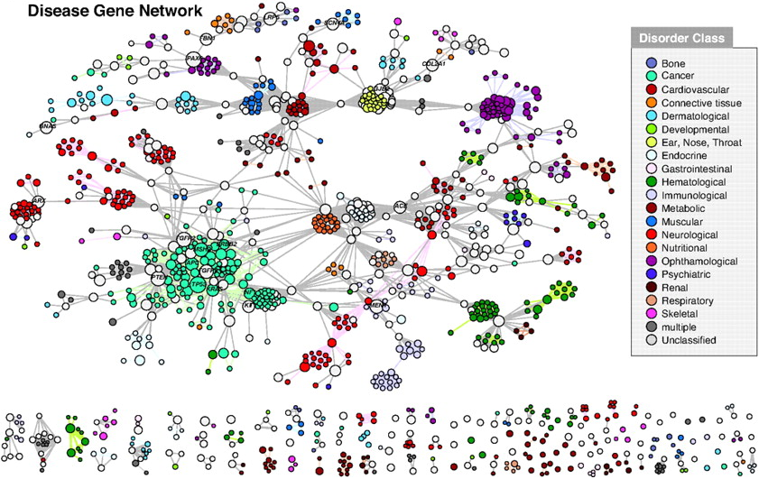
Goh KI, Cusick ME, Valle D, Childs B, Vidal M, Barabási AL.Proc Natl Acad Sci U S A. 2007 May 22;104(21):8685-90.
Genes have PPI and share pathways with known casual genes of the same or phenotypically similar disease.

Slide 28
A multilayer automated filtration and prioritization framework
Variants and/or genotypes called from sequencing data in variants formats
Exclude variants outside identity by descent (IBD) regions
Genetic level
Exclude variants conflicting with disease inheritance patterns/modes
Exclude common variants (e.g., MAF 0.001) in dbSNP, 1K Genome Project and other datasets
Exclude variants not affecting proteins
Variant-Gene level
Known disease genes
Exclude predicted non-disease variants
Disease names
Knowledge level
Explore variants whose genes have physical protein-protein interaction with candidate genes
Explore variants whose genes share the same biological pathways with candidate genes
Explore available literature in NCBI PubMed about genes/ideogram and interested diseases
Prioritized and annotated variants in an Excel or text file
Li MX, Gui HS, Kwan SH, Bao SY, Sham PC. A comprehensive framework for prioritizing variants in exome sequencing studies of Mendelian diseases. Nucleic Acids Research (Nucleic Acids Res. 2012 Apr 1;40(7):e53)

Slide 29

Automatically look up the relevant literature information in NCBI PubMed database (http://www.ncbi.nlm.nih.gov/pubmed) using gene symbol, ideogram location and the disease name(s) as keywords.
be very effective for finding causal variants (either novel or not) of a disease within known casual genes or published genetic linkage regions.

Slide 30
Testing of the framework for rare Mendelian diseases
Synthesized exomes with disease causal variants
6 HapMap subjects [NA12156 and NA12878 (Caucasian) NA18507 and NA19240 (African), NA18956 (Japanese) and NA18555 (Chinese)
A missense mutation (in heterozygote genotype) on MYH3 for Freeman-Sheldon syndrome (FS) (Ng, et al., 2009) (S_exome1 ~ S_exome6) ——— Dominant
A truncating mutation (in homozygote genotype) on SERPINF1 for Osteogenesis imperfect (OI) (Becker, et al.) S_exome7 ——— Recessive

Slide 31
--candi-list TNNI2,TNNT3,TPM2,MYBPC1
--pubmed-mesh Freeman-Sheldon+syndrome,Distal+arthrogryposis+type+2A,Distal+arthrogryposis+type+1A
Steps | S_exome1 | S_exome2 | S_exome3 | S_exome4 | S_exome5 | S_exome6 | S_exome7
 | SNV | SNV | SNV | SNV | SNV | SNV | SNV
Initial | 16120 | 15971 | 19721 | 19518 | 16012 | 16048 | 16048
Inheritance pattern¹ | 10180 (Dom) | 9929 (Dom) | 12897 (Dom) | 12867 (Dom) | 9133 (Dom) | 9182 (Dom) | 6867 (Rec)
Nonsynonymous² | 4705 | 4582 | 5837 | 5833 | 4171 | 4163 | 3089
Rare in dbSNP + 1000 Genome³ | 457 | 508 | 709 | 794 | 410 | 508 | 51
Predicted to be disease causal | 106 (90) | 127 (117) | 149(133) | 164 (152) | 95 (87) | 120 (107) | 2 (2)
Knowledge-related⁴ | 1 (1) | 7 (7) | 4 (4) | 6 (6) | 6 (5) | 1 (1) | —
PPI | 1 (1) | 2 (2) | 1 (1) | 1 (1) | 1 (1) | 1 (1) | —
Pathway | 1 (1) | 5 (5) | 2 (2) | 4 (4) | 2 (2) | 1 (1) | —
PubMed | 1 (1) | 3 (3) | 3 (3) | 4 (4) | 4 (3) | 1 (1) | —
Notes: 1, dominant mode only considered with variants with heterozygous genotypes and recessive mode only considered with variants with homozygous genotypes; 2, nonsynonymous includes missence, stopgain, stoploss and splicing SNVs and insertions/deletions causing frameshift, nonframeshift, stoploss, stopgain and splicing differences; 3,The rare variants referred to variants with MAF<0.01 in dbSNP and 1000 Genome. 4, knowledge-related variants/genes refer to those variants’ genes having PPI(s) or sharing pathway(s) with provided candidate gene(s), and those variants fell into region(s) or gene(s) which co-occurred in the titles or abstracts of papers in PubMed database.
Notes:
对于这个Ｍｅｎｄｅｌ常染色体显性疾病，经过一系列的过滤后，我们发现

Slide 33
Steps | S_exome1 | S_exome2 | S_exome3 | S_exome4 | S_exome5 | S_exome6 | S_exome7
 | SNV | SNV | SNV | SNV | SNV | SNV | SNV
Initial | 16120 | 15971 | 19721 | 19518 | 16012 | 16048 | 16048
Inheritance pattern¹ | 10180 (Dom) | 9929 (Dom) | 12897 (Dom) | 12867 (Dom) | 9133 (Dom) | 9182 (Dom) | 6867 (Rec)
Nonsynonymous² | 4705 | 4582 | 5837 | 5833 | 4171 | 4163 | 3089
Rare in dbSNP + 1000 Genome³ | 457 | 508 | 709 | 794 | 410 | 508 | 51
Predicted to be disease causal | 106 (90) | 127 (117) | 149( (133) | 164 (152) | 95 (87) | 120 (107) | 2 (2)
Knowledge-related⁴ | 1 (1) | 7 (7) | 4 (4) | 6 (6) | 6 (5) | 1 (1) | —
PPI | 1 (1) | 2 (2) | 1 (1) | 1 (1) | 1 (1) | 1 (1) | —
Pathway | 1 (1) | 5 (5) | 2 (2) | 4 (4) | 2 (2) | 1 (1) | —
PubMed | 1 (1) | 3 (3) | 3 (3) | 4 (4) | 4 (3) | 1 (1) | —
Notes: 1, dominant mode only considered with variants with heterozygous genotypes and recessive mode only considered with variants with homozygous genotypes; 2, nonsynonymous includes missence, stopgain, stoploss and splicing SNVs and insertions/deletions causing frameshift, nonframeshift, stoploss, stopgain and splicing differences; 3,The rare variants referred to variants with MAF<0.01 in dbSNP and 1000 Genome. 4, knowledge-related variants/genes refer to those variants’ genes having PPI(s) or sharing pathway(s) with provided candidate gene(s), and those variants fell into region(s) or gene(s) which co-occurred in the titles or abstracts of papers in PubMed database.

Slide 34
Chromosome | Position | ReferenceAlternativeAllele | GeneSymbol | GeneFeatures | GeneFeature | PhyloP_score | SIFT_score | Polyphen2_score | LRT_score | MutationTaster_score | PostProbLogit | IsDiseaseMutaLogitModel
17 | 1625154 | C/G | SERPINF1 | SERPINF1:NM_002615:exon6:c.C696G:p.Y232*&stopgain | stopgain | 0.935883 | 0.898747 | 0.725012 | 0.999983 | 1 | 0.385531259 | Y
9 | 95137568 | C/T | C9orf129 | C9orf129:NM_001098808:exon3:c.G274A:p.G92S&missense | missense | 0.980232 | 1 | 0.98 | 0.985903 | 0.77626 | 0.369606713 | Y

Slide 35

http://statgenpro.psychiatry.hku.hk/kggseq/index.php
KGGSeq
Genotypes
In VCF/Pileup format
Statistic summaries from Plink/Seq
A biological Knowledge-based mining system/platform for Genomic and Genetic studies using Sequence data
Public domain knowledge in databases
Users’ knowledge on diseases/traits
Pipelines on KGGSeq
Goal: Knowledge-based downstream analysis by integrating available diverse genomic data and statistical evidences to quantitatively and/or qualitatively prioritize rare/common variants derived from next generation sequencing data.
Prioritized and annotated variants

Slide 36
Internal applications
Mendelian diseases
  Spinocerebellar ataxias [Clin Genet. 2013 Mar;83(3):269-73]
  Hereditary Spastic Paraplegia
  Cardiomyopathy [Hum Mol Genet [In press]
  Atrial Standstill
  ….
Complex diseases
  Hepatitis B Virus infection [Hepatology. 2012 Nov;56(5):1661-70]
  Hirschsprung disease
  Schizophrenia
  Hepatocellular carcinoma
  …

Slide 37

The Bioinformatics and Statistical Framework for Genetic Mapping
Integrate Genotypes
Resources ─ IGG
Integrate functional
resources
for GWAS ─ KGG
Integrate functional
resources
for NGS─ KGGSeq
Li MX, Jiang L, Kao PYP, Sham PC, Song YQ. Bioinformatics. 2009;25(11):1449-50.
Li MX, Jiang L, Ho SL, Song YQ, Sham PC. Bioinformatics. 2007;23(22):3105-7.
Li MX*, Cheng TS*, Ho PWL, et al. (2008) J Peripher Nerv Syst. 2009;14(1):14-21.
Li MX, Gui HS, Kwan JS, Sham PC. Am J Hum Genet. 2011;88(3):283-293.
Li MX, Yeung JM, Cherny SS, Sham PC. Hum Genet. 2012; 131(5):747-56
Li MX, Sham PC, Cherny SS, Song YQ.(2010) PLoS One;5(12):e14480.
Li MX*, Kwan JS*, Sham PC. Am J Hum Genet. 2012;91(3):478-88
Li MX, Gui HS, Kwan JS, Bao SY, Sham PC. Nucleic Acids Res. 2012;40(7):e53.
Li MX, Pang S, Song Y, Kung M, Ho SL, Sham PC.Clin Genet. 2013 83(3):269-73.
Li MX*, Kwan JS, Sham PC. PLOS Genetics 2013; 9(1):e1003143
Statistical genetics
Local data
Bioinformatics
Public Resources
Integration makes power!!!
Notes:
Philosophy

