Slide 1
Mendelian Randomization: Genes as Instrumental Variables
David Evans

Slide 2
Some Criticisms of GWA Studies…
So you have a new GWAS hit for a disease… so what!?
You can’t change people’s genotypes (at least not yet)
You can however modify people’s environments…
Mendelian Randomization is a method of using genetics to inform us about associations in traditional observational epidemiology

Slide 3
RCTs are the Gold Standard in Inferring Causality
RANDOMISED CONTROLLED TRIAL
RANDOMISATION METHOD
EXPOSED:
INTERVENTION
CONTROL:
NO INTERVENTION
CONFOUNDERS EQUAL BETWEEN GROUPS
OUTCOMES COMPARED BETWEEN GROUPS

Slide 4
Observational Studies
RCTs are expensive and not always ethical or practically feasible
Association between environmental exposures and disease can be assessed by observational epidemiological studies like case-control studies or cohort studies
The interpretation of these studies in terms of causality is problematic

Slide 5
CHD risk according to duration of current Vitamin E
supplement use compared to no use
RR
Rimm et al NEJM 1993; 328: 1450-6

Slide 6
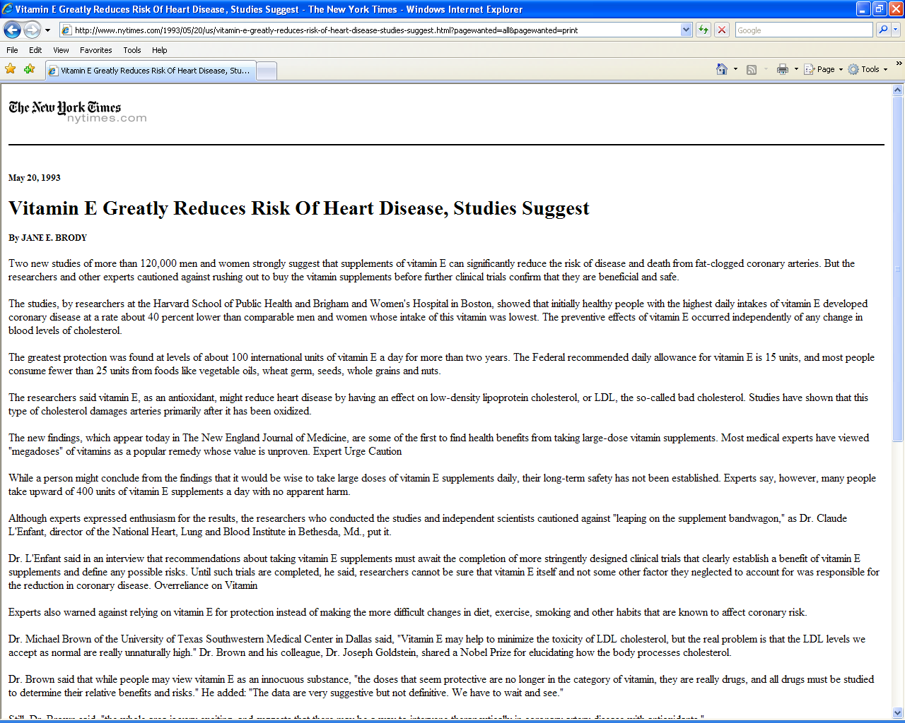

Slide 8
Use of vitamin supplements by US adults, 1987-2000
Percent
Source: Millen AE, Journal of American Dietetic Assoc 2004;104:942-950

Slide 9
Vitamin E levels and risk factors: Women’s Heart Health Study
Childhood SES
Manual social class
No car access
State pension only
Smoker
Daily alcohol
Exercise
Low fat diet
Obese
Height
Leg length
Lawlor et al, Lancet 2004

Slide 10
Vitamin E supplement use and risk of Coronary Heart Disease
1.0
Stampfer et al NEJM 1993; 328: 144-9; Rimm et al NEJM 1993; 328: 1450-6; Eidelman et al Arch Intern Med 2004; 164:1552-6

Slide 11
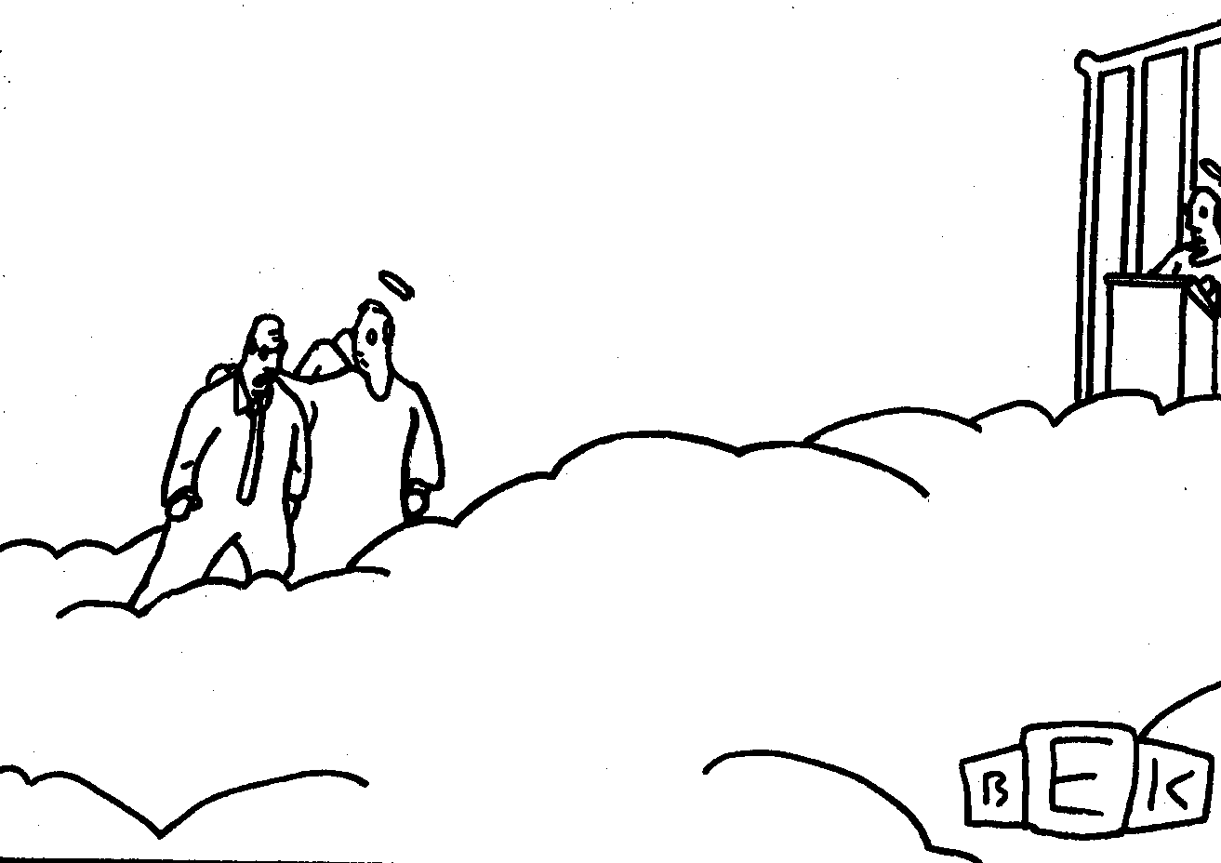
“Well, so much for antioxidants.”

Slide 12
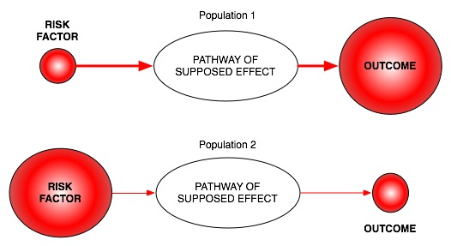
Classic limitations to “observational” science
Confounding
Reverse Causation
Bias

Slide 13
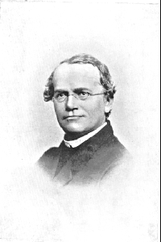
An Alternative to RCTs: Mendelian randomization
In genetic association studies the laws
of Mendelian genetics imply that
comparison of groups of individuals
defined by genotype should only differ
with respect to the locus under study
(and closely related loci in linkage
disequilibrium with the locus under study)
Genotypes can proxy for some modifiable
risk factors, and there should
be no confounding of genotype by
behavioural, socioeconomic or
physiological factors (excepting those
influenced by alleles at closely proximate
loci or due to population stratification)
Mendel in 1862

Slide 14
Mendelian randomisation and RCTs
MENDELIAN RANDOMISATION
RANDOMISED CONTROLLED TRIAL
RANDOM SEGREGATION OF ALLELES
RANDOMISATION METHOD
EXPOSED: FUNCTIONAL ALLELLES
CONTROL: NULL ALLELLES
EXPOSED:
INTERVENTION
CONTROL:
NO INTERVENTION
CONFOUNDERS EQUAL BETWEEN GROUPS
CONFOUNDERS EQUAL BETWEEN GROUPS
OUTCOMES COMPARED BETWEEN GROUPS
OUTCOMES COMPARED BETWEEN GROUPS

Slide 15
Assumptions of Mendelian randomisation analysis
U
Z
X
Y
Z associated with X
Z is independent of U
Z is independent of Y given U and X

Slide 16
Examples – using instruments for adiposity
U
Adiposity
Z
X
Y
FTO

Slide 17
Examples – using instruments for adiposity
U
Adiposity
Traits of metabolism
CRP/BMI
FTO

Slide 18
Do intermediate metabolic traits differ as one would expect
given a FTO-BMI effect?
Given the per allele FTO effect of ~0.1SD and known observational
Estimates one can derive an expected, per allele, effect on metabolic traits
Phenotype | Expected Change | Observed Change | Observed Change (BMI adjusted)
Fasting insulin | 0.038 (0.033, 0.043) | 0.039 (0.013,0.064) | -0.005 (-0.027, 0.018)
Fasting Glucose | 0.018 (0.014, 0.021) | 0.024 (0.001, 0.048) | 0.006 (-0.017, 0.029)
Fasting HDL | -0.026 (-0.029, -0.023) | -0.032 (-0.057, -0.008) | -0.004 (-0.027, 0.019)
…
N~12,000 samples of European ancestry

Slide 19
Examples – using instruments for adiposity
U
Adiposity
Traits of metabolism
CRP
FTO

Slide 20
CRP and BMI
C-Reactive Protein (CRP) is a biomarker of inflammation
It is associated with BMI, metabolic syndrome, CHD and a number of other diseases
It is unclear whether these observational relationships are causal or due to confounding or reverse causality
This question is important from the perspective of drug development

Slide 21
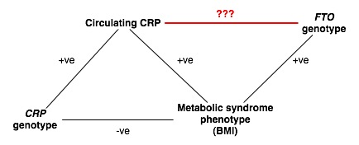
“Bi-directional Mendelian Randomization”
???

Slide 22
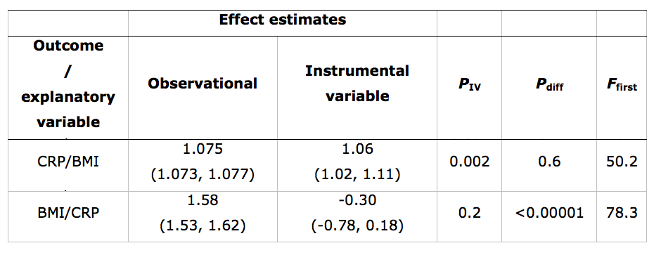
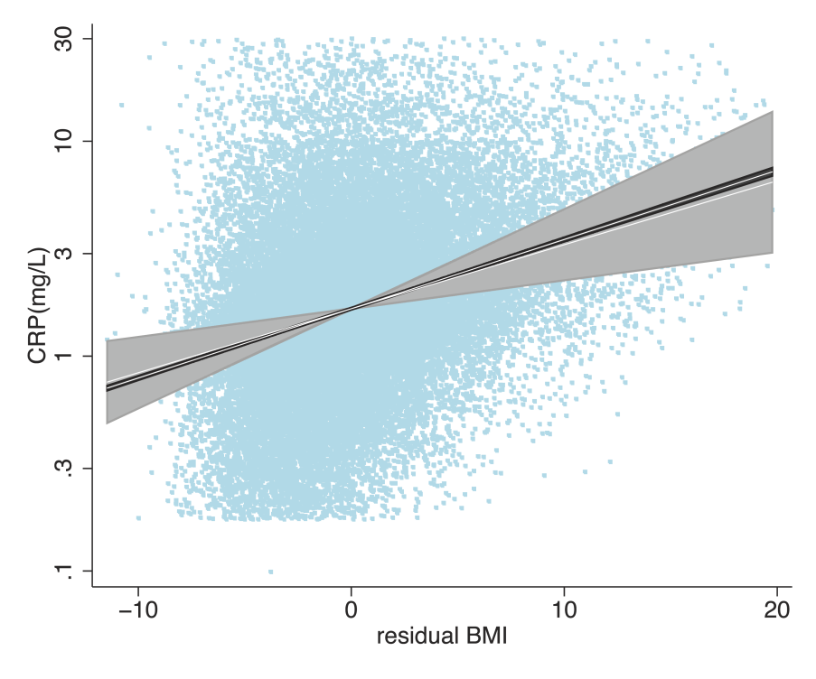
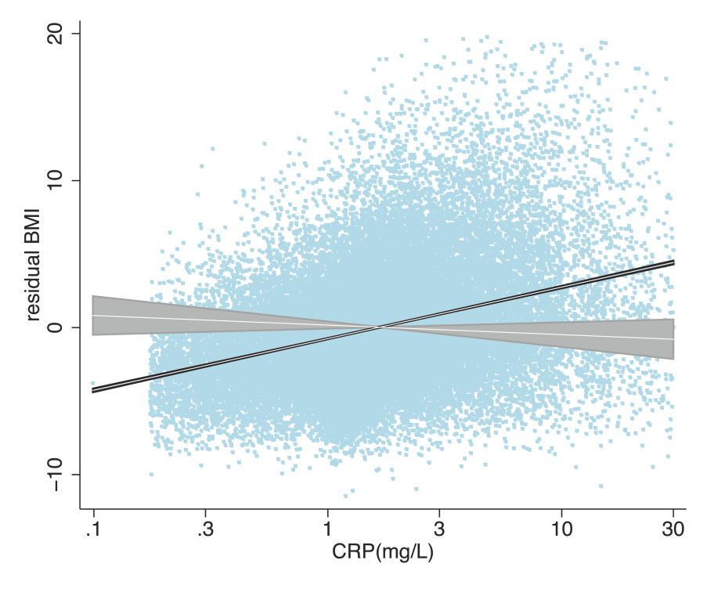

Slide 23
Limitations to Mendelian Randomisation
1- Pleiotropy
2- Population stratification
3- Canalisation
4- Power (also “weak instrument bias”)
5- The existence of instruments

Slide 24
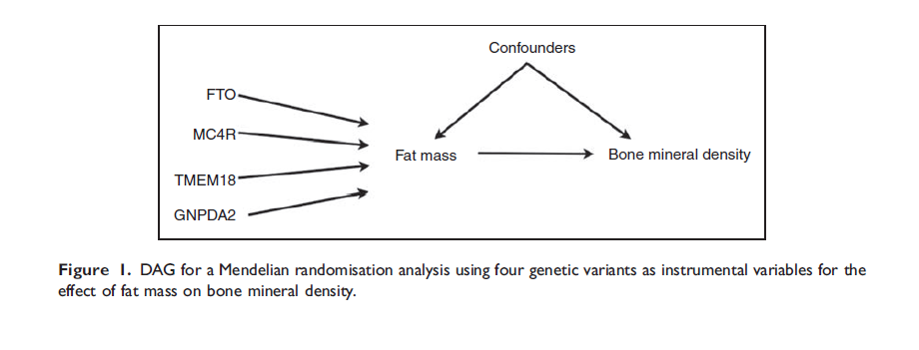
Using Multiple Genetic Variants as Instruments
Allelic scores
Palmer et al (2011) Stat Method Res
Testing multiple variants individually

Slide 25
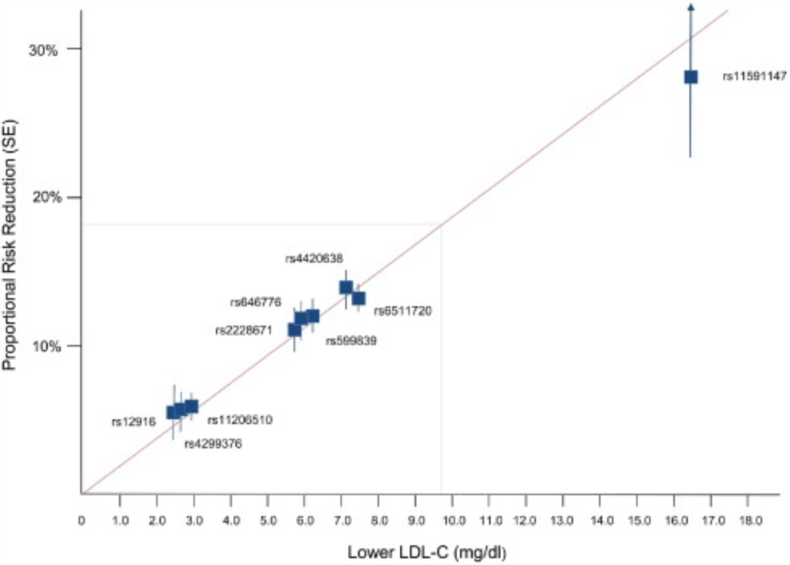
LDL and CHD Risk
Ference et al, JACC 2012

Slide 26
Informative Interactions

Slide 27
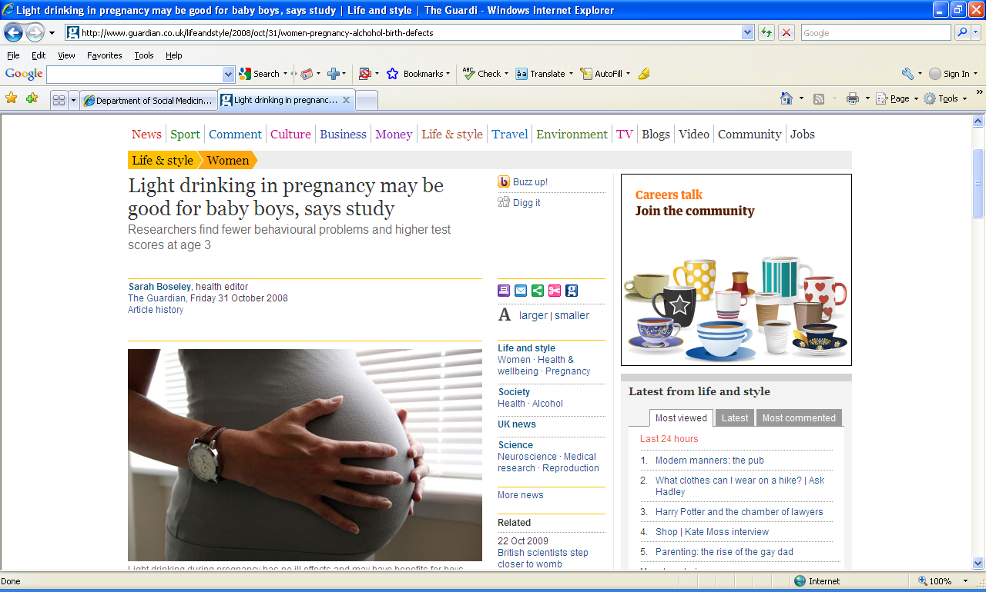

Slide 28
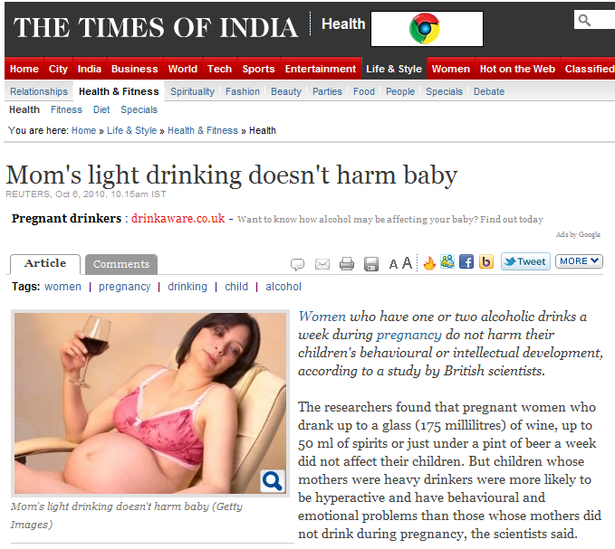

Slide 29
Kelly Y, Sacker A, Gray R et al. J Epidemiol Community Health (2010), doi:10.1136/jech.2009.103002

Slide 30
Kelly Y, Sacker A, Gray R et al. J Epidemiol Community Health (2010), doi:10.1136/jech.2009.103002

Slide 31
Kelly Y, Sacker A, Gray R et al. J Epidemiol Community Health (2010), doi:10.1136/jech.2009.103002

Slide 32
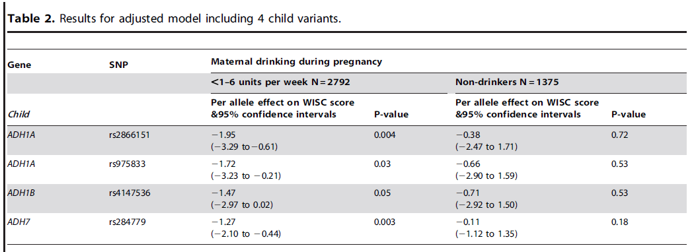

Slide 33
Alcohol dehydrogenase (ADH) risk allele score in offspring and offspring IQ, stratified by maternal alcohol intake during pregnancy
IQ Change
Women not drinking in pregnancy
All women
Women drinking during pregnancy
P value for interaction of risk allele score and drinking during pregnancy equals 0.009
Lewis S et al, PLoS One Nov 2012.

Slide 34
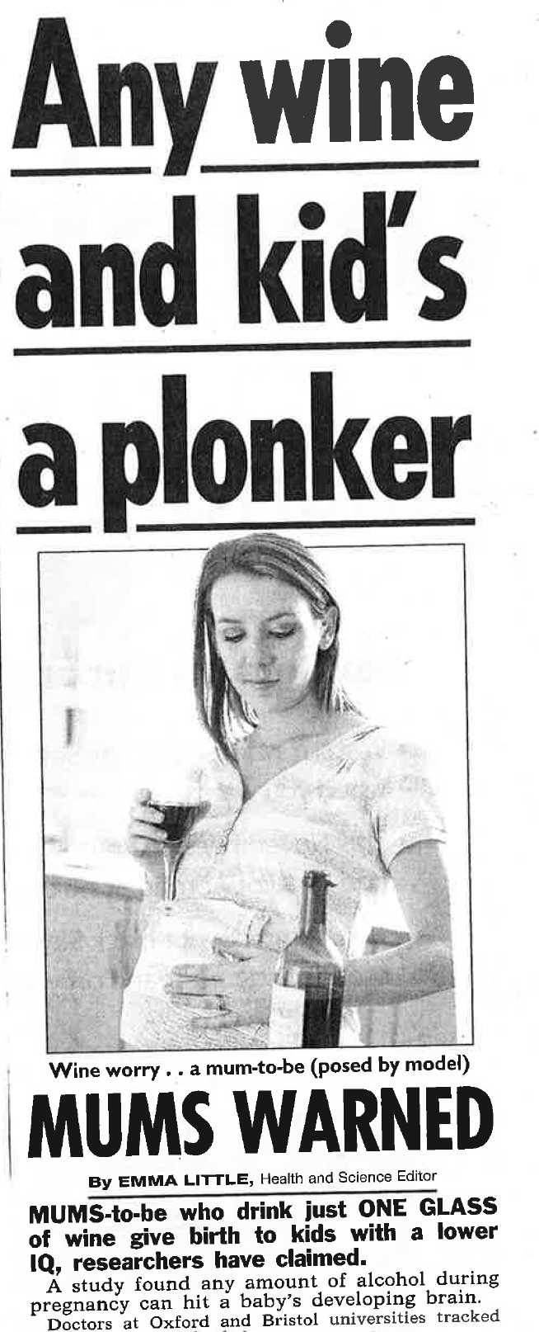

Slide 35
Fitting in R

Slide 36
Fitting in R - Datafile
BMI BMD BMI_SCORE BMD_SCORE
.371031158022524 .860471934 0.0554687 0.01974
-.77975167453452 .862923791 0.06125 0.03244
-.697738302042461 .86130172 0.0684375 0.038
...

Slide 37
Fitting in R
library(sem)
#Load BMI and BMD Data
x <- read.table(file="BMI_BMD_known.txt", header=TRUE, na.strings=-9)
#Observational regression of BMD on BMI
print("Observational regression of BMD on BMI")
summary(lm(x$BMD ~ x$BMI))
#Regression of BMI on BMI score – Check Instrument Strength
print("Regression of BMI on BMI score")
summary(lm(x$BMI ~ x$BMI_SCORE))
#Perform two stage least squares analysis
print("Two stage least squares analysis of BMD on BMI score")
summary(tsls(x$BMD ~ x$BMI, ~ x$BMI_SCORE))

Slide 38
Fitting in R
#Observational regression of BMI on BMD
print("Observational regression of BMI on BMD")
summary(lm(x$BMI ~ x$BMD))
#Regression of BMI on BMI score – Check Instrument Strength
print("Regression of BMI on BMI score")
summary(lm(x$BMI ~ x$BMI_SCORE))
#Perform two stage least squares analysis
print("Two stage least squares analysis of BMD on BMI score")
summary(tsls(x$BMD ~ x$BMI, ~ x$BMI_SCORE))
Notes:
Examples: HDL?; DRINKING DURING PREGNANCY

Slide 39
[1] "Observational regression of BMD on BMI"
Call:
lm(formula = x$BMD ~ x$BMI)
Coefficients:
Estimate Std. Error t value Pr(>|t|)
(Intercept) 0.9020479 0.0006254 1442.38 <2e-16 ***
x$BMI 0.0195233 0.0006458 30.23 <2e-16 ***
[1] "Regression of BMI on BMI score"
Call:
lm(formula = x$BMI ~ x$BMI_SCORE)
Coefficients:
Estimate Std. Error t value Pr(>|t|)
(Intercept) -1.30067 0.09708 -13.4 <2e-16 ***
x$BMI_SCORE 20.56254 1.53438 13.4 <2e-16 ***
Residual standard error: 0.9532 on 5552 degrees of freedom
Multiple R-squared: 0.03133, Adjusted R-squared: 0.03116
F-statistic: 179.6 on 1 and 5552 DF, p-value: < 2.2e-16

Slide 40
[1] "Observational regression of BMD on BMI"
Call:
lm(formula = x$BMD ~ x$BMI)
Coefficients:
Estimate Std. Error t value Pr(>|t|)
(Intercept) 0.9020479 0.0006254 1442.38 <2e-16 ***
x$BMI 0.0195233 0.0006458 30.23 <2e-16 ***
[1] "Two stage least squares analysis of BMD on BMI score"
2SLS Estimates
Model Formula: x$BMD ~ x$BMI
Instruments: ~x$BMI_SCORE
Estimate Std. Error t value Pr(>|t|)
(Intercept) 0.90199 0.0006302 1431.368 0.000e+00
x$BMI 0.01442 0.0036687 3.931 8.551e-05

Slide 41
[1] "Observational regression of BMI on BMD"
Call:
lm(formula = x$BMI ~ x$BMD)
Coefficients:
Estimate Std. Error t value Pr(>|t|)
(Intercept) -6.5402 0.2163 -30.24 <2e-16 ***
x$BMD 7.2398 0.2395 30.23 <2e-16 ***
[1] "Regression of BMD on BMD score"
Call:
lm(formula = x$BMD ~ x$BMD_SCORE)
Coefficients:
Estimate Std. Error t value Pr(>|t|)
(Intercept) 0.874212 0.003681 237.510 < 2e-16 ***
x$BMD_SCORE 0.848434 0.111170 7.632 2.71e-14 ***
Residual standard error: 0.05003 on 5552 degrees of freedom
Multiple R-squared: 0.01038, Adjusted R-squared: 0.0102
F-statistic: 58.25 on 1 and 5552 DF, p-value: 2.707e-14

Slide 42
[1] "Observational regression of BMI on BMD"
Call:
lm(formula = x$BMI ~ x$BMD)
Coefficients:
Estimate Std. Error t value Pr(>|t|)
(Intercept) -6.5402 0.2163 -30.24 <2e-16 ***
x$BMD 7.2398 0.2395 30.23 <2e-16 ***
[1] "Two stage least squares analysis of BMI on BMD score"
2SLS Estimates
Model Formula: x$BMI ~ x$BMD
Instruments: ~x$BMD_SCORE
Estimate Std. Error t value Pr(>|t|)
(Intercept) 0.1752 2.297 0.07626 0.9392
x$BMD -0.2065 2.547 -0.08108 0.9354

