Slide 1
METAL Practical
You have ran a GWA analysis yesterday (practical Jeff Barrett)
We will take the results file and a second results file to run a meta-analysis using METAL
Copy files from faculty/meike/2013/metal-practical to your own folder
Slides and prac based on B.Neale 2011

Slide 2
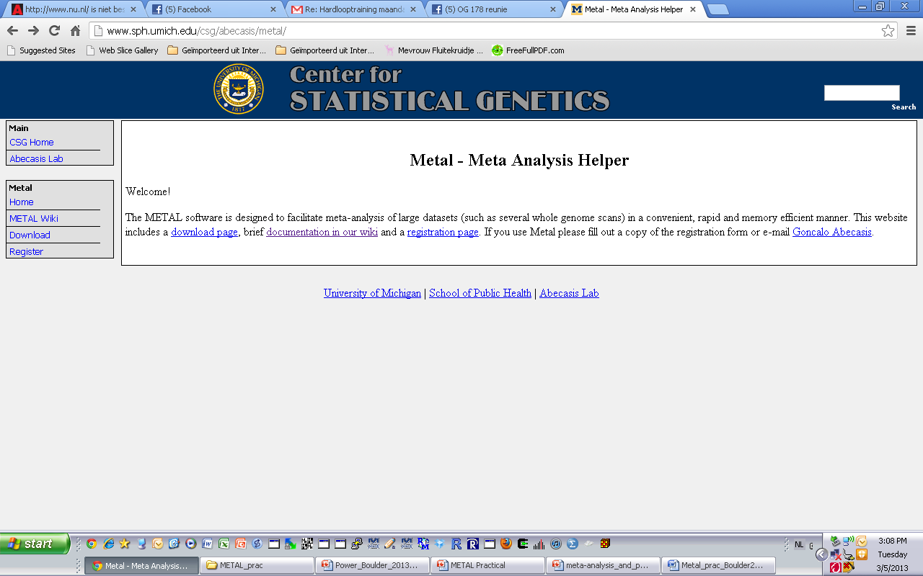
METAL
http://www.sph.umich.edu/csg/abecasis/metal/
Documentation can be found at the metal wiki:
http://genome.sph.umich.edu/wiki/Metal_Documentation

Slide 3
METAL
Metal is flexible
It can run fixed effects meta-analysis
Heterogeneity tests
Effect size, Sample Size, or Weighted meta-analysis

Slide 4
METAL
Requires results files
‘Driver’ file
Describes the input files
Defines meta-analysis strategy
Names output file

Slide 5
Steps
Check format of results files
Ensure all necessary columns are available
Modify files to include all information
Prepare driver file
Ensure headers match description
Crosscheck each results file matches Process name
Run metal

Slide 6
INPUT FILES
We will use yesterdays results (results1.txt)
We will use a second set of results (results2.txt)

Slide 7
Columns METAL uses
SNP
OR
SE [for standard error meta-analysis]
P-value [for Z-score meta-analysis]
If we had two samples of different sizes we would have to add an N/weight column

Slide 8
Meta-analysis running
We will run meta-analysis based on effect size and on test statistic
For the weights of test statistic, I’ve assumed that the sample sizes are the same
METAL defaults to weight of 1 when no weight column is supplied

Slide 9
Step 2: driver file: meta_run_file
# PERFORM META-ANALYSIS based on effect size and on test statistic
# Loading in the input files with results from the participating samples
# Note: Order of samples is …[sample size, alphabetic order,..]
# Phenotype is ..
# MB March 2013
MARKER SNP
ALLELE A1 A2
PVALUE P
EFFECT log(OR)
STDERR SE specifies column names
PROCESS results1.txt
PROCESS results2.txt processes two results files
OUTFILE meta_res_Z .txt Output file naming
ANALYZE Conducts Z-based meta-analysis from test statistic
CLEAR Clears workspace
SCHEME STDERR Changes meta-analysis scheme to beta + SE
PROCESS results1.txt
PROCESS results2.txt processes two results files
OUTFILE meta_res_SE .txt Output file naming
ANALYZE Conducts effect size meta-analysis

Slide 10
Larger Consortia
# PERFORM META-ANALYSIS on P-values
module load metal
metal << EOT
# Loading in the inputfiles with results from the participating samples
# Note: Order of samples is alpahabetic
# Phenotype is WB
# 1. AGES_HAP
MARKER SNPID
ALLELE coded_all noncoded_all
EFFECT Beta
PVALUE Pval
WEIGHT n_total
GENOMICCONTROL ON
COLUMNCOUNTING LENIENT
PROCESS AGES_HAP.txt
# 2. ALSPAC_HAP
MARKER SNPID
ALLELE coded_all noncoded_all
EFFECT Beta
PVALUE Pval
WEIGHT n_total
GENOMICCONTROL ON
COLUMNCOUNTING LENIENT
PROCESS ALSPAC_HAP.txt
AND SO ON (in this case 40 files)

Slide 11
Running metal
metal < metal_run_file
metal is the command
metal_run_file is the driver file
This will output information on the running of METAL things to standard out [the terminal]
It will spawn 4 files:
2 results files: meta_res_Z1.txt + meta_res_SE1.txt
2 info files: meta_res_Z1.txt.info + meta_res_SE1.txt.info

Slide 12
Output you’ll see
Overview of METAL commands
Any errors
And your best hit from meta-analysis

Slide 13
To load into Haploview
We have to change the header
In the same directory run:
./reformat.sh
This changes 1st column name to SNP
We can then load the meta-analysis results files into haploview
Same as before but load in the meta_res_Z1.txt
Make sure to include gwas-example.bim

Slide 14
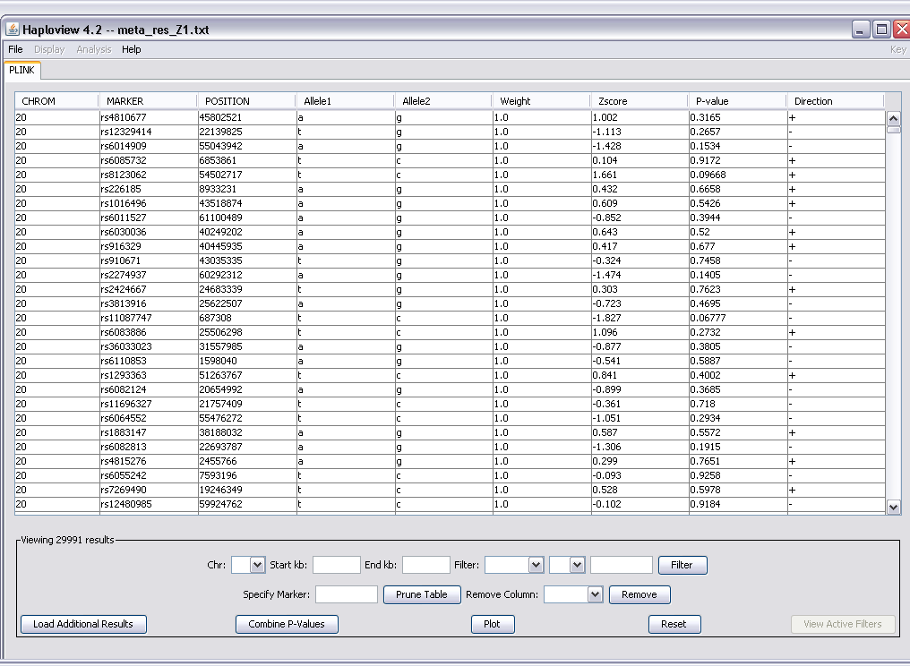

Slide 15
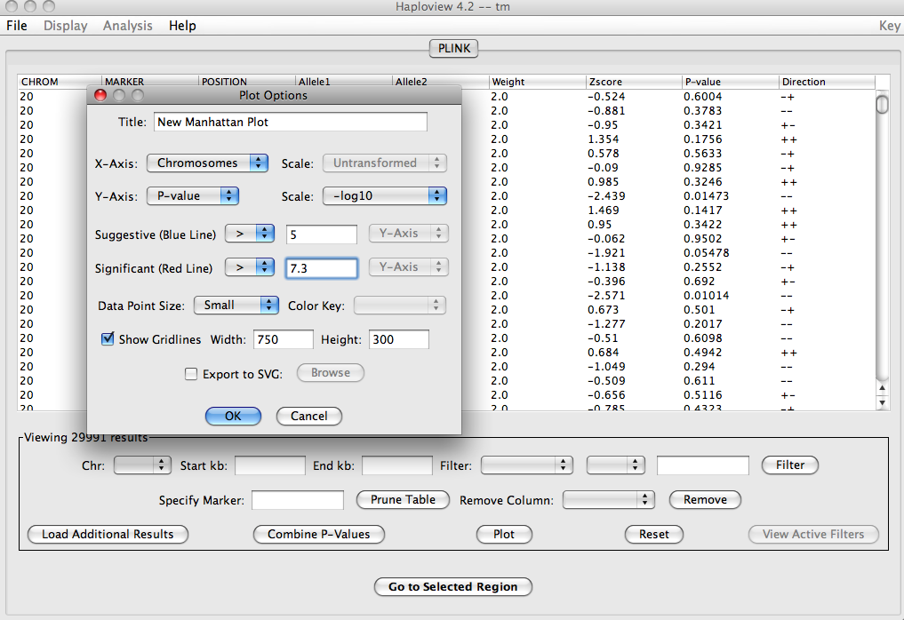
Plot

