Slide 1

Power and Sample Size
+
Principles of Simulation
Benjamin Neale
March 8th, 2012
International Twin Workshop, Boulder, CO

Slide 2
Slide of Questions
What is power?
What affects power?
How do we calculate power?
What is simulation?
Why do we simulate?
How do we simulate?

Slide 3
What is power?
Definitions of power
The probability that the test will reject the null hypothesis if the alternative hypothesis is true
The chance the your statistical test will yield a significant result when the effect you are testing exists

Slide 4
Key Concepts and Terms
Null Hypothesis
Alternative Hypothesis
Distribution of test statistics

Slide 5
Key Concepts and Terms
Null Hypothesis
  The baseline hypothesis, generally assumed to be the absence of the tested effect
Alternative Hypothesis
  The hypothesis for the presence of an effect
Distribution of test statistics
  The frequencies of the values of the tests statistics under the null and the alternative

Slide 6
Practical 1
We are going to simulate a normal distribution using R
We can do this with a single line of code, but let’s break it up

Slide 7
Simulation functions
R has functions for many distributions
Normal, χ², gamma, beta (others)
Let’s start by looking at the random normal function: rnorm()

Slide 8
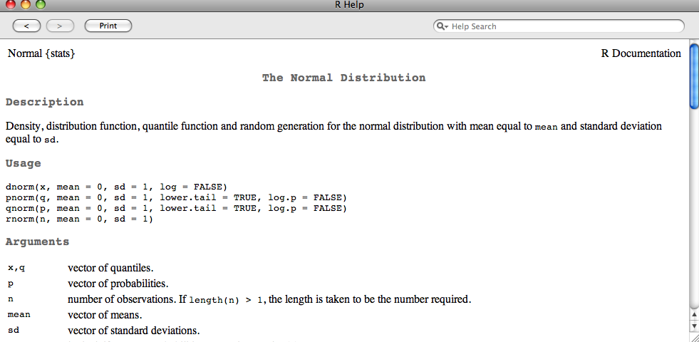
rnorm Documentation
In R: ?rnorm

Slide 9
rnorm syntax
rnorm(n, mean = 0, sd = 1)
Function name
Mean of distribution
with default value
Number of Observations to simulate
Standard deviation of distribution
with default value

Slide 10
R script: Norm_dist_sim.R
This script will plot 4 samples from the normal distribution
Look for changes in shape
Thoughts?

Slide 11
What did we learn?
You have to comment
The presentation will not continue without audience participation
  No this isn’t a game of chicken

Slide 12
One I made earlier

Slide 13
Concepts
Sampling variance
  We saw that the ‘normal’ distribution from 100 observations looks stranger than for 1,000,000 observations
Where else may this sampling variance happen?
How certain are we that we have created a good distribution?

Slide 14
Mean estimation
Rather than just simulating the normal distribution, let’s simulate what our estimate of a mean looks like as a function of sample size
We will run the R script mean_estimate_sim.R

Slide 15
R script: mean_estimate_sim.R
This script will plot 4 samples from the normal distribution
Look for changes in shape
Thoughts?

Slide 16
What did we learn?
You have to comment
The presentation will not continue without audience participation
  No this isn’t a game of chicken

Slide 17
One I made earlier

Slide 18
Standard Error
We see an inverse relationship between sample size and the variance of the estimate
This variability in the estimate can be calculated from theory
SE_{x} = s/√n
SE_{x} is the standard error, s is the sample standard deviation, and n is the sample size

Slide 19
Existential Crisis!
What does this variability mean?
Again—this is where you comment

Slide 20
Key Concept 1
The sampling variability in my estimate affects my ability to declare a parameter as significant (or significantly different)

Slide 21
Power definition again
The probability that the test will reject the null hypothesis if the alternative hypothesis is true

Slide 22
Hypothesis Testing
Mean different from 0 hypotheses:
  h_{o} (null hypothesis) is μ=0
  h_{a} (alternative hypothesis) is μ ≠ 0
    Two-sided test, where μ > 0 or μ < 0 are one-sided
Null hypothesis usually assumes no effect
Alternative hypothesis is the idea being tested

Slide 23
Possible scenarios
 | Reject H₀ | Fail to reject H₀
H₀ is true | α | 1-α
H_{a} is true | 1-β | β
α=type 1 error rate
β=type 2 error rate
1-β=statistical power

Slide 24
Statistical Analysis
Rejection of H₀
Non-rejection of H₀
Type I error
at rate α
Nonsignificant result
(1- α)
H₀ true
Truth
Significant result
(1-β)
Type II error
at rate β
H_{A} true

Slide 25
Expanded Power Definition
The probability of rejection of the null hypothesis depends on:
  The significance criterion (α)
  The sample size (N)
  The effect size (Δ)
The probability of detecting a given effect size in a population from a sample size, N, using a significance criterion, α.

Slide 26
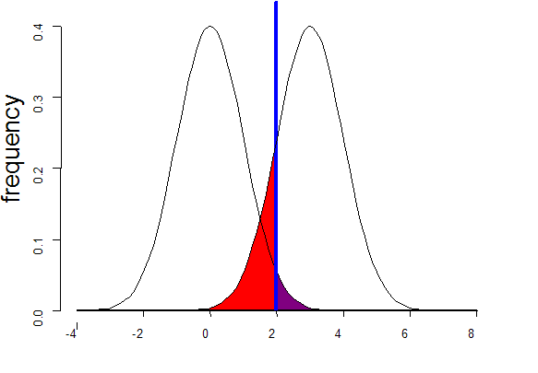
Standard Case
Sampling distribution if H₀ were true
Sampling distribution if H_{A} were true
alpha 0.05
POWER:
1 - β
β
α
T
Non-centrality parameter

Slide 27
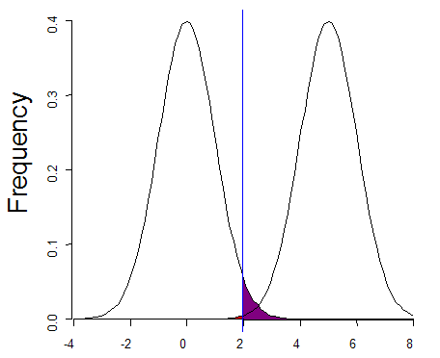
Increased effect size
Sampling distribution if H₀ were true
Sampling distribution if H_{A} were true
alpha 0.05
POWER:
1 - β ↑
β
α
T
Non-centrality parameter

Slide 28
Standard Case
Sampling distribution if H₀ were true
Sampling distribution if H_{A} were true
alpha 0.05
POWER:
1 - β
β
α
T
Non-centrality parameter

Slide 29
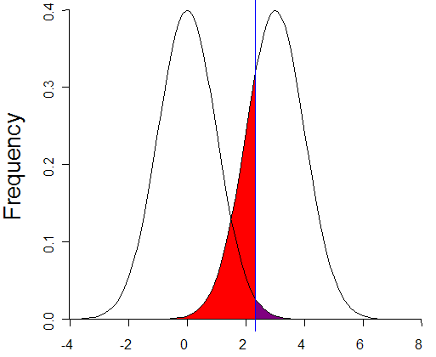
More conservative α
Sampling distribution if H₀ were true
Sampling distribution if H_{A} were true
alpha 0.01
POWER:
1 - β ↓
β
α
T
Non-centrality parameter

Slide 30
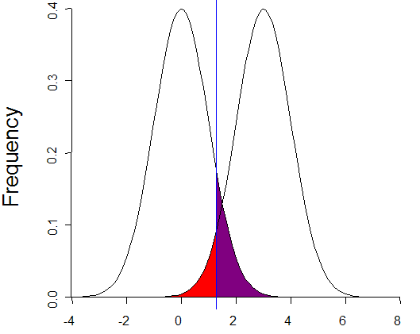
Less conservative α
Sampling distribution if H₀ were true
Sampling distribution if H_{A} were true
alpha 0.10
POWER:
1 - β ↑
β
α
T
Non-centrality parameter

Slide 31
Standard Case
Sampling distribution if H₀ were true
Sampling distribution if H_{A} were true
alpha 0.05
POWER:
1 - β
β
α
T
Non-centrality parameter

Slide 32
Increased sample size
Sampling distribution if H₀ were true
Sampling distribution if H_{A} were true
alpha 0.05
POWER:
1 - β ↑
β
α
T
Non-centrality parameter

Slide 33
Increased sample size
Sampling distribution if H₀ were true
Sampling distribution if H_{A} were true
alpha 0.05
POWER:
1 - β ↑
Sample size scales linearly with NCP
β
α
T
Non-centrality parameter

Slide 34
Additional Factors
Type of Data
  Continuous > Ordinal > Binary
  Do not turn “true” binary variables into continuous
Multivariate analysis
Remove confounders and biases
MZ:DZ ratio

Slide 35
Effects Recap
Larger effect sizes
  Reduce heterogeneity
Larger sample sizes
Change significance threshold
  False positives may become problematic

Slide 36
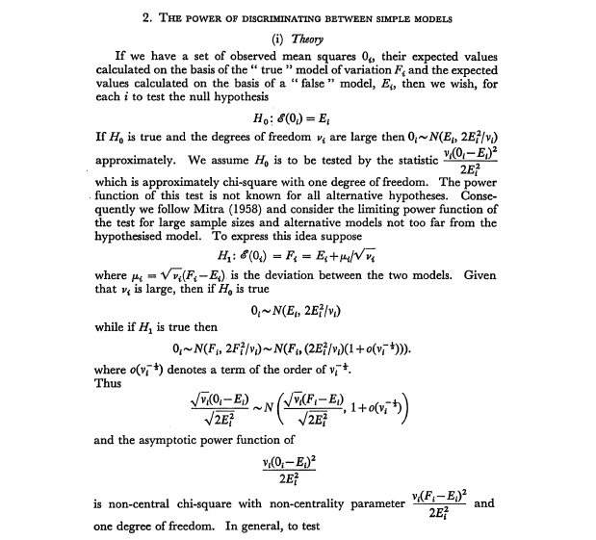
Power of Classical Twin Model

Slide 37
Power of Classical Twin Model
You can do this by hand
But machines can be much more fun
Martin, Eaves, Kearsey, and Davies Power of the Twin Study, Heredity, 1978

Slide 38
How can we determine our power to detect variance components?

Slide 39
A trio of scripts
We’ll run through three different scripts
power_approximation.R
  This lays out a theoretical consideration for correlations
test_C_sim.R
  Creates a function for running a simulated ACE model to drop C
run_C_sim.R
  This will run the function from test_C_sim.R

Slide 40
power_approximation.R
We’ll walk through the script to explore the core statistical concepts we discussed earlier
Most of the rest of this session will be done in R ☺.

Slide 41
Simulation is king
Just like we simulated estimates of means we can simulate chi squares from dropping C
We get to play God [well more than usual]
  We fix the means and variances as parameters to simulate
  We fit the model ACE model
  We drop C
  We generate our alternative sampling distribution of statistics

Slide 42
Script: test_C_sim.R
This script does not produce anything, but rather creates a function
I will walk through the script explaining the content
We will make this function and then run the function once to see what happens
Then we can generate a few more simulations (though I’m not super keen on the computation power of the machines)

Slide 43
Script: run_C_sim.R
Now we understand what the function is doing, we can run it many times
We are going to use sapply again
This time we will sapply the new function we made
In addition to generating our chis, we create an object of the chis to assess our power and see what our results look like

Slide 44
Principles of Simulation
“All models are wrong but some are useful”
--George Box
Simulation is useful for refining intuition
Helpful for grant writing
Calibrates need for sample size
Many factors affect power
  Ascertainment
  Measurement error
  Many others

Slide 45
Why R is great
Simulation is super easy in R
ClassicMx did not have such routines
We can evaluate our power easily using R as well
We can generate pictures of our power easily

Slide 46
Additional Online Resources
Genetic Power Calculator
  Good for genetic studies with genotype data
  Also includes a probability function calculator
  http://pngu.mgh.harvard.edu/~purcell/gpc/
Wiki has pretty good info on statistical power
  http://en.wikipedia.org/wiki/Statistical_power

Slide 47
Citations for power in twin modeling
Visscher PM, Gordon S, Neale MC., Power of the classical twin design revisited: II detection of common environmental variance. Twin Res Hum Genet. 2008 Feb;11(1):48-54.
Neale BM, Rijsdijk FV, Further considerations for power in sibling interactions models. Behav Genet. 2005 Sep 35(5):671-4
Visscher PM., Power of the classical twin design revisited., Twin Res. 2004 Oct;7(5):505-12.
Rietveld MJ, Posthuma D, Dolan CV, Boomsma DI, ADHD: sibling interaction or dominance: an evaluation of statistical power. Behav Genet. 2003 May 33(3): 247-55
Posthuma D, Boomsma DI., A note on the statistical power in extended twin designs. Behav Genet. 2000 Mar;30(2):147-58.
Neale MC, Eaves LJ, Kendler KS. The power of the classical twin study to resolve variation in threshold traits. Behav Genet. 1994 May;24(3):239-58.
Nance WE, Neale MC., Partitioned twin analysis: a power study. Behav Genet. 1989 Jan;19(1):143-50.
Martin NG, Eaves LJ, Kearsey MJ, Davies P., The power of the classical twin study. Heredity. 1978 Feb;40(1):97-116.

