Slide 1
More on thresholds
Sarah Medland

Slide 2
A plug for OpenMx?
Very few packages can handle ordinal data adequately…
OpenMx can also be used for more than just genetic analyses
  Regression
  Polycohoric correlations
  Factor analysis...

Slide 3
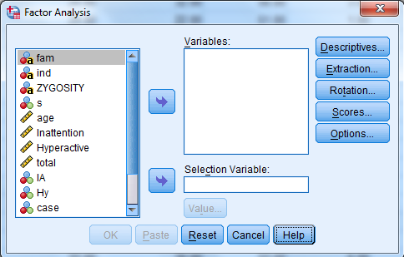
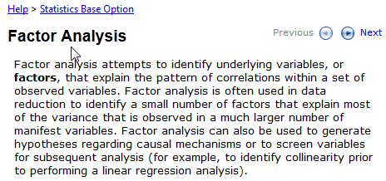
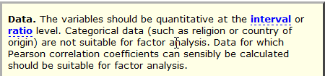

Slide 4
Two approaches to the liability threshold model
Problem
  Ordinal data has 1 less degree of freedom
    MZcov, DZcov, Prevalence
    No information on the variance
  Thinking about our ACE/ADE model
    4 parameters being estimated
    A C E mean
  ACE/ADE model is unidentified without adding a constraint

Slide 5
Two approaches to the liability threshold model
Solution?
Traditional
  Maps data to a standard normal distribution
  Total variance constrained to be 1
Alternate
  Fixes an alternate parameter (usually E)
  Estimates the remaining parameters

Slide 6
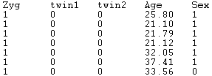
Traditional Approach
Imagine we have a set of binary data
Trait – lifetime cannabis use
  Never Smoked/Ever Smoked

Slide 7
Twin 1 cannabis use
0 = never used

Slide 8
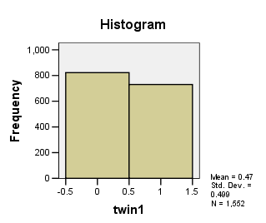
Twin 1 cannabis use

Slide 9
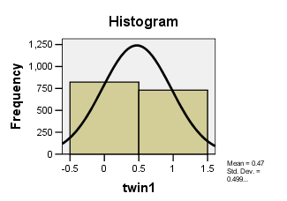
Twin 1 cannabis use
Liability or ‘risk’ of initiation distribution
Just because an individual has never used cannabis does not mean their ‘risk’ of initiation is zero

Slide 10
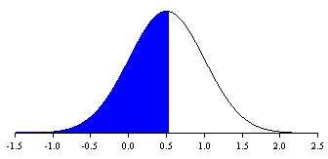
Mean = .47
SD =.499
Non Smokers =53%
The observed phenotype is an imperfect measurement of an underlying continuous distribution
ie Obesity vs BMI
MDD vs quantitative depression scales

Slide 11
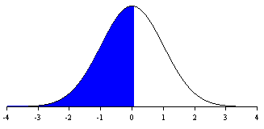
Raw data distribution
Mean = .47
SD =.499
Non Smokers =53%
Threshold =.53
Standard normal distribution
Mean = 0
SD =1
Non Smokers =53%
Threshold =.074

Slide 12
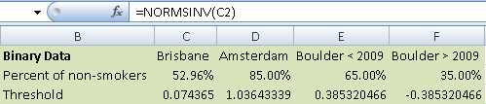
Threshold = .074 – Huh what?
How can I work this out
  Excell
    =NORMSINV()
    Thresholds.xls

Slide 13
Why rescale the data this way?
Convenience
  Variance always 1
  Mean is always 0
  We can interpret the area under a curve between two z-values as a probability or percentage

Slide 14
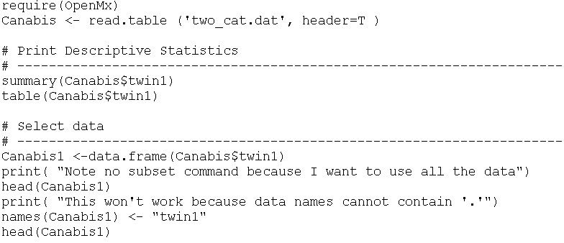
Threshold.R

Slide 15
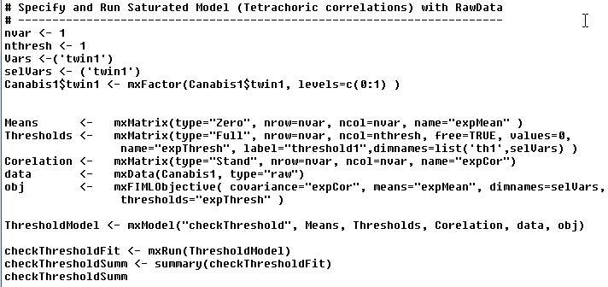
Threshold.R

Slide 16

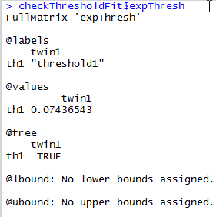
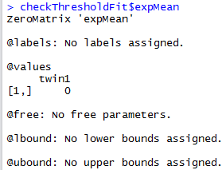
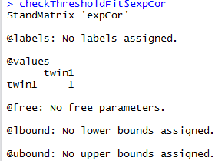
Threshold = .075 – Huh what?

Slide 17
What about more than 2 categories?
Very similar
  We create a matrix containing the 1st threshold and the displacements between subsequent matrices
  We then add the 1st threshold and the displacement to obtain the subsequent thresholds

Slide 18

Mx Threshold Specification: 3+ Cat.
Threshold matrix: T Full 2 2 Free
Twin 1 Twin 2
2.2
-3
-1
0
1.2
3
1st threshold
increment

Slide 19
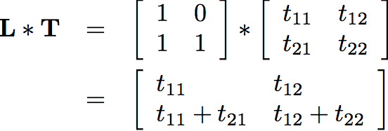
Mx Threshold Specification: 3+ Cat.
Threshold matrix: T Full 2 2 Free
Twin 1 Twin 2
2.2
-3
-1
0
1.2
3
1st threshold
increment
MxAlgebra L%*%T

Slide 20
Mx Threshold Specification: 3+ Cat.
Threshold matrix: T Full 2 2 Free
Twin 1 Twin 2
2.2
-3
-1
0
1.2
3
1st threshold
increment
MxAlgebra L%*%T
2nd threshold

Slide 21
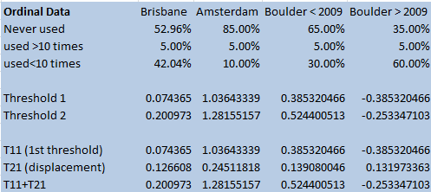
Check the xls spreadsheet…

Slide 22
Two approaches to the liability threshold model
Solution?
Traditional
  Maps data to a standard normal distribution
  Total variance constrained to be 1
Alternate
  Fixes an alternate parameter
    Binary or Ordinal data fix E
    Ordinal data fix 1st two thresholds (aka invariant threshold approach)
  Estimate the remaining parameters

Slide 23
Models are equivalent, but…
Alternate approach means the data is no longer mapped to a standard normal
No easy conversion to %
Makes it difficult to compare between groups as the scaling is now arbitrary

Slide 24
We are going to run traditional and FixedE ACE models with binary data
  twinAceBin-Traditional.R
  twinAceBin-FixE.R
There is are scripts in the folder that have multiple threshold models in them – take a look later
  twinAceOrd-Traditional.R
  twinAceOrd-FixE.R
  twinAceOrd-FixThresholds.R

Slide 25
Lisbon Castle

