Slide 1
Re-introduction to openMx
Sarah Medland

Slide 2
Starting at the beginning…
Data preparation
The algebra style used in Mx expects 1 line per case/family
(Almost) limitless number of families and variables
Data needs to be read into R before it can be analysed
(the commands to read the data can be nested within the R script)
Default missing code is now NA

Slide 3
Getting your data into R
Example data:ozbmi2.txt
data<-read.table("ozbmi2.txt", header=T, na.strings = "NA")
head(data)

Slide 4
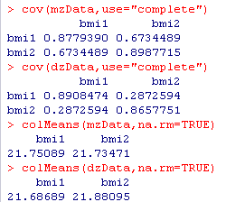
Selecting and sub-setting data
Make separate data sets for the MZ and DZ
Check data is
numeric and behaves
as expected

Slide 5
Common problem
Problem: data contains a non numeric value
Equivalent Mx Classic error - Uh-oh... I'm having trouble reading a number in D or E format

Slide 6
Important structural stuff
openMx has a very fluid and flexible stucture
Each code snippet is being saved as a variable
We tend to reuse the variable names in our scripts
This makes it very important to create a new project for each series of analyses
Remember the project also contains the data so these files can become very large.

Slide 7
Matrices are the building blocks
Many types eg. type="Lower"
Denoted by names eg. name="a“
Size eg. nrow=nv, ncol=nv
All estimated parameters must be placed in a matrix & Mx must be told what type of matrix it is
mxMatrix( type="Lower", nrow=nv, ncol=nv, free=TRUE, values=.6, label="a11", name="a" ), #X

Slide 8
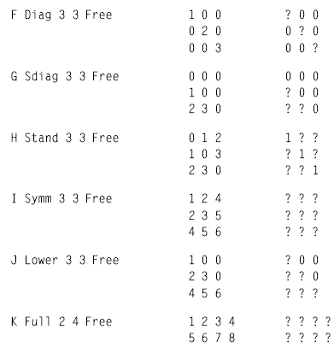
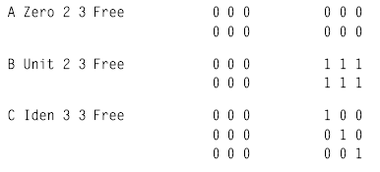
Matrices are the building blocks
mxMatrix( type=“Diag", nrow=3, ncol=3, free=TRUE, name="a" )
mxMatrix( type=“Sdiag", nrow=3, ncol=3, free=TRUE, name="a" )
mxMatrix( type=“Stand", nrow=3, ncol=3, free=TRUE, name="a" )
mxMatrix( type=“Symm", nrow=3, ncol=3, free=TRUE, name="a" )
mxMatrix( type=“Lower", nrow=3, ncol=3, free=TRUE, name="a" )
mxMatrix( type=“Full", nrow=2, ncol=4, free=TRUE, name="a" )
Many types
mxMatrix( type=“Zero", nrow=2, ncol=3, name="a" )
mxMatrix( type=“Unit", nrow=2, ncol=3, name="a" )
mxMatrix( type=“Ident", nrow=3, ncol=3, name="a" )

Slide 9
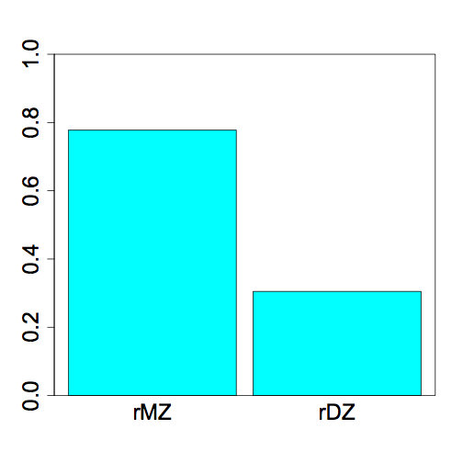
Yesterday we ran an ADE Model
Why?
0.78
0.30

Slide 10
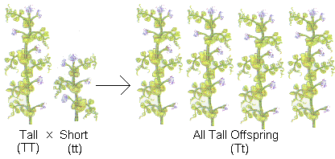
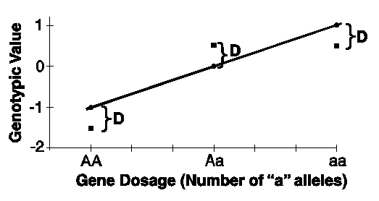
What is D again?
Dominance refers to non-additive genetic effects resulting from interactions between alleles at the same locus or different loci (epistasis)

Slide 11
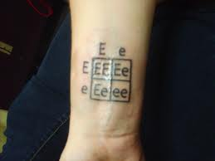
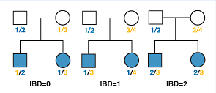
What is D again?
DZ twins/full siblings share
~50% of their segregating DNA &
for ~25% loci they share not only the genotype but also the parental origin of each allele

Slide 12
DZ twins/full siblings share
~50% of their segregating DNA &
for ~25% loci they share not only the genotype but also the parental origin of each allele
This is where the .5A comes from
Consider a mating between mother AB x father CD:
Sib2 | Sib1
 |  | AC | AD | BC | BD
 | AC | 2 | 1 | 1 | 0
 | AD | 1 | 2 | 0 | 1
 | BC | 1 | 0 | 2 | 1
 | BD | 0 | 1 | 1 | 2
This is where the .25D comes from
IBD 0 : 1 : 2 = 25% : 50% : 25%

Slide 13
Today we will run an ACE model
1
1/.5
E
C
A
A
C
E
1
1
1
1
1
1
e
c
a
a
c
e
Twin 1
Twin 2
MZ DZ
a²+c²+e² | a²+c²
a²+c² | a²+c²+e²
a²+c²+e² | .5a²+c²
.5a²+c² | a²+c²+e²

Slide 14
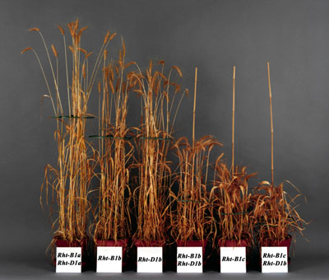
Today we will run an ACE model
Additive genetic effects
Why is the coefficient for DZ pairs .5?
Average genetic sharing between siblings/DZ twins
Sib2 | Sib1
 |  | AC | AD | BC | BD
 | AC | 2 | 1 | 1 | 0
 | AD | 1 | 2 | 0 | 1
 | BC | 1 | 0 | 2 | 1
 | BD | 0 | 1 | 1 | 2
MZ DZ
a²+c²+e² | a²+c²
a²+c² | a²+c²+e²
a²+c²+e² | .5a²+c²
.5a²+c² | a²+c²+e²

Slide 15
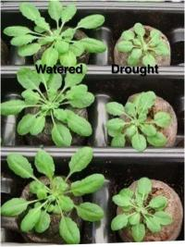
Today we will run an ACE model
Common environmental effects
Coefficient =1 for MZ and DZ pairs
Equal environment assumption – for all the environmental influences THAT MATTER there is ON AVERAGE no differences in the degree of environmental sharing between MZ and DZ pairs
MZ DZ
a²+c²+e² | a²+c²
a²+c² | a²+c²+e²
a²+c²+e² | .5a²+c²
.5a²+c² | a²+c²+e²

Slide 16
Today we will run an ACE model
Open RStudio
faculty/sarah/tues_morning
Copy everything

Slide 17
Today we will run an ACE model
1
1/.5
E
C
A
A
C
E
1
1
1
1
1
1
e
c
a
a
c
e
Twin 1
Twin 2

Slide 18
Today we will run an ACE model
MZ DZ
a²+c²+e² | a²+c²
a²+c² | a²+c²+e²
a²+c²+e² | .5a²+c²
.5a²+c² | a²+c²+e²

Slide 19
To fit a model to data, the differences between the observed covariance matrix and model-implied expected covariance matrix are minimized.
Objective functions are functions for which free parameter values are chosen such that the value of the objective function is minimized.
mxFIMLObjective() uses full-information maximum likelihood to provide maximum likelihood estimates of free parameters in the algebra defined by the covariance and means arguments.

Slide 20
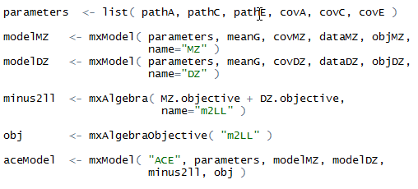
Automatic naming – you don’t need to predefine this
This models requires path parameters, means, covariance, data and objectives

Slide 21
Submodels
Pickup the previously prepared model
Edit as required
Rerun and compare

Slide 22
Saving your output
Save the R workspace
On closing click yes
Very big
Saves everything
Save the fitted model
Equivalent to save in classic Mx
save(univACEFit, file="test.omxs")
load("test.omxs") – need to load OpenMx first

Slide 23
What to report
Summary statistics
Usually from a simplified ‘saturated’ model
Standardized estimates
Easier to conceptualise
ie 40% of the phenotypic variance vs a genetic effect of 2.84
Can easily be returned to original scale if summary statistics are provided

Slide 24
What to report
Path coefficients
Very important in multivariate analyses
Gives a much clearer picture of the directionality of effects
Variance components/proportion of variance explained
Genetic correlations

Slide 25
General Advice/Problem solving
Scripting styles differ
Check the sample description
Learn to love the webpage
Comments are your friends

Slide 26
Bus shelter on the road to Sintra (Portugal)

