Slide 1


Including covariates in your model
Sarah Medland

Slide 2

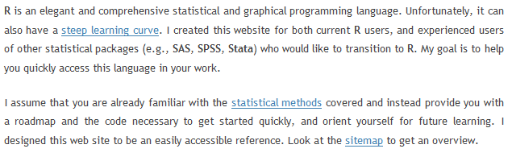
Before I forget…
http://www.statmethods.net/

Slide 3
The approach up till now…
Account for sex by using different means matrices for males and females
Ignore other covariates
This is a very bad idea…
  Be guided by the literature Age, Sex, Age², SES, birthweight…

Slide 4
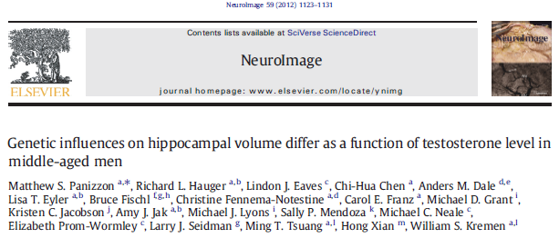
Can you include a covariate that is in itself influenced by genes?
Eg correcting for total brain size when estimating the heritability of specific brain regions
Depends on your research question
  Is it a moderator or a confounder

Slide 5
Accounting or correcting for a covariate
Most common method
  Add a correction in the form of a linear regression to the mean
  If the covariate is binary code it as 0 vs 1
expMean = intercept + β*covariate
Coded 0/1
Mean for the group coded 0
Unstandarised regression B/ the devition of group 1 from group 0

Slide 6
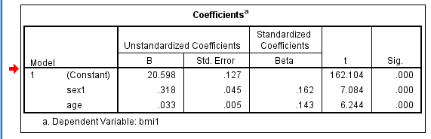
Coded 0/1
  expMean = intercept + β*covariate
Mean for the group coded 0
Unstandarised regression B/ the devition of group 1 from group 0

Slide 7
Setting this up in openMx…
  intercept <- mxMatrix( type="Full", nrow=1, ncol=ntv, free=TRUE,
  values= 20, label="mean", name="Mean" )
  # Matrix for moderating/interacting variable
  defSex <- mxMatrix( type="Full", nrow=1, ncol=2, free=FALSE,
  labels=c("data.sex1","data.sex2"), name="Sex")
  # Matrices declared to store linear Coefficients for covariate
  B_Sex <- mxMatrix( type="Full", nrow=1, ncol=1, free=TRUE,
  values= .01, label="betaSex", name="bSex" )
  meanSex <- mxAlgebra( bSex%*%Sex, name="SexR")
  expMean <- mxAlgebra( Mean + SexR + AgeR, name="expMean")
  defs <- list( intercept, defSex, B_Sex, meanSex)

Slide 8

Setting this up in openMx…
  intercept <- mxMatrix( type="Full", nrow=1, ncol=ntv, free=TRUE, values= 20, label="mean", name="Mean" )
    1*2 matrix
    Containing 2 elements
  $$\left[\begin{matrix}mean & mean\end{matrix}\right]$$
    Start value =20
  $$\left[\begin{matrix}20 & 20\end{matrix}\right]$$

Slide 9

Setting this up in openMx…
  # Matrix for moderating/interacting variable
  defSex <- mxMatrix( type="Full", nrow=1, ncol=2, free=FALSE, labels=c("data.sex1","data.sex2"), name="Sex")
    1*2 matrix
    Containing 2 elements – the values of sex1 and sex2
  $$\left[\begin{matrix}sex1 & sex2\end{matrix}\right]$$
    This matrix is repopulated for each family with the actual values of sex1 and sex2
  $$\left[\begin{matrix}sex1 & sex2\end{matrix}\right]$$

Slide 10

Setting this up in openMx…
  B_Sex <- mxMatrix( type="Full", nrow=1, ncol=1, free=TRUE, values= .01, label="betaSex", name="bSex" )
    1*1 matrix
    Containing 1 element – the unstandardise regression beta for sex on bmi
  $$\left[B_{sex}\right]$$
    This element will be estimated and has a start value of .01
  $$\left[.01\right]$$

Slide 11

Setting this up in openMx…
  meanSex <- mxAlgebra( bSex%*%Sex, name="SexR")
  $\left[B_{sex}\right]$*$\left[\begin{matrix}sex1 & sex2\end{matrix}\right]$ =$\left[\begin{matrix}B_{sex}.sex1 & B_{sex}.sex2\end{matrix}\right]$
  expMean <- mxAlgebra( Mean + SexR + AgeR, name="expMean")
  $$\left[\begin{matrix}mean & mean\end{matrix}\right]+\left[\begin{matrix}B_{sex}.sex1 & B_{sex}.sex2\end{matrix}\right]$$
  =$\left[\begin{matrix}{mean+B}_{sex}.sex1 & {mean+B}_{sex}.sex2\end{matrix}\right]$
  Eg:
  =$\left[\begin{matrix}{20+(.5∗0)}_{} & 20+(.5∗1)\end{matrix}\right]$
  =$\left[\begin{matrix}{20}_{} & 20.5\end{matrix}\right]$

Slide 12
Lets give it a go…
  twinACE.R
  twinACECovSex.R
  Does it make a difference to the fit?
  3. twinACECovSexAge.R
  Lets build a script together?

