Slide 1
Getting the most out of the workshop
Ask questions!!!
Don’t sit next to someone you already know
Work with someone with a different skillset and different experience level
Use the workshop laptop
You will have access to your files after you leave
Come to the social functions
Ask questions!!!

Slide 2
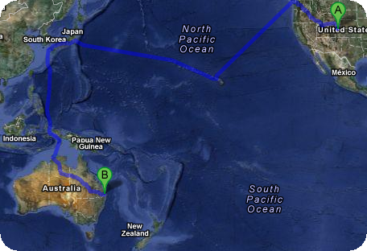
A first look at the operating system and R-studio…
Sarah Medland

Slide 3
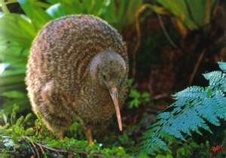
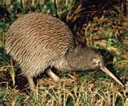
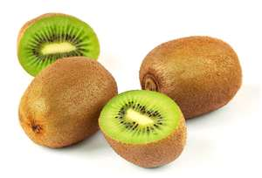
not

Slide 4
Morning sessions
Optional
Feel free to wander in and out/check email etc
Topics
Shift in response to feedback
Tomorrow: OpenMx code and concepts, assumption testing and univariate modeling

Slide 5
This year’s OS
Debian (linux)
Free
Many free software packages available
Open office
R
PSPP
Terminal
Based on Unix
long and venerable history
http://en.wikipedia.org/wiki/Unix

Slide 6
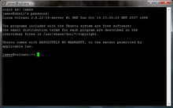
Close but not the same…
Most basic shortcuts will work
crtl+C for copy crtl+V for paste etc
Supports folder based navigation
/\ BIG PROBLEM is \ vs /
You will have used some version of unix previously

Slide 7
File hygiene is very important
Files are stored in Unix format not DOS or Mac
Changes the line ending characters
Use dos2unix, unix2dos, mac2unix, unix2mac to change formats
Can use the file command to check format
Unix systems are case sensitive!
NO SPACES in your file/directory names!!
Wildcards ie dos2unix *.dat

Slide 8
Working in the terminal
Input …. Output
Input
Most commands don’t need input signifiers
< can be used to specify
Output
Without specifying most output will print to the screen
> can be used to direct
type: echo ‘this is a dummy file’
echo ‘this is a dummy file’ > dummy.txt
| (pipe) | more pauses the output after a screen worth of text has appeared hit the space bar to get the next screens worth

Slide 9
The manual
The man command can be used in conjunction with other commands to put up some basic instructions
type: man ls
ls is the list command it pulls up a list of the files in the directory
Also many many helpful webpages w examples

Slide 10
Permissions the ability to read, write and execute files
type: ls –l
These are the permissions
1st a directory flag (d or -)
then 3 letters to define the owners permissions
3 letters to define the groups permissions
3 letters to define the everyone else's permissions

Slide 11
Permissions the ability to read, write and execute files
read access
write access
execute
to ‘run’ script or a program the file must be made executable

Slide 12
Permissions the ability to read, write and execute files
To change the mode/permissions use chmod
a number of ways to do this
type: echo “this is a test” > dummy.txt
ls –l
chmod +x dummy.txt
ls –l
chmod -x dummy.txt
ls –l
what happened?

Slide 13
Useful ‘one liners’
cp copy
mv move = rename
rm remove
ls list
echo
head looks at the top 10 lines
tail looks at the last 10 lines
wc counts number of lines, words, characters
sed find and replace
grep find and report
awk restructure files

Slide 14
Grep
search globally for lines matching the regular expression, and print them
For association output for chromosome 2
To extract the result for snp rs59831
Type: grep ‘rs59831’ output.txt > summary.txt

Slide 15
Grep
Useful flags
-v
reverse grep select line that does not have the pattern
-C x
To x rows before and after the target
-n
Print the line number before the line
Many more…

Slide 16
Awk
derived from the surnames of its authors — Alfred Aho, Peter Weinberger, and Brian Kernighan
Many functions
Very useful for restructuring data

Slide 17
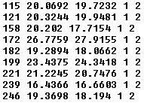
Awk
Ozbmi2.rec
awk ‘{ print $1, $10, $11, $4, $5 }’ ozbmi2.rec > new.rec

Slide 18
Awk
$1 = column 1
Print $0 = print whole line
add subtract multiply etc
change number of decimals
Many functions

Slide 19
Sort
Useful flags
-f ignore case
-n numeric sort
-r reverse
-c check if a file is sorted
-u prints only unique lines
-k2 sort starting at column2

Slide 20
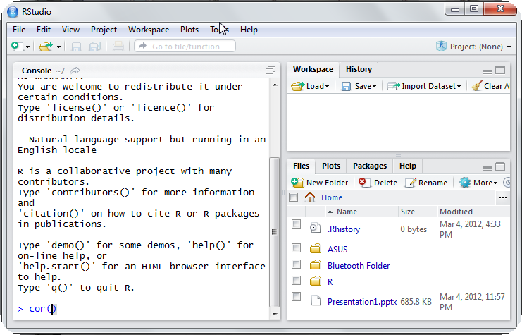
Using R this week
R-studio http://rstudio.org/

Slide 21
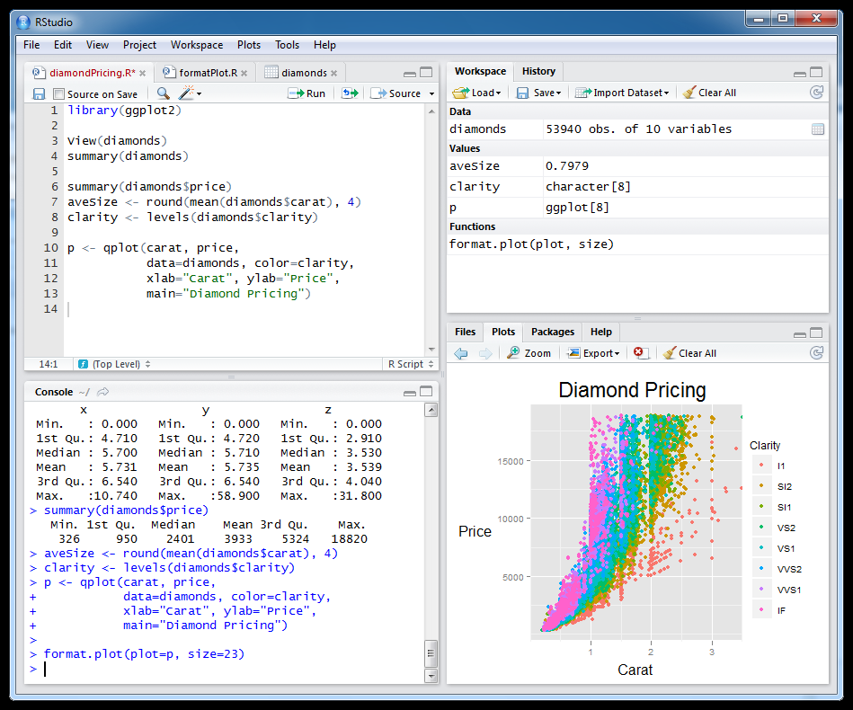
Setting this up at home
Install R first
Install R studio
Install packages

Slide 22
Vienna

