Slide 1
Heterogeneity
Sarah Medland
& Nathan Gillespie

Slide 2
Types of Heterogeneity
Terminology depends on research question
Moderation, confounding, GxE
Systematic differences
Measured or Manifest moderator/confounder
Discrete traits
Ordinal & Continuous traits (Thursday)
Unmeasured or latent moderator/confounder
Moderation and GxE

Slide 3
Heterogeneity Questions
Univariate Analysis:
What are the contributions of additive genetic, dominance/shared environmental and unique environmental factors to the variance?
Heterogeneity:
Are the contributions of genetic and environmental factors equal for different groups,
sex, race, ethnicity, SES, environmental exposure, etc.?

Slide 4
The language of heterogeneity
Are these differences due to differences in the magnitude of the effects (quantitative)?
e.g. Is the contribution of genetic/environmental factors greater/smaller in males than in females?
Are the differences due to differences in the source/nature of the effects (qualitative)?
e.g. Are there different genetic/environmental factors influencing the trait in males and females?

Slide 5
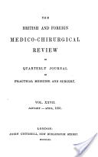
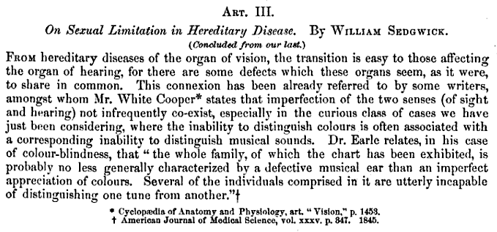
The language of heterogeneity
Sex differences = Sex limitation
1861
1948
1840

Slide 6
The language of heterogeneity
Quantitative - differences in the magnitude of the effects | Qualitative - differences in the source/nature of the effects
Models Scalar Non-scalar with OS twins | Models Non-scalar without OS twins General Non-scalar

Slide 7
The language of heterogeneity
Scalar limitation (Quantitative)
% of variance due to A,C,E are the same between groups
The total variance is not ie:
var_{Female} = k*var_{Male}
A_{Female} = k*A_{Male}
C_{Female} = k*C_{Male}
E_{Female} = k*E_{Male}
k here is the scalar

Slide 8
1
1/.5
E
C
A
A
C
E
1
1
1
1
1
1
e
c
a
a
c
e
Twin 1
Twin 2
No Heterogeneity

Slide 9
1
1/.5
E
C
A
A
C
E
1
1
1
1
1
1
e
c
a
a
c
e
Twin 1
Twin 2
MZ DZ
a²+c²+e² | a²+c²
a²+c² | a²+c²+e²
a²+c²+e² | .5a²+c²
.5a²+c² | a²+c²+e²

Slide 10
1
1/.5
E
C
A
A
C
E
1
1
1
1
1
1
e
c
a
k*a
k*c
k*e
Male
Twin
Female
Twin
Scalar Sex-limitation
aka scalar sex-limitation of the variance

Slide 11
The language of heterogeneity
Non-Scalar limitation
Without opposite sex twin pairs (Qualitative)
var_{Female} ≠ var_{Male}
A_{Female} ≠ A_{Male}
C_{Female} ≠ C_{Male}
E_{Female} ≠ E_{Male}

Slide 12
The language of heterogeneity
Non-Scalar limitation
Without opposite sex twin pairs (Qualitative)
Male Parameters
means_{M}
A_{M} C_{M} and E_{M}
Female Parameters
mean_{F}
A_{F} C_{F} and E_{F}
Parameters are estimated separately

Slide 13
1
Male ACE model
1/.5
E_{M}
C_{M}
A_{M}
A_{M}
C_{M}
E_{M}
1
1
1
1
1
1
e_{M}
c_{M}
a_{M}
a_{M}
c_{M}
e_{M}
Twin 1
Twin 2
1
1/.5
E_{F}
C_{F}
A_{F}
A_{F}
C_{F}
E_{F}
1
1
1
1
1
1
e_{F}
c_{F}
a_{F}
a_{F}
c_{F}
e_{F}
Female ACE model
Twin 1
Twin 2

Slide 14
The language of heterogeneity
Non-Scalar limitation
With opposite sex twin pairs (Quantitative)
Male Parameters
means_{M}
A_{M} C_{M} and E_{M}
Female Parameters
mean_{F}
A_{F} C_{F} and E_{F}
Parameters are estimated jointly – linked via the opposite sex correlations
r(A_{Female ,}A_{male}) = .5
r(C_{Female} ≠ C_{Male} ) = 1
r(E_{Female} ≠ E_{Male} ) = 0

Slide 15
1
.5/1
E_{M}
C_{M}
A_{M}
A_{F}
C_{F}
E_{F}
1
1
1
1
1
1
e_{M}
c_{M}
a_{M}
a_{F}
c_{F}
e_{F}
Male
Twin
Female
Twin
Non-scalar Sex-limitation
aka common-effects sex limitation

Slide 16
The language of heterogeneity
General Non-Scalar limitation
With opposite sex twin pairs (semi-Qualitative)
Male Parameters
means_{M}
A_{M} C_{M} E_{M} and A_{Specific}
Extra genetic/ environmental effects
Female Parameters
mean_{F}
A_{F} C_{F} and E_{F}
Parameters are estimated jointly – linked via the opposite sex correlations

Slide 17
1
.5/1
E_{M}
C_{M}
A_{M}
A_{F}
C_{F}
E_{F}
1
1
1
1
1
1
A_{S}
e_{M}
c_{M}
a_{M}
a_{F}
c_{F}
e_{F}
1
a_{s}
Male
Twin
Female
Twin
General Non-scalar Sex-limitation
aka general sex limitation

Slide 18
The language of heterogeneity
General Non-Scalar limitation via r_{G}
With opposite sex twin pairs (semi-Qualitative)
Male Parameters
means_{M}
A_{M} C_{M} E_{M}
Female Parameters
mean_{F}
A_{F} C_{F} and E_{F}
Parameters are estimated jointly – linked via the opposite sex correlations
r(A_{Female ,}A_{male}) = ? (estimated)
r(C_{Female} ≠ C_{Male} ) = 1
r(E_{Female} ≠ E_{Male} ) = 0

Slide 19
1
?
E_{M}
C_{M}
A_{M}
A_{F}
C_{F}
E_{F}
1
1
1
1
1
1
e_{M}
c_{M}
a_{M}
a_{F}
c_{F}
e_{F}
Male
Twin
Female
Twin
General Non-scalar Sex-limitation
aka general sex limitation

Slide 20
How important is sex-limitation?
Let have a look
Height data example using older twins
Zygosity coding
6 & 8 are MZF & DZF
7 & 9 are MZM & DZM
10 is DZ FM
Scripts ACEf.R ACEm.R ACE.R
Left side of the room ACEm.R
Right side of the room ACE.R
Record the answers from the estACE* function

Slide 21
How important is sex-limitation?
Female parameters
Male parameters
Combined parameters
Conclusions?

Slide 22
Lets try this model
1
?
E_{M}
C_{M}
A_{M}
A_{F}
C_{F}
E_{F}
1
1
1
1
1
1
e_{M}
c_{M}
a_{M}
a_{F}
c_{F}
e_{F}
Male
Twin
Female
Twin
General Non-scalar Sex-limitation
aka general sex limitation

Slide 23
twinHet5AceCon.R
Use data from all zygosity groups

Slide 24
1
?
E_{M}
C_{M}
A_{M}
A_{F}
C_{F}
E_{F}
1
1
1
1
1
1
e_{M}
c_{M}
a_{M}
a_{F}
c_{F}
e_{F}
Male
Twin
Female
Twin

Slide 25
1
?
E_{M}
C_{M}
A_{M}
A_{F}
C_{F}
E_{F}
1
1
1
1
1
1
e_{M}
c_{M}
a_{M}
a_{F}
c_{F}
e_{F}
Male
Twin
Female
Twin

Slide 26
Means
Have a think about this as we go through
is this the best way to set this up?

Slide 27
Covariances

Slide 29
Run it
What would we conclude?
Do we believe it?
Checking the alternate parameterisation…

Slide 30
Lets try this model
1
?
E_{M}
C_{M}
A_{M}
A_{F}
C_{F}
E_{F}
1
1
1
1
1
1
e_{M}
c_{M}
a_{M}
a_{F}
c_{F}
e_{F}
Male
Twin
Female
Twin
General Non-scalar Sex-limitation
aka general sex limitation

Slide 31
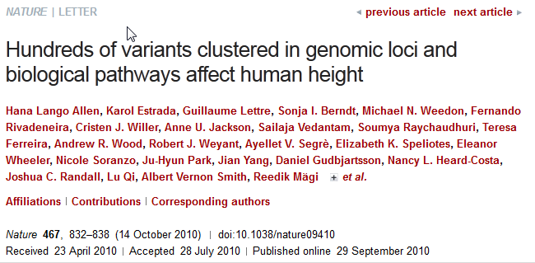
af = -.06
am = -.06
rg = -.9
Dzr = -.06*(.5*-.9) .06
=.45

Slide 32
Means
Add a correction using a regression model
expectedMean = maleMean + β*sex
β is the female deviation from the male mean
Sex is coded 0/1

