Slide 1
Longitudinal Modeling
Nathan & Lindon
Template_Developmental_Twin_Continuous_Matrix.R
Template_Developmental_Twin_Ordinal_Matrix.R
jepq.txt
GenEpiHelperFunctions.R

Slide 2
Why run longitudinal models?
Map changes in the magnitude of genetic & environmental influence across time
ID same versus different genetic or environmental risks across development
ID factors driving change versus factors maintaining stability
Improve power to detect A, C & E
- using multiple observations from the same individual & the cross twin cross trait correlations

Slide 3
Common methods for longitudinal data analyses in genetic epidemiology
Cholesky Decomposition
- Advantages
- Logical: organized such that all factors are constrained to impact later, but not earlier time points
- Requires few assumptions, can predict any pattern of change
- Disadvantages
- Not falsifiable
- No predictions
- Feasible for limited number of measurements
Latent Growth Curve Modeling
Simplex Modeling

Slide 4
Layout
Recap Common Pathway Model
Latent Growth Models
Simplex Models
A caveat emptor or two from Lindon

Slide 5
Common Pathway
1
1
1
A_{C}
C_{C}
E_{C}
c₁₁
a₁₁
e₁₁
Common Path
f₂₁
f₁₁
f₂₁
Phenotype 1
Phenotype 2
Phenotype 3
A_{S1}
C_{S1}
E_{S1}
A_{S2}
C_{S2}
E_{S2}
A_{S3}
C_{S3}
E_{S3}
1
1
1
1
1
1
1
1
1

Slide 6
Common Pathway: Genetic components of variance
1
# Specify a, c & e path coefficients from latent factors A, C & E to Common Pathway
mxMatrix( type="Lower", nrow=nf, ncol=nf, free=TRUE, values=.6, name="a" ),
# Specify a, c & e path coefficients from residual latent factors As, Cs & Es to observed variables i.e. specifics
mxMatrix( type="Diag", nrow=nv, ncol=nv, free=TRUE, values=4, name="as" ),
# Specify factor loadings ‘f’ from Common Path to observed variables
mxMatrix( type="Full", nrow=nv, ncol=nf, free=TRUE, values=15, name="f" ),
# Matrices A, C, & E to compute variance components
mxAlgebra( expression = f %&% (a %*% t(a)) + as %*% t(as), name="A" ),
A_{C}
a₁₁
Common Path
f₁₁
f₂₁
f₃₁
a_{s11}
a_{s11}
’
’
= A
f₂₁
&
a₁₁
X
a₁₁
+
a_{s22}
X
a_{s22}
a_{s33}
a_{s33}
f₁₁
f₂₁
Phenotype 1
Phenotype 2
Phenotype 3
a_{s11}
a_{s22}
a_{s33}
A_{s1}
A_{s2}
A_{s3}
1
1
1

Slide 7
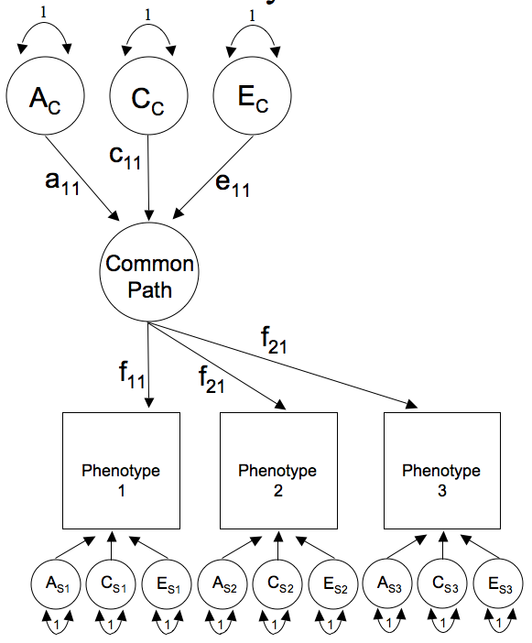
Common Pathway: Matrix algebra + variance components
# Matrices to store a, c, and e path coefficients for latent phenotype(s)
mxMatrix( type="Lower", nrow=nf, ncol=nf, free=TRUE, values=.6, name="a" ),
mxMatrix( type="Lower", nrow=nf, ncol=nf, free=TRUE, values=.6, name="c" ),
mxMatrix( type="Lower", nrow=nf, ncol=nf, free=TRUE, values=.6, name="e" ),
# Matrices to store a, c, and e path coefficients for specific factors
mxMatrix( type="Diag", nrow=nv, ncol=nv, free=TRUE, values=4, name="as" ),
mxMatrix( type="Diag", nrow=nv, ncol=nv, free=TRUE, values=4, name="cs" ),
mxMatrix( type="Diag", nrow=nv, ncol=nv, free=TRUE, values=4, name="es" ),
# Matrix f for factor loadings from common pathway to observerd phenotypes
mxMatrix( type="Full", nrow=nv, ncol=nf, free=TRUE, values=15, name="f" ),
# Matrices A, C, & E to compute variance components
mxAlgebra( expression = f %&% (a %*% t(a)) + as %*% t(as), name="A" ),
mxAlgebra( expression = f %&% (c %*% t(c)) + cs %*% t(cs), name="C" ),
mxAlgebra( expression = f %&% (e %*% t(e)) + es %*% t(es), name="E" ),
Within twin (co)variance
 | T₁ | T₂
T₁ | A+C+E
T₂ |  | A+C+E

Slide 8
CP Model: Expected covariance
# Algebra for expected variance/covariance
covMZ <- mxAlgebra( expression= rbind( cbind( A+C+E , A+C),
cbind( A+C , A+C+E)), name="expCovMZ" )
covMZ <- mxAlgebra( expression= rbind( cbind( A+C+E , 0.5%x%A+C),
cbind(0.5%x%A+C , A+C+E)), name="expCovMZ" )
1 / 0.5
1
MZ | T₁ | T₂
T₁ | A+C+E | A+C
T₂ | A+C | A+C+E
DZ | T₁ | T₂
T₁ | A+C+E | 0.5@A+C
T₂ | 0.5@A+C | A+C+E
Twin 1
Twin 2

Slide 9
Got longitudinal data?
Do means & variance components change over time?
- Are G & E risks stable?
How to best explain change?
- Linear, non-linear?
One solution == Latent Growth Model
Build LGC from scratch
Phenotype 1
Time 1
Phenotype 1
Time 2
Phenotype 1
Time 3

Slide 10
Common Pathway Model
1
1
1
A_{I}
C_{I}
E_{I}
c₁₁
e₁₁
a₁₁
B
_{m}
f₃₁
f₁₁
f₂₁
a_{s11}
c_{s11}
e_{s11}
a_{s22}
e_{s22}
a_{s33}
c_{s33}
e_{s33}
c_{s22}
A_{S1}
C_{S1}
E_{S1}
A_{S2}
C_{S2}
E_{S2}
A_{S3}
C_{S3}
E_{S3}
1
1
1
1
1
1
1
1
1

Slide 11
CPM to Latent Growth Curve Model
1
1
1
1
1
1
nf <- 1
nf <- 2
a₁₁
 | a₂₂
A₁
C₁
E₁
A₂
C₂
E₂
e₁₁
a₁₁
c₁₁
e₁₁
a₁₁
c₁₁
a₂₂
c₂₂
e₂₂
c₁₁
 | c₂₂
e₁₁
 | e₂₂
B₁
B₂
_{m1}
_{m2}
f₁₁
f₂₁
f₃₁
f₃₁
f₁₂
f₃₂
f₂₁
f₂₂
f₁₁
Phenotype 1
Time 1
Phenotype 1
Time 2
Phenotype 1
Time 3
f₁₁ | f₁₂
f₂₁ | f₂₂
f₃₁ | f₃₂
a_{s11}
c_{s11}
e_{s11}
a_{s22}
e_{s22}
a_{s33}
c_{s33}
e_{s33}
c_{s22}
A_{S1}
C_{S1}
E_{S1}
A_{S2}
C_{S2}
E_{S2}
A_{S3}
C_{S3}
E_{S3}
1
1
1
1
1
1
1
1
1

Slide 12
CP to Latent Growth Curve Model
1
1
1
1
1
1
nf <- 1
nf <- 2
a₁₁
a₂₁ | a₂₂
A₁
C₁
E₁
A₂
C₂
E₂
e₁₁
a₁₁
c₁₁
e₁₁
a₁₁
c₁₁
a₂₂
c₂₂
e₂₂
c₁₁
c₂₁ | c₂₂
e₂₁
c₂₁
a₂₁
e₁₁
e₂₁ | e₂₂
B₁
B₂
_{m1}
_{m2}
f₁₁
f₂₁
f₃₁
f₃₁
f₁₂
f₃₂
f₂₁
f₂₂
f₁₁
Phenotype 1
Time 1
Phenotype 1
Time 2
Phenotype 1
Time 3
f₁₁ | f₁₂
f₂₁ | f₂₂
f₃₁ | f₃₂
a_{s11}
c_{s11}
e_{s11}
a_{s22}
e_{s22}
a_{s33}
c_{s33}
e_{s33}
c_{s22}
A_{S1}
C_{S1}
E_{S1}
A_{S2}
C_{S2}
E_{S2}
A_{S3}
C_{S3}
E_{S3}
1
1
1
1
1
1
1
1
1

Slide 13
Latent Growth Curve Model
1
1
1
1
1
1
Intercept: Factor which explains initial variance components (and mean) for all measures. Accounts for the stability over time.
Slope: Factor which influences the rate of change in the variance components (and mean) over time. Slope(s) is (are) pre-defined: linear & non linear (quadratic, logistic, gompertz etc) hence factor loading constraints required.
A_{I}
C_{I}
E_{I}
A_{s}
C_{s}
E_{s}
c₁₁
e₁₁
e₂₂
a₁₁
a₂₂
c₂₂
e₂₁
c₂₁
a₂₁
B_{i}
B_{s}
i_{m}
Intercept
Slope
s_{m}
1
0
1
2
1
1
Phenotype 1
Time 1
Phenotype 1
Time 2
Phenotype 1
Time 3
Twin 1
a_{s11}
c_{s11}
e_{s11}
a_{s22}
e_{s22}
a_{s33}
c_{s33}
e_{s33}
c_{s22}
A_{S1}
C_{S1}
E_{S1}
A_{S2}
C_{S2}
E_{S2}
A_{S3}
C_{S3}
E_{S3}
1
1
1
1
1
1
1
1
1

Slide 14
LGC Model: Within twin genetic components of variance
1
1
a₁₁
a₂₁ | a₂₂
A_{I}
A_{s}
Genetic pathway coefficients matrix
a₁₁
a₂₂
a₂₁
Intercept
Slope
1 | 0
1 | 1
1 | 2
1
0
1
2
Factor loading matrix
1
1
Phenotype 1
Time 1
Phenotype 1
Time 2
Phenotype 1
Time 3
Twin 1
a_{s11}
a_{s22}
a_{s33}
a_{S11}
a_{S22}
Residual genetic pathway coefficients matrix
A_{S1}
A_{S2}
A_{S3}
a_{S33}
1
1
1

Slide 15
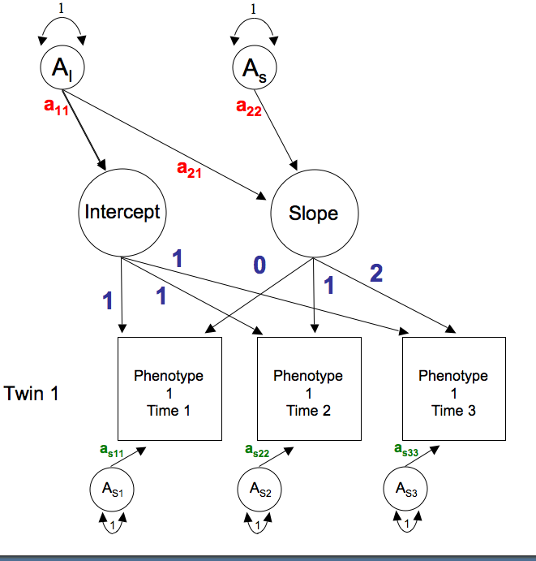
LGC Model: Specifying variance components in R
# Matrix for a path coefficients from latent factors to Int’ & Slope latent factors
pathAl <- mxMatrix( type="Lower", nrow=nf, ncol=nf, free=TRUE, values=.6, labels=AlLabs, name="al" )
# Matrix for a path coefficients from residuals to observed phenotypes
pathAs <- mxMatrix( type="Diag", nrow=nv, ncol=nv, free=TRUE, values=4, labels=AsLabs, name="as" )
# Factor loading matrix of Int & Slop on observed phenotypes
pathFl <- mxMatrix( type="Full", nrow=nv, ncol=nf, free=FALSE, values=c(1,1,1,0,1,2), name="fl" )
1 | 0
1 | 1
1 | 2
’
a_{S11}
a_{S11}
’
a₁₁
a₂₁ | a₂₂
a₁₁ | a₂₁
 | a₂₂
&
X
+
a_{S22}
X
a_{S22}
= A
a_{S33}
a_{S33}
# Matrix A to compute additive genetic variance components
covA <- mxAlgebra( expression=fl %&% (al %*% t(al)) + as %*% t(as), name=“A”)
a₁₁² + a_{S11}² | = A_{var time 1}
a₁₁² + a₂₁a₁₁ + a₂₁a₁₁ + a₂₂² + a_{S22}² | = A_{var time 2}
a₁₁² +2a₂₁a₁₁ + 2a₂₁a₁₁+ 2a₂₂² + a_{S33}² | = A_{var time 3}

Slide 16
LGC Model: Specifying variance components in R

Slide 17
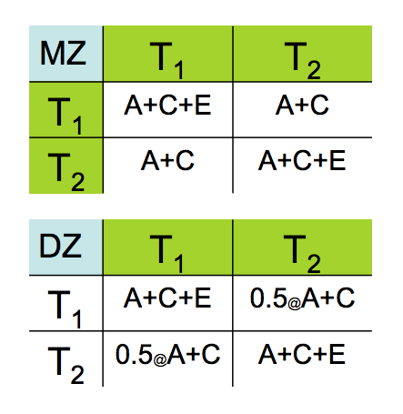
LGC Model: Specifying covariance components in R

Slide 18
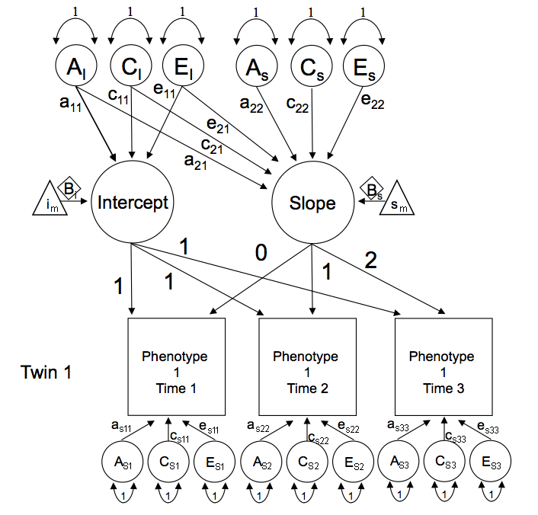
LGC Model: 1.Continuous_Developmental_Twin_Matrix.R

Slide 19
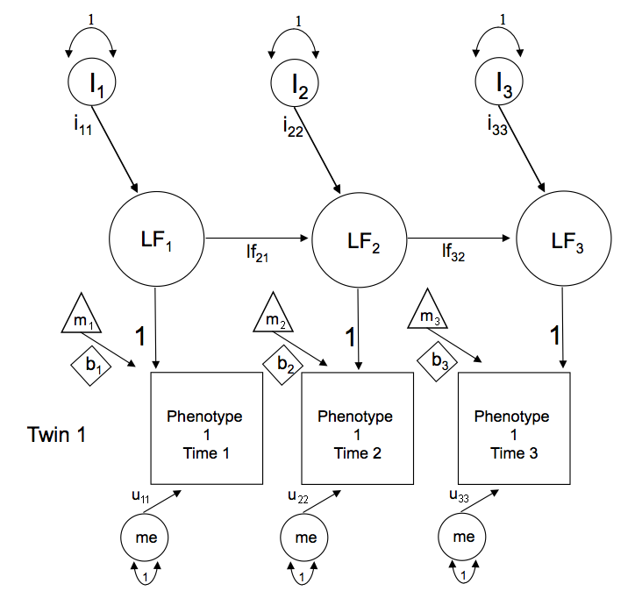
Simplex Models
Simplex designs model changes in the latent factor structure over time by fitting auto-regressive or Markovian chains
Determine how much variation in a trait is caused by stable & enduring effects versus transient effects unique to each time
The chief advantage of this model is the ability to partition environmental & genetic variation at each time point into:
- genetic & environmental effects unique to each occasion
- genetic and environmental effects transmitted from previous time points

Slide 20
Simplex Models
1
1
1
I₁
I₂
I₃
innovations
i₁₁
i₂₂
i₃₃
latent factor means
LF₁
LF₂
LF₃
latent factors
lf₂₁
lf₃₂
m₂
means
m₁
1
1
m₃
1
b₁
b₂
b₃
Phenotype 1
Time 1
Phenotype 1
Time 2
Phenotype 1
Time 3
observed phenotype
u₁₁
u₂₂
u₃₃
me
me
me
measurement error
1
1
1

Slide 21
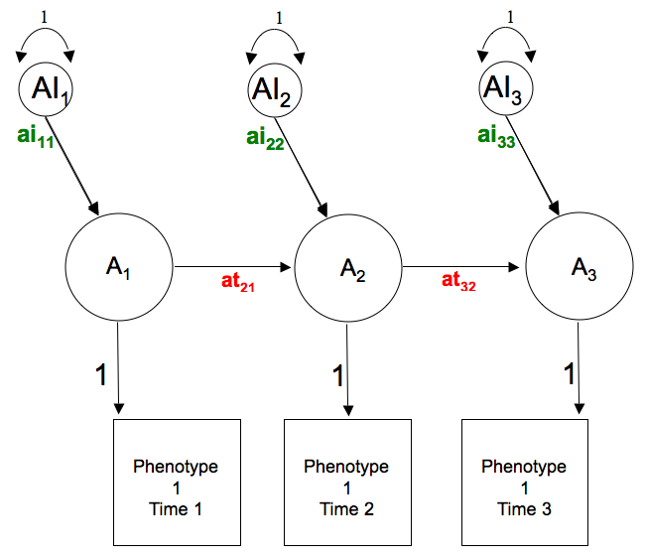
Simplex Models: Within twin genetic variance
A₁
A₂
A₃
1 | 0 | 0
0 | 1 | 0
0 | 0 | 1
A₁
?
? | ?
? | ? | ?
Transmission pathways
A₂
A₃
ai₁₁
 | ai₂₂
 |  | ai₃₃
Innovation pathways

Slide 22
Simplex Models: Genetic variance
A₁
A₂
A₃
1 | 0 | 0
0 | 1 | 0
0 | 0 | 1
A₁
0
at₂₁ | 0
0 | at₃₂ | 0
Transmission pathways
A₂
A₃
ai₁₁
 | ai₂₂
 |  | ai₃₃
Innovation pathways
-1
’
1 | 0 | 0
0 | 1 | 0
0 | 0 | 1
0
at₂₁ | 0
0 | at₃₂ | 0
ai₁₁
 | ai₂₂
 |  | ai₃₃
ai₁₁
 | ai₂₂
 |  | ai₃₃
-
&
*
= A
matI <- mxMatrix( type="Iden", nrow=nv, ncol=nv, name="I”)
pathAt <- mxMatrix( type="Lower", nrow=nv, ncol=nv, free=tFree, values=ValsA, labels=AtLabs, name="at" )
pathAi <- mxMatrix( type="Diag", nrow=nv, ncol=nv, free=TRUE, values=iVals, labels=AiLabs, name="ai" )
covA <- mxAlgebra( expression=solve( I - at ) %&% ( ai %*% t(ai)), name="A" )

Slide 23
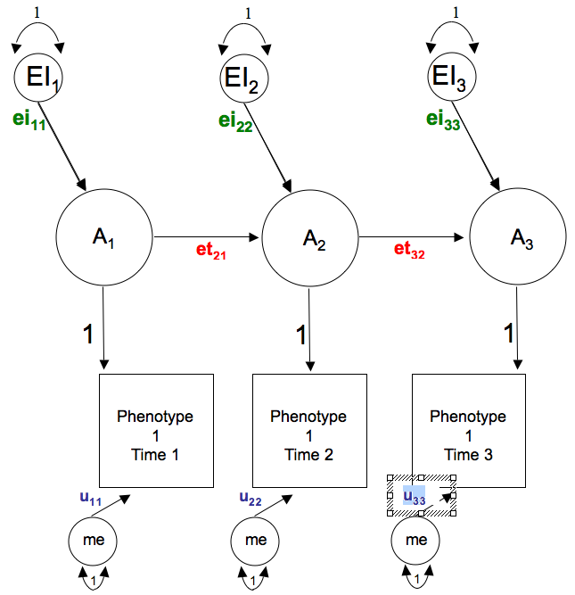
Simplex Models: E variance + measurement error
matI <- mxMatrix( type="Iden", nrow=nv, ncol=nv, name="I”)
pathEt <- mxMatrix( type="Lower", nrow=nv, ncol=nv, free=tFree, values=tValsE, labels=EtLabs, name="et" )
pathEi <- mxMatrix( type="Diag", nrow=nv, ncol=nv, free=TRUE, values=iVals, labels=EiLabs, name="ei" )
pathMe <- mxMatrix( type="Diag", nrow=nv, ncol=nv, free=TRUE, labels=c("u","u","u"), values=5, name="me" )
covE <- mxAlgebra( expression=solve( I-et ) %&% (ei %*% t(ei))+ (me %*% t(me)), name="E" )
~
’
1 | 0 | 0
0 | 1 | 0
0 | 0 | 1
0
et₂₁ | 0
0 | et₃₂ | 0
ei₁₁
 | ei₂₂
 |  | ei₃₃
ei₁₁
 | ei₂₂
 |  | ei₃₃
-
&
*
+
’
u₁₁
 | u₂₂
 |  | u₃₃
u₁₁
 | u₂₂
 |  | u₃₃
*
= E

Slide 24
LGC Model: Specifying covariance components in R

Slide 25
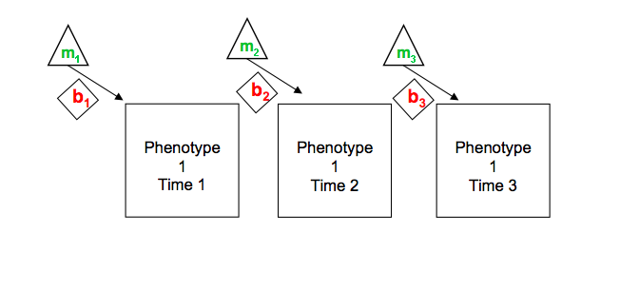
Simplex Models: Means & sex in R
Time 1 | Time 2 | Time 3
m1 | m2 | m3

Slide 26
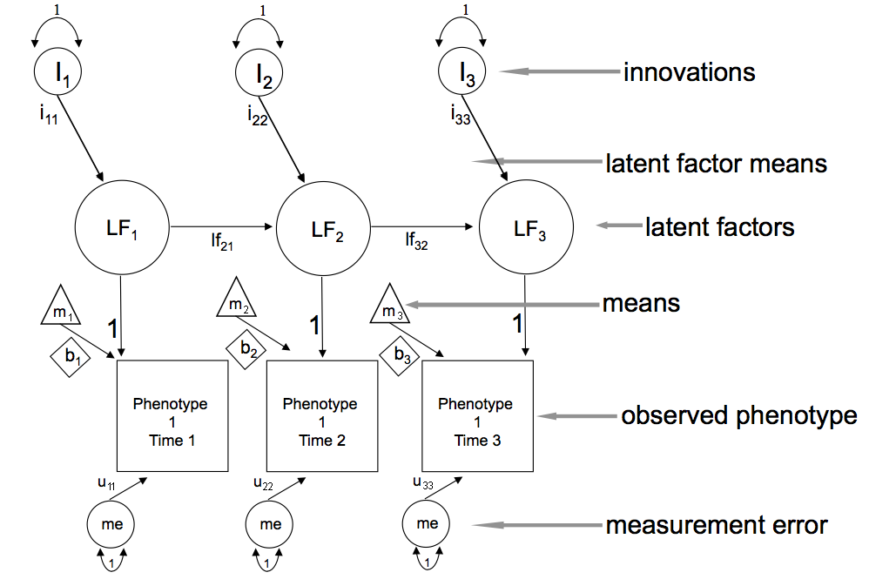
Simplex Model: 1.Continuous_Developmental_Twin_Matrix.R

Slide 27
Ordinal Data Latent Growth Curve Modeling
1
1
1
1
1
1
A_{I}
C_{I}
E_{I}
A_{s}
C_{s}
E_{s}
c₁₁
e₁₁
e₂₂
a₁₁
a₂₂
c₂₂
e₂₁
c₂₁
a₂₁
B_{i}
B_{s}
i_{m}
Intercept
Slope
s_{m}
1
0
1
2
1
1
Phenotype 1
Time 1
Phenotype 1
Time 2
Phenotype 1
Time 3
a_{s11}
c_{s11}
e_{s11}
a_{s22}
e_{s22}
a_{s33}
c_{s33}
e_{s33}
c_{s22}
A_{S1}
C_{S1}
E_{S1}
A_{S2}
C_{S2}
E_{S2}
A_{S3}
C_{S3}
E_{S3}
1
1
1
1
1
1
1
1
1

Slide 28
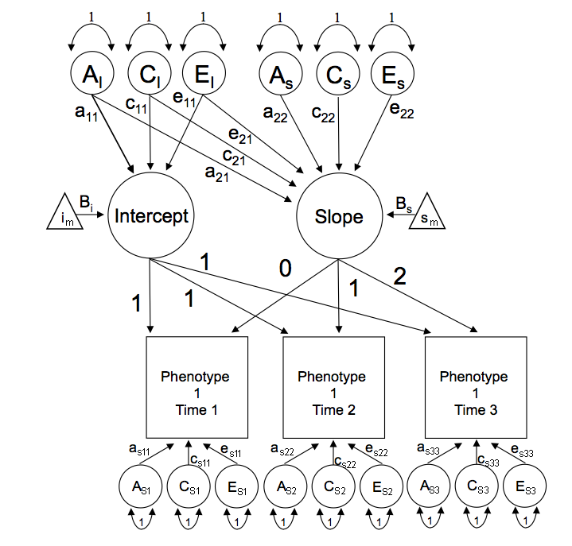
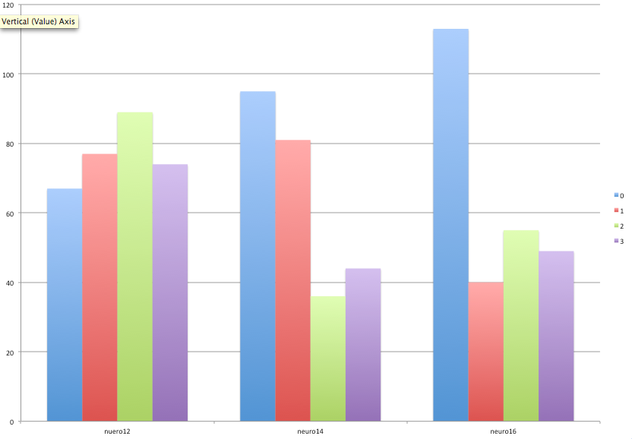
Ordinal Data Latent Growth Curve Modeling

Slide 29
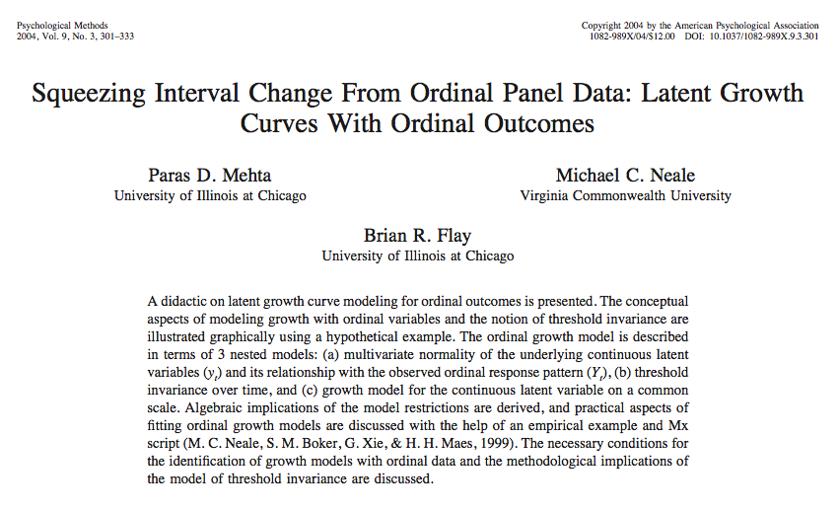
Ordinal Data Latent Growth Curve Modeling

Slide 30
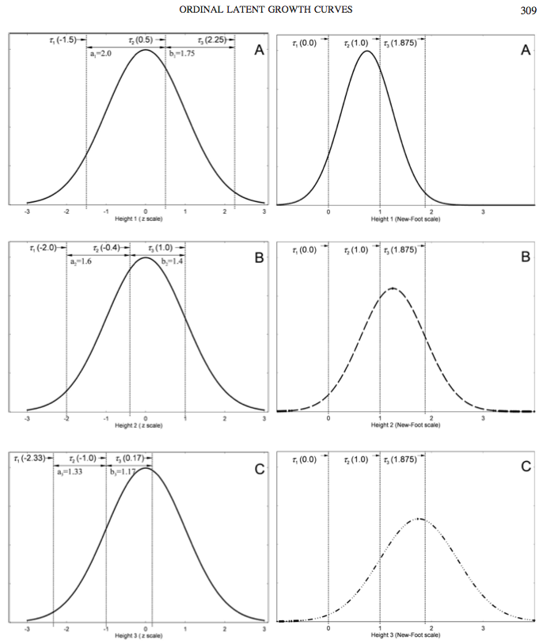
Ordinal Data Latent Growth Curve Modeling
Two tasks:
Estimate means
Fix thresholds
Assumes Measurement Invariance

Slide 31
LGC Model: Estimating means (& sex) in R
Means on observed phenotypes versus means on Intercept & Slope?
i_{m}
s_{m}
B_{i}
B_{s}
I_{m}
Intercept
Slope
S_{m}
1
0
B_{i}
B_{s}
1
2
1
1
1 | 0
1 | 1
1 | 2
Twin 1
Phenotype 1
Time 1
Phenotype 1
Time 2
Phenotype 1
Time 3
MeansIS <- mxMatrix( type="Full", nrow=2, ncol=1, free=T, labels=c("Im","Sm"), values=c(5,2), name="LMeans" )
pathB <- mxMatrix( type="Full", nrow=2, ncol=1, free=T, values=c(5,2), labels=c("Bi","Bs"), name="Beta" )
pathFl <- mxMatrix( type="Full", nrow=nv, ncol=nf, free=FALSE, values=c(1,1,1,0,1,2), labels=FlLabs,name="fl" )
# Read in covariates
defSex1 <- mxMatrix( type="Full", nrow=1, ncol=1, free=FALSE, labels=c("data.sex_1"), name="Sex1")

Slide 32
LGC Model: Means Algebra
1 | 0
1 | 1
1 | 2
i_{m}
s_{m}
+
Sex_{T1}
B_{i}
B_{s}
X
@
= Expected means for Twin 1
1 | 0
1 | 1
1 | 2
(i_{m} + B_{i}Sex_{T1})
(i_{m} + B_{i}Sex_{T1} ) + 1(s_{m} + B_{s}Sex_{T1} )
(i_{m} + B_{i}Sex_{T1}) + 2(s_{m} + B_{s}Sex_{T1} )
Time 1
Time 2
Time 3
i_{m} + B_{i}Sex_{T1}
s_{m}+ B_{s}Sex_{T1}
=
X
Means1 <- mxAlgebra( expression= ( t((fl %*% ( LMeans - Sex1 %x% Beta )))), name="Mean1")
B_{i}
B_{s}
I_{m}
Intercept
Slope
S_{m}
1
0
1
2
1
1
Twin 1
Phenotype 1
Time 1
Phenotype 1
Time 2
Phenotype 1
Time 3

Slide 33
LGC: Threshold Invariance or Fixed Thresholds

Slide 34
LGC: Threshold Invariance or Fixed Thresholds

Slide 35
LGC Model: 2.Ordinal_Template_Developmental_Twin_Matrix.R

Slide 37
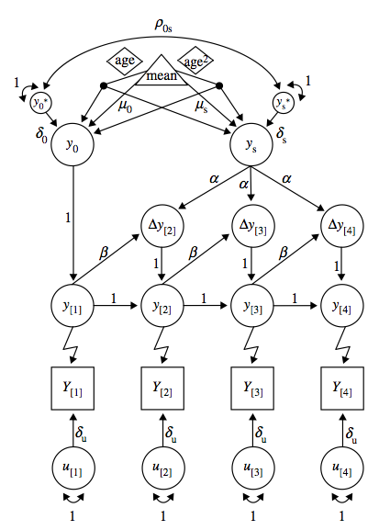
Dual Change Models Simplex + LGC

