Slide 1

Association Mapping
David Evans

Slide 2
Outline
Definitions / Terminology
What is (genetic) association?
How do we test for association?
When to use association
HapMap, 1000 genomes and tagging
Genome-wide Association
Sequencing and Rare variants

Slide 3
Definitions
Locus: Location on the genome
SNP: “Single Nucleotide Polymorphism” a mutation that produces a
single base pair change in the DNA sequence
alleles
A
A
C
A
T
alternate forms of a SNP (mutation)
C
C
G
A
T
genotypes
A
A
C
A
T
both alleles at a locus form a genotype
C
C
G
A
T
haplotypes
A
A
C
A
T
the pattern of alleles on a chromosome
C
C
G
A
T
QTL: “Quantitative trait locus” a region of the genome that changes the mean value
of a quantitative phenotype

Slide 4
What is (genetic) association?
Correlation between an allele/genotype/haplotype and a trait of interest (disease or quantitative phenotype)

Slide 5
Genetic Association
Three Common Forms
Direct Association
  Polymorphism of interest is functionally involved in the phenotype
  ~70% of Cystic Fibrosis patients have a deletion of 3 base
  pairs resulting in the loss of a phenylalanine amino acid
  at position 508 of the CFTR gene
Indirect Association
  Genotyped polymorphism is not involved, but a nearby correlated variant changes the phenotype (linkage disequilibrium)

Slide 6
Indirect association and Linkage disequilibrium

Slide 7
Indirect association and Linkage disequilibrium
time

Slide 8
Linkage Disequilibrium
Variants in close proximity to each other tend to be correlated (i.e. in linkage disequilibrium)
Linkage disequilibrium means that we don’t need to genotype the exact aetiological variant, but only a variant that is correlated with it

Slide 9
Genetic Association
Three Common Forms
Direct Association
  Mutant or ‘susceptible’ polymorphism
  Allele of interest is itself involved in phenotype
Indirect Association
  Allele itself is not involved, but a nearby correlated
marker changes phenotype
Spurious association
  Apparent association not related to genetic aetiology
    (e.g. population stratification)

Slide 10
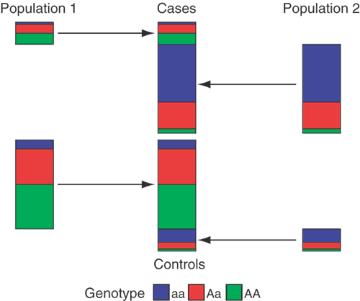
Population Stratification
Marchini, Nat Genet. 2004

Slide 11
How do we test for association?

Slide 12
Genetic Case Control Study
Controls
Cases
G/T
G/G
T/T
T/T
T/T
T/G
T/G
T/T
T/G
T/G
G/G
T/G
T/G
T/T
Allele G is ‘associated’ with disease

Slide 13
Allele-based tests
Each individual contributes two counts to 2x2 table.
Test of association
where
X² has χ² distribution with 1 degrees of freedom under null hypothesis.
 | Cases | Controls | Total
G | n_{1A} | n_{1U} | n_{1·}
T | n_{0A} | n_{0U} | n_{0·}
Total | n_{·A} | n_{·U} | n··

Slide 14
Genotypic tests
SNP marker data can be represented in 2x3 table.
Test of association
where
X² has χ² distribution with 2 degrees of freedom under null hypothesis.
 | Cases | Controls | Total
GG | n_{2A} | n_{2U} | n_{2·}
GT | n_{1A} | n_{1U} | n_{1·}
TT | n_{0A} | n_{0U} | n_{0·}
Total | n_{·A} | n_{·U} | n··

Slide 15
Simple Regression Model of Association
(Unrelated individuals)
Y_{i} = α + βX_{i} + e_{i}
where
Y_{i} = trait value for individual i
X_{i} = number of ‘A’ alleles an individual has
1.2
1
0.8
Y
0.6
0.4
0.2
0
X
0
1
2
Association test is whether β is different from 0

Slide 16
Transmission Disequilibrium Test
Rationale: Related individuals have to be from the same population
Compare number of times heterozygous parents transmit “A” vs “C” allele to affected offspring
AC
AA
AC

Slide 17
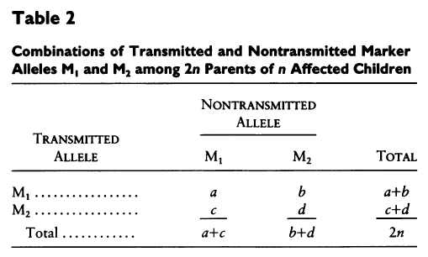

Transmission Disequilibrium Test
Spielman et al. (1993) AJHG

Slide 18
Transmission Disequilibrium Test
Difficult to gather families
Difficult to get parents for late onset / psychiatric conditions
Inefficient for genotyping (particularly GWA)
AC
AA
AC

Slide 19
Case-control versus TDT
p = 0.1; RAA = RAa = 2

Slide 20
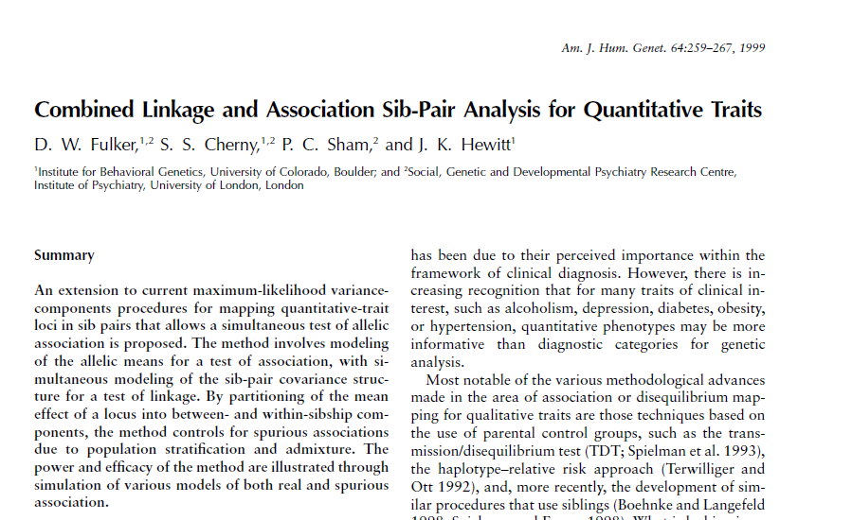


Slide 21
When to use association...

Slide 22
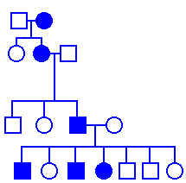
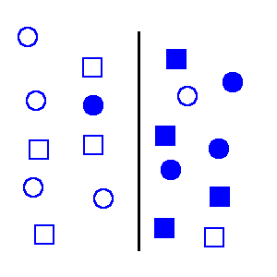
Methods of gene hunting
rare, monogenic (linkage)
Effect Size
common, complex (association)
Frequency

Slide 23
Molecular Genetic Studies-
Linkage Analysis
MARKER
DISEASE GENE

Slide 24
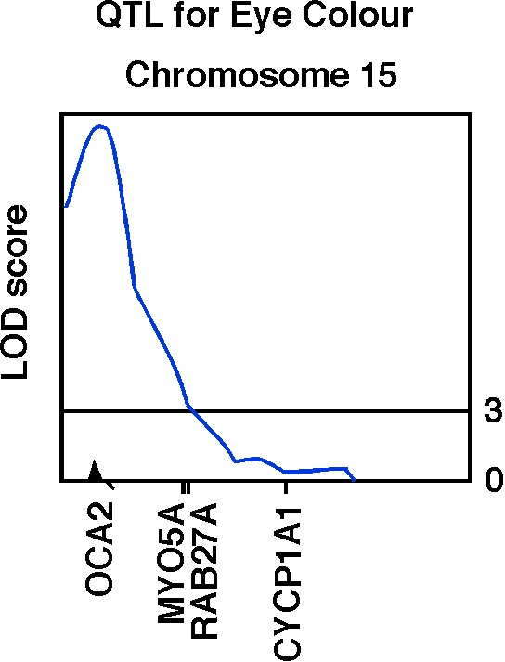
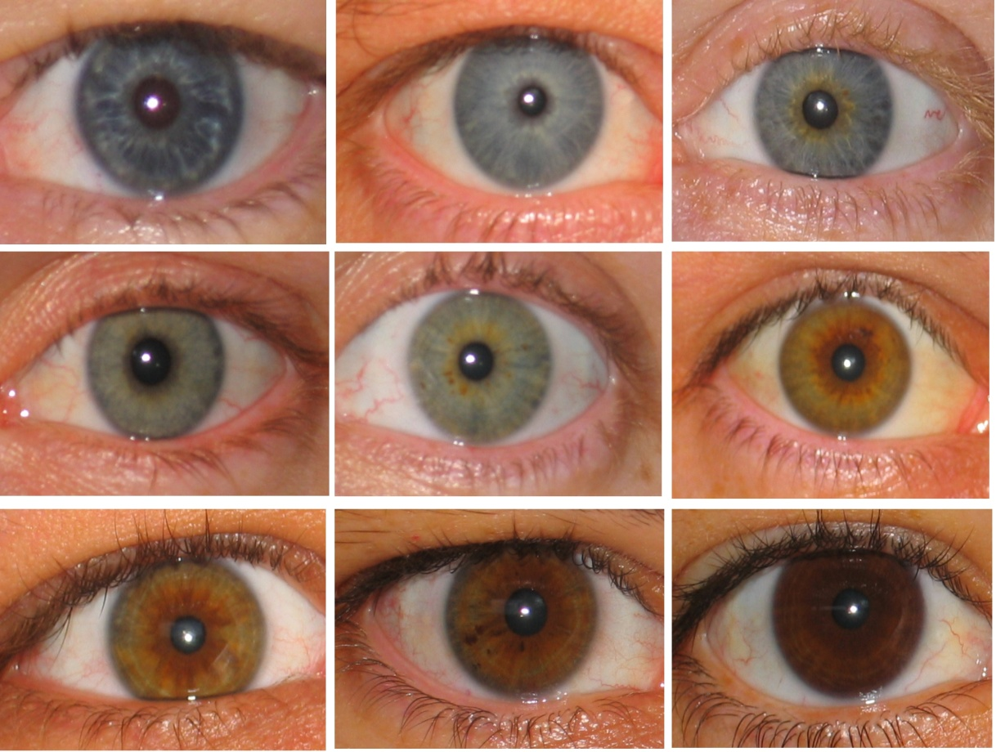
Human OCA2 and eye colour
Zhu et al., Twin Research 7:197-210 (2004)

Slide 25
Association Summary
Families or unrelateds
Matching/ethnicity important
Many markers required for genome coverage (10⁵ – 10⁶ SNPs)
Powerful design
Ok for initial detection; good for fine-mapping
Powerful for common variants; rare variants difficult

Slide 26
HapMap and Tagging

Slide 27
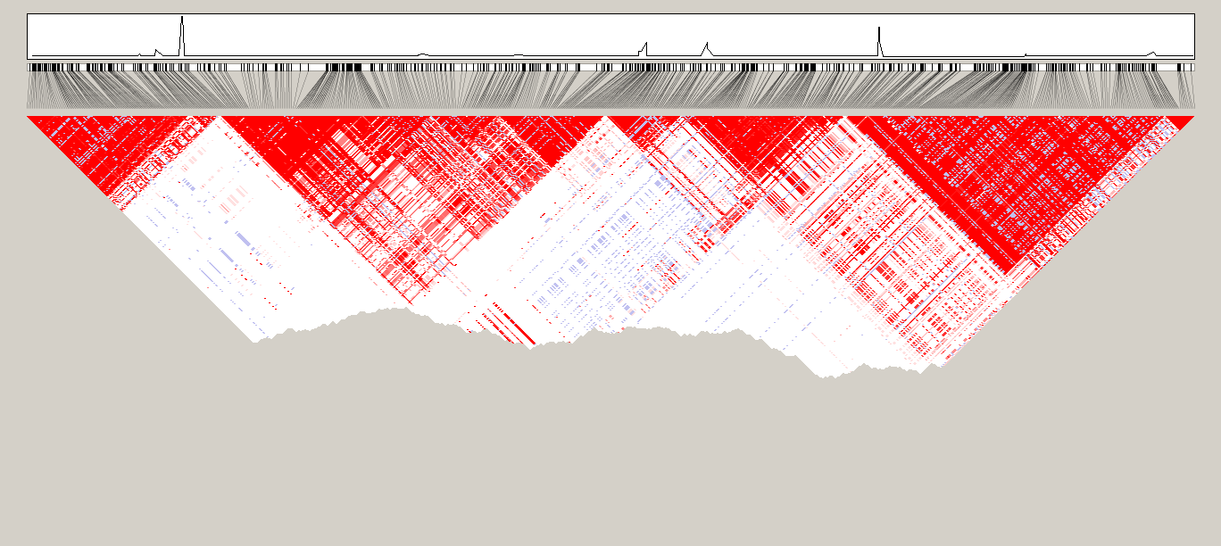
Visualizing empirical LD

Slide 28

Pairwise tagging
A/T
1
G/A
2
G/C
3
T/C
4
G/C
5
A/C
6
Tags:
SNP 1
SNP 3
SNP 6
3 in total
Test for association:
SNP 1
SNP 3
SNP 6
A
A
G
G
G
G
G
T
T
G
G
A
C
C
C
C
C
C
C
C
C
C
C
C
T
T
A
A
A
A
G
G
G
C
C
C
high r²
high r²
high r²
Carlson et al. (2004) AJHG 74:106

Slide 29
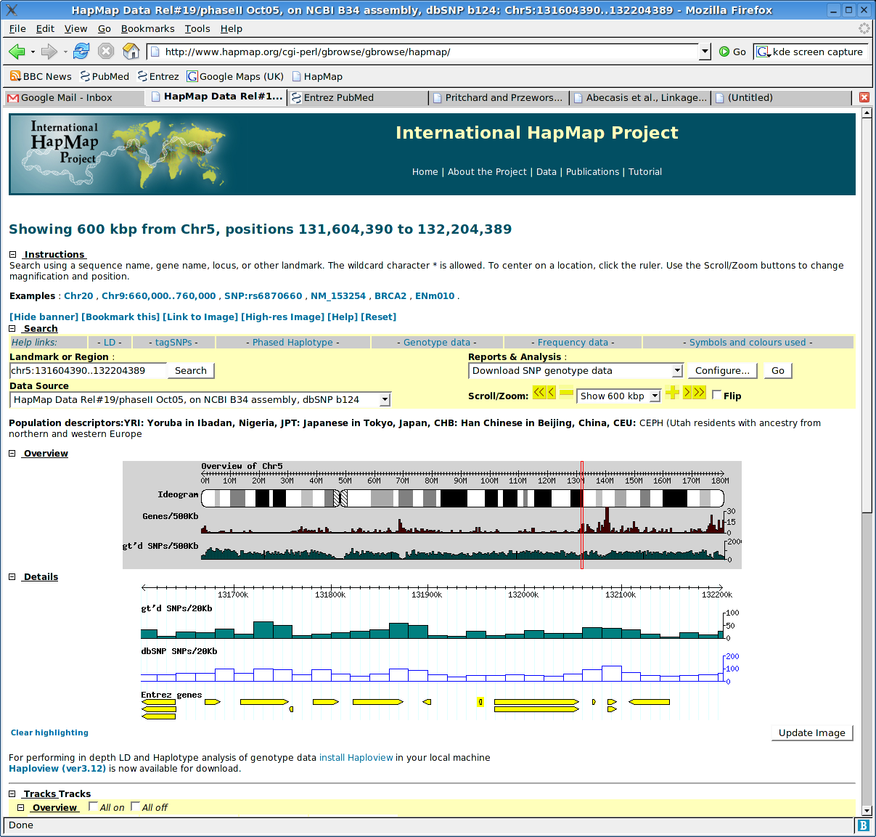
Enabling association studies: HapMap

Slide 30
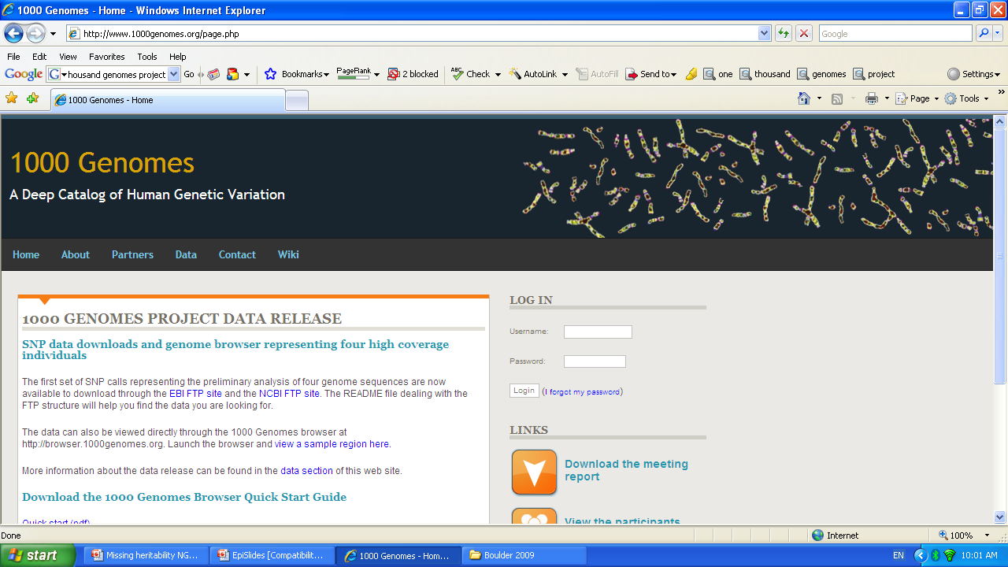

Slide 31
Genome-wide Association
Studies

Slide 32
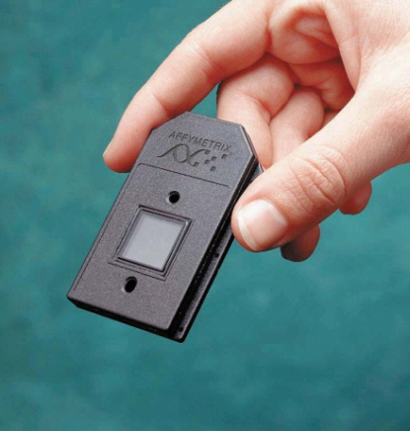



Enabling Genome-wide Association Studies
HAPlotype MAP
High throughput genotyping
Large cohorts

Slide 33
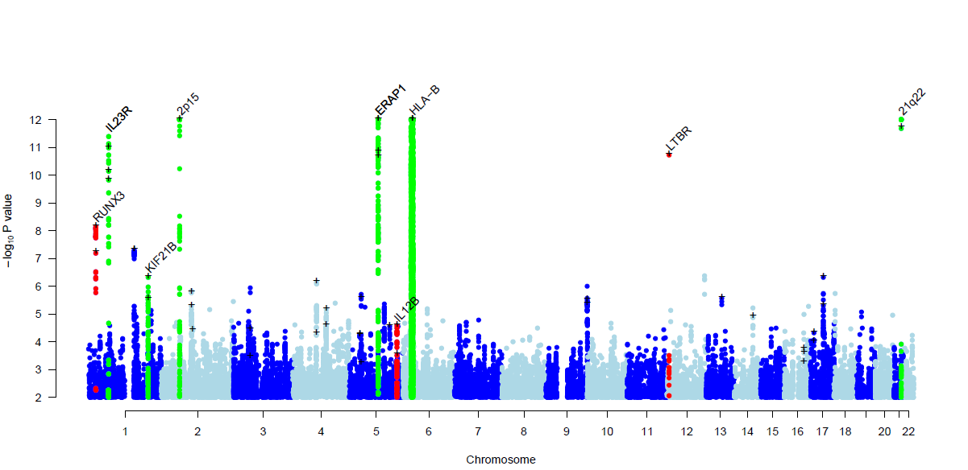
TBKBP1
ANTXR2
CARD9
PTGER4
Evans et al. (2011) Nat Genet

Slide 34
Imputation

Slide 35
Imputation
Recombination Rate
1 1 0 1 1 0 1 0 1 1 0 1 1 0……….
1 1 0 1 1 0 1 0 1 1 0 1 1 0……….
1 1 0 1 1 0 1 0 1 1 0 1 1 0……….
HapMap Phase II
1 1 0 1 1 0 1 0 1 1 0 1 1 0……….
2 1 1 2 ? 2 1 ? ? 1 ? 2 2 0……….
2 1 1 2 ? 2 2 ? ? 0 ? 2 1 0……….
2 ? 1 2 ? 2 1 ? ? 1 ? 1 1 0……….
Cases
2 1 2 1 ? 2 2 ? ? 1 ? 1 1 0……….
2 1 1 1 ? 2 1 ? ? 1 ? 2 2 0……….
2 1 1 1 ? 2 2 ? ? 0 ? 2 2 0……….
Controls
1 0 1 2 ? 2 1 ? ? 1 ? 1 1 ?……….
2 1 2 1 ? 2 2 ? ? 1 ? 1 1 ?……….

Slide 36
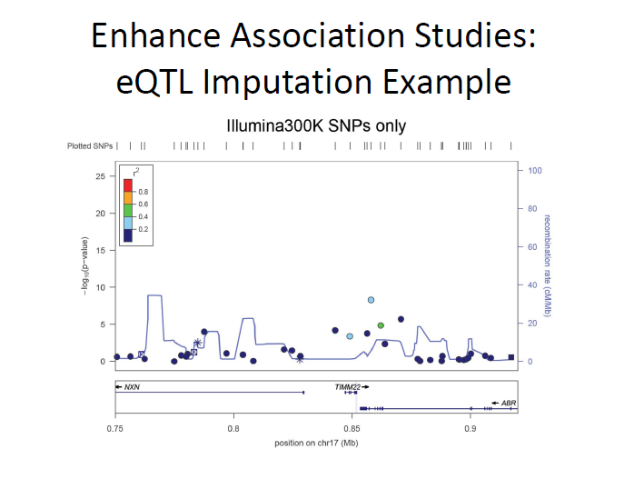

Slide 37
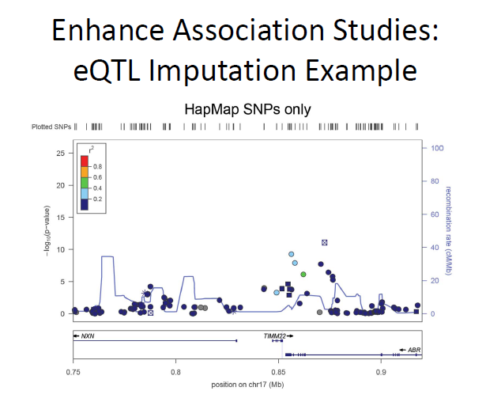

Slide 38
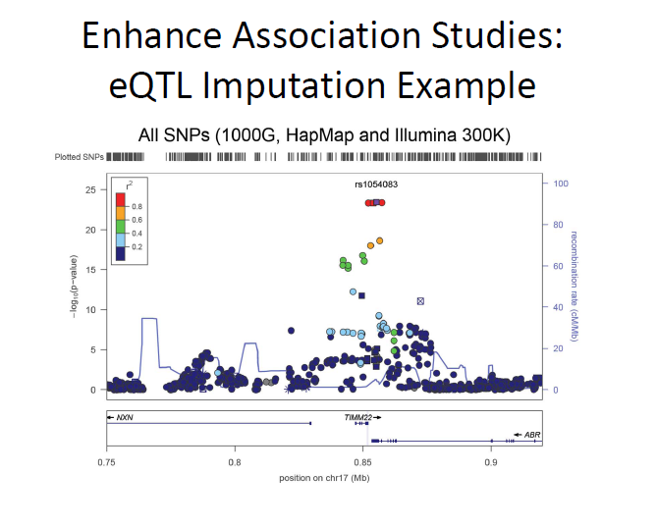

Slide 39
Population Stratification

Slide 40
Genomic control
χ²
No stratification
Test locus
Unlinked ‘null’ markers
χ²
Stratification → adjust test statistic

Slide 41
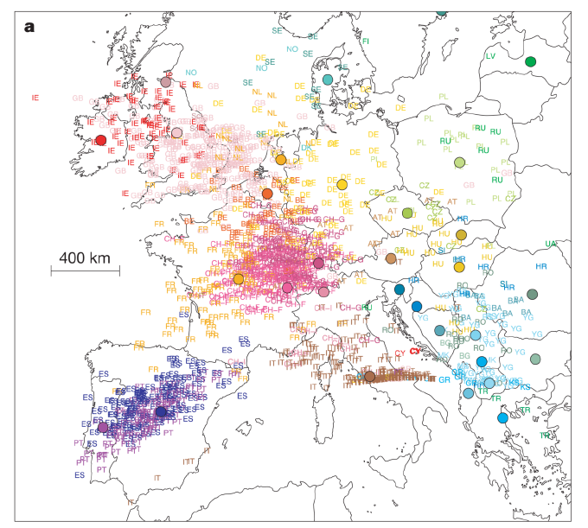
Novembre et al, Nature (2008)
Principal Component Two
Principal Component One

Slide 42
Meta-analysis

Slide 43
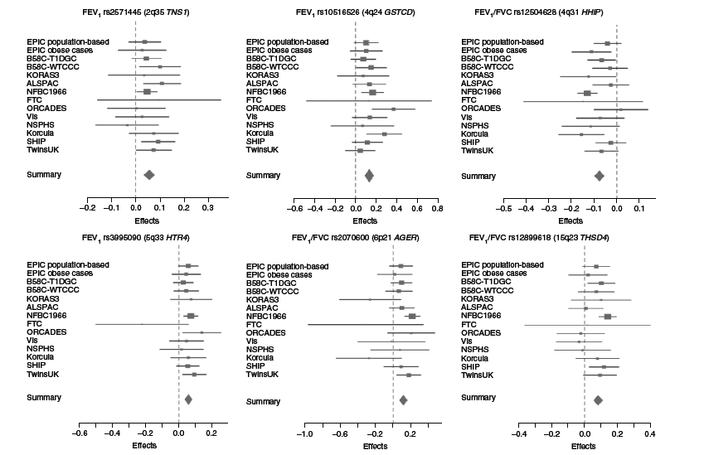
Meta-analysis
Repapi et al. (2009) Nature Genetics

Slide 44
Replication

Slide 45
Replication
Replication studies should be of sufficient size to demonstrate the effect
The same SNP should be tested
The replicated signal should be in the same direction
Replication studies should conducted in independent datasets
Joint analysis should lead to a lower p value than the original report
Replication should involve the same phenotype
Replication should be conducted in a similar population
Well designed negative studies are valuable

Slide 46
Programs for performing association analysis
Mx (Neale)
  Fully flexible, ordinal data
  Not ideal for large pedigrees or GWAs
PLINK (Purcell, Neale, Ferreira)
  GWA
Haploview (Barrett)
  Graphical visualization of LD, tagging, basic tests of association
MERLIN, QTDT (Abecasis)
  Association and linkage in families

Slide 47
How have we done?

Slide 48
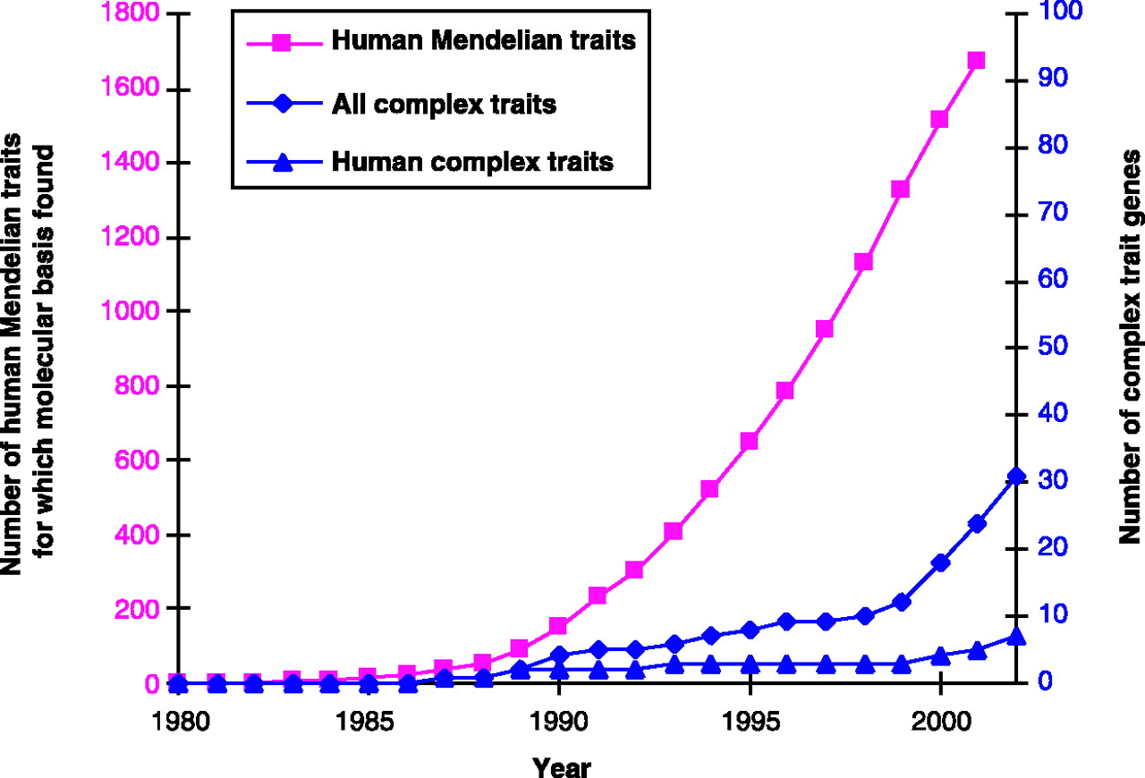
Historical gene mapping
Glazier et al, Science (2002).

Slide 49
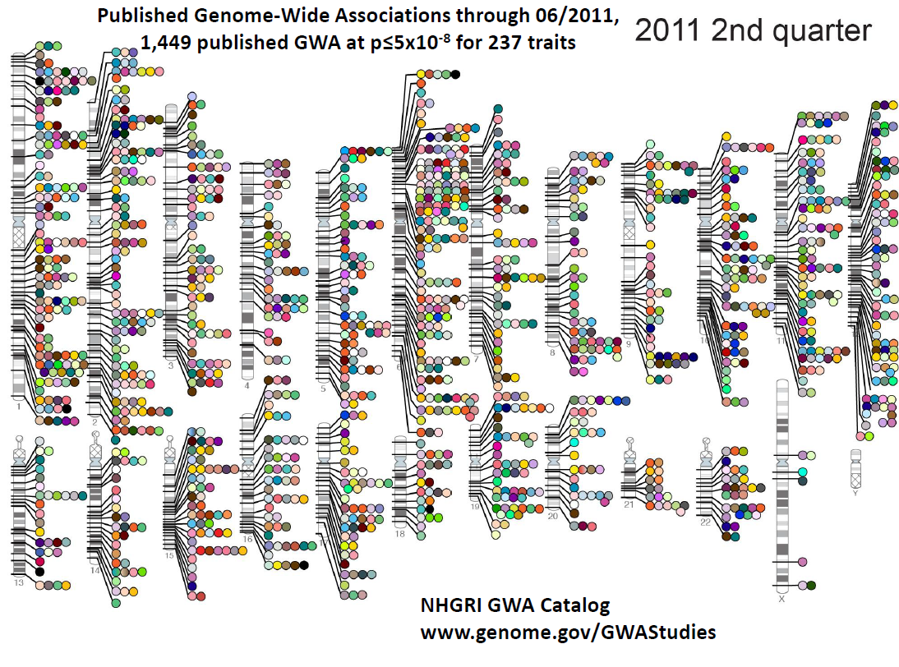

Slide 50
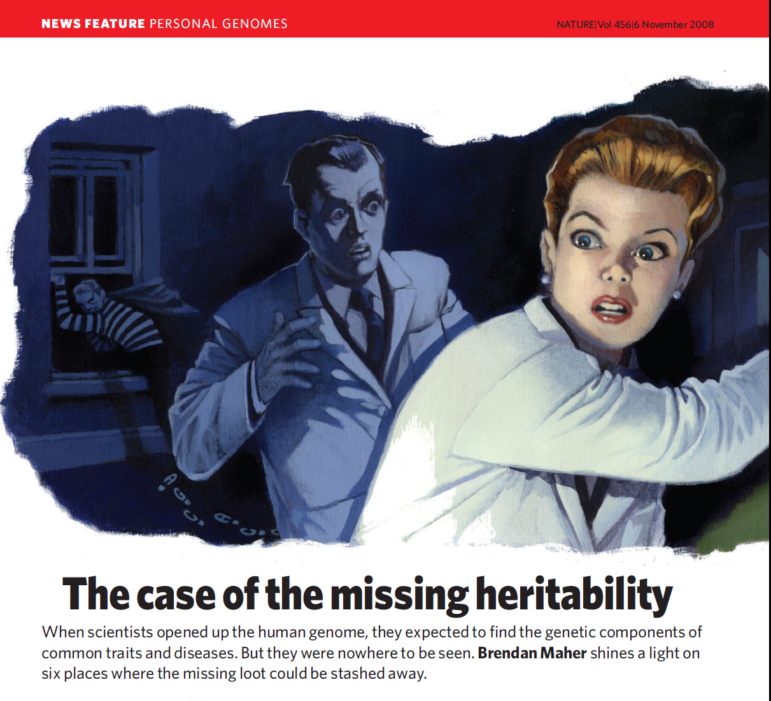

Slide 51
Sequencing and Rare Variants

Slide 52
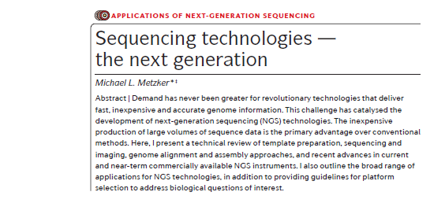
Metzker et al (2010) Nature Reviews Genetics

Slide 53
Analysis of Rare Variants
How to combine rare variants?
  “Ordinary” tests of association won’t work
  Collapse across all SNPs?
Which SNPs to include?
  Frequency?
  Function?
How to define a region?

Slide 54
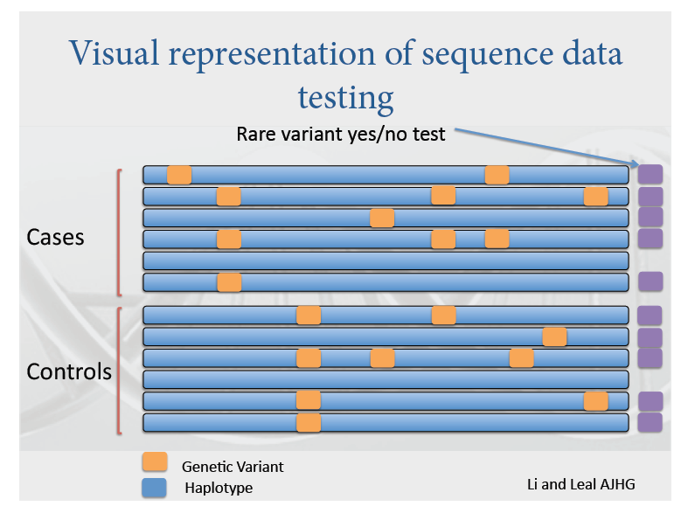

Slide 55
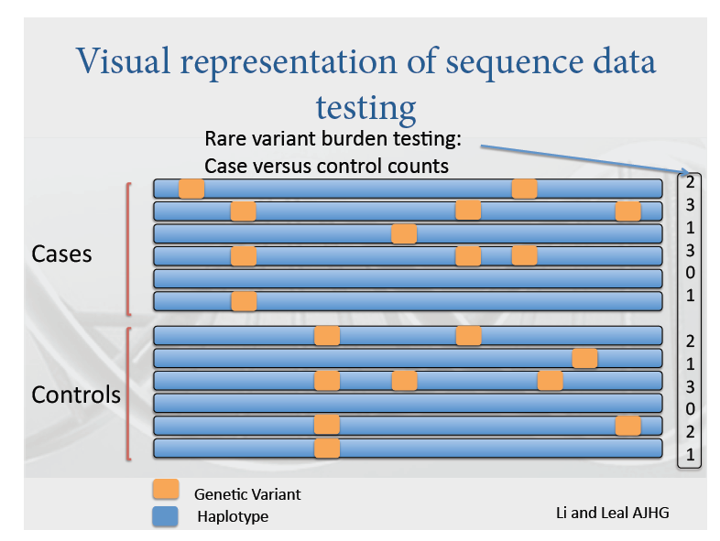

Slide 56
Summary
Genetic association studies can be used to locate common genetic variants that increase risk of disease/affect quantitative phenotypes
Genome-wide association spectacularly successful in identifying common variants underlying complex traits and disease
The next challenge is to explain the “missing heritability” in the genome. Genome-wide sequencing and the analysis of rare variants will play a major part in this effort

