Slide 1
The Causes of Variation
Lindon Eaves,
VIPBG, Richmond
Boulder,CO
March 2012

Slide 2
Goals
Summarize Causes of Variation
Provide some historical and conceptual background
Introduce some of the ideas to be encountered this week

Slide 3
“Genetics”
The Study of
Variation and Heredity

Slide 4
“Variation”
“Why aren’t we all the same?”

Slide 5
“Heredity”
“Why do things run in families?”

Slide 6
Conflicting Paradigms?
Emerging Synthesis?

Slide 7
1865
Mendel
(particulate inheritance)
Galton (correlation between relatives)
Darwin
(natural selection)
Archibald Garod
R.A. Fisher
Sewall Wright
“Human” Genetics
Oligogenic
Quantitative Genetics
Polygenic
Population Genetics
Sociobiology
Conflicting Paradigms
“Gene Hunting” (HGI)
“Structural Modeling”
(Twins etc.)
SYNTHESiS?
2010

Slide 8
Pretest

Slide 9
Who are the Following People?

Slide 10
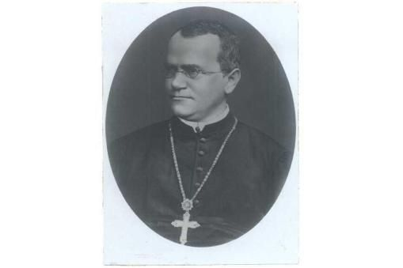

Slide 11
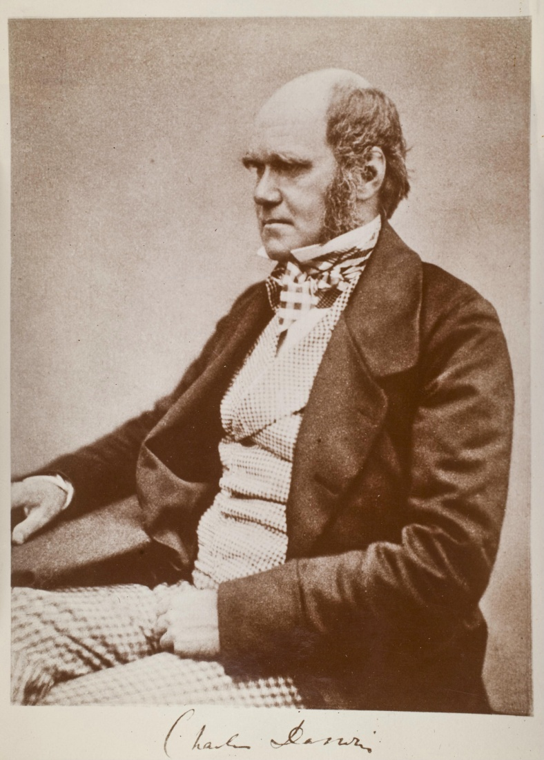

Slide 12
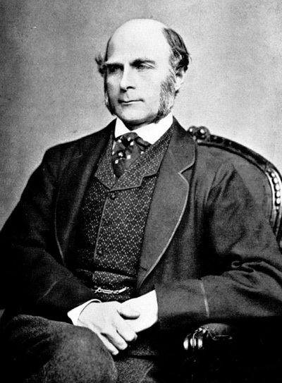
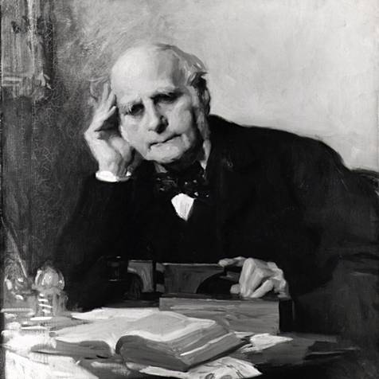

Slide 13
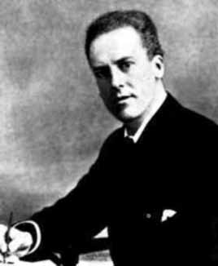
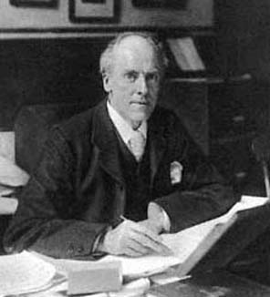

Slide 14
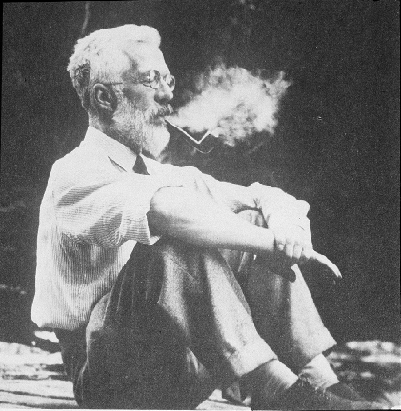

Slide 15
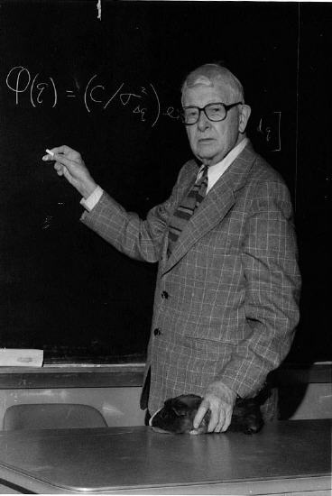

Slide 16
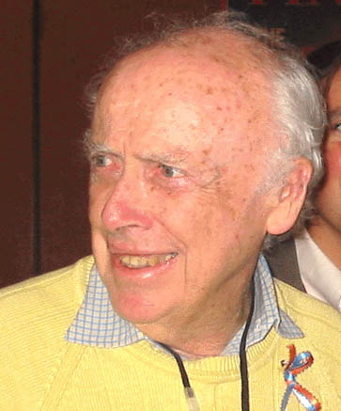
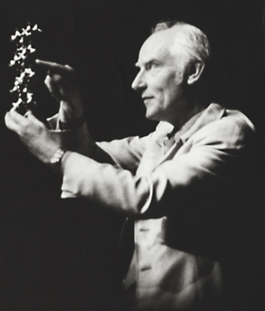

Slide 17
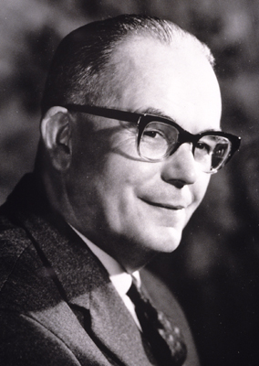
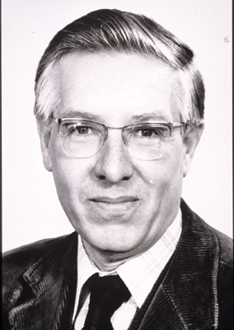

Slide 18
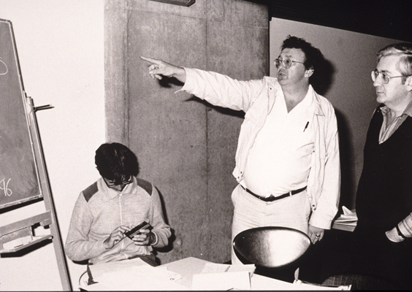

Slide 19
“VARIATION”

Slide 20
Continuous variation

Slide 21
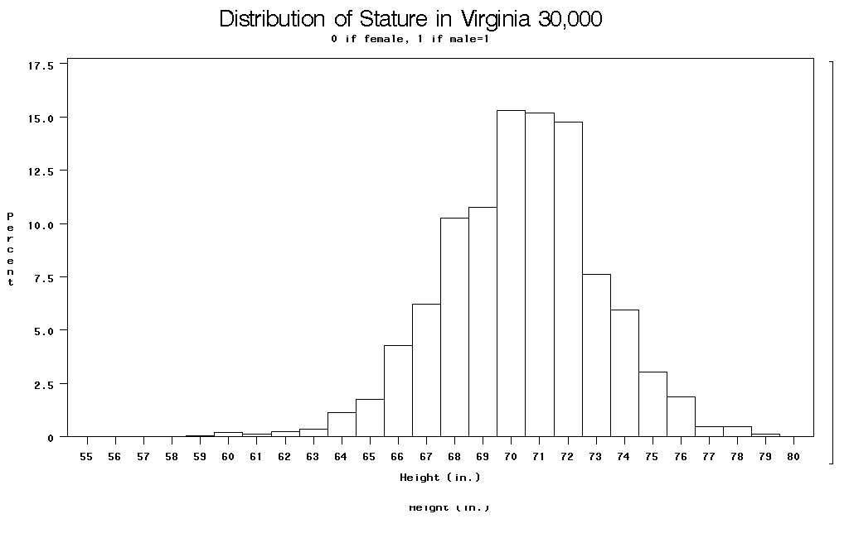

Slide 22
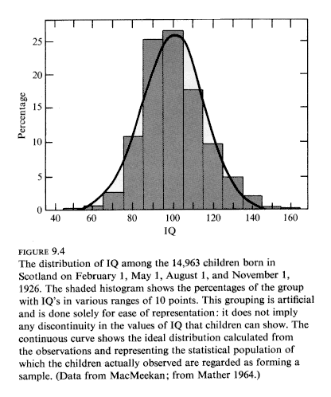

Slide 23
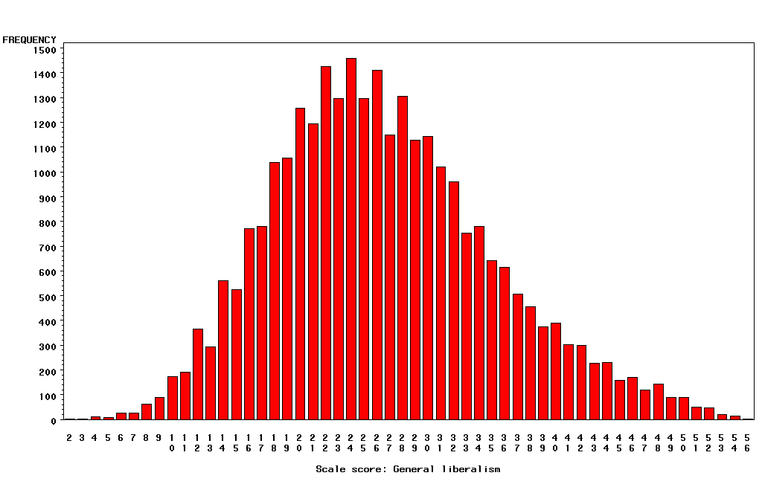
“Liberalism”

Slide 24
Categorical Outcomes
Often called “threshold traits” because people “affected” if they fall above some level (“threshold”) of a measured or hypothesized continuous trait.

Slide 25
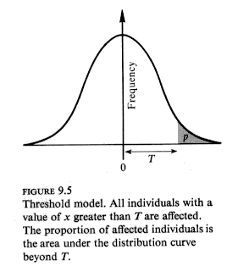

Slide 26
∞
Relationship between continuous normal “liability”
and risk of “diagnosis”
Probability
of
Diagnosis
1
0.5
0
-∞
0
t
+∞
Liability
(Trait Value)
Notes:
Consider e.g. “hypertension”: liability is blood pressure (contininous measure); diagnosis is doctor deciding you are “hypertension”.
Also, e.g. “diabetes” and “fasting glucose”; “republican” and “conservatism”. “Genius” and “IQ”. Etc.

Slide 27
The Causes of Variation

Slide 28
Path diagram for the effects of genes and environment on phenotype
Genotype
Environment
G
r
Latent variables
E
h
e
P
Measured variable
Phenotype

Slide 29
Path diagram for the effects of genes and environment on phenotype
Genotype
Environment
G
r
E
Measured variables
E
h
e
P
Measured variable
Phenotype

Slide 30
A Basic Model
Phenotype=Genotype+Environment
P=G+E {+f(G,E)}
f(G,E) = Genotype-environment interaction and correlation

Slide 31
GENES (G)
Contribution (“Heritability”)
Type of Action (“Additive”, “Dominant”, Epistatic”)
Number, location and function

Slide 32
Environment “E”
Contribution (“1-heritability”)
Type (Shared by family, unique to individual, remote, proximal,short-, long-term)
Non-genetic inheritance
Identification

Slide 33
Interactions and Correlations f(G,E)
Mating system, population structure
GxE interaction
Multiple variables: Genetic and Environmental Correlation
Direction of Causation and Causal networks
G x E interaction
G – E correlation
Remembering, Forgetting, Development (GxAge, G x Time etc.)

Slide 34
“Heredity”

Slide 35
Francis Galton (1822-1911)
1869: Hereditary Genius
1883: Inquiries into Human Faculty and its Development
1884-5: Anthropometic Laboratory at “National Health Exhibition”
Notes:
Astonishing intellectual curiosity: 3-volume biography by his graduate student (Karl Pearson). Self-styled “gentleman”
i.e. didn’t need to earn his living. Could afford to do research. Many interests: numbers (devised vest with grid of pockets to accumulate contingency table from observations); finger-prints; composite photographs; family history (pedigree methods); statistics (devised correlation coefficient);
Measured family resemblance; collected first “twin” data (though Augustine hit on the method in the 4th Cent. Ch. 5 of Civitas Dei.)

Slide 36
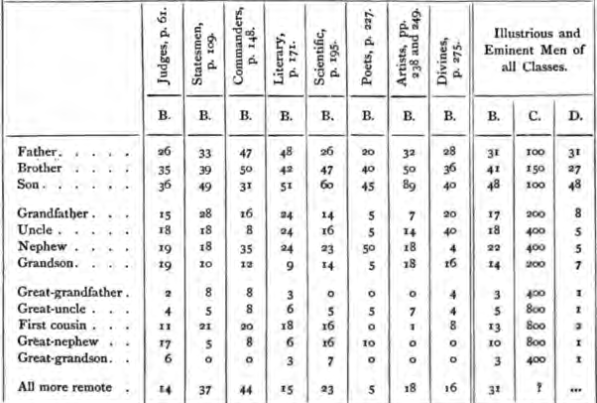
Hereditary Genius (1869, p 317)

Slide 37
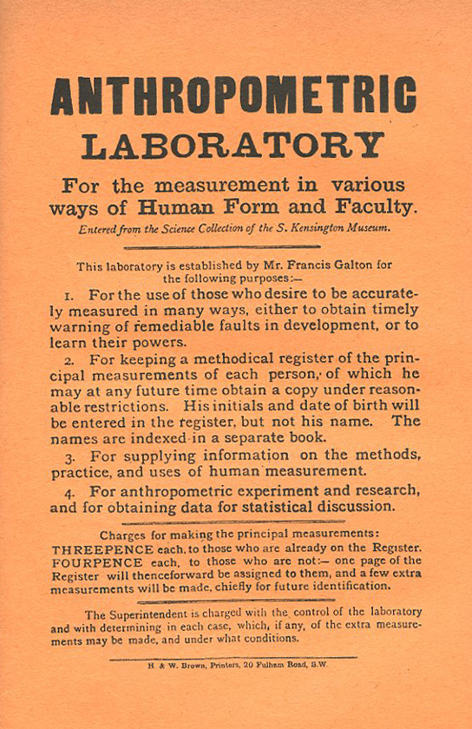
Galton’s Anthropometric Laboratory:

Slide 38
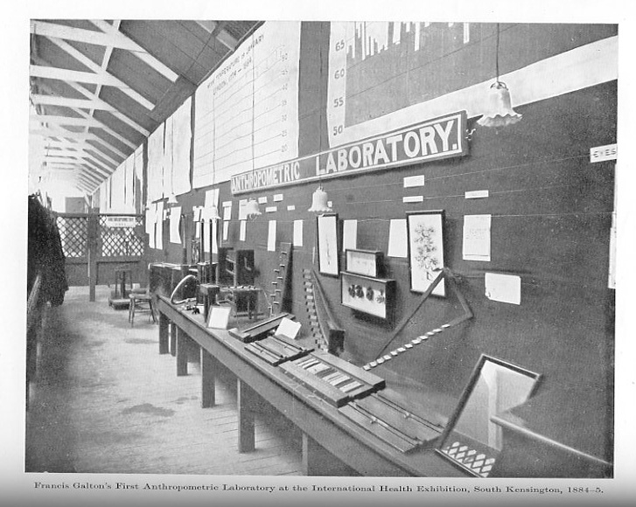

Slide 39
Karl Pearson (1857-1936)
1903: On the Laws of Inheritance in Man: I Physical Characteristics (with Alice Lee)
1904: II Mental and Moral Characteristics
1914: The Life, Letters and Labours of Francis Galton

Slide 40
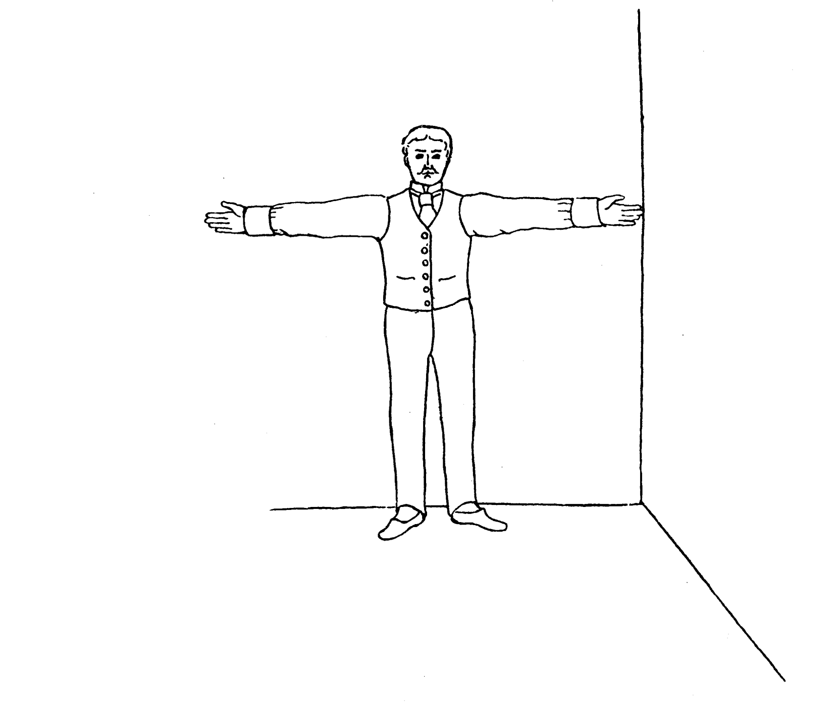
Pearson and Lee’s diagram for measurement of “span” (finger-tip to finger-tip distance)

Slide 41
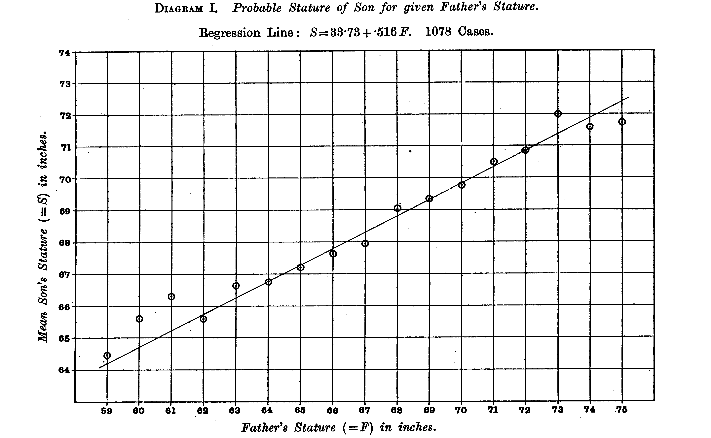
From Pearson and Lee (1903) p.378
Notes:
Notice “Regression to mean”
i.e. Extreme fathers produce son’s who are different from mean in same direction but not as extreme
This happens because fathers only account for part of the differences among their sons – the effects of the mother and random
effects of the environment “dilute” the effects of the father (and vice-versa).

Slide 42
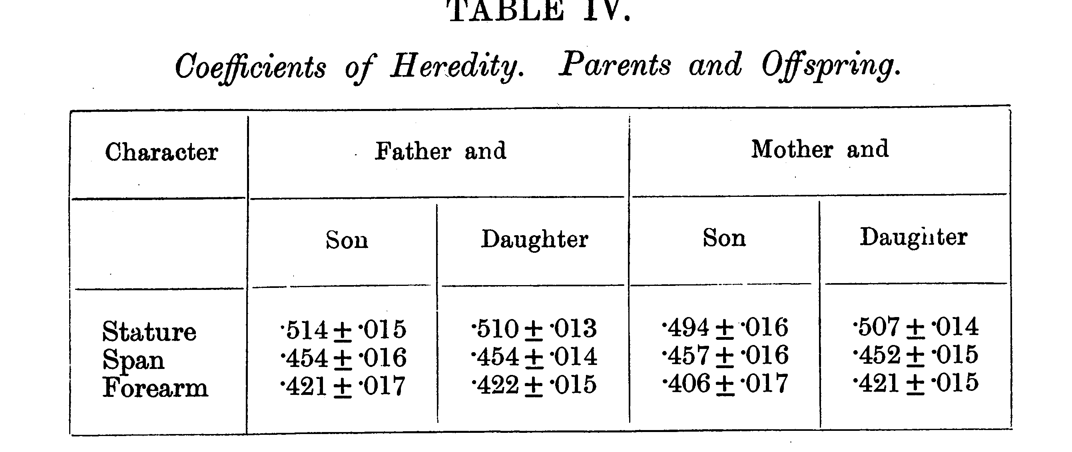
From Pearson and Lee (1903) p.378

Slide 43
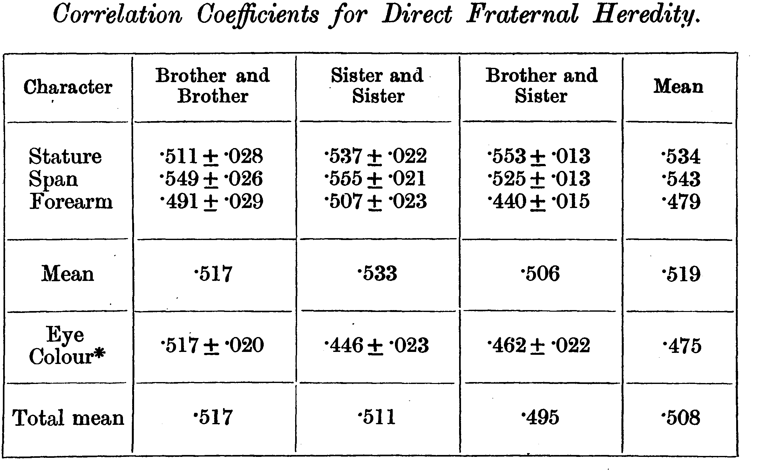
From Pearson and Lee (1903) p.387

Slide 44
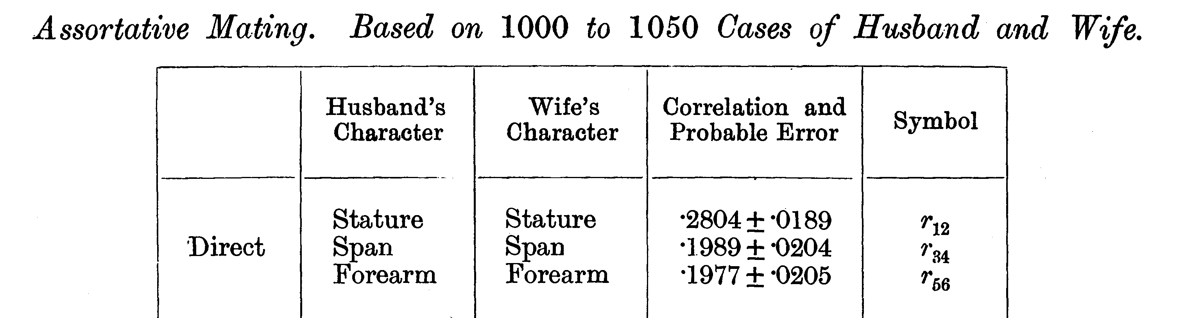
From Pearson and Lee (1903) p. 373

Slide 45
Modern Data
The Virginia 30,000 (N=29691)
The Australia 22,000
(N=20480)

Slide 46
ANZUS 50K: Extended Kinships of Twins
Parents of Twins
Siblings of Twins
Spouses of Twins
Twins
Offspring of Twins
© Lindon Eaves, 2009

Slide 47
Overall sample sizes
Relationship | # of pairs
Parent-offspring Siblings | 25018 18697
Spouses | 8287
DZ Twins MZ Twins | 5120 4623

Slide 48
Nuclear Family Correlations for Stature
(Virginia 30,000 and OZ 22,000)
© Lindon Eaves, 2009
Notes:
Notice: effects of mother and father equal; correlations for sibs close to parents;
Slight correlation between mates (assortative mating).

Slide 49
Nuclear Family Correlations for Liberalism/Conservatism
(Virginia 30,000 and Australia 22,000)
© Lindon Eaves, 2009

Slide 50
The (Really!) BIG Problem
Families are a mixture of genetic and social factors

Slide 51
The Extended Phenotype
World
Parents
Me
Spouse
Siblings
Child
Extended Phenotype

Slide 52
From Genes to Behavior: A Developmental Perspective
Pre- and Peri-Natal,
Culture, Media, Parents,
Siblings, Peers,
Teachers, Infection
Accidents, Life events, Habits,
Life-styles, SES
Environment
Population structure
Stratification
Admixture
DNA
Epi-Genetics
Brain
Behavior
Expression
Methylation
CNVs
Hormones
Metabolites
Proteins
Achievement
Adaptation
Social/Anti-social
Drugs
Depression Anxiety
Suicide
Etc……
Markers
SNPs
Candidate genes
“Imaging”
“Time and Age”

Slide 53
Measured Genotypes
Measured Environments
G₁
G₂
G₃
G₄
E₁
E₂
E₃
E₄
G’₄
G’₁
Endophenotypes
P₁
T
I
ME
?
P₂
P₃
P₄
E’₁
G’₂
E’₃
E’₄
P₅
E
G
P
Outcome Phenotype
G’₅

Slide 54
The (Really!) BIG Problem
Families are a mixture of genetic and social factors

Slide 55
Francis Galton (1822-1911)
1869: Hereditary Genius
1883: Inquiries into Human Faculty and its Development
1884-5: Anthropometic Laboratory at “National Health Exhibition”
Notes:
Astonishing intellectual curiosity: 3-volume biography by his graduate student (Karl Pearson). Self-styled “gentleman”
i.e. didn’t need to earn his living. Could afford to do research. Many interests: numbers (devised vest with grid of pockets to accumulate contingency table from observations); finger-prints; composite photographs; family history (pedigree methods); statistics (devised correlation coefficient);
Measured family resemblance; collected first “twin” data (though Augustine hit on the method in the 4th Cent. Ch. 5 of Civitas Dei.)

Slide 56
Galton’s Solution:
      Twins
      (Though Augustine may have got there first – 5th cent.)

Slide 57
One (?ideal) solution
Twins separated at birth

Slide 58
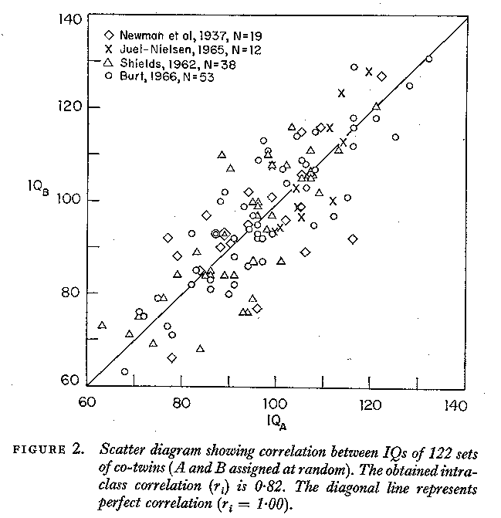

Slide 59
But separated MZs are rare

Slide 60
An easier alternative:
Identical and non-identical twins reared together:
Galton (Again!)

Slide 61
IDENTICAL TWINS
MONOZYGOTIC: Have IDENTICAL genes (G)
Come from the same family (C)
Have unique experiences during life (E)

Slide 62
FRATERNAL TWINS
DIZYGOTIC: Have DIFFERENT genes (G)
Come from the same family (C)
Have unique experiences during life (E)

Slide 63
Figure 9. The correlation between twins for stature (data from the Virginia Twin Study of Adolescent Behavioral Development).
Data from the Virginia Twin Study of Adolescent Behavioral Development

Slide 64
Data from the Virginia Twin Study of Adolescent Behavioral Development

Slide 65
Four scenarios
Twin
Correlation
Causes of Variation

Slide 66
Twin Correlations for Adult Stature
(Virginia 30,000 and Australia 22,000)
© Lindon Eaves, 2009

Slide 67
Four scenarios
Twin
Correlation
Causes of Variation

Slide 68
Twin Correlations for Stature and Liberalism
(Virginia 30,000 and Australia 22,000)
© Lindon Eaves, 2009

Slide 69
Four scenarios
Twin
Correlation
Causes of Variation

Slide 70
Twin correlations for gene expression
York et al.

Slide 71
“Quantitative Genetics”
Analysis of the patterns and mechanisms underlying variation in continuous traits to resolve and identify their genetic and environmental causes.

Slide 72
Gregor Mendel (1822-1884)
1865: “Experiments in Plant Hybridization”
Notes:
Subsequent research showed: a) Mendel’s theory applied to other species; b) applied to humans (inborn errors of metabolism);
c) Mendel’s laws mirrored by behavior of chromsomes at meiosis; d) chromosomes were repositories of genetic information encoded in DNA.

Slide 73
Karl Pearson (1857-1936)
1903: On the Laws of Inheritance in Man: I Physical Characteristics (with Alice Lee)
1904: II Mental and Moral Characteristics
1914: The Life, Letters and Labours of Francis Galton

Slide 74
“Mendelian” Crosses
with Quantitative Traits

Slide 75
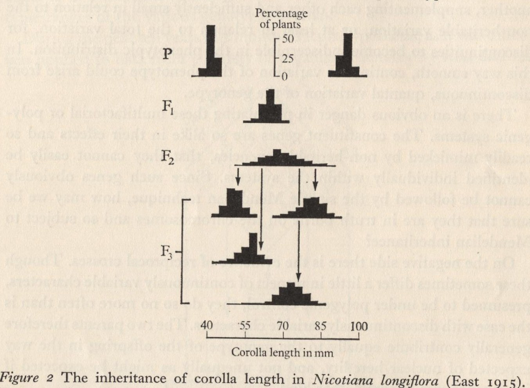
Mendelian Basis of Continuous Variation?
Experimental Breeding Experiments

Slide 76
Experiments Show:
Variation within inbred lines: Environment
F₁’s typically show same within-line variation
F₂’s more variable: Mirrors Mendelian segregation of Mendel’s classical hybridization experiments
Average differences between individual F₂ plants continue to progeny generations (F₃’s etc.)

Slide 77
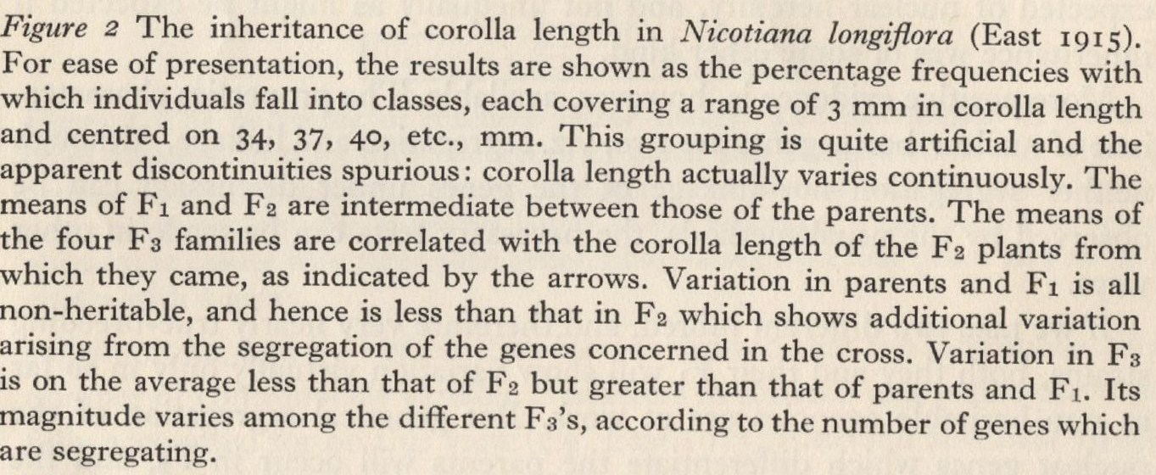
Description of East’s Experiment

Slide 78
Ronald Fisher (1890-1962)
1918: On the Correlation Between Relatives on the Supposition of Mendelian Inheritance
1921: Introduced concept of “likelihood”
1930: The Genetical Theory of Natural Selection
1935: The Design of Experiments

Slide 79
Fisher developed mathematical theory that reconciled Mendel’s work with Galton and Pearson’s correlations

Slide 80
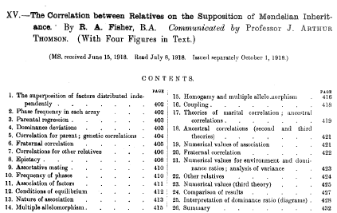

Slide 81
a.
b.
c.

Slide 82
Fisher (1918): Basic Ideas
Continuous variation caused by lots of genes (“polygenic inheritance”)
Each gene followed Mendel’s laws
Environment smoothed out genetic differences
Genes may show different degrees of “dominance”
Genes may have many forms (“mutliple alleles”)
Mating may not be random (“assortative mating”)
Showed that correlations obtained by e.g. Pearson and Lee were explained well by polygenic inheritance

Slide 83
Kenneth Mather 1911-1990
John Jinks 1929-1987

Slide 84
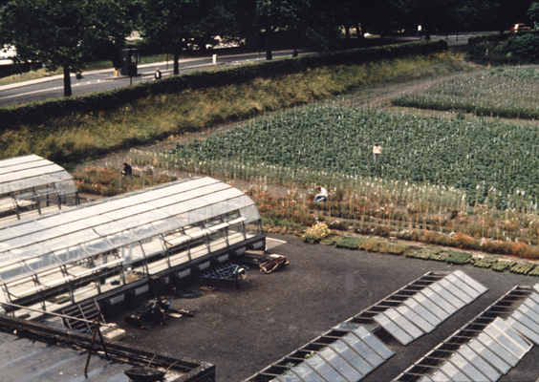

Slide 85
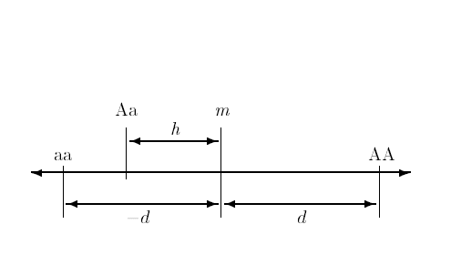
Basic Model for Effects of a Single Gene on a Quantitative Trait
Mid-homozygote
Decreasing
Increasing
Dominance
deviation
Homozygous effect

Slide 86
Parallel (“duplicate”) genes
Sequential (“complementary”) genes
A
A
aa
B
aa
bb
bb
B
C
= Pathway blocked by mutant gene

Slide 87
Combining pathways
Complementary Genes
Phenotypic
Response
Additive
Duplicate Genes
Dose of Bad Alleles

Slide 90
Path diagram for the effects of genes and environment on phenotype
Genotype
Environment
G
r
Latent variables
E
h
e
P
Measured variable
Phenotype

Slide 91
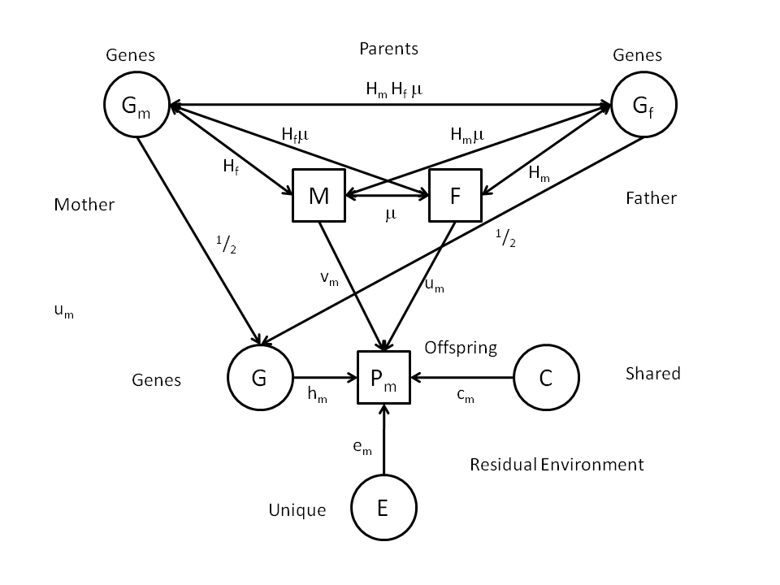
Genetic AND Cultural inheritance?
Notes:
Diagram shows possible causes – called “Path Diagram” (Sewall Wright, 1921).
Will deal with these later in the course.

Slide 92
Multiple Variables

Slide 93
F
N
V
S
U_{N}
U_{V}
U_{S}

Slide 94
EN₁
EV₁
ES₁
Specific
Environments
N₁
V₁
S₁
Twin 1
G₁
Common Genes
g
G₂
Twin 2
N₂
V₂
S₂
Specific
Environments
EN₂
EV₂
ES₂

Slide 95
Development

Slide 96
a. Genetic variation in developmental change: time series with common genes and time-specific environmental “innovations”
Genes
G
h
h
h
h
h
Phenotype
T0
b
T1
b
T2
b
T4
b
T5
Age
e
e
e
e
e
E1
E2
E3
E4
E5
Environment

Slide 98
Genetic differences in growth
G1
Phenotype
G2
Genotypes
G3
Age

Slide 99
Attitudes over the life-span

Slide 100
“Mating”

Slide 101
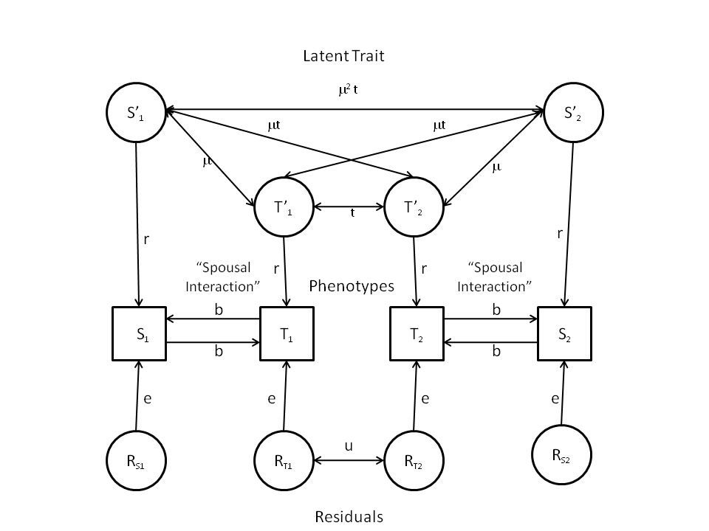
“Twins and Spouses”

Slide 102
f(G,E)
Genotype x Environment Interaction (“GxE”)
Genotype-Environment Correlation
(“rGE”)

Slide 103
GxE

Slide 104
Effect of Strict Religious Upbringing on Expression of Genetic Differences in Behavioral Disinhibition Among Dutch Juveniles.

Slide 105
Genetic Variance and Shared Life Events in Adolescent Females

Slide 106
“The Logic of Scientific Discovery”
NO
Fits?
YES
Revise
Publish
estimates
Model-Fitting
Theory
Model
Data
Model-building
Study design
Data collection

Slide 107
Statisical approach
“Likelihood” (Fisher)
Some models and values of quantities (“parameters”, V_{A}, V_{D} etc) are “unlikely” to produce the data.
Choose those parameters values for that make the data “most likely”, i.e. maximum likelihood.
General statistical approach: applied widely in genetics

Slide 108
Have fun!!!

