Slide 1
Biometrical Genetics
Lindon Eaves,
VIPBG Richmond
Boulder CO, 2012

Slide 2
Biometrical Genetics
How do genes contribute to statistics (e.g. means, variances,skewness, kurtosis)?

Slide 3
Some Literature:
Jinks JL, Fulker DW (1970): Comparison of the biometrical genetical, MAVA, and classical approaches to the analysis of human behavior. Psychol Bull 73(5):311-349.
Kearsy MJ, Pooni HS (1996) The Genetic Analysis of Quantitative Traits. London UK: Chapman Hall.
Falconer DS, Mackay TFC (1996). Introduction to Quantitative Genetics, 4th Ed. Harlow, UK: Addison Wesley Longman.
Neale MC, Cardon LR (1992). Methodology for Genetic Studies of Twins and Families. Ch 3. Dordrecht: Kluwer Academic Publisher. (See revised ed. Neale and Maes, pdf on VIPBG website)

Slide 4
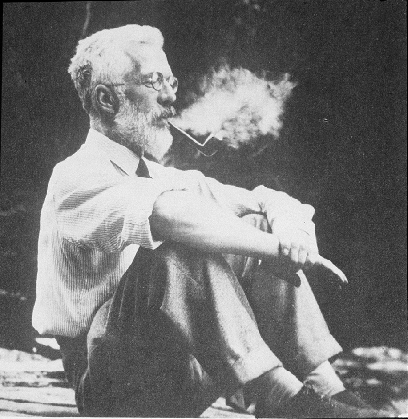
Ronald Fisher (1890-1962)
1918: The Correlation Between Relatives on the Supposition of Mendelian Inheritance
1921: Introduced concept of “likelihood”
1930: The Genetical Theory of Natural Selection
1935: The Design of Experiments

Slide 5
Fisher (1918): Basic Ideas
Continuous variation caused by lots of genes (“polygenic inheritance”)
Each gene followed Mendel’s laws
Environment smoothed out genetic differences
Genes may show different degrees of “dominance”
Genes may have many forms (“mutliple alleles”)
Mating may not be random (“assortative mating”)
Showed that correlations obtained by e.g. Pearson and Lee were explained well by polygenic inheritance

Slide 6
a.
b.
c.

Slide 7
“Mendelian” Crosses
with Quantitative Traits

Slide 8
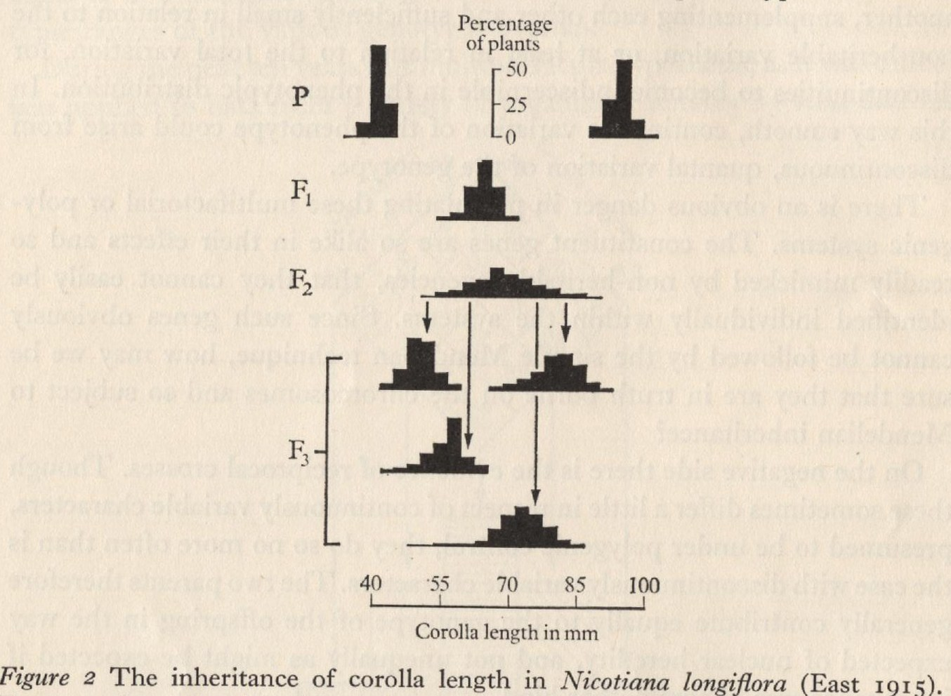
Mendelian Basis of Continuous Variation?
Experimental Breeding Experiments

Slide 9
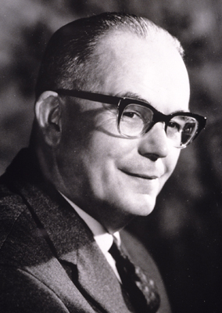
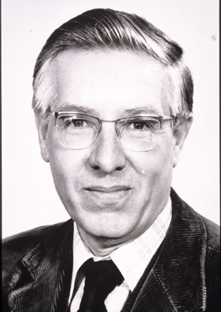

Slide 10
“Biometrical Genetics”
Parsimonious specification of genetic influences in terms of effects and frequencies of individual genes (“model-building”)
Systematic approach to choosing between different interpretations of the same data (“model-fitting”)

Slide 11
A “Good” Model
Fits the data
Explains a lot of different data in terms of relatively few theoretical constructs
Embraces new data without substantial modification or post-hoc explanation (“fudging”)
See e.g. Lakatos (1972) “Criticism and the Growth of Knowledge”

Slide 12
“The Logic of Scientific Discovery”
NO
Fits?
YES
Revise
Publish
estimates
Model-Fitting
Theory
Model
Data
Model-building
Study design
Data collection

Slide 13
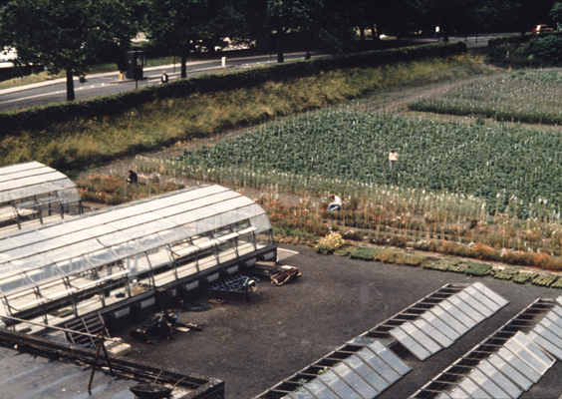

Slide 14
Assumptions (Initially)
Autosomal inheritance
No epistasis
No sex-dependent gene expression
Random mating
Genes of relatives (e.g. mothers) do not affect phenotype directly
No GxE (see Mather and Jinks for GxE)
No G-E correlation
Simple model for environment
Effects of selection/mutation too small to affect result.

Slide 15
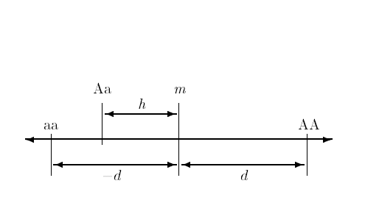
Basic Model for Effects of a Single Gene on a Quantitative Trait
Mid-homozygote
Decreasing
Increasing
Dominance
deviation
Homozygous effect

Slide 16
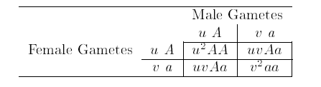
Derivation of Genotype Frequencies
“Hardy-Weinberg Equilibrium”

Slide 17

Genotype Frequencies
in Randomly Mating Population
“Hardy-Weinberg Equilibrium”
frequencies

Slide 18


What is the mean expected to be?
Note: Effects measured from mid-homozygote (“m”)

Slide 19

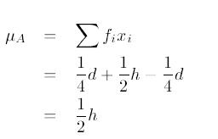
With equal allele frequencies (easier!) put u=v= ½
And the mean is expected to be….

Slide 20
How does A/a affect the variance?

Slide 21
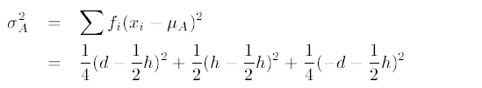
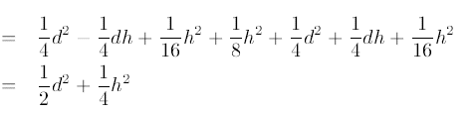
Equal allele frequencies u=v= ½
Dominance component
Additive component

Slide 22
Q: What happens with lots of genes?
A: The effects of the individual genes add up.
IF… the genes are independent
(“linkage equilibrium”)
Requires random mating, complete admixture

Slide 23
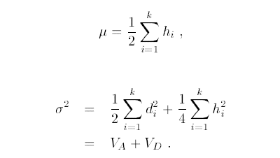
So:
Additive Genetic Variance
Dominance Genetic Variance

Slide 24
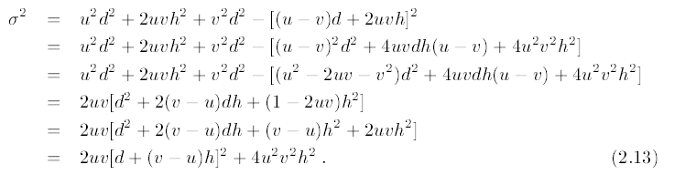
Additive and Dominance Components:
Unequal allele frequencies.
Can show (see e.g. Mather, 1949)
Q: What happens when u=v?
V_{A} V_{D}

Slide 25
Bottom line:
With unequal allele frequencies can still separate V_{A} and V_{D} but their definitions change

Slide 26
Plotting Effect of Allele frequency on Genetic Variance Components (“R”)
d<-1 # Homozygous effect ("additive")
h<-1 # Heterozygous deviation ("dominance")
u<-seq(0.01,0.99,by=.01) # Vector of frequencies of increasing allele
v<-1-u # Frequencies of decreasing allele
VA<-2*u*v*(d+(v-u)*h)^2 # Additive genetic variance
VD<-4*u*u*v*v*h*h # Dominance genetic variance
VP<-VA+VD # Total (genetic) variance
# Plot results
plot(u,VP,type="l",
main="VA (red) and VD (green) as function of increasing allele frequency",
xlab="Frequency of increasing allele",ylab="Variance component")
# Add line for VA
lines(u,VA,col="red")
# Add line for VD
lines(u,VD,col="green")

Slide 27
VA+VD
VA
VD

Slide 28
What about the environment???

Slide 29
Two main sources of environment
Individual experiences – not shared with siblings:
V_{E}
“Family” environment – shared with siblings:
V_{C}

Slide 30
So: the TOTAL variance
(Genes + Environment) is:
V_{P} = V_{A}+V_{D}+V_{E}+V_{C}

Slide 31
“Heritability”
“Broad” heritability:
h²_{b}=(V_{A}+V_{D})/V_{P}
Proportion of total variance explained by genes
“Narrow” heritability:
h²_{n}=V_{A}/V_{P}
Proportion of total variance explained by additive (homozygous) genetic effects (predicts response to selection – Fisher, 1930)

Slide 32
So far: have looked at effects on total variance…
How do V_{A} and V_{D} affect the correlations between relatives?

Slide 33
Contribution of genes to correlation between relatives (r):
r = C/V_{P}
Where C=Covariance between relative pairs
“C” depends of kind of relationship (sibling, parent-offspring, MZ twin etc)
But can also be expressed in terms of V_{A} and V_{D}

Slide 34
Approach
For a given relationship, work out expected frequencies of
each type of pair (AA, aa etc.)
Write phenotypes of each type of relative
Compute cross-products of phenotypes of members of
type of pair
Each cross-product by the corresponding frequency
Add the result of “4” across all pair types
The answer is the covariance you want (if you have done
the algebra right!)

Slide 35
For equal allele frequencies….

Slide 36
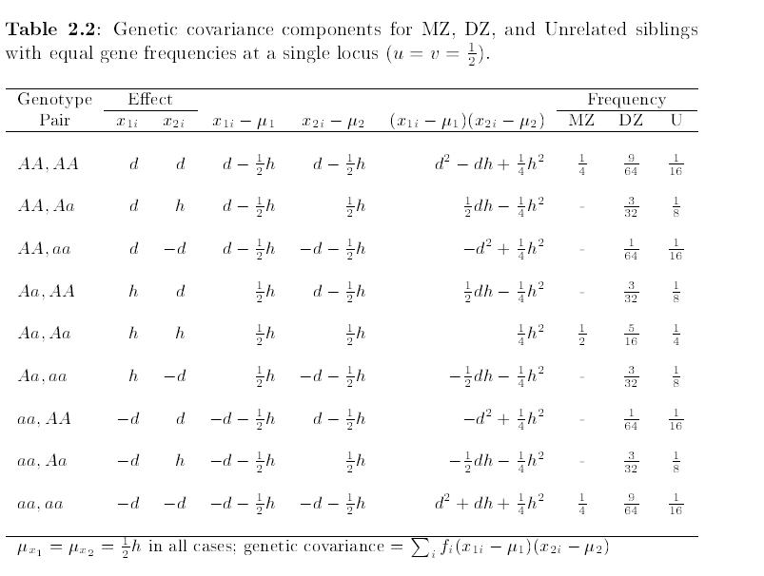

Slide 37
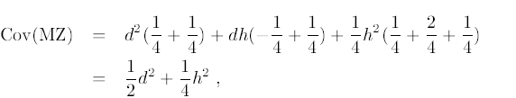
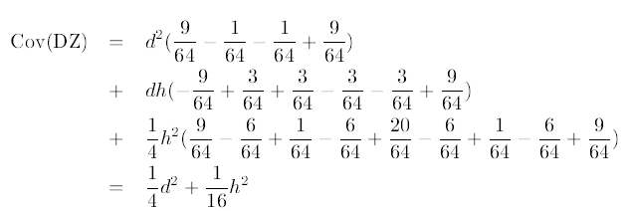
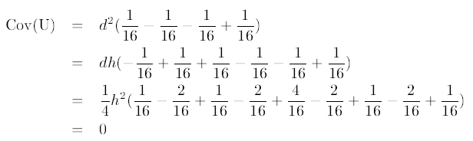
Contribution of one gene to covariance:

Slide 38
Notice that terms in d² and h² are separated – but their coefficients change as a function of relationship

Slide 39
Can add over all genes to get total contribution to covariance
Cov(MZ) = V_{A} + V_{D}
Cov(DZ) = ½V_{A} + ¼V_{D}
Cov(U)= 0

Slide 40
Can use the same approach for other relationships

Slide 41
Contributions of V_{A} and V_{D} to covariances between relatives (ignoring environment)
Relationship | Contribution to Covariance
 | V_{A} | V_{D}
Total variance | 1 | 1
Sibling (DZ twin) | ½ | ¼
MZ twin | 1 | 1
Half-sibling | ¼ | 0
First cousin | ¹/₈ | 0
Parent-offspring | ½ | 0
Avuncular | ¼ | 0
Grand-parent | ¹/₈ | 0
Unrelated | 0 | 0

Slide 42
Adding effects of Environment
V_{P} = V_{A} + V_{D} + V_{E} + V_{C}
Cov(MZ) = V_{A} + V_{D} + V_{C}
Cov(DZ) = ½V_{A} + ¼V_{D} + V_{C}
Cov(UT) = V_{C}
Etc.

Slide 43
To get the expected correlations
Just divided expectations by expected total variance
Results are proportional contributions of V_{A}, V_{D} etc. to total variance

Slide 44
Practice (paper and pencil)
Pick a “d” and “h” (e.g. d=1,h=1; d=1,h=0)
Pick a frequency for the increasing (A) allele (e.g. u=0.2, u=0.7)
Work out VA and VD
Tabulate on board

