Slide 1
“Beyond Twins”
Lindon Eaves,
VIPBG, Richmond
Boulder CO,
March 2012

Slide 2
The Twin Tool-Kit
Continuous and categorical data
Twins
Univariate and Multivariate ACE
Developmental Change
Heterogeneity/Moderation
Definition variables
THIS IS JUST A TOOL KIT TO GET STARTED

Slide 3
This week we have pretty much ignored
Assortative Mating
Explicit Specification of the Family Environment (e.g. enviromental effects of parental genotype)
Genotype-environment covariance (e.g. “passive” rGE)
Causal pathways between measures
Some aspects of development

Slide 4
The chances are…
…that your real questions don’t fit into this basic framework
BE CREATIVE…
IMAGINE…

Slide 5
If you can write the model…
…you can fit it
(If you can get the data)

Slide 6
Choose the design and write the model to reflect your own scientific questions
You can combine different elements to answer your question
Here are a few examples but they do not exhaust the possibilities

Slide 7
Extended Kinships of Twins
Parents of Twins
Siblings of Twins
Spouses of Twins
Twins
Offspring of Twins

Slide 8
Can Extend Pedigrees by Using Reports by Relatives
BUT NEED TO BE CAREFUL ABOUT RATER BIASES

Slide 9
Twins and Siblings
Parents of Twins
Siblings of Twins
Spouses of Twins
Twins
Offspring of Twins

Slide 10
Twins and Parents (“TAP”)
Parents of Twins
Siblings of Twins
Spouses of Twins
Twins
Offspring of Twins
© Lindon Eaves, 2009

Slide 11
Behav Genet. 2008 May;38(3):247-56.

Slide 13
Path model for biological and cultural inheritance

Slide 16
The mediating effect of parental neglect on adolescent and young adult anti-sociality: A longitudinal study of twins and their parents (LTAP).
Running title: Childhood adversity and anti-social behavior.
Lindon J Eaves, Elizabeth C Prom, Judy L Silberg
Behav Genet. 2010 Jul;40(4):425-37.

Slide 17
Twins and Parents (“TAP”)
ADULTS
TWINS MEASURED
AS JUVENILES AND ADULTS

Slide 18
Conceptual model for the effects of genes and the family environment on anti-social behavior.

Slide 19
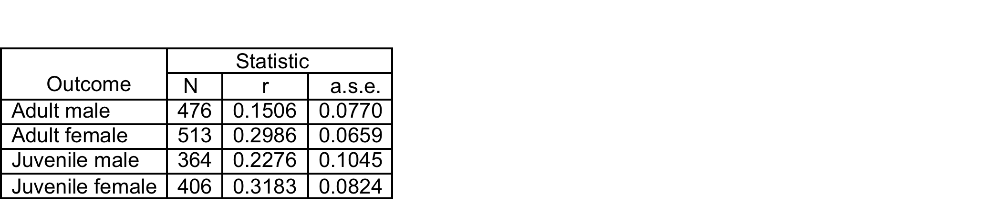
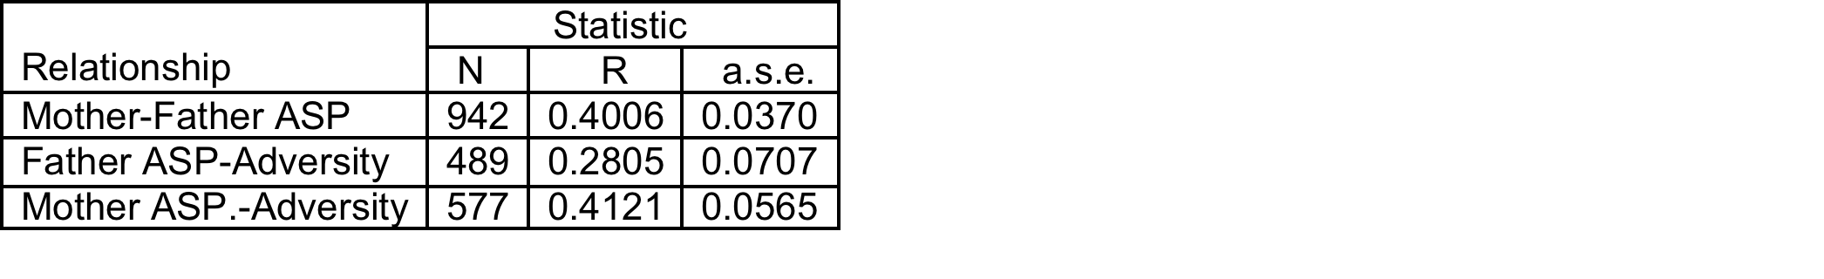
Polychoric correlations between childhood adversity and anti-social behavior of adult and juvenile offspring
Polychoric correlations between parental (adult) anti-social behavior (ASP) and childhood adversity

Slide 20
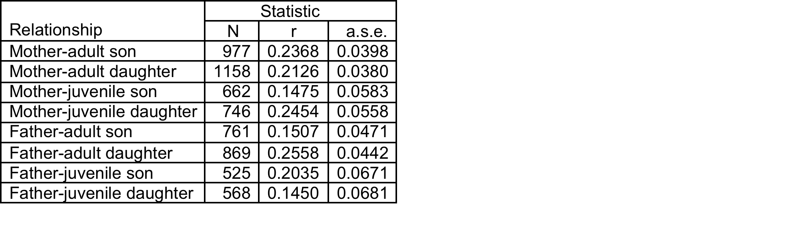
Polychoric correlations between anti-social behavior of (adult) parents
adult (ASP) and juvenile (CD) anti-social behavior of their offspring.

Slide 21
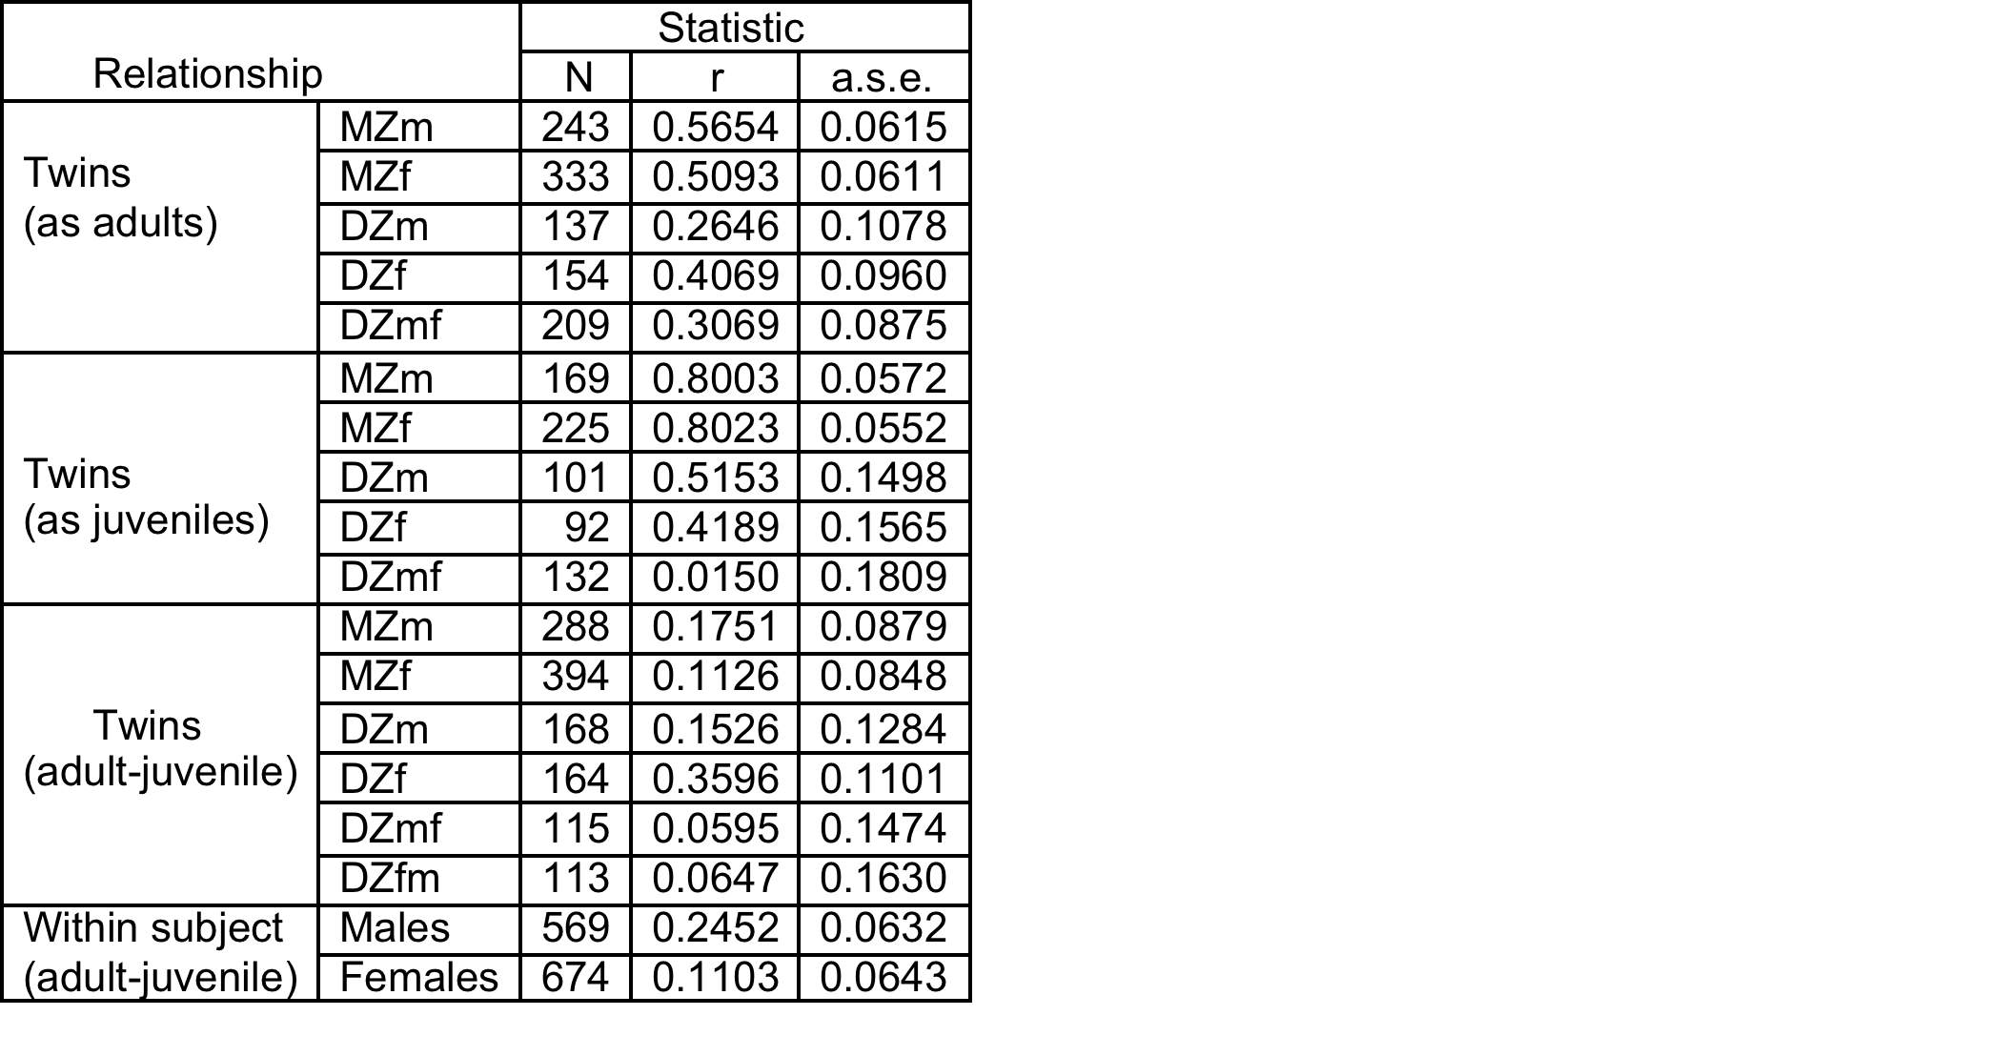
Polychoric correlations for juvenile conduct disorder and
adult anti-social personality in YAFU/VTSABD twins.

Slide 22
Estimated contributions of parents and residual effects to the shared environment of twin offspring.

Slide 23
Effects of the unique and shared environment on adult and juvenile anti-social behavior and females.

Slide 24
Children of Twins (“COT”)
Parents of Twins
Siblings of Twins
Spouses of Twins
Twins
Offspring of Twins

Slide 25
Gestational Age
Racial Differences in Genetic and Environmental Risk to Preterm Birth
Timothy P. York, Jerome F. Strauss,
Michael C. Neale, Lindon J. Eaves
PLoS One. 2010 Aug 25;5(8):e12391.

Slide 26
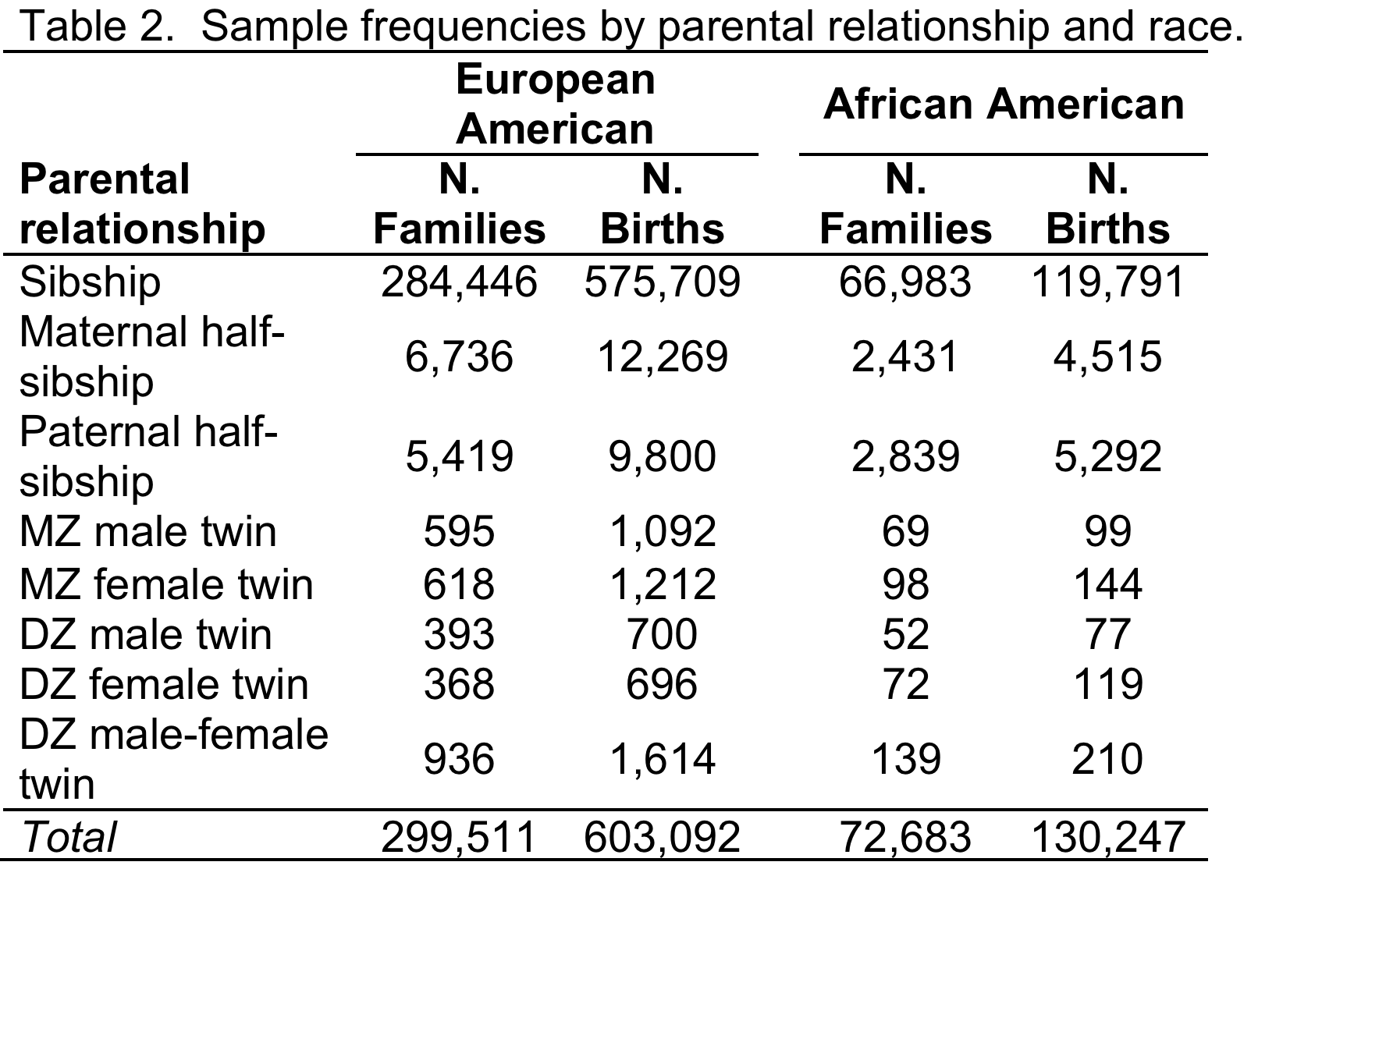

Slide 27
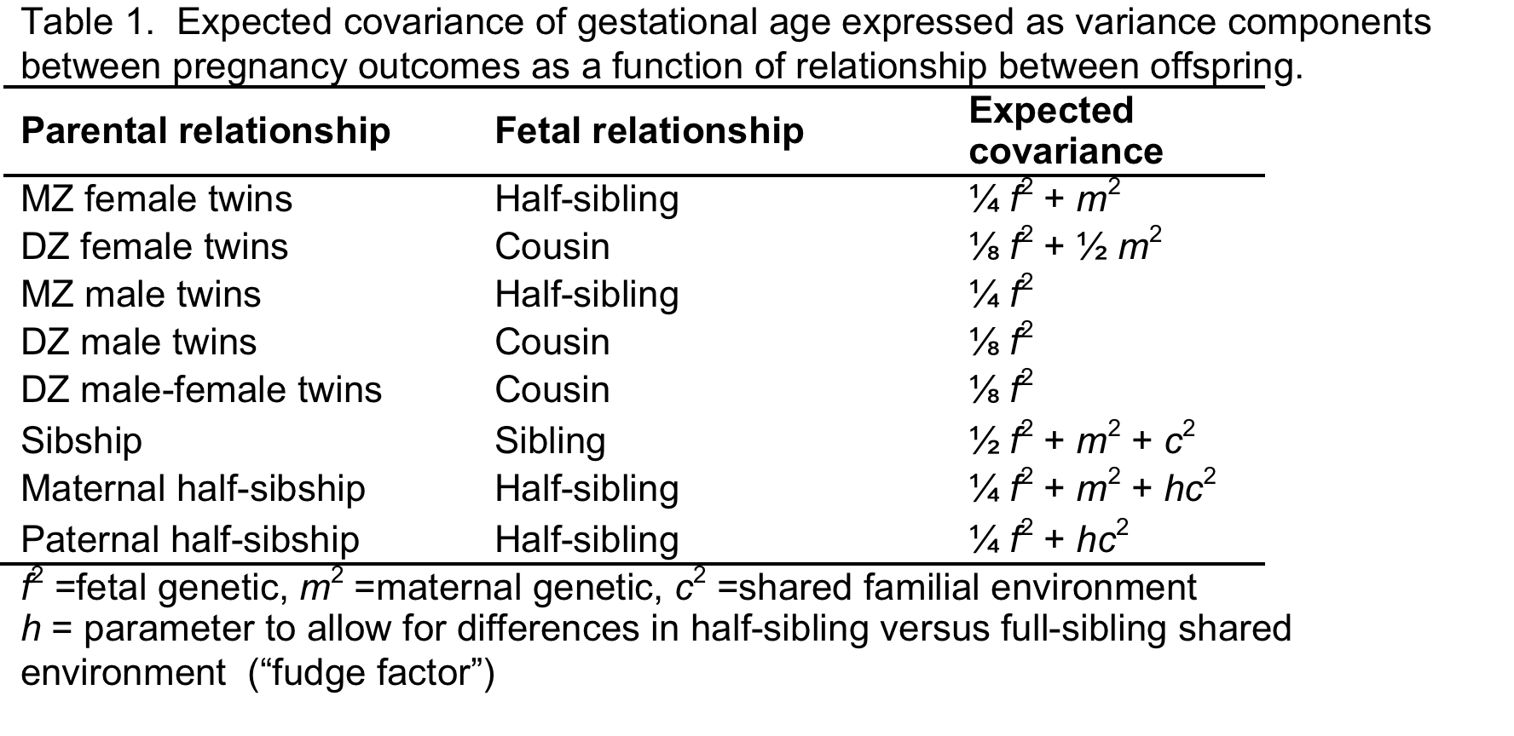

Slide 28
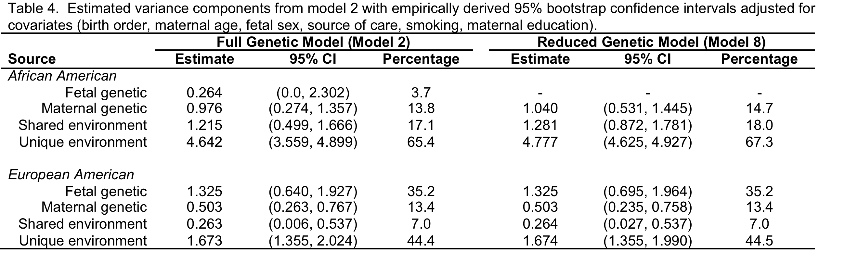

Slide 29
Spouses of Twins (“SPOT”)
Parents of Twins
Siblings of Twins
Spouses of Twins
Twins
Offspring of Twins
© Lindon Eaves, 2009

Slide 30
Modeling the Cultural and Biological Inheritance
of Social and Political Behavior
in Twins and Nuclear Families
Lindon J. Eaves, Peter K. Hatemi,
Andrew C. Heath, Nicholas G. Martin
In P.Hatemi and R.McDermott (2011) “Man is by Nature a Political Animal”, Chicago, IL: University of Chicago Press.

Slide 31
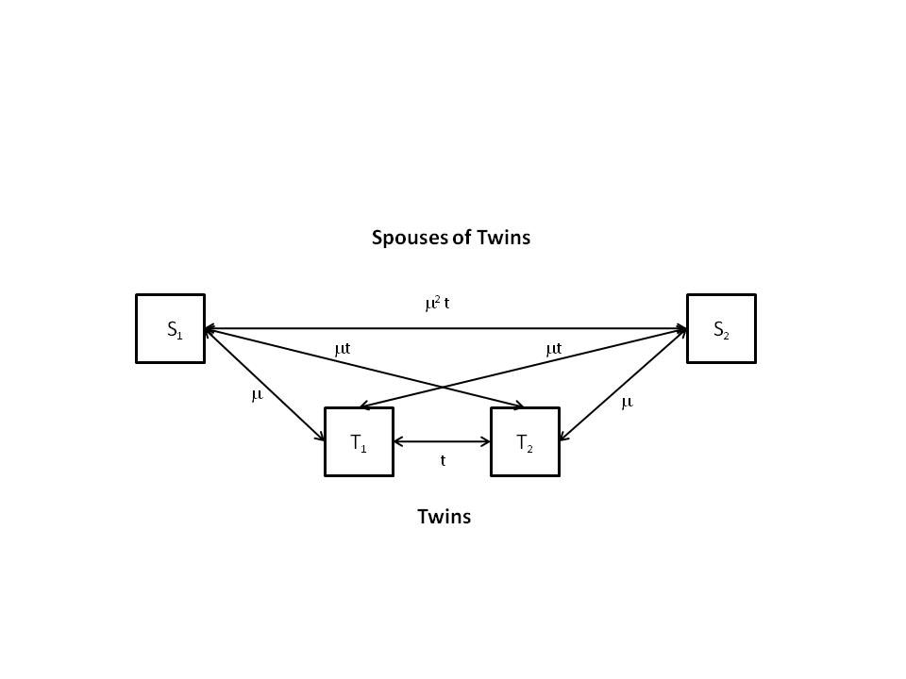
Phenotypic Assortment

Slide 32
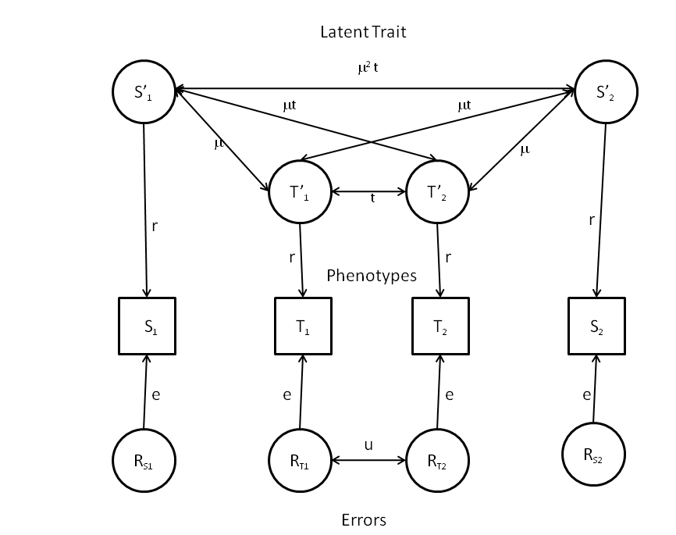
Latent Variable Assortment
(Phenotype subject to error)

Slide 33
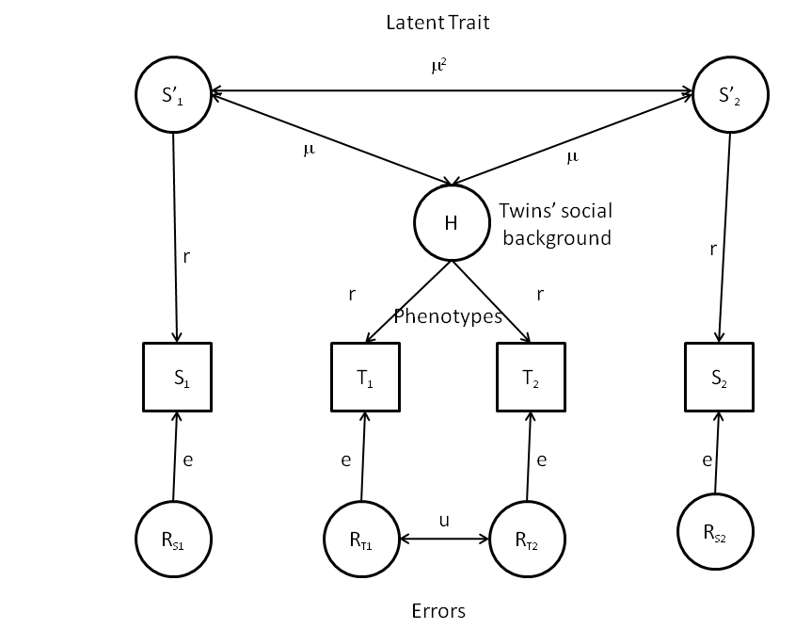
“Social Homogamy”

Slide 34
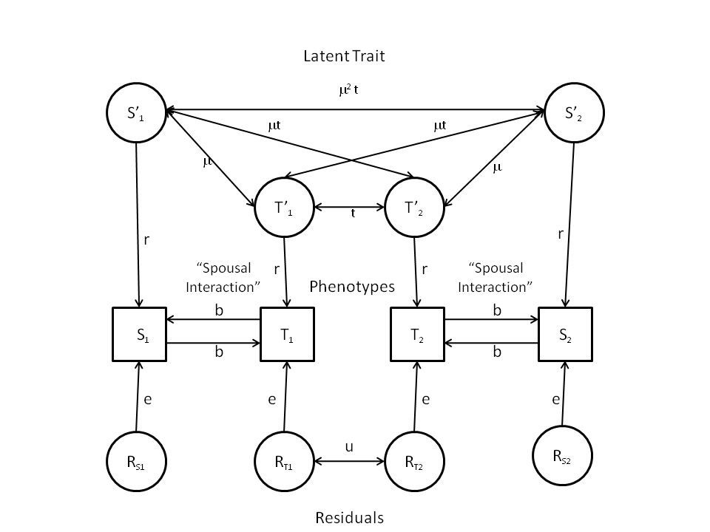
Spousal Interaction

Slide 35
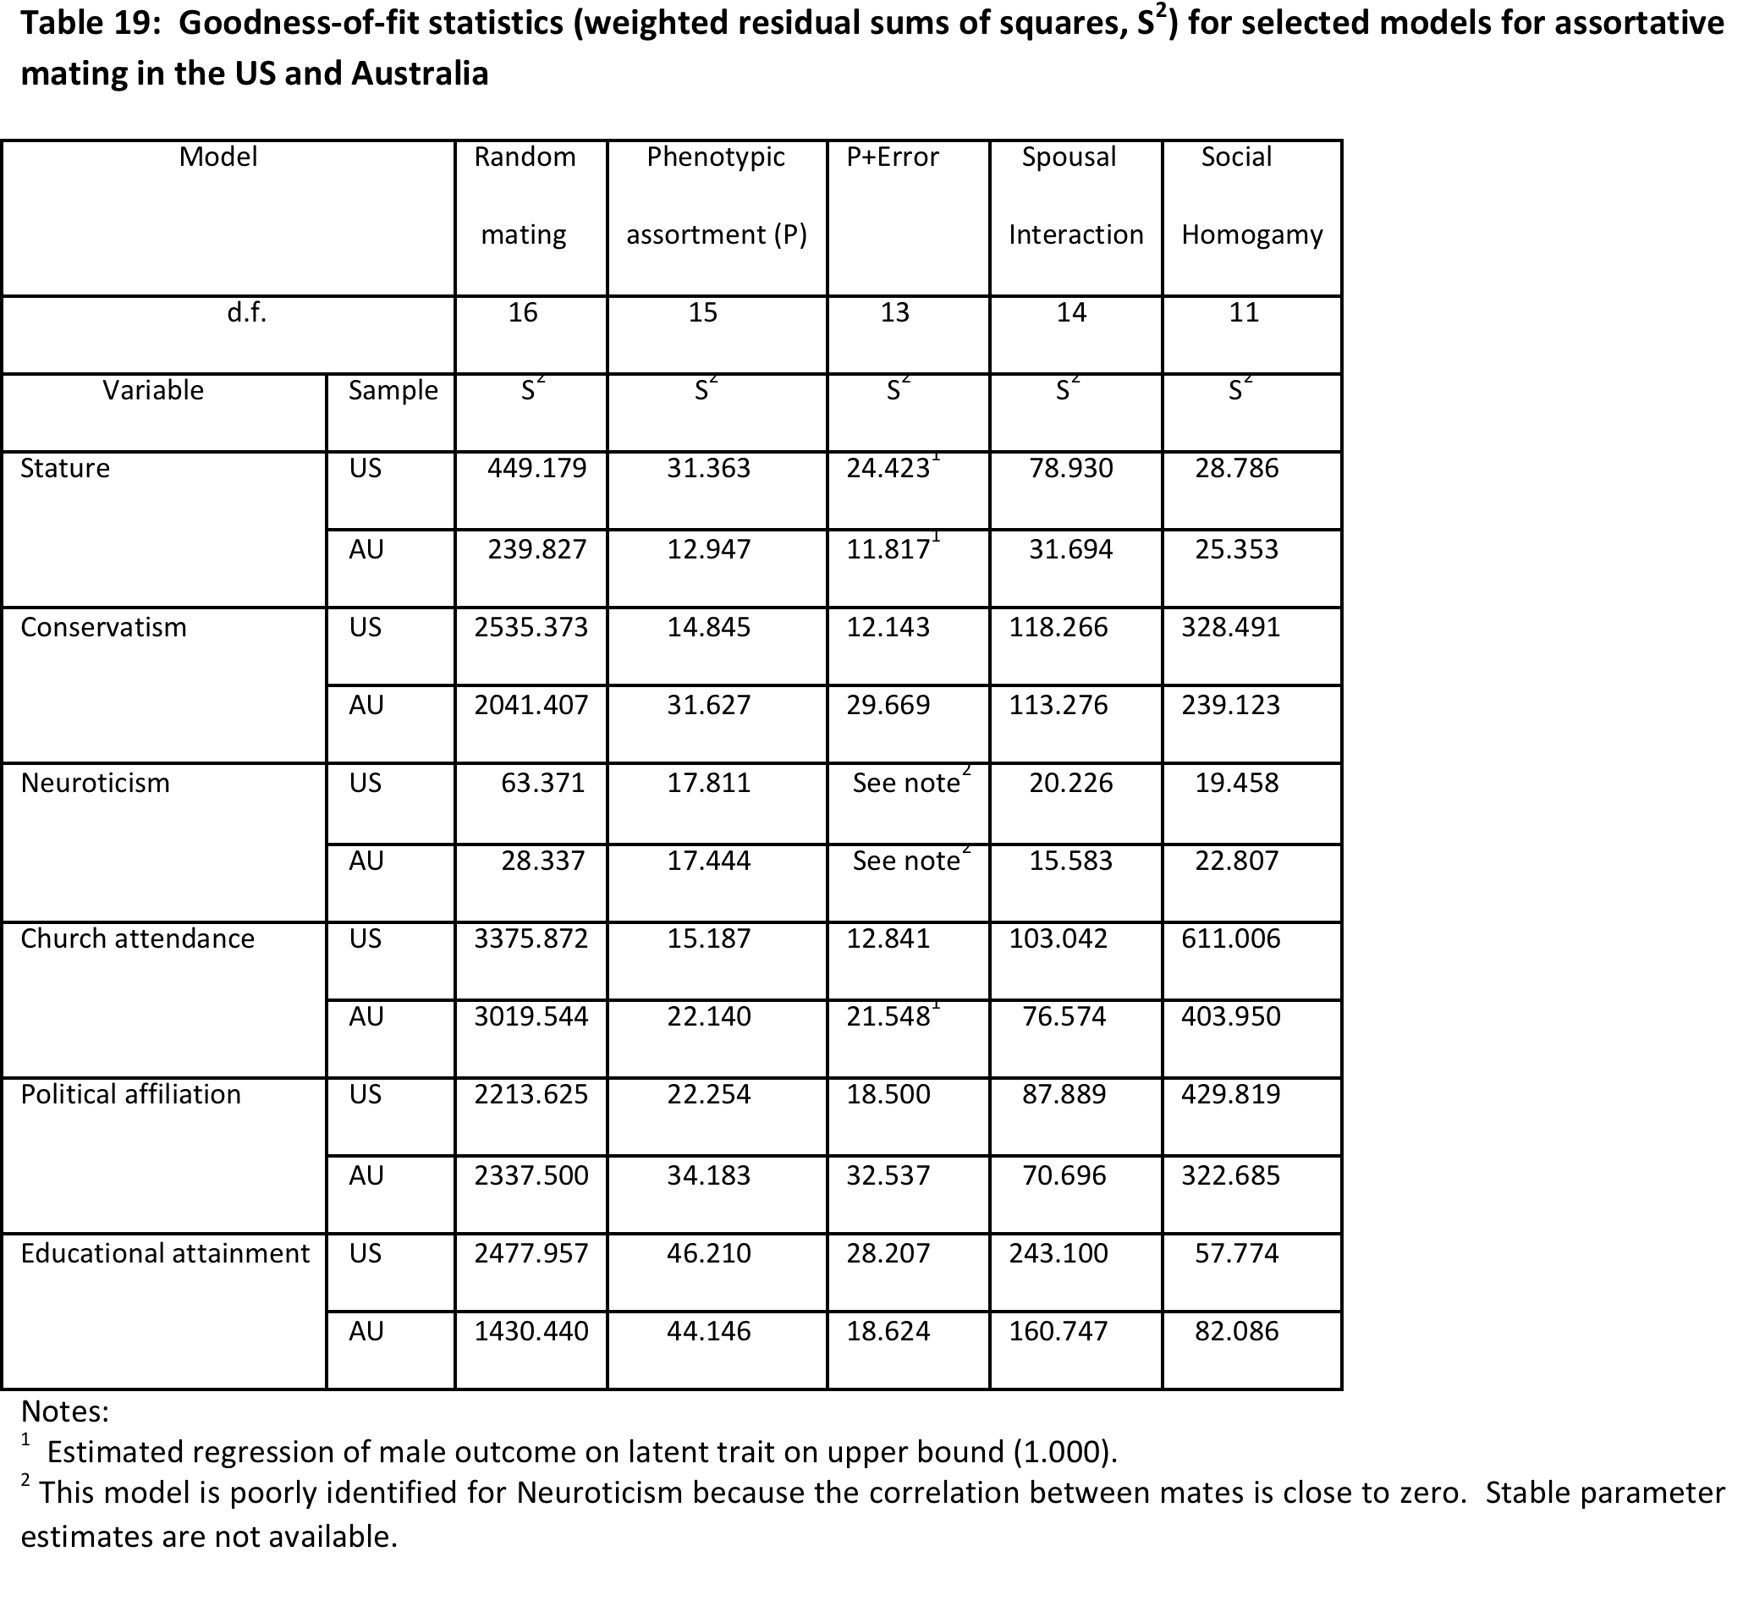

Slide 37
E-COT
ADULTS
Parents of Twins
Twins
Twins
Offspring of Twins
JUVENILES

Slide 38
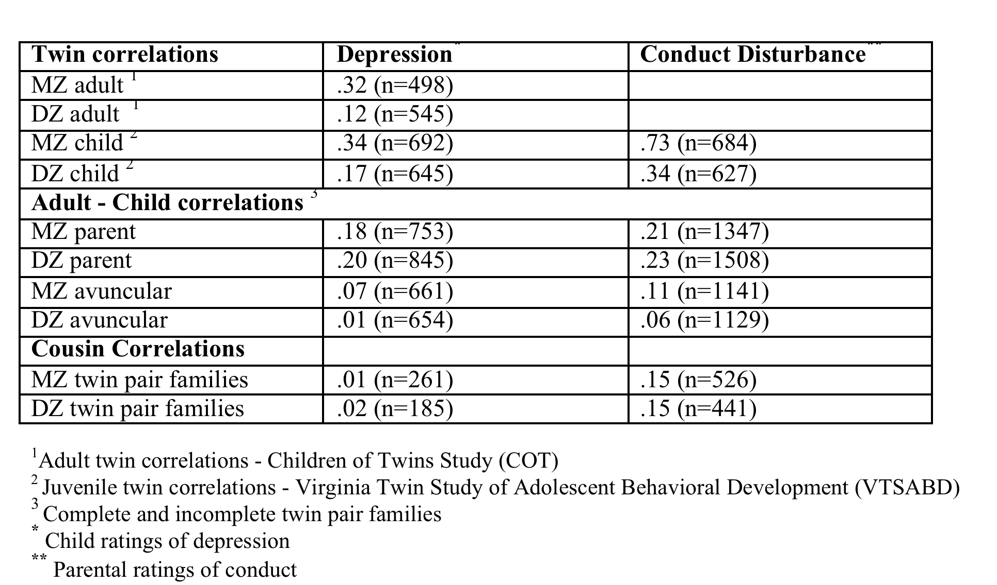
Twin, parent - child, avuncular – offspring, and cousin correlations for MZ and DZ twins.

Slide 39
Children of Twins Model (COT)

Slide 40
Parental Depression and Childhood Outcomes: Results

Slide 41
The Full Monty
Parents of Twins
Siblings of Twins
Spouses of Twins
Twins
Offspring of Twins

Slide 42
Genetic and Environmental Factors in Relative Body Weight and Human Adiposity
Hermine H. M. Maes, Michael C. Neale and Lindon J. Eaves.
Behavior Genetics, Vol. 27. No. 4, 1997

Slide 44
The “Stealth” Model

