Slide 1
Copy files
Go to Faculty\marleen\Boulder2012\Multivariate
Copy all files to your own directory
Go to Faculty\kees\Boulder2012\Multivariate
Copy all files to your own directory

Slide 2
Introduction to Multivariate
Genetic Analysis (1)
Marleen de Moor, Kees-Jan Kan & Nick Martin

Slide 3
Outline
11.00-12.30
  Lecture Bivariate Cholesky Decomposition
  Practical Bivariate analysis of IQ and attention problems
12.30-13.30 LUNCH
13.30-15.00
  Lecture Multivariate Cholesky Decomposition
  PCA versus Cholesky
  Practical Tri- and Four-variate analysis of IQ, educational attainment and attention problems

Slide 4
Outline
11.00-12.30
  Lecture Bivariate Cholesky Decomposition
  Practical Bivariate analysis of IQ and attention problems
12.30-13.30 LUNCH
13.30-15.00
  Lecture Multivariate Cholesky Decomposition
  PCA versus Cholesky
  Practical Tri- and Four-variate analysis of IQ, educational attainment and attention problems

Slide 5
Aim / Rationale multivariate models
Aim:
To examine the source of factors that make traits correlate or co-vary
Rationale:
Traits may be correlated due to shared genetic factors (A or D) or shared environmental factors (C or E)
Can use information on multiple traits from twin pairs to partition covariation into genetic and environmental components

Slide 6
Example
Interested in relationship between ADHD and IQ
How can we explain the association
  Additive genetic factors (r_{G})
  Common environment (r_{C})
  Unique environment (r_{E})
r_{G}
r_{C}
1
1
1
1
A₁
C₁
A₂
C₂
a11
c11
a22
c22
ADHD
IQ
e11
e22
1
1
E₁
E₂
r_{E}

Slide 7
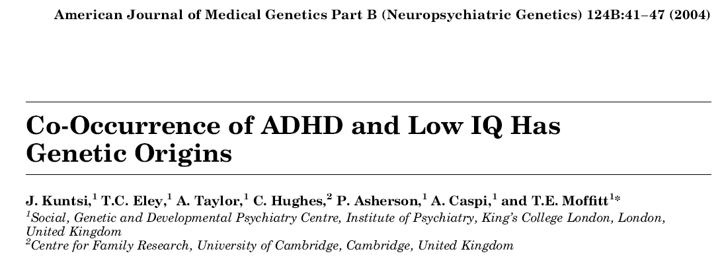
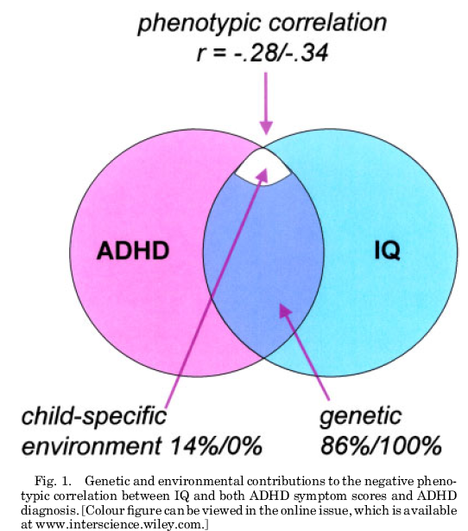

Slide 8
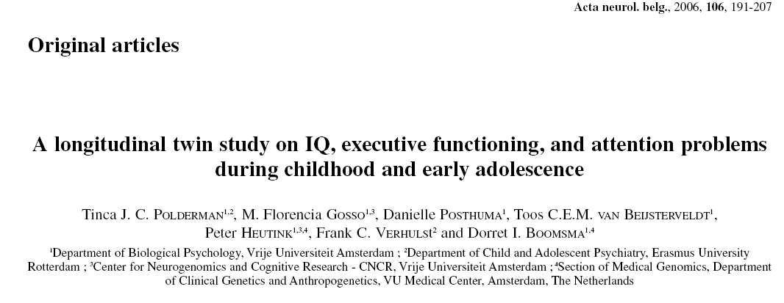
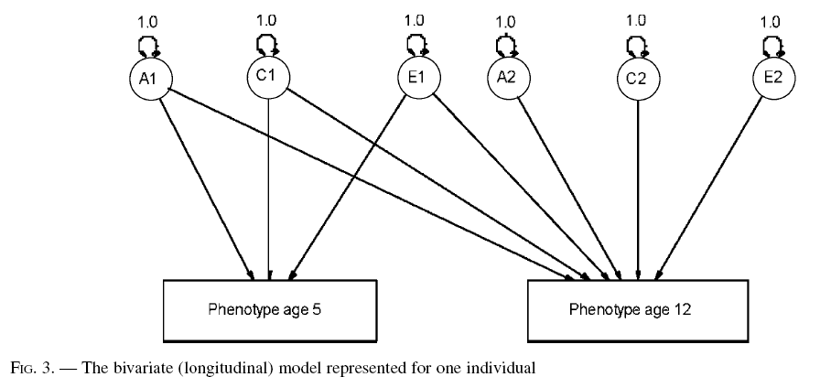
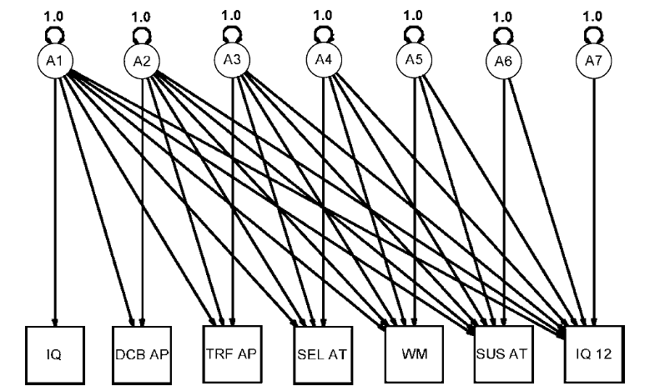
Bivariate Cholesky
Multivariate Cholesky

Slide 9
Sources of information
Two traits measured in twin pairs
Interested in:
  Cross-trait covariance within individuals = phenotypic covariance
  Cross-trait covariance between twins = cross-trait cross-twin covariance
  MZ:DZ ratio of cross-trait covariance between twins

Slide 10
Observed Covariance Matrix: 4x4
Twin 1
Twin 2
 | Phenotype 1 | Phenotype 2 | Phenotype 1 | Phenotype 2
Phenotype 1 | Variance P1
Phenotype 2 | Covariance P1-P2 | Variance P2
Phenotype 1 | Within-trait P1 | Cross-trait | Variance P1
Phenotype 2 | Cross-trait | Within-trait P2 | Covariance P1-P2 | Variance P2
Twin 1
Twin 2

Slide 11
Observed Covariance Matrix: 4x4
Twin 1
Twin 2
 | Phenotype 1 | Phenotype 2 | Phenotype 1 | Phenotype 2
Phenotype 1 | Variance P1
Phenotype 2 | Covariance P1-P2 | Variance P2
Phenotype 1 | Within-trait P1 | Cross-trait | Variance P1
Phenotype 2 | Cross-trait | Within-trait P2 | Covariance P1-P2 | Variance P2
Within-twin covariance
Twin 1
Within-twin covariance
Twin 2

Slide 12
Observed Covariance Matrix: 4x4
Twin 1
Twin 2
 | Phenotype 1 | Phenotype 2 | Phenotype 1 | Phenotype 2
Phenotype 1 | Variance P1
Phenotype 2 | Covariance P1-P2 | Variance P2
Phenotype 1 | Within-trait P1 | Cross-trait | Variance P1
Phenotype 2 | Cross-trait | Within-trait P2 | Covariance P1-P2 | Variance P2
Within-twin covariance
Twin 1
Cross-twin covariance
Within-twin covariance
Twin 2

Slide 13
Cholesky decomposition
1
1
1/.5
1/.5
1
1
C₁
1
1
C₂
1
1
C₁
1
1
C₂
A₁
A₂
A₁
A₂
c₂₁
c₂₁
a₁₁
c₁₁
a₂₁
a₂₂
c₂₂
a₁₁
c₁₁
a₂₁
a₂₂
c₂₂
Twin 1
Phenotype 1
Twin 1
Phenotype 2
Twin 2
Phenotype 1
Twin 2
Phenotype 2
e₁₁
e₂₁
e₂₂
e₁₁
e₂₁
e₂₂
1
1
1
1
E₁
E₂
E₁
E₂

Slide 14
Now let’s do the path tracing!
1
1
1/.5
1/.5
1
1
C₁
1
1
C₂
1
1
C₁
1
1
C₂
A₁
A₂
A₁
A₂
c₂₁
c₂₁
a₁₁
c₁₁
a₂₁
a₂₂
c₂₂
a₁₁
c₁₁
a₂₁
a₂₂
c₂₂
Twin 1
Phenotype 1
Twin 1
Phenotype 2
Twin 2
Phenotype 1
Twin 2
Phenotype 2
e₁₁
e₂₁
e₂₂
e₁₁
e₂₁
e₂₂
1
1
1
1
E₁
E₂
E₁
E₂

Slide 15
Within-Twin Covariances (A)
1
1
A₁
A₂
a₁₁
a₂₁
a₂₂
Twin 1
Phenotype 1
Twin 1
Phenotype 2
Twin 1
 | Phenotype 1 | Phenotype 2
Phenotype 1 | a₁₁²+c₁₁²+e₁₁²
Phenotype 2 | a₁₁a₂₁+c₁₁c₂₁+e₁₁e₂₁ | a₂₂²+a₂₁²+c₂₂²+c₂₁²+e₂₂²+e₂₁²
Twin 1

Slide 16
Within-Twin Covariances (A)
1
1
A₁
A₂
a₁₁
a₂₁
a₂₂
Twin 1
Phenotype 1
Twin 1
Phenotype 2
Twin 1
 | Phenotype 1 | Phenotype 2
Phenotype 1 | a₁₁²+c₁₁²+e₁₁²
Phenotype 2 | a₁₁a₂₁+c₁₁c₂₁+e₁₁e₂₁ | a₂₂²+a₂₁²+c₂₂²+c₂₁²+e₂₂²+e₂₁²
Twin 1

Slide 17
Within-Twin Covariances (A)
1
1
A₁
A₂
a₁₁
a₂₁
a₂₂
Twin 1
Phenotype 1
Twin 1
Phenotype 2
Twin 1
 | Phenotype 1 | Phenotype 2
Phenotype 1 | a₁₁²+c₁₁²+e₁₁²
Phenotype 2 | a₁₁a₂₁+c₁₁c₂₁+e₁₁e₂₁ | a₂₂²+a₂₁²+c₂₂²+c₂₁²+e₂₂²+e₂₁²
Twin 1

Slide 18
Within-Twin Covariances (A)
1
1
A₁
A₂
a₁₁
a₂₁
a₂₂
Twin 1
Phenotype 1
Twin 1
Phenotype 2
Twin 1
 | Phenotype 1 | Phenotype 2
Phenotype 1 | a₁₁²+c₁₁²+e₁₁²
Phenotype 2 | a₁₁a₂₁+c₁₁c₂₁+e₁₁e₂₁ | a₂₂²+a₂₁²+c₂₂²+c₂₁²+e₂₂²+e₂₁²
Twin 1

Slide 19
Within-Twin Covariances (C)
1
1
C₁
C₂
c₁₁
c₂₁
c₂₂
Twin 1
Phenotype 1
Twin 1
Phenotype 2
Twin 1
 | Phenotype 1 | Phenotype 2
Phenotype 1 | a₁₁²+c₁₁²+e₁₁²
Phenotype 2 | a₁₁a₂₁+c₁₁c₂₁+e₁₁e₂₁ | a₂₂²+a₂₁²+c₂₂²+c₂₁²+e₂₂²+e₂₁²
Twin 1

Slide 20
Within-Twin Covariances (E)
Twin 1
Phenotype 1
Twin 1
Phenotype 2
e₁₁
e₂₁
e₂₂
1
1
E₁
E₂
Twin 1
 | Phenotype 1 | Phenotype 2
Phenotype 1 | a₁₁²+c₁₁²+e₁₁²
Phenotype 2 | a₁₁a₂₁+c₁₁c₂₁+e₁₁e₂₁ | a₂₂²+a₂₁²+c₂₂²+c₂₁²+e₂₂²+e₂₁²
Twin 1

Slide 21
Cross-Twin Covariances (A)
1/0.5
1/0.5
1
1
1
1
A₁
A₂
A₁
A₂
a₁₁
a₂₁
a₂₂
a₁₁
a₂₁
a₂₂
Twin 1
Phenotype 1
Twin 1
Phenotype 2
Twin 2
Phenotype 1
Twin 2
Phenotype 2
Twin 1
 | Phenotype 1 | Phenotype 2
Phenotype 1
Phenotype 2 | +c₁₁c₂₁ | +c₂₂²+c₂₁²
Twin 2

Slide 22
Cross-Twin Covariances (A)
1/0.5
1/0.5
1
1
1
1
A₁
A₂
A₁
A₂
a₁₁
a₂₁
a₂₂
a₁₁
a₂₁
a₂₂
Twin 1
Phenotype 1
Twin 1
Phenotype 2
Twin 2
Phenotype 1
Twin 2
Phenotype 2
Twin 1
 | Phenotype 1 | Phenotype 2
Phenotype 1 | 1/0.5a₁₁²+
Phenotype 2 | +c₁₁c₂₁ | +c₂₂²+c₂₁²
Twin 2

Slide 23
Cross-Twin Covariances (A)
1/0.5
1/0.5
1
1
1
1
A₁
A₂
A₁
A₂
a₁₁
a₂₁
a₂₂
a₁₁
a₂₁
a₂₂
Twin 1
Phenotype 1
Twin 1
Phenotype 2
Twin 2
Phenotype 1
Twin 2
Phenotype 2
Twin 1
 | Phenotype 1 | Phenotype 2
Phenotype 1 | 1/0.5a₁₁²+c₁₁²
Phenotype 2 | 1/0.5a₁₁a₂₁+c₁₁c₂₁ | +c₂₂²+c₂₁²
Twin 2

Slide 24
Cross-Twin Covariances (A)
1/0.5
1/0.5
1
1
1
1
A₁
A₂
A₁
A₂
a₁₁
a₂₁
a₂₂
a₁₁
a₂₁
a₂₂
Twin 1
Phenotype 1
Twin 1
Phenotype 2
Twin 2
Phenotype 1
Twin 2
Phenotype 2
Twin 1
 | Phenotype 1 | Phenotype 2
Phenotype 1 | 1/0.5a₁₁²+c₁₁²
Phenotype 2 | 1/0.5a₁₁a₂₁+c₁₁c₂₁ | 1/0.5a₂₂²+1/0.5a₂₁²+c₂₂²+c₂₁²
Twin 2

Slide 25
Cross-Twin Covariances (C)
1
1
1
1
1
C₁
1
C₂
C₁
C₂
c₂₁
c₂₁
c₁₁
c₂₂
c₁₁
c₂₂
Twin 1
Phenotype 1
Twin 1
Phenotype 2
Twin 2
Phenotype 1
Twin 2
Phenotype 2
Twin 1
 | Phenotype 1 | Phenotype 2
Phenotype 1 | 1/0.5a₁₁²+c₁₁²
Phenotype 2 | 1/0.5a₁₁a₂₁+c₁₁c₂₁ | 1/0.5a₂₂²+1/0.5a₂₁²+c₂₂²+c₂₁²
Twin 2

Slide 26
Predicted Model
Twin 1
Twin 2
 | Phenotype 1 | Phenotype 2 | Phenotype 1 | Phenotype 2
Phenotype 1 | a₁₁²+c₁₁²+e₁₁²
Phenotype 2 | a₁₁a₂₁+c₁₁c₂₁+e₁₁e₂₁ | a₂₂²+a₂₁²+c₂₂²+c₂₁²+e₂₂²+e₂₁²
Phenotype 1 | 1/.5a₁₁²+c₁₁² |  | a₁₁²+c₁₁²+e₁₁²
Phenotype 2 | 1/.5a₁₁a₂₁+ c₁₁c₂₁ | 1/.5a₂₂²+1/.5 a₂₁²+c₂₂²+c₂₁² | a₁₁a₂₁+c₁₁c₂₁+e₁₁e₂₁ | a₂₂²+a₂₁²+c₂₂²+c₂₁²+e₂₂²+e₂₁
Within-twin covariance
Twin 1
Cross-twin covariance
Within-twin covariance
Twin 2

Slide 27
Predicted Model
Twin 1
Twin 2
 | Phenotype 1 | Phenotype 2 | Phenotype 1 | Phenotype 2
Phenotype 1 | Variance P1
Phenotype 2 | Covariance P1-P2 | Variance P2
Phenotype 1 | Within-trait P1 | Cross-trait | Variance P1
Phenotype 2 | Cross-trait | Within-trait P2 | Covariance P1-P2 | Variance P2
Within-twin covariance
Twin 1
Cross-twin covariance
Within-twin covariance
Twin 2

Slide 28
Predicted Model
Twin 1
Twin 2
 | Phenotype 1 | Phenotype 2 | Phenotype 1 | Phenotype 2
Phenotype 1 | Variance P1
Phenotype 2 | Covariance P1-P2 | Variance P2
Phenotype 1 | Within-trait P1 | Cross-trait | Variance P1
Phenotype 2 | Cross-trait | Within-trait P2 | Covariance P1-P2 | Variance P2
Within-twin covariance
Variance of P1 and P2
the same across twins
and zygosity groups
Twin 1
Cross-twin covariance
Within-twin covariance
Twin 2

Slide 29
Predicted Model
Twin 1
Twin 2
 | Phenotype 1 | Phenotype 2 | Phenotype 1 | Phenotype 2
Phenotype 1 | Variance P1
Phenotype 2 | Covariance P1-P2 | Variance P2
Phenotype 1 | Within-trait P1 | Cross-trait | Variance P1
Phenotype 2 | Cross-trait | Within-trait P2 | Covariance P1-P2 | Variance P2
Within-twin covariance
Covariance of P1 and P2
the same across twins
and zygosity groups
Twin 1
Cross-twin covariance
Within-twin covariance
Twin 2

Slide 30
Predicted Model
Twin 1
Twin 2
 | Phenotype 1 | Phenotype 2 | Phenotype 1 | Phenotype 2
Phenotype 1 | Variance P1
Phenotype 2 | Covariance P1-P2 | Variance P2
Phenotype 1 | Within-trait P1 | Cross-trait | Variance P1
Phenotype 2 | Cross-trait | Within-trait P2 | Covariance P1-P2 | Variance P2
Within-twin covariance
Cross-twin covariance
within each trait differs
by zygosity
Twin 1
Cross-twin covariance
Within-twin covariance
Twin 2

Slide 31
Predicted Model
Twin 1
Twin 2
 | Phenotype 1 | Phenotype 2 | Phenotype 1 | Phenotype 2
Phenotype 1 | Variance P1
Phenotype 2 | Covariance P1-P2 | Variance P2
Phenotype 1 | Within-trait P1 | Cross-trait | Variance P1
Phenotype 2 | Cross-trait | Within-trait P2 | Covariance P1-P2 | Variance P2
Within-twin covariance
Cross-twin cross-trait
covariance differs by
zygosity
Twin 1
Cross-twin covariance
Within-twin covariance
Twin 2

Slide 32
Example covariance matrix MZ
Twin 1
Twin 2
 | ADHD | IQ | ADHD | IQ
ADHD | 1
IQ | -0.26 | 1
ADHD | 0.64 | -0.21 | 1
IQ | -0.25 | 0.70 | -0.31 | 1
Within-twin covariance
Twin 1
Cross-twin covariance
Within-twin covariance
Twin 2

Slide 33
Example covariance matrix DZ
Twin 1
Twin 2
 | ADHD | IQ | ADHD | IQ
ADHD | 1
IQ | -0.31 | 1
ADHD | 0.20 | -0.12 | 1
IQ | -0.12 | 0.53 | -0.27 | 1
Within-twin covariance
Twin 1
Cross-twin covariance
Within-twin covariance
Twin 2

Slide 34
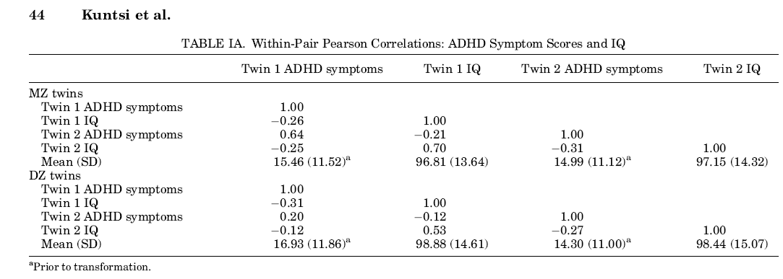
Kuntsi et al. study

Slide 35
Summary
Within-twin cross-trait covariance (phenotypic covariance) implies common aetiological influences
Cross-twin cross-trait covariances >0 implies common aetiological influences are familial
Whether familial influences are genetic or common environmental is shown by MZ:DZ ratio of cross-twin cross-trait covariances

Slide 36
Specification in OpenMx?
OpenMx script….

Slide 37


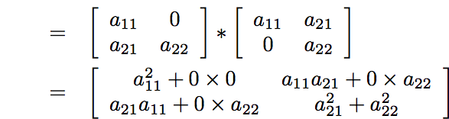
Within-Twin Covariance (A)
1
1
Path Tracing:
A₁
A₂
a₁₁
a₁₁
a₂₁
a₂₁
a₂₂
a₂₂
Lower 2 x 2 matrix:
a1
a2
P1
P2
P1
P2

Slide 38
Within-Twin Covariance (A)
OpenMx
Vars <- c("FSIQ","AttProb")
nv <- length(Vars)
aLabs <- c("a11“, "a21", "a22")
pathA <- mxMatrix(name = "a", type = "Lower", nrow = nv, ncol = nv, labels = aLabs)
covA <- mxAlgebra(name = "A", expression = a %*% t(a))

Slide 39



Within-Twin Covariance (A+C+E)
Using matrix addition, the total within-twin covariance
for the phenotypes is defined as:

Slide 40
OpenMx Matrices & Algebra
OpenMx
Vars <- c("FSIQ","AttProb")
nv <- length(Vars)
aLabs <- c("a11“, "a21", "a22")
cLabs <- c("c11", "c21", "c22")
eLabs <- c("e11", "e21", "e22")
# Matrices a, c, and e to store a, c, and e Path Coefficients
pathA <- mxMatrix(name = "a", type = "Lower", nrow = nv, ncol = nv, labels = aLabs)
pathC <- mxMatrix(name = "c", type = "Lower", nrow = nv, ncol = nv, labels = cLabs)
pathE <- mxMatrix(name = "e", type = "Lower", nrow = nv, ncol = nv, labels = eLabs)
# Matrices generated to hold A, C, and E computed Variance Components
covA <- mxAlgebra(name = "A", expression = a %*% t(a))
covC <- mxAlgebra(name = "C", expression = c %*% t(c))
covE <- mxAlgebra(name = "E", expression = e %*% t(e))
# Algebra to compute total variances and standard deviations (diagonal only)
covPh <- mxAlgebra(name = "V", expression = A+C+E)
matI <- mxMatrix(name= "I", type="Iden", nrow = nv, ncol = nv)
invSD <- mxAlgebra(name ="iSD", expression = solve(sqrt(I*V)))

Slide 41

MZ Cross-Twin Covariance (A)
Twin 1
Twin 2
1
1
1
1
1
1
A₁
A₂
A₁
A₂
a₁₁
a₂₁
a₂₂
a₁₁
a₂₁
a₂₂
P1
P2
P1
P2
Cross-twin within-trait:
P1-P1 = 1*a₁₁²
P2-P2 = 1*a₂₂²+1*a₂₁²
Cross-twin cross-trait:
P1-P2 = 1*a₁₁a₂₁
P2-P1 = 1*a₂₁a₁₁

Slide 42
DZ Cross-Twin Covariance (A)
Twin 1
Twin 2
0.5
0.5
1
1
1
1
A₁
A₂
A₁
A₂
a₁₁
a₂₁
a₂₂
a₁₁
a₂₁
a₂₂
P1
P2
P1
P2
Cross-twin within-trait:
P1-P1 = 0.5a₁₁²
P2-P2 = 0.5a₂₂²+0.5a₂₁²
Cross-twin cross-trait:
P1-P2 = 0.5a₁₁a₂₁
P2-P1 = 0.5a₂₁a₁₁

Slide 43

MZ/DZ Cross-Twin Covariance (C)
Twin 1
Twin 2
1
1
1
1
1
1
C₁
C₂
C₁
C₂
c₁₁
c₂₁
c₂₂
c₁₁
c₂₁
c₂₂
P1
P2
P1
P2
Cross-twin within-trait:
P1-P1 = 1*c₁₁²
P2-P2 = 1*c₂₂²+1*c₂₁²
Cross-twin cross-trait:
P1-P2 = 1*c₁₁c₂₁
P2-P1 = 1*c₂₁c₁₁

Slide 44
Covariance Model for Twin Pairs
OpenMx
# Algebra for expected variance/covariance matrix in MZ
expCovMZ <- mxAlgebra(name = "expCovMZ",
expression = rbind (cbind(A+C+E, A+C),
cbind(A+C, A+C+E) ) )
# Algebra for expected variance/covariance matrix in DZ
expCovDZ <- mxAlgebra(name = "expCovDZ",
expression = rbind (cbind(A+C+E, 0.5%x%A+C),
cbind(0.5%x%A+C, A+C+E) ) )

Slide 45
Unstandardized vs standardized solution

Slide 46
Genetic correlation
It is calculated by dividing the genetic covariance
by the square root of the product of the genetic
variances of the two variables

Slide 47
Genetic correlation
1/.5
1/.5
A1
A2
A1
A2
_{a11}
_{a21}
_{a22}
_{a11}
_{a21}
_{a22}
P1₁
P2₁
P1₂
P2₂
Twin 1
Twin 2
Genetic covariance
Sqrt of the product of the genetic variances

Slide 48
Standardized Solution = Correlated Factors Solution
1/.5
1/.5
A1
A2
A1
A2
a₁₁
a₂₂
a₁₁
a₂₂
P1₁
P2₁
P1₂
P2₂
Twin 1
Twin 2

Slide 49
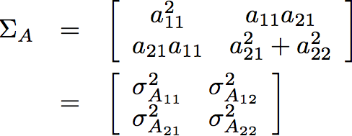
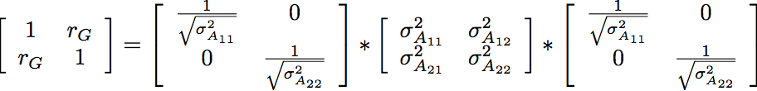
Genetic correlation – matrix algebra
OpenMx
corA <- mxAlgebra(name ="rA", expression = solve(sqrt(I*A))%*%A%*%solve(sqrt(I*A)))

Slide 50
Contribution to phenotypic correlation
If the r_{g} = 1, the two sets of genes overlap completely
r_{g}
A1
A2
If however a₁₁ and a₂₂ are near to zero, genes do not contribute much to the phenotypic correlation
a₁₁
a₂₂
P1₁
P2₁
Twin 1
The contribution to the phenotypic correlation is a function of both heritabilities and the r_{g}

Slide 51
Contribution to phenotypic correlation
r_{g}
Proportion of r_{P1,P2} due to additive genetic factors:
1
1
A₁
A₂
√a_{P1}²
√a_{P2}²
P1
P2
r_{g}
1
1
A₁
A₂
a11
a21
a22
P1
P2

Slide 52



Contribution to phenotypic correlation
OpenMx
ACEcovMatrices <- c("A","C","E","V","A/V","C/V","E/V")
ACEcovLabels <-("covComp_A","covComp_C","covComp_E","Var","stCovComp_A","stCovComp_C","stCovComp_E")
formatOutputMatrices(CholACEFit,ACEcovMatrices,ACEcovLabels,Vars,4)
Proportion of the phenotypic correlation due to genetic
effects
Proportion of the phenotypic correlation due to shared environmental effects
Proportion of the phenotypic correlation due to unshared environmental effects

Slide 53
Summary / Interpretation
Genetic correlation (r_{g}) = the correlation between two latent genetic factors
  High genetic correlation = large overlap in genetic effects on the two phenotypes
Contribution of genes to phenotypic correlation = The proportion of the phenotypic correlation explained by the overlapping genetic factors
  This is a function of the r_{g} and the heritabilities of the two traits

Slide 54
Outline
11.00-12.30
  Lecture Bivariate Cholesky Decomposition
  Practical Bivariate analysis of IQ and attention problems
12.30-13.30 LUNCH
13.30-15.00
  Lecture Multivariate Cholesky Decomposition
  Practical Tri- and Four-variate analysis of IQ, educational attainment and attention problems

Slide 55
Practical
Replicate findings from Kuntsi et al.
126 MZ and 126 DZ twin pairs from Netherlands Twin Register
Age 12
FSIQ
Attention Problems (AP) [mother-report]

Slide 56
Practical – exercise 1
Script CholeskyBivariate.R
Dataset Cholesky.dat
Run script up to saturated model

Slide 57
Practical – exercise 1
Fill in the table with correlations:
MZ | FSIQ1 | AP1 | FSIQ2 | AP2
FSIQ1 | 1
AP1 |  | 1
FSIQ2 |  |  | 1
AP2 |  |  |  | 1
DZ | FSIQ1 | AP1 | FSIQ2 | AP2
FSIQ1 | 1
AP1 |  | 1
FSIQ2 |  |  | 1
AP2 |  |  |  | 1

Slide 58
Practical – exercise 1 - Questions
Are correlations similar to those reported by Kuntsi et al.?
What is the phenotypic correlation between FSIQ and AP?
What are the MZ and DZ cross-twin cross-trait correlations?
What are your expectations for the common aetiological influences?
  Are they familial?
  If yes, are they genetic or shared environmental?

Slide 59
Practical – exercise 2
Run Bivariate ACE model in the script
Look whether you understand the output. If not, ask us!
Adapt the first submodel such that you drop all C
Compare fit of AE model with ACE model
Script: CholeskyBivariate.R

Slide 60
Practical – exercise 2
Fill in the table with fit statistics:
Question:
  Is C significant?
Script: CholeskyBivariate.R
 | -2LL | df | chi2 | ∆df | P-value
ACE model |  |  | - | - | -
AE model

Slide 61
Practical – exercise 3
Now try to fill in the estimates for all paths in the path model (grey boxes):
1
1
A₁
A₂
√
√
FSIQ
AP
√
√
1
1
E₁
E₂

