Slide 1
Slides:
faculty/sanja/Boulder_2012/Moderating_covariances_IQ_SES/Slides

Slide 2
Moderating covariances: practical

Slide 3
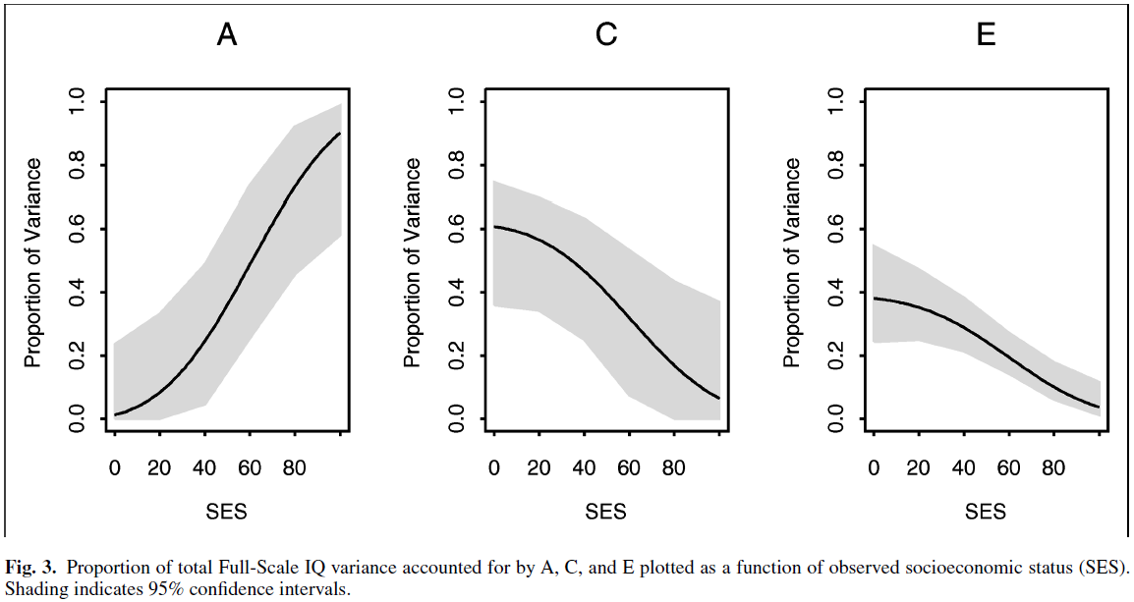
Turkheimer, E., Haley, A., Waldron, M., D'Onofrio, B., & Gottesman, I.I. (2003). Socioeconomic status modifies heritability of IQ in young children. Psychological Science, 14(6), 623-628.

Slide 4
Current practical: Does SES modify variance components of IQ in 5 year old children?
Data:
N = 430 twin pairs (205 MZ, 225 DZ)
IQ scaled to have mean = 0 and variance = 1
SES measured on a 5-point scale (1 = low, 5 = high)
Is the magnitude of variance components modified by the children’s SES?
zygosity
socioeconomic status
IQ twin 1
IQ twin 2
zyg | ses | iq1 | iq2
1 | 3 | -0.88 | -1.36
2 | 3 | 0.1 | -0.11
2 | 3 | 1.14 | 0.44
2 | 2 | 0.1 | -0.18
1 | 3 | -0.39 | -0.74
1 | 3 | 0.1 | 1.7
…

Slide 5
Current practical: Does SES modify variance components of IQ in 5 year old children?
Model:
r_{A}=.5/1
r_{C}=1
A₁
C₁
E₁
A₂
C₂
E₂
a+β_{X}M₁
c+β_{Y}M₁
e+β_{Z}M₁
a+β_{X}M₂
c+β_{Y}M₂
e+β_{Z}M₂
1
μ+β_{M}M₁
IQ₁
IQ₂
μ+β_{M}M₂
1
Twin 1
Twin 2

Slide 6
Current practical: Does SES modify variance components of IQ in 5 year old children?
Model:
r_{A}=.5/1
r_{C}=1
A₁
C₁
E₁
A₂
C₂
E₂
a+β_{X}SES₁
c+β_{Y}SES₁
e+β_{Z}SES₁
a+β_{X}SES₂
c+β_{Y}SES₂
e+β_{Z}SES₂
1
μ+β_{M}SES₁
IQ₁
IQ₂
μ+β_{M}SES₂
1
Twin 1
Twin 2

Slide 7
Current practical: Does SES modify variance components of IQ in 5 year old children?
Parameters to estimate:
r_{A}=.5/1
r_{C}=1
A₁
C₁
E₁
A₂
C₂
E₂
a+β_{X}SES₁
c+β_{Y}SES₁
e+β_{Z}SES₁
a+β_{X}SES₂
c+β_{Y}SES₂
e+β_{Z}SES₂
1
μ+β_{M}SES₁
IQ₁
IQ₂
μ+β_{M}SES₂
1
Twin 1
Twin 2

Slide 8
Current practical: Does SES modify variance components of IQ in 5 year old children?
Parameters to estimate:
r_{A}=.5/1
r_{C}=1
A₁
C₁
E₁
A₂
C₂
E₂
a+β_{X}SES₁
c+β_{Y}SES₁
e+β_{Z}SES₁
a+β_{X}SES₂
c+β_{Y}SES₂
e+β_{Z}SES₂
1
μ+β_{M}SES₁
IQ₁
IQ₂
μ+β_{M}SES₂
1
Twin 1
Twin 2
magnitude of A effects on IQ
magnitude of C effects on IQ
magnitude of E effects on IQ

Slide 9
Current practical: Does SES modify variance components of IQ in 5 year old children?
Parameters to estimate:
r_{A}=.5/1
r_{C}=1
A₁
C₁
E₁
A₂
C₂
E₂
a+β_{X}SES₁
c+β_{Y}SES₁
e+β_{Z}SES₁
a+β_{X}SES₂
c+β_{Y}SES₂
e+β_{Z}SES₂
1
μ+β_{M}SES₁
IQ₁
IQ₂
μ+β_{M}SES₂
1
Twin 1
Twin 2
moderation of A effects on IQ by SES
moderation of C effects on IQ by SES
moderation of E effects on IQ by SES

Slide 10
Current practical: Does SES modify variance components of IQ in 5 year old children?
Parameters to estimate:
r_{A}=.5/1
r_{C}=1
A₁
C₁
E₁
A₂
C₂
E₂
a+β_{X}SES₁
c+β_{Y}SES₁
e+β_{Z}SES₁
a+β_{X}SES₂
c+β_{Y}SES₂
e+β_{Z}SES₂
1
μ+β_{M}SES₁
IQ₁
IQ₂
μ+β_{M}SES₂
1
Twin 1
Twin 2
intercept
magnitude of main effect of SES on IQ

Slide 11
Current practical: Does SES modify variance components of IQ in 5 year old children?
Model:
r_{A}=.5/1
r_{C}=1
A₁
C₁
E₁
A₂
C₂
E₂
a+β_{X}M₁
c+β_{Y}M₁
e+β_{Z}M₁
a+β_{X}M₂
c+β_{Y}M₂
e+β_{Z}M₂
1
μ+β_{M}M₁
IQ₁
IQ₂
μ+β_{M}M₂
1
Twin 1
Twin 2

Slide 12
Current practical: Does SES modify variance components of IQ in 5 year old children?
Model:
Expectations for means (conditional on the level of the moderator M_{i}):
mean(IQ_{i}|M_{i}) = (a+β_{X}M_{i})*mean(A_{i}) + (c+β_{Y}M_{i})*mean(C_{i}) + (e+β_{Z}M_{i})*mean(E_{i}) + (μ+β_{M}M_{i})*1
= (a+β_{X}M_{i})*0 + (c+β_{Y}M_{i})*0 + (e+β_{Z}M_{i})*0 + (μ+β_{M}M_{i})*1
= μ+β_{M}M_{i}
for i = 1, 2 (twin 1, twin 2)
r_{A}=.5/1
r_{C}=1
A₁
C₁
E₁
A₂
C₂
E₂
a+β_{X}M₁
c+β_{Y}M₁
e+β_{Z}M₁
a+β_{X}M₂
c+β_{Y}M₂
e+β_{Z}M₂
1
μ+β_{M}M₁
IQ₁
IQ₂
μ+β_{M}M₂
1
Twin 1
Twin 2

Slide 13
Current practical: Does SES modify variance components of IQ in 5 year old children?
Model:
Expectations for variances (conditional on the level of the moderator M_{i}):
var(IQ_{i}|M_{i}) = (a+β_{X}M_{i})^2*var(A_{i}) + (c+β_{Y}M_{i})^2*var(C_{i}) + (e+β_{Z}M_{i})^2*var(E_{i}) + (μ+β_{M}M_{i})^2*0
= (a+β_{X}M_{i})^2*1 + (c+β_{Y}M_{i})^2*1 + (e+β_{Z}M_{i})^2*1 + 0
= (a+β_{X}M_{i})^2 + (c+β_{Y}M_{i})^2 + (e+β_{Z}M_{i})^2
for i = 1, 2 (twin 1, twin 2)
r_{A}=.5/1
r_{C}=1
A₁
C₁
E₁
A₂
C₂
E₂
a+β_{X}M₁
c+β_{Y}M₁
e+β_{Z}M₁
a+β_{X}M₂
c+β_{Y}M₂
e+β_{Z}M₂
1
μ+β_{M}M₁
IQ₁
IQ₂
μ+β_{M}M₂
1
Twin 1
Twin 2

Slide 14
Practical:
faculty/sanja/Boulder_2012/Moderating_covariances_IQ_SES/Practical

