Slide 1
Attention Problems – SNP association
Dorret Boomsma
Toos van Beijsterveldt
Michel Nivard

Slide 2
SNP=single nucleotide polymorphism
Test of association between SNP and trait = test of genetic association

Slide 3
Simple biometrical system:
One SNP with two alleles (di-allelic):
A and a; with frequencies p and q; (p+q = 1).
Three genotypes: AA, Aa, aa;
with frequencies p², 2pq and q² ; (p² + 2pq + q² = 1).
AA, Aa and aa are coded as 0, 1, 2 (N of copies of e.g. a)

Slide 4
model
d
aa
Aa
m
AA
-a
a
trait
With the 0,1,2 coding we assume that d = 0
0 1 2

Slide 5
Y = intercept + β1*SNP + β2*Sex + residual
ADHD score = μ + β1*SNP + β2*Sex + ε
SNP and Sex are observed and are treated as ‘definition variables’
We do not model their covariance structure, but only their effect on phenotypes

Slide 6
Are Attention Problems influenced by measured genotypes?
AAP1
β
SNP1
Test of β = 0 gives a test of the significance of the SNP
The value of the SNP (0,1,2) MUST be present in the data file for each subject

Slide 7
Attention Problems in twin1 and twin2 are correlated (as a function of zygosity)
r
Sex1
β2
AAP1
AAP2
Sex2
β2
β1
β1
SNP1
SNP2

Slide 8
Data file
Note: - missing values for phenotypes are “.”
- missing values for definition variables are -9
(!! Take care that Ss with missing definition variables also have missing phenotypes)

Slide 9
Genotyping in 4 candidate genes: *mono-aminergic system: -serotonin receptors (HTR) 2A (HTR2A) -catechol-O-methyltransferase (COMT) -tryptophane hydroxylase type 2 (TPH2) *neurogenesis: -brain derived neurotrophic factor (BDNF)

Slide 10
Genes | SNPs |  | MAF | p-value HWE
BDNF | rs2049048 | A<G | 15.6 | Ns
 | rs7103873 | C<G | 45.1 | Ns
 | rs6265 | T<C | 22.4 | Ns
 | rs11030107 | G<A | 24.8 | Ns
 | rs11030123 | A<G | 9.2 | Ns
 | rs1491851 | T<C | 40.6 | Ns
 | rs17309930 | A<C | 17.6 | Ns
 | rs7124442 | C<T | 31.6 | Ns
COMT | rs4680 | G<A | 43.8 | Ns
HTR2A | rs6311 | T<C | 42.0 | Ns
 | rs6314 | A<G | 8.6 | Ns
 | rs6313 | A<G | 44.1 | 0.008

Slide 11
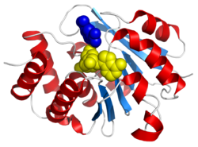
COMT: Catechol-O-methyltransferase
COMT is involved in the inactivation of the catecholamine neurotransmitters (dopamine, epinephrine, and norepinephrine).
A functional single-nucleotide polymorphism (a common normal variant) of COMT results in a valine to methionine mutation at position 158 (Val158Met) [rs4680 ].
HTR2A 5-hydroxytryptamine (serotonin) receptor 2A
This gene encodes one of the receptors for serotonin, a neurotransmitter with many roles

Slide 12
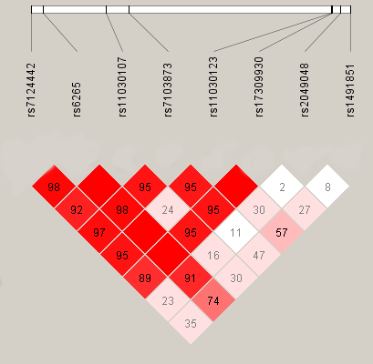
BDNF (Brain-derived neurotrophic factor)
LD plot of D’ between the SNPs
LD: linkage disequilibrium is the non-random association of alleles at two or more loci

Slide 13
TPH2 | rs1007023 | G<T | 14.9 | Ns
 | rs10748190 | G<A | 42.0 | Ns
 | rs12231356 | T<C | 7.3 | Ns
 | rs1352251 | C<T | 43.2 | Ns
 | rs1473473 | C<T | 16.1 | 0.00005
 | rs2129575 | T<G | 25.4 | Ns
 | rs2171363 | A<G | 44.4 | Ns
 | rs3903502 | T<C | 41.7 | Ns
 | rs4474484 | A<G | 36.9 | Ns
 | rs4760820 | G<C | 41.6 | Ns
 | rs7305115 | A<G | 44.2 | Ns
 | rs10748185 | A<G | 48.7 | Ns
 | rs17110489 | C<T | 26.5 | Ns
 | rs7300641 | T<G | 17.7 | Ns

Slide 14
LD plot of TPH2 indicating D’ between the SNPs
Tryptophan hydroxylase is the rate-limiting enzyme in the synthesis of serotonin
TPH2

Slide 15
Attention Problems in twin1 and twin2 are correlated (as a function of zygosity)
Parameters to be estimated:
Intercept (T1 = T2)
Regression SNP (T1 = T2)
Regression Sex (T1=T2)
MZ and DZ covariance
Variance of AP
Sex1
AAP1
AAP2
β2
Sex2
β2
β1
β1
SNP1
SNP2
Test of β = 0 gives the significance of the SNP

Slide 16
Exercise
Fit the association model for 1 SNP per run (we consider 5 SNPs, script is for BDNF - SNP).
Try to run for the other 4 SNPs.
Test the significance of the regression coefficients (by comparing constrained and free model).

Slide 17
Univariate means modeling practical

Slide 18
Univariate mean moderation
Copy the folder univariate means moderation to your drive (its in faculty/Michel)
Open the R project in R studio.
It is a five group script. (MZM,DZM,MZF,DZM,DOS)
First we read in the data, run the script till line 20.
Then we run “universal” matrices, these are the same in each group (till line 32)

Slide 19
Univariate mean moderation
On line 41,65,91,116 and 142 we rad in the SNP rs4680 for twin 1 and twin 2.
In openMX we tell the software to read actual data by adding the prefix ”data.” to the labels.
Change the snp id into one of the following:
rs6265, rs4680, rs6314, rs1007023, rs12231356
Now run the model untill the mxRun command around line: 172.

Slide 20
Univariate mean moderation
Around line 180 you are required to drop the SNP. Reset the starting value. What should this be according to you guys?
Also reset the parameter to fixed!

Slide 21
Results
rs6265
rs4680
rs6314
rs1007023
rs12231356

Slide 22
-Genotyping was done in twin pairs (related)
-Phenotypes : ratings by both parents (bivariate)
-Parental ratings at ages 3, 7, 10, 12 (longitudinal)
-Not all children reached at 12 yet (missing data)

Slide 23
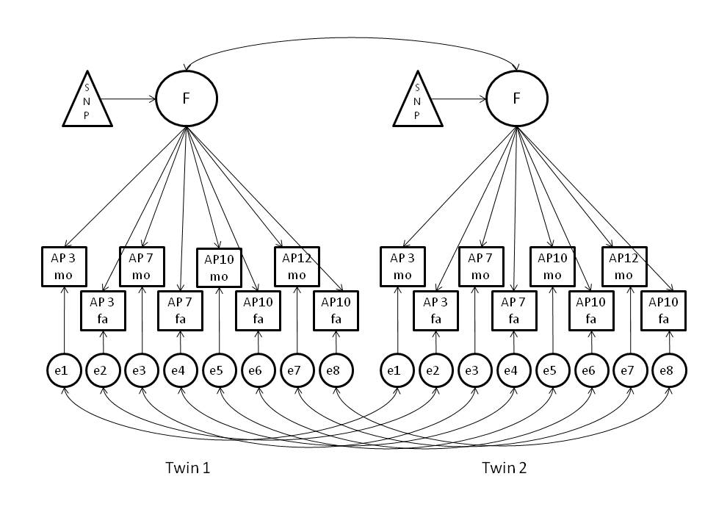
Factorial association model for longitudinal Attention Problems in children
Circle = latent (not observed) individual score; square / triangle= observed score;
arrow = regression; double headed arrow = correlation

Slide 24
Implementation in Mx
Factor loadings and correlations among latent phenotypes were obtained from running the model in a larger dataset of > 32,000 twins from 16,169 families, who participated at least once:
2,436 MZM, 2,856 DZM,
2,742 MZF, 2,556 DZF, 5,602 (DOS) twin pairs

Slide 25
Age | Rater | Factor Loading | Factor loading Residual | rMZ (residual) | rDZ (residual)
3 | Mother | 1.2337 | 1.7753 | 0.6465 | 0.1539
 | Father | 1.2310 | 1.7186 | 0.6334 | 0.1807
7 | Mother | 2.3359 | 1.8036 | 0.5994 | 0.3254
 | Father | 2.0936 | 1.7091 | 0.6365 | 0.3872
10 | Mother | 2.5046 | 1.7403 | 0.5652 | 0.3108
 | Father | 2.2797 | 1.6928 | 0.6110 | 0.3767
12 | Mother | 2.3230 | 1.7810 | 0.6231 | 0.3063
 | Father | 2.1039 | 1.7563 | 0.6472 | 0.4104

Slide 26
Factorial association model : 16 phenotypes (2 twins, 2 raters, 4 time points)
SNP is 0,1, 2
β
λ
Parameters to be estimated: effect of SNP, effect of sex /age /rater, grand mean,
twin correlations (for MZ and DZ twins)

Slide 27
Exercise
1 Fit the Factorial association model for 1 SNP per run (consider one of the 5 SNPs).
2 Fit the Factorial association model for all 5 SNPs simultaneously.

Slide 28
The factor model
Use multivariate approaches to model all phenotypic data (all time points / all raters / all indicators) and do not force multivariate data into a single sum score.
Advantage: increase in power
Disadvantage: no standard GWAS software

Slide 29
Increase in statistical power
Ferreira MA, Purcell SM. A multivariate test of association.
Bioinformatics. 2009, 1;25(1):132-3 (intercorrelations among phenotypes equal)
Medland SE, Neale MC. An integrated phenomic approach to multivariate allelic association. Eur J Hum Genet. 2010 18(2):233-9 (factor models)
van der Sluis S, Verhage M, Posthuma D, Dolan CV. Phenotypic complexity, measurement bias, and poor phenotypic resolution contribute to the missing heritability problem in genetic association studies. PLoS One. 2010 ;5(11):e13929 (measurement invariance)
Minica CC, Boomsma DI, van der Sluis S, Dolan CV. Genetic association in multivariate phenotypic data: power in five models. Twin Res Hum Genet. 2010, 13(6):525-43 (also includes longitudinal simplex models)

Slide 30
A = additive genes
i
i
i
i
C = common environment
E = unique environment
P = latent phenotype
3
7
10
12
Mo = mother rating Fa = mother rating
Parameter in red = 1
Mo
Fa
Mo
Fa
Mo
Fa
Mo
Fa
Parameters to be estimated:
Loading innovation
Transmission
A,C, E loadings

