Slide 1
PSEQ practical
shaun@atgu.mgh.harvard.edu
Boulder Workshop, March 2011

Slide 2
Overview
Variant Call Format (VCF) files
Working with VCF files in PLINK/Seq
Reference databases and annotation of variants (coding status, PolyPhen2, HGMD, dbSNP, etc)
Working with a subset of pilot 3 1000 Genomes data
PLINK/Seq and GWAS2.0 example

Slide 3
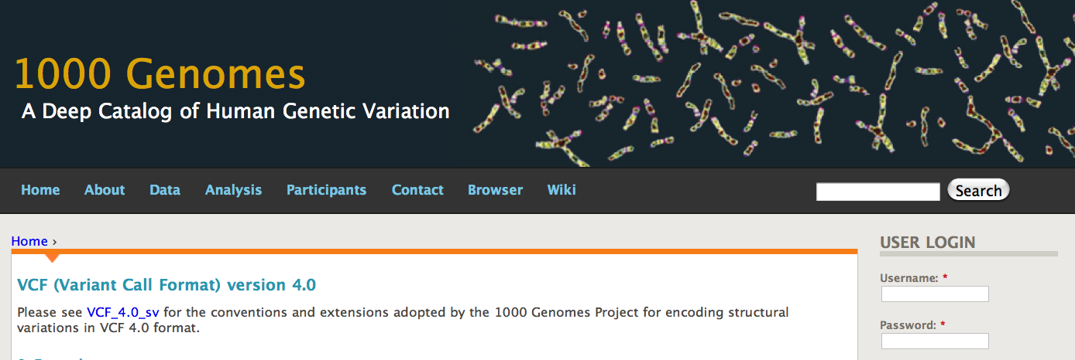
http://www.1000genomes.org/node/101
An extensible text-based format for representing variant and genotype
Information and meta-information.
Evolving in a number of different areas
Representing haplotype phase and identity-by-descent information
Structural variation
Somatic mutation and cancer genetics

Slide 4
example.vcf
##fileformat=VCF4.0
##INFO=<ID=DP,Number=1,Type=Integer,Description=“Total read depth”>
##INFO=<ID=HM,Number=0,Type=Flag,Description=“Seen in HapMap 2 or 3”>
##FILTER=<ID=q10,Description=“Quality below 10”>
##FORMAT=<ID=GQ,Number=1,Type=Integer,Description=“Genotype quality”>
#CHROM POS ID REF ALT QUAL FILTER INFO FORMAT S001 S002
1 1001 . A G 55 PASS DP=82 GT:GQ 0/0:56 0/1:80
1 8888 rs123 T A 5 q10 DP=8 ;HM GT:GQ ./.:. 0|1:58
Numeric allele encoding & multi-allelic sites:
If REF is A, ALT is T 0/0 is A/A 0/1 is A/T
If REF is A, ALT is T,C 0/2 is A/C 2/1 is C/T
Missing genotype ./.
Representing haplotype phase
0/1 unphased heterozygote
1|0 phased with respect to previous site (implies 01/10 haplotypes )
(Encoding of haplotypic information will be more explicit in future VCF specs.)

Slide 5
example.vcf
##fileformat=VCF4.0
##INFO=<ID=DP,Number=1,Type=Integer,Description=“Total read depth”>
##INFO=<ID=HM,Number=0,Type=Flag,Description=“Seen in HapMap 2 or 3”>
##FILTER=<ID=q10,Description=“Quality below 10”>
##FORMAT=<ID=GQ,Number=1,Type=Integer,Description=“Genotype quality”>
#CHROM POS ID REF ALT QUAL FILTER INFO FORMAT S001 S002
1 1001 . A G 55 PASS DP=82 GT:GQ 0/0:56 0/1:80
1 8888 rs123 T A 5 q10 DP=8 ;HM GT:GQ ./.:. 0|1:58
The raw genotype calls as represented in the less expressive PED/MAP format:
example.map
example.ped
1 novel1 0 1001
1 rs123 0 8888
S001 1 0 0 1 0 A A A G
S002 1 0 0 1 0 0 0 A T

Slide 6
##fileformat=VCFv4.0
##fileDate=20090805
##source=myImputationProgramV3.1
##reference=1000GenomesPilot-NCBI36
##phasing=partial
##INFO=<ID=NS,Number=1,Type=Integer,Description="Number of Samples With Data">
##INFO=<ID=DP,Number=1,Type=Integer,Description="Total Depth">
##INFO=<ID=AF,Number=.,Type=Float,Description="Allele Frequency">
##INFO=<ID=AA,Number=1,Type=String,Description="Ancestral Allele">
##INFO=<ID=DB,Number=0,Type=Flag,Description="dbSNP membership, build 129">
##INFO=<ID=H2,Number=0,Type=Flag,Description="HapMap2 membership">
##FILTER=<ID=q10,Description="Quality below 10">
##FILTER=<ID=s50,Description="Less than 50% of samples have data">
##FORMAT=<ID=GT,Number=1,Type=String,Description="Genotype">
##FORMAT=<ID=GQ,Number=1,Type=Integer,Description="Genotype Quality">
##FORMAT=<ID=DP,Number=1,Type=Integer,Description="Read Depth">
##FORMAT=<ID=HQ,Number=2,Type=Integer,Description="Haplotype Quality">
#CHROM POS ID REF ALT QUAL FILTER INFO
20 14370 rs6054257 G A 29 PASS NS=3;DP=14;AF=0.5;DB;H2
20 17330 . T A 3 q10 NS=3;DP=11;AF=0.017
20 1110696 rs6040355 A G,T 67 PASS NS=2;DP=10;AF=0.333,0.667;AA=T;DB
20 1230237 . T . 47 PASS NS=3;DP=13;AA=T
20 1234567 microsat1 GTCT G,GTACT 50 PASS NS=3;DP=9;AA=G
FORMAT NA00001 NA00002 NA00003
GT:GQ:DP:HQ 0|0:48:1:51,51 1|0:48:8:51,51 1/1:43:5:.,.
GT:GQ:DP:HQ 0|0:49:3:58,50 0|1:3:5:65,3 0/0:41:3
GT:GQ:DP:HQ 1|2:21:6:23,27 2|1:2:0:18,2 2/2:35:4
GT:GQ:DP:HQ 0|0:54:7:56,60 0|0:48:4:51,51 0/0:61:2
GT:GQ:DP 0/1:35:4 0/2:17:2 1/1:40:3

Slide 7
##fileformat=VCFv4.0
##FILTER=<ID=HomopolymerRun,Description="HRun>=4">
##FILTER=<ID=Mask,Description="Overlaps a user-input mask">
##FILTER=<ID=NearIndel,Description="Overlaps a user-input mask">
##FILTER=<ID=QualByDepth,Description="QD<5.0">
##FILTER=<ID=SnpCluster,Description="SNPs found in clusters">
##FILTER=<ID=StrandBias,Description="SB>=0.10">
##FORMAT=<ID=AD,Number=.,Type=Integer,Description="Allelic depths for the ref and alt alleles in the order listed">
##FORMAT=<ID=DP,Number=1,Type=Integer,Description="Read Depth (only filtered reads used for calling)">
##FORMAT=<ID=GQ,Number=1,Type=Float,Description="Genotype Quality">
##FORMAT=<ID=GT,Number=1,Type=String,Description="Genotype">
##FORMAT=<ID=PL,Number=3,Type=Float,Description="Normalized, Phred-scaled likelihoods for AA,AB,BB genotypes where A=ref and
B=alt; not applicable if site is not biallelic">
##GenomicAnnotator="analysis_type=GenomicAnnotator input_file=[] sample_metadata=[] read_buffer_size=null phone_home=STANDARD
read_filter=[] intervals=[/seq/references/HybSelOligos/whole_exome_agilent_designed_120/whole_exome_agilent_designed_120.
Homo_sapiens_assembly19.targets.interval_list] excludeIntervals=null reference_sequence=/seq/references/Homo_sapiens_assembly19/
v1/Homo_sapiens_assembly19.fasta rodBind=[/humgen/gsa-pipeline/P2TXY/all_batches_v002/Sw1_B2/SnpCalls/SCZ_Sklar_Sw1_B2.cleaned.vcf,
/humgen/gsa-hpprojects/GATK/data/Annotations/refseq/refGene-big-table-hg19.txt] rodToIntervalTrackName=variant BTI_merge_rule=UNION
DBSNP=null downsampling_type=null downsample_to_fraction=null downsample_to_coverage=null baq=OFF baqGapOpenPenalty=1.0E-4
performanceLog=null useOriginalQualities=false validation_strictness=SILENT unsafe=null num_threads=1 interval_merging=ALL
read_group_black_list=null logging_level=INFO log_to_file=null quiet_output_mode=false debug_mode=false help=false
out=org.broadinstitute.sting.gatk.io.stubs.VCFWriterStub NO_HEADER=org.broadinstitute.sting.gatk.io.stubs.VCFWriterStub
vcfOutput=null sampleName=null oneToMany=false maxJoinTableSize=500000 ignoreFilteredSites=false"
##INFO=<ID=AC,Number=.,Type=Integer,Description="Allele count in genotypes, for each ALT allele, in the same order as listed">
##INFO=<ID=AF,Number=.,Type=Float,Description="Allele Frequency, for each ALT allele, in the same order as listed">
##INFO=<ID=AN,Number=1,Type=Integer,Description="Total number of alleles in called genotypes">
##INFO=<ID=DB,Number=0,Type=Flag,Description="dbSNP Membership">
##INFO=<ID=DP,Number=1,Type=Integer,Description="Total Depth">
##INFO=<ID=DS,Number=0,Type=Flag,Description="Were any of the samples downsampled?">
##INFO=<ID=Dels,Number=1,Type=Float,Description="Fraction of Reads Containing Spanning Deletions">
##INFO=<ID=GenericAnnotation,Number=1,Type=Integer,Description="For each variant in the 'variants' ROD, finds all entries in the other
-B files that overlap the variant's position.">
##INFO=<ID=HRun,Number=1,Type=Integer,Description="Largest Contiguous Homopolymer Run of Variant Allele In Either Direction">
##INFO=<ID=HaplotypeScore,Number=1,Type=Float,Description="Consistency of the site with two (and only two) segregating haplotypes">
##INFO=<ID=MQ,Number=1,Type=Float,Description="RMS Mapping Quality">
##INFO=<ID=MQ0,Number=1,Type=Integer,Description="Total Mapping Quality Zero Reads">
##INFO=<ID=QD,Number=1,Type=Float,Description="Variant Confidence/Quality by Depth">
##INFO=<ID=SB,Number=1,Type=Float,Description="Strand Bias">

Slide 8
Partial data for 1 variant from one batch of SCZ exome study
1 69428 . T G 15168.41 PASS
AC=7;AF=0.0333;AN=210;DP=35576;DS;Dels=0.00;HRun=0;
HaplotypeScore=1120.87;MQ=20.85;MQ0=17414;QD=6.74;SB=-5867.69;
refseq.changesAA=true;refseq.chr=1;refseq.codingCoordStr=c.338T>G;
refseq.codonCoord=113;refseq.end=69428;refseq.frame=1;
refseq.functionalClass=missense;refseq.haplotypeAlternate=G;
refseq.haplotypeReference=T;refseq.inCodingRegion=true;
refseq.mrnaCoord=338;refseq.name=NM_001005484;
refseq.name2=OR4F5;refseq.positionType=CDS;
refseq.proteinCoordStr=p.F113C;
refseq.referenceAA=Phe;refseq.referenceCodon=TTT;
refseq.spliceDist=338;refseq.start=69428;refseq.transcriptStrand=+;
refseq.variantAA=Cys;refseq.variantCodon=TGT
GT:AD:DP:GQ:PL 0/0:128,19:1:3:0,3,25 0/0:221,0:100:99:0,300,2834
1/1:130,224:163:99:4805,489,0 0/0:368,0:187:99:0,558,5649 ./.
0/0:124,2:70:99:0,210,2020 0/0:510,0:365:99:0,1095,10944
0/0:65,0:1:3.01:0,3,34 0/0:174,11:1:3:0,3,25 0/0:71,10:1:3:0,3,25
0/0:208,8:90:99:0,270,2747 ./. ./. ./.
0/0:327,16:178:99:0,534,5190 0/0:276,15:137:99:0,411,3999
0/0:366,11:200:99:0,600,5980 0/0:250,22:150:99:0,450,4467
0/0:64,17:1:3.01:0,3,34 0/1:302,217:360:99:3955,0,5465
0/0:515,0:371:99:0,1113,11101 0/0:501,1:361:99:0,1083,10905
0/0:310,13:172:99:0,513,5256 0/0:115,50:1:3:0,3,25
{ …… + ~100 more calls }

Slide 9
What does this genotype mean?
0/0:366,11:200:99:0,600,5980
GT hard genotype call
AD and DP read-depth information
GQ quality score
PL is (phred-scaled) genotype-likelihoods (soft-calls)
VCF likely to be primary out of imputation packages in the future, as it can represent hard-calls (most likely genotype) but also the expected dosage and/or posterior probabilities (and also R² in the INFO field, etc)
GT : AD : DP : GQ : PL

Slide 10
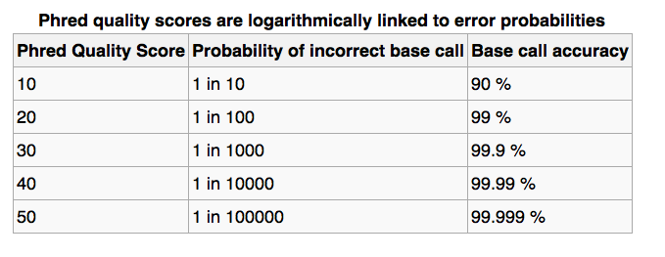


Phred-scale

Slide 11
GT:AD:DP:GQ:PL 0/0:174,11:1:3:0,3,25
Homozygous reference genotype; 174 reference reads, 11 alternate; but only 1 read used for calling; genotype quality score of 3 (0-99); Phred-scaled genotyped likelihoods {0,3,25}
Genotype | VCF | PL Phred-scaled genotype likelihood | GL Genotype likelihoods P( read data | true genotype ) | P( genotype | read data ) assuming flat priors
Homozygous reference | 0/0 | 0 | 1.000 | 0.66
Heterozygote | 0/1 | 3 | 0.501 | 0.33
Homozygous alternate | 1/1 | 25 | 0.003 | 0.00
GT:GL 0|1:
GT:DP:PL 0/0:2:

Slide 12
GT:AD:DP:GQ:PL 0/1:28,35:62:99:1151,0,889
Heterozygote genotype; 28 reference reads, 35 alternate; 62 of 63 reads used in calling; genotype quality score of 99; Phred-scaled genotyped likelihoods {1151,0,889}
Genotype | VCF | PL Phred-scaled genotype likelihood | GL Genotype likelihoods P( read data | true genotype ) | P( genotype | read data ) assuming flat priors
Homozygous reference | 0/0 | 1151 | 0.000 | 0.000
Heterozygote | 0/1 | 0 | 1.000 | 1.000
Homozygous alternate | 1/1 | 889 | 0.000 | 0.000
GT:GL 0|1:
GT:DP:PL 0/0:2:

Slide 13
GT:AD:DP:GQ:PL 0/1:6,1:7:8.7:9,0,187
Heterozygote genotype; 7 reads, 6 reference 1 non-reference. Called in a multi-sample context: 16 other non-reference alleles. Overall variant fails FILTERs: QualByDepth;StrandBias;SNPCluster
Genotype | VCF | PL Phred-scaled genotype likelihood | GL Genotype likelihoods P( read data | true genotype ) | P( genotype | read data ) assuming flat priors
Homozygous reference | 0/0 | 9 | 0.126 | 0.112
Heterozygote | 0/1 | 0 | 1.000 | 0.888
Homozygous alternate | 1/1 | 187 | 0.000 | 0.000
GT:GL 0|1:
GT:DP:PL 0/0:2:

Slide 14
Working with VCF files in
PLINK/Seq

Slide 15
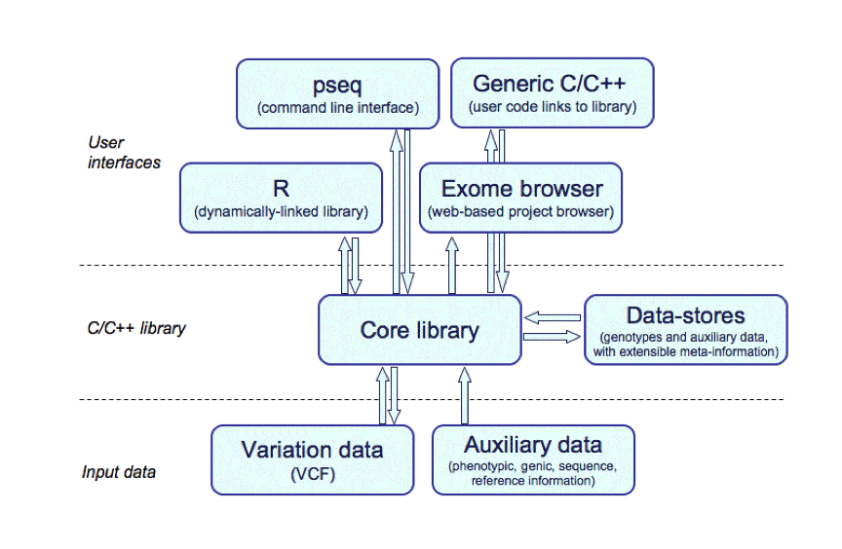

Slide 16
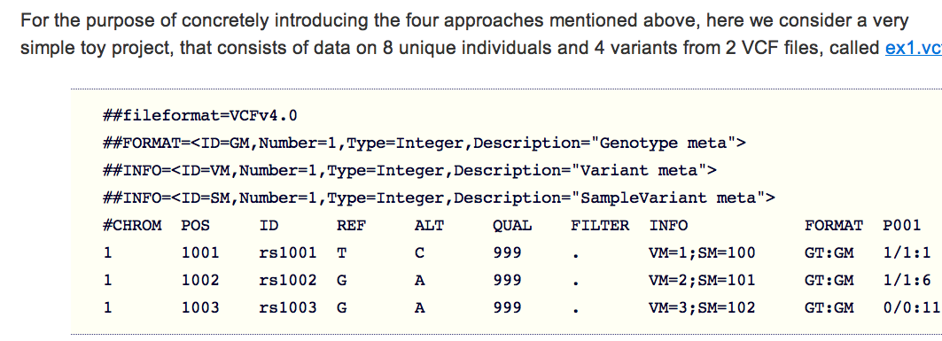
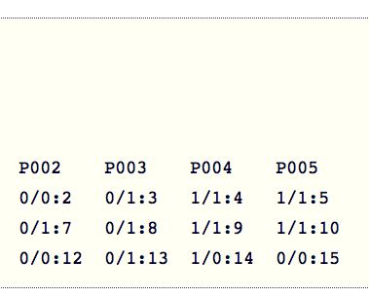
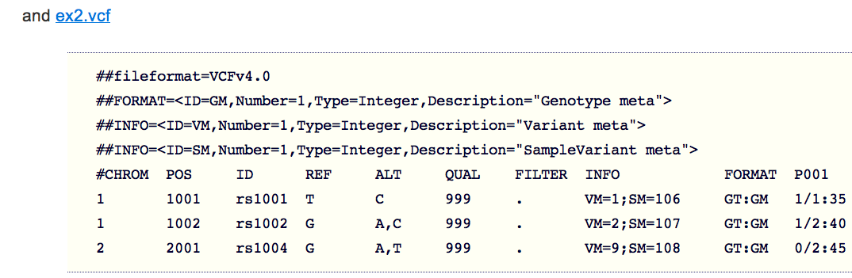
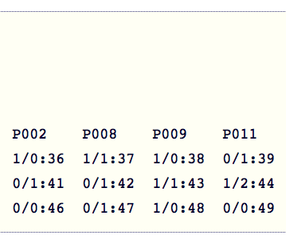

Slide 17
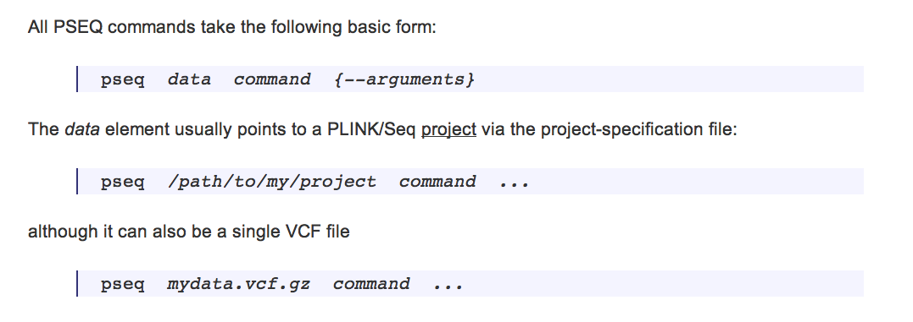

Slide 18
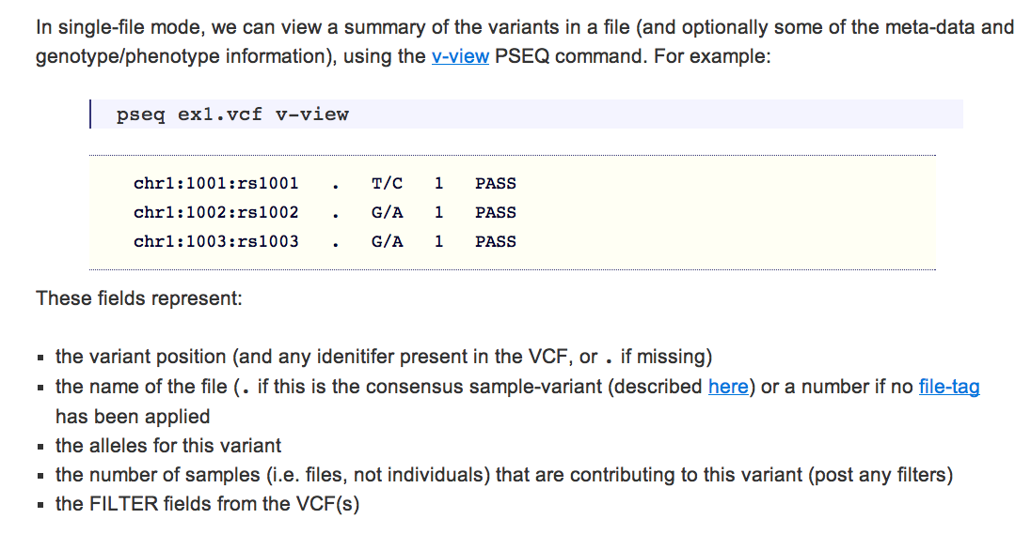

Slide 19
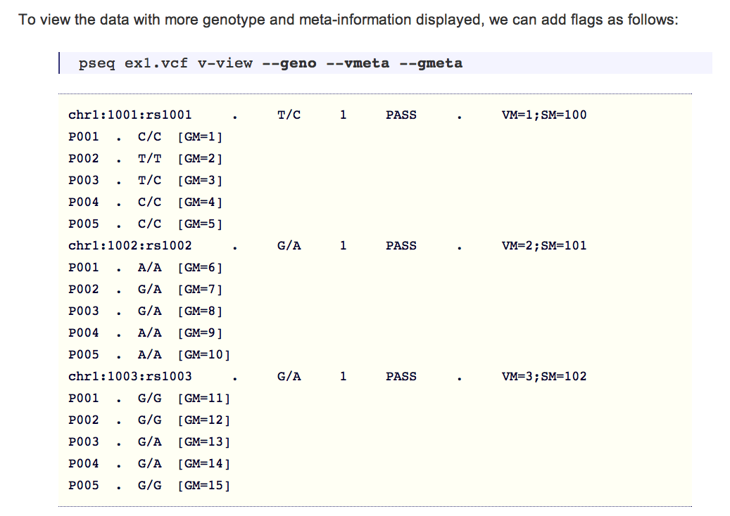

Slide 20
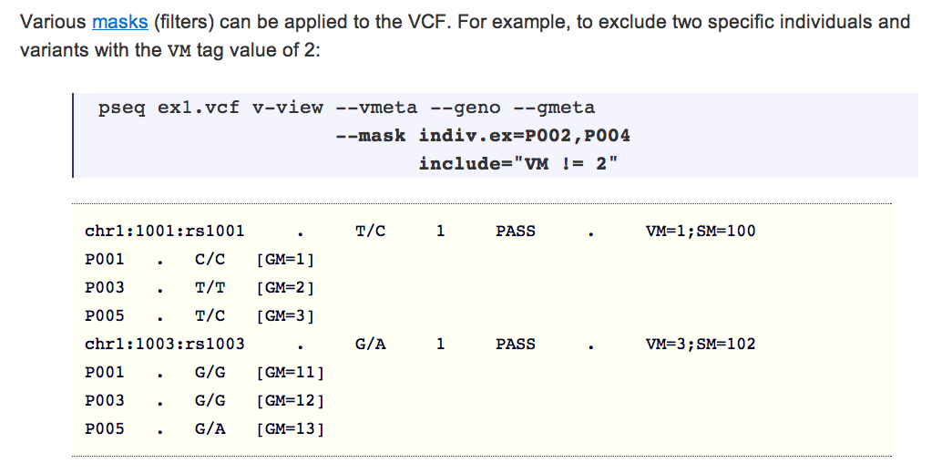

Slide 21
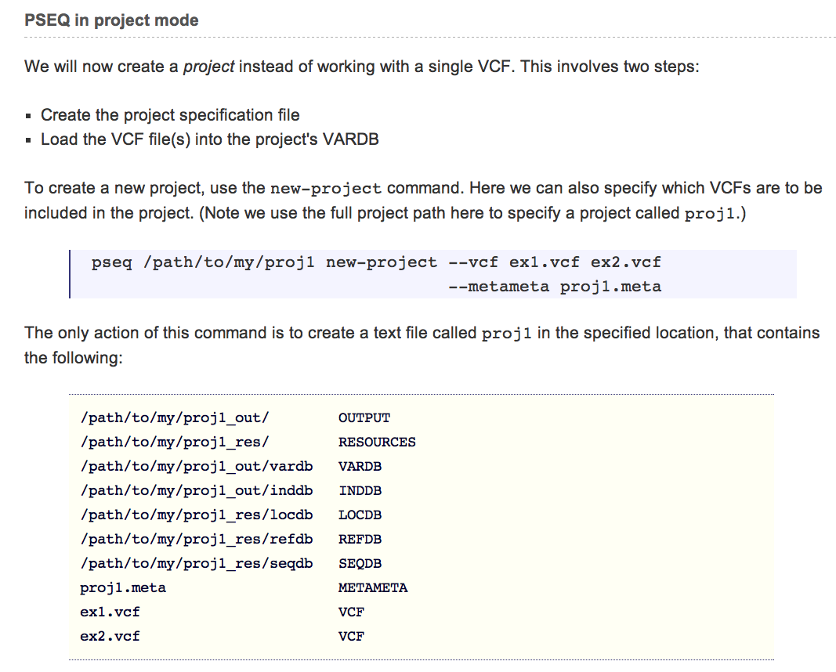

Slide 22
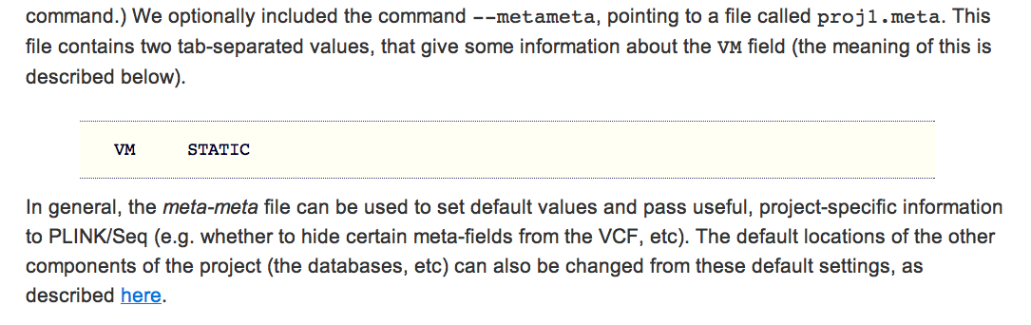

Slide 23
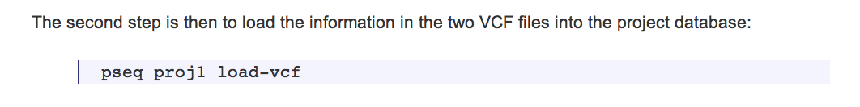
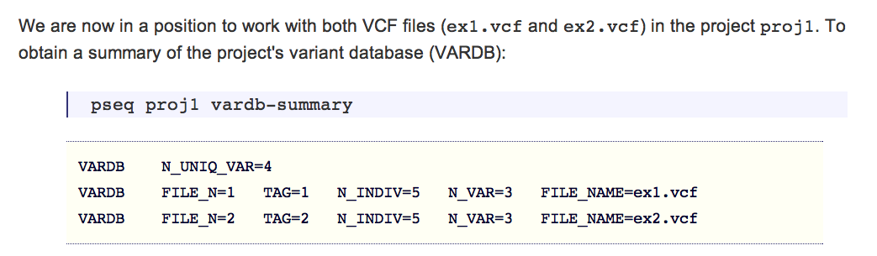

Slide 24
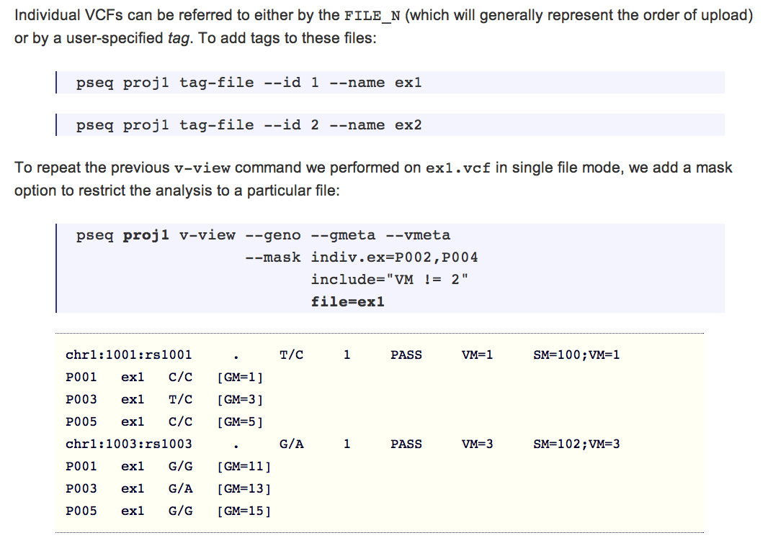

Slide 25
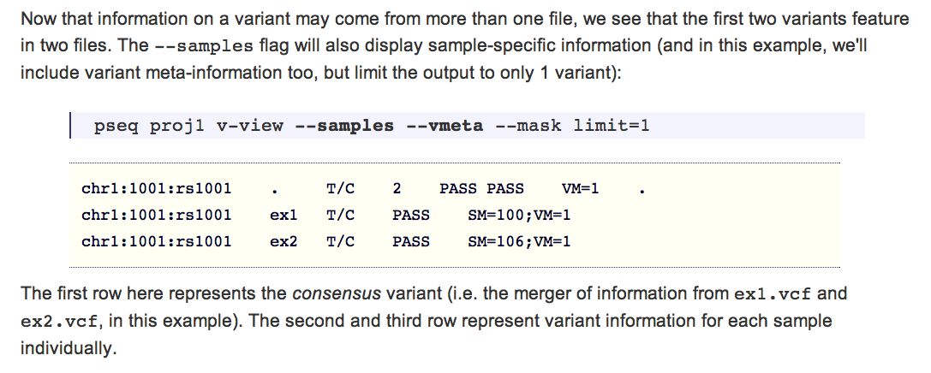

Slide 26
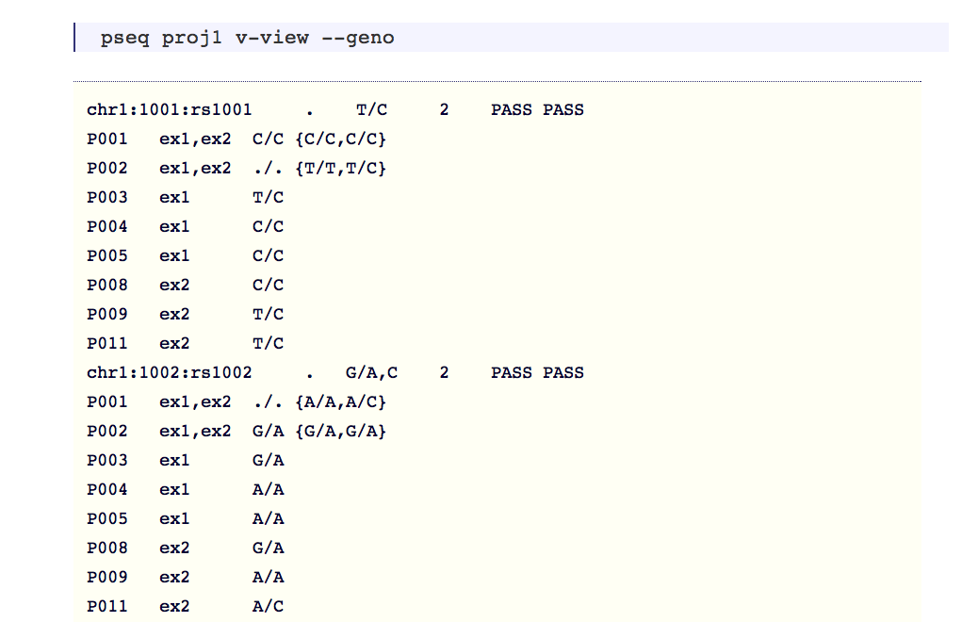
{ -- continues -- }

Slide 27

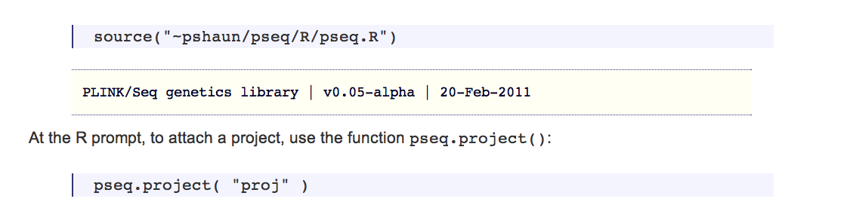

Slide 28
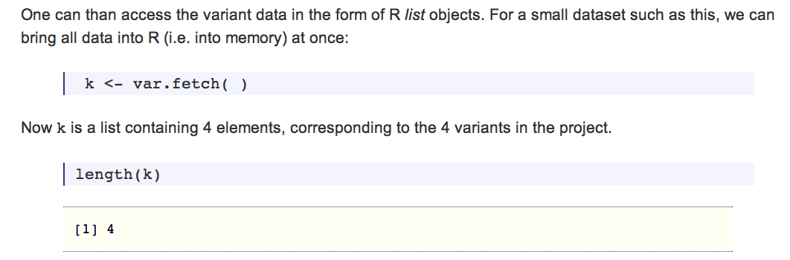

Slide 29
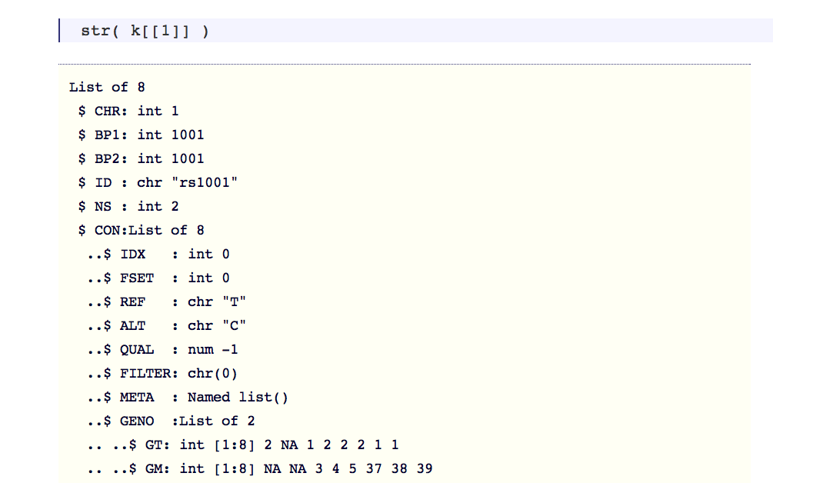
Continued on next slide

Slide 30
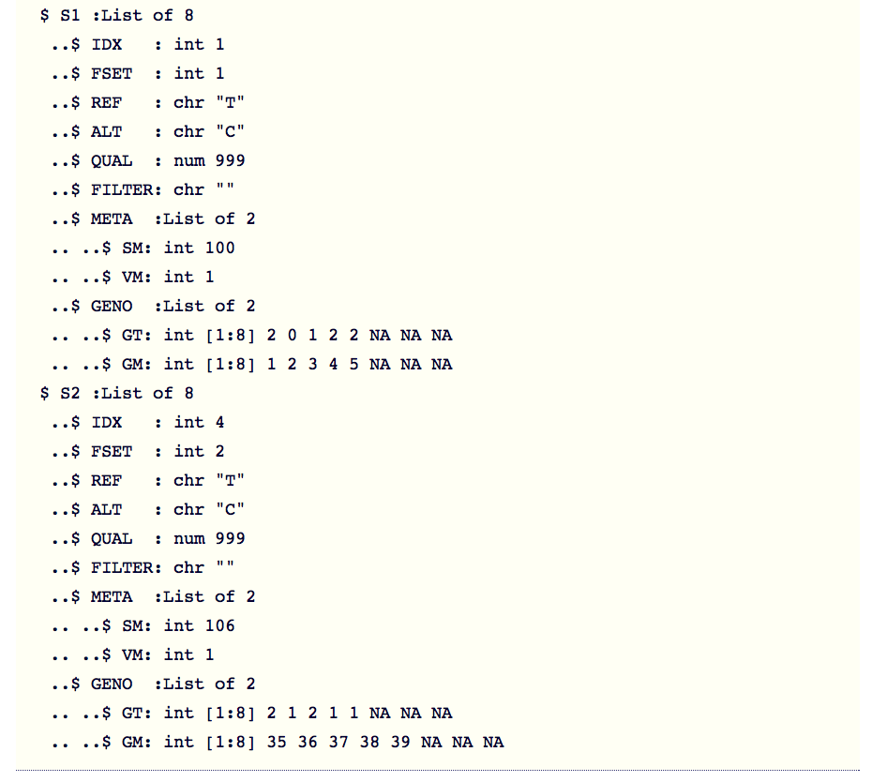
continued

Slide 31
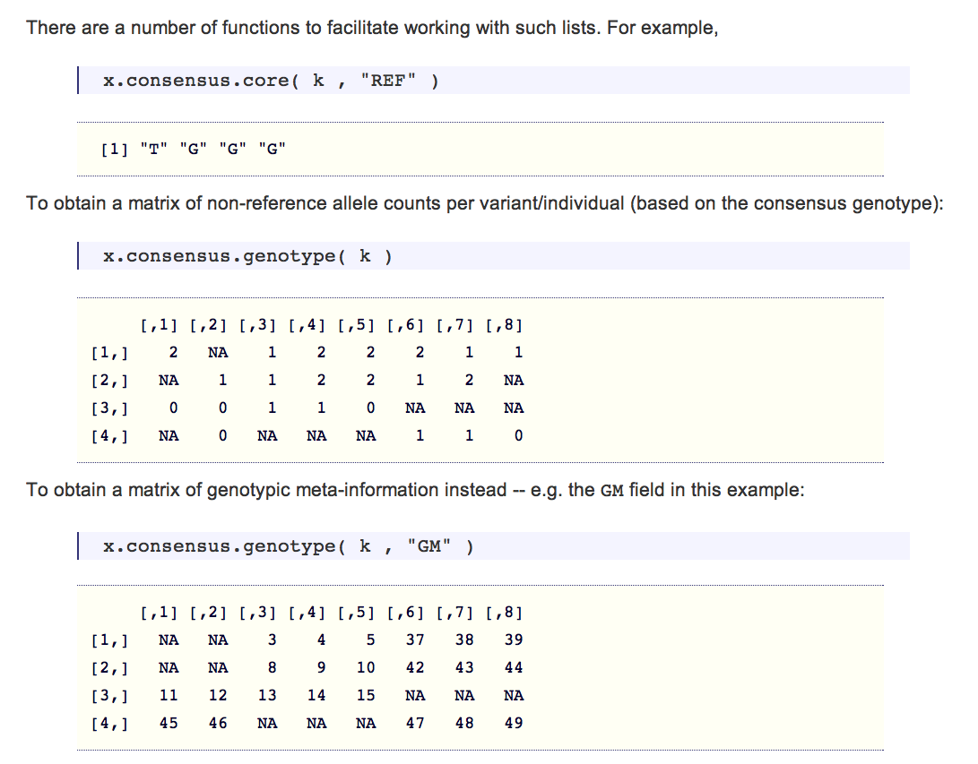

Slide 32
Reference databases and annotation of variants

Slide 33
Variant (and genotype) annotations
Technical
  Read depth, allele balance, mean mapping quality, etc
  QC Filters (PASS, or reasons for exclusion)
  Hardy-Weinberg disequilibrium
  (Distribution of) individual genotype likelihoods
Population
  Novelty (presence in dbSNP and/or 1000Genomes)
  Population frequencies
  Linkage disequilibrium/phase information on individual genotypes
  Prior disease/functional associations
Genomic
  Gene and coding status
  Transition/transversion
  Ancestral/derived allele status

Slide 34
Per-variant QC metric | Description
QUAL | Confidence score, estimates P(variant exists at site)
DP | Depth of coverage
AB | Proportion reference / total reads
AN | Number of called alleles
SB | Strand bias
AB | Allele balance
QD | Quality to depth ratio
Dels | % reads with deletions
HRun | Indicator of homopolymer runs
Haplotype Score | Are reads consistent with exactly 2 haplotypes?
MQ | Root mean square mapping quality of reads
MQ0 | Number of MQ == 0 reads
SB | Bias calls from forward vs. reverse reads
H | Mean entropy of posterior genotype probabilities
NSNP | Local clustering of SNP calls
HWE | Sample Hardy-Weinberg test
Target properties | Description
COV | Mean read-depth per individual
X10 | Proportion of sample at mean 10x coverage
X20 | Proportion of sample at mean 20x coverage
GC | Mean GC content of target
N | Proportion of repeat-masked bases in target
For groups of variants, “figures of merit” | Description
Ti/Tv | Transition / Transversion ratio (AG and CT SNPs versus others)
DB | Presence in dbSNP (novel / known)
Per-individual | Description
CONC | Genotypic concordance with GWAS
NALT | Number of alternate alleles
SING | Number of “singletons”
NOBS | Number of called genotypes
All samples GWAS, so already assessed for relatedness,
population outliers, etc

Slide 35
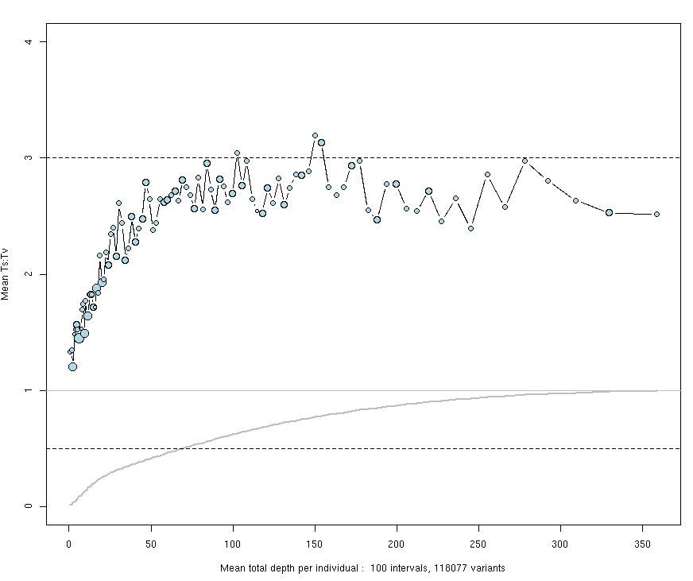
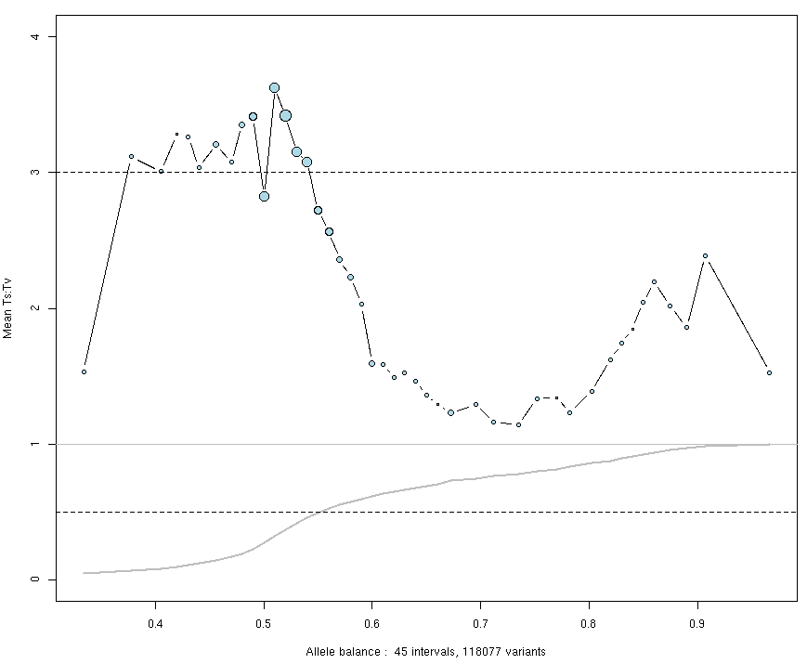
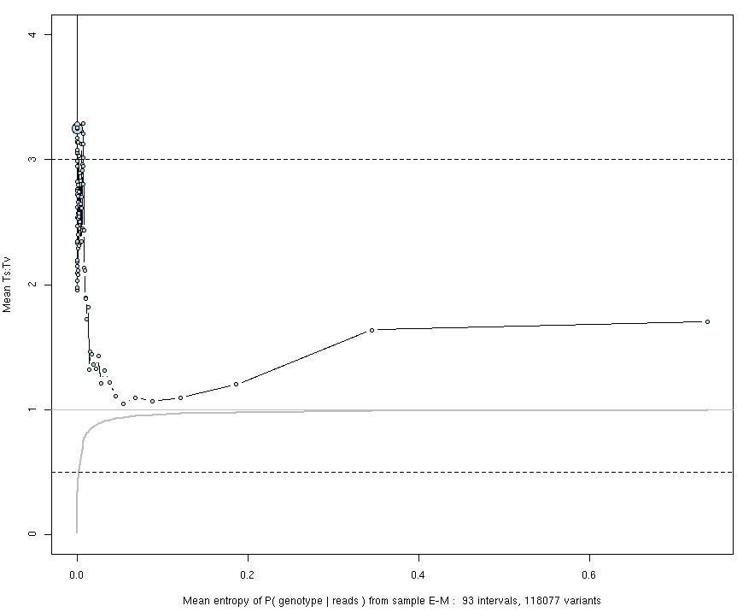
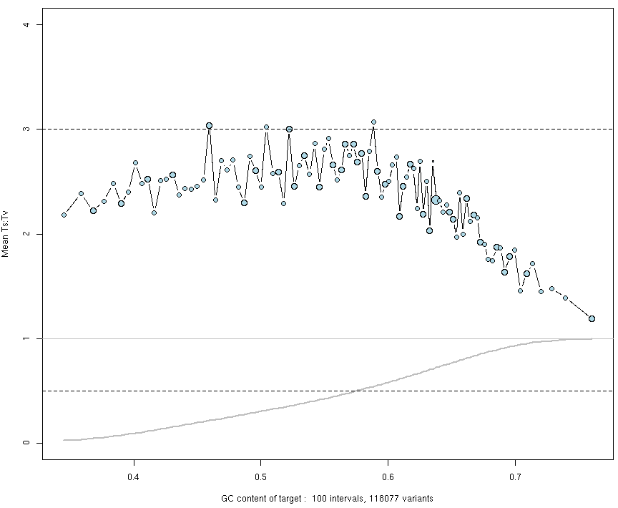
Read depth (binned to 100 quantiles)
3.0
Mean Ti/Tv
Cumulative freq.
0.5
Allele balance
Mean entropy of posteriors
(post EM)
Mean target GC content
Notes:
Ti AG and CT
Ts all others
twice as many possible Ts, but involves purine to pyrimidine bases, so less likely to occur in practice,

Slide 36
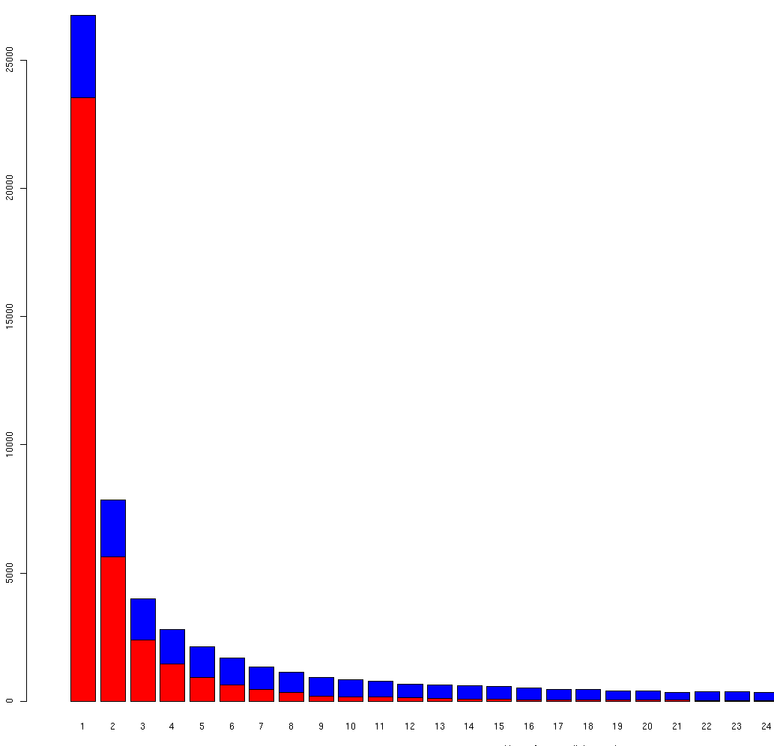
Assumed ~all true positives
known variant (in dbSNP)
novel
Mixture of true positives and technical artefacts
# of called variants (pre-QC)
Alternate allele count distribution
from first 132 Swedish exomes
. . .
1 2 3 4 5 6 7 8 . . .
# of non-reference alleles per variant

Slide 37
Novel variants
For an individual and/or a tranche of variants, overall “dbSNP %” or “G1K %” is a common figure of merit
  A false positive call is not likely to be in dbSNP
For high-coverage exome data
  For any one individual, ~95% of calls are in dbSNP
  For sample as a whole, ~50% of calls are in dbSNP
For any one variant, sometimes appropriate to interpret absence in dbSNP (“novelty”) to imply an ultra-rare population frequency
  For Mendelian disease, effectively used as a screening strategy
  e.g. if true population freq. if 1/10,000, seeing ~5 of 10 cases with this “novel” allele would be highly unlikely
For Mendelian diseases, presence in dbSNP is a sensible filter
  Absence from dbSNP less informative, given less than perfect ascertainment in dbSNP
For common, multifactorial diseases, neither presence or absence in dbSNP will by itself be informative for association

Slide 38
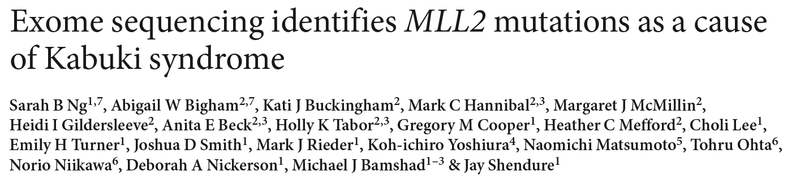
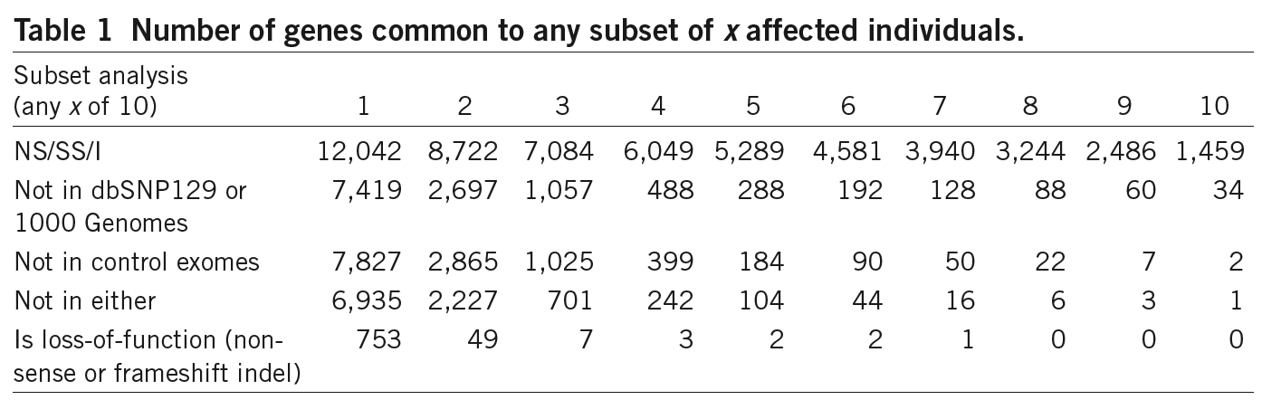
Nat Genet (2010)
Several early successful
applications of exome
sequencing, to identify
Mendelian disease genes.
Study design
50 cases, 1000 controls
“Filtering” strategy
1% disease, MAF = 0.001
But for common multifactorial diseases, different designs will be required
P(risk allele observed in controls only)
P(multiple cases, no controls)
Genotypic
relative risk

Slide 39
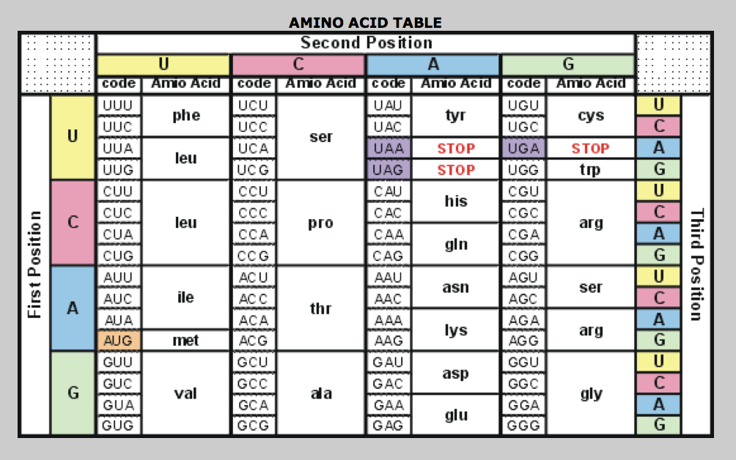

Slide 40
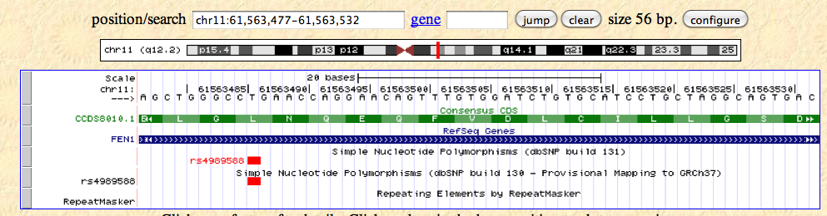
In addition to assigning missense/nonsense coding status, other complications include:
Splice-site, UTR, regions
Frameshift mutations (indels)
Multi-nucleotide polymorphisms
Full haplotype-based per-individual annotation & compound heterozygosity
Nonsense-medicated decay
Ranking of missense variants
Genomic annotation for non-coding variants

Slide 41
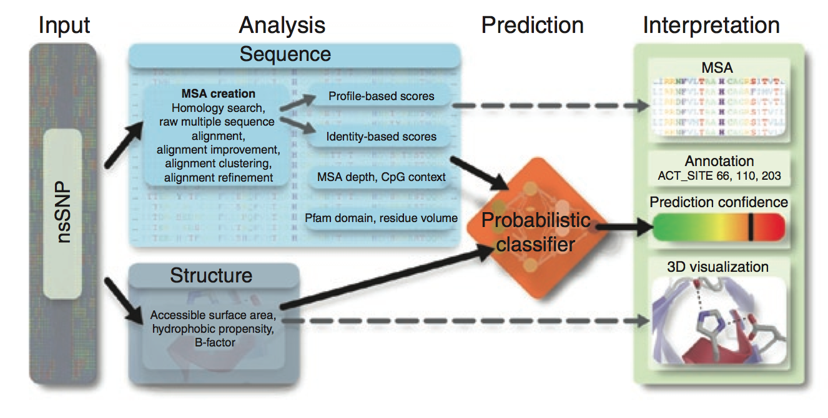
PolyPhen2: predicting the damaging effects of missense mutations
Adzhubei et al. Nature Methods (2010).

Slide 42
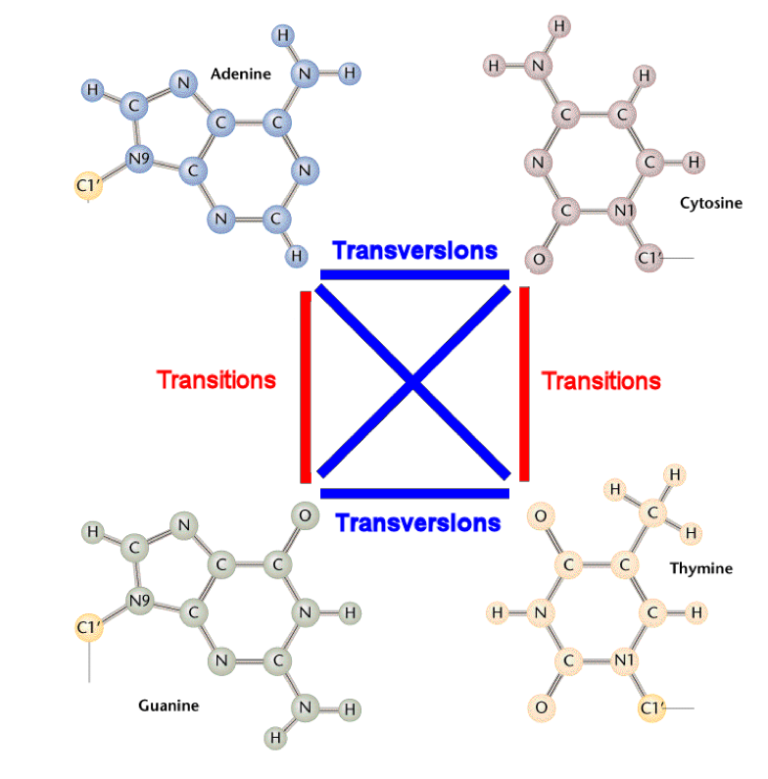
two-ring purines
one-ring pyrimidines
http://www.mun.ca/biology/scarr/Transitions_vs_Transversions.html

Slide 43
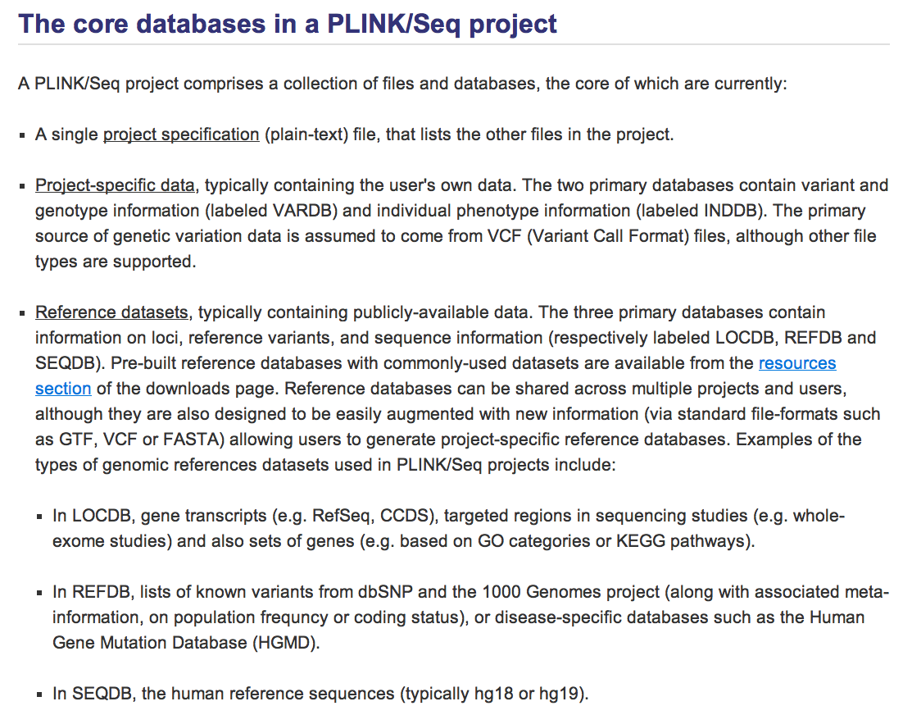

Slide 44
Working with real next-generation sequencing data
1000 Genomes Project
CEU and TSI pilot 3 (exon study)

