Slide 1
PLINK/Seq Analysis of genetic variation data from large-scale, population-based medical sequencing studies
Shaun Purcell
shaun@atgu.mgh.harvard.edu
Analytic and Translational Genetics Unit, MGH
Center for Human Genetic Research, MGH

Slide 2
What is PLINK/Seq (versus PLINK)?
Structure and data-flow of PLINK/Seq projects
Working with exome/NGS data (aka VCF files)
Some different “front-ends”, applications

Slide 3
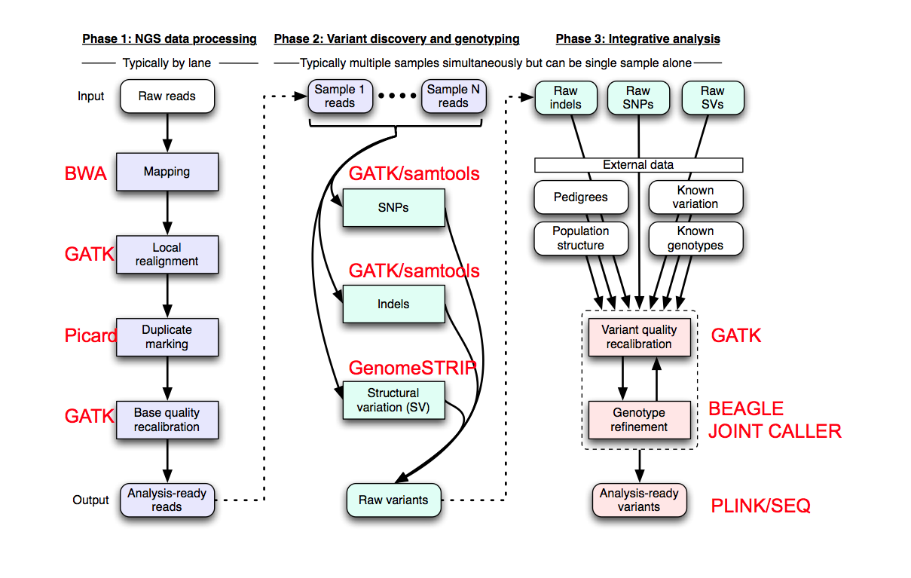
Components of the NGS analysis pipeline @ Broad

Slide 4
PLINK | PLINK/Seq
GWAS | Whole-exome sequencing studies (& whole-genome sequencing, “GWAS 2.0”)
PED file | VCF files (and BCF, PED, binary-PED, …)
Large datasets (but held in RAM) | Very large datasets (much larger than fits in RAM)
Common variation | Rare (and common) variation
Simple SNPs | More general, extensible representation of genetic variation data and meta-data
Sequential tests of single variants | Groups of variants (e.g. genes/regions/pathways)
Analysis largely “self-contained” | Intersection with other reference datasets and genomic resources (RefSeq transcripts, hg19, dbSNP, PolyPhen2, existing GWAS data, etc… )
Command-line interface | Command-line interface (but also via R package, the web, and other interfaces in the pipeline)
Downstream of Birdsuite | Downstream of { Picard, BWA, GATK, Samtools, … }

Slide 5
“PLINK/Seq project”
VCF
Variant, genotype & phenotype
data and metadata
VCF
VCF
View/reformat
data
Summary stats
for variants,
individuals, genes
Rare variant
association
An object in R,
in a user-defined
R function
Viewed via
web-browser
interface
…
NGS data
Loaded into
Individuals
PED
BED
PED
BED
Iterate over
(groups of)
variants
PED
BED
Queries
Filtered,
merged,
reconciled
& annotated
dataset for
analysis
GWAS SNP data
Variants
TXT
“singleton,
case-only
coding
variants,
not seen
in dbSNP,
from genes
on chr22”
TXT
TXT
Reference Variants
(dbSNP, 1KG)
Arbitrary annotation
Indexed
BCF
Loci/transcripts (RefSeq, CCDS, exome targets)
BCF
BCF
Sequence
(hg18, hg19)
Lots of NGS data

Slide 6
Command-line interface: pseq
Some basic commands illustrated here: a growing number of utilities for viewing, filtering,
annotating, presenting summary statistics and performing various types of association analysis
Initiate a new project
./pseq project1 new-project
--vcf /path/to/data1.vcf.gz /path/to/data2.vcf.gz
--resources /path/to/core/databases/hg19
Populate with phenotype and genotype information
./pseq project1 load-vcf
./pseq project1 load-pheno --file /path/to/data.phe
View variants, genotypes for a certain gene, excluding variants with non-PASS filters
./pseq project1 v-view --gene ABC123 --mask any.filter.ex
Gene-based association
./pseq project1 assoc --phenotype dis1 --mask loc.group=refseq

Slide 7
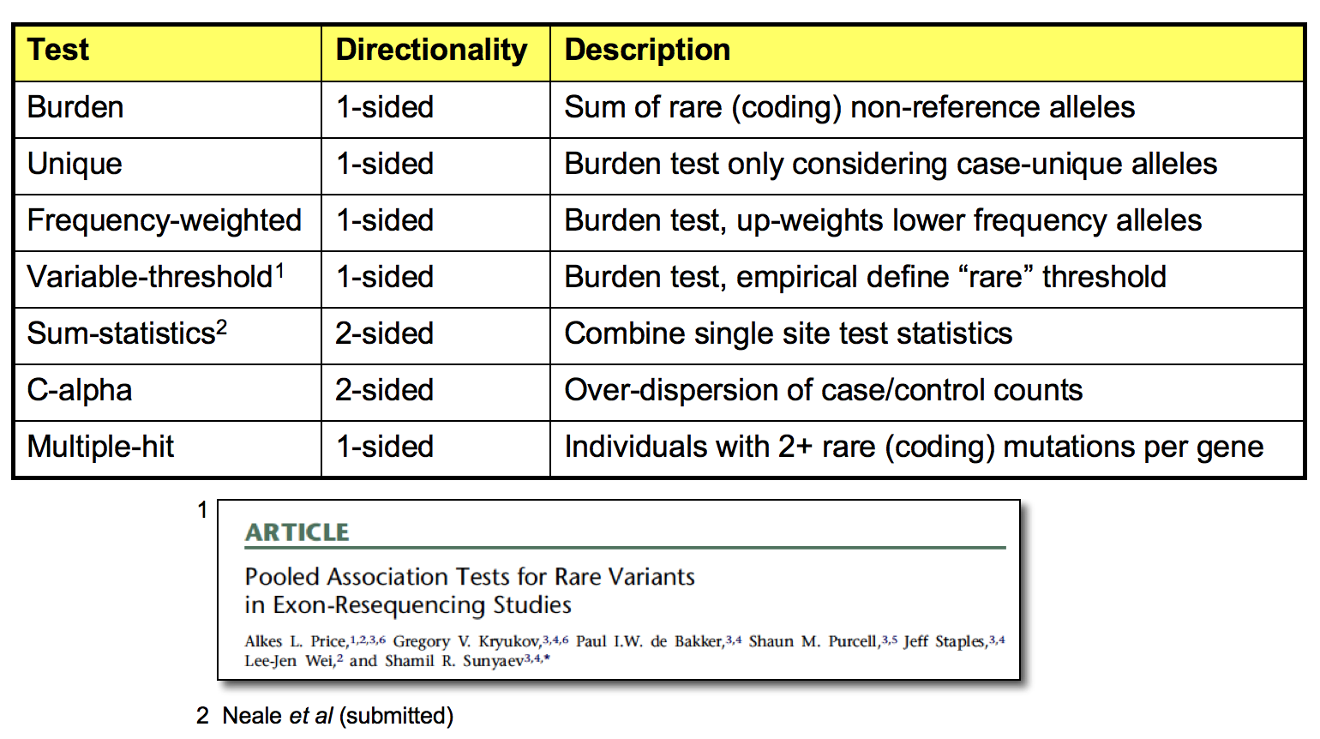
A growing number of gene-based rare-variant association tests
A core set of methods, including the variable threshold test (Price et al, 2010) and C-Alpha (Neale et al, in press)
External investigators collaborating to incorporate their methods in this framework (e.g. J. Witte, S. Leal)
PolyPhen2 weights (courtesy of Sunyaev lab) can be applied
One-sided tests
Two-sided tests
The PSEQ command line
interface to the library
implements a number of
gene-based association
statistics for rare-variant
data. In all cases, empirical
significance values are
available, that provide a
control for multiple testing.

Slide 8
Filters and grouping data with masks
List variants in genes in file mygenes.txt that are seen not more than twice, not in dbSNP,
and are unique to cases. Exclude the MHC region. Set to missing individual genotypes with
an individual read depth less than 10.
./pseq project1 v-view
--mask loc.subset=refseq,@mygenes.txt
mac=1-2
ref.ex=dbsnp
case.uniq
reg.ex=chr6:25000000..35000000
geno=DP:ge:10
Arbitrary expressions can be evaluated based on a variant’s metadata, to use as a filter
for inclusion in analysis, or to produce on-the-fly new metadata
--mask include=“ XX = g( GQ > 0.95 ); DB || XX > 0.8 “
Here, a new tag XX is added to the variant for this particular analysis
The function g(cond) gives the proportion of individuals for whom GQ greater 0.95

Slide 9
Filtering against 1000 Genomes data
(1) Obtain VCF from 1000Genomes FTP site (sites and some meta-information)
wget ftp://ftp-trace.ncbi.nih.gov/1000genomes/…/ALL…sites.vcf.gz
(2) Load into a “REFDB” (database of reference variants, e.g. dbSNP, HGMD, etc)
./pseq . load-ref --refdb g1k.db --group g1k
--vcf ALL.2of4intersection.20100804.sites.vcf.gz
(3) With REFDB as part of project, can filter your data for presence in G1K and G1K metadata
./pseq /path/to/project v-view
--mask ref=g1k v-include="g1k_AF < 0.01 && g1k_DP > 100"
chr1:865628:rs41285790 G/A g1k_DP=1955;g1k_AF=0.002
chr1:879413:rs116279254 G/A g1k_DP=1321;g1k_AF=0.005
chr1:879482:. G/C g1k_DP=1366;g1k_AF=0.004
chr1:892569:rs41285806 C/T g1k_DP=2226;g1k_AF=0.002
chr1:901922:rs62639980 G/C g1k_DP=1171;g1k_AF=0.007
...

Slide 10
Accessing data via R
Attach an existing PLINK/Seq project
pseq.project( “/path/to/my/project” )
Either “apply” a user-defined function func1 to the data given a mask…
res <- var.iterate( func1 , “mac=1-2 any.filter.ex” )
… or obtain a list of variants
k <- var.fetch( “mac=1-2 any.filter.ex” )
Various convenience functions to work with Variant and VariantGroup list data and metadata
x.consensus.altcount( k )
Individuals
[,1] [,2] [,3] [,4] [,5] [,6] [,7] [,8]
[1,] 2 NA 1 2 2 2 1 1
[2,] NA 1 1 2 2 1 2 NA
[3,] 0 0 1 1 0 NA NA NA
[4,] NA 0 NA NA NA 1 1 0
Variants

Slide 11
> str( k[[1]]$VAR[[1]] , max.level=3)
List of 7
$ CHR: int 10
$ BP1: int 61472483
$ BP2: int 61472483
$ ID : chr ".”
$ CON:List of 8
..$ REF : chr "C"
..$ ALT : chr "T"
..$ QUAL : num 13194
..$ FILTER: chr ”PASS"
..$ META :List of 20
.. ..$ cDNAchange : chr "c.13106G>A"
.. ..$ codonchange : chr "c.(13105-13107)CGG>CAG"
.. ..$ gene : chr "ANK3"
.. ..$ genomechange : chr "g.chr10"
.. ..$ proteinchange: chr "p.R4369Q"
.. ..$ strand : chr "-"
.. ..$ transcript : chr "NM_020987"
.. ..$ type : chr "Missense"
.. ..$ AC : int 2
.. ..$ AN : int 262
.. ..$ DB : int 0
.. ..$ DP : int 49758
.. ..$ AB : num 0.61
.. ..$ AF : num 0.01
.. ..$ MQ : num 94.7
.. ..$ QD : num 17.2
.. ..$ SB : num -5285
..$ GENO :List of 4
.. ..$ GT: int [1:132] 0 0 0 0 0 0 0 0 0 0 ...
.. ..$ DP: int [1:132] 355 259 504 463 451 76 499 99 420 349 ...
.. ..$ GL: num [1:132, 1:3] -1.16 -7.27 -5.08 -4.89 -1.2 -1.15 -1.24 -3.06 -1.15 -3.37 ...
.. ..$ GQ: num [1:132] 99 99 99 99 99 99 99 99 99 99 ...

Slide 12
## C-alpha, implemented as a single R function
calpha.test <- function(g) {
d <- x.consensus.genotype(g);
y <- apply( g[ ,p==1 ], 1, sum )
n <- apply( g, 1, sum )
score <- sum( (y - n * ratio)^2 - n * ratio2 )
var <- sum( sapply( lwr:upr , function(m)
sum(length(n[n==m])
* ((0:m-m*ratio)^2-m*ratio2)^2
* dbinom(0:m,m,ratio))))
return( score/sqrt(var) )
}
## Attach project
pseq.project(”/path/to/my/project")
## Phenotype data from individual datastore
p <<- inddb.phenotype("scz")
## Specify a mask: rare missense variants in CCDS genes
mask <- “loc.group=CCDS mac=2-10 include =
type == ‘Missense’ || type == ‘Nonsense’ “
## Run the analysis
results <- vardb.iterate( calpha.test , mask )
PLINK/Seq library to handle the large datasets and serve up variation data according to “genomically-oriented” queries
R to provide a rich, standardised and well-documented statistical and graphical environment
Easy prototyping of methods

Slide 13
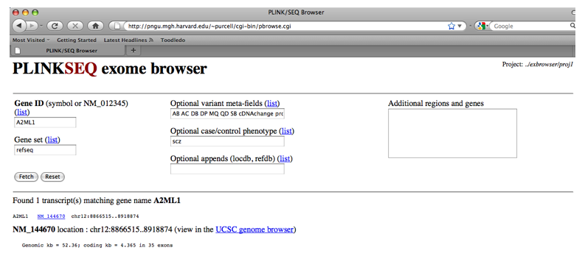

Slide 14
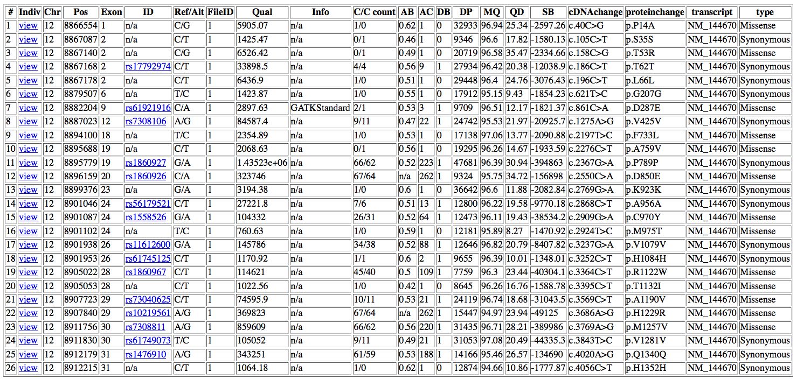

Slide 15
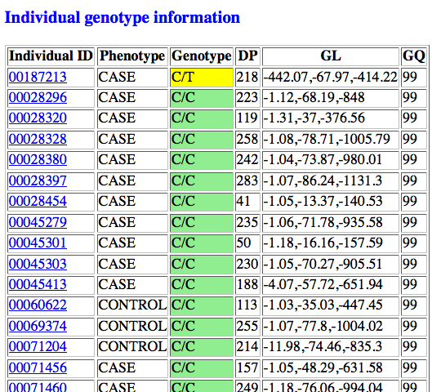

Slide 16
Sharing of summary data (counts) across exome-studies
Create a summary-level VCF of genotype counts by group, and variant meta-data
./pseq /my/project counts --options vcf --name scz1 > my.vcf
Upload to summary database (ACDB: “a counts database”)
./acdb db1 load --vcf my.vcf
Can be queried (by qualified investigators) by position, count, disease-specificity, etc
./acdb db1 lookup --pos chr1:887188 --mask any.filter.ex
chr1:887188:
./. C/C C/G G/G Project|Sample
--- --- --- --- --------------
. 23/23 1/2 1/0 aut1|1 N=50 PASS MQ0=0;AB=0.55
1/0 20/20 1/2 . aut1|2 N=44 PASS MQ0=0;AB=0.51
. 12/35 0/6 . aut1|3 N=53 PASS MQ0=0;AB=0.59
. 19/20 5/5 1/0 aut1|4 N=50 PASS MQ0=0;AB=0.6
. 24/21 1/3 0/1 aut1|5 N=50 PASS MQ0=0;AB=0.58
. 22/22 2/3 0/1 aut1|6 N=50 PASS MQ0=0;AB=0.59
1/0 52/56 12/11 . scz1|1 N=132 PASS MQ0=0;AB=0.53

Slide 17
GWAS 2.0
Directly genotyping >>1 million SNPs in large samples, PLINK becomes unwieldy
Imputation packages (e.g. BEAGLE) will output VCFs
calls, quality scores and posterior genotype probabilities/dosages
PLINK/Seq as a platform for GWAS analysis
Basic QC, stratification analysis (MDS), linear & logistic regression of direct and imputed genotypes, etc
The R interface enables easier extension of methods
e.g. multinomial logistic regression for a cross-disorder GWAS

Slide 18
Project has been evolving slowly but steadily over the past year
First public release within one month
http://atgu.mgh.harvard.edu/plinkseq/
Developers/collaborators/colleagues:
Brett Thomas, Mark Daly, Ron Do, Jason Flannick, Menachem Fromer, Jared McGuire, Ben Neale, Douglas Ruderfer, Shamil Sunyaev
Funding: NHGRI grant R01 HG005827

