Slide 1
Meta-analysis and Power
Benjamin Neale
March 8th 2011
Boulder Workshop

Slide 2
Slide of Contents
Meta-analysis
Motivation
Principles
Approaches
Practical using METAL
Power
Concept
Importance
Practical using GPC

Slide 3
Why do we want to do meta-analysis?
You’re meant to volunteer answers [really, I don’t have any slides on this, so please help]

Slide 4
Meta-analysis motivations

Slide 5
Goal: Combine Data from Multiple Sources
Test statistics
Estimates + standard error
P-values

Slide 6
Test statistic combination
Z-score combination
A little bit of variance/covariance rules:
Cov(X,X) =Var(X)
Var(X+Y) = Var(X) + Var(Y) + 2*cov(X,Y)
Var(k*X) = k²*Var(X)
Var(X+X) = Var(X) + Var(X) + 2*cov(X,X)
= 4*Var(X)
Var(2*X) = 2²Var(X) = 4*Var(X)

Slide 7
So we have Z-scores
We can combine Z-scores for meta-analysis
We want to weight the contribution of each dataset by the amount of ‘information’
Information in this context largely reflects sample size

Slide 8
Two samples which are the same size
+
=
Var(T1) = 1
Var(T2) = 1
Var(T1 + T2) = ?
T1 and T2 are 10,000 test statistics simulated under the null [no effect]
More on the null later
Why do we want to know what the variance of T1 + T2 is?

Slide 9
Why variance matters
Test Statistic | # P < 0.05 | # P < 0.01 | # P < 0.001
T1 | 513 | 104 | 12
T2 | 512 | 105 | 12
T1 + T2 (σ² = 1) | 1643 | 694 | 217
T1 + T2 (σ² = sqrt(2)) | 508 | 103 | 12
If we assume the wrong variance of the test statistic
we dramatically inflate our distribution of results

Slide 10
Weighted Z meta-analysis
Meta Z
Each study Z
Sum from 1 to m
Where m is # Z’s
w_{i} is each test weight
w_{t} is the sum of the weights

Slide 11
We can work on betas too…
For regression we can get a test statistic from the beta
Regression estimate
Test statistic
Variance of the beta

Slide 12
For meta-analysis
B_{i} = study beta; σ² = variance of each individual betas

Slide 13
Warning: for Beta meta-analysis to be appropriate, the constituent data need to be measured on the same phenotype and the same scale
For example, meta-analysis of height in inches and height in centimeters would not be appropriate on beta and standard errors, and so we have to transform

Slide 14
We can also assess blind to direction
Fisher’s method:
Sum of χ²
These give similar, though not
Identical answers for P-values
K = # of tests; p_{i} are the p-values of each study;

Slide 15
These methods can be less efficient than Z-score meta-analysis
Though it depends on model and heterogeneity etc.

Slide 16
What about practical details?

Slide 17
Strand, strand, strand
DNA is a double helix
A pairs with T and C pairs with G
There are two strands:
ATCTGGTACTCCAT
TAGACCATGAGGTA
Strand 1
Strand 2

Slide 18
Strand, strand, strand
What about SNPs?
ATCTGGT[A/C]CTCCAT
TAGACCA[T/G]GAGGTA
Strand 1
Strand 2

Slide 19
Strand, strand, strand
What’s the big/annoying problem?
ATCTGGT[A/T]CTCCAT
TAGACCA[T/A]GAGGTA
Strand 1
Strand 2

Slide 20
Strand, strand, strand
Two ambiguous SNP types
A/T and G/C
All others are resolved
How to check?
Allele frequencies [know your population]
LD [if you have raw data]
PLINK and METAL can re-orient strand
Remember the ambiguous ones!

Slide 21
Metal How To

Slide 22
Metal Documentation: http://genome.sph.umich.edu/wiki/Metal_Documentation

Slide 23
Results files examples
Metal is flexible
It can run fixed effects meta-analysis
Heterogeneity tests
Effect size, Sample Size, or Weighted meta-analysis

Slide 24
METAL
Requires results files
‘Driver’ file
Describes the input files
Defines meta-analysis strategy
Names output file

Slide 25
Practical

Slide 26
Steps
Check format of results files
Ensure all necessary columns are available
Modify files to include all information
Prepare driver file
Ensure headers match description
Crosscheck each results file matches Process name
Run metal

Slide 27
Step 1: Preparing Input Files
PLINK results files are readable by metal
For CMH and logistic regression, we’ll have to specify that the OR is reported
I’ve made a second set of results
res_for_metal2.txt
Simulated using final.cmh.cmh as a seed

Slide 28
Columns METAL uses
SNP
OR
SE [for standard error meta-analysis]
P-value [for Z-score meta-analysis]
If we had two samples of different sizes we would have to add an N/weight column

Slide 29
Meta-analysis running
We will run meta-analysis based on effect size and on test statistic
For the weights of test statistic, I’ve assumed that the sample sizes are the same
METAL defaults to weight of 1 when no weight column is supplied

Slide 30
To run metal
Copy over files from /faculty/ben/2011/meta_analysis_power/
cp final.cmh.cmh
[or keep it where you generated the data]
Results file 1
cp res_for_metal2.cmh
New results file generated
cp metal_run_file
Driver file for Metal
cp reformat.sh
A little reformatting script to change the header

Slide 31
Step 2: driver file: meta_run_file
MARKER SNP
ALLELE A1 A2
PVALUE P
EFFECT log(OR)
STDERR SE
PROCESS final.cmh.cmh
PROCESS res_for_metal2.txt
OUTFILE meta_res_Z .txt
ANALYZE
CLEAR
SCHEME STDERR
PROCESS final.cmh.cmh
PROCESS res_for_metal2.txt
OUTFILE meta_res_SE .txt
ANALYZE
Specifies columns in file
Processes two results files
Conducts Z-based meta-analysis from Test statistic
Output file naming
Clears workspace
Changes meta-analysis scheme to beta + SE
Processes two results file
Output file naming
OR is the column in the file
log(OR) tells METAL to take the log of the OR

Slide 32
Running metal
metal < metal_run_file
metal is the command
metal_run_file is the driver file
This will output information on the running of METAL things to standard out [the terminal]
It will spawn 4 files:
2 results files: meta_res_Z1.txt and meta_res_SE1.txt
2 info files: meta_res_Z1.txt.info and meta_res_SE1.txt.info

Slide 33
Output you’ll see
Overview of METAL commands
Any errors
There are some—we’ll chat :)
And your best hit from meta-analysis

Slide 34
Results files
head meta_res_Z1.txt
MarkerName Allele1 Allele2 Weight Zscore P-value Direction
rs4810677 a g 2.00 -0.524 0.6004 -+
rs12329414 t g 2.00 -0.881 0.3783 --
rs6014909 a g 2.00 -0.950 0.3421 +-
rs6085732 t c 2.00 1.354 0.1756 ++
rs8123062 t c 2.00 0.578 0.5633 -+
rs226185 a g 2.00 -0.090 0.9285 -+
rs1016496 a g 2.00 0.985 0.3246 ++
rs6011527 a g 2.00 -2.439 0.01473 --
rs6030036 a g 2.00 1.469 0.1417 ++

Slide 35
To load into Haploview
We have to change the header
In the same directory run:
./reformat.sh
This changes 1st column name to SNP
We can then load the meta-analysis results files into haploview
Same as before but load in the meta_res_Z1.txt
Make sure to include the bim file that Jeff used earlier

Slide 36
Make sure you ran reformat.sh otherwise Haploview will not work

Slide 37
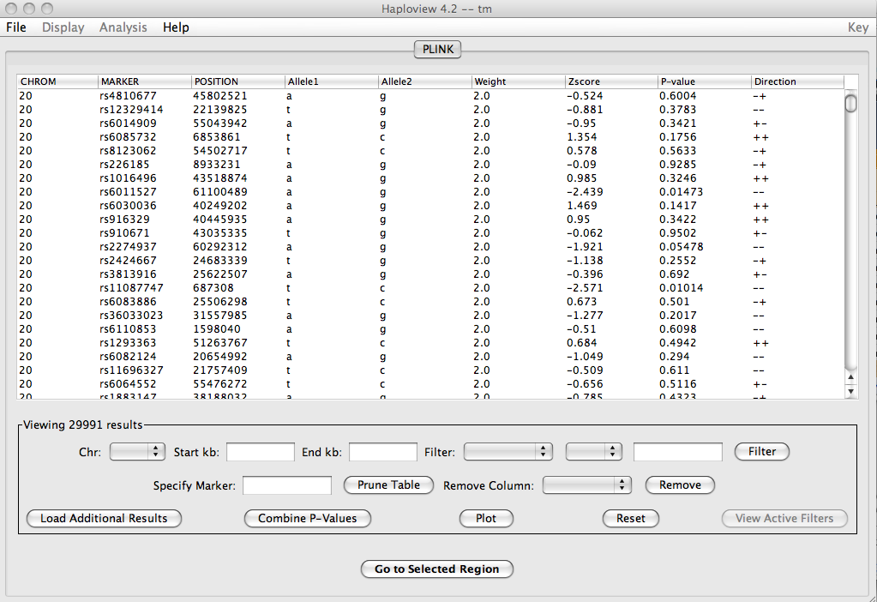
What you should see

Slide 38
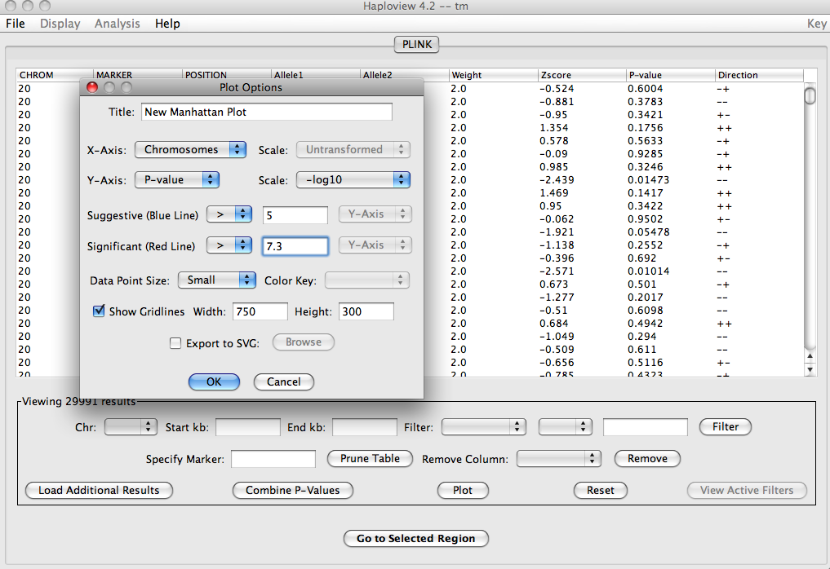
Plot
Y-axis P-value scaled –log10
Suggestive at 5
Significant at 7.3

Slide 39
New results

Slide 40
Power!

Slide 41
Importance of power calculation
Help design studies that are likely to succeed
Determine the minimum sample size necessary to achieve the desired level of statistical power (usually > 80%), for a given effect size
Determine the minimum effect size that can be detected with adequate statistical power, for a fixed sample size

Slide 42
Importance of power calculation
Help design studies that are likely to succeed
Determine the minimum sample size necessary to achieve the desired level of statistical power (usually > 80%), for a given effect size
Determine the minimum effect size that can be detected with adequate statistical power, for a fixed sample size
Usually obligatory for grant applications

Slide 43
Hypothesis Testing
SNP testing hypotheses:
h_{o} (null hypothesis) is β=0
h_{a} (alternative hypothesis) is β≠0
Two-sided test, where β > 0 or β < 0 are one-sided
Null hypothesis usually assumes no effect
Alternative hypothesis is the idea being tested

Slide 44
Summary of Possible Results
Statistics
 | Rejection of H₀ | Non-rejection H₀
H₀ true | α | 1-α
H_{A} true | 1-β | β
Reality
α=type 1 error rate
β=type 2 error rate
1-β=statistical power

Slide 45
STATISTICS
Rejection of H₀
Non-rejection of H₀
Type I error
at rate α
Nonsignificant result
(1- α)
H₀ true
R E A L I T Y
Significant result
(1-β)
Type II error
at rate β
H_{A} true

Slide 46
Power
The probability of rejection of a false null-hypothesis depends on:
the significance criterion (α)
the sample size (N)
the effect size (Δ)
“The probability of detecting a given effect size
in a population from a sample of size N,
using significance criterion α”

Slide 47
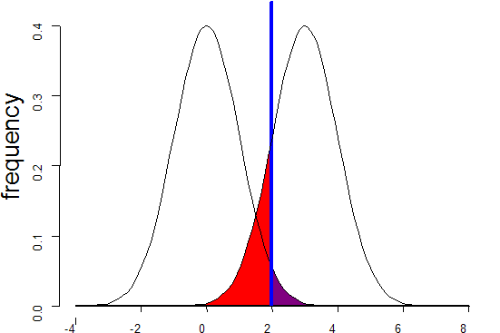
Standard Case
Sampling distribution if H₀ were true
Sampling distribution if H_{A} were true
alpha 0.05
POWER:
1 - β
β
α
T
Non-centrality parameter

Slide 48
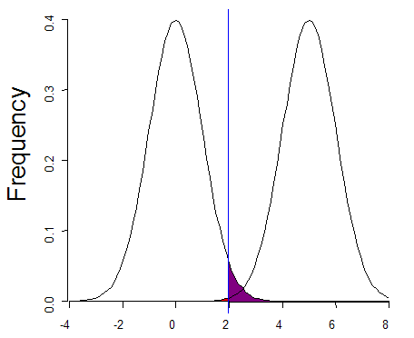
Increased effect size
Sampling distribution if H₀ were true
Sampling distribution if H_{A} were true
alpha 0.05
POWER
1 - β ↑
β
α
T
Non-centrality parameter

Slide 49
Standard Case
Sampling distribution if H₀ were true
Sampling distribution if H_{A} were true
alpha 0.05
POWER:
1 - β
β
α
T
Non-centrality parameter

Slide 50
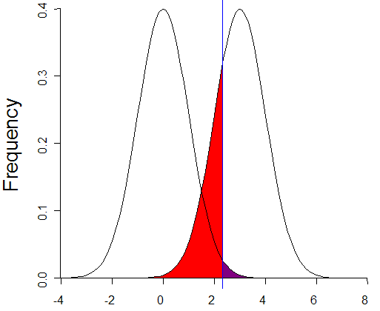
More conservative α
Sampling distribution if H₀ were true
Sampling distribution if H_{A} were true
alpha 0.01
POWER:
1 - β ↓
β
α
T
Non-centrality parameter

Slide 51
Increased sample size
Sampling distribution if H₀ were true
Sampling distribution if H_{A} were true
alpha 0.05
POWER
1 - β ↑
β
α
T
Non-centrality parameter

Slide 52
Increased sample size
Sampling distribution if H₀ were true
Sampling distribution if H_{A} were true
alpha 0.05
POWER
1 - β ↑
Sample size scales linearly with NCP
β
α
T
Non-centrality parameter

Slide 53
Short practical on GPC
Genetic Power Calculator is an online resource for carrying out basic power calculations
For our 1st example we will use the probability function calculator to play with power
http://pngu.mgh.harvard.edu/~purcell/gpc/
Google GPC purcell

Slide 54
GPC Power Practical
Ceiling cat is watching
you practical
Click this link [no this isn’t a banner ad]

Slide 55
Parameters in probability function calculator
Click on the link to probability function calculator
4 main terms:
X: critical value of the chi-square
P(X>x): Power
df: degrees of freedom
NCP: non-centrality parameter

Slide 56
GPC
Ceiling cat is watching
you practical
Fill in three
Click the button
Reveals the fourth

Slide 57
GPC
Ceiling cat is watching
you practical
Fill in three
Click the button
Reveals the fourth

Slide 58
GPC
Ceiling cat is watching
you practical
Fill in three
Click the button
Reveals the fourth

Slide 59
Exercises
Find the power when NCP=5, degrees of freedom=1, and the critical X is 3.84
Find the NCP for power of .8, degrees of freedom=1 and critical X is 13.8

Slide 60
Answers
Power=0.608922, when NCP=5, degrees of freedom=1, and the critical X is 3.84
NCP=20.7613 when power of .8, degrees of freedom=1 and critical X is 13.8

Slide 61
Practical using GPC for association
Ceiling cat is watching
you practical
These are all association tests
Each refers to a different study design

Slide 62
Question 1
What case control sample size do we need to achieve genome-wide significance for an odds ratio of 1.2 in a multiplicative model and an allele frequency of 20% when we directly type the locus for a disease with 5% prevalence?

Slide 63
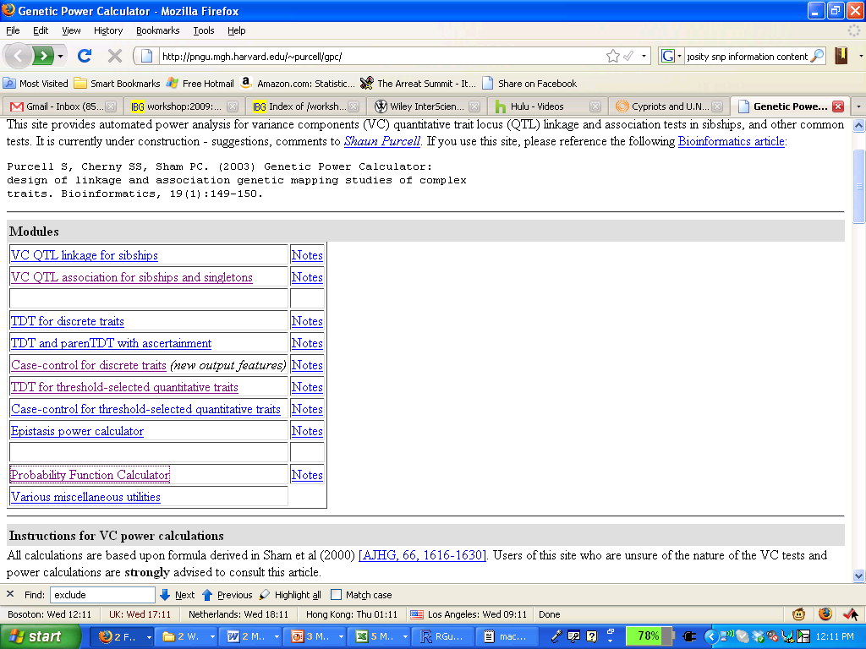
Question 1
Ceiling cat is watching
you practical
Click this link

Slide 64
Question 1
Ceiling cat is watching
you practical
Allele frequency at the risk locus

Slide 65
Question 1
Ceiling cat is watching
you practical
How common disease is

Slide 66
Question 1
Ceiling cat is watching
you practical
This is the relative risk—not the odds ratio. The OR is approximately equivalent to the RR for small values of RR.

Slide 67
Question 1
Ceiling cat is watching
you practical
Risk of the AA genotype. Note that the model of risk is defined by the relationship between Aa and AA. We have a multiplicative model because 1.44 = 1.2*1.2.

Slide 68
Question 1
Ceiling cat is watching
you practical
The LD statistic D’ which represents recombination patterns historically. D’ + allele frequency at the typed locus information yields r²

Slide 69
Question 1
Ceiling cat is watching
you practical
Sample size for cases

Slide 70
Question 1
Ceiling cat is watching
you practical
Ratio of Controls to Cases

Slide 71
Question 1
Ceiling cat is watching
you practical
Genome-wide significance threshold
We’ll learn about this later in the session

Slide 72
Question 1
Ceiling cat is watching
you practical
Power level—what we’re interested in observing

Slide 73
Question 1
Ceiling cat is watching
you practical
Click here to process

Slide 74
Answer 1
Ceiling cat is watching
you practical
Scroll to the bottom for answer

Slide 75
Answer 1
Ceiling cat is watching
you practical
Scroll to the bottom for answer
6,362 case samples required: total sample size 12,724

Slide 76
Questions on your own
For the same model as above, find the total sample size required for a TDT
Hint: use TDT for discrete traits
Try for different effect sizes and models (e.g. dominance)
What is the effect of degrading LD in case-control data?
Change the D’ and keep allele freq the same
Change allele freq and keep D’ the same
How well does the additive model capture a dominance only effect?
Should you use 2x population controls vs 1x screened controls
For a prevalence of 5% and for a prevalence of 25%?

Slide 77
Answers
Additive
Total case number for CC: 6,362
Total case number for TDT: 7,079
Dominance only
RR: 1; 1; 1.44
30,595 cases for CC
33,950 cases for TDT

